Slide 1
WEB SENSOR
October 2019
Hamed Siasi
UBX-19049140

Slide 2


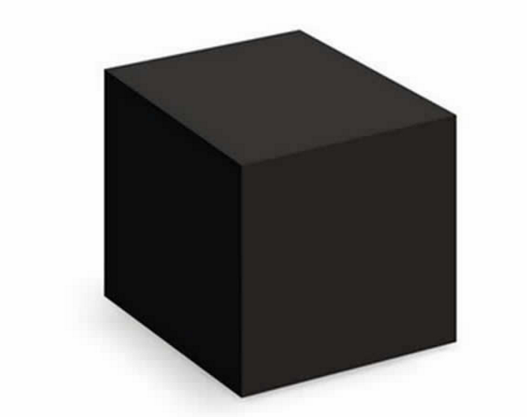
Web Sensors
Connecting REST API interface to I2C bus interface (TEST)
REST API Interface
I2C Bus Interface
Testing PC
DC Carrier board
SENSIRION sensor board
SHTC1
Developer
Proxy
Application
PC
u-blox
NINA-W103
Short Range
(ESP32)
0X70
SGP30
ROHM
BM1383AGLV
Listening socket
sda=5 scl=18
0X19
CLGA12V025M
UART (Debug)
Tester
Microchip MCP23008
LED
POST i2c/config
GET i2c/detect
Accelerometer
(Board sensor)
0X5d
0X20
GET i2c/get
Battery-charger sensor
(Carrier sensor)
Process
POST i2c/set
0X6b
GET i2c/dump

Slide 3
Web Sensors
Connecting REST API interface to I2C bus interface (Prototype)
REST API Interface
Network
I2C Bus Interface
U-blox SARA-R412M
Cellular
U-blox NINA-W102
ESP32 Short Range
Developer
I2C
Generic Object
SENSIRION sensor board
I2C
Generic Object
WEB SENSORS
FIRMWARE
UART
sda=5
scl=18
0X70
LwM2M
SERVER
ROHM
BM1383AGLV
Tester
LwM2M
Client
0X19
Process
Microchip MCP23008
POST i2c/config
Accelerometer
(Board sensor)
GET i2c/detect
0X5d
0X20
GET i2c/get
Battery-charger sensor
(Carrier sensor)
POST i2c/set
0X6b
GET i2c/dump
DC Carrier board
Breadboard

Slide 4
Thank you for your attention

