Slide 1
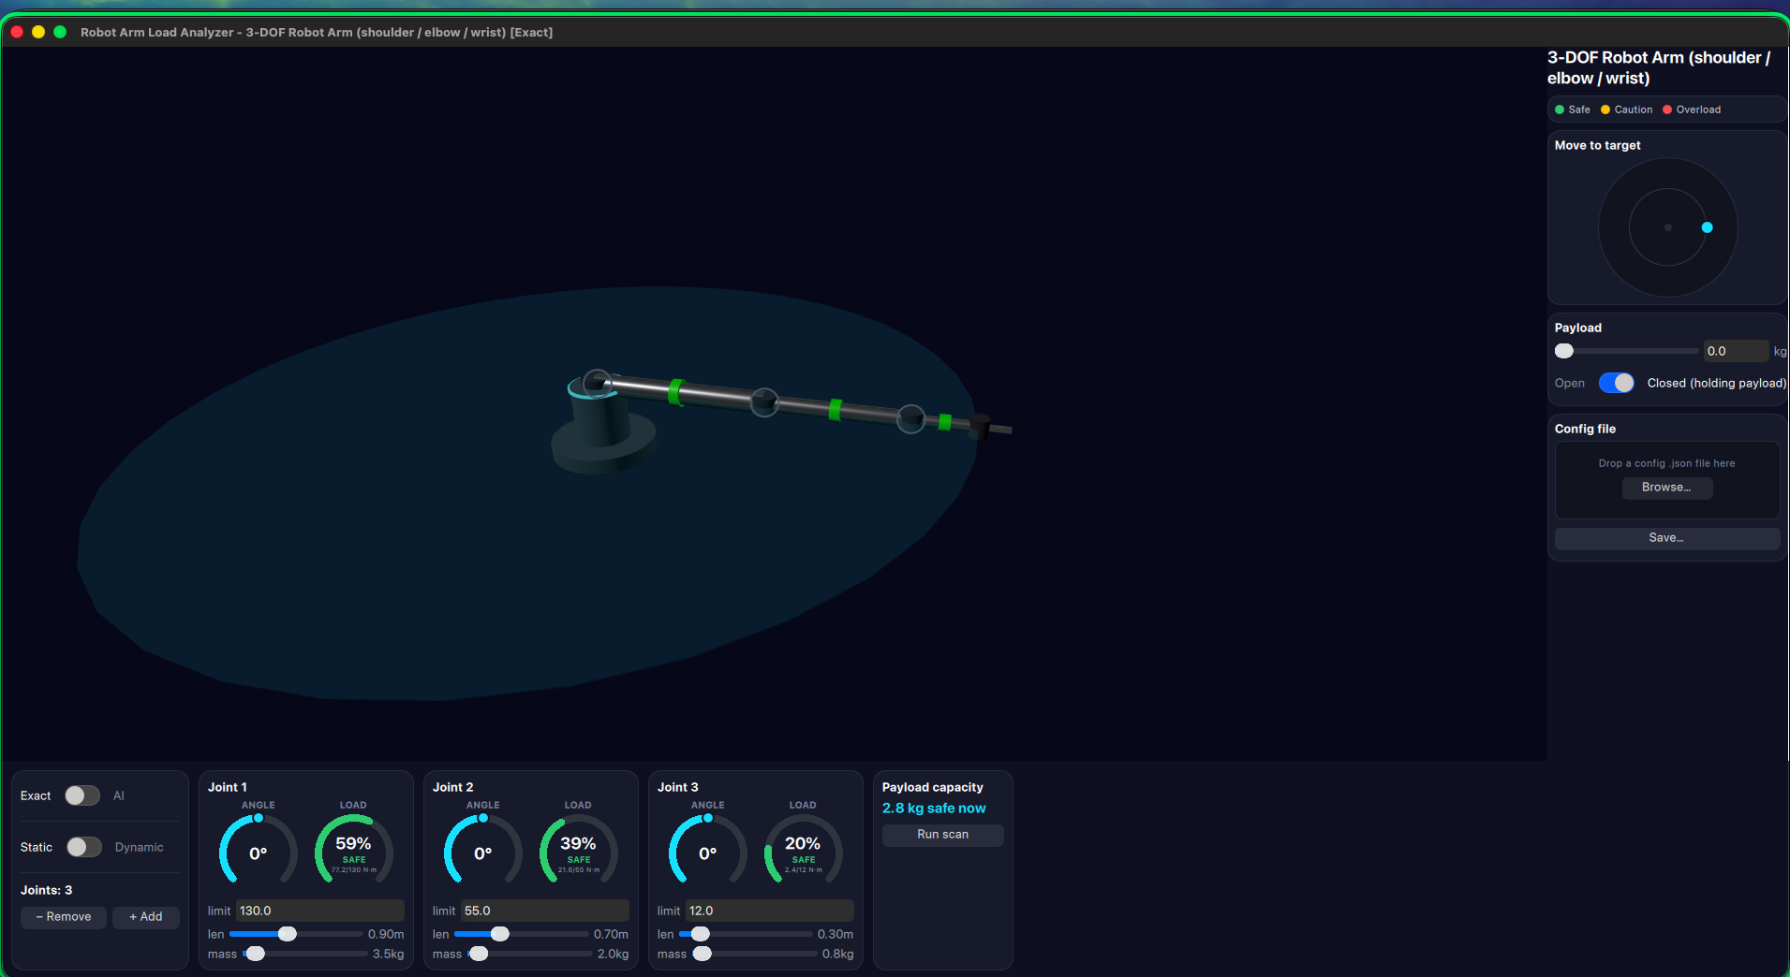
INTRO TO AI · MIDTERM PROJECT
Robot Arm
Load Analyzer
An interactive physics + AI tool for safe robot-arm
payload planning — drag it, load it, and watch the
math happen live.
Sley Hortes
Student ID 411221407

Slide 2
THE PROBLEM
Will this arm actually hold that weight?
▸ Every joint motor has a torque limit.
Exceed it anywhere in the chain and that joint stalls, strains, or fails.
▸ The real answer depends on the whole arm at once.
Pose, payload, gravity — and if it's moving, velocity and acceleration too.
▸ Manufacturers publish exactly this as a load-moment diagram.
A payload-vs-reach “derating curve,” printed once on a spec sheet.
▸ A printed curve only answers the question for the arm as built.
This project makes the answer live — change the arm's length, mass, payload, or pose, and the safe-lift number recomputes instantly.
Robot Arm Load Analyzer
1

Slide 3
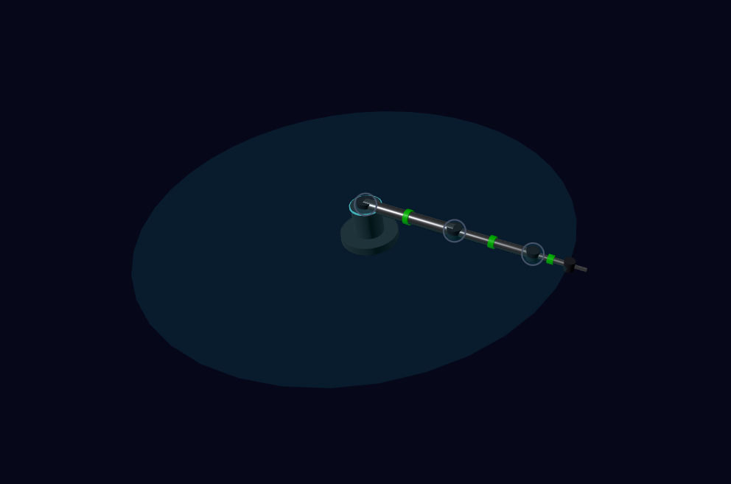
THE INTERFACE — PIECE BY PIECE
The 3D view is not just a picture
▸ Every joint is a draggable ring — click and drag directly in 3D space to change that joint's angle, with a live degree readout
▸ The translucent disc is the arm's reach envelope — literally the sum of every link's length, updating live as geometry changes
▸ Pedestal, limbs, and “motor drum” joints are procedurally built, not an imported 3D model — styled to read as real hardware
▸ The pink sphere is the payload, held exactly where a real two-finger gripper would hold it
Robot Arm Load Analyzer
2

Slide 4
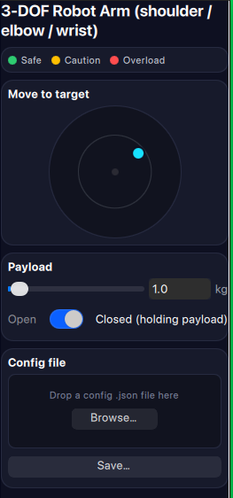
THE INTERFACE — PIECE BY PIECE
Sidebar: reach, payload, and files
▸ Legend
Safe / Caution / Overload, explained once at the top.
▸ Move to target
Drag the dot on the circular pad to send the end effector anywhere in its reach plane — inverse kinematics solves the joint angles.
▸ Payload
Slider + exact-value field for the staged weight, plus the Open/Closed gripper switch that actually picks it up.
▸ Config file
Drag-and-drop or Browse… to load an arm definition; Save… writes the current arm, edits included, back out.
Robot Arm Load Analyzer
3

Slide 5
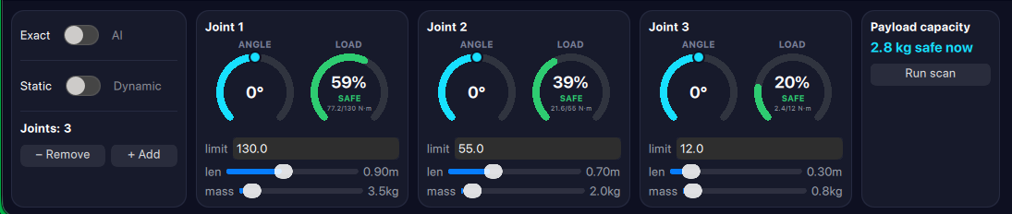
THE INTERFACE — PIECE BY PIECE
Bottom bar: every joint, side by side
▸ Exact / AI
Real physics, or the trained neural network.
▸ Static / Dynamic
Whether velocity/acceleration factor into torque at all.
▸ Joints: N, − Remove / + Add
The arm's own topology is editable.
▸ Each joint's own card
Angle dial, load gauge, torque limit, length, mass — all live.
▸ Payload capacity
Safe-lift number right now, plus a one-click workspace scan.
Robot Arm Load Analyzer
4

Slide 6
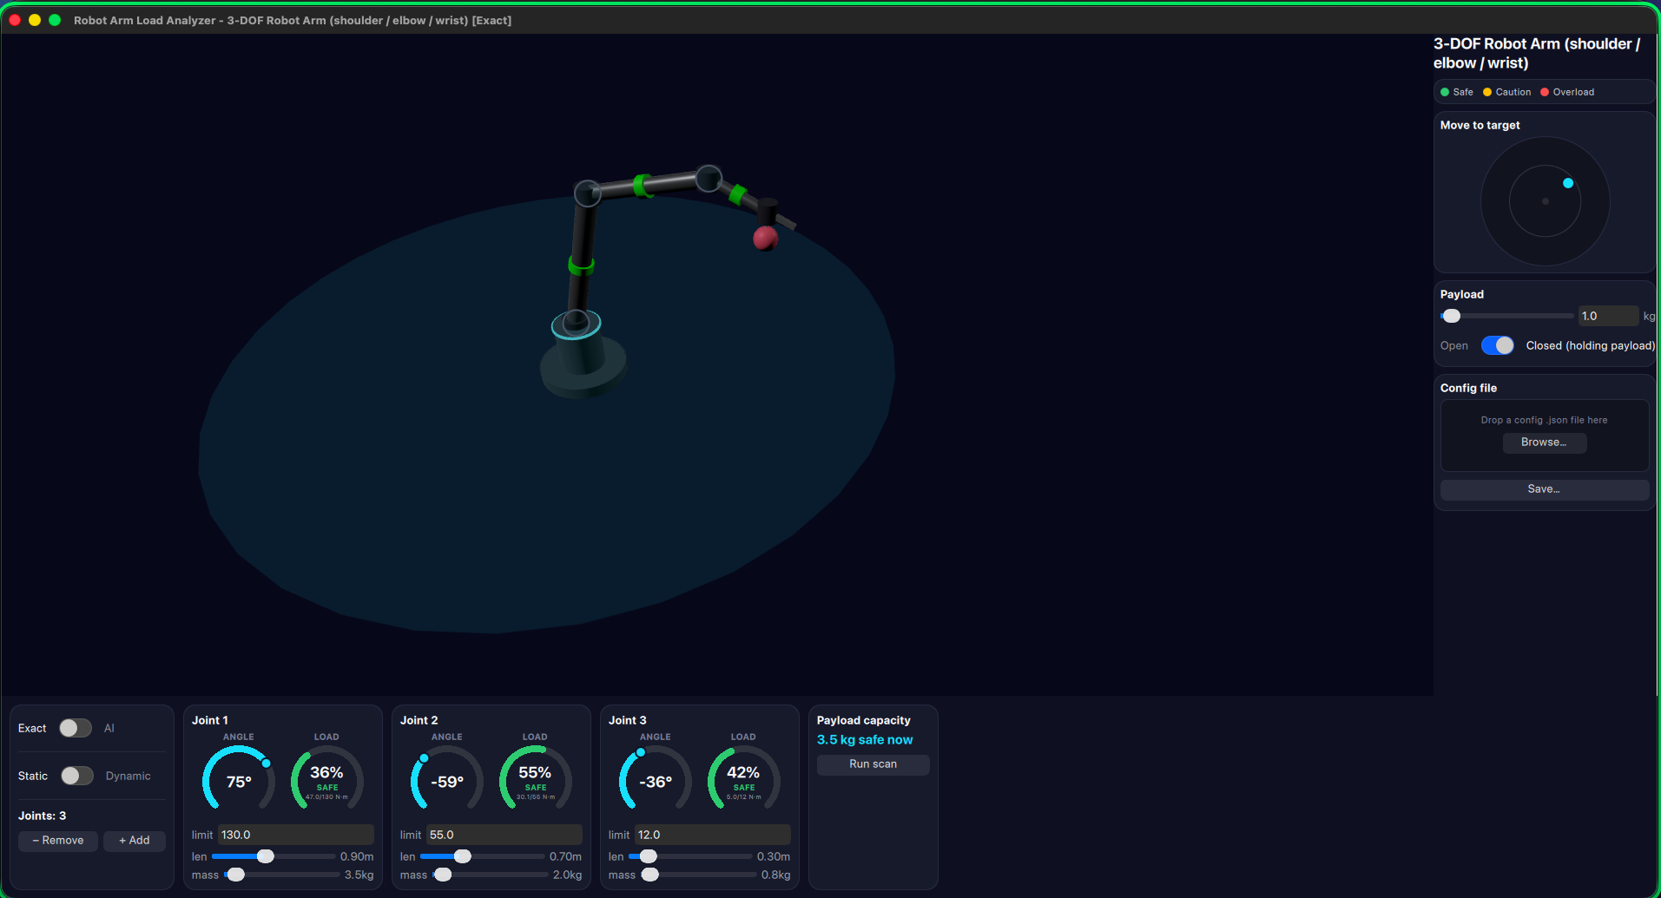
IN ACTION
Grip it, and feel the load change instantly
▸ Stage a payload's weight on the Payload slider — nothing changes yet, it's just waiting to be gripped
▸ Flip Open to Closed — the payload attaches, hanging below the gripper exactly where a real cable under tension would
▸ Every joint's load gauge jumps by the weight the instant the gripper closes, wherever the arm currently is
▸ Pose the arm anywhere in reach and watch which joint gets closest to its limit first
Robot Arm Load Analyzer
5

Slide 7
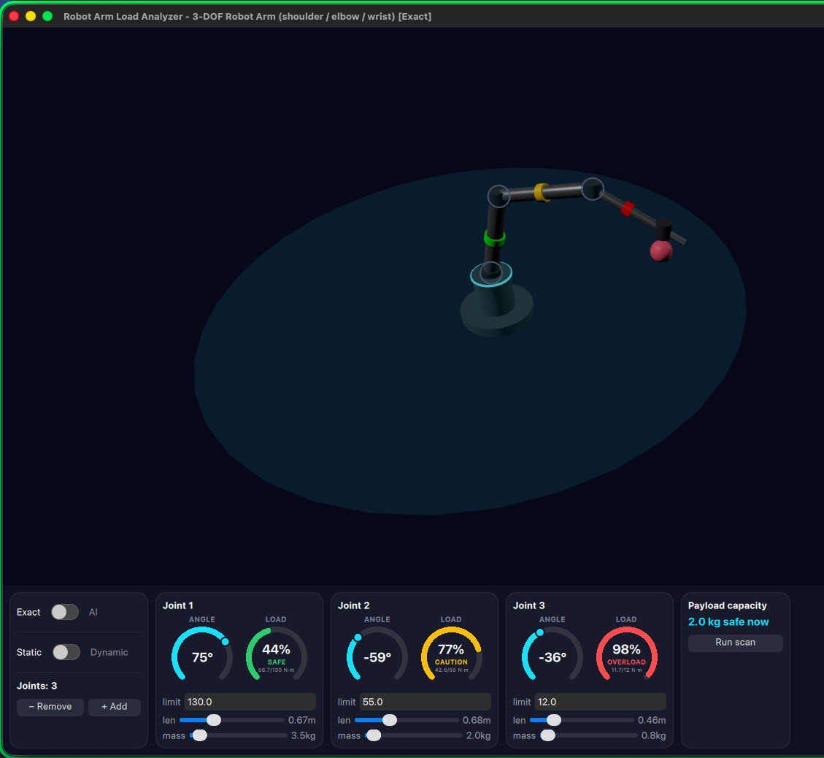
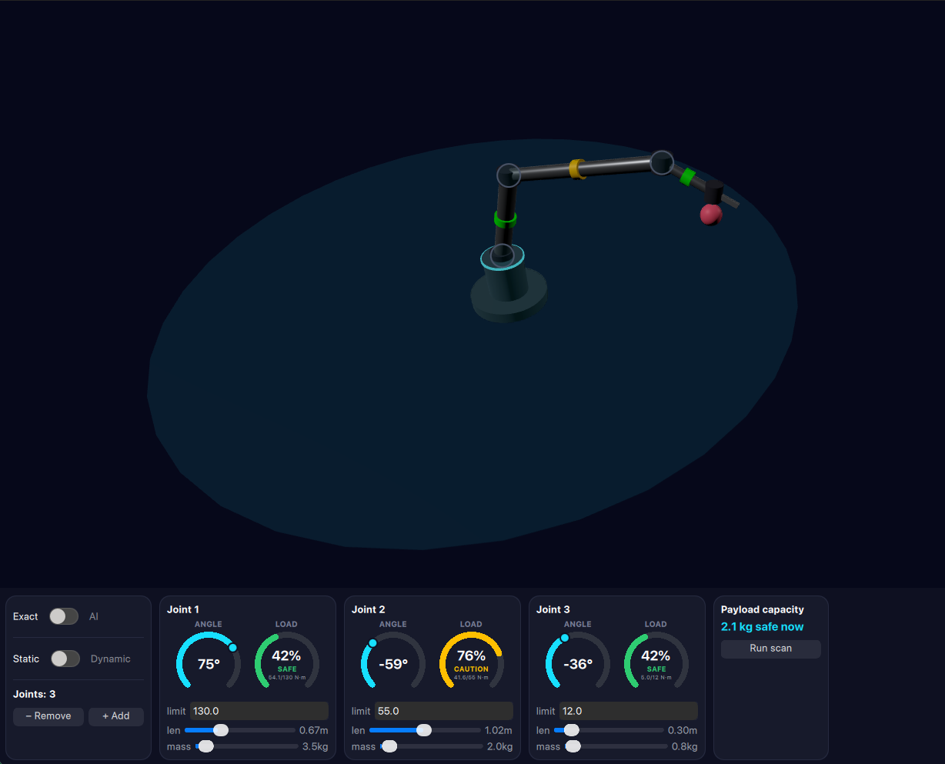
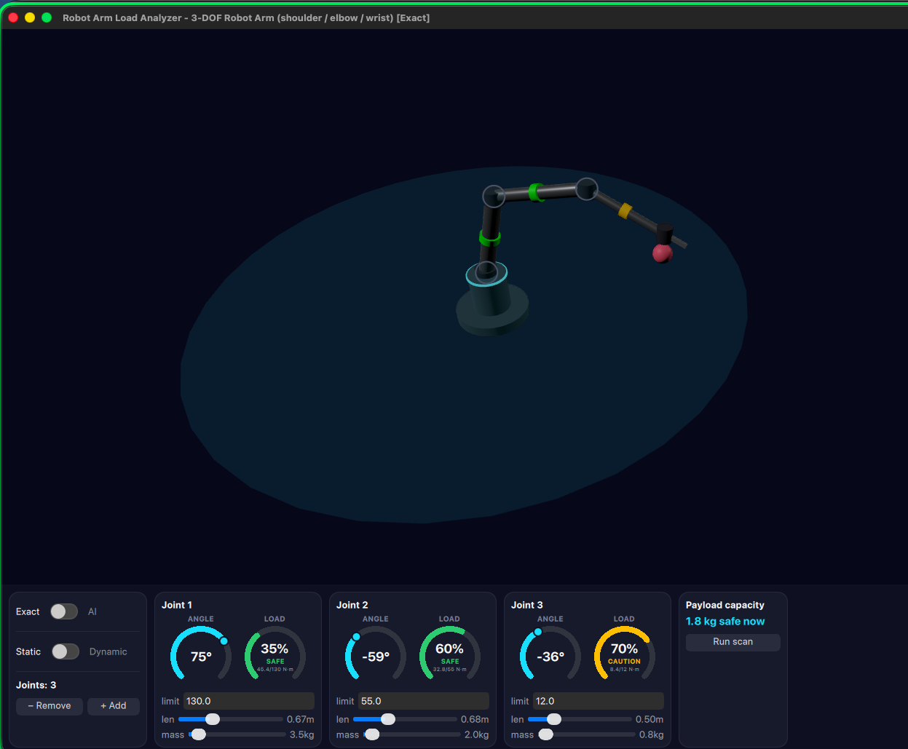
IN ACTION
Edit the arm itself — watch the safety math follow
Dragging a joint's length or mass slider is a real geometry change, not a cosmetic one — every gauge recomputes against the new arm immediately.
Lengthen a link → Joint 2 enters Caution
Keep going → margins tighten further
Push it → Joint 3 goes Overload, in red
Robot Arm Load Analyzer
6

Slide 8
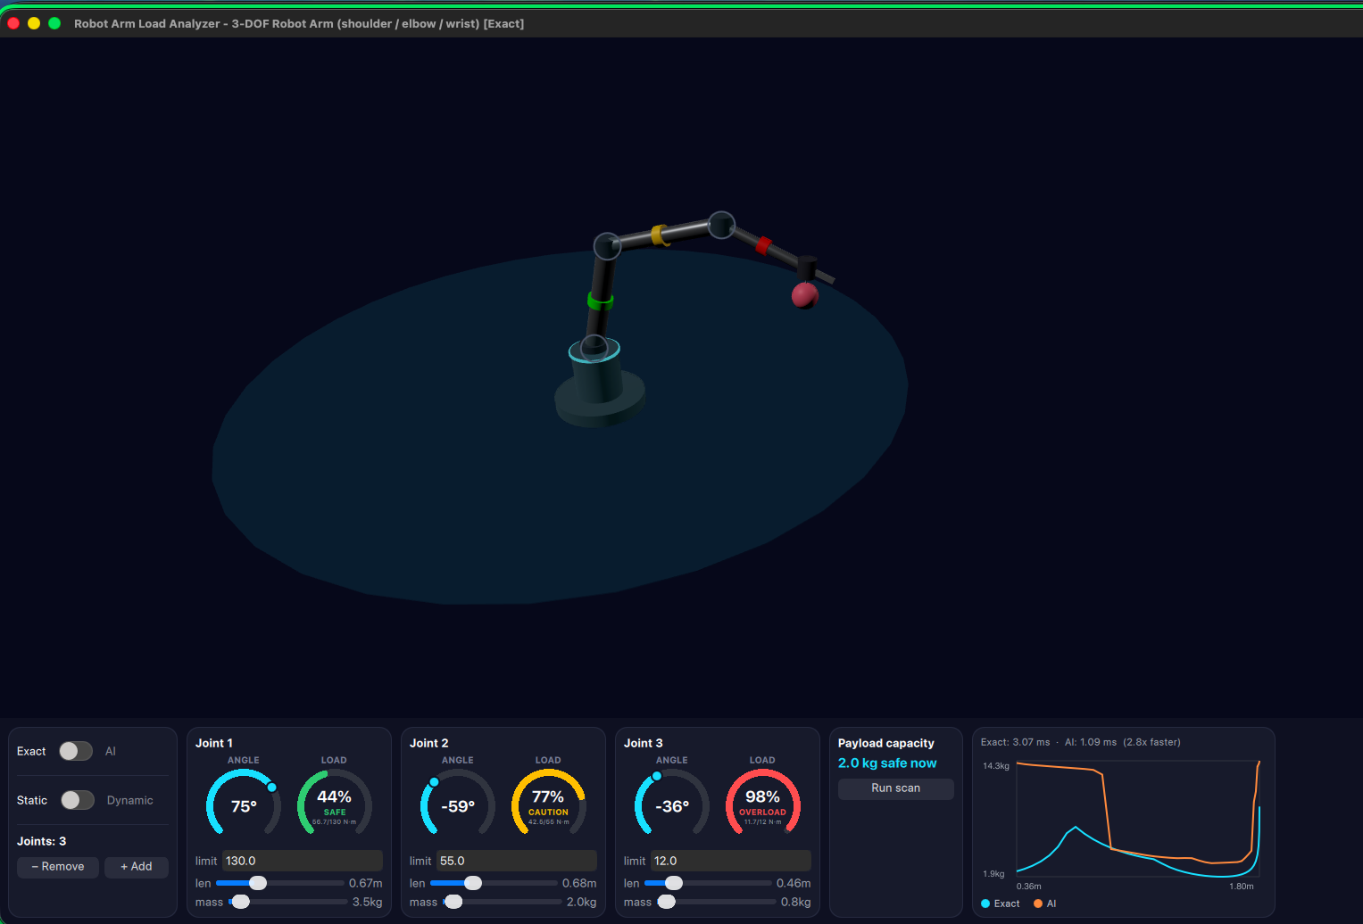
WHY AI?
A trained surrogate, benchmarked honestly
▸ The question isn't “can an AI approximate physics” — it's “is it worth it.”
▸ Run scan sweeps the arm from extended to folded,
computing the exact safe-payload curve twice: once through the real engine, once through the trained network.
▸ Both timings are measured and shown, live, every run.
Here: Exact 3.07 ms · AI 1.09 ms — 2.8x faster, and the curves nearly overlap.
Robot Arm Load Analyzer
7

Slide 9
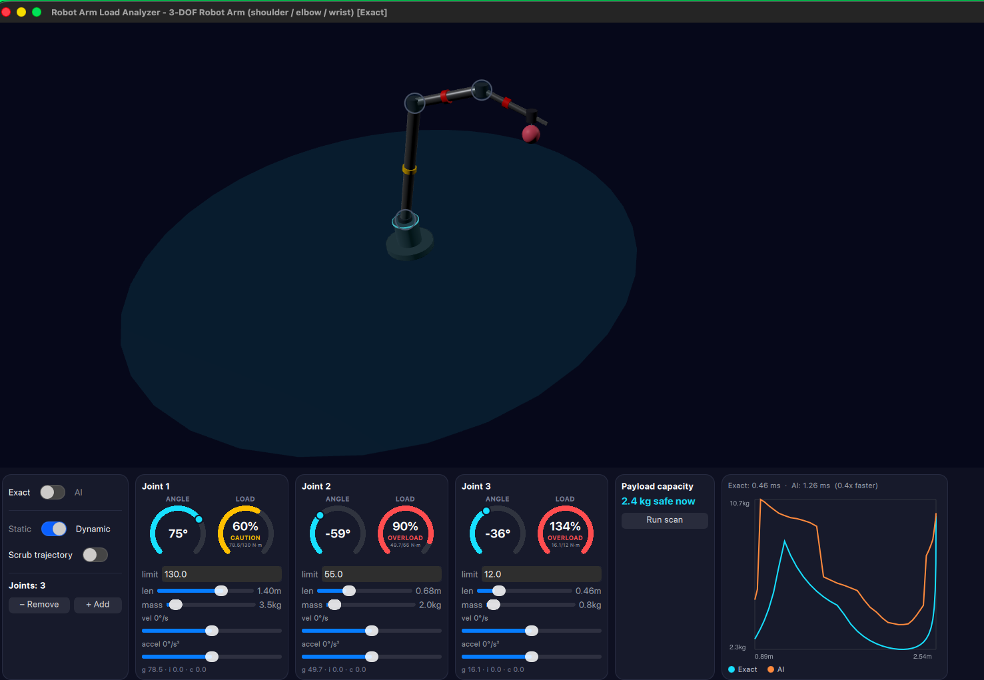
WHY AI? — PART 2
Honest engineering: AI isn't always faster
▸ In Dynamic mode, the real engine is already cheap,
and the neural network's own overhead stops paying for itself.
▸ Here: Exact 0.46 ms · AI 1.26 ms — the exact engine wins, 0.4x.
▸ This isn't a bug — it's the point of measuring instead of assuming.
A tool that only ever claims “AI is faster” isn't measuring anything; this one shows you both numbers, every single time.
Robot Arm Load Analyzer
8

Slide 10
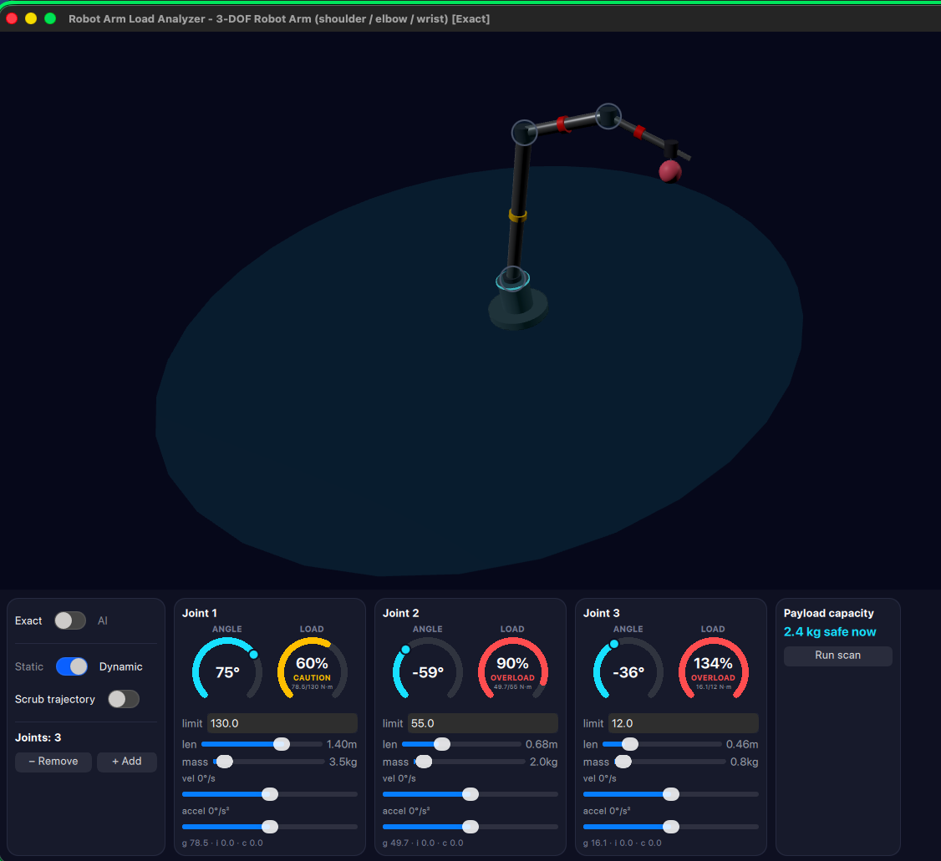
FULL DYNAMICS
Gravity, inertia, and Coriolis — separated
▸ Switch to Dynamic mode and every joint also gets velocity / acceleration sliders
▸ The torque shown is no longer just “holding still” — it's the full rigid-body dynamics equation
▸ Each joint's own line (g · i · c) breaks that total down into gravity, inertia, and Coriolis contributions — the why, not just the how much
▸ This is computed with a full Recursive Newton-Euler solve, not an approximation
Robot Arm Load Analyzer
9

Slide 11
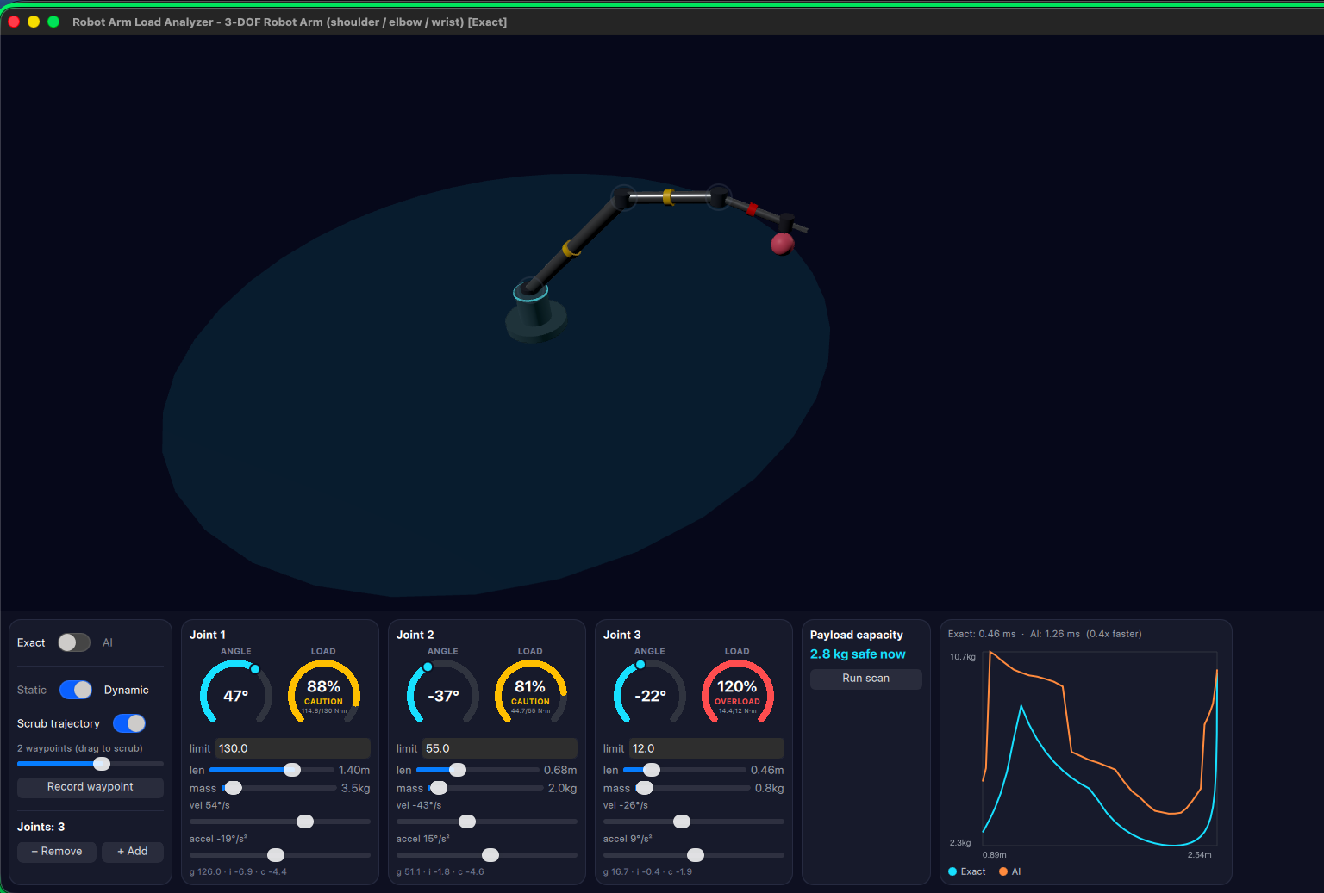
MOTION OVER TIME
Record a trajectory, then scrub through it
▸ Pose the arm, hit Record waypoint, pose it again — build up a short motion
▸ Drag the scrub slider and the arm smoothly interpolates between recorded poses
▸ Velocity and acceleration are read directly off that motion, not typed in by hand
▸ The torque breakdown updates in real time as the arm actually moves through the sequence
Robot Arm Load Analyzer
10

Slide 12
ENGINEERING
What's actually running underneath
▸ Forward & inverse kinematics
Classic Denavit-Hartenberg convention, chained 4×4 transforms.
▸ Static torque
Jacobian-transpose method, cross-checked against an independent virtual-work energy derivation.
▸ Full dynamics
Recursive Newton-Euler (RNEA) — gravity, inertia, and Coriolis torque, computed and decomposed.
▸ Inverse kinematics
Damped least-squares — chosen specifically to stay numerically finite at a singularity (full extension) instead of blowing up.
▸ AI surrogate
A small neural network trained on the exact engine's own output, with normalization folded into the exported weights for a single, dependency-free C++ forward pass.
Robot Arm Load Analyzer
11

Slide 13
SUMMARY
A complete, integrated system
Physics Engine
AI Surrogate
Interactive 3D UI
▸ DH kinematics, Jacobian statics,
full RNEA dynamics
▸ Damped least-squares inverse
kinematics
▸ A real safety number, computed
live on every change
▸ Trained on the exact engine's
own data — nothing hand-labeled
▸ Hand-written C++ inference,
no ML runtime dependency
▸ Benchmarked honestly —
shown faster AND slower
▸ Procedural hardware look,
no imported 3D models
▸ Direct manipulation in 3D
or on a 2D reach pad
▸ A fully editable arm —
topology, geometry, and mass
Robot Arm Load Analyzer
12

Slide 14
Thank you
Robot Arm Load Analyzer — Sley Hortes · Student ID 411221407
Questions?

