Slide 1
GUIDE

Slide 2
Expression
Symbol
Operator
Single
Field
Interaction
(Nauticle interface)
Arithmetic function
Arithmetic operator
Constant
Variable
Particle system
sin, cos, ...
+, -, *, /, ^,%
Filter
DEM
(Discrete Element Method)
N-body
(Self-gravitating systems)
SFM
(Social Force Model)
...
Fsearch
SPH
(Smoothed Particle Hydrodynamics)
DVM
(Discrete Vortex Method)
Fmean
Fmin
Fmax
Fsum

Slide 3
Expression
Symbol
Operator
Single
Field
Interaction
(Nauticle interface)
Arithmetic function
Arithmetic operator
Constant
Variable
Particle system
sin, cos, ...
+, -, *, /, ^,%
Filter
DEM
(Discrete Element Method)
N-body
(Self-gravitating systems)
SFM
(Social Force Model)
...
Fsearch
SPH
(Smoothed Particle Hydrodynamics)
DVM
(Discrete Vortex Method)
Fmean
Fmin
Fmax
Fsum

Slide 4

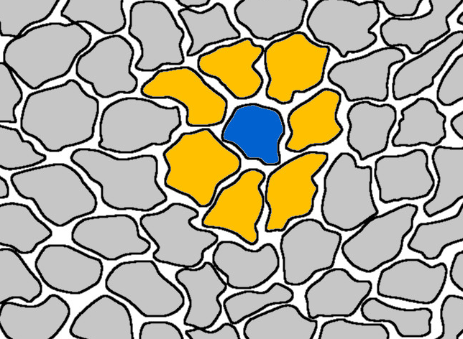














$$a.$$
$$b.$$
$$j$$
$$i$$
$$i$$
$$j$$
$$c.$$
$$d.$$
$$j$$
$$j$$
$$i$$
$$i$$
$$j$$
$$i$$
$$j$$
$$i$$
Interaction
$$I_{ij}$$

Slide 5
XML Document
Nauticle - Case manager
XML reader
UDE parser
Case assembler
Parameter space
Simulation scheduler
Case
Nodal coordinates
XYZ reader
Workspace
Equations
c | 7
x | ?
y | ?
x=c+5
y=x^2+2
a=sph()
VTK reader
VTK writer
VTK
Document

Slide 6










$$ω_{i}$$
$$δ_{ij}$$
$$v_{i}$$
$$v_{j}$$
$$R_{i}$$
$$n_{ji}$$
$$R_{j}$$
$$r_{i}$$
$$r_{j}$$
$$ω_{j}$$

Slide 7









Hash key
Positions
Start
End
20 | 21 | 22 | 23 | 24
15 | 16 | 17 | 18 | 19
10 | 11 | 12 | 13 | 14
5 | 6 | 7 | 8 | 9
0 | 1 | 2 | 3 | 4
$$0$$
$$0$$
$$0$$
$$0$$
$$1$$
$$1$$
$$1$$
$$1$$
$$1$$
$$2$$
$$⋮$$
$$0.$$
$$1.$$
$$2.$$
$$3.$$
$$4.$$
$$5.$$
$$6.$$
$$7.$$
$$8.$$
$$9.$$
$$⋮$$
$$r_{i}$$
$$r_{j}$$
$$r_{k}$$
$$r_{l}$$
$$r_{m}$$
$$r_{n}$$
$$r_{o}$$
$$r_{p}$$
$$r_{q}$$
$$r_{r}$$
$$⋮$$
$$0.$$
$$4.$$
$$9.$$
$$13.$$
$$19.$$
$$23.$$
$$3.$$
$$8.$$
$$12.$$
$$15.$$
$$21.$$
$$27.$$
$$∂Ω_{p}$$
$$Ω$$
Particles in the $0^{th}$ cell
$$∂Ω_{s}$$
$$r_{1}$$
$$r_{2}$$

Slide 8




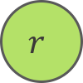


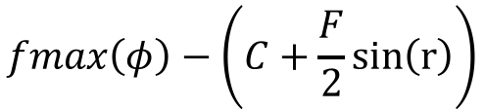
-
$$fmax$$
+
$$φ$$
$$C$$
*
$$fmax\left(φ\right)−\left(C+\frac{F}{2}sin\left(r\right)\right)$$
÷
$$sin$$
$$F$$
$$2$$
$$r$$

Slide 9
W | t | n | n | n | n | n
1 | 2 | 3 | 4 | 5 | 6 | 7
1. | W
2. | Type of the kernel, p: polynomial, e: exponential.
3. | Order of the kernel.
4. | Number of pieces along the influence radius.
5. | influence/smoothing radius. Zero for infinite influence radius.
6. | Number of dimensions.
7. | Serial number. Currently zero for all kernels.

Slide 10
User level | Application of already implemented schemes (interactions). Usage of XML and VTK files. No coding or recompilation
Intermediate user/developer level | Level for new schemes to be implemented. Communication with the core through the Nauticle interface. Knowledge of the code core is not required.
Core developer level | Development of new features. Code optimisation. Paralellisation. …

Slide 11
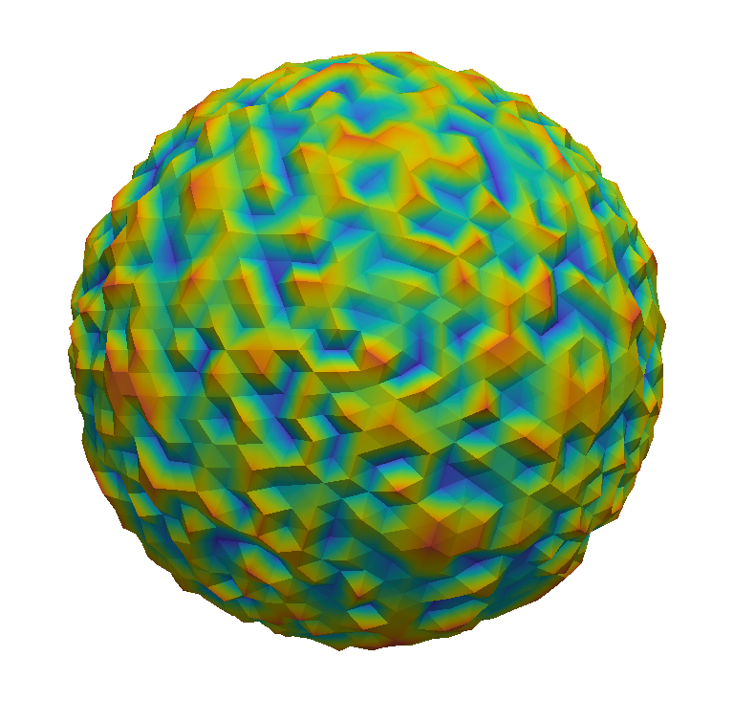
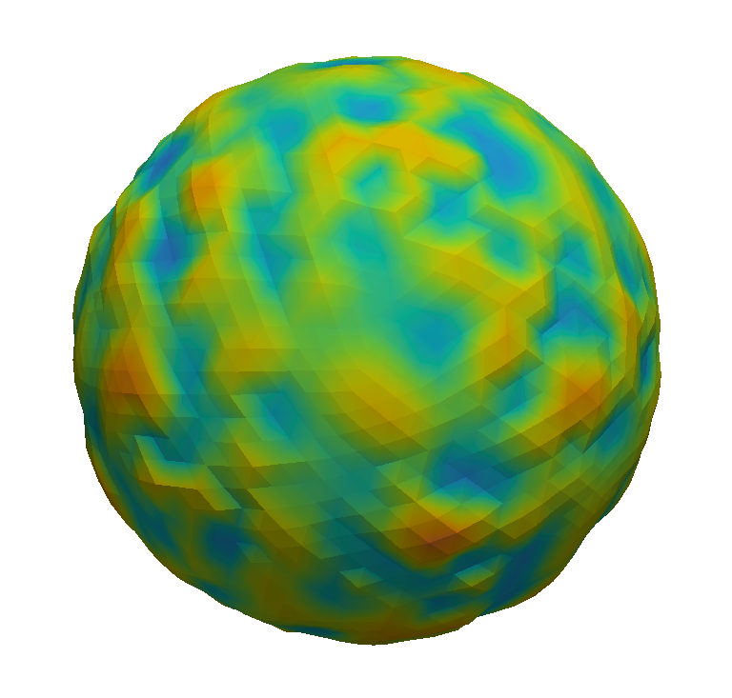
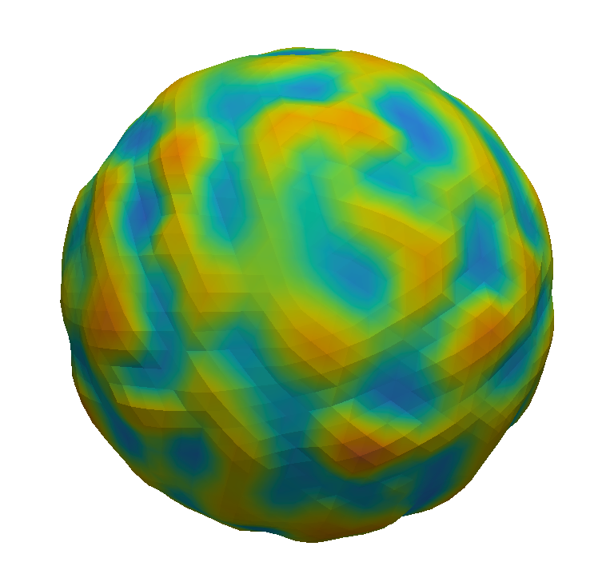
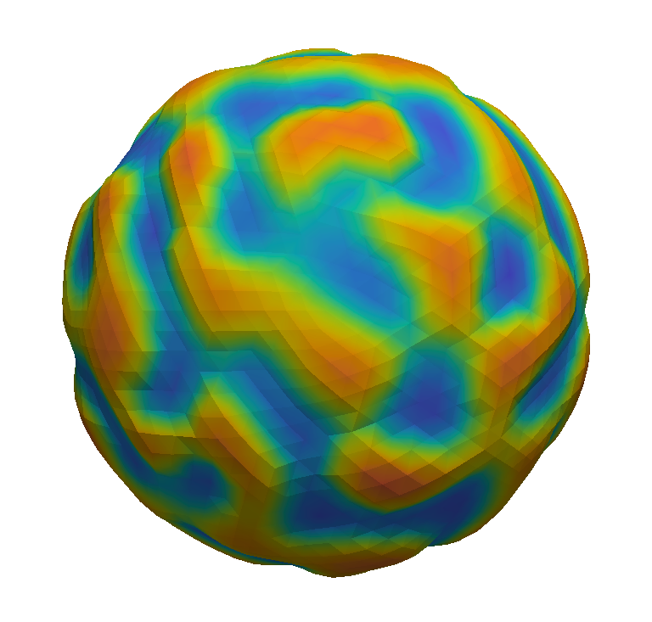
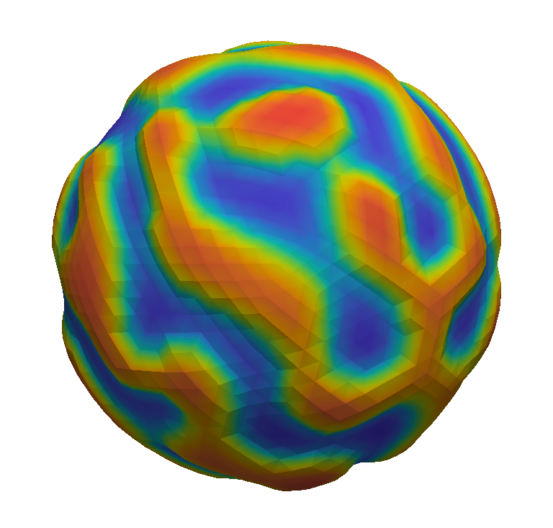
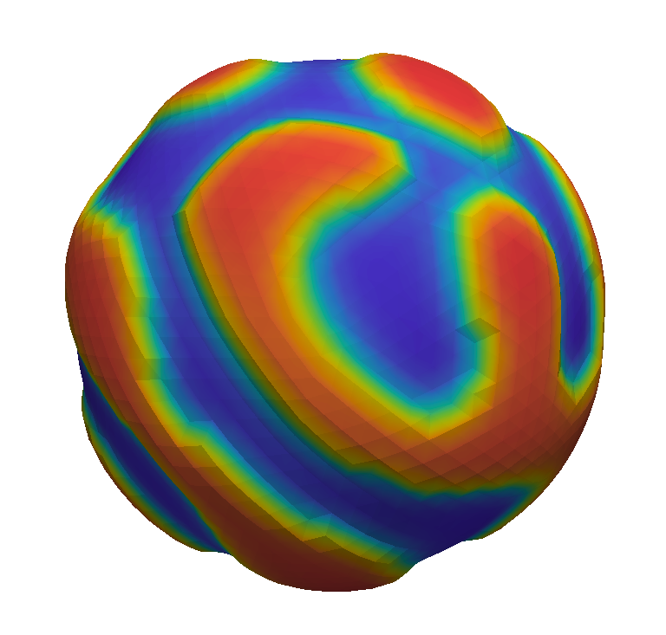


















$v_{2}=1$m/s
$T_{2}=100°$C
$$x$$
$$v(x)$$
$t=0$s
$t=1$s
$t=3$s
$$L$$
$$y$$
$T_{1}=0°$C
$v_{1}=0$m/s
$$L_{x}$$
$t=8$s
$t=19$s
$t=120$s
$$W$$
$$L_{y}$$
$$H$$

Slide 12
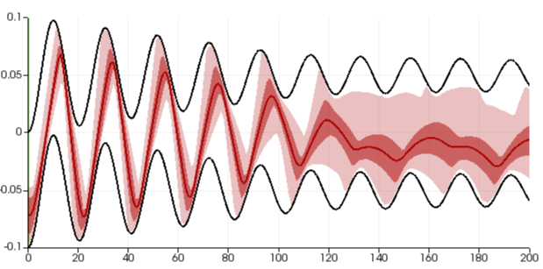

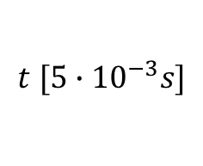




$$Z$$
$$L$$
$$R$$
$$M$$
z$[m]$
$$g$$
$$S$$
$$t [{5∙10}^{−3}s]$$

Slide 13



$$L$$
$$d$$
$$ω_{i}$$

Slide 14
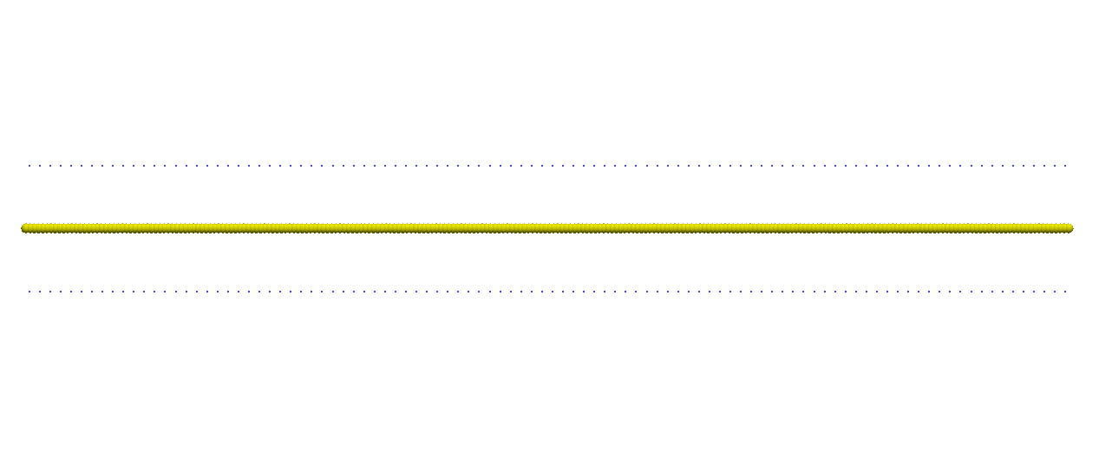
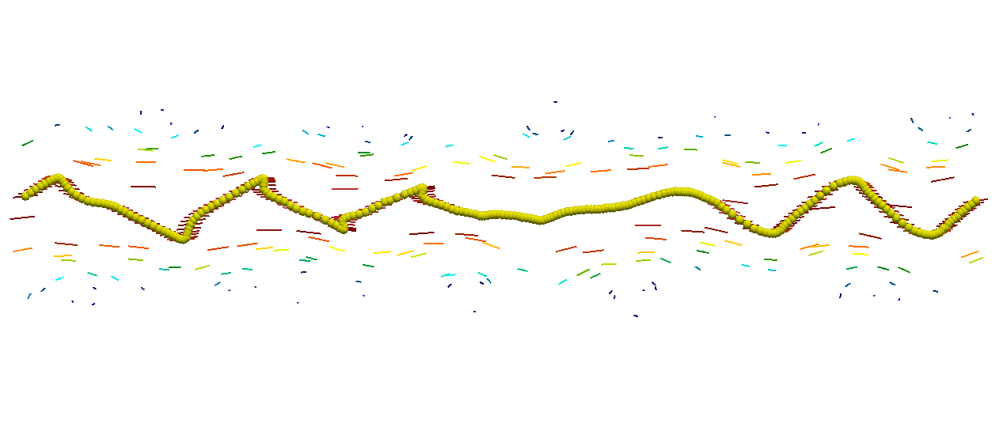
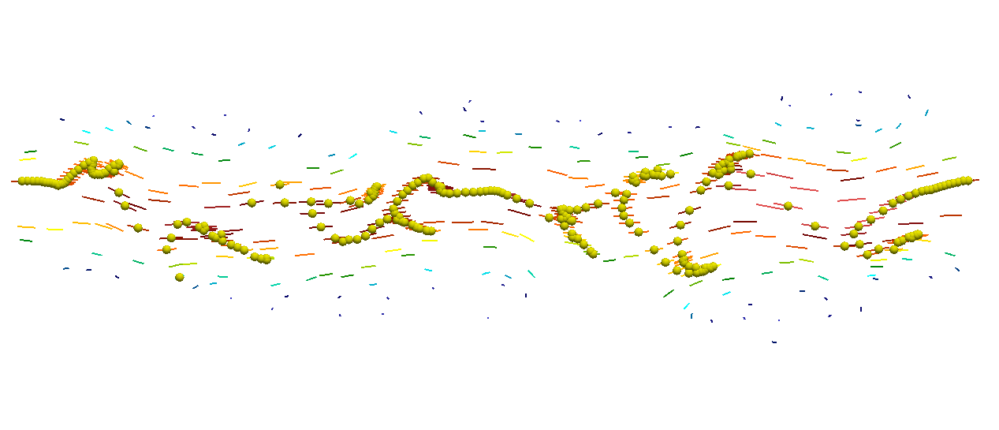
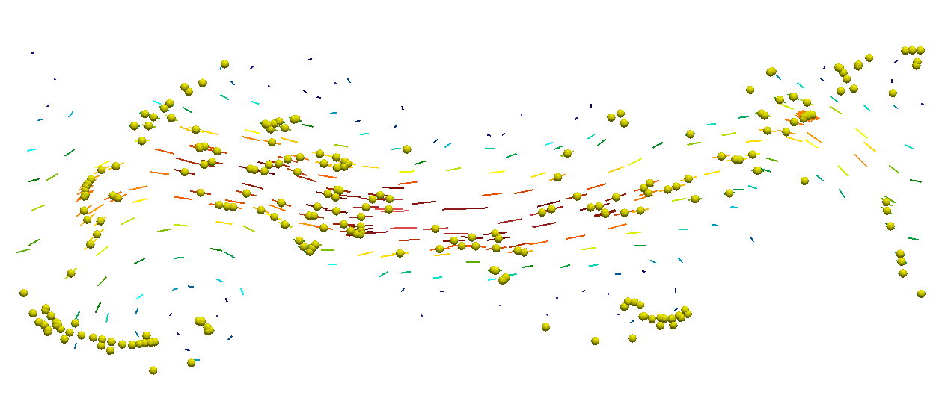
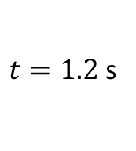
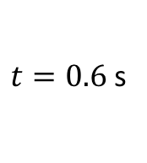
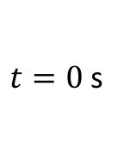
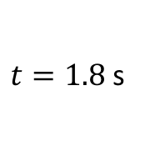
$t=0$s
$t=0.6$s
$t=1.2$s
$t=1.8$s

Slide 15
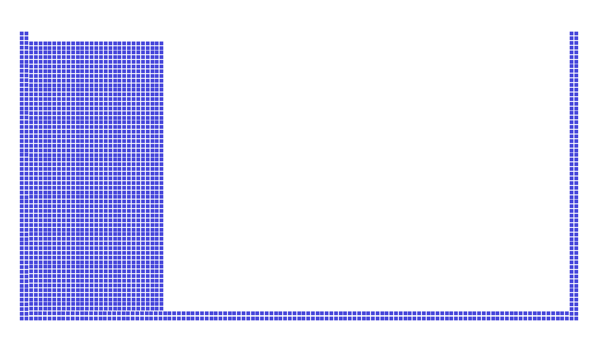
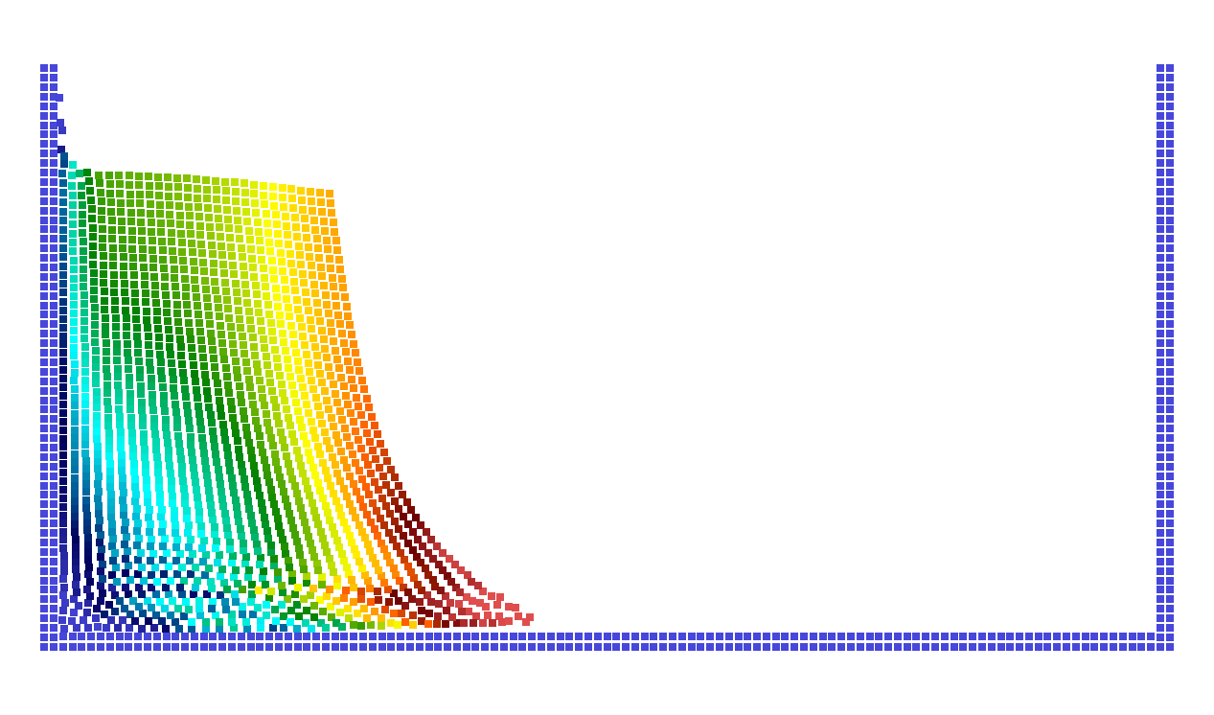
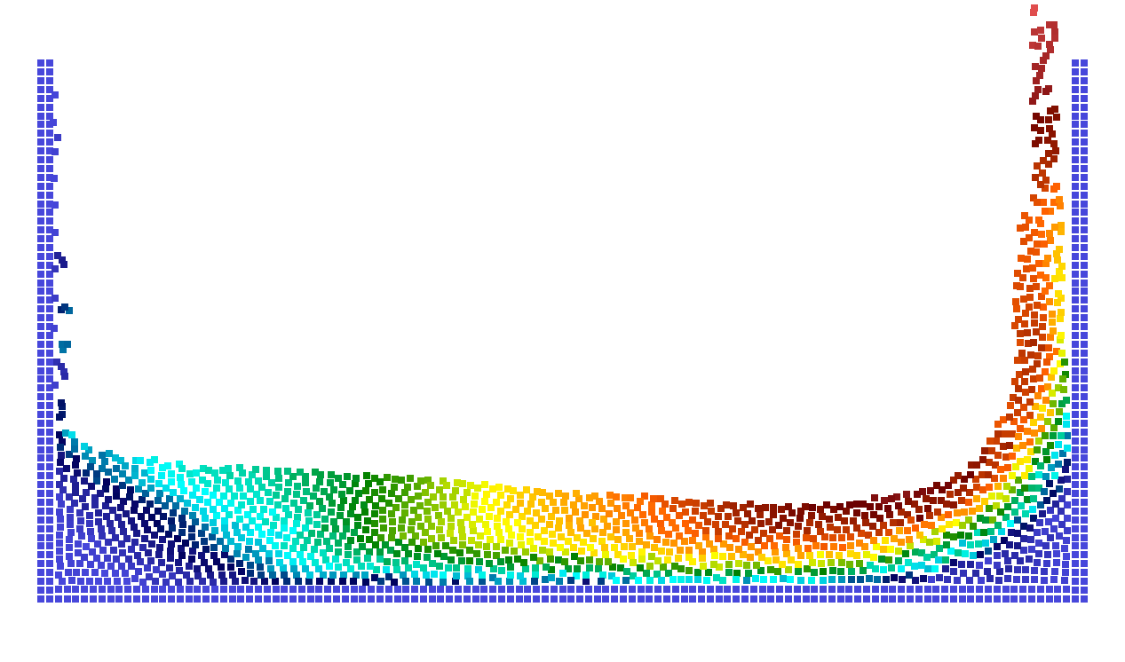
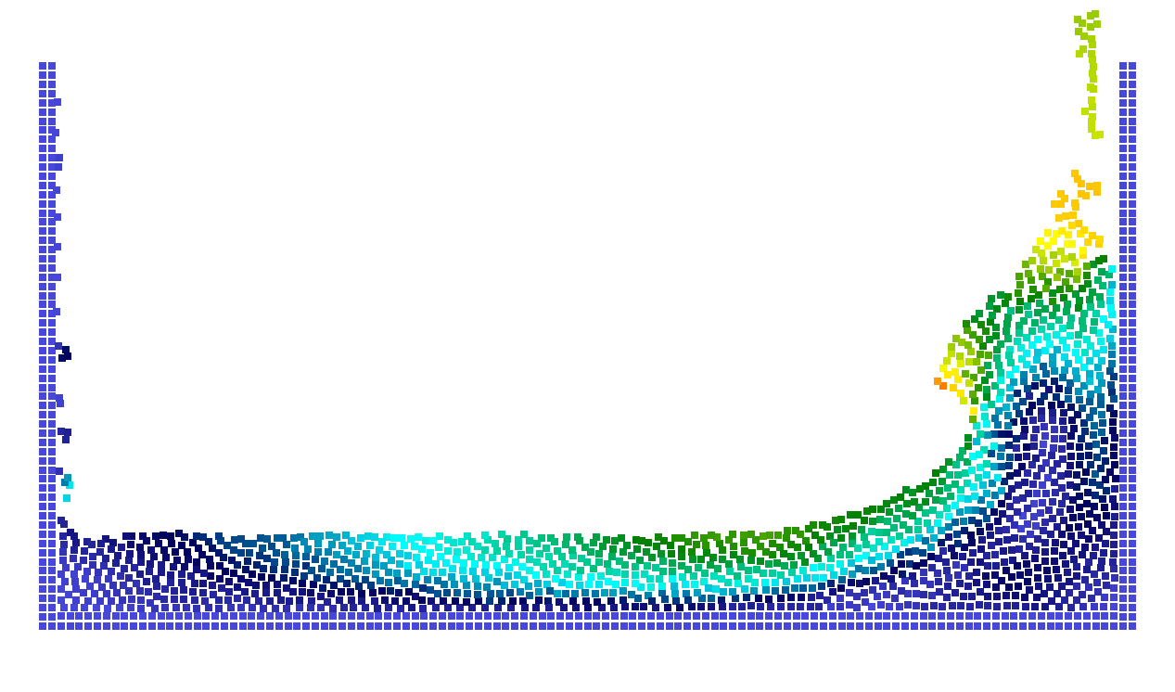
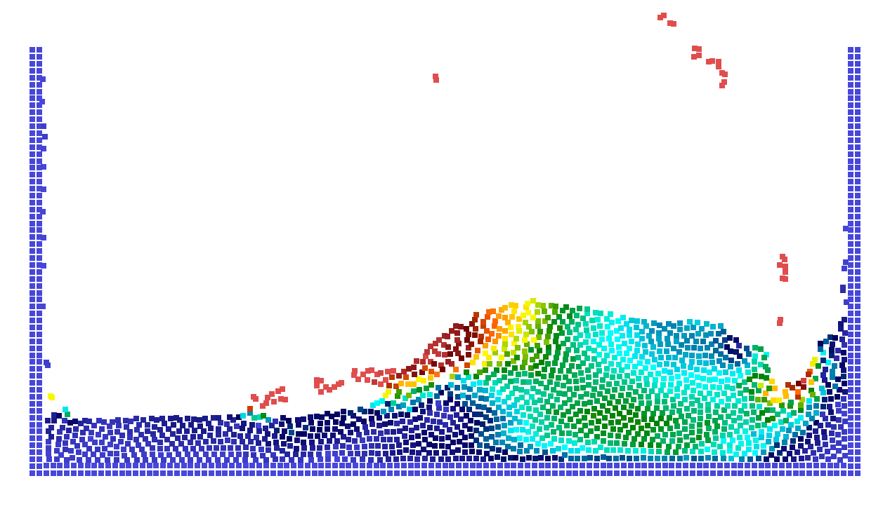
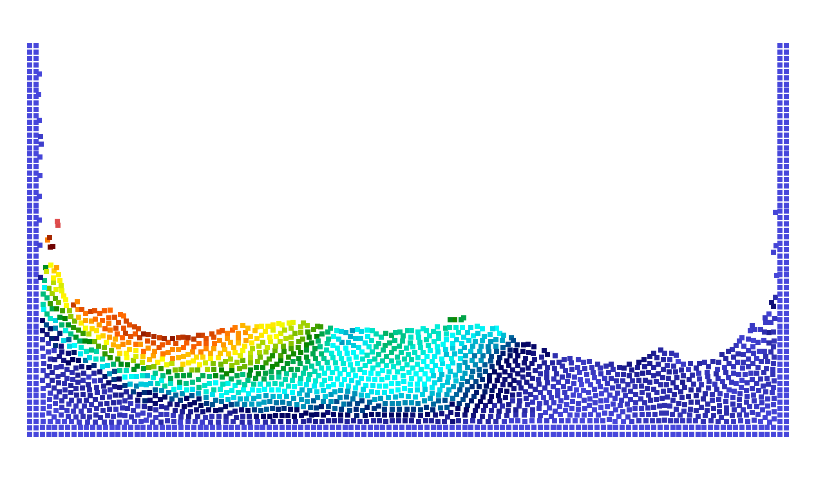
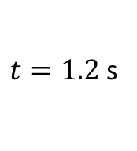
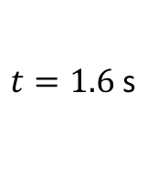
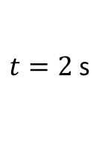
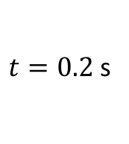
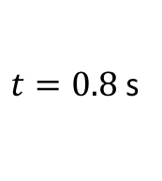
$t=0$s
$t=0.2$s
$t=0.8$s
$t=1.2$s
$t=1.6$s
$t=2$s

Slide 16



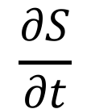

$$\frac{∂S}{∂t}$$
$$T_{w}$$
$$q=0$$
$$T_{m}$$
$$S(t)$$
$$L$$

Slide 17
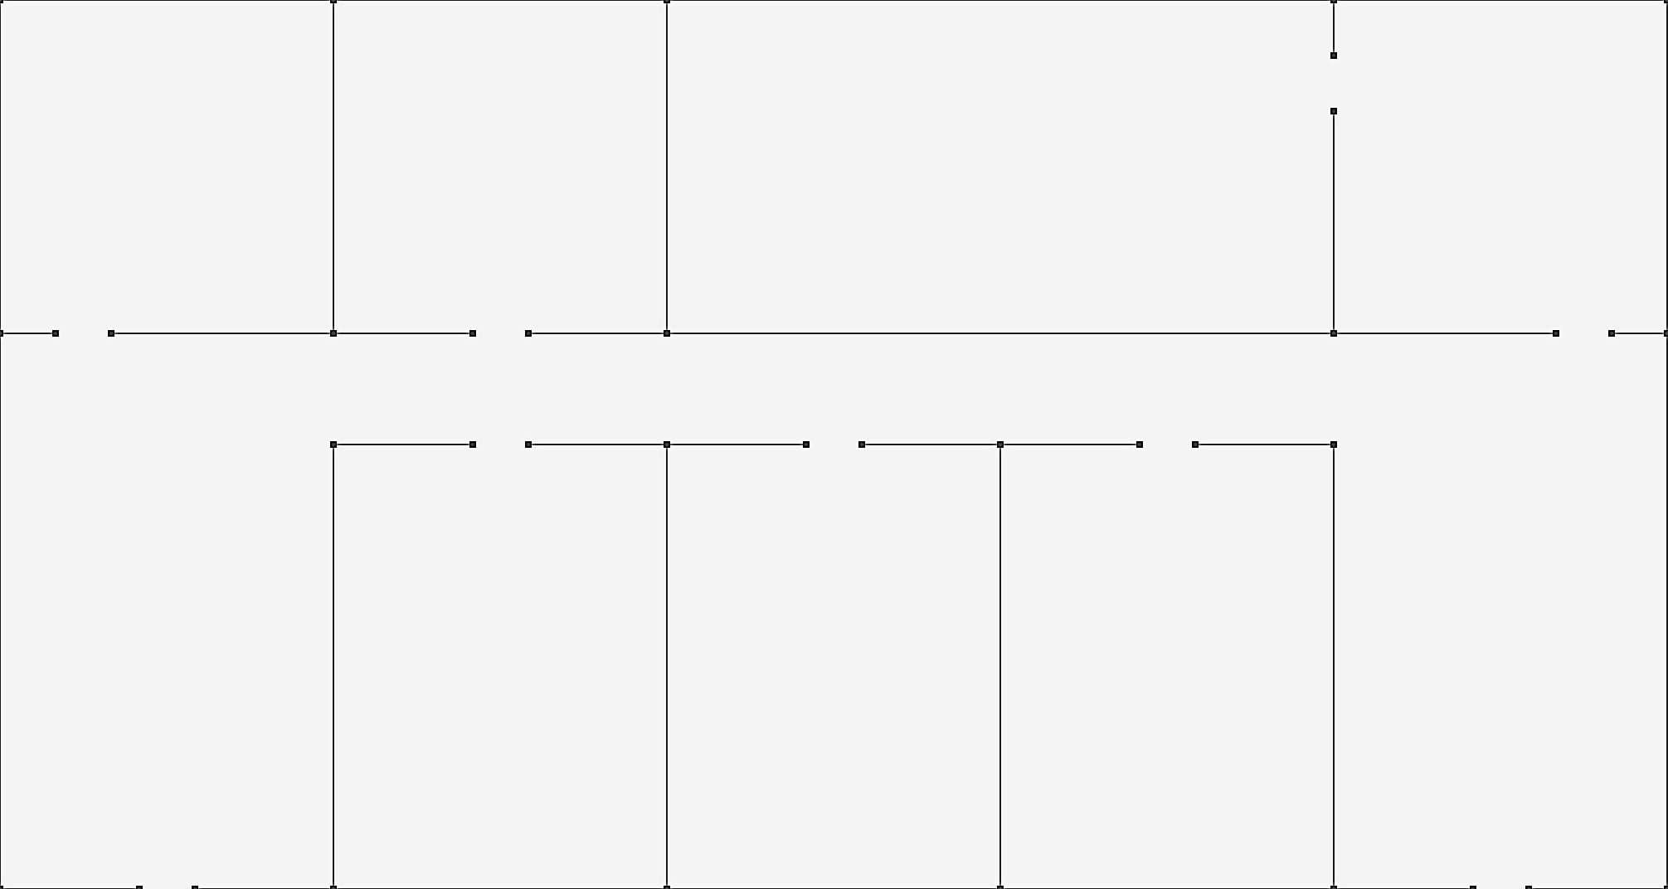
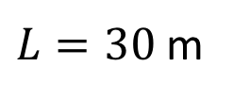
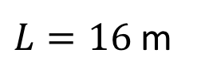
$L=16$ m
$L=30$ m

Slide 18
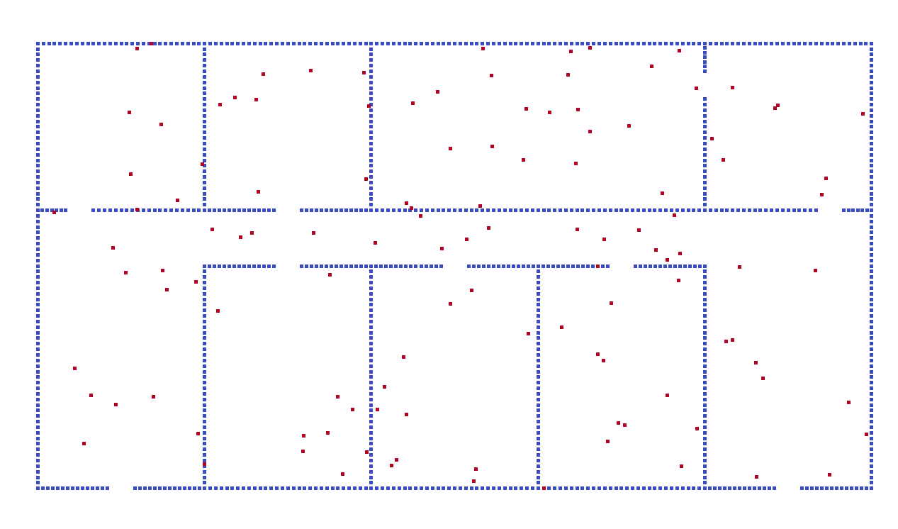
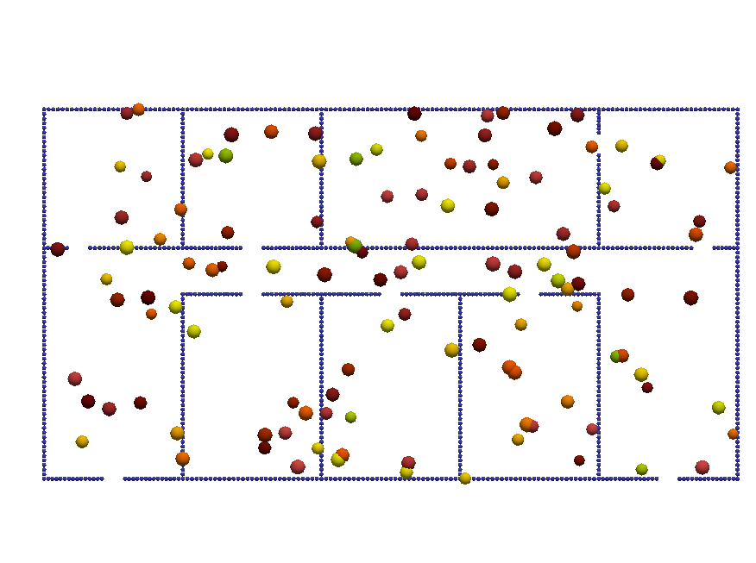
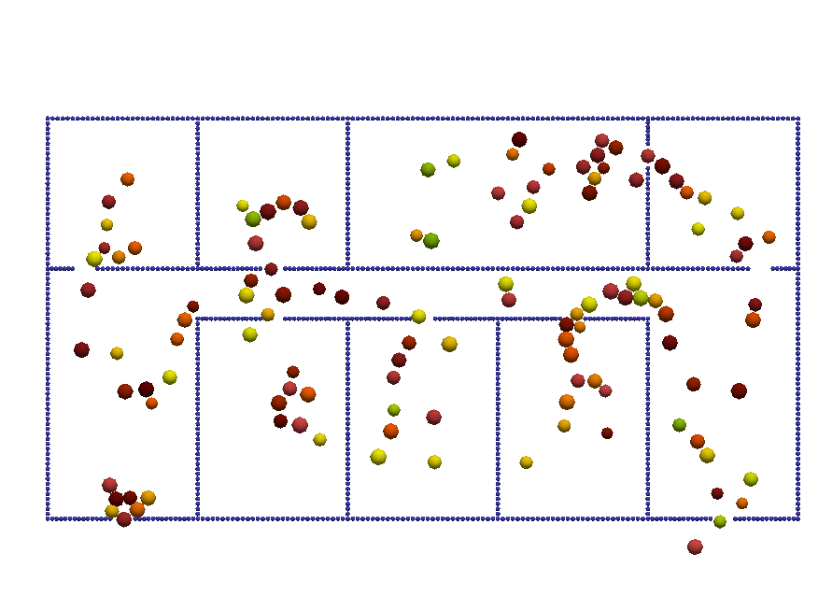
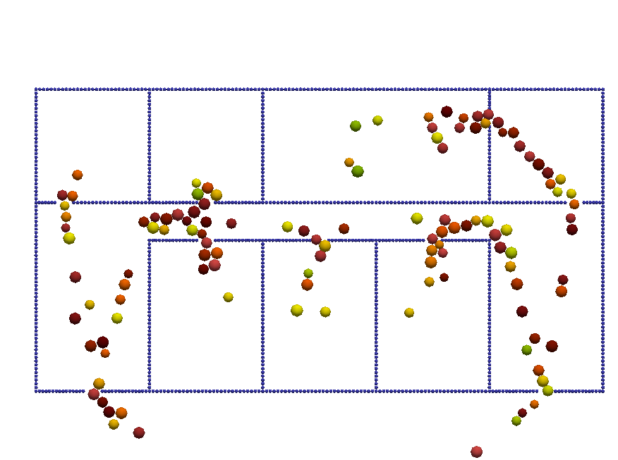
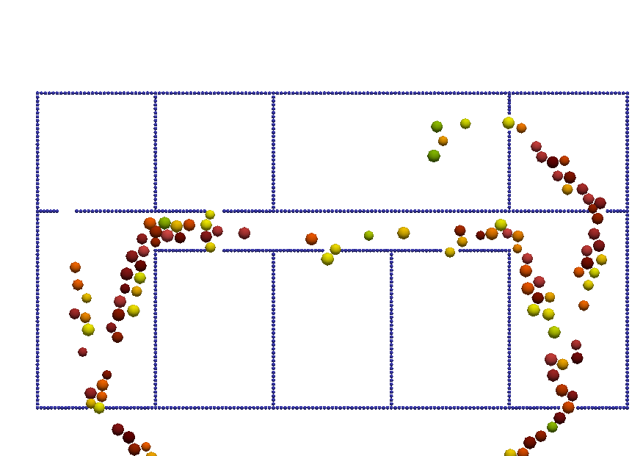
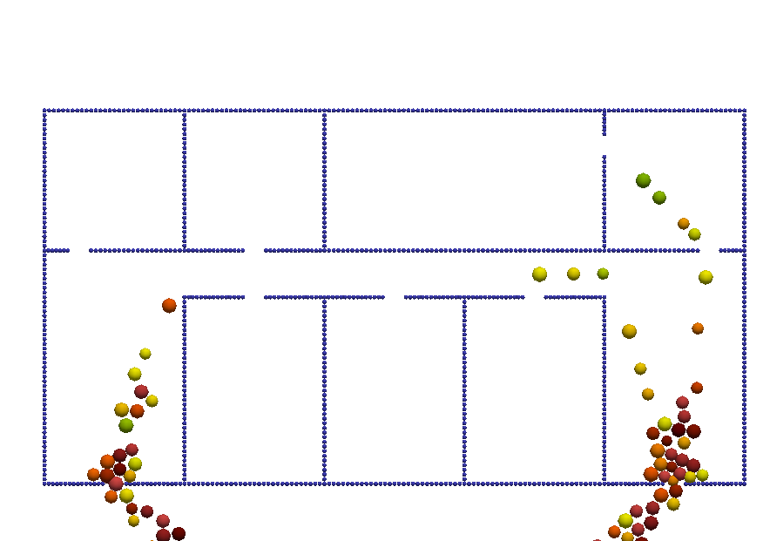
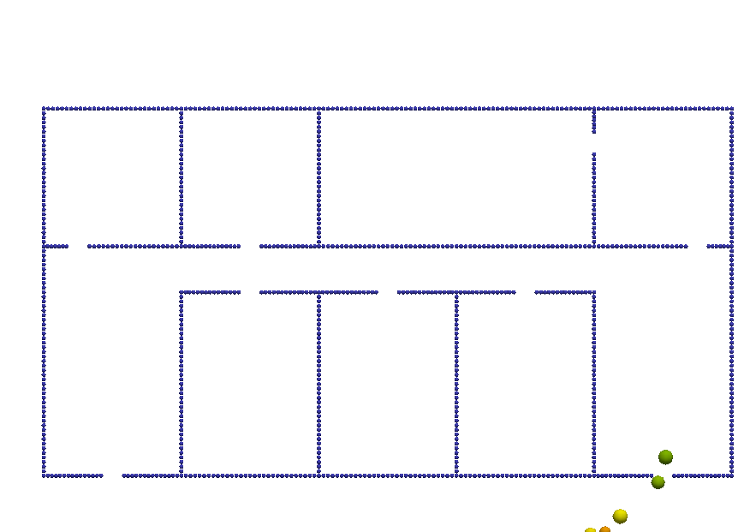
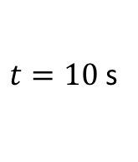
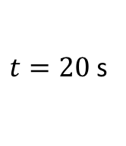
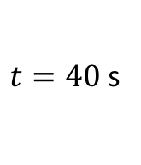
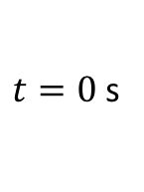
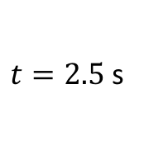
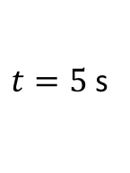
$t=0$s
$t=2.5$s
$t=5$s
$t=10$s
$t=20$s
$t=40$s

Slide 19
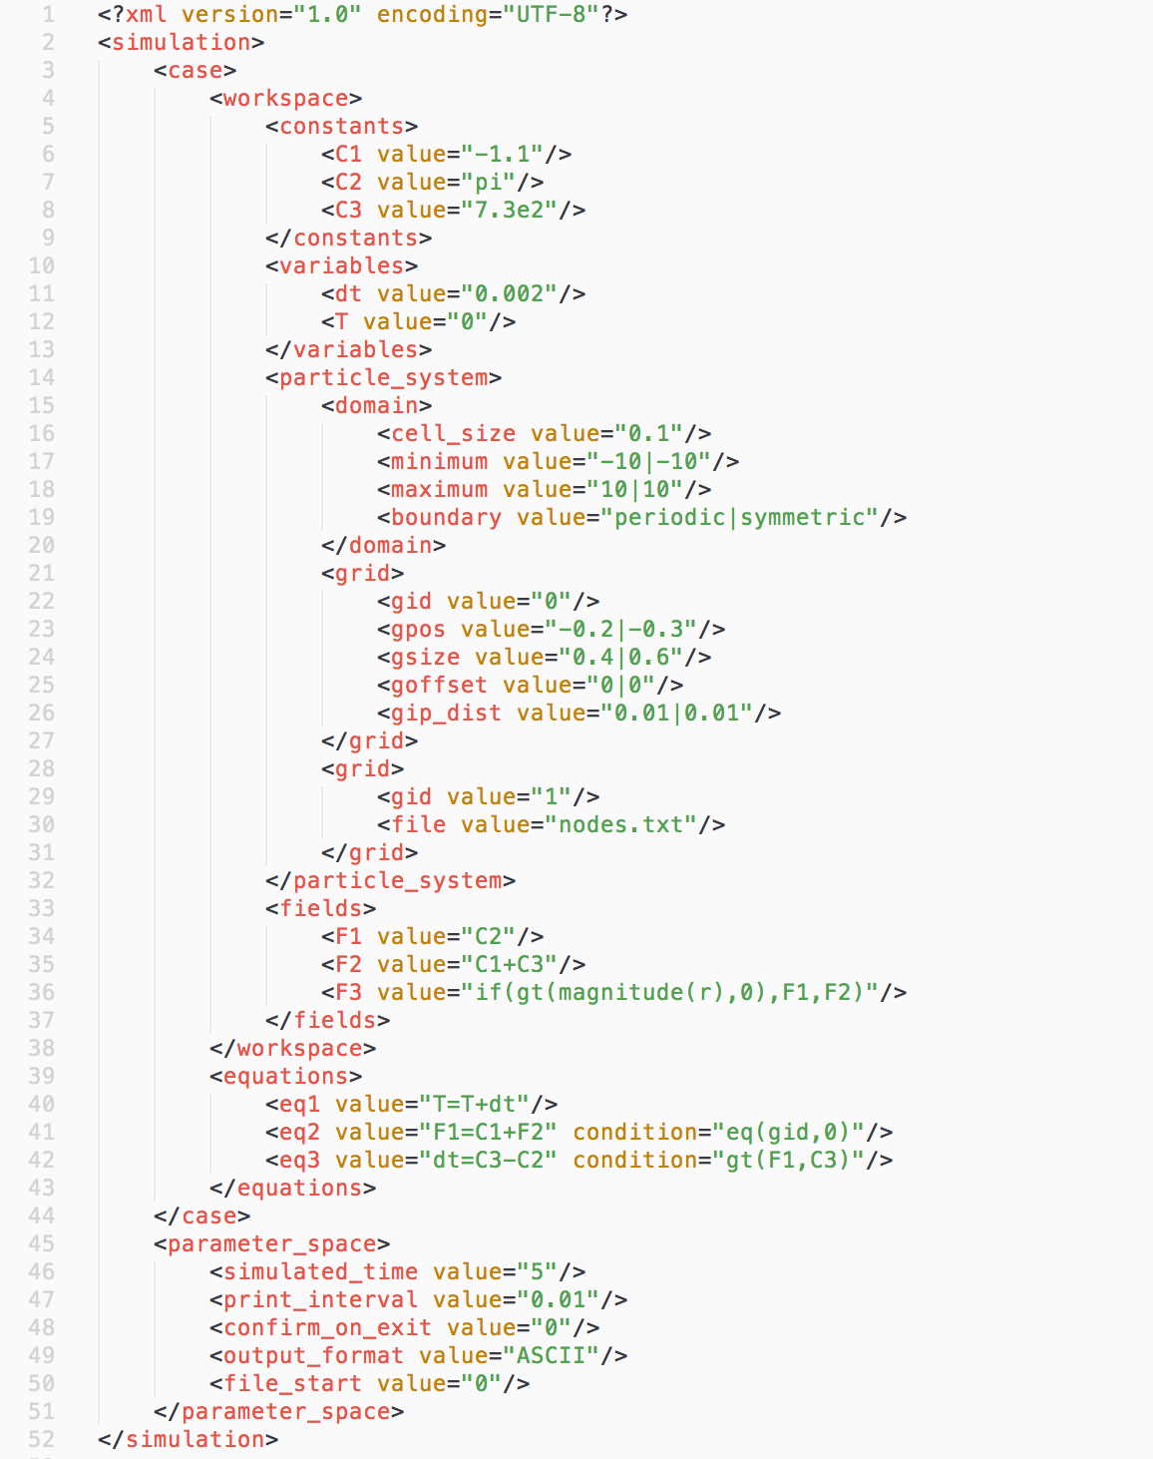
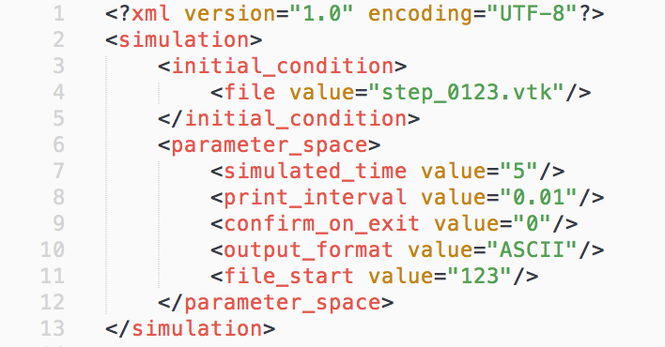
Reference to the VTK-file
Constants
Variables
Domain
Particle
system
Particles on a grid
Particles from a file
Fields
UDE’s
Simulation parameters

Slide 20
PAPER

Slide 21
XML Document
Nauticle - Case manager
XML reader
UDE parser
Case assembler
Parameter space
Simulation scheduler
Case
Nodal coordinates
XYZ reader
Workspace
Equations
c | 7
x | ?
y | ?
x=c+5
y=x^2+2
a=sph()
VTK reader
VTK writer
VTK
Document

Slide 22

Case
Workspace
Equations
Particle system
equation 1
Domain
Neighbor search
equation 2
Variables
Constants
$$⋮$$
Fields
equation n

Slide 23
Expression
Symbol
Operator
Single
Field
Arithmetic function
sin, cos, ...
Constant
Particle system
Arithmetic operator
+, -, *, ...
Variable
Interaction
(Nauticle interface)
Filter
Fsearch
Fmax
Fmean
DVM
SPH
DEM
N-body
SFM
Fsum
Fmin
Fmax

