Slide 1
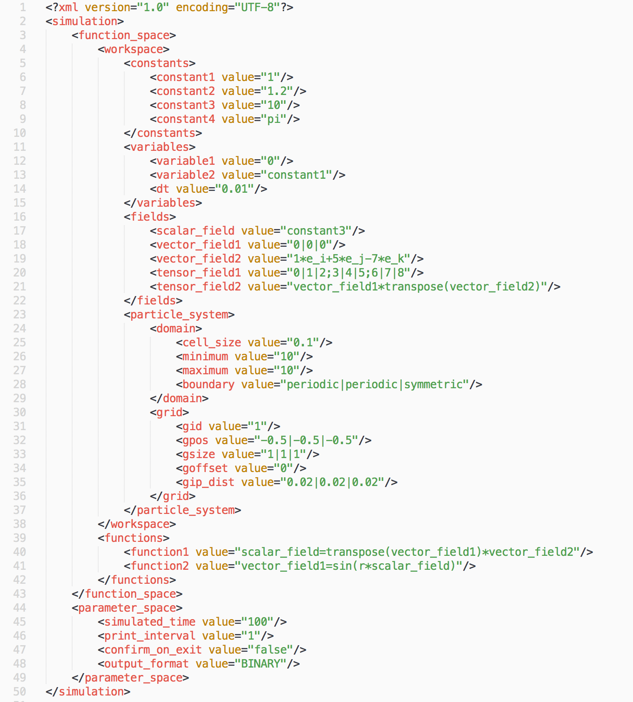
Global values
Field values
Function space
Computational domain
Particle system
Particle generation
Functions in solution order
Simulation parameters

Slide 2
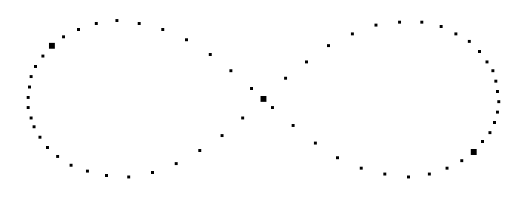
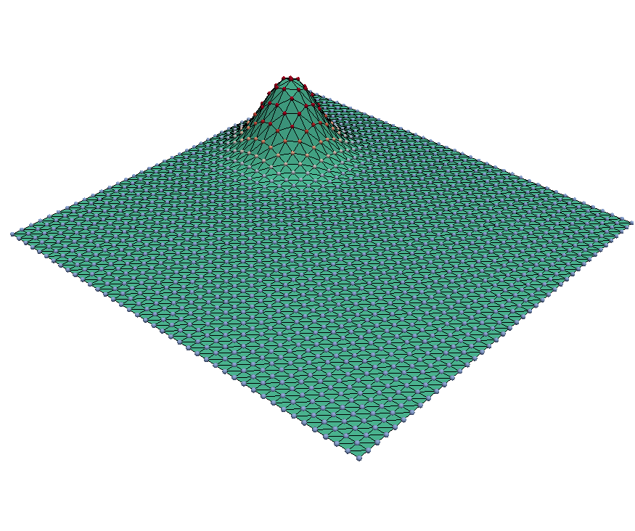
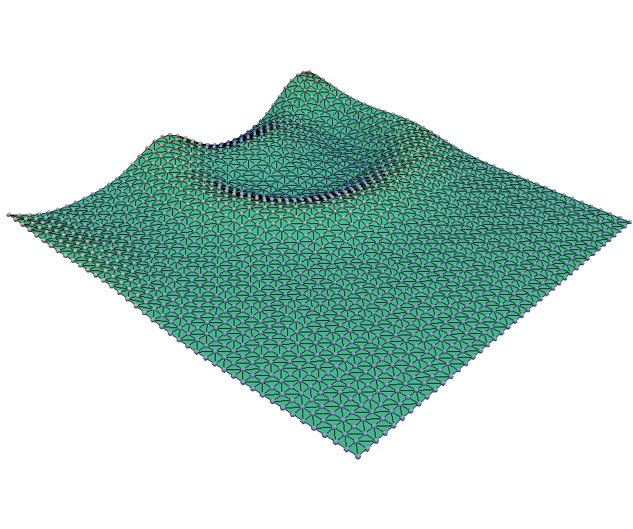
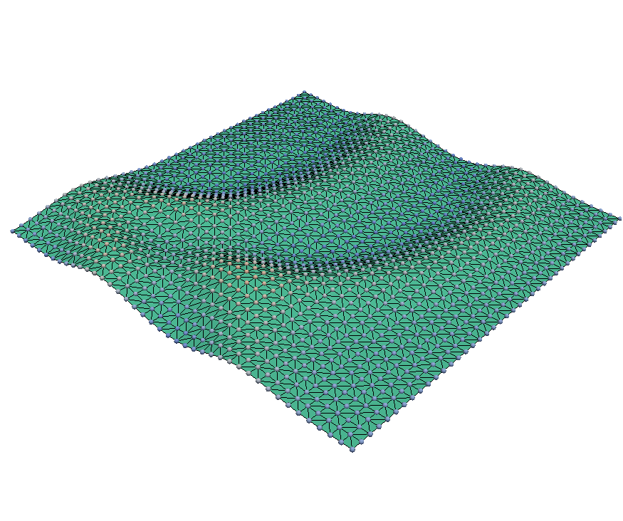
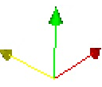
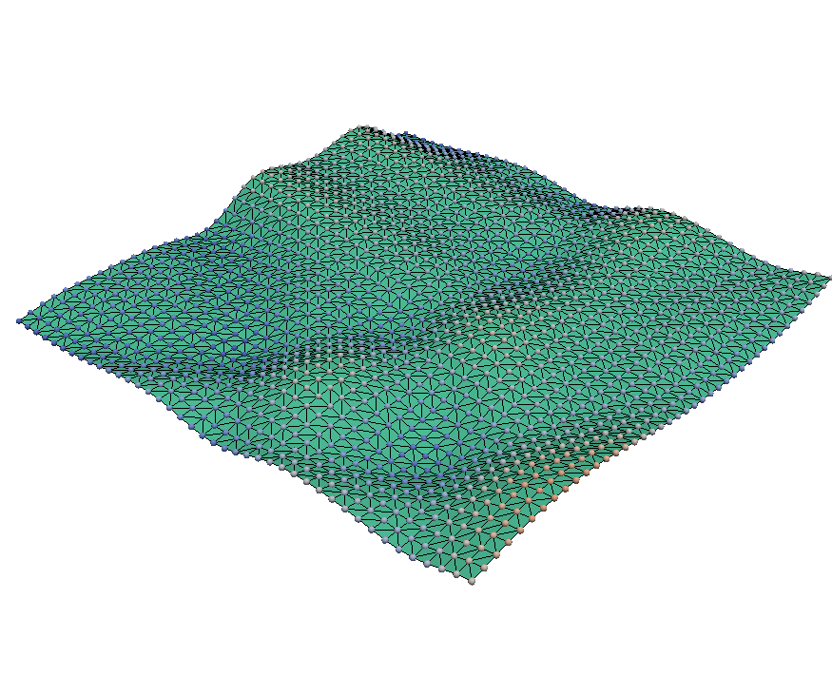
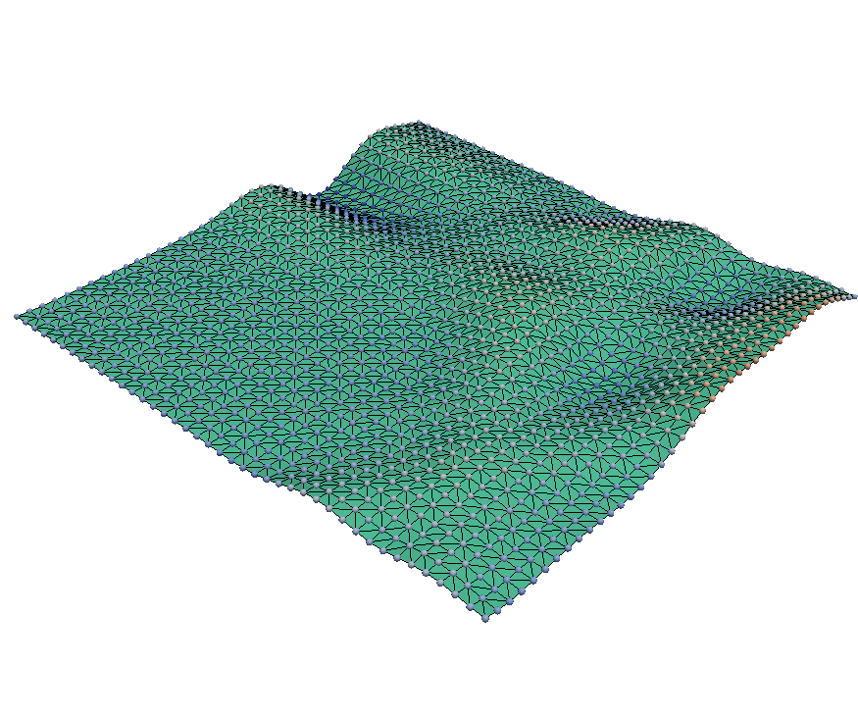
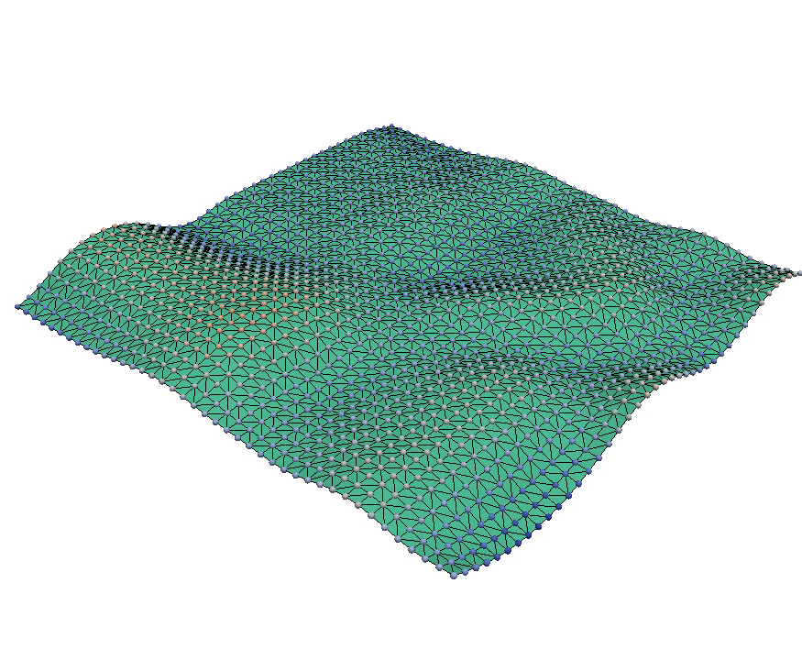









Simulation
Function space
Workspace
Workspace
Constants
Variables
Fields
Particle system
Functions
Functions
function1
$t=0$s
$t=1$s
$t=2$s
function2
…
$$z$$
fuctionN
$$y$$
$$x$$
Parameter space
$t=3$s
$t=4$s
$t=5$s
simulated_time
print_interval
confirm_on_exit
output_format

