Slide 1
Glamup Innerworkings
A step-by-step visual guide of how our website “Glamup” works

Slide 2
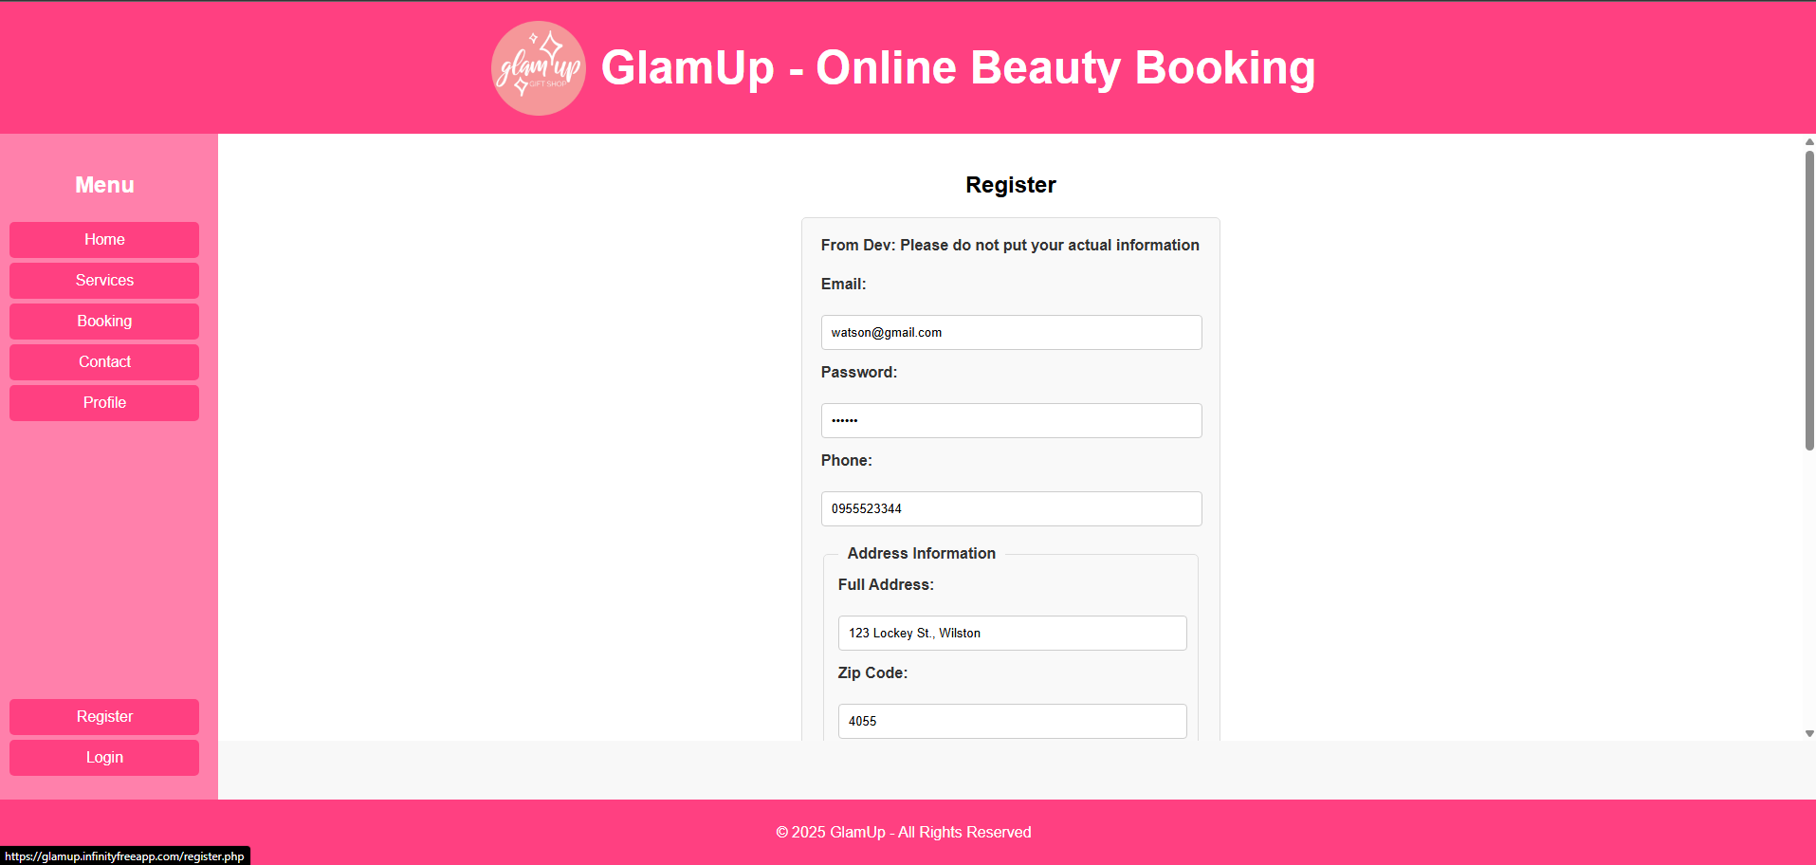
Register as Customer - Fill in info required

Slide 3
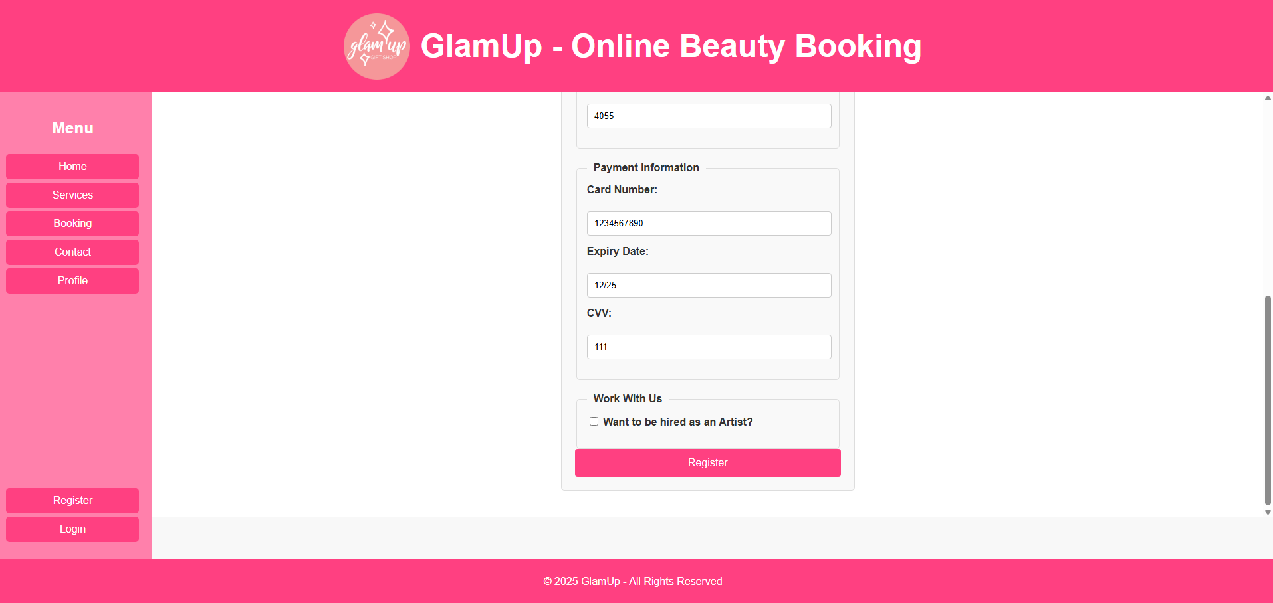
Register as Customer - Fill in info required
- Finish the registration

Slide 4
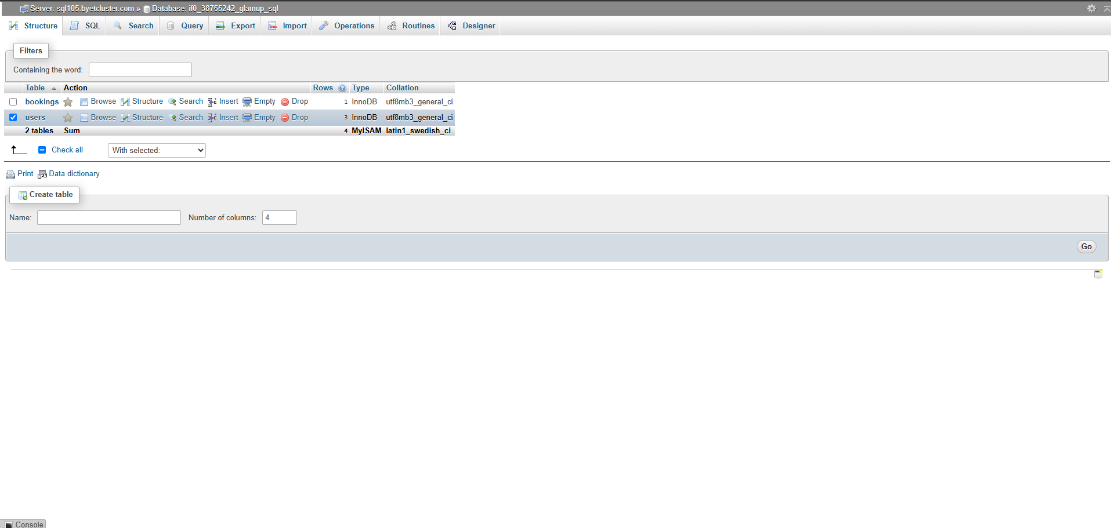
In the database, in the users table

Slide 5
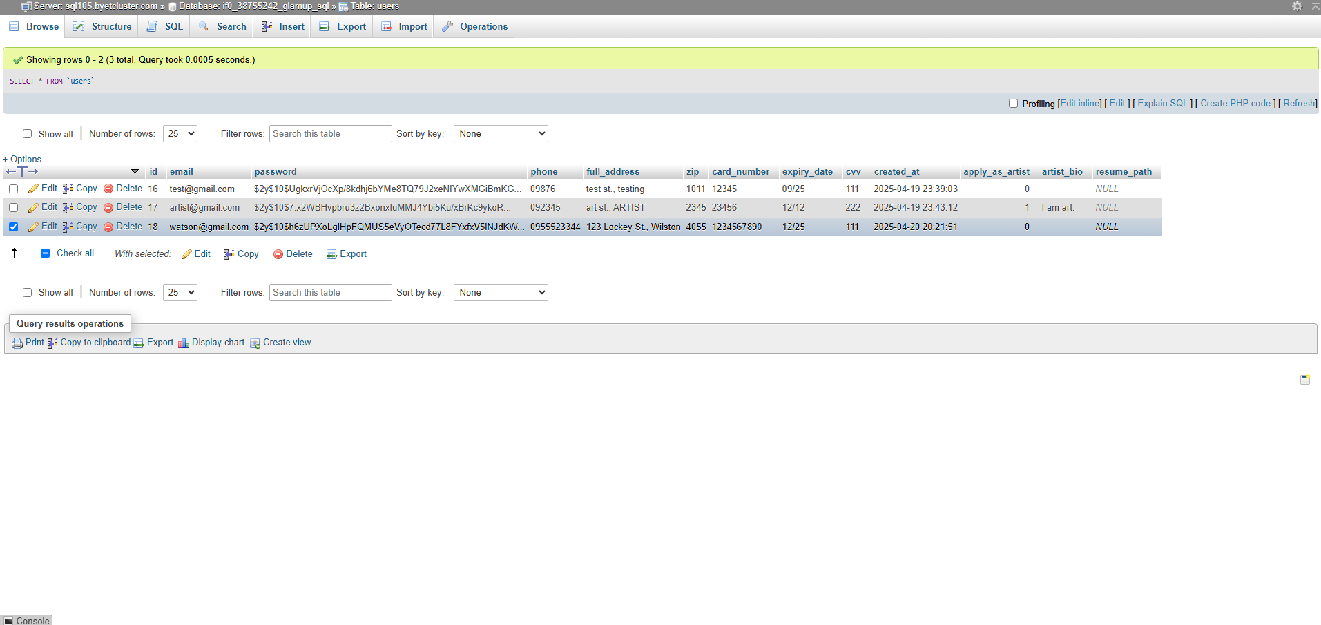
The user has been added with all their info

Slide 6
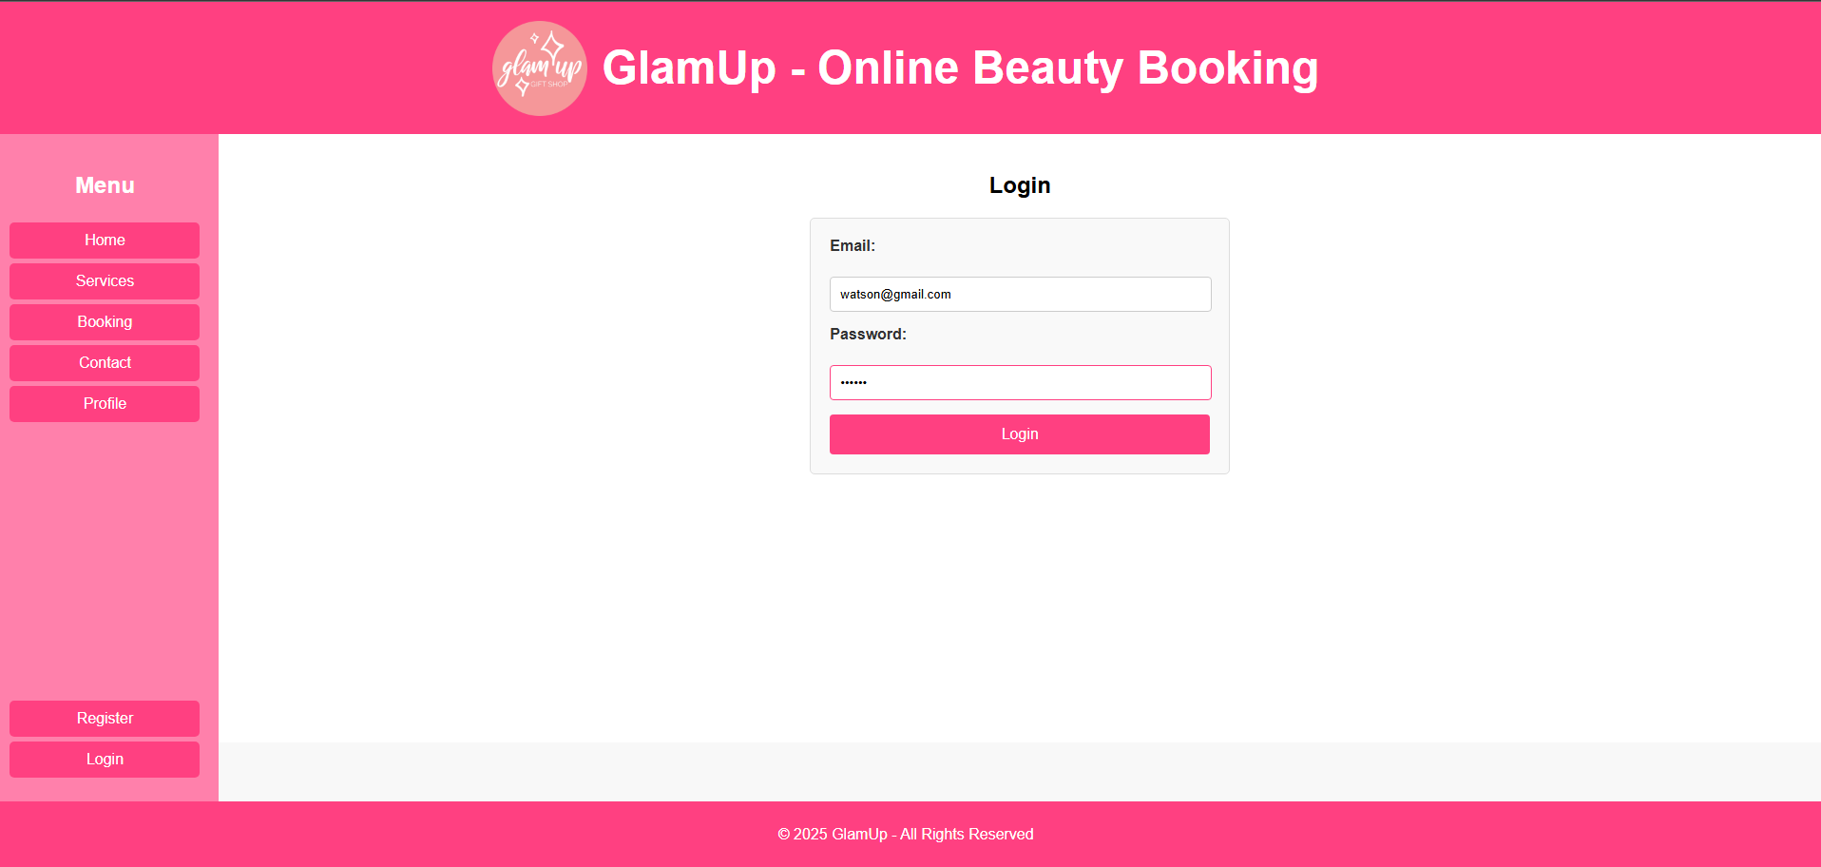
Login as Customer - Fill in info required
- Finish the login

Slide 7
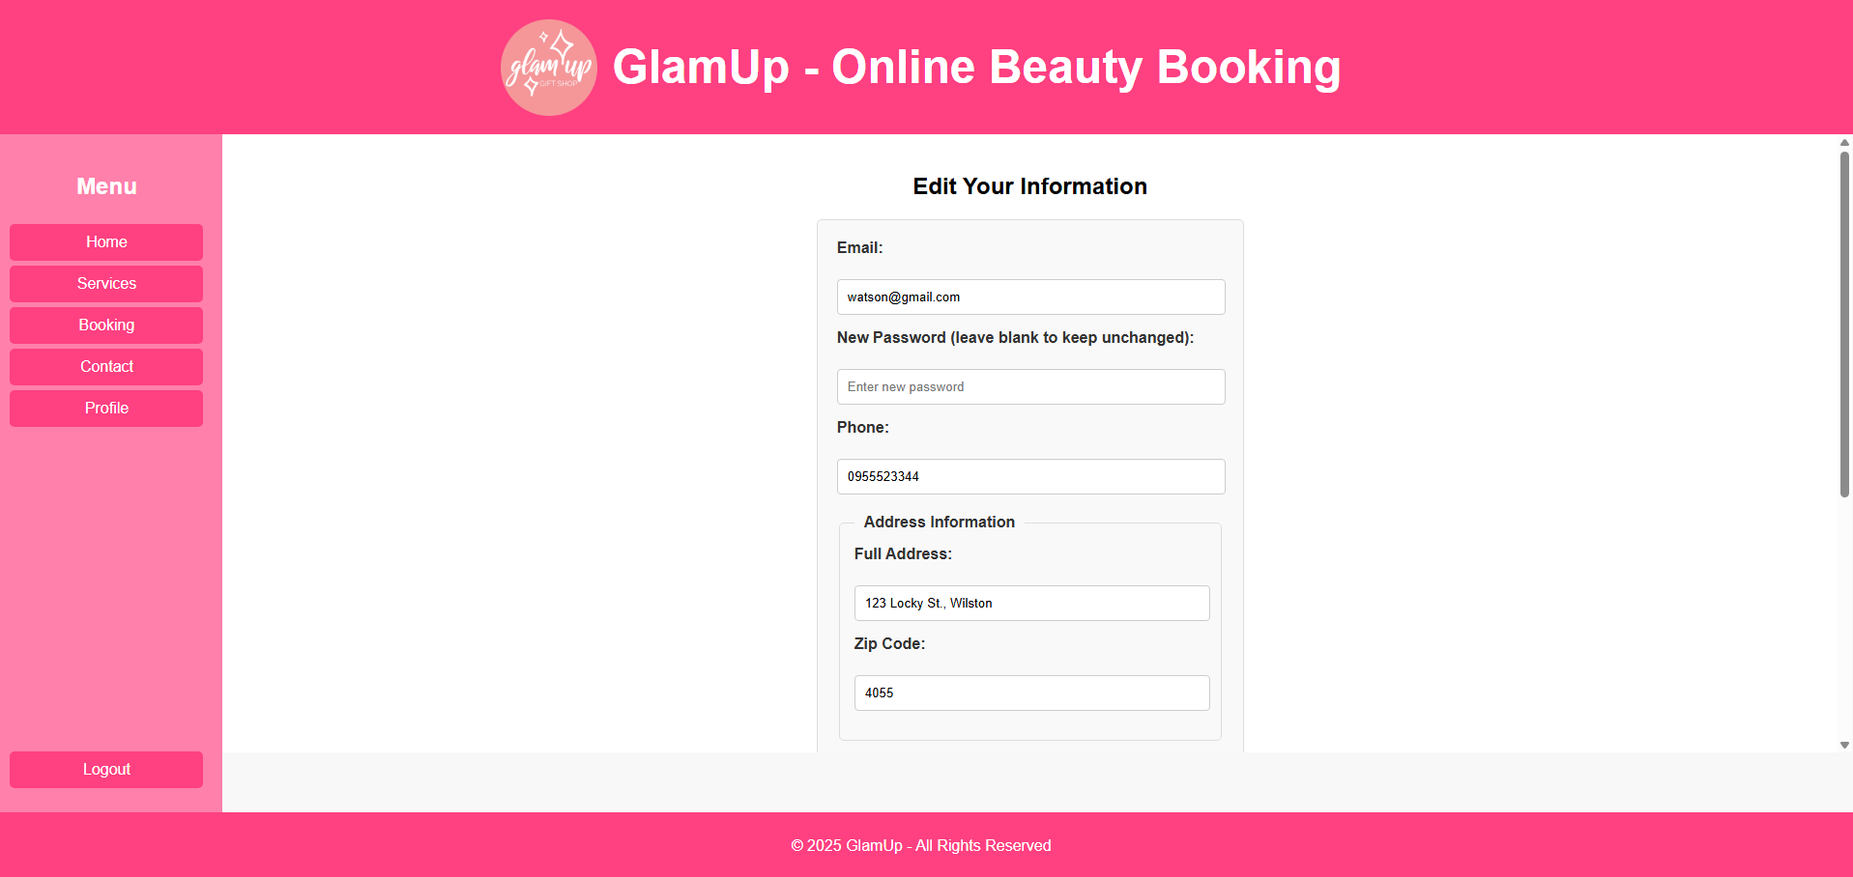
Users can check their profile in “Profile” page

Slide 8

Users can check their profile in “Profile” page
Users can also edit their info as well
(edited)

Slide 9
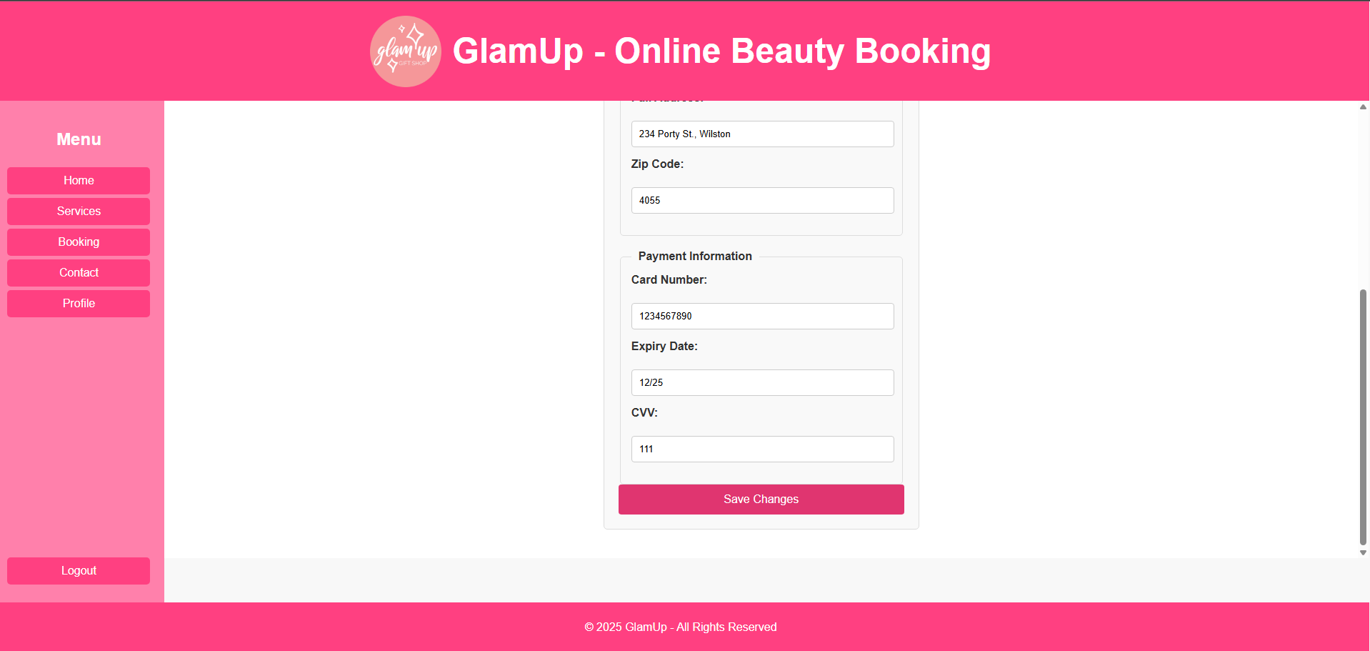
Users can check their profile in “Profile” page
Users can also edit their info as well and save their changes

Slide 10

(notification)
Users can check their profile in “Profile” page
Users can also edit their info as well and save their changes

Slide 11
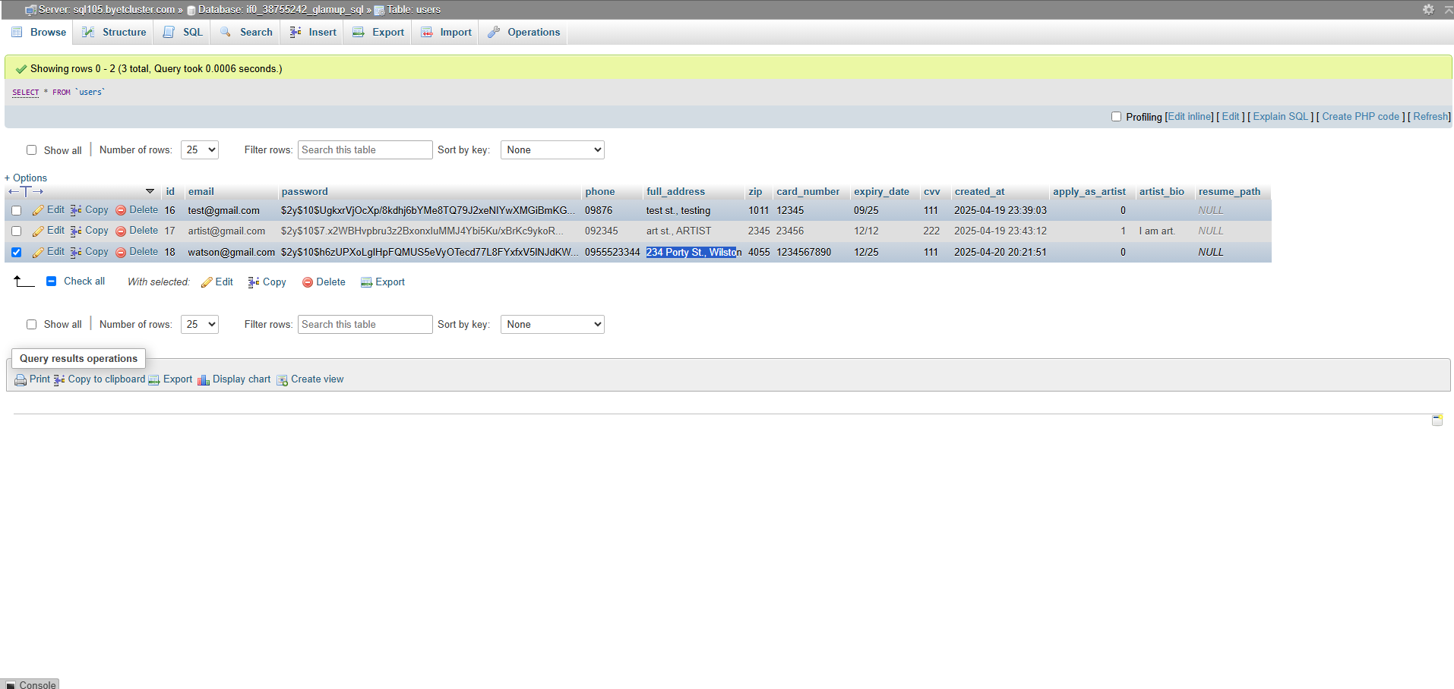
Here is the updated address in the database

Slide 12
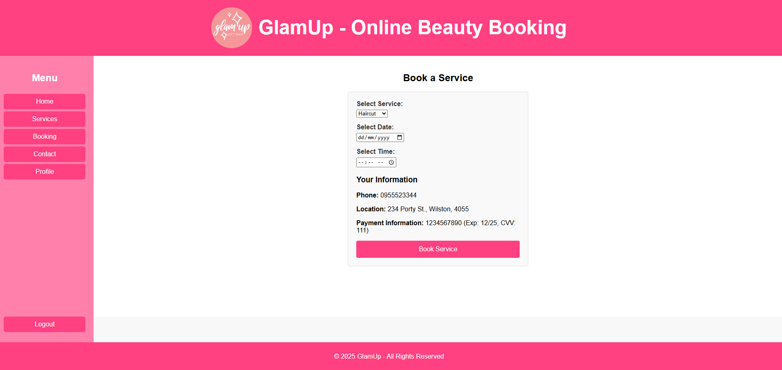
If the user is Customer, there will be a “Booking” page…

Slide 13

If the user is Customer, there will be a “Booking” page…
where they can create bookings:
select service
select Date & Time
check their information
Finish booking

Slide 14
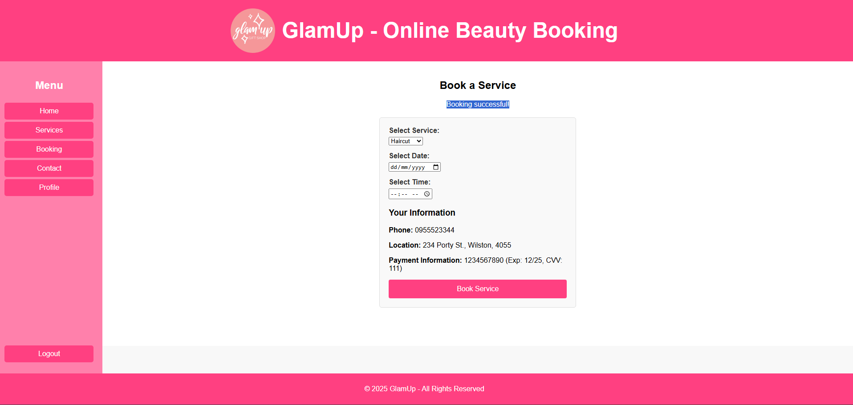
(notification)
If the user is Customer, there will be a “Booking” page…
where they can create bookings:
select service
select Date & Time
check their information
Finish booking

Slide 15
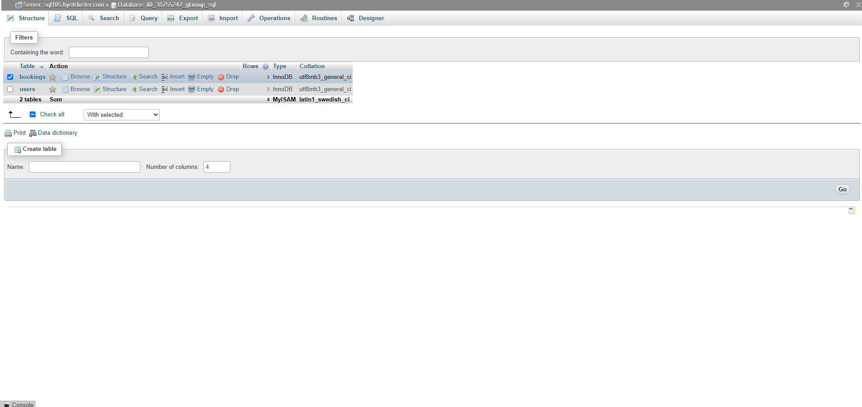
Bookings are recorded in the “bookings” table in the database

Slide 16
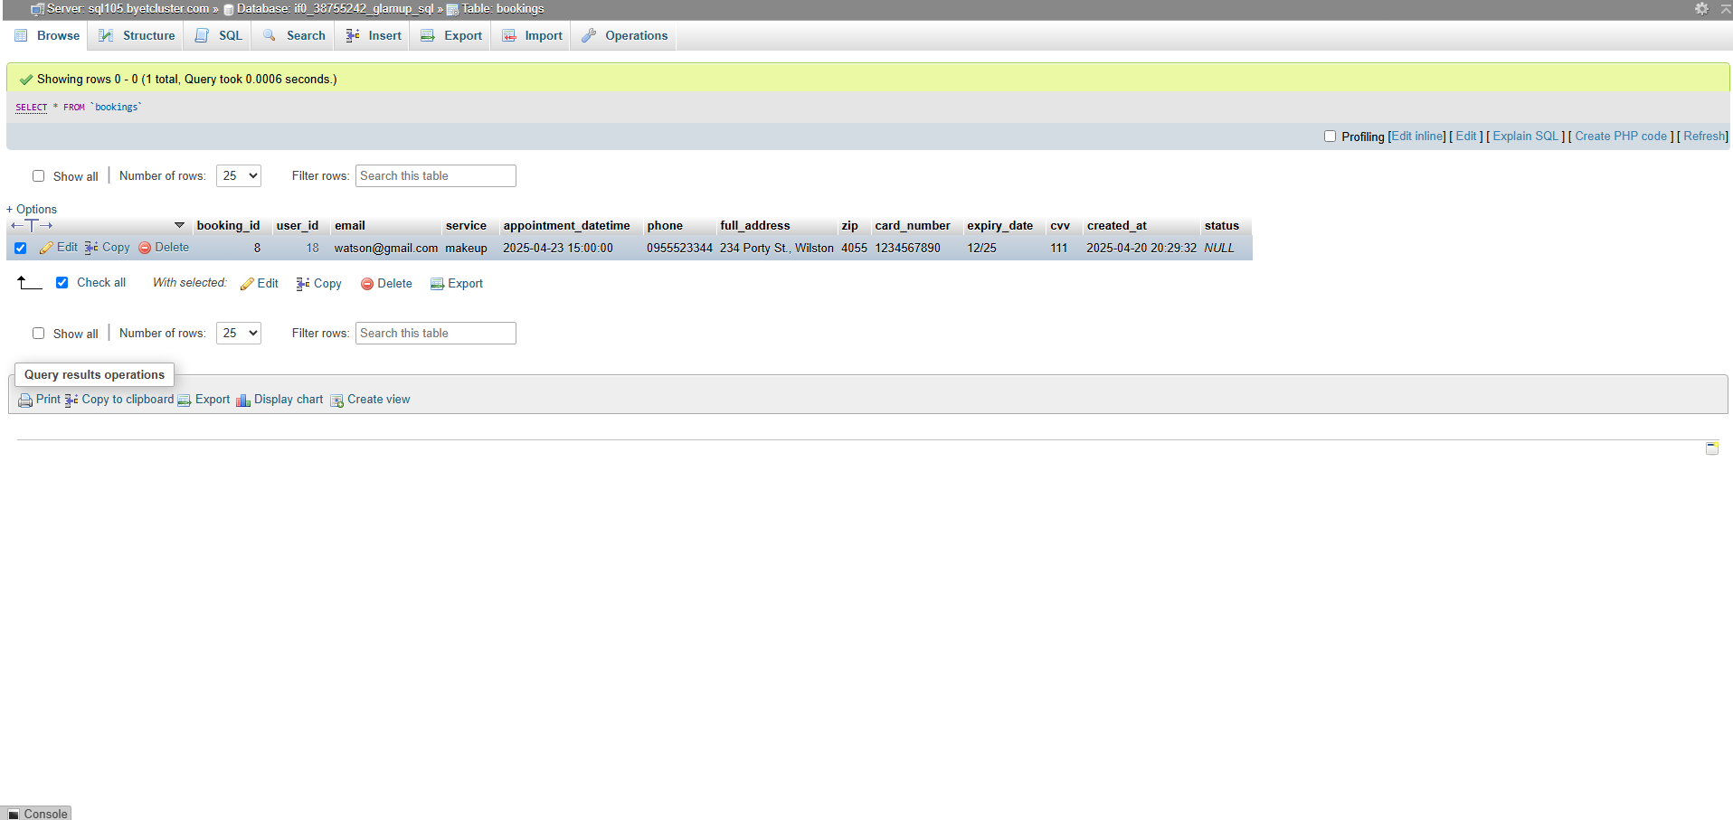
Bookings are saved as ‘records’, because the same user could create a booking with different email, location, phone, etc.

Slide 17
Log-out…

Slide 18
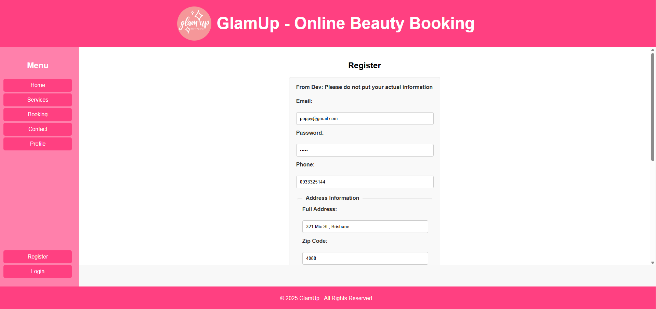
Log-out… and register as different type of user

Slide 19

Log-out… and register as different type of user Click the checkmark to be hired as Artist

Slide 20
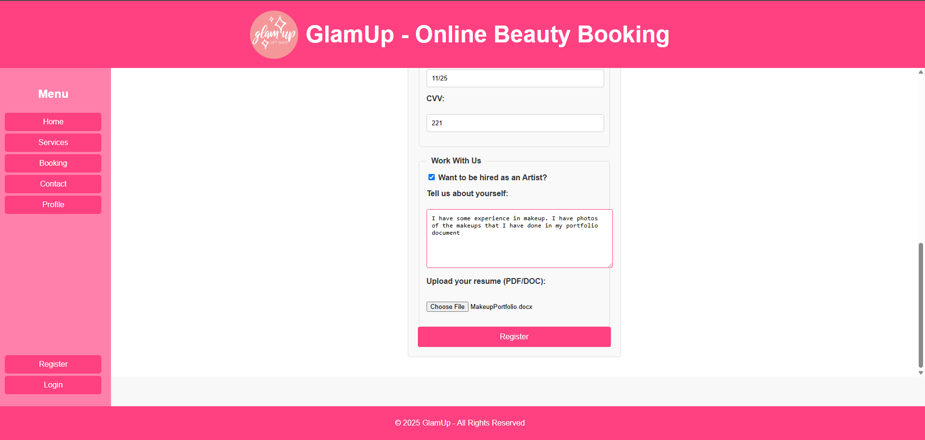
Log-out… and register as different type of user Click the checkmark to be hired as Artist
Add required information and register as Artist

Slide 21
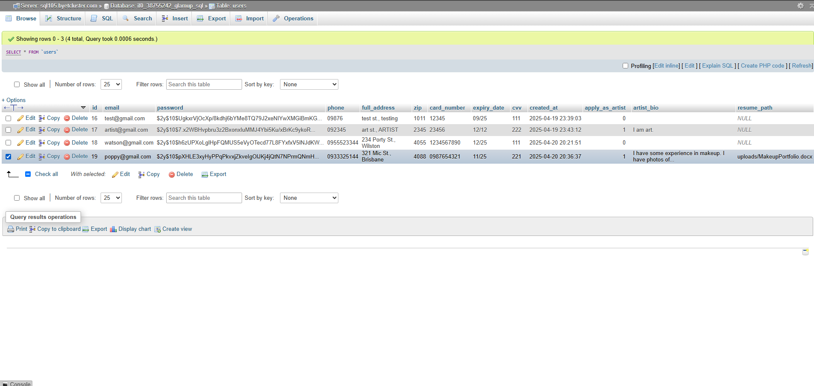
In the same user table, the new user is saved, but marked as Artist

Slide 22
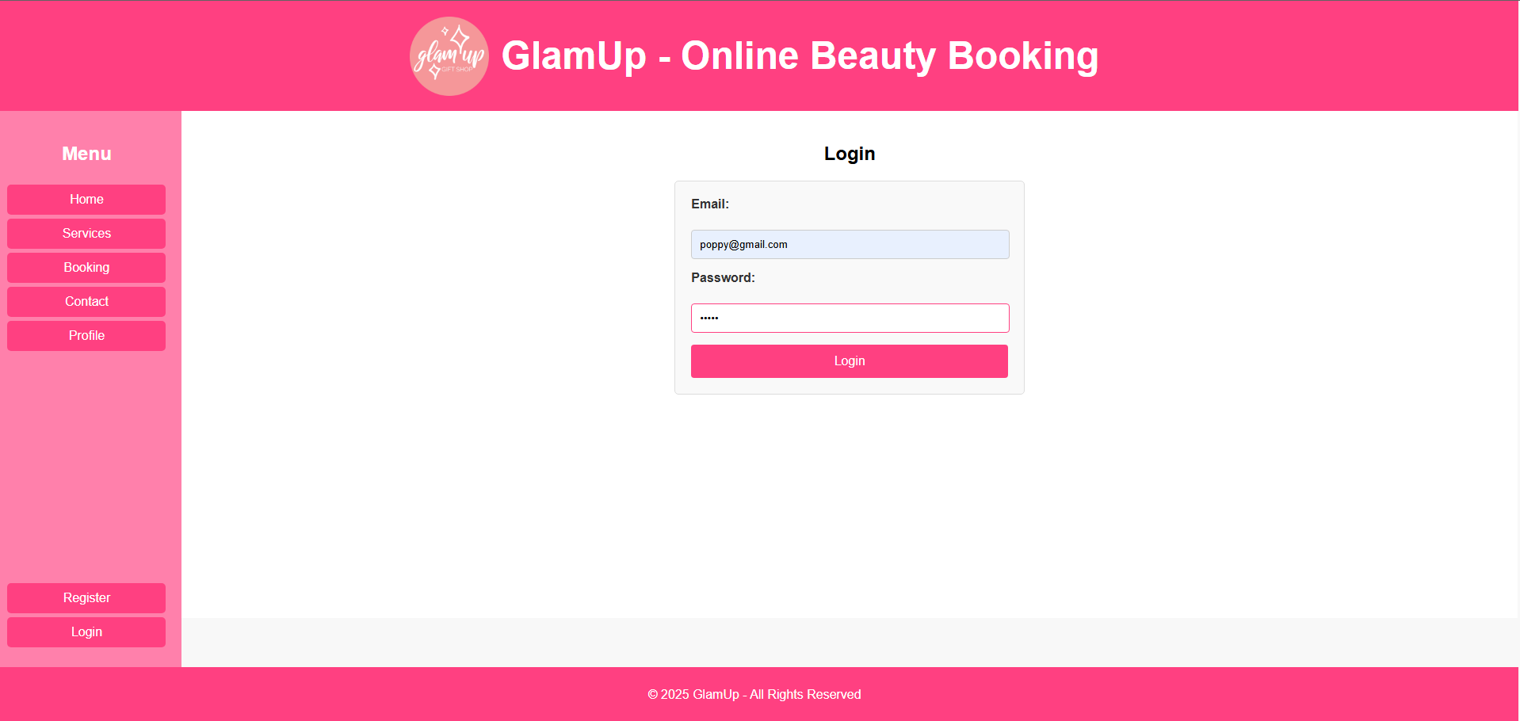
Login as Artist

Slide 23
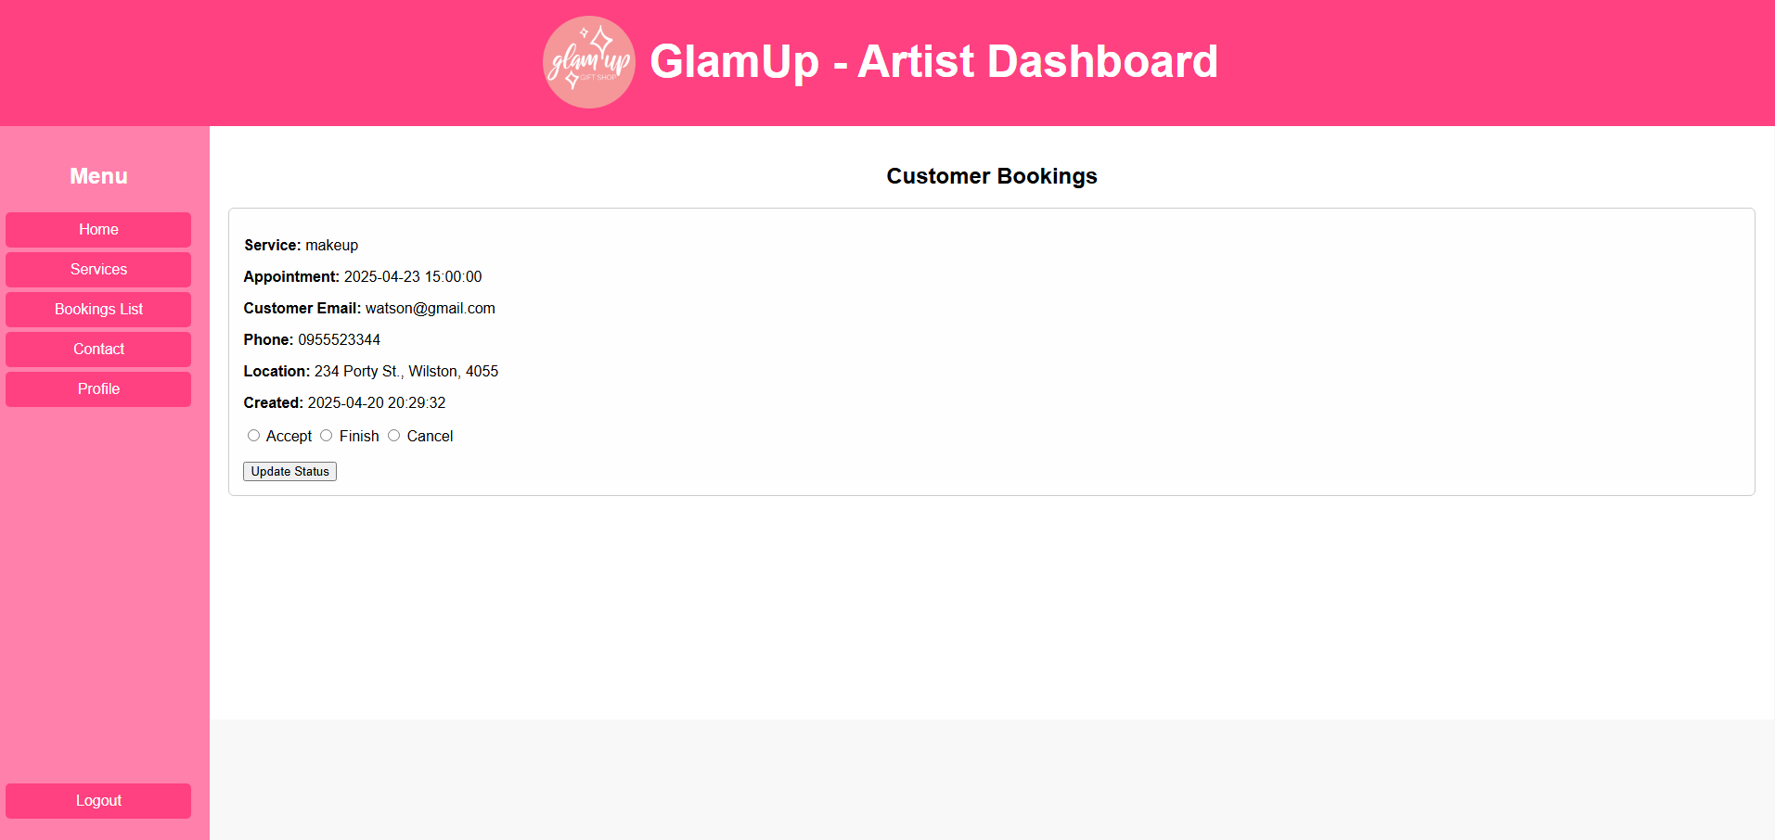
The “Booking” page is now “Booking List” page for users who are ‘Artist’. Booking list shows all the bookings created by customers

Slide 24

Artists can choose to Accept, Finish or Cancel bookings and finish status update to confirm

Slide 25
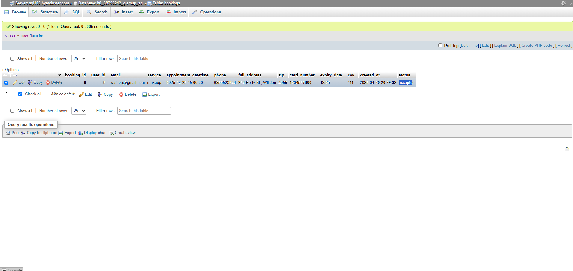
The booking status will be updated in the database

Slide 26
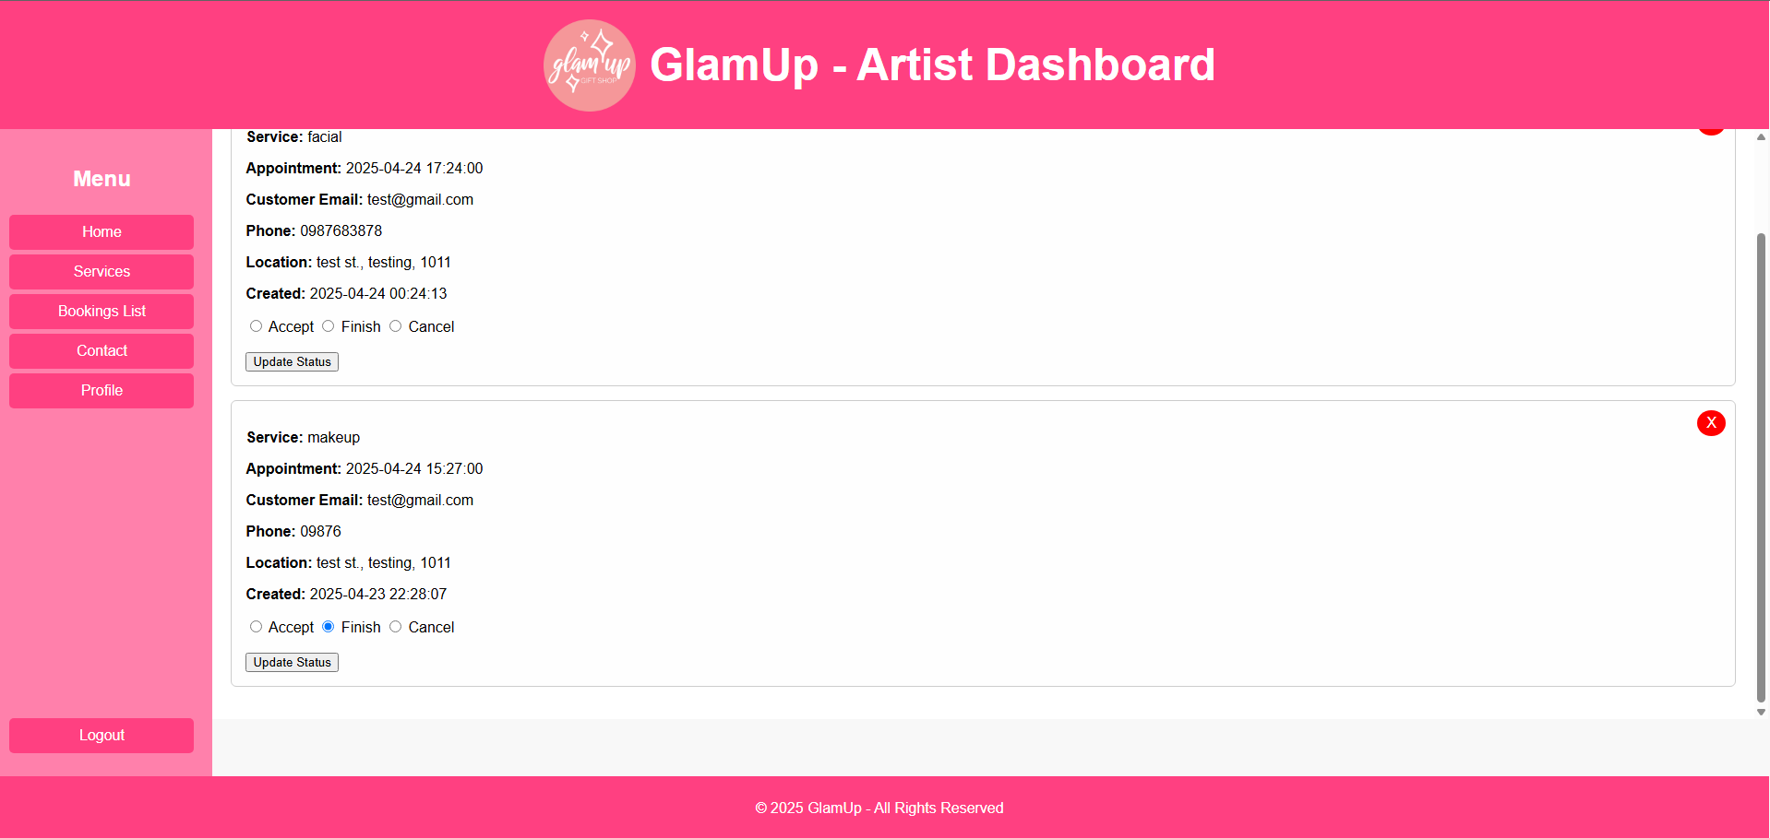
I have added a new feature: delete bookings from the database

Slide 27
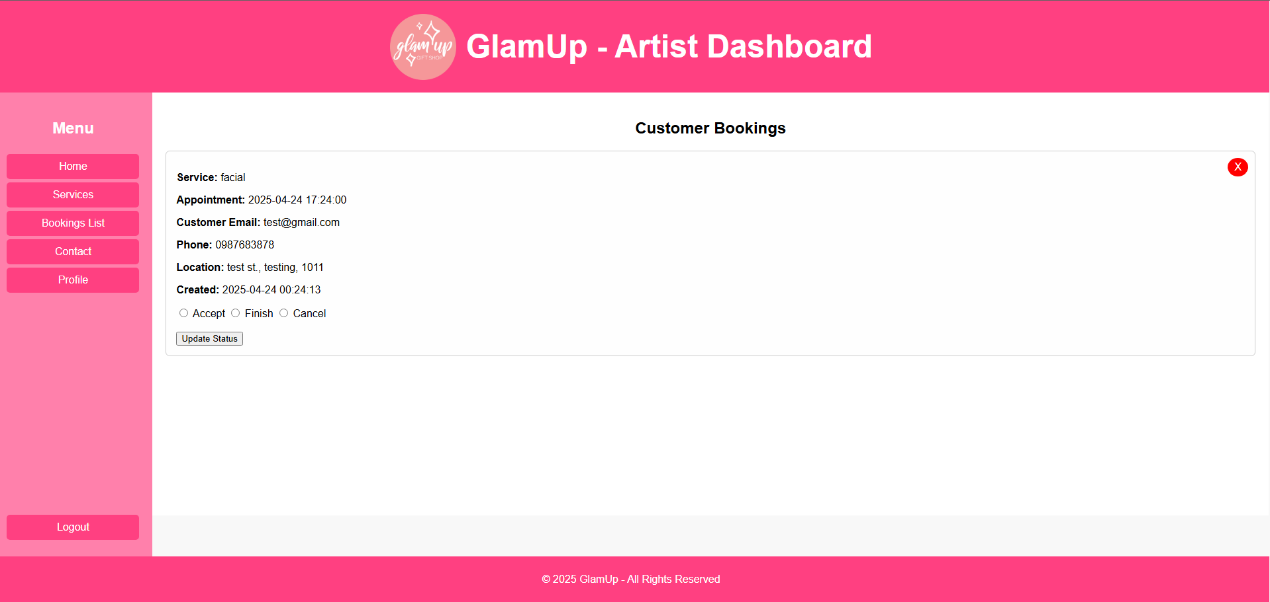
(now only one booking left)

Slide 28
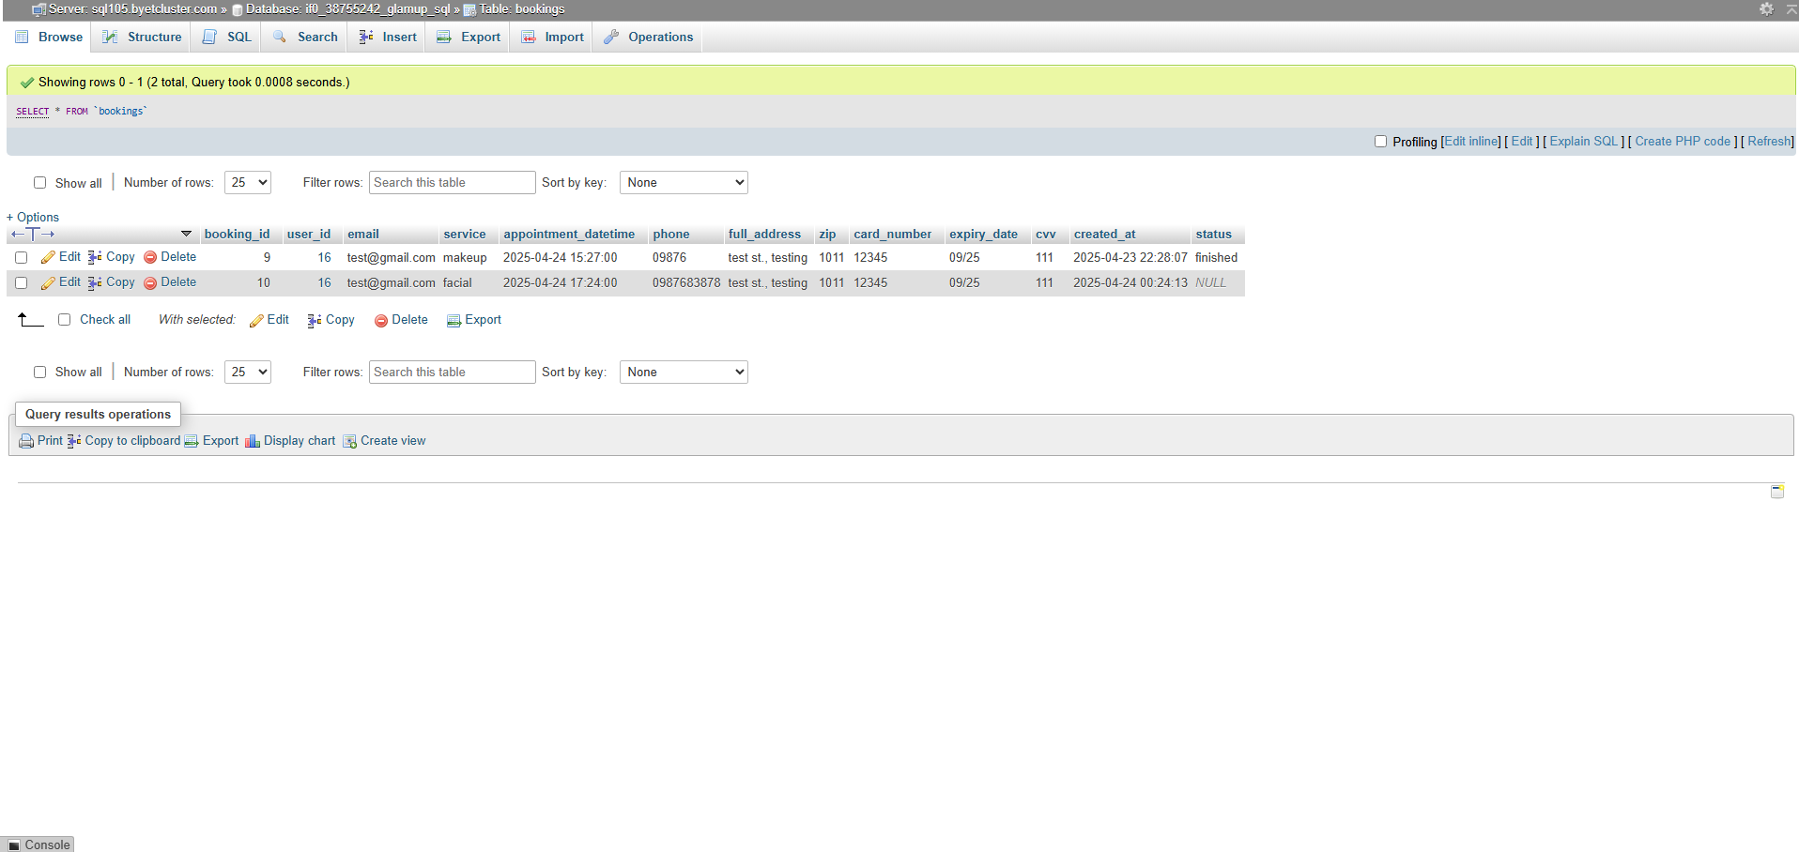
(Database view: BEFORE deletion)

Slide 29
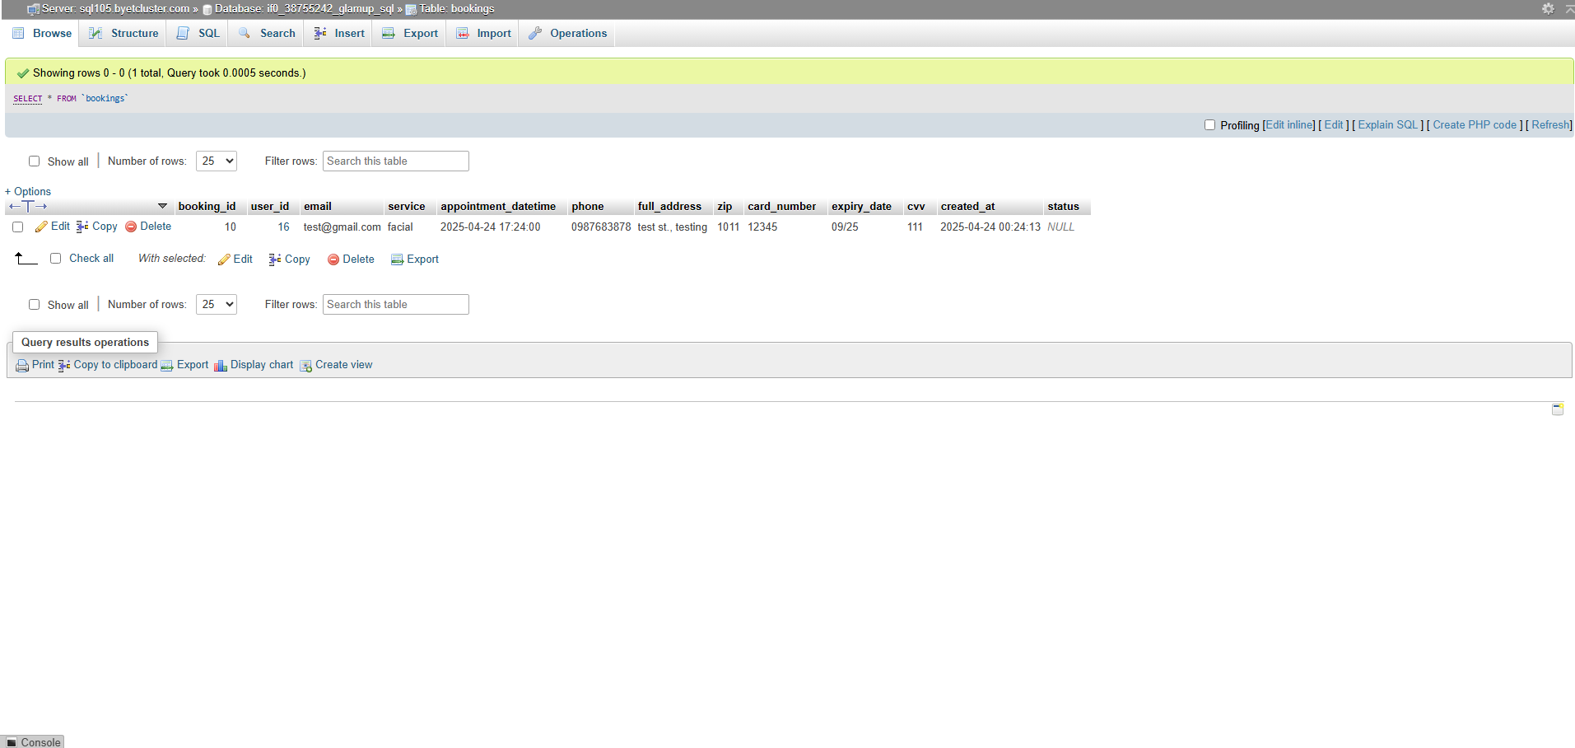
(Database view: AFTER deletion)

Slide 30
That’s how Glamup Works!
Thank you for watching!

