Slide 1


2. Modules and subworkflows
Nextflow from zero to hero
2026/01/24

Slide 2
Modularity
and why it is your friend
Problem: monolitic pipelines are hard to scale and maintain
Solution: modularity
Maintainability
Code reuse across pipelines
Independent testing of components
Clear code organization
Community collaboration
Variant calling pipeline
FASTP
FASTQC
BWA_MEM
SAMTOOLS_SORT
SAMTOOLS_INDEX
SAMTOOLS_STATS
MOSDEPTH
DEEPVARIANT
MULTIQC

Slide 3
Scope of the “box”
Modules and Subworkflows
Module
Process that is stored in a separate file and can be imported into different workflows.
Subworkflow
Higher-level building block that groups multiple modules into a logical unit of execution, also in a separate file.
Variant calling pipeline
FASTP
FASTQC
BWA_MEM
SAMTOOLS_SORT
SAMTOOLS_INDEX
SAMTOOLS_STATS
MOSDEPTH
DEEPVARIANT
MULTIQC
READS_QC
MAPPING
MAPPING_STATS
VARIANT_CALL
REPORTING

Slide 4
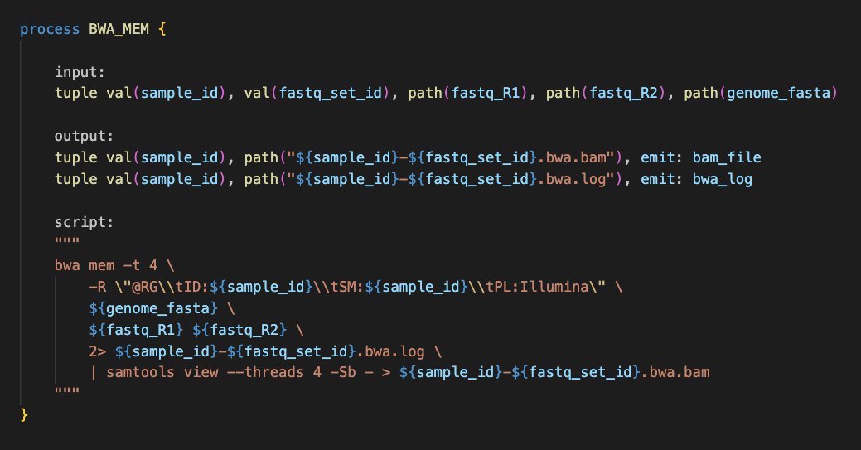
Creating a module
Put the process in a separate, independent file with extesion .nf (ie. bwa.nf)
Input, logic and output of the module are controlled with input, script and output in the process definition.

Slide 5
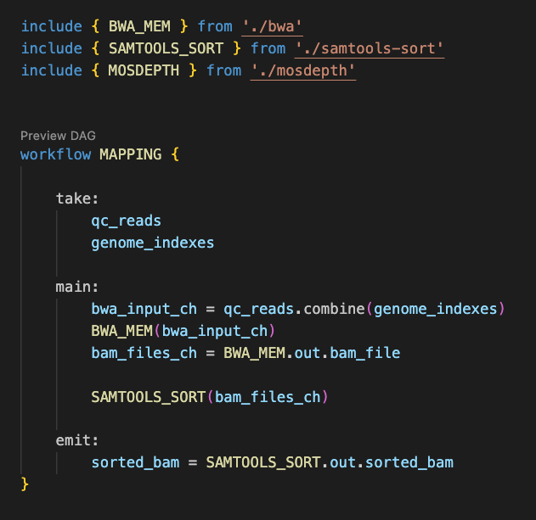
Creating a subworkflow
Import the modules using include.
Create a named workflow.
Input, logic and output of the subworkflow are controlled with take, main and emit in the workflow definition.

