Slide 1
Sentiment and Text Analysis of News Articles Relating to Airlines and Technology Updates
Harmon Hawkins

Slide 2
Updates
Finished writing python code to scrape web sites
Compiled a list of around 1500 article URLs
Scraped data and compiled it into a csv
Started data cleaning and analysis

Slide 3
Data Collection
Article title, published date, author’s name, article tags, article content, article comments, site name
Two websites instead of three (One Mile at a Time, The Points Guy), three airlines (American, Delta, United)
Imported the data into RStudio for cleaning and initial analysis

Slide 4
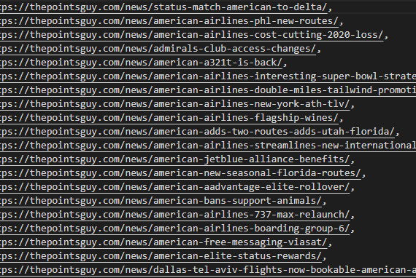
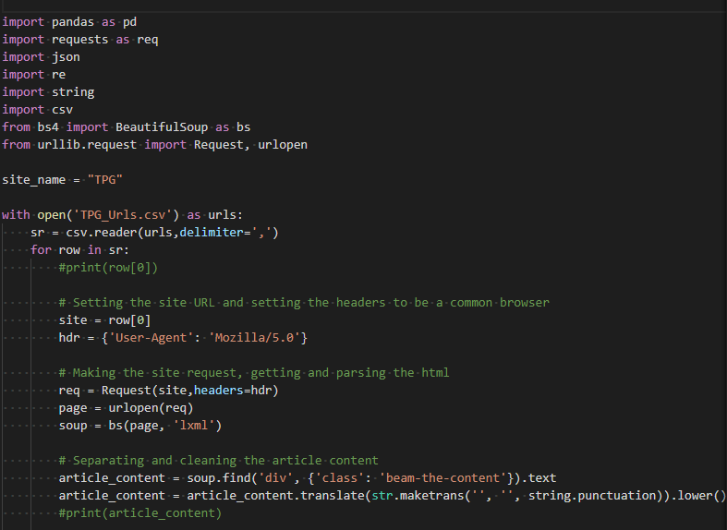
Data Collection

Slide 5
Data Cleaning
What has been done:
Removed all punctuation, new line characters, numbers, etc.
Changed everything to lowercase
ToDo:
Synchronize date format (Jan 01 2021 vs. January 1st 2021 vs. 1/1/2021, 4d ago, etc.)
How to handle emojis in the comments?

Slide 6
Data Analysis
Started doing some sentiment and data analysis of the article content
While looking for resources on sentiment analysis found some new types of analysis
Different types of sentiment and emotion analysis
What is the best type of sentiment analysis for this data?

Slide 7
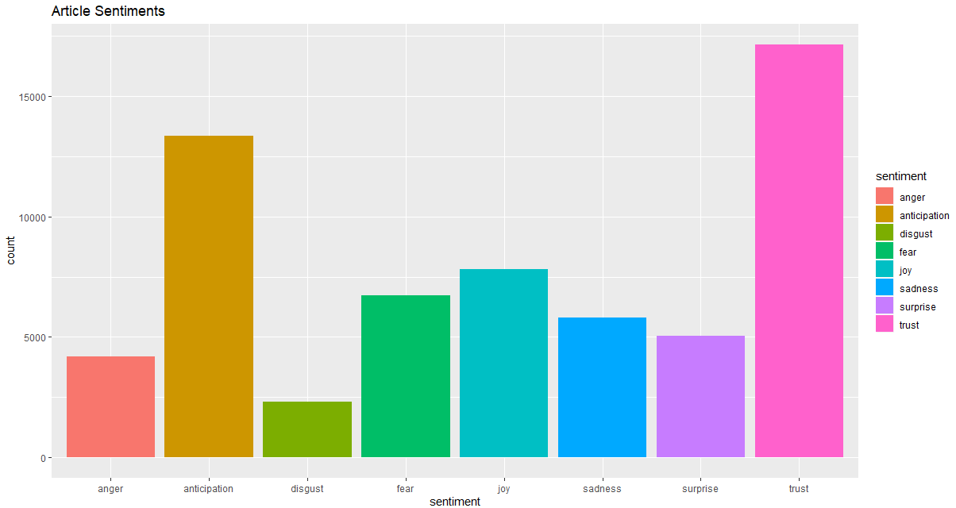
Data Analysis

Slide 8
What is next?
Finish standardizing the data
Continue reading and researching about the different types of sentiment analysis.
Decide how to handle emojis in the comments
Relate sentiment scores to different airlines, dates, authors, and any outside information that might be important

