Slide 1
Sentiment Analysis and Comparison of Reporting between Different Airlines
Harmon Hawkins

Slide 2





Introduction
Are airlines reported on differently?
Do certain airlines have higher public sentiment than others?

Slide 3

Process
Use news sources that report on airlines to gather articles and the comments on those sources
Perform sentiment analysis on the articles and their comments
Use the sentiment scores to see if there were any differences between airlines
If there was time, relate these scores to outside factors such as stock price

Slide 4



Technologies
Python - web scraping and data collection
Pandas, BeautifulSoup, Requests, etc.
R – Data cleaning and Analysis
Dplyr, Syuzhet, Stringr, Ggplot2, etc.

Slide 5


Data
Used two different travel websites
Collected Date, Author, Tags, Title, article text, article comments, website
American, Delta, United
Articles dating from around January 1st , 2019 to around January 31st , 2021
Around 1500 total articles

Slide 6

Cleaning
Punctuation removed
Converted everything to lowercase
Standardized the date format
Removed any strange characters, including emojis

Slide 7

Analysis
Sentiment Analysis: compares input to a lexicon and assigns each word a score
Done with the Syuzhet package in R
Two different methods were used
Bing – binary sentiment classification
Afinn – scale of sentiment classification

Slide 8
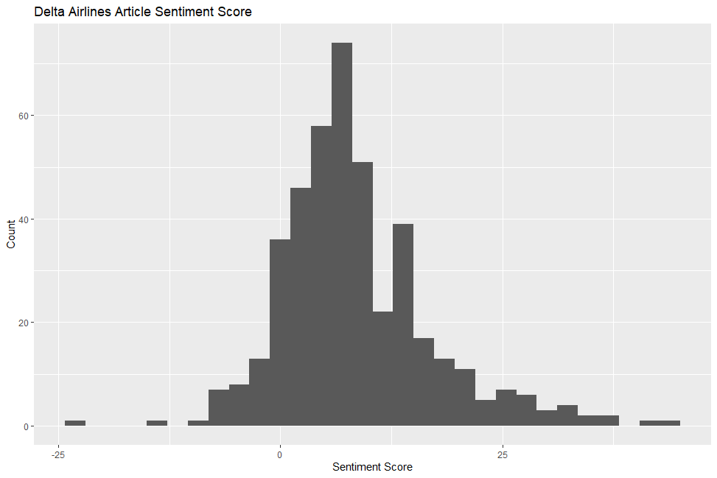
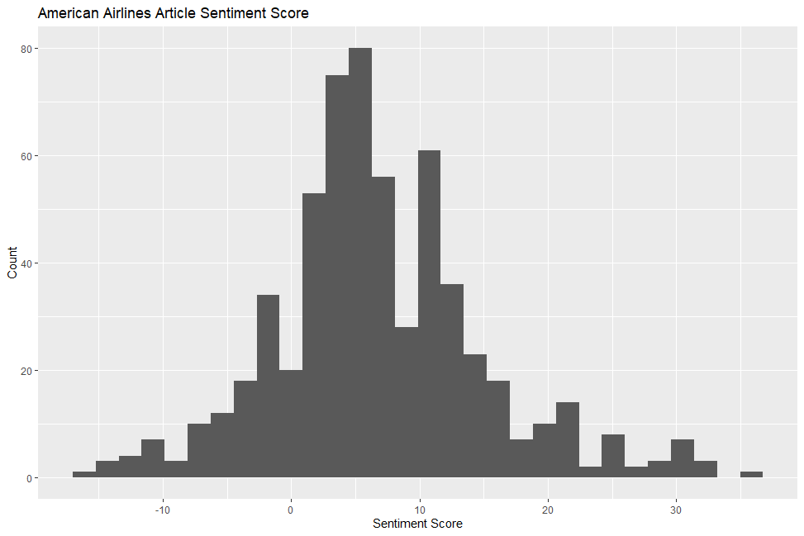
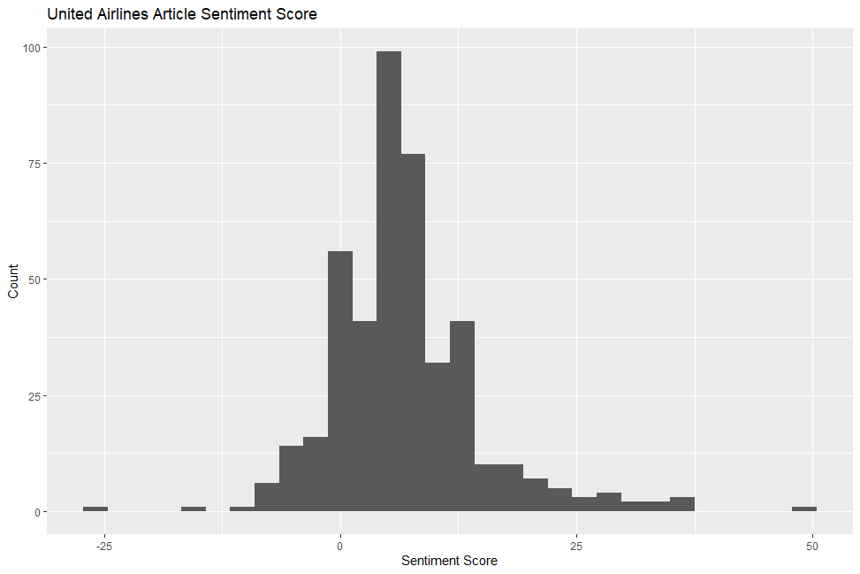
Article Sentiment Score

Slide 9
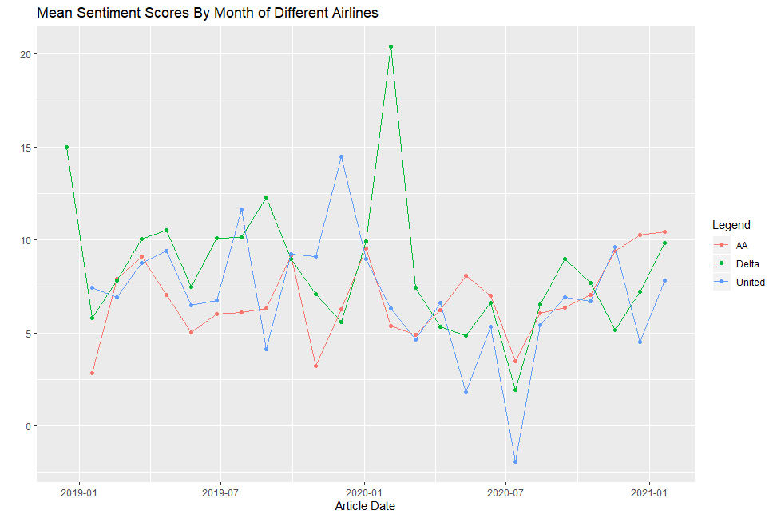

Slide 10
Article Sentiment Results
Average Sentiment For Articles
AA = 6.74
Delta = 8.55
United = 6.78
After significance testing:
American and United scores were the same
Delta was significantly higher

Slide 11
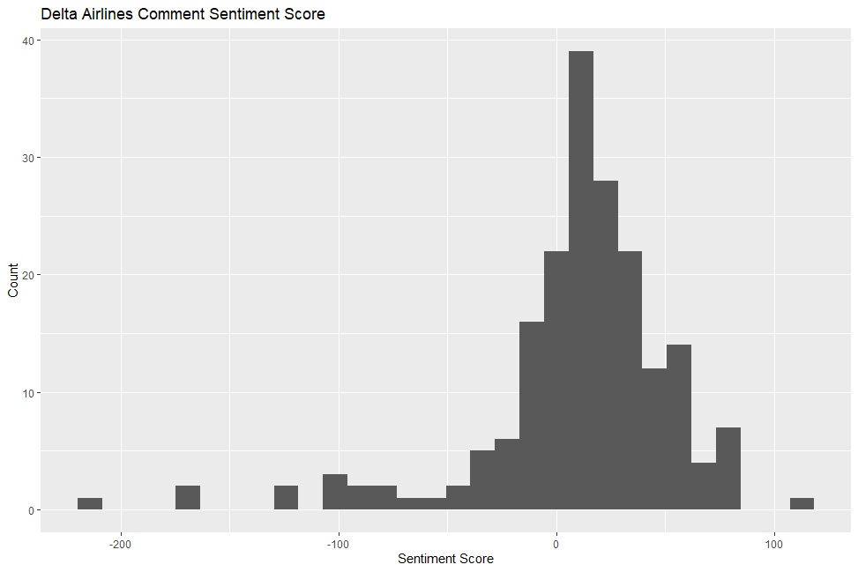
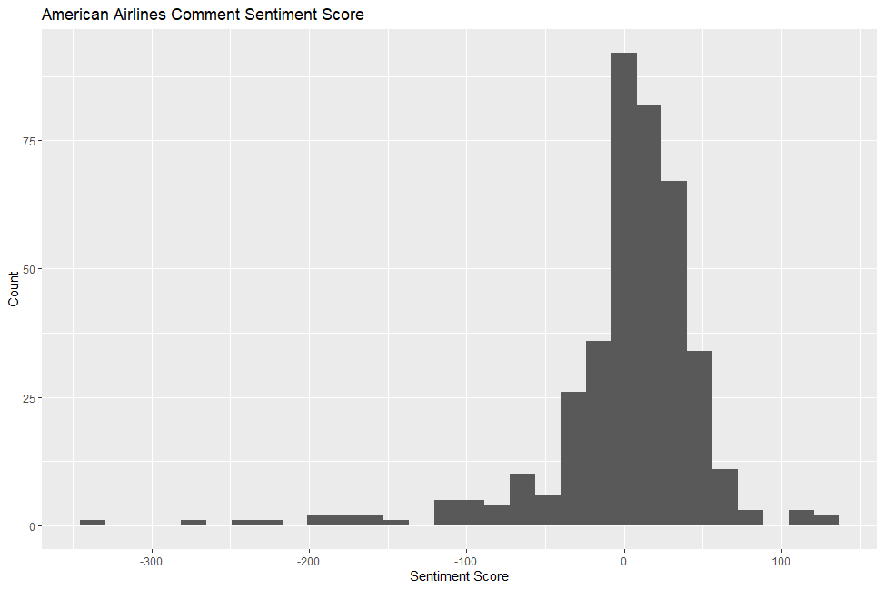
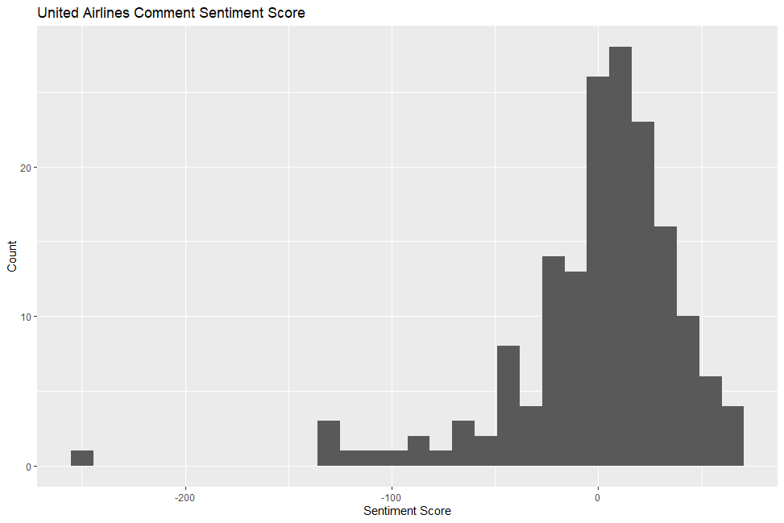
Comment Sentiment Score

Slide 12
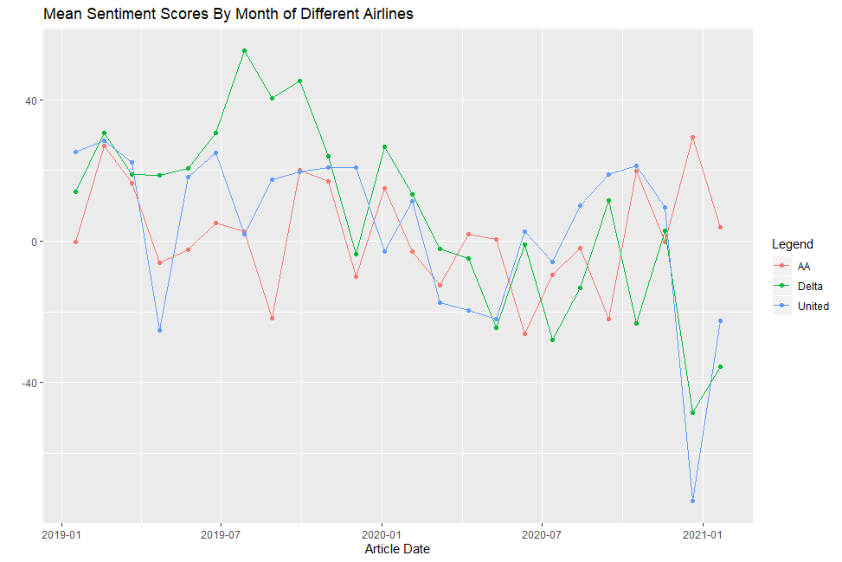

Slide 13
Comment Sentiment Results
Average Sentiment for Comments
AA = 1.61
Delta = 10.07
United = -0.55
After significance testing:
American and United scores were the same
Delta was significantly higher

Slide 14
Conclusion
Surprised by the results
Expected little or no difference
Delta had a higher sentiment in both the article writing and the comments than AA or Untied

Slide 15


Unforeseen Issues or Difficulties
Data gathering and cleaning
Grouping the data
More types and options of sentiment analysis that I thought

Slide 16

Future Work
Refining the sentiment analysis
Different algorithms or processes
Exploring more about article authors or commenters
How does sentiment relate to Stock price?
Started some analysis

Slide 17
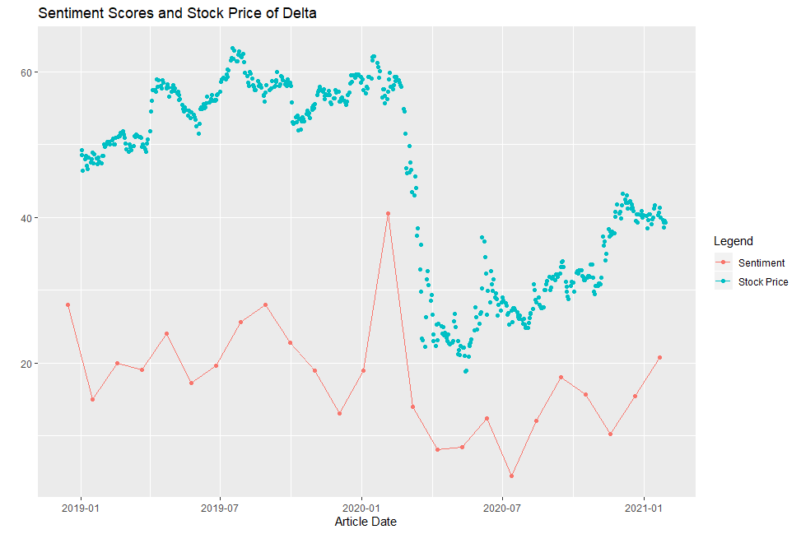
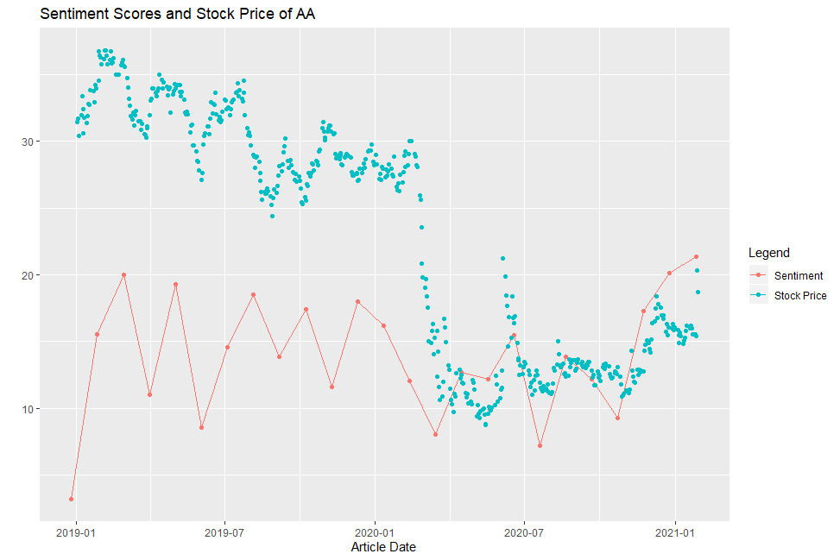
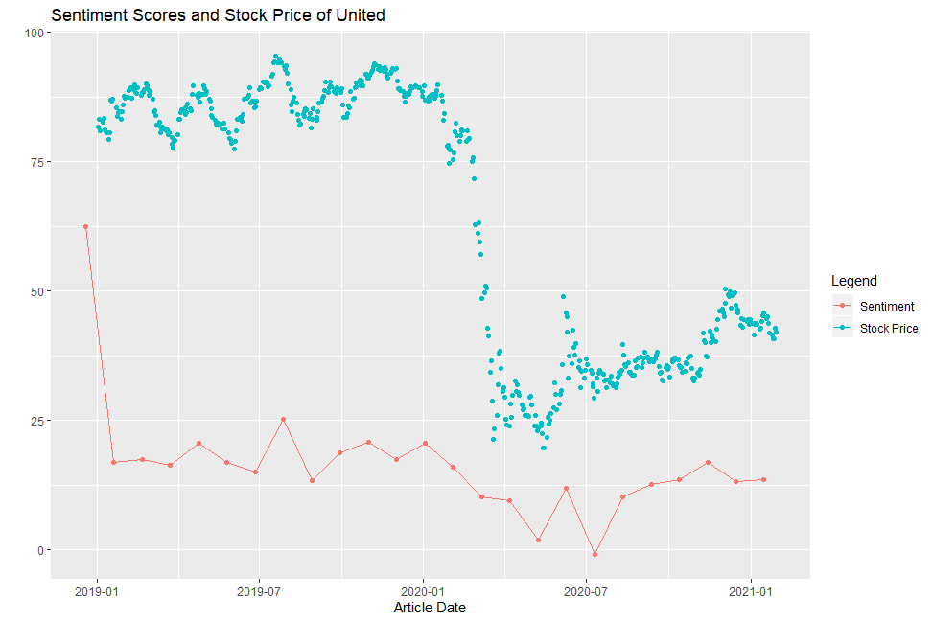
Sentiment and Stock price

Slide 18
References
Bing Liu, Minqing Hu and Junsheng Cheng. "Opinion Observer: Analyzing and Comparing Opinions on the Web." Proceedings of the 14th International World Wide Web conference (WWW-2005), May 10-14, 2005, Chiba, Japan.
Minqing Hu and Bing Liu. "Mining and Summarizing Customer Reviews." Proceedings of the ACM SIGKDD International Conference on Knowledge Discovery and Data Mining (KDD-2004), Aug 22-25, 2004, Seattle, Washington, USA. See: http://www.cs.uic.edu/~liub/FBS/sentiment-analysis.html#lexicon
Saif Mohammad and Peter Turney. "Emotions Evoked by Common Words and Phrases: Using Mechanical Turk to Create an Emotion Lexicon." In Proceedings of the NAACL-HLT 2010 Workshop on Computational Approaches to Analysis and Generation of Emotion in Text, June 2010, LA, California. See: http://saifmohammad.com/WebPages/lexicons.html
Finn Årup Nielsen. "A new ANEW: Evaluation of a word list for sentiment analysis in microblogs", Proceedings of the ESWC2011 Workshop on 'Making Sense of Microposts':Big things come in small packages 718 in CEUR Workshop Proceedings : 93-98. 2011 May. http://arxiv.org/abs/1103.2903. See: http://www2.imm.dtu.dk/pubdb/views/publication_details.php?id=6010
Manning, Christopher D., Surdeanu, Mihai, Bauer, John, Finkel, Jenny, Bethard, Steven J., and McClosky, David. 2014. The Stanford CoreNLP Natural Language Processing Toolkit. In Proceedings of 52nd Annual Meeting of the Association for Computational Linguistics: System Demonstrations, pp. 55-60. See: http://nlp.stanford.edu/software/corenlp.shtml
Richard Socher, Alex Perelygin, Jean Wu, Jason Chuang, Christopher Manning, Andrew Ng and Christopher Potts. "Recursive Deep Models for Semantic Compositionality Over a Sentiment Treebank Conference on Empirical Methods in Natural Language Processing" (EMNLP 2013). See: http://nlp.stanford.edu/sentiment/

Slide 19

Questions?

