Slide 1
Node-Red application with FP-CLD-WATSON1

Slide 2
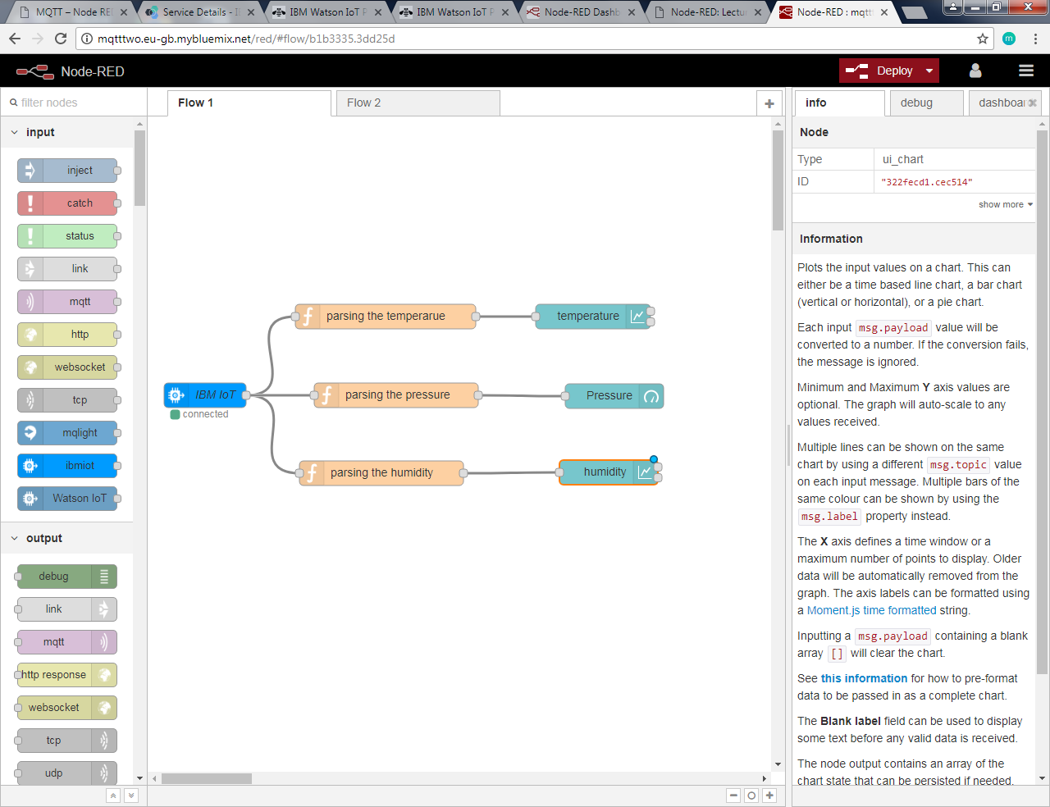

Purpose
To show Sensor Node data in IBM Watson in Registered Mode.
To do this we are using Node-RED
Node-RED is a browser based flow editor.
It makes our programming easier as it allows to Drag and Drop the software commands and wire them together in order to make them communicate.
It focuses on the creating rather than doing.
The flow created in Node-RED are stored using JSON which can be easily imported and exported for sharing with others.
Node-RED flow in Node-RED editor

Slide 3
Getting Started with Node-RED on IBM Bluemix
Log in to or register for Bluemix at https://www.bluemix.net
Select the Watson IoT Platform Starter Boilerplate
Open the Catalog by selecting the Catalog Tab
Select the Boilerplate Category
Select the Internet of Things Platform Starter Boilerplate
On the Internet of Things Platform starter page, verify the selections for create an app
Click create to add Node-RED to your Bluemix organization.
From your Bluemix dashboard, open your Node-RED instance by clicking the Route link that is listed for your Watson IoT Starter App.
Click Go To Your Node-RED Flow Editor to open the editor.

Slide 4
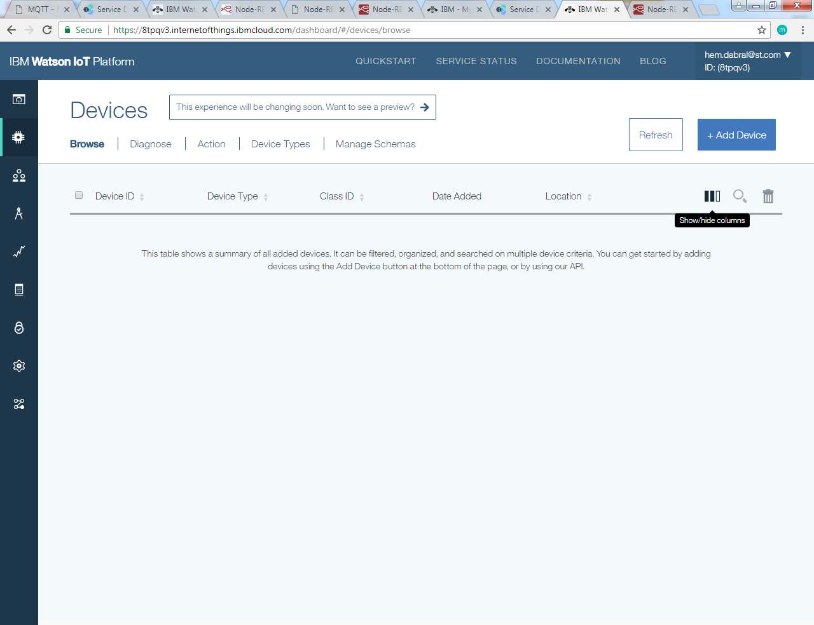
Adding a device in Watson IoT Platform
Launch the Watson IoT Platform dashboard.
Scroll to the Services section and click the name of your Node-RED Watson IoT Platform instance. The instance name usually ends with -iotf-service.
Click Launch Dashboard to open the Watson IoT Platform dashboard
Create a device type.
From the main menu, select Devices, and then click Add Device.
Click to Add Device

Slide 5
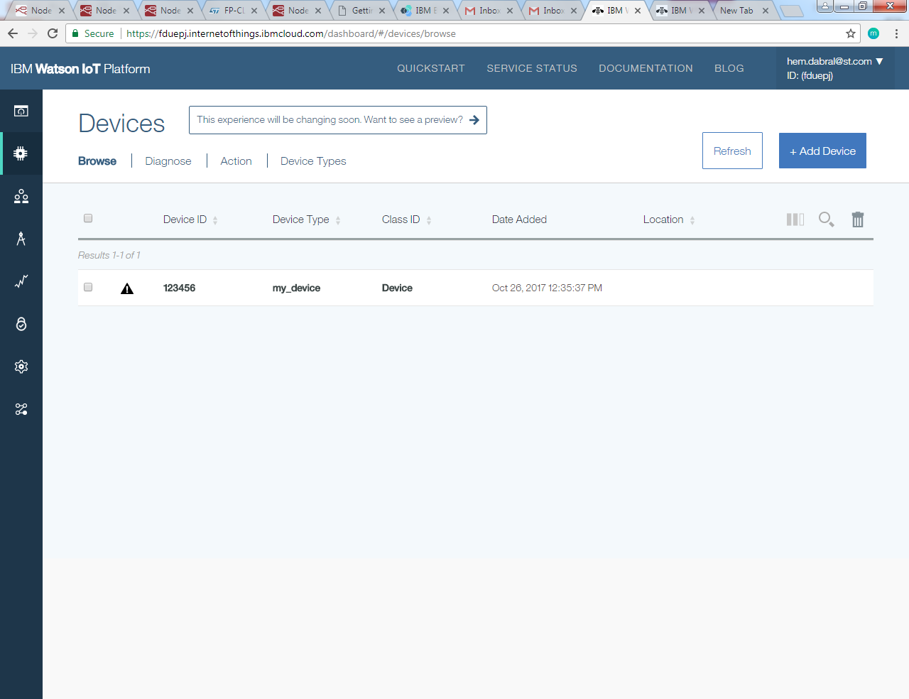
Adding a device in Watson IoT Platform (contd.)
In the add device page, click Create Device type.
In the Create Device Type Page, click Create Device Type
Enter a unique name and description for your device, and click next.
Defining a Template and meta data on the next two pages is optional.
Click create to add a device type.
Your added Device

Slide 6
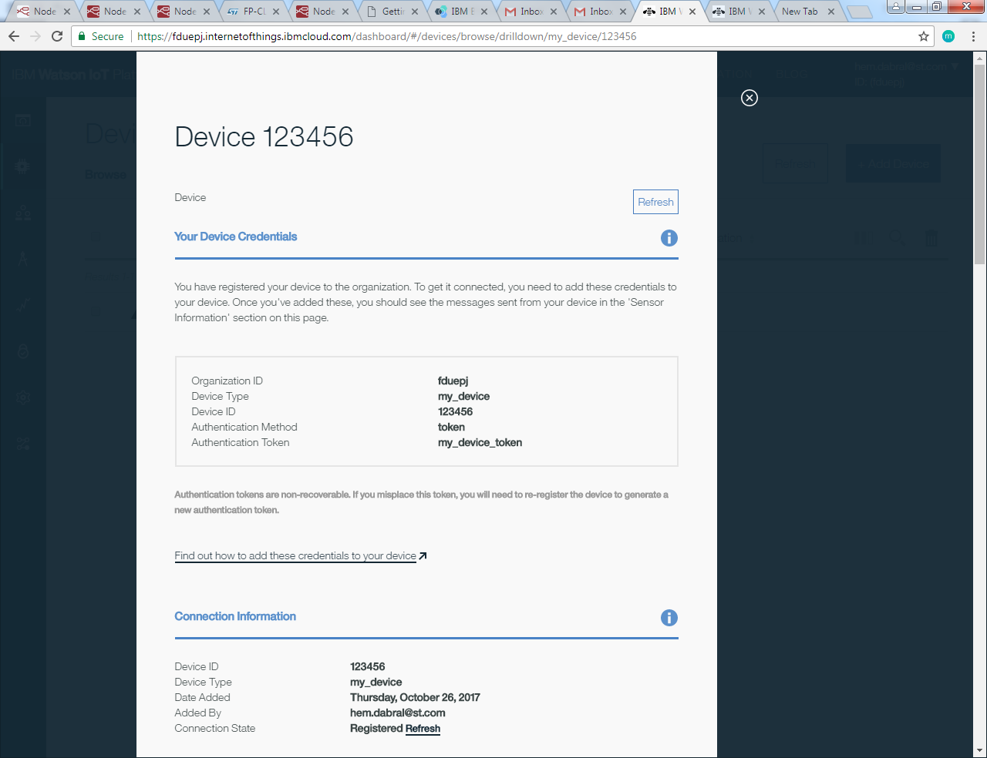
Adding a device in Watson IoT Platform (contd.)
Save your device credentials, you will need it for further use.

Slide 7
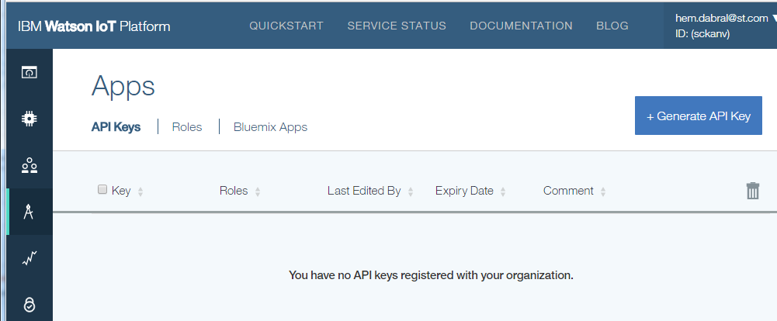
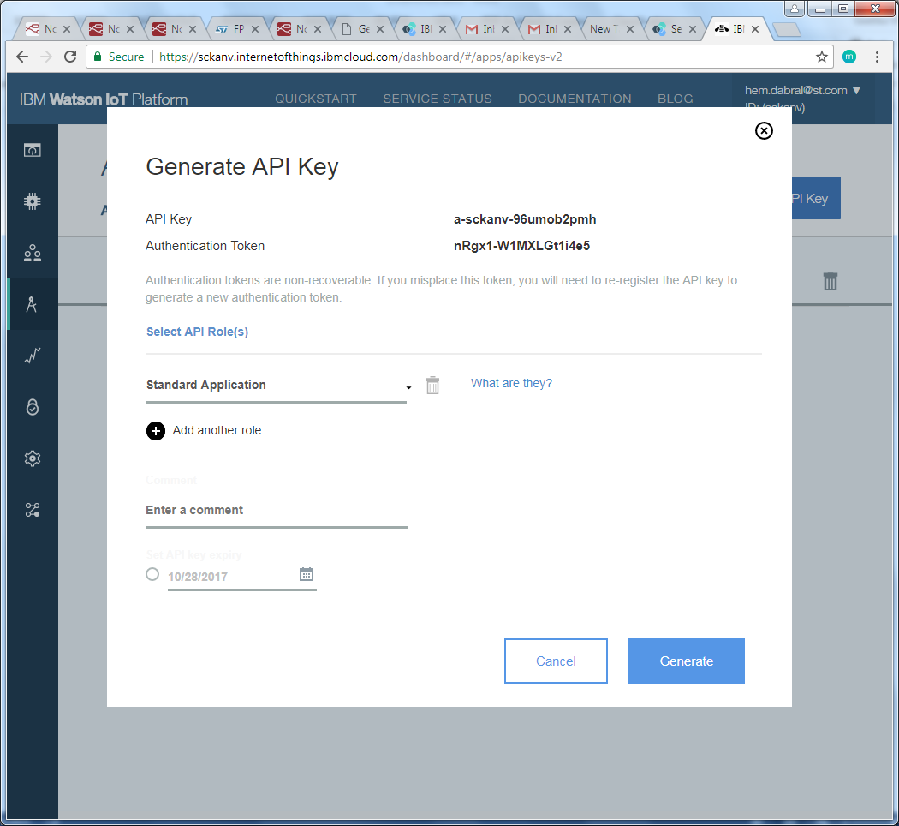
Generate an API Key for your Device
From the Watson IoT platform dashboard, Select Apps
Click on the Generate API Key button on the right of the Dashboard.
Save API Key and Authentication Token.
Click to Generate API Key
Save these values

Slide 8
Starting Sensor node in Registered Mode
Click on start and follow the same instructions as written on section 2.7

Slide 9
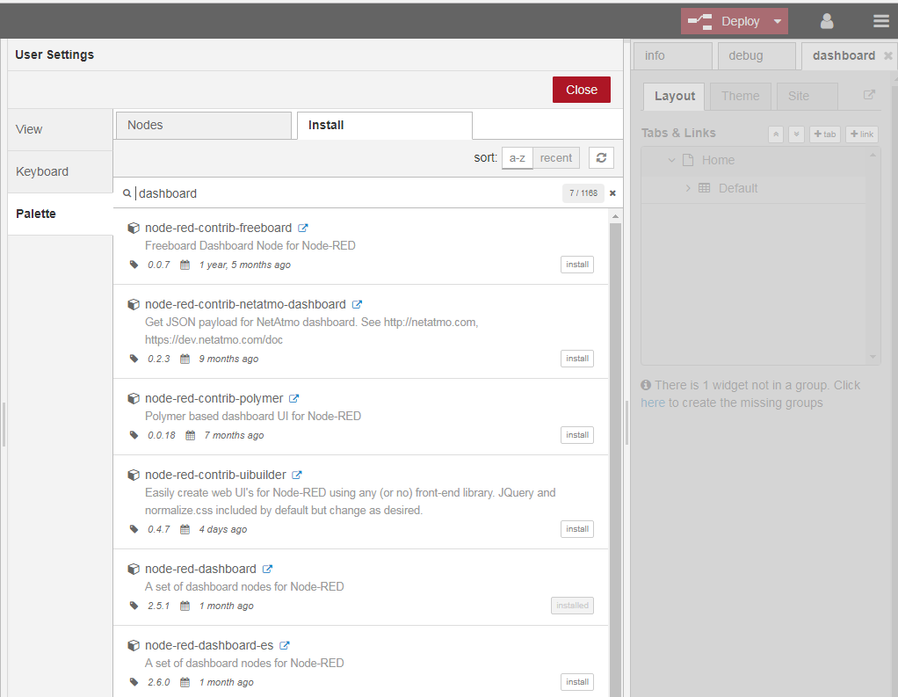
Sensor node data in Node-RED Dashboard
Right Navigation Pane
Open your Node-RED editor
Install Node-RED dashboard
Open the Right Navigation Pane
Select Manage Palette
Go to Install tab
Install Node-RED dashboard
Import flow
Open the Right Navigation Pane
Select Import
Paste JSON Data on Clipboard
Click on Import button.
Install Node-RED dashboard

Slide 10
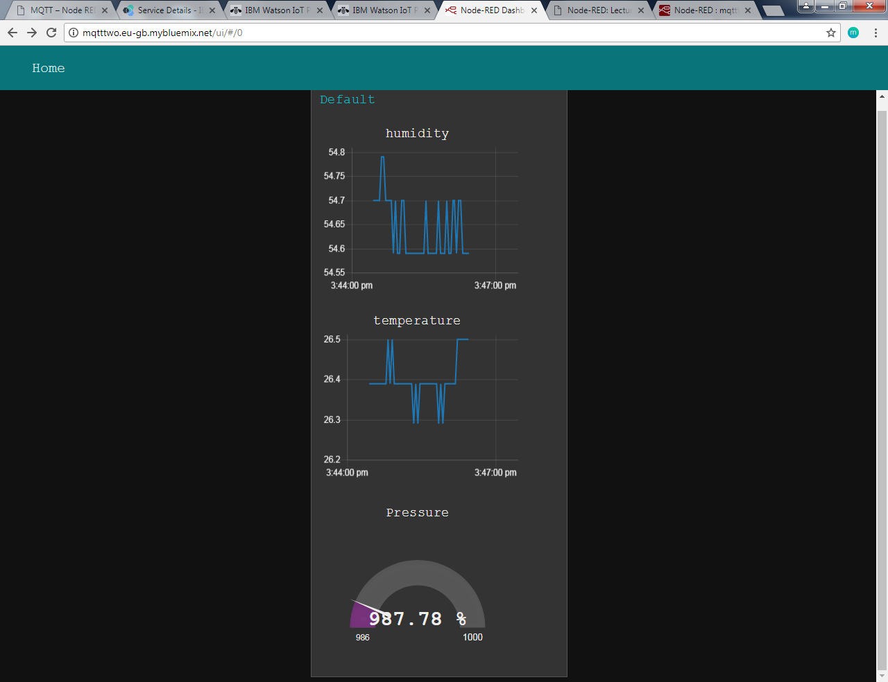
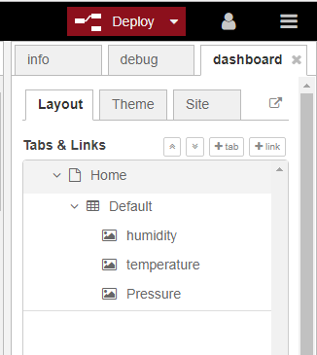
Sensor Node Data in Node-RED Dashboard (contd.)
4. Edit IBM IoT Node
Enter your API Key and Authentication Token
Enter your organization_id.messaging.internetofthings.ibmcloud.com in Server Name
5. Click on update and deploy new changes
6. Open Node-RED Dashboard and visualize Data.
Open Dashboard tab
Click on icon to open Node-RED Dashboard in browser
Node-RED Dashboard with Sensor Node Data

Slide 11
Thank You

