Slide 1

《Seek My Sheep》
Game proposal presentation
Team4：What A Team
LingWeiyue（凌微月）
MaJunhang（马俊航）
LiuJunqi（刘俊琦）
RenJianpeng（任健鹏）
2023.7.13
Notes:
版权声明：300套精品模板商业授权，请联系【锐旗设计】:https://9ppt.taobao.com，专业PPT老师为你解决所有PPT问题！

Slide 2
Contents
01
INTRODUCTION
03
FRAME&CHALLENGES
02
PLAY METHOD
04
GOALS

Slide 3
01
INTRODUCTION

Slide 4




Our game is about...
an old lonely shepherd
overcomes difficulties
to find his missing sheep
But it's not that simple at all!!!
Memories...Truth....

Slide 5
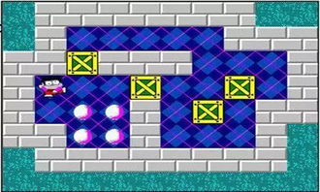
Inspired by
The classic Sokoban（推箱子）
-to push objects to their designated target locations
-or, to push obstacles away so that reach our target sheep
-certain mechanism to increase the complexity
Notes:
版权声明：300套精品模板商业授权，请联系【锐旗设计】:https://9ppt.taobao.com，专业PPT老师为你解决所有PPT问题！

Slide 6
02
PLAY METHOD
Notes:
版权声明：300套精品模板商业授权，请联系【锐旗设计】:https://9ppt.taobao.com，专业PPT老师为你解决所有PPT问题！

Slide 7
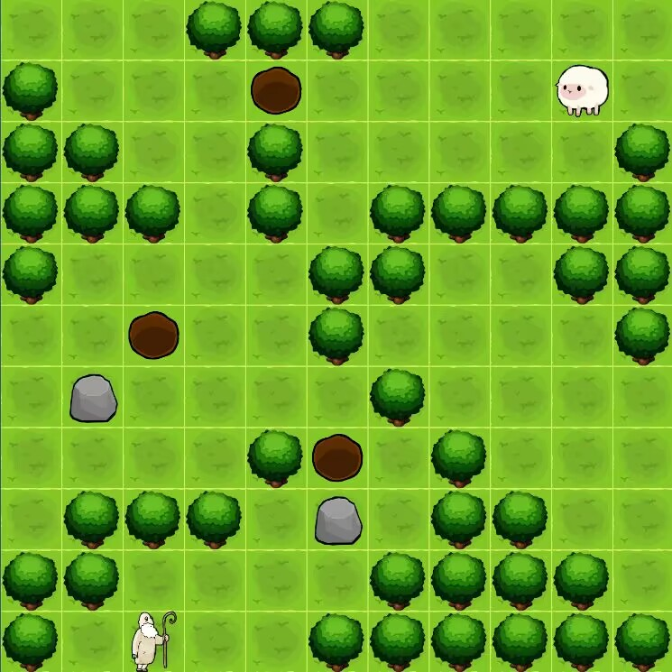
key settings
W A S D
control our shepherd‘s movement
SPACE
to push the obstacle away(when there’s space)
F/R
Collecting / using tools

Slide 8
deal with different environment
DAY AND NIGHT
Our shephed looks for his sheep day and night.when it’s dark,the field of view is limited
Terrains
Our shephed looks for his sheep so hard,meeting different terrains to explore different ways of objects’ movement
The evirenment of the game is not always the same,which means you have to be flexible...
Tools
Sometimes, using tools could help...

Slide 9
03
FRAME&CHALLENGES

Slide 10
The Frame
objects
shepherd
sheep(each one is individual)
obstacles
tools
Arts&Audio
the arts style
the bgm
scenes
the map designed for each level
mechanism
how objects meet and interact
how different maps influence
others
words and frames to tell the storyline

Slide 11
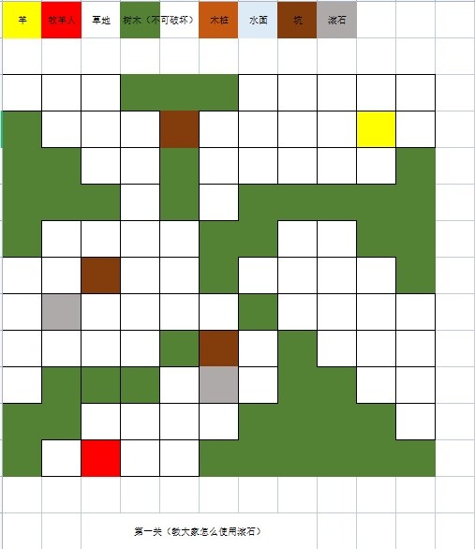
Challenges
1
The Map Design.
2
The Art Effect

Slide 12
04
GOALS

Slide 13
Goals
1.Experience the joy of leisure and puzzle solving
2.Gain a good gaming experience through the interesting content design
3.An interesting storyline that stimulates emotions

Slide 14
THANKS!
THANK YOU FOR WATCHING
Notes:
版权声明：300套精品模板商业授权，请联系【锐旗设计】:https://9ppt.taobao.com，专业PPT老师为你解决所有PPT问题！

