Slide 1
History Beyond Camera
Presented by four programmers

Slide 2
Contents
Introduction
Details
Sketches
Challenges

Slide 3
1
Introduction

Slide 4
1.Introduction
Type&features
1.
Strategy
2.
Blow your mind (脑洞大开）

Slide 5
2.Details
Four programmers
①Background
②Characters
③Win/lose condition

Slide 6
①Background
You use the time machine to travel back in time, it’s a best chance to discover the history! But you can only move around in the“camera”,and you need to use your intelligence to achieve your goals, make the history(for you is the present) likes it should be!
Notes:
[what is “camera” 可能需要解释]

Slide 7
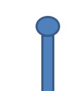
②Characters
This is YOU.
Simple lines, extreme enjoyment.
(We did our best as four programmers……)
(We promise to make you looks better !)
At least have arms and legs

Slide 8
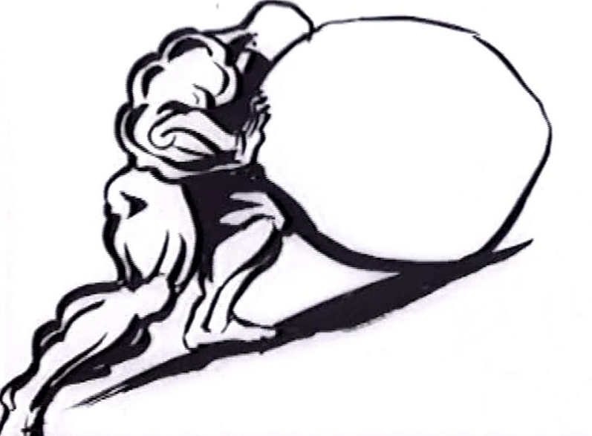

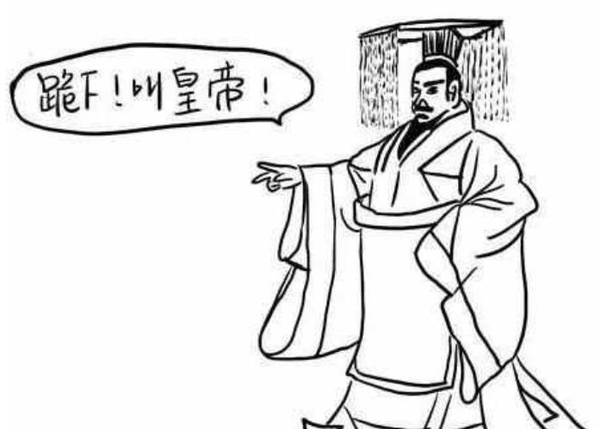
②Characters
And I am sure you will meet many historical figures…
Sisyphus
Newton
First Emperor of Qin

Slide 9
③Win/lose condition
1.
Win condition: Find the key items in the scene, try to use it as the facilitator of history.
2.
Lose condition: you step into a trap/use too many steps to get to the point/…

Slide 10
But what is it on earth?

Slide 11
Demonstration

Slide 12
2
Details

Slide 13
2.Details
Four programmers
①Control
②What’s More

Slide 14
① Control
How to play?
Use w,a,s,d to control your character.
Use ↑，←，↓，→ to control the “camera”.
*You can only move in the range of camera!
Try to interact with the scene.
(e.g: push/pull the boxes,to get something…)

Slide 15
②What’s more
Realize large scenes in a scroll style（卷轴式场景）
Different conditions:
Death because of the trap,
The “camera” is broken,
Main Character keep moving left…
Eggs waiting to be discovered…
And even more!

Slide 16
3
Sketches
the game
of

Slide 17
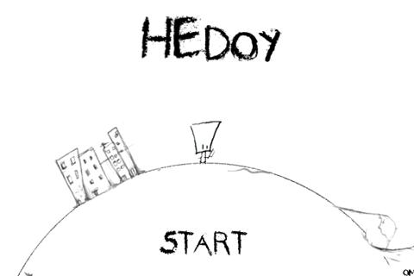

Style
Black & White
stick figure
Imagine ↓

Slide 18
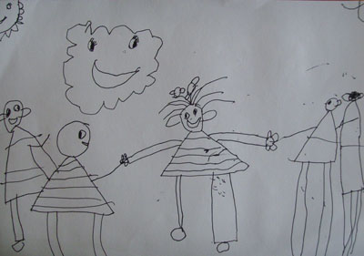
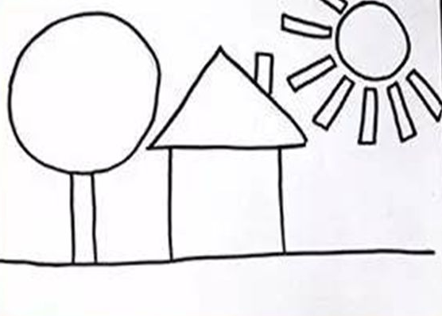
Style
Hope it won’t be like this…

Slide 19
4
Challenges
Prototypes
&

Slide 20
Challenges
Main Character behavior (Walking, Jumping, Dragging…)
The moving of the “camera”, the corresponding effect on the background(the scene inside the “camera” is clear, while outside is vague)
Level design(really really hard)
Small animations
Notes:
[what is “camera” 可能需要解释]

Slide 21
Thank you!

