Slide 1

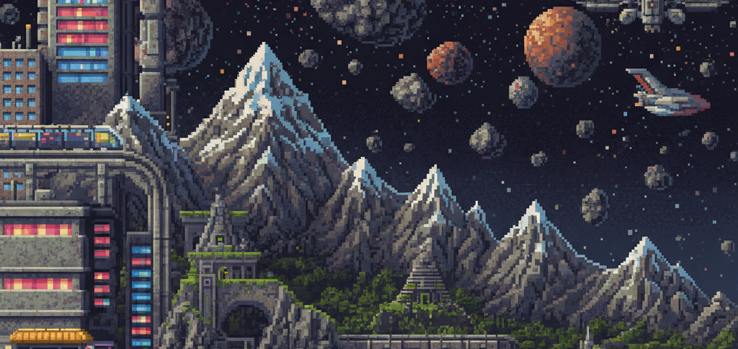


Escape
from the Earth
GameObject
Wu Di / Li Wanchen / Shi Mengcheng / Zhu Siyu

Slide 2


目 录
01
Overview
03
Sketches
02
UI Design
04
Core Function
CONTENTS

Slide 3

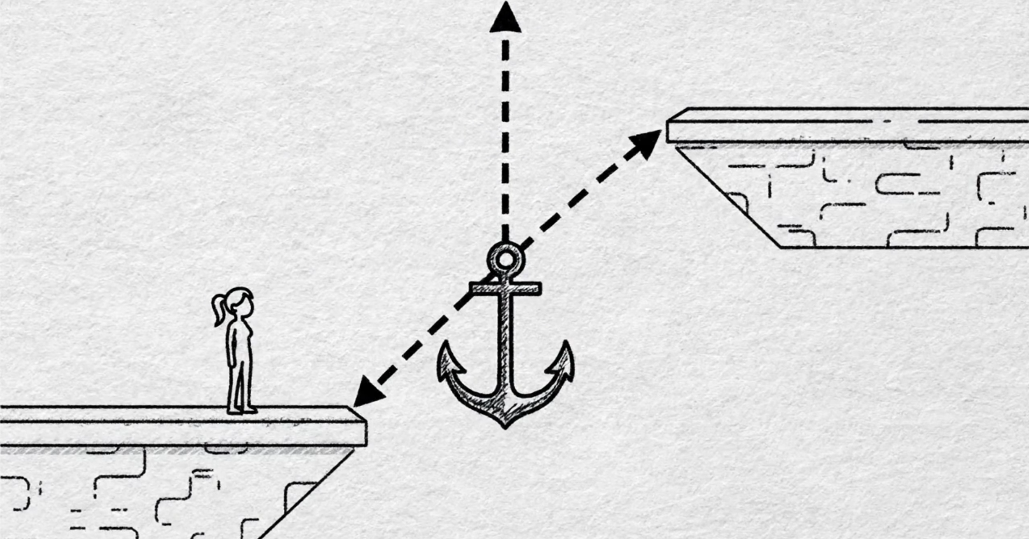

A jump WITHOUT a jump
On Earth, you cannot actively jump –
you can only move symmetrically in an instant with the help of a thrown fulcrum.

Slide 4

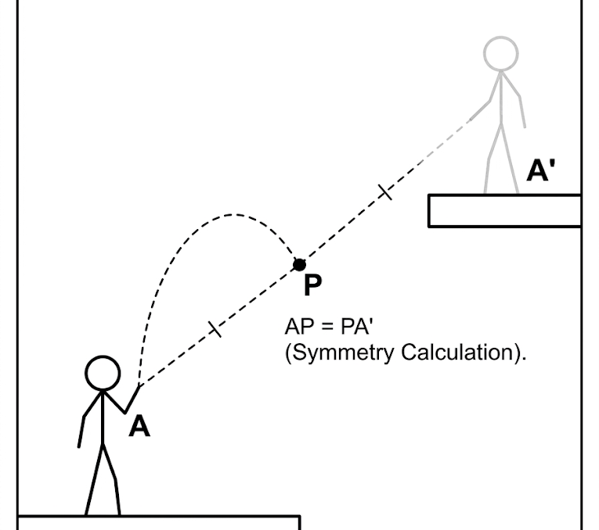
point-symmetry teleportation mechanic 点对称传送机制

Slide 5
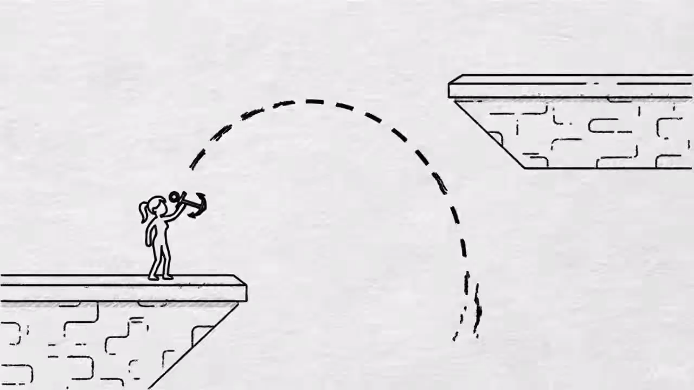
Animation Demonstration

Slide 6
The Rules
Winning Condition
· reach the UFO at the end of the final level
· Each level ends with a portal; make it through all of them, and you escape
Failing Condition
· standing on spikes drains your health over time until it goes to zero
· Fall into the void, and you fail immediately—the level resets.

Slide 7

UI Design
· Top left corner: Health (heart icon)
· Top center: Current level number (Level 1 / 2 / 3)
· Top right corner: Number of pivots remaining
· Bottom center: Prompt text "E: Projectile Fulcrum …"

Slide 8
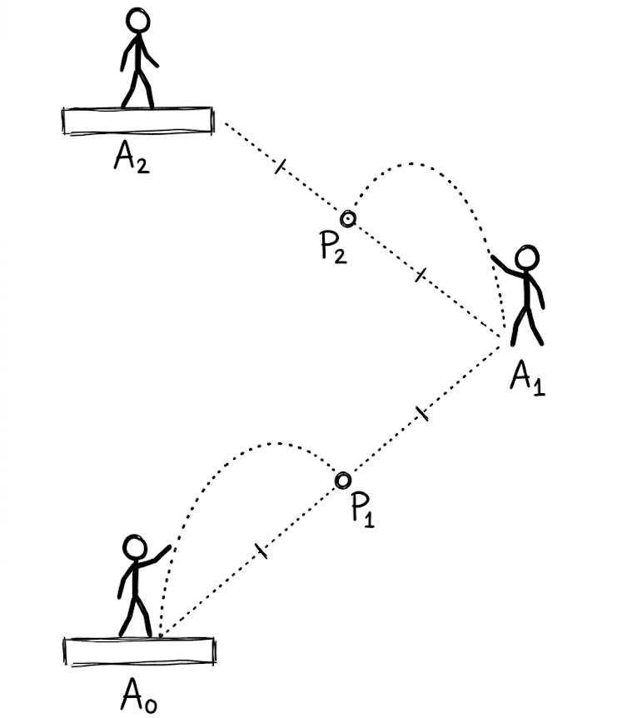
Advanced
gameplay modes 进阶玩法

Slide 9
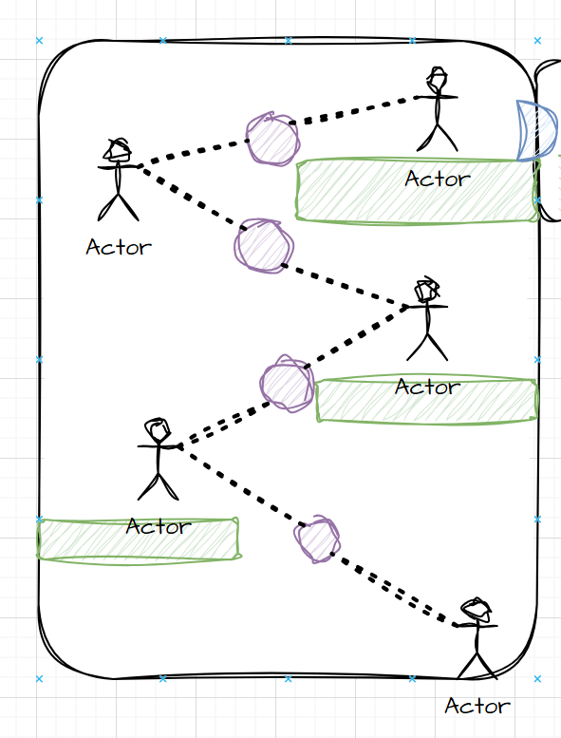
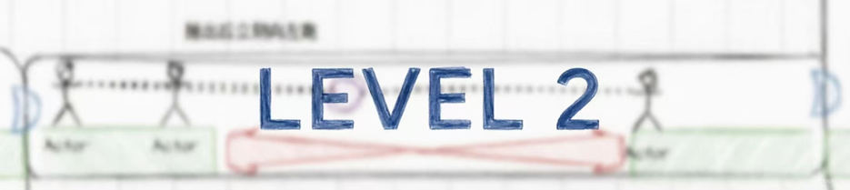

Sketches – Game Level
Please stay tuned…

Slide 10
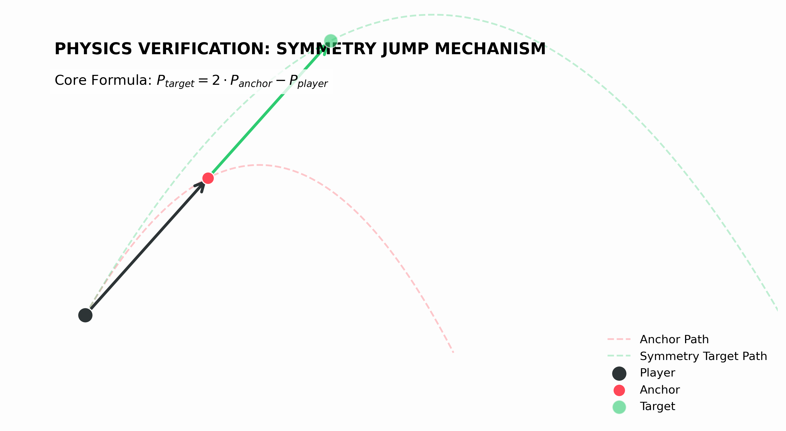
Modeling & Theory

Slide 11
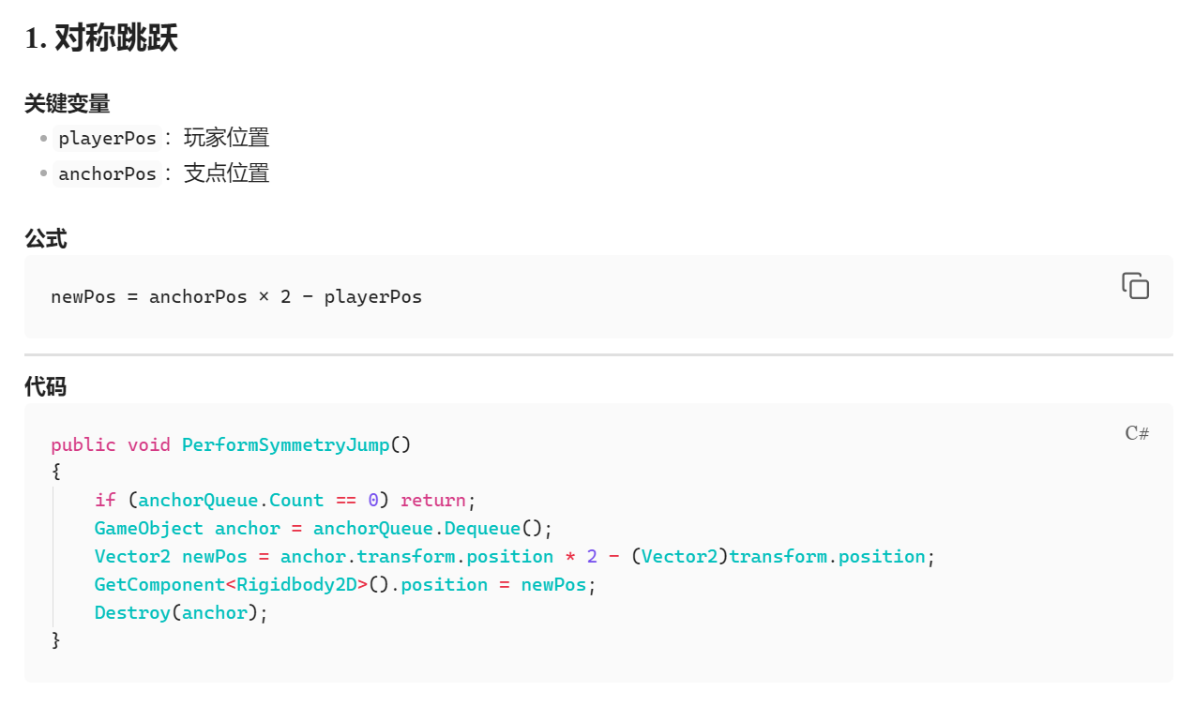
Key Function Code

Slide 12
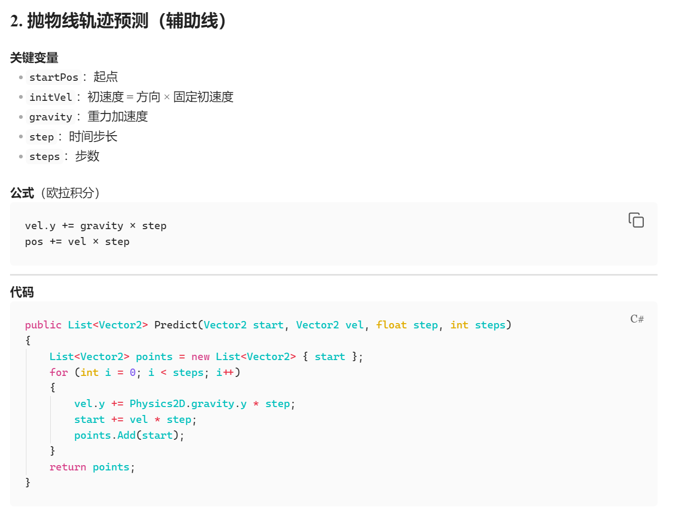
Key
Function
Code

Slide 13
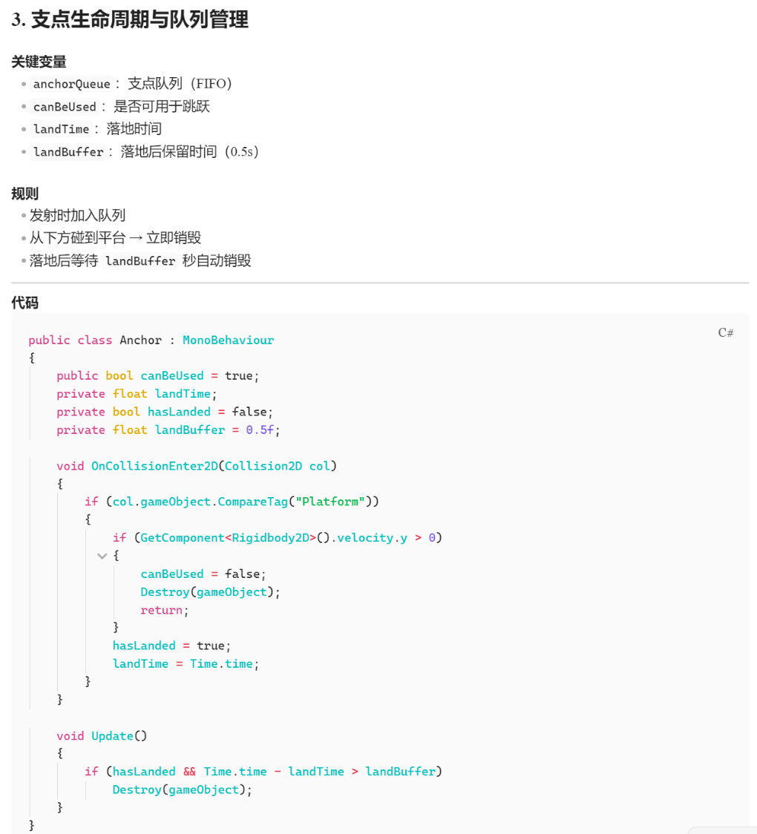
Key
Function
Code

Slide 14


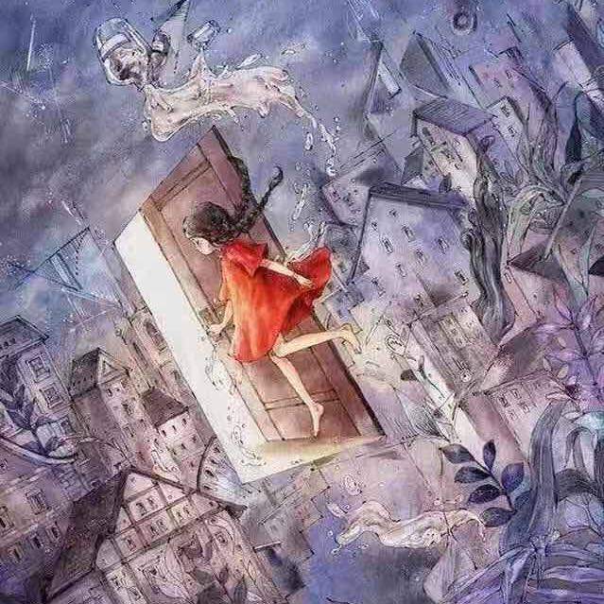

Questions?
Thanks for listening！！
GameObject
Wu Di / Li Wanchen / Shi Mengcheng / Zhu Siyu

