Slide 2
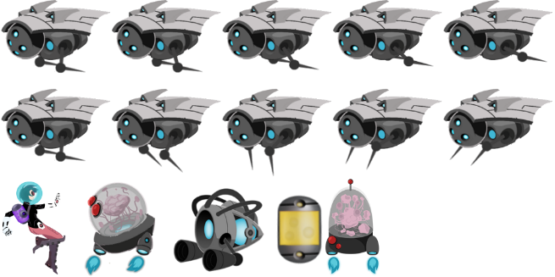
1024
204
164
164
512
180
(5, 0)
120x180
(130, 0)
180x180
(315, 0)
180x180
(510, 23)
180x180
(130, 0)
100x180
Figure 6-2

Slide 3






$$P_{b}$$
($x_{b},y_{b}$)
$${\overset{⃑}{V}}_{ab}$$
($x_{b}−x_{a},y_{b}−y_{a}$)
$$P_{a}$$
($x_{a},y_{a}$)
Figure 6-3

Slide 4


$${\overset{⃑}{V}}_{a}=(5, 0)$$
$${\hat{V}}_{a}=vec2.normalize\left({\overset{⃑}{V}}_{a} \right)$$
$=(0, 1)$
Figure 6-4

Slide 5





${\overset{⃑}{V}}_{r}$ ($x_{r},y_{r}$)
$\overset{⃑}{V}$ ($x_{v},y_{v}$)
$$\begin{aligned}x_{r}= x_{v}\cos{θ}−y_{v}\sin{θ} \\ y_{r}= x_{v}\sin{θ}+y_{v}\cos{θ} \end{aligned}$$
$$θ$$
$$(0, 0)$$
Figure 6-5

Slide 6







$${\overset{⃑}{V}}_{a}$$
$$P_{c}$$
$${\overset{⃑}{V}}_{d}$$
$${\overset{⃑}{V}}_{bc}$$
$$P_{a}$$
$$P_{d}$$
$$P_{b}$$
Figure 6-6

Slide 7



${\overset{⃑}{V}}_{2}$ ($x_{2},y_{2}$)
${\overset{⃑}{V}}_{1}$ ($x_{1},y_{1}$)
$$θ$$
Figure 6-7

Slide 8




$${\overset{⃑}{V}}_{3}={\overset{⃑}{V}}_{1}×{\overset{⃑}{V}}_{2}$$
${\overset{⃑}{V}}_{2}$ ($x_{2},y_{2}$)
${\overset{⃑}{V}}_{1}$ ($x_{1},y_{1}$)
$${−\overset{⃑}{V}}_{3}={\overset{⃑}{V}}_{2}×{\overset{⃑}{V}}_{1}$$
Figure 6-8

Slide 9
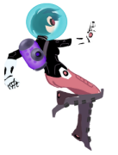
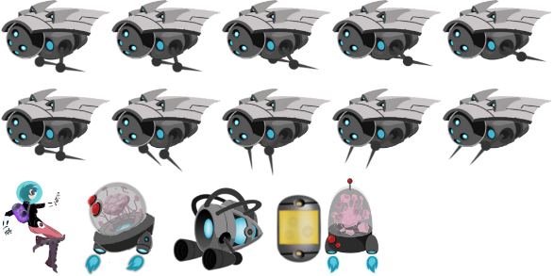

dir
$$θ$$
fdir
Current GameObject
Figure 6-10

Slide 10
Center Position
Height
Width
mLL (lower left corner)
Figure 6-11

Slide 11

eCollideTop
WC Center
eCollideLeft
Camera WC Bounds
eCollideRight
eCollideLeft | eCollideBottom
zone
eCollideBottom
eOutside
Figure 6-13

Slide 12
Bounding box not rotated
Bounding boxes overlapped without actual collision
Figure 6-14

Slide 13


Collector object with transparent background
Object bounding boxes overlap
Figure 6-16

Slide 14
Collector object with transparent background
Collector and portal objects with non-transparent pixels overlap
Figure 6-17

Slide 15

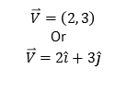



$$\overset{⃑}{V}=\left(2, 3\right)$$
Or
$$\overset{⃑}{V}=2\hat{i}+3\hat{j}$$
$$\overset{⃑}{V}∙\hat{j}$$
$$\hat{j}=(0,1)$$
$$\hat{i}=(1,0)$$
$$\overset{⃑}{V}∙\hat{i}$$
Figure 6-18

Slide 16






$$\overset{⃑}{V}$$
Always true: $\overset{⃑}{V}=\left(\overset{⃑}{V}∙\hat{L}\right) \hat{L}+\left(\overset{⃑}{V}∙\hat{M}\right) \hat{M}$
$$\hat{M}$$
$$\left(\overset{⃑}{V}∙\hat{M}\right)$$
$$\hat{L}$$
$$\left(\overset{⃑}{V}∙\hat{L}\right)$$
Figure 6-19

Slide 17




Original Reference Axes: $\hat{i}$ and $\hat{j}$
$$\hat{j}$$
$$\hat{i}$$
Figure 6-20

Slide 18



Rotate Reference Axes: $\hat{L}$ and $\hat{M}$
$$\hat{M}$$
$$\hat{L}$$
Figure 6-21

