Slide 1





$$\left(0,1\right)$$
$$\left(1,1\right)$$
v
$$\left(0,0\right)$$
u
$$\left(1,0\right)$$

Slide 2









Model Space
Texture Space
$$\left(−0.5,0.5\right)$$
y
$$\left(0.5,0.5\right)$$
$$\left(0,1\right)$$
$$\left(1,1\right)$$
x
$$\left(−0.5,−0.5\right)$$
$$\left(0.5,−0.5\right)$$
$$\left(0,0\right)$$
$$\left(1,0\right)$$

Slide 3
Engine/Game State
Image State
Operations
Engine and WebGL Initialization
Image in Server
_initializeWebGL()
VertexBuffer.initialize()
Scene Initialization and Loading
Image in Memory
loadTexture()
_processLoadedImage()
WebGL Texture
TextureRenderable.draw()
Game Loop
Data Fetched for Shader
activateTexture()
Drawn on Canvas
void main(void) of GLSL Shaders
Scene Unload
Removed from Memory
unloadTexture()

Slide 4
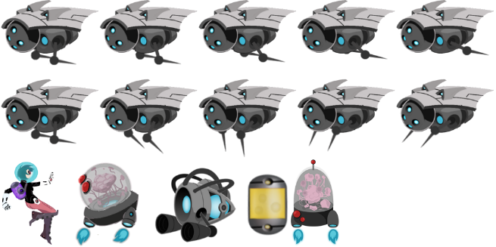
1024
204
164
328
164
512
(0, 184)
180
120
180
180
(5, 0)
(130, 0)
(315, 0)

Slide 5
















$$\left(1023,511\right)$$
Pixel Positions
$$\left(495,180\right)$$
$$\left(315,0\right)$$
$$\left(0,0\right)$$
$$u=\frac{495}{1024}=0.483$$
$$\left(1,1\right)$$
$$v=\frac{180}{512}=0.352$$
UV Values
$$u=\frac{315}{1024}=0.308$$
$$\left(0,0\right)$$
$$v=\frac{0}{512}=0.0$$
$$\left(x,y\right)=\left(−0.5,0.5\right)$$
$$\left(u,v\right)=\left(0.308,0.352\right)$$
$$\left(x,y\right)=\left(0.5,0.5\right)$$
$$\left(u,v\right)=\left(0.483,0.352\right)$$
Use in Model Space
$$\left(x,y\right)=\left(−0.5,−0.5\right)$$
$$\left(u,v\right)=\left(0.308,0.0\right)$$
$$\left(x,y\right)=\left(0.5,−0.5\right)$$
$$\left(u,v\right)=\left(0.483,0.0\right)$$

