Slide 1
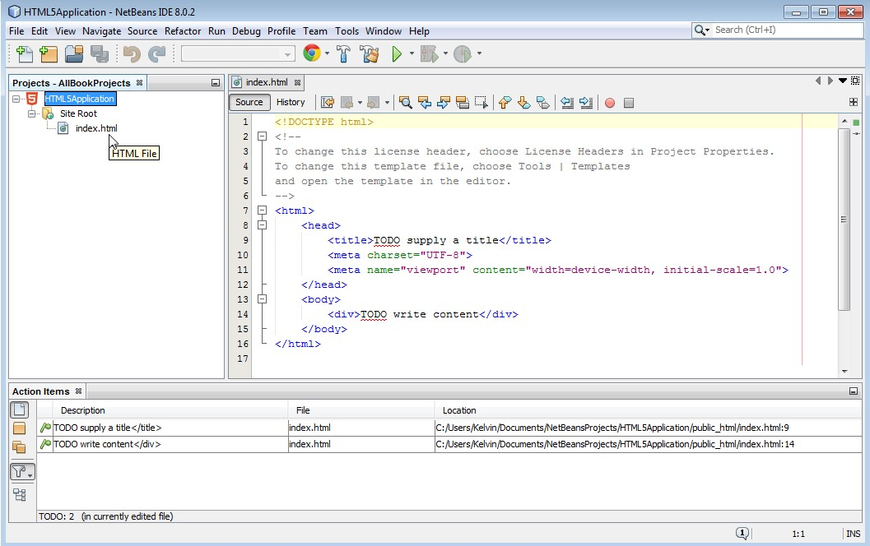
Projects
window
Editor
window
Action Items
window

