Slide 1
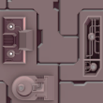
2x3 Tiled
Image

Slide 2
sees
eye
eye
sees

Slide 3
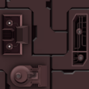
y
World Coordinate
Canvas WC bounds
x
Tile covering the lower left corner of WC bounds

Slide 4
slower
P2
Layer 2 background
faster
P1
Layer 1 background
Hero
Default distance
Camera WC bounds

Slide 5
slower
P2
Layer 2 background
faster
P1
Layer 1 background
Hero
Default distance
Camera WC bounds

Slide 6
0.75d
P2
Layer 2 background
0.25d
P1
Layer 1 background
Hero
Default distance
Camera WC bounds
d
New Camera WC bounds

