Slide 1





$$\left(0,1\right)$$
$$\left(1,1\right)$$
v
$$\left(0,0\right)$$
u
$$\left(1,0\right)$$

Slide 2









Model Space
Texture Space
$$\left(−0.5,0.5\right)$$
y
$$\left(0.5,0.5\right)$$
$$\left(0,1\right)$$
$$\left(1,1\right)$$
x
$$\left(−0.5,−0.5\right)$$
$$\left(0.5,−0.5\right)$$
$$\left(0,0\right)$$
$$\left(1,0\right)$$

Slide 3
Engine/Game State
Image State
Operations
Engine and WebGL Initialization
Image in Server
gl.init()
vertexBuffer.init()
Scene Initialization and Loading
Image in Memory
texture.load()
processLoadedImage()
WebGL Texture
TextureRenderable.draw()
Game Loop
Data Fetched for Shader
texture.activate()
Drawn on Canvas
void main(void) of GLSL Shaders
Scene Unload
Removed from Memory
texture.unload()

Slide 4
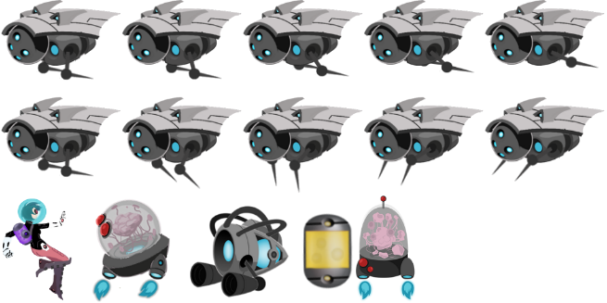
1024
204
164
328
164
512
(0, 184)
180
120
180
180
(5, 0)
(130, 0)
(315, 0)

Slide 5
















$$\left(1023,511\right)$$
Pixel Positions
$$\left(495,180\right)$$
$$\left(315,0\right)$$
$$\left(0,0\right)$$
$$u=\frac{495}{1024}=0.483$$
$$\left(1,1\right)$$
$$v=\frac{180}{512}=0.352$$
UV Values
$$u=\frac{315}{1024}=0.308$$
$$\left(0,0\right)$$
$$v=\frac{0}{512}=0.0$$
$$\left(x,y\right)=\left(−0.5,0.5\right)$$
$$\left(u,v\right)=\left(0.308,0.352\right)$$
$$\left(x,y\right)=\left(0.5,0.5\right)$$
$$\left(u,v\right)=\left(0.483,0.352\right)$$
Use in Model Space
$$\left(x,y\right)=\left(−0.5,−0.5\right)$$
$$\left(u,v\right)=\left(0.308,0.0\right)$$
$$\left(x,y\right)=\left(0.5,−0.5\right)$$
$$\left(u,v\right)=\left(0.483,0.0\right)$$

