Slide 1
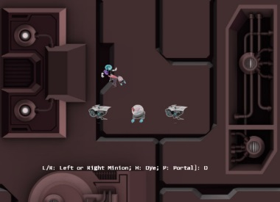
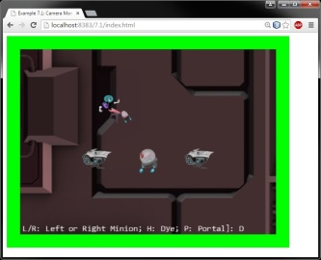
Camera. setViewAndCameraMatrix()
W_{wc}
W_{v}
H_{wc}
H_{v}
WC window
WC center
(V_{x},V_{y})
Viewport bounds
HTML canvas bounds

Slide 2
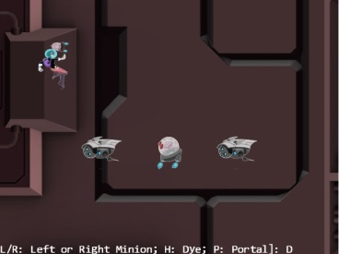
Zoom to ½ of original size
½d
½d
WC center
New WC center
Original WC center

Slide 3
Value
Intermediate results from linear interpolation
Old Value
New Value
t₁
t₂
Time
Intermediate results from interpolation based on an exponential function

Slide 4
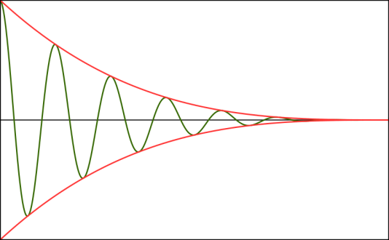



Value
Damping function e.g. $t^{2}$
Oscillation function e.g. $\cos\left(2πk2t\right)$
k₁
Time
Damped Simple Harmonic motion e.g. ${\left(k1−t\right)}^{2}\cos\left(2πk2t\right)$

Slide 5
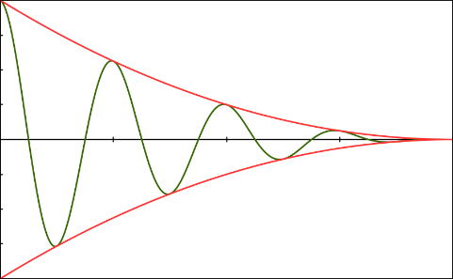




Value
$${\left(\frac{k−t}{k}\right)}^{2}$$
$$1$$
$f$= frequency
$k$= duration (mCycles)
ω = $2πf$ (mOmega)
$$0.5$$
$$\frac{9}{16}$$
$$0.25$$
$$\frac{4}{16}$$
$$\frac{1}{16}$$
$k$
Time
$$\frac{k}{4}$$
$$\frac{k}{2}$$
$$\frac{3k}{4}$$
$$−1$$
$${\left(\frac{k−t}{k}\right)}^{2}\cos\left(\text{ω}\frac{t}{k}\right)$$

Slide 6
Canvas
Canvas
W_{v}
Viewport
(mouseX,mouseY)
H_{v}
(mouseX,mouseY)
mouseX
mouseY
(V_{x},V_{y})
(0,0)
mouseDCX = mouseX-V_{x}
mouseDCY = mouseY-V_{y}

Slide 7


Device Coordinate Space
World Coordinate Space
Viewport
W_{wc}
W_{v}
H_{v}
H_{wc}
(V_{x},V_{y})
mouseDCX
(minWCX,minWCY)
mouseDCY
mouseWCX = minWCX+ (mouseDCX $×\frac{Wwc}{Wv}$)
mouseWCY = minWCY+ (mouseDCY $×\frac{Hwc}{Hv}$)

