Slide 1
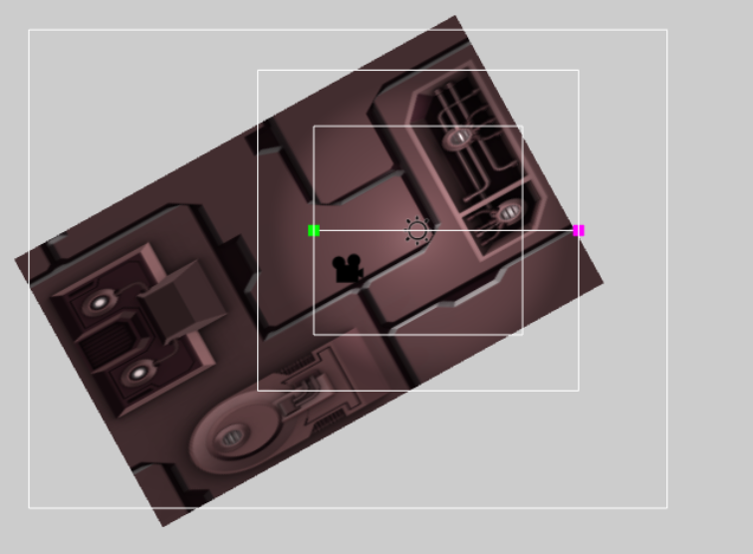
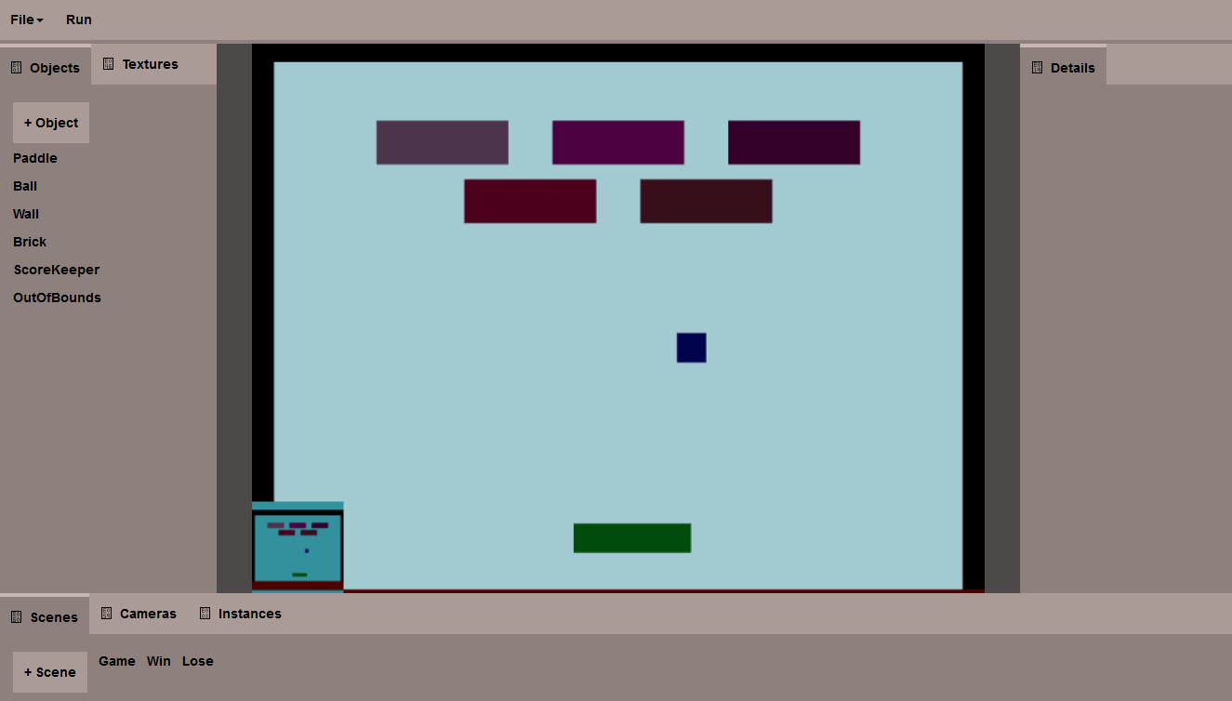
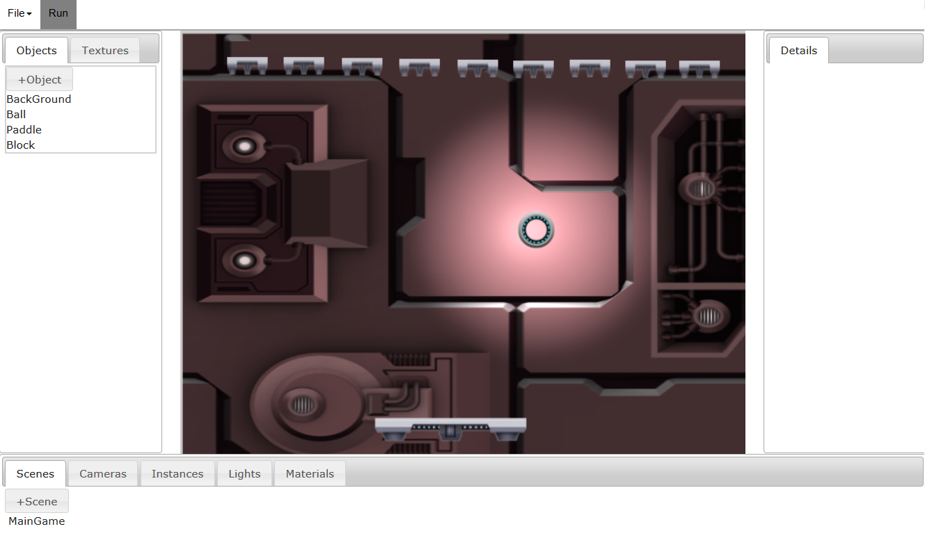
Front end development for a Game Engine GUI
Jason Herold, Kelvin Sung (Advisor), Jason Pace (Sponsor) CSS 497 August 19th, 2016
Introduction
Student-built javascript game engine for teaching students how to program games
GUI interface desired to reduce cognitive load of programming games
May eventually be used in teaching the game engine development course
Agile development cycle, one week sprints
Direct scene manipulation
Goal: Let the user directly manipulate the scene
Built from the ground up – no prior work done
Move/resize any game object/light/camera
Rotate game objects
Content addition system
Goal: Simplify process of changing frontend
Tabs hold content objects, which hold widgets
Widgets need to directly modify the HTML
Easily extensible
Direct manipulation interface for a light
Panel/Tab modifications
Goal: Allow the user to customize their view
Used JQuery UI to add the following functionality:
Resizable panels
Drag-and-drop tabs into other panels, or reorder within a panel
Drag a tab out to create a floating window
Tab content structure
Conclusion
User interface goals accomplished
User experience better than before, but requires more focused development
User testing needed
Old look versus new look

