Slide 1

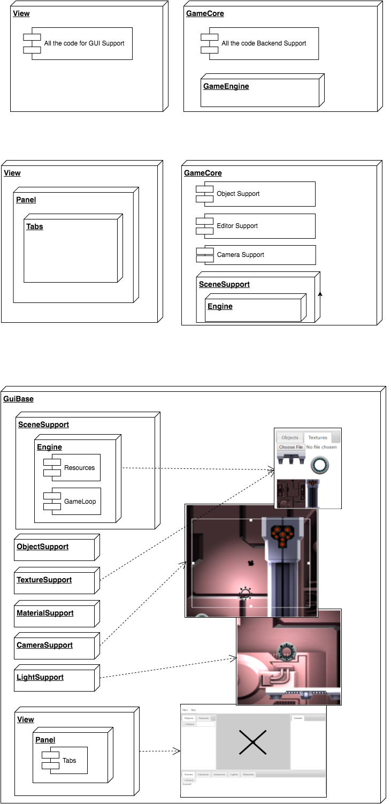



August 19th, 2016, Jonathan Earl, Contributors: Jason Herold, Dexter Hu
Advisor: Kelvin Sung, Sponsor: Jason Pace
Backend development for a Game Engine GUI
Introduction
GUI for JavaScript game engine for teaching students how to program games
May be used to learn game engine development
Prototype by previous student
Solution
Restructuring: 4 weeks
Able to quickly add new content:
1.5 weeks for Textures
1 week for camera scripts/layers
2 weeks for lights and light textures
Results
Prototype
Restructure Code
Extend GUI
Tools
Develop prototype into full web application
Add:
Textures
Materials
Lights
Illuminate Renderable
Extend:
Camera
Easy to maintain and add content
Goals
Conclusion
Division of code allows for easier implementation
Completed goals of adding all features
More effective data structures can be used

