Slide 1
Investigation into GUI Support for a Web-Based Game Engine
Dexter Hu

Slide 2
Introduction
Problem Statement
Existing system
Goals
Literature Review
Architecture
Lifecycle
Design Process
Implementation
Results
Limitations
Conclusion

Slide 3
Problem Statement
Existing backend
Reduce technical understanding needed
Why web-based?
Accessibility
Why a GUI?
Visuals
Instant feedback
Stakeholders

Slide 4
Project Scope
Goals and requirements
What would be ideal?
What have we done?

Slide 5
Literature Review
Reviewed literatures for theories relating to GUI design
Additionally: observed design of two game engines
Unity3D
Unreal Engine

Slide 6
Designing the User Interface [5]
Classical survey considering consistency and simplicity
Consistency: 3 levels
Semantic
Syntactic
Physical
Simplicity
Direct manipulation
Automatically-updating information
Conclusion
Rapid technology growth
Low-detail design principle investigation
Take-away
Maintain consistency and simplicity

Slide 7
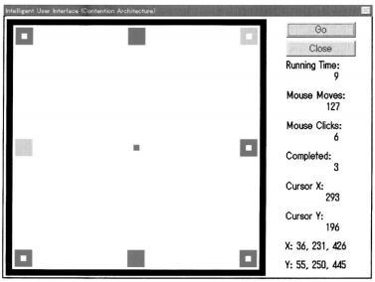
Intelligent Graphical User Interface Design Utilizing Multiple Fuzzy Agents [1]
Experiment
Tests usability of fuzzy agents in “contention architecture”
Contention architecture
Metrics
Running time
Number of mouse moves
Number of operations
Reduce the amount of work a user needs to do
Conclusion
Scalability concerns for complex applications
Take-away
Reduce work if applicable

Slide 8
The Role of Cognitive Theory in Human–Computer Interface [2]
Report of findings
Extend cognitive theories from traditional learning to human-computer interactions
Screen design and automatic processing
Layout
Consistency
Controversial
Color
Spatial display
Conclusion
Theories still need validation
Take-away
Maintain consistency
Group and list related items
Avoid unwanted distraction/confusion

Slide 9
Factors that Guide or Disrupt Attentive Visual Processing [3]
Report of findings
Attention-attracting features
Distinctiveness
Expectable
Schema-matching
Conclusion
Limited to traditional single-user applications (relative to 2006)
Take-away
Reduce cognitive load
Manage attention
Avoid unwanted distraction/confusion

Slide 10
SOCIALSENSE: Graphical User Interface Design Considerations for Social Network Experiment Software [4]
Experiment and study
Four usability principles
Reading gravity
Cognitive load
Schema-matching
Color, as a means to attract attention
Conclusion
These principles caused an increase in user-friendliness all-around
Validates the experimental procedure, as well as findings from other literatures
Take-away
Apply reading gravity
Reduce cognitive load
Appeal to visual fields
Manage attention

Slide 11
GUI Design Based on Cognitive Psychology: Theoretical, Empirical and Practical Approaches [6]
Several experiments
Confirmed Left-to-Right theory
Avoid bright and highly-contrasting colors
Backgrounds: Soft colors preferred
Text: Black color is preferred
Conclusion
Psychology is important to consider
Advocates for simplicity, familiarity, and carefulness when choosing colors
Take-away
Appeal to visual fields
Apply reading gravity
Manage attention
Avoid unwanted distraction/confusion

Slide 12
Design Guidelines
Maintain consistency
Maintain simplicity
Apply reading gravity
Reduce cognitive load
Group and list related items
Reduce work if applicable
Appeal to visual fields
Manage attention
Avoid unwanted distraction/confusion

Slide 13
Goal Adjustment
Delivery a simple proof-of-concept prototype
Rationale and change of objective

Slide 14
Functionality that Must be Verified
Scenes
Cameras
Objects
User Input
Autonomous Behaviors
Object Behaviors
Collision Detection

Slide 15
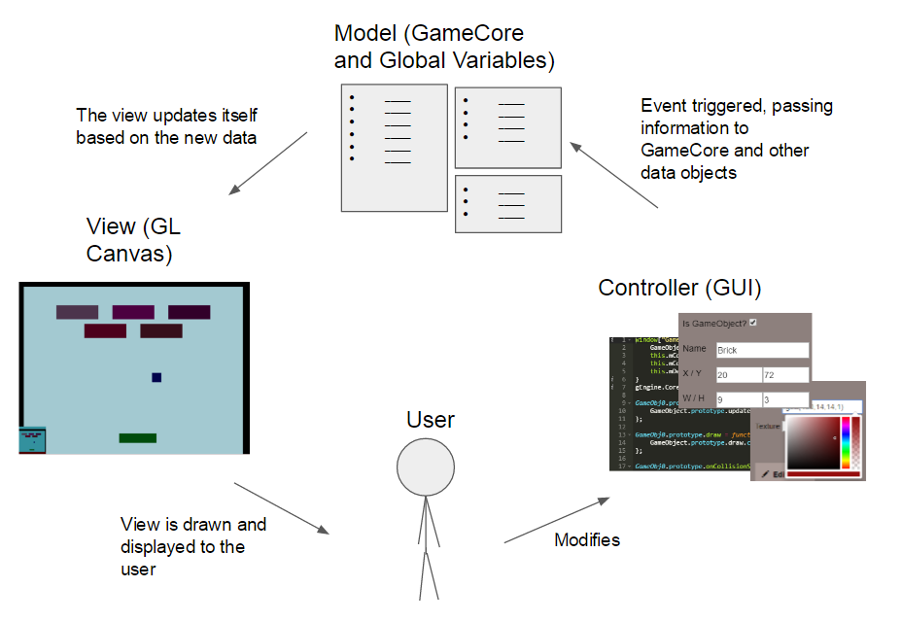
Architecture
MVC
Alternative: Client-Server
Accessibility
Security
Event-based messaging

Slide 16
Lifecycle
Waterfall
Requirements
Design Process
Implementation
Verification/Results

Slide 17
Requirements
Develop a GUI for a web-based game engine
Create a simple game using it
Proof-of-concept demonstration
On the functionality for building classical games

Slide 18
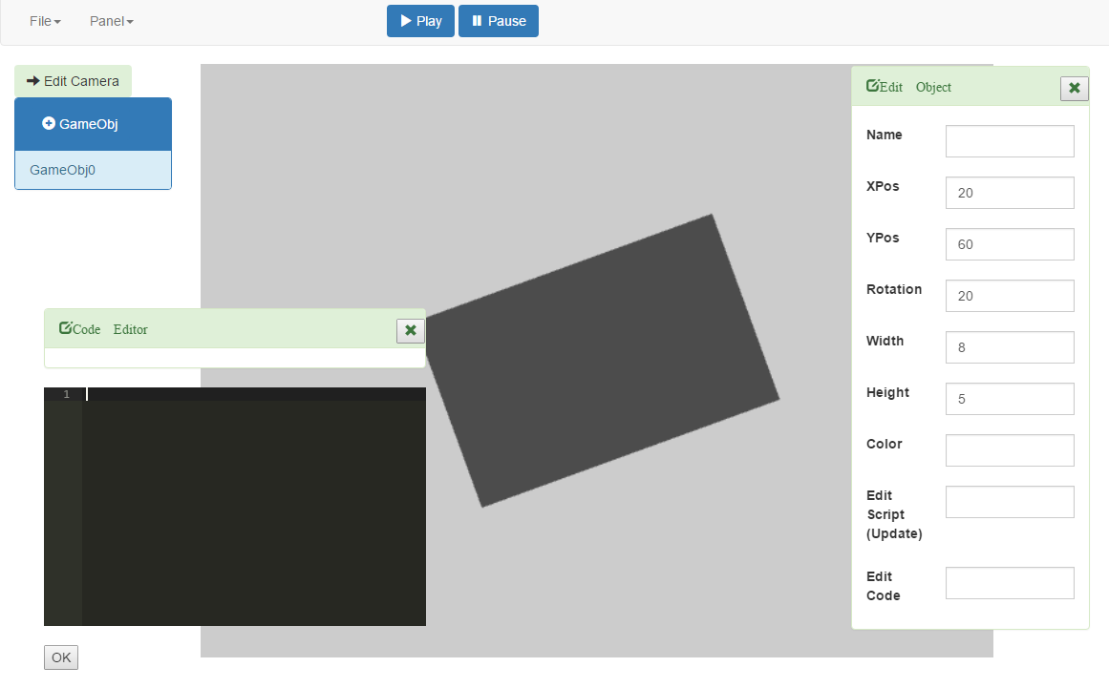
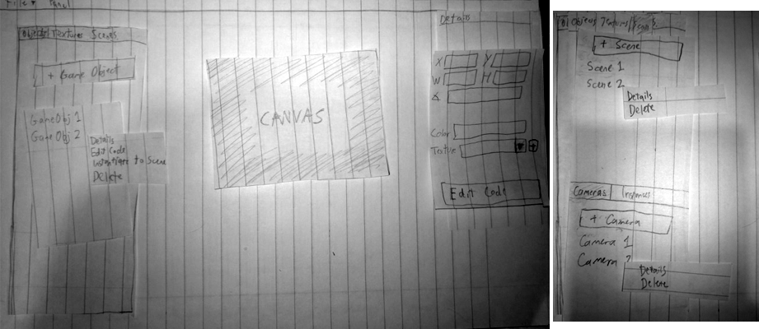
Design Process
Technology investigation within a “sandbox” application
Paper prototyping

Slide 19
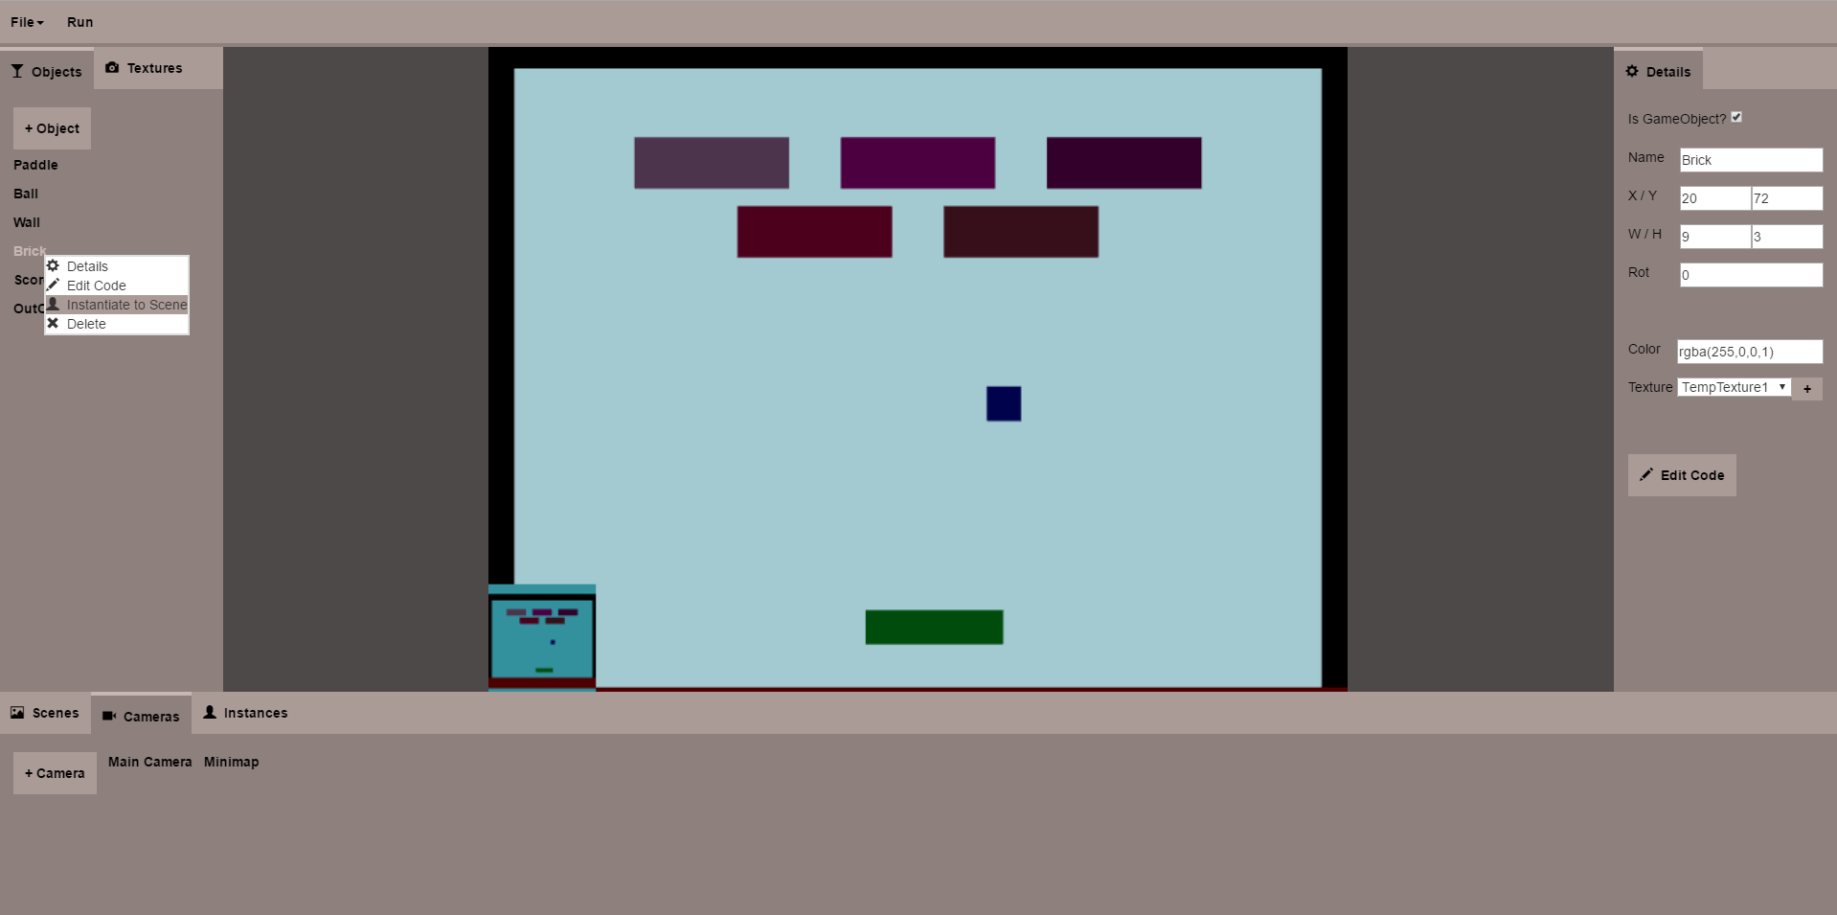
Implementation
GUI development based on investigation and derived guidelines

Slide 20

Implementation
GUI development based on investigation and derived guidelines
Maintain consistency

Slide 21
Implementation
GUI development based on investigation and derived guidelines
Maintain consistency
Maintain simplicity
1x

Slide 22
Implementation
GUI development based on investigation and derived guidelines
Maintain consistency
Maintain simplicity
Apply reading gravity

Slide 23
Implementation
GUI development based on investigation and derived guidelines
Maintain consistency
Maintain simplicity
Apply reading gravity
Reduce cognitive load
Group and list related items

Slide 24
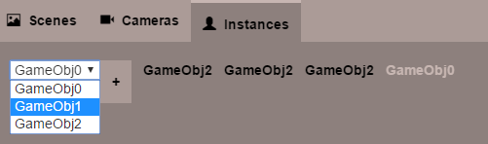
Implementation
GUI development based on investigation and derived guidelines
Maintain consistency
Maintain simplicity
Apply reading gravity
Reduce cognitive load
Group and list related items
Reduce work if applicable

Slide 25
Implementation
GUI development based on investigation and derived guidelines
Maintain consistency
Maintain simplicity
Apply reading gravity
Reduce cognitive load
Group and list related items
Reduce work if applicable
Appeal to visual fields

Slide 26

Implementation
GUI development based on investigation and derived guidelines
Maintain consistency
Maintain simplicity
Apply reading gravity
Reduce cognitive load
Group and list related items
Reduce work if applicable
Appeal to visual fields

Slide 27
Implementation
GUI development based on investigation and derived guidelines
Maintain consistency
Maintain simplicity
Apply reading gravity
Reduce cognitive load
Group and list related items
Reduce work if applicable
Appeal to visual fields

Slide 28
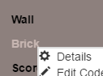
Implementation
GUI development based on investigation and derived guidelines
Maintain consistency
Maintain simplicity
Apply reading gravity
Reduce cognitive load
Group and list related items
Reduce work if applicable
Appeal to visual fields
Manage attention
Avoid unwanted distraction/confusion

Slide 29
Results
Extent and metrics of success
Caveat: API required

Slide 30

Results: Game Build
Super Breakout game
Proof-of-concept demonstration

Slide 31
Results: Game Build
Super Breakout game
Proof-of-concept demonstration
Game
Win
Lose
Scenes

Slide 32
Results: Game Build
Super Breakout game
Proof-of-concept demonstration
1
Scenes
Cameras
2

Slide 33
Results: Game Build
Super Breakout game
Proof-of-concept demonstration
Scenes
Cameras
Objects

Slide 34
Results: Game Build
Super Breakout game
Proof-of-concept demonstration
Scenes
Cameras
Objects
User Input

Slide 35
Results: Game Build
Super Breakout game
Proof-of-concept demonstration
Scenes
Cameras
Objects
User Input
Autonomous Behaviors
Object Behaviors
Collision Detection

Slide 36
Limitations
In the context of classical games
No textures or sound
UI GameObject (UIGO) vs. Dynamic subclassed GameObject
In the context of usability
Need to perform end-user tests
In the context of other functionalities
Animation, lights, illumination, rigid bodies, particles, etc.

Slide 37
Implementation Challenges
Creation of new game objects
Dynamic subclassing
Floating editor panels
Multiple floating editor panels
Run-state saving
One GL Canvas
Loading in a .zip
FileReader
JSZip
Updating game engine code

Slide 38
Conclusion
Accomplished project goal
Future work
Support additional functionalities from game engine
Usability testing
Micro scale
Macro scale

Slide 39
Bibliography
[1] Agah, A., and K. Tanie. “Intelligent Graphical User Interface Design Utilizing Multiple Fuzzy Agents.” Interacting with
Computers 12.5 (2000): 529-42. Oxford Journals Oxford UP]. Web. 14 Feb. 2016.
[2] Chalmers, Patricia A. “The Role of Cognitive Theory in Human–computer Interface.” Computers in Human Behavior
19.5 (2003): 593-607. ScienceDirect. Web. 4 Mar. 2016.
[3] Hillstrom, Anne P., and Yu-Chin Chai. “Factors That Guide or Disrupt Attentive Visual Processing.” Computers in Human
Behavior 22.4 (2006): 648-56. ScienceDirect. Web. 4 Mar. 2016.
[4] Stupak, Noah, et al. “SOCIALSENSE: Graphical User Interface Design Considerations for Social Network Experiment
Software.” Computers in Human Behavior 26.3 (2010): 365-70. Elsevier ScienceDirect. Web. 15 Feb. 2016.
[5] Pangalos, George J. “Designing the User Interface.” Computers in Industry 22.2 (1993): 193-200. ScienceDirect. Web. 12
Mar. 2016.
[6] Yee, Chee Kit, et al. “GUI Design Based on Cognitive Psychology: Theoretical, Empirical and Practical Approaches.”
Computing Technology and Information Management 2 (2012): 836-41. IEEE. Web. 10 Mar. 2016.

Slide 40
Questions?

Slide 41
What I Have Learned
Design
Color usage
Generality of design principles
Problem solving
“Stepping back”
Weighing various strategies against each other

Slide 42
Advice for Future Work
Include:
Usability testing
Additional functionalities from game engine
Understand:
jQuery
Panels

Slide 43
Technologies Used
jQuery
CSS
Twitter bootstrap colorpicker
Ace
JSZip
FileSaver
Bootstrap 3 Glyphicons

Slide 44
What I Would Do Differently
Change distinct feature for “interactible”
Boldness
File loading
Add additional features
Dragging (e.g. for objects)
Direct manipulation of objects through the GL Canvas

