Slide 1
Chapter 10
Camera Background Support

Slide 2
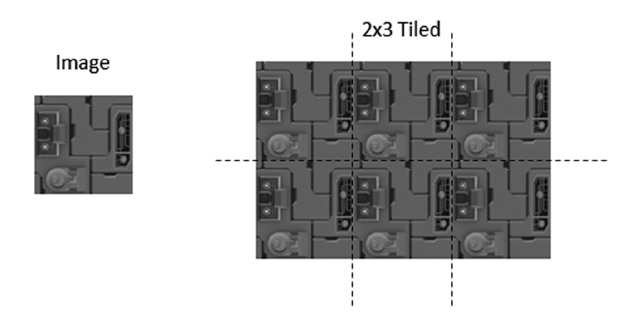
Camera background
Tiling

Slide 3
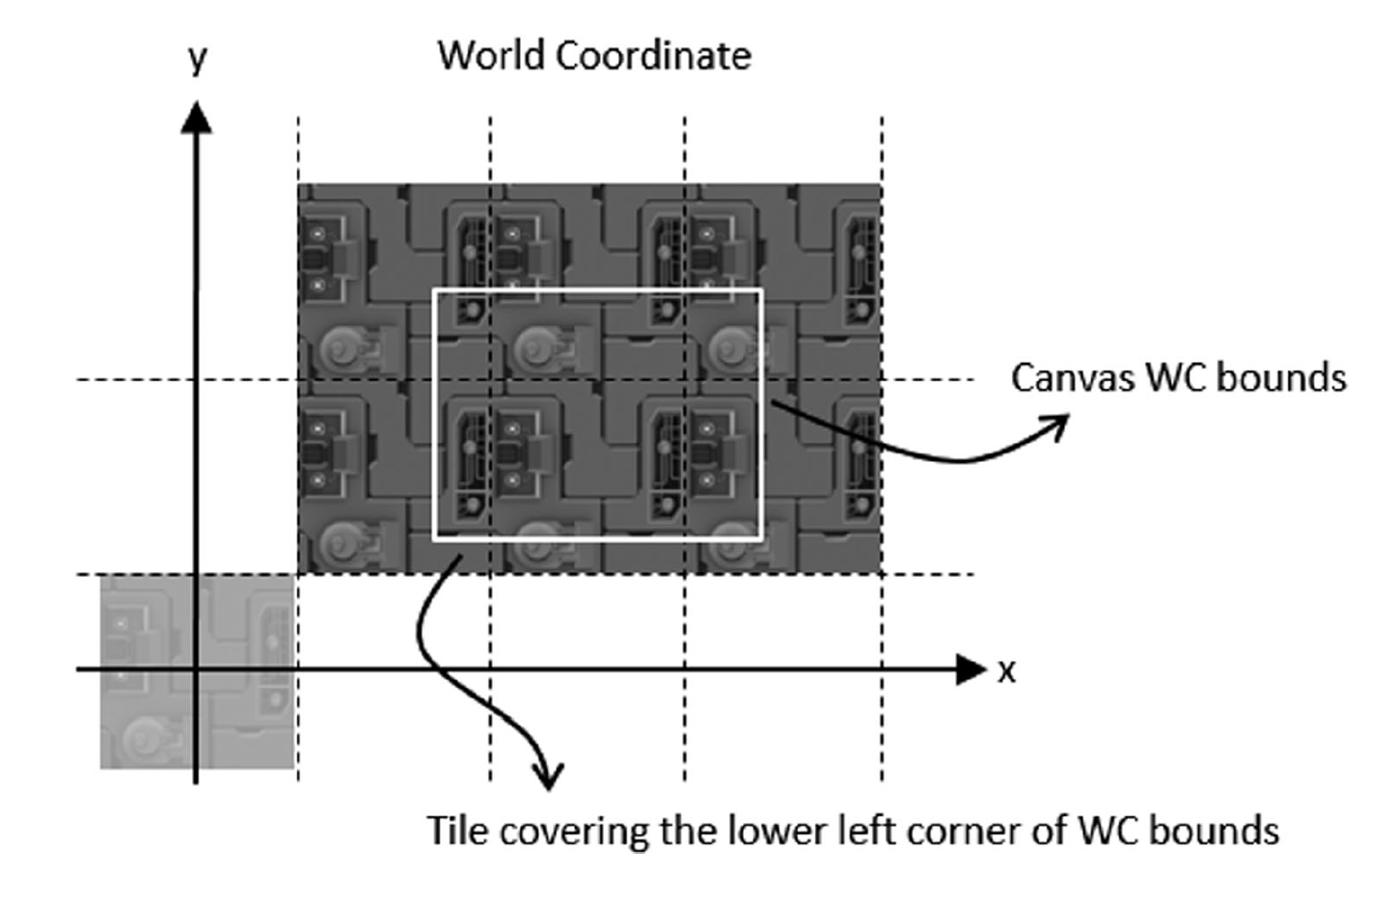

Slide 4
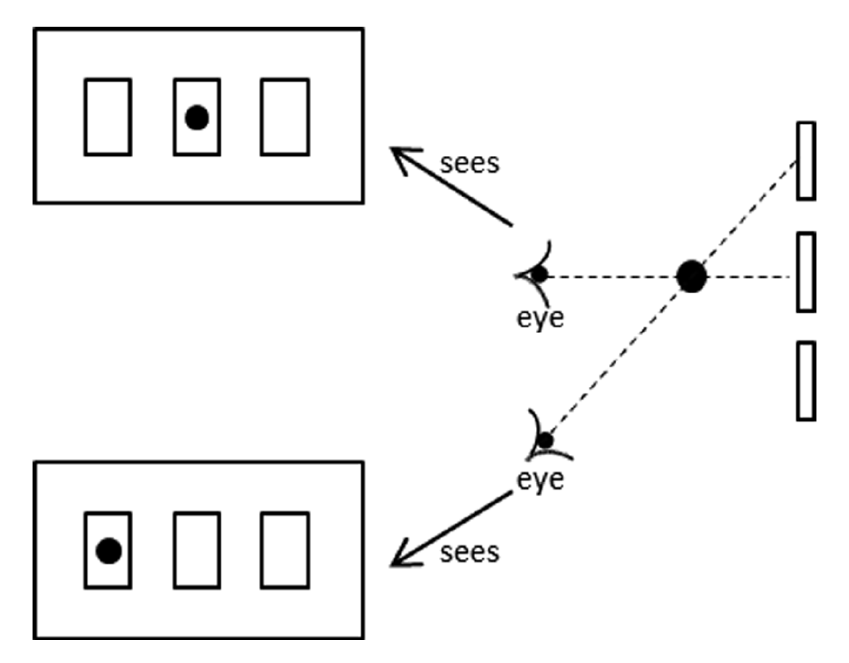
Parallax

Slide 5
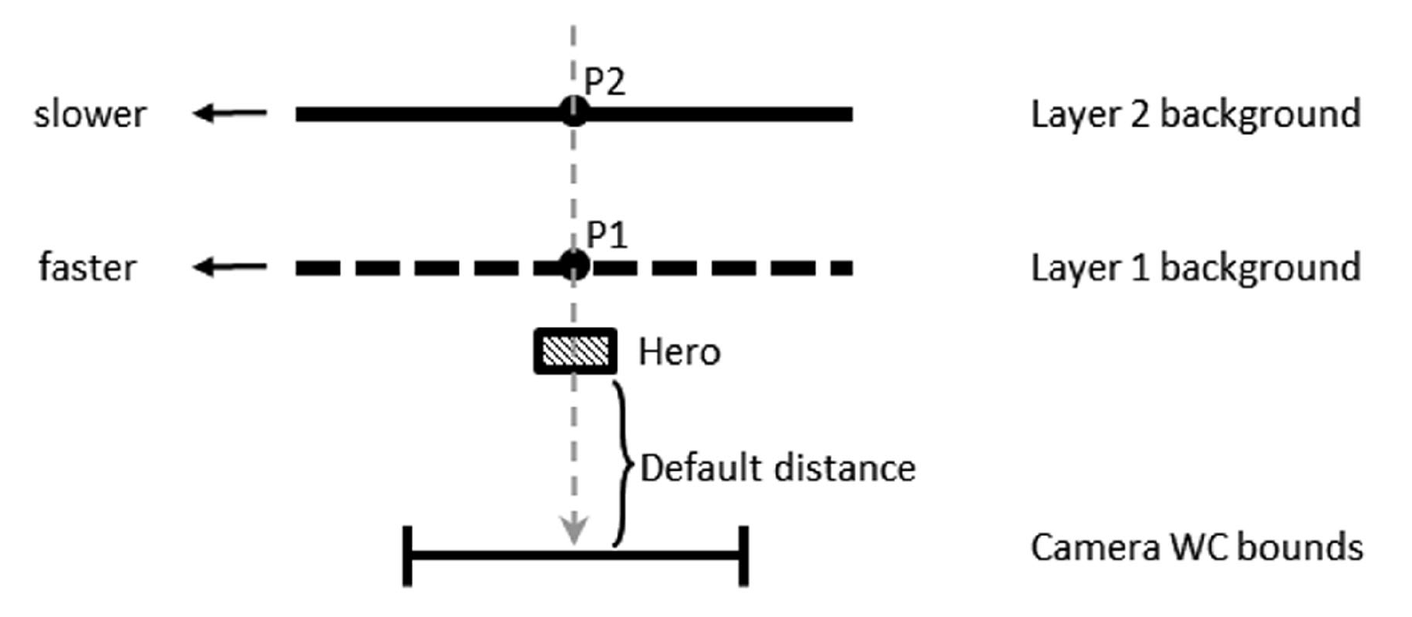
Motion Parallax with Parallax Scrolling

Slide 6
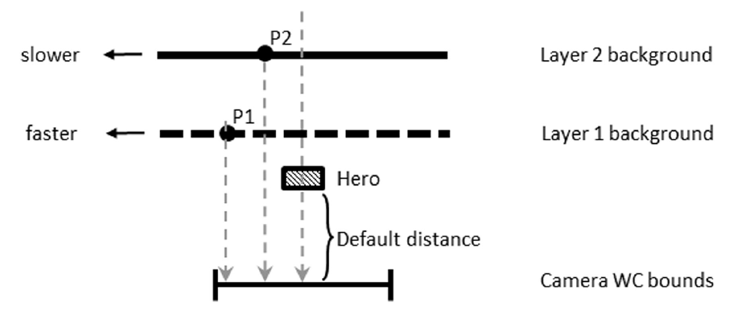
Motion Parallax with Parallax Scrolling

Slide 7
Layer Manager
HUD
Foreground or front
Actor
All objects
Shadow Receiver
Backgroun

