Slide 1
Chapter 4
Implementing Common Components of Video Games

Slide 2
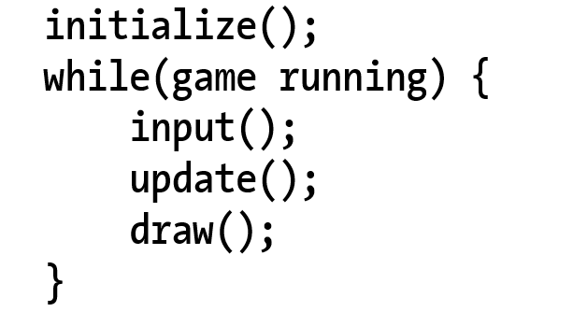
Game Loop
Typical structure
Notice: the input() update!

Slide 3
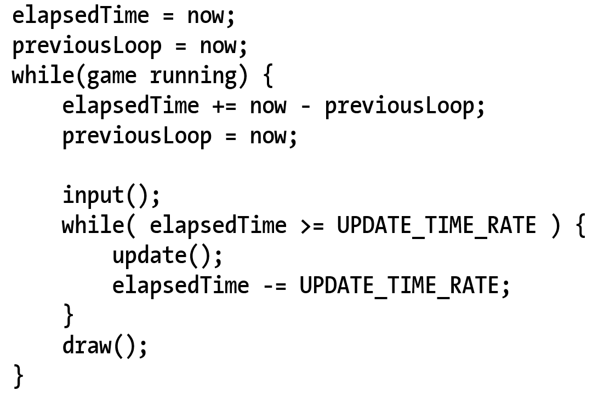
Game Loop: Implementation
Input() inside vs outside of the real-time loop?
Responsiveness when game is lagging
Fixed update rate:
Simple physics implementation (later in Chapter 9)

Slide 4
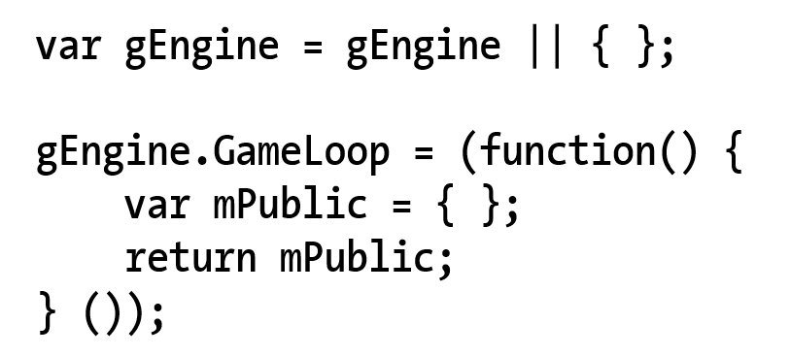
4.1: Game Loop Project
New Engine component (similarity to gEngine.VertexBuffer!!)

Slide 5
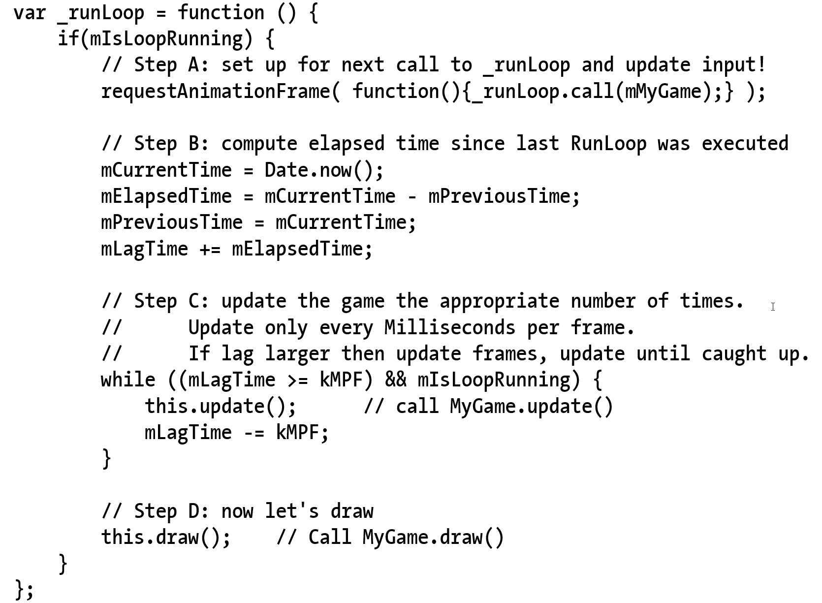
_runLoop function
requestAnimationFrame()
.call(class) ← syntax!
mIsLoopRunning not checked
Will do so later
No input() checking yet
update() and draw()
Separated!!
No update in draw
No draw in update!!

Slide 6
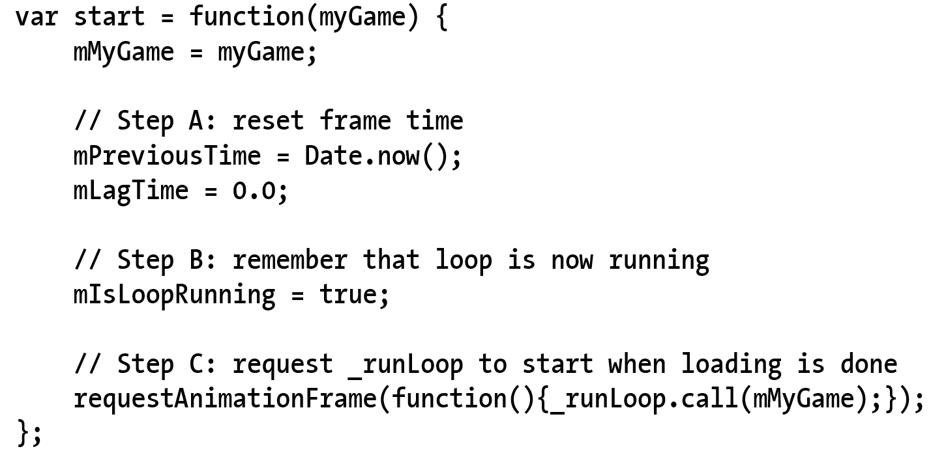
Trigger to start the loop
Note the initializations

Slide 7
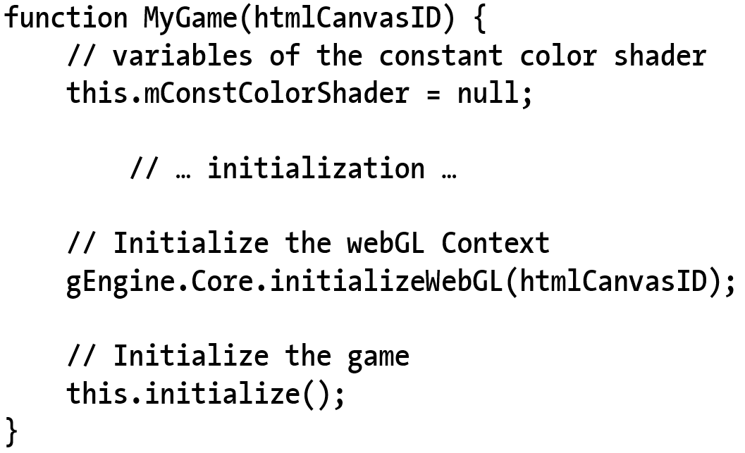
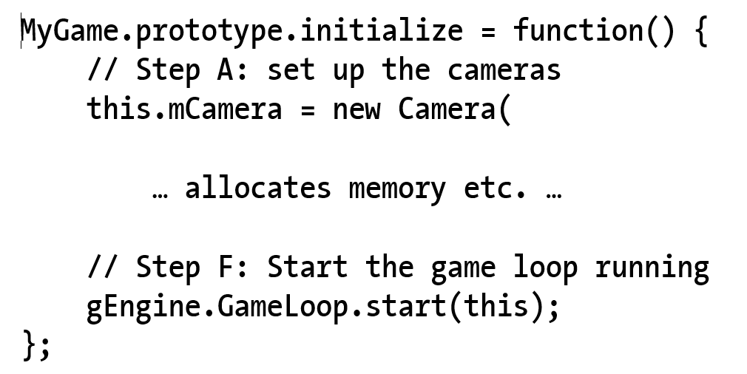
Starting the loop: MyGame.Initialize()

Slide 8
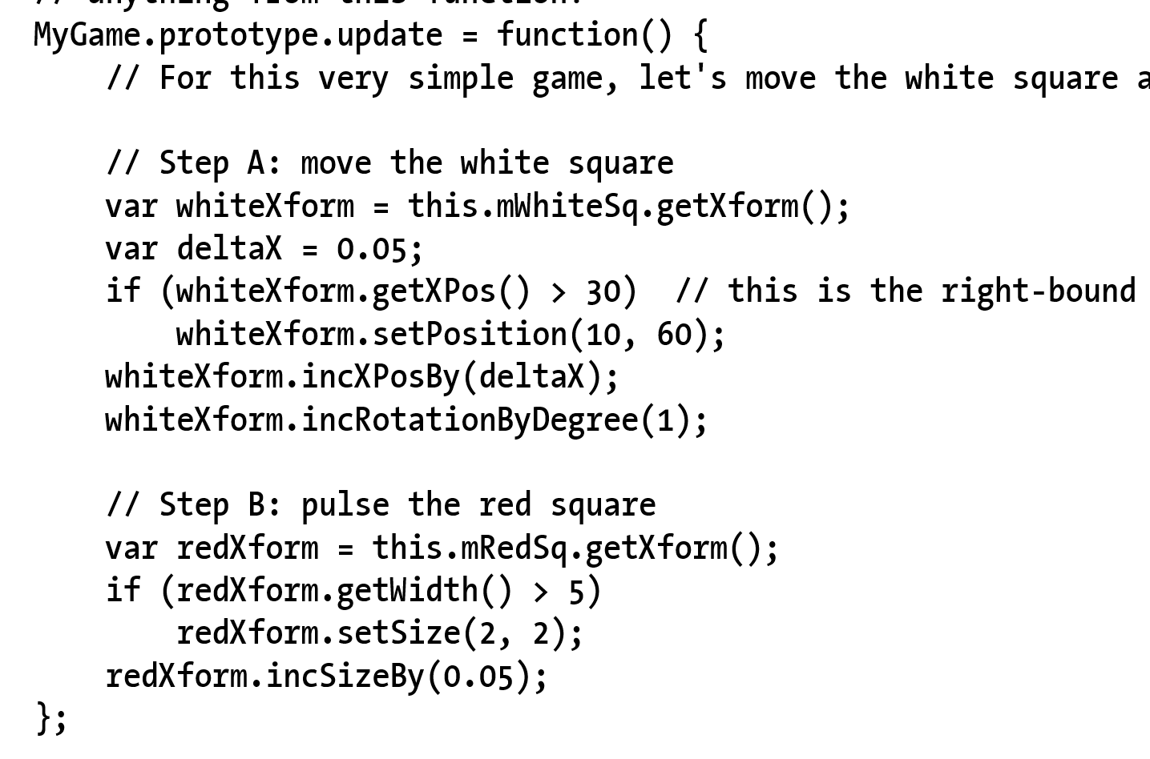
MyGame: update()

Slide 9
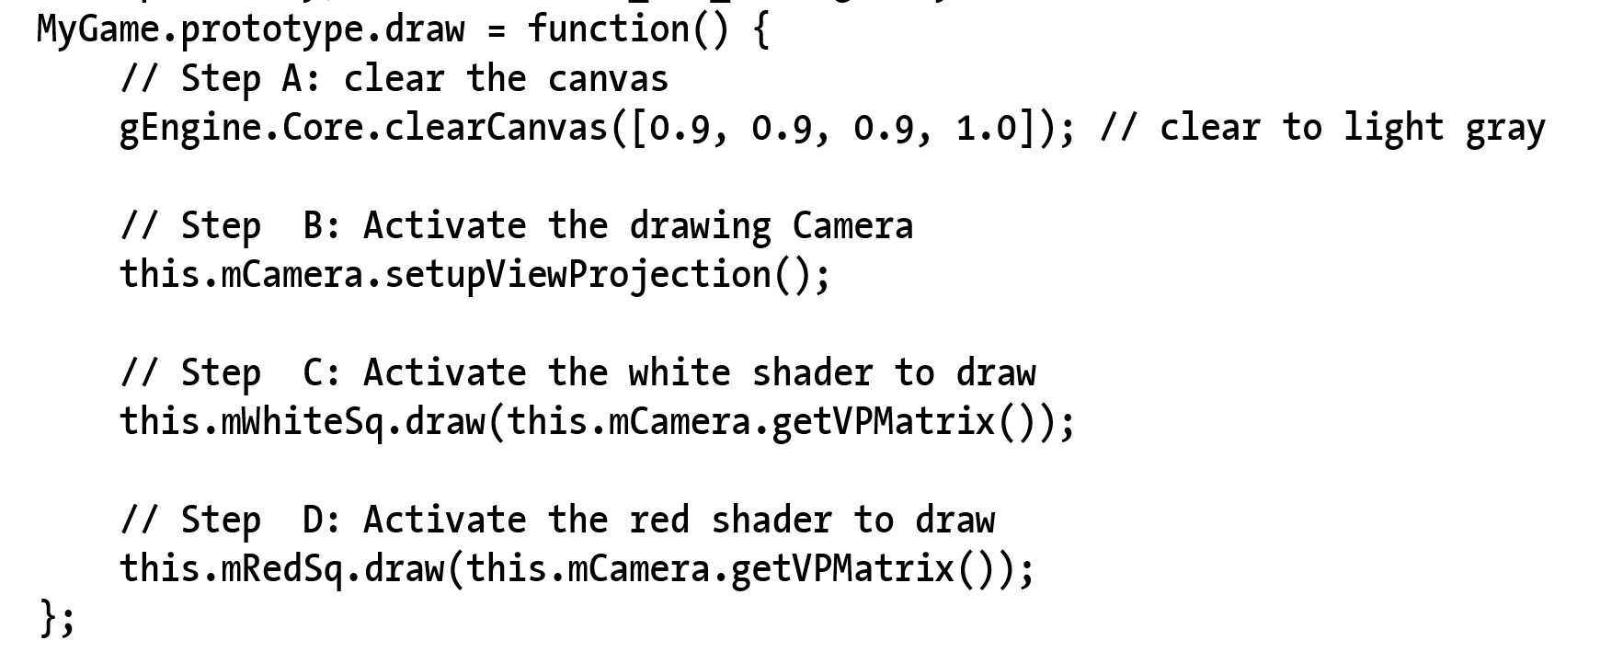
MyGame: draw()

Slide 10
4.2: Keyboard Input
Events and event handlers
HTML5 Event registration and handlers
window.addEventListener(“Event”, handler)
Keycodes:
‘A’ = xx
‘B’ = xx+1
…

Slide 11
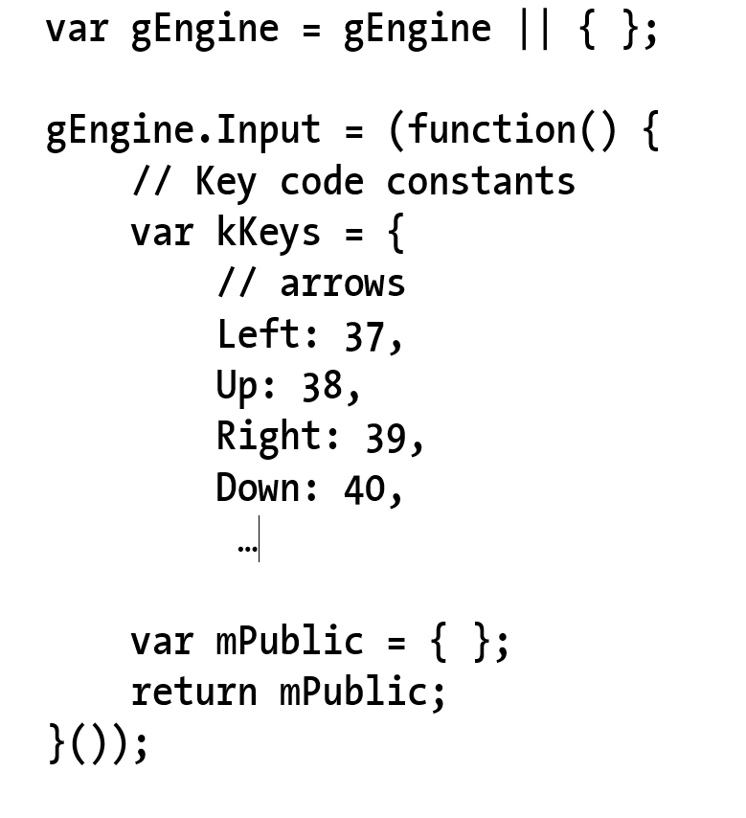
The Engine.Input component

Slide 12
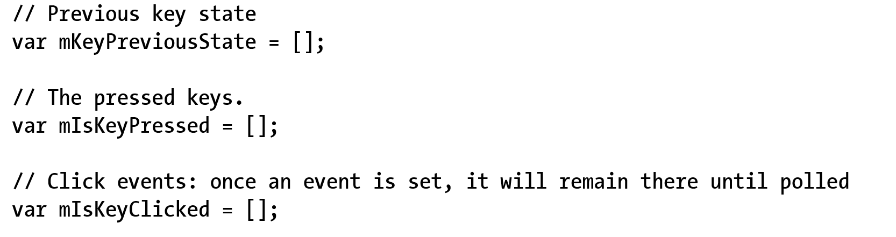
Input: variables for key states

Slide 13
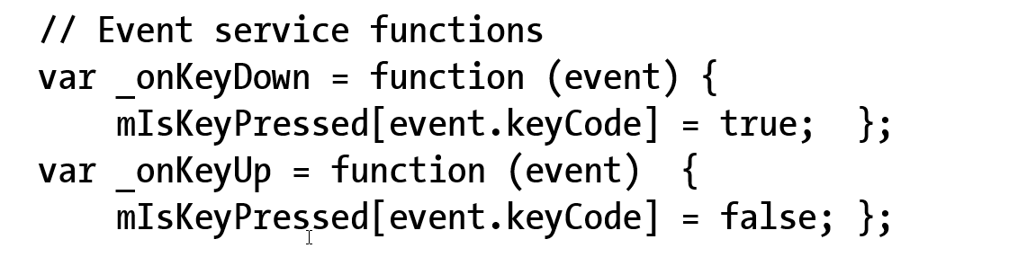
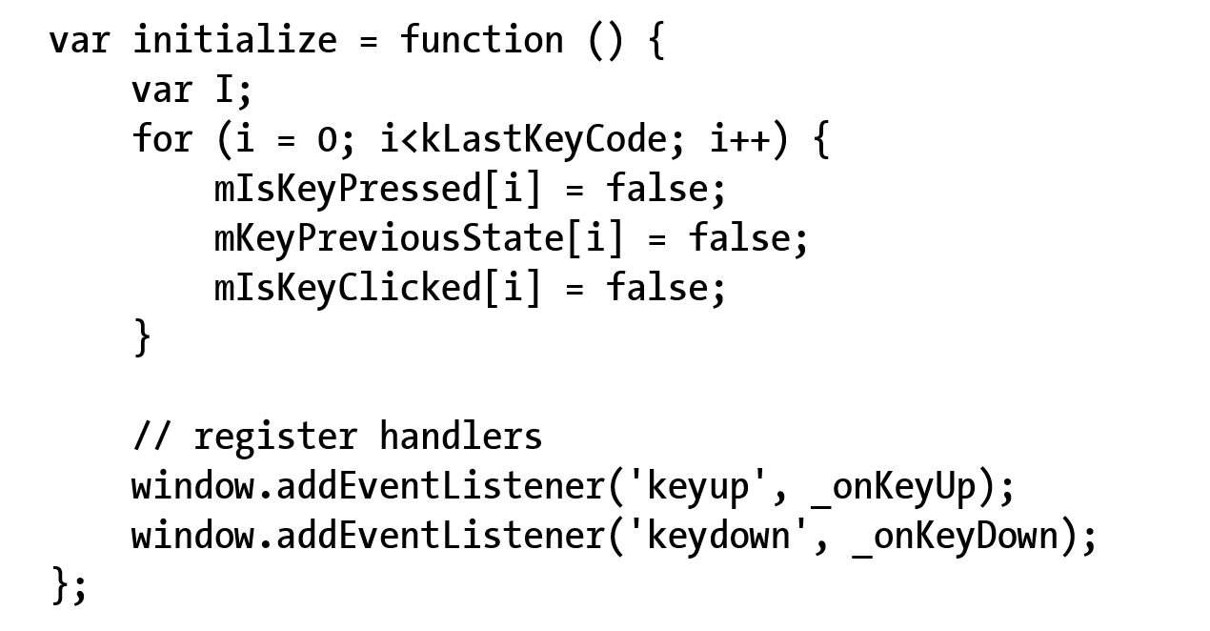
Event handlers and initialization

Slide 14
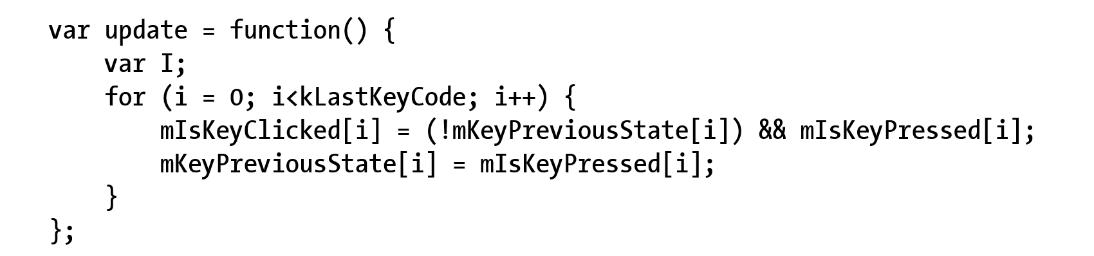
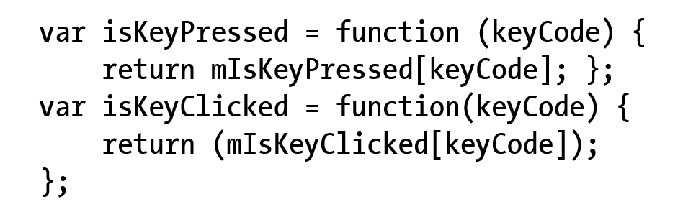
Keyboard update() and support

Slide 15
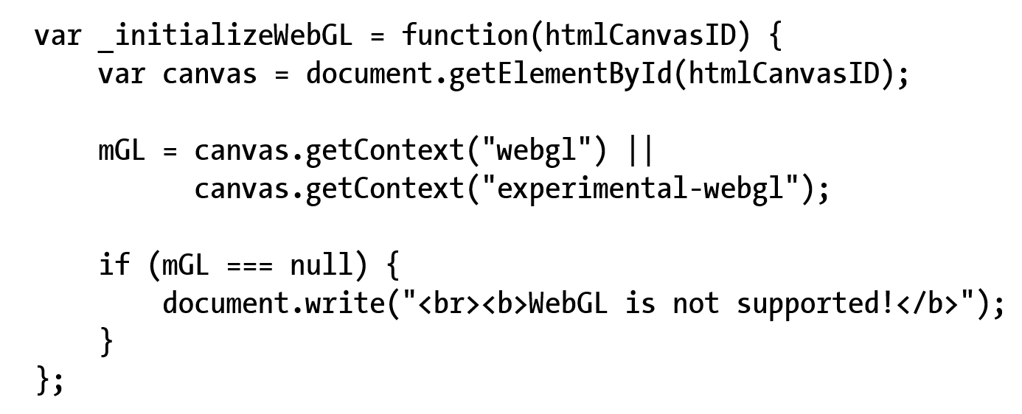
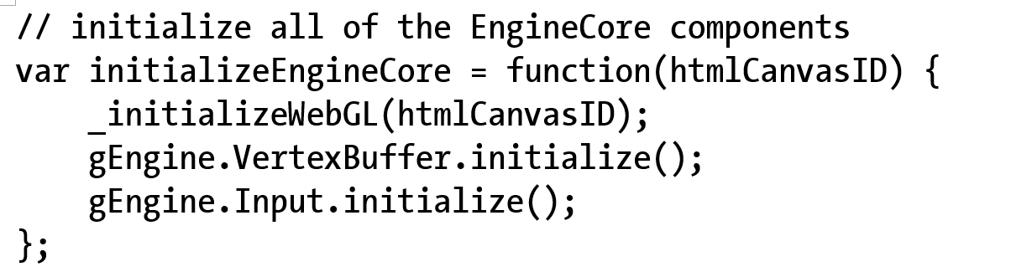
Engine.Core: to init Input

Slide 16
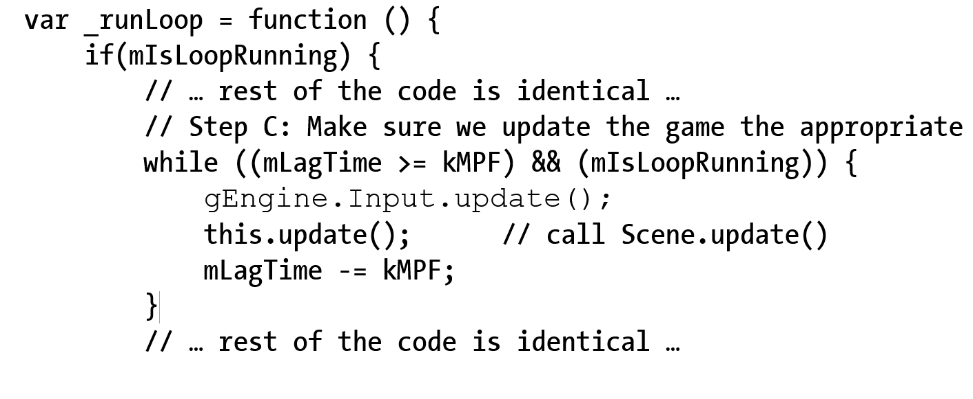
Engine.Loop: to update input

Slide 17
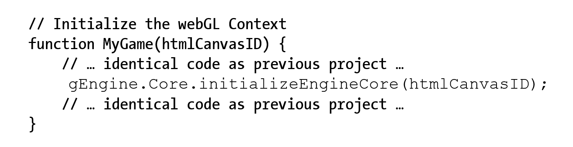
Engine initialization (from MyGame)

Slide 18
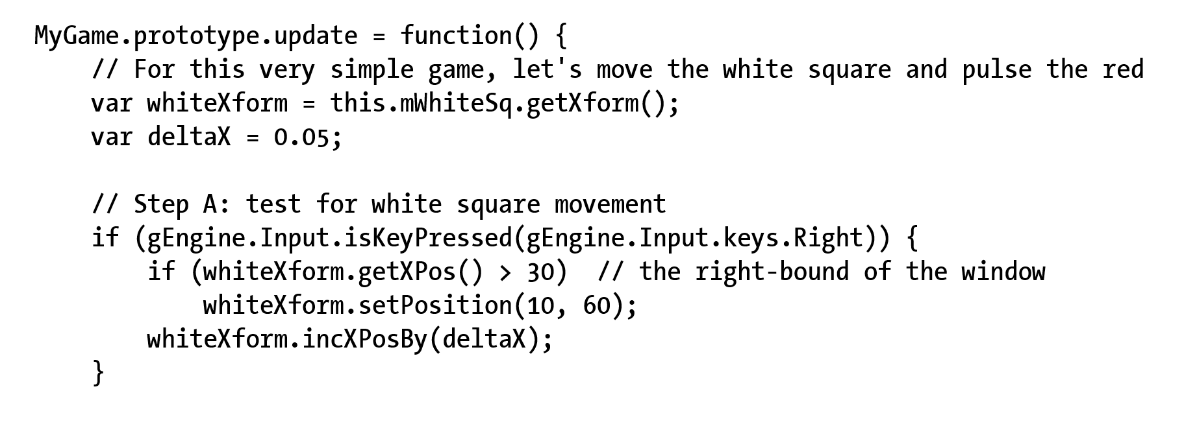
Testing Keyboard input: MyGame.update()

Slide 19
Resource Management
Synchronous load:
Issue load and wait
Stops web browser!!
May seem “hang” to user
Asynchronous load:
Issue load, provide “Callback” and continue
“Callback” is called when load is completed
Pro:
Efficient, support interactivity
Con:
Complex, requires synchronization

Slide 20
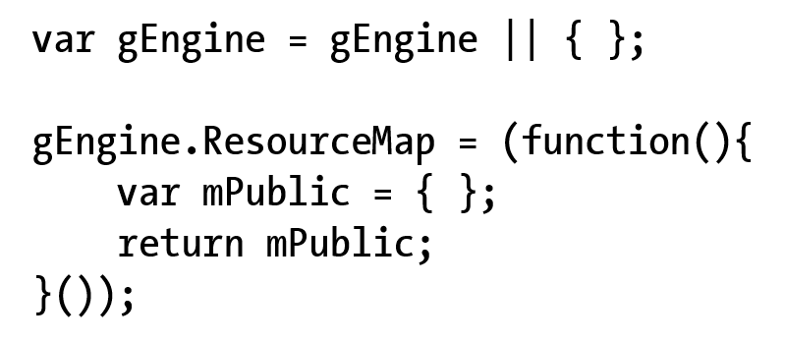
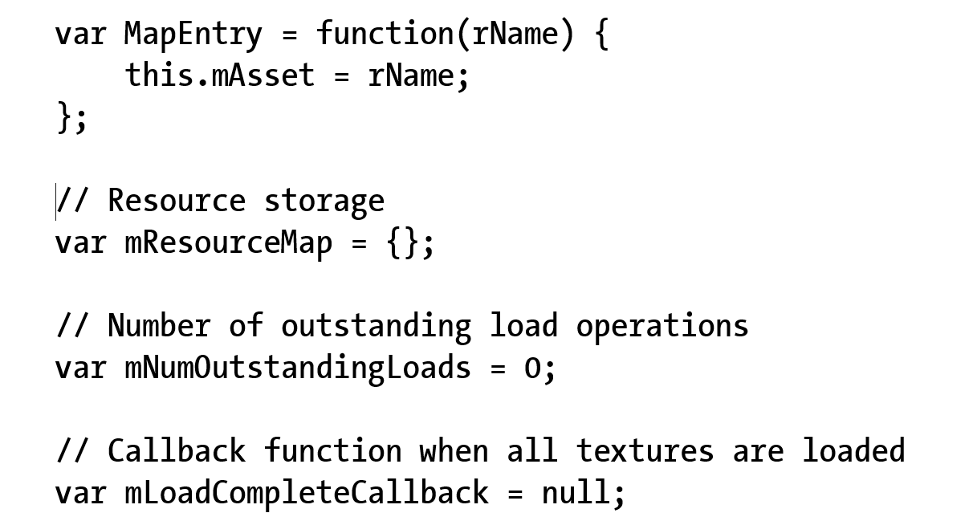
4.3: ResourceMap Project
ResourceMap:
Key-value pair of “string=id” and resource
E.g., file name and content of file

Slide 21
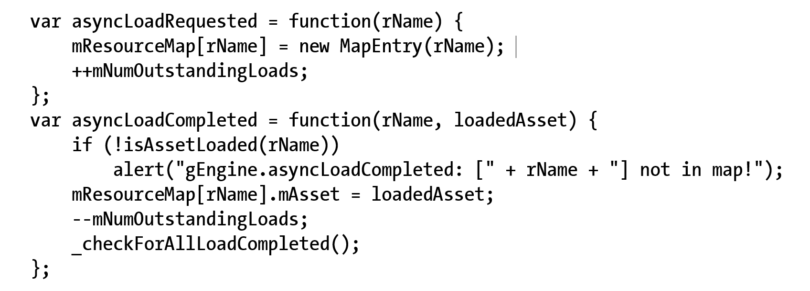
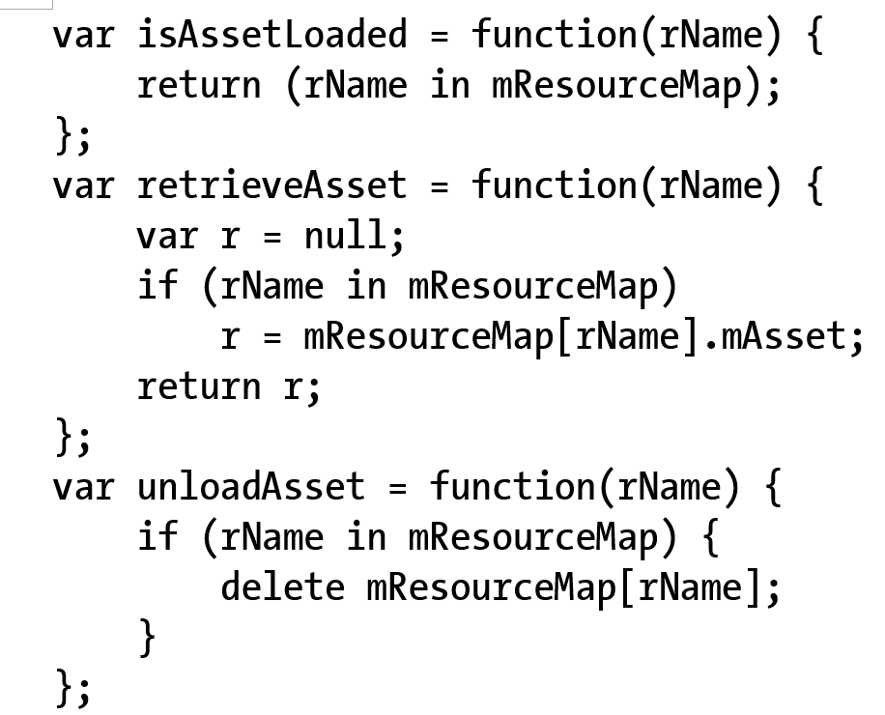
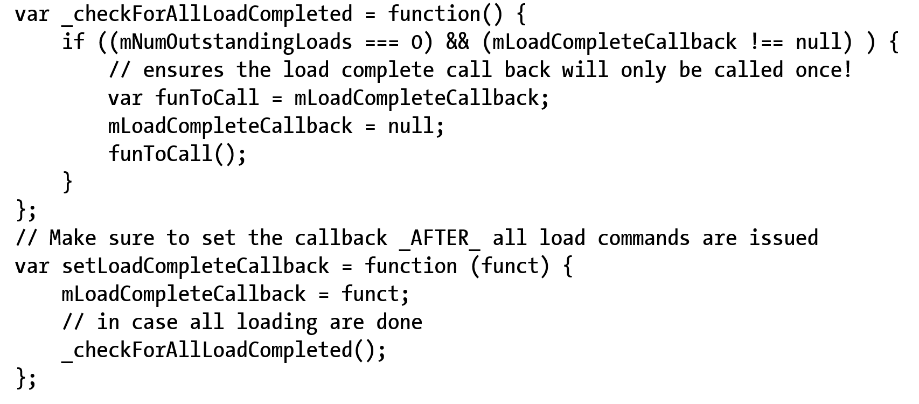
ResourceMap: functions
Load synchronization support
Create/Store-to EntryMap
Nothing else!
Asset assessing support
Check and retrieve
Misc support (e.g., call back)

Slide 22
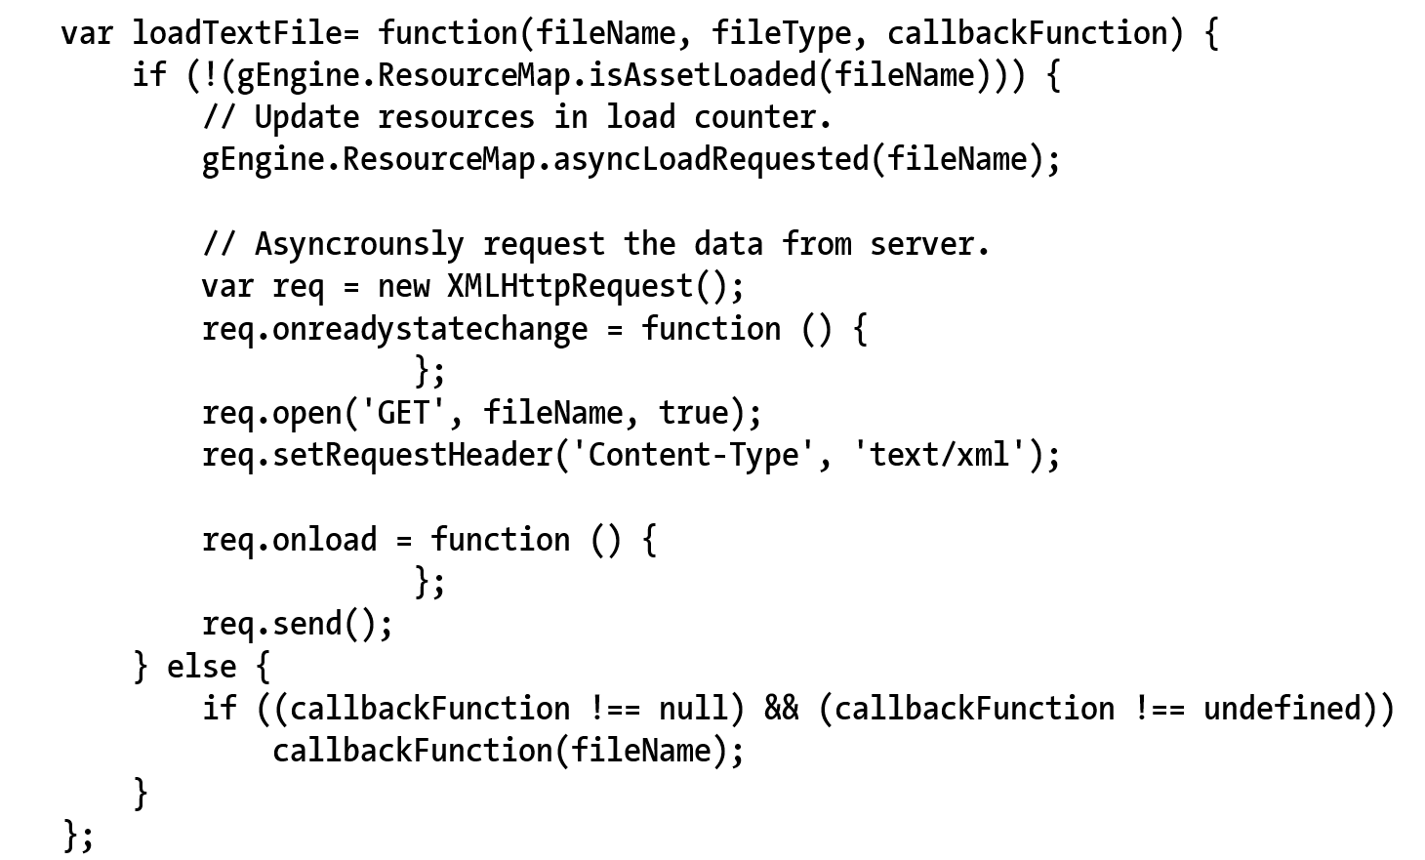
TextFileLoader: An Engine Component
Working with ResourceMap
isAssetLoaded():
Check before (re)-load!
Call to: asyncLoadRequest()
Filename (path) as ID
onreadystatechange()
Status report: next slide
onLoad()
When loaded: next slides

Slide 23
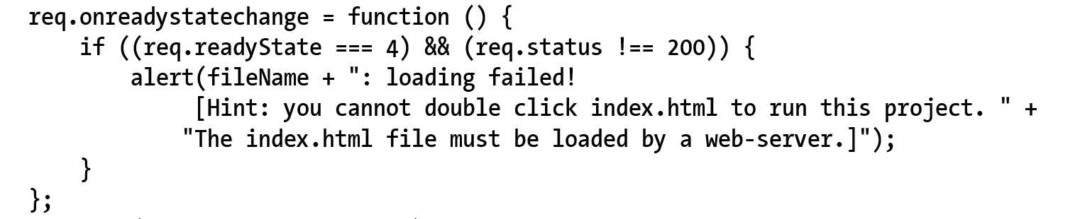
TextFileLoader: status check
Status check!

Slide 24
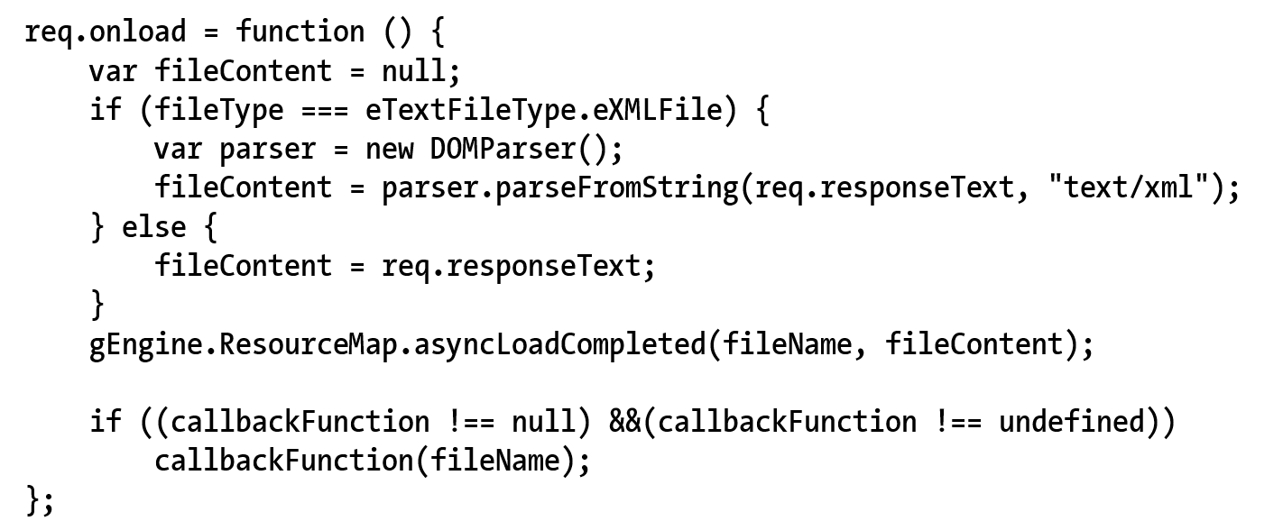
TextFileLoader: onLoad()
Successful loaded
If loading XML
Create DOMParser()
If plain textfile
Return the entire text source
Work with ResourceMap
asyncLoadCompleted()

Slide 25
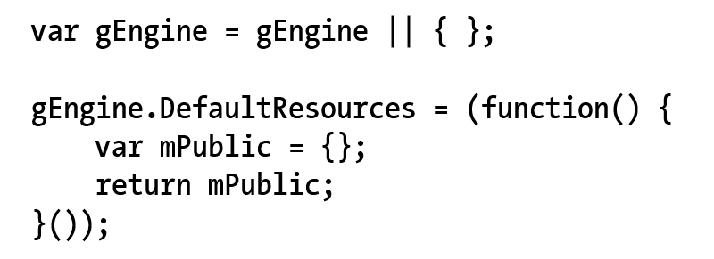
Engine DefaultResoruces
Notice SimpleShader is shared by all Renderables!!
There will be many other examples
Define DefaultResources engine component

Slide 26
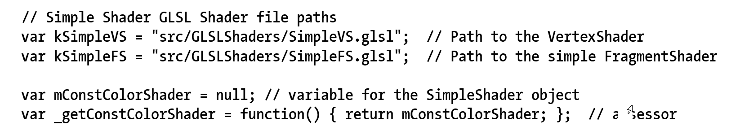
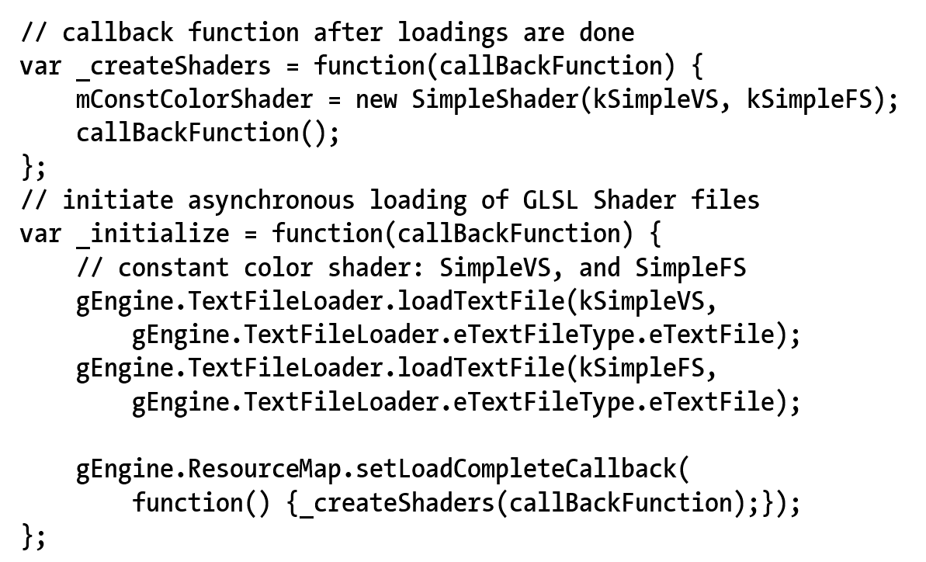
Default SimpleShader engine resource

Slide 27
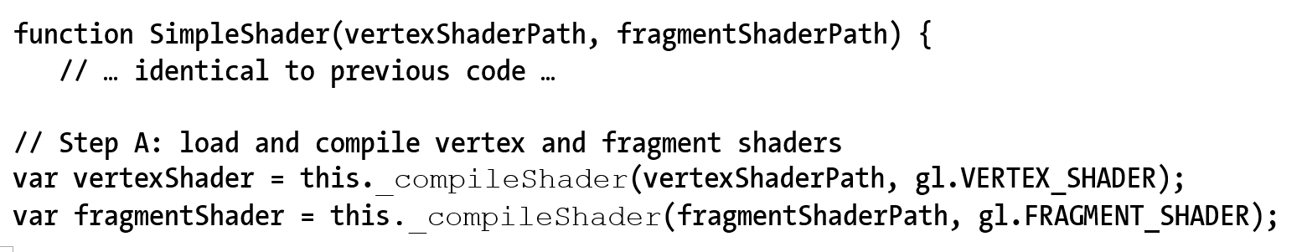
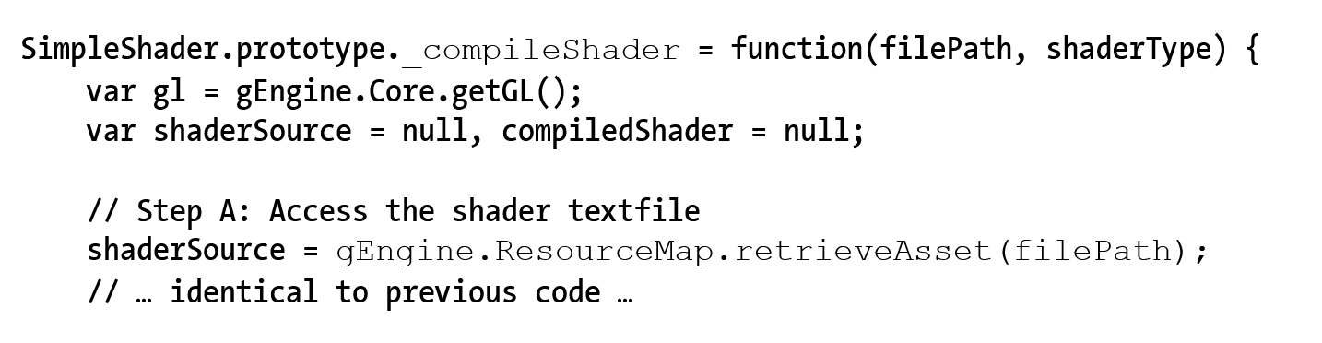
SimpleShader: user default resource

Slide 28
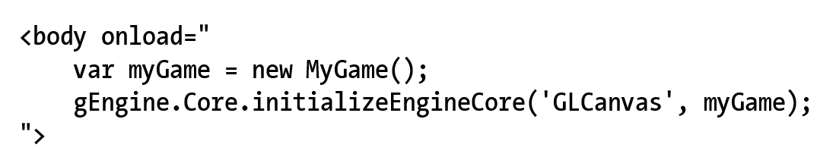
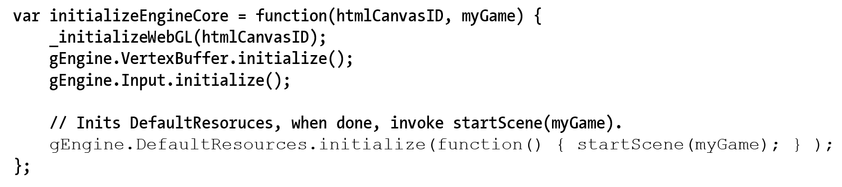
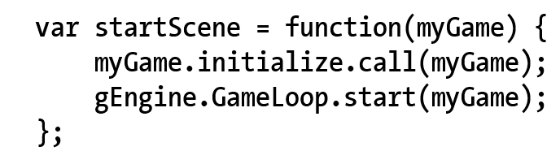
Engine: starting sequence
Index.html
Engine_Core.js

Slide 29
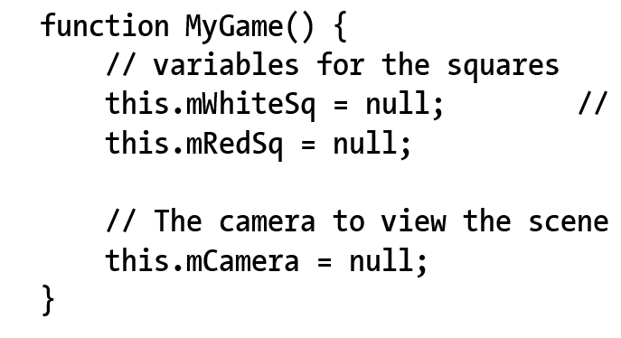
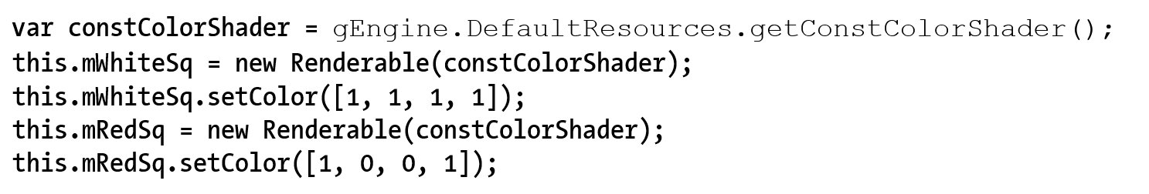
Testing async loading: MyGame
No need to worry about initialization Game Engine Core (good!)
MyGame Constructor simple again!
Access shader from default resource

Slide 30
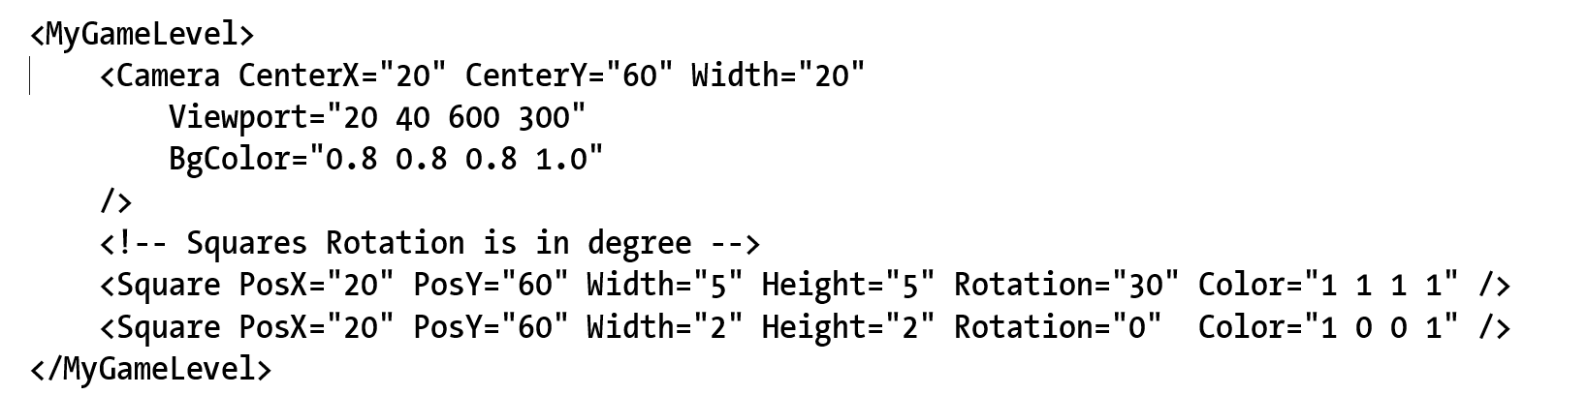
4.4: Scene File
The “assets” folder
A convention for ourselves (NOT defined by anything!!)
XML format and parsing (not cover here)

Slide 31
MyGame class
Constructor: declaring var and defining constants
Game specific resources (assets) MAY NOT be there!!
Initialize(): allocate and instantiate, setting up states
Game specific resources are loaded!!
update()/draw(): Seen this before … again:
update(): DO NOT try to draw anything
draw(): DO NOT make any changes to game state!
loadScene()/unloadScene(): loading/unloading of scene specific information!!

Slide 32
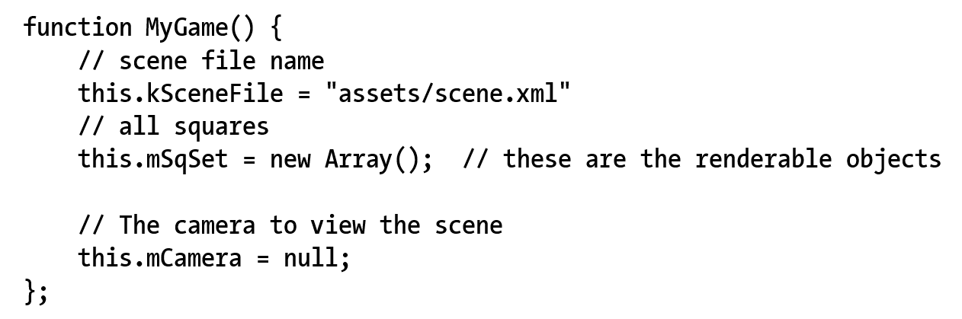
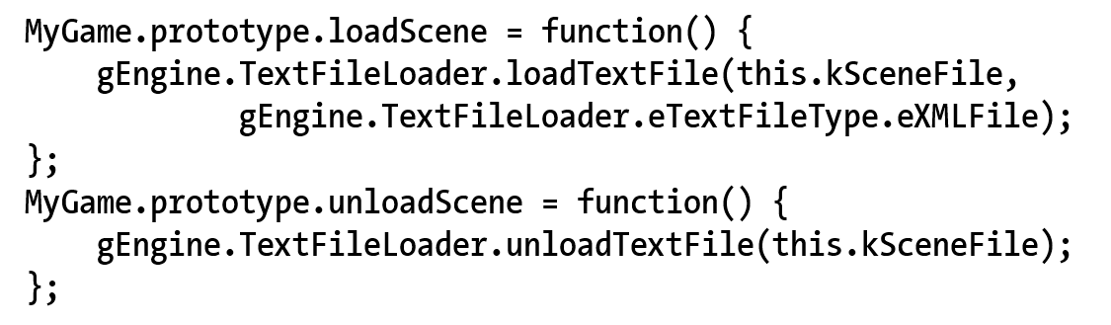
MyGame: construct and load!

Slide 33
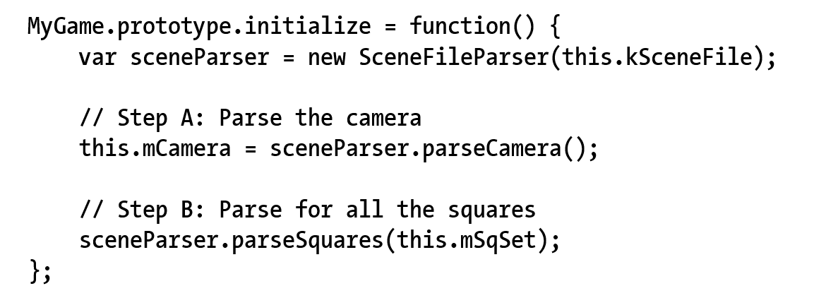
MyGame:initialize()
Game specific resources are now loaded!!

Slide 34
Engine: starting sequence with new MyGame
Index.html
Engine_Core.js

Slide 35
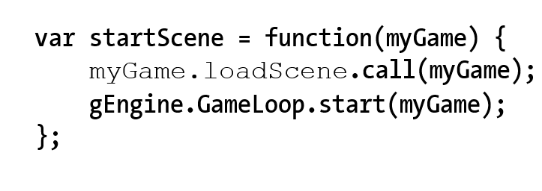
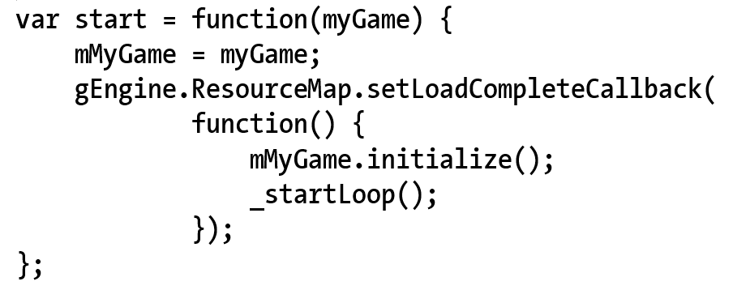
Engine Core: startScene()
Engine_Core.js
Engine_Loop.js

Slide 36
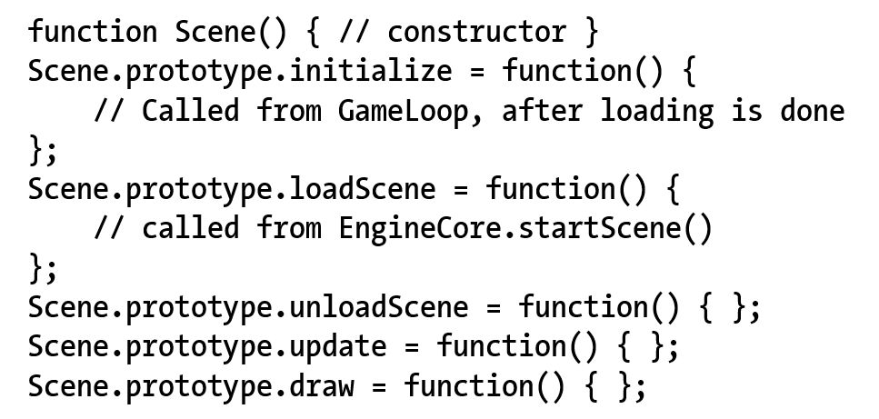
4.5: Scene Objects
Define GameEngine (Core and Loop) interface protocol with game developer (our API user)
Abstract class for subclass by clients

Slide 37
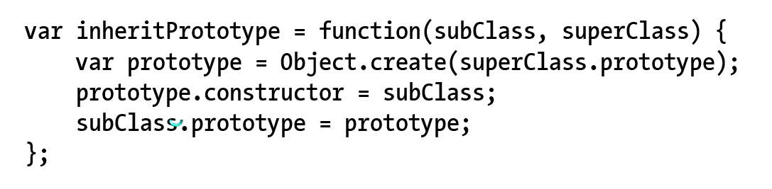
Support for “sub-classing”
Engine_Core.js

Slide 38
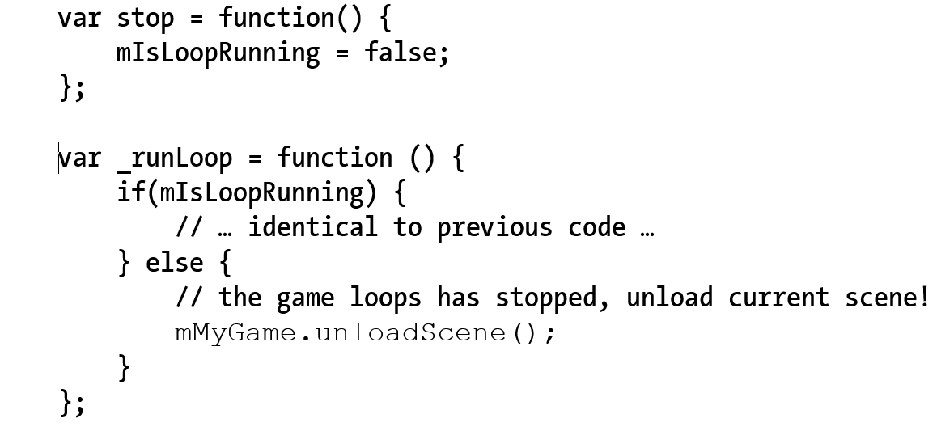
Game Loop: stop to unload resources
Engine_Loop.js

Slide 39
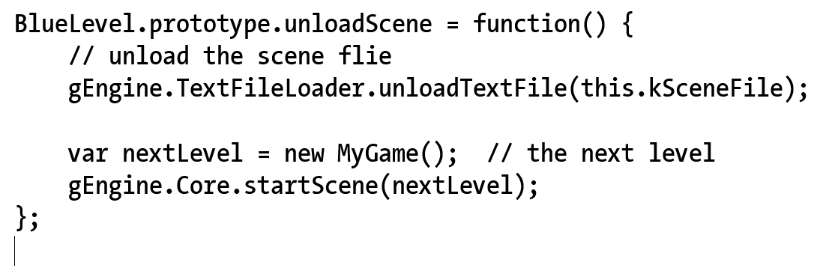
Loading the next Scene …

Slide 40
4.6: Audio support
Audio: files
Just another example of external resource!
Support for mp3 and wav formats
HTML5: AudioContext
Load/Decode audio resources
Play audio resources!!
Two important categories
Audio as music: e.g., background
Continuous playing, need control
Audio as cue:
Short, no need for control

Slide 41
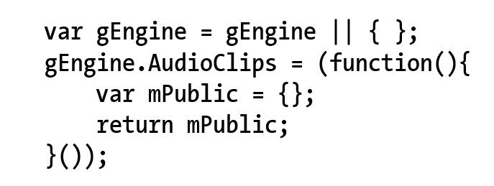
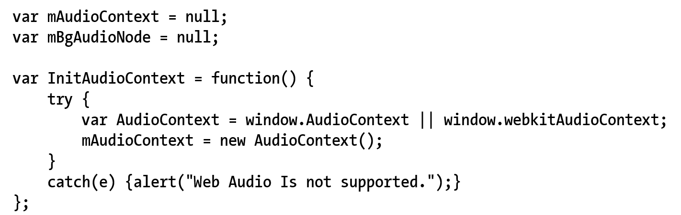
Engine_AudioClip: Component

Slide 42

Loading of AudioClips
Exact same structure as TextFile loader
Work with ResourceMap
isAssetLoaded()
asyncLoadRequested()
NEW: incAssetRefCount()
In case loaded multiple times!!
req.onLoad() … next slide

Slide 43

req.onLoad(): once loaded …
Store the entire file content to ResourceMap
asyncLoadCompleted()!

Slide 44

Audio as Cue
Each Cue must be a separate file!
Start and no more control!

Slide 45


Background music support
Keep reference for future control

