Slide 1
Chapter 6
Examples 4, 5, and 6 Defining Behaviors and Detecting Collisions

Slide 2
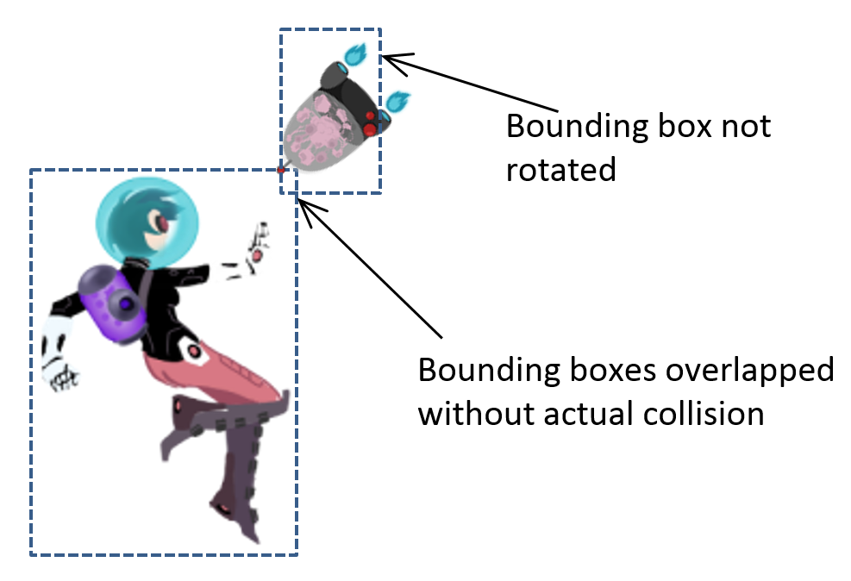
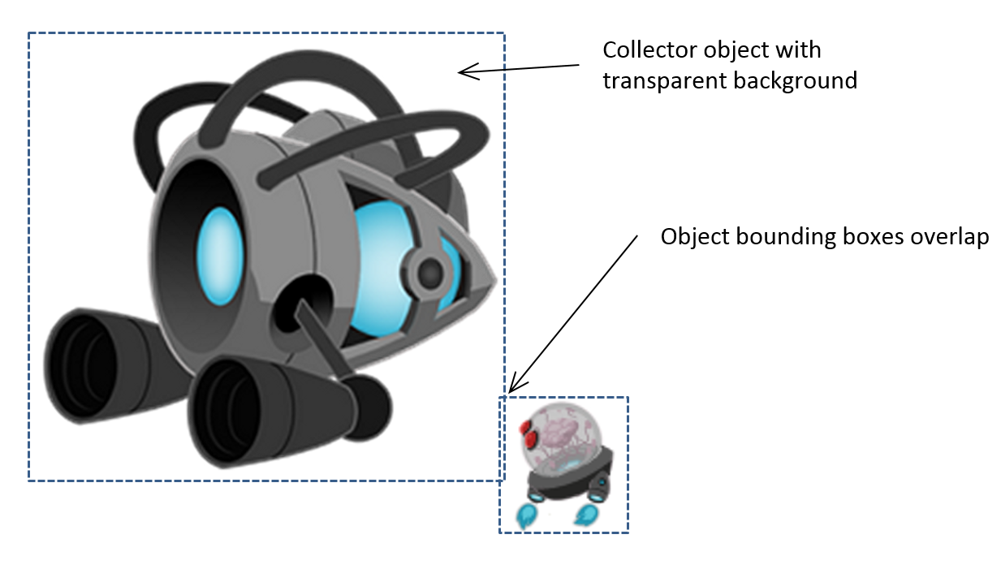
Problem with Bbox
We have seen: does not support rotation (at all!)
Even in the absence of rotation
Does not approximate collision well
Too much void space!
Collision: pixel overlaps!

Slide 3
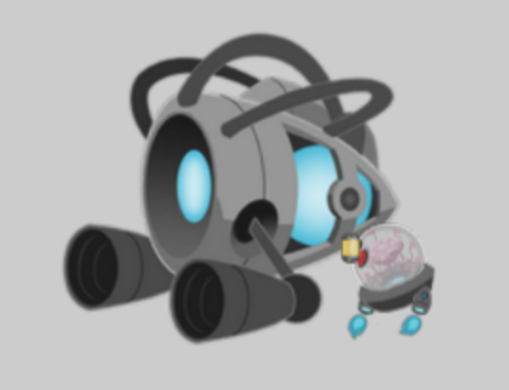
6.4: Per Pixel Collisions Project

Slide 4
6.4: Goals
Derive per-pixel collision detection algorithm
Implement the algorithm
Understand the limitations and run-time complexity

Slide 5
Per-pixel accurate collision detection
Detect one of the non-transparent pixel overlaps
Good at answer: yes or no
BAD at answering: where
Does not answer: “first collision point”
Runtime:
VERY sensitive to image resolution (as expected)
VERY sensitive to which image collide with which!? ←

Slide 6
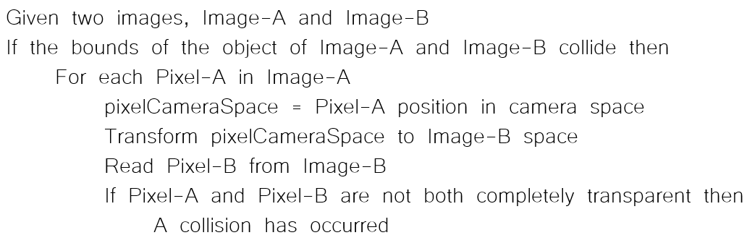
Colliding pixels of two images
Each of images, A and B are in WC space
Algorithm:

Slide 7


Algorithm: explained
Image-A, 6x5pixels
WC Size: 60x50
Lower-Left corner at WC (5,5)
Image-B, 3x4 pixels
WC size: 30x40
Lower-Left corner at WC (45, -15)

Slide 8
In WC:
Width = 60
Height = 50
WC Space: (5,5)
WC origin: (0, 0)
Height = 40
WC Space: (45, -15)
Width = 30

Slide 9
In WC:
Width = 60
WC Space: (65,55)
WC Space: (10,30)
WC Space: (75,25)
Height = 50
WC Space: (5,5)
WC Space: (15,5)
Height = 40
WC Space: (45, -15)
Width = 30

Slide 10
WC Space: (65,55)
Image-A Pixel: (0,2)
WC: (10, 30)
Image-A Pixel: (5,1)
WC: (60, 20)
Image-B Pixel: (1, 3)
WC: (60, 20)
WC Space: (5,5)
Image-B Pixel: (2, 0)
WC: (70, -10)
WC Space: (45, -15)

Slide 11
WC Space: (65,55)
Image-A Pixel: (5,1)
WC: (60, 20)
Image-A space: pixel (5,1)
WC space: (60, 20)
Image-B space: pixel (1, 3)
Per-pixel collision Algorithm test
Image-A pixel (5,1) against
Image-B pixel (1,3)
Image-B Pixel: (1, 3)
WC: (60, 20)

Slide 12
The algorithm again
Image-A space: pixel (5,1)
WC space: (60, 20)
Image-B space: pixel (1, 3)
Per-pixel collision Algorithm test
Image-A pixel (5,1) against
Image-B pixel (1,3)

Slide 13
Per-pixel accurate collision: run time?
Runtime:
Worst case: O(W x H)
WxH is the resolution of Image A
Choose Image-A wisely!!
Collision between a small projectile (16x32) and the hero (128x64)!
Memory complexity?
CPU need to have access to color!
For both images!
O(W x H): of the larger image!
Expensive memory!

Slide 14
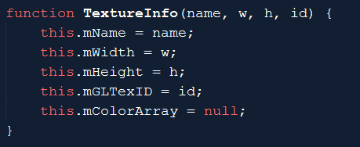
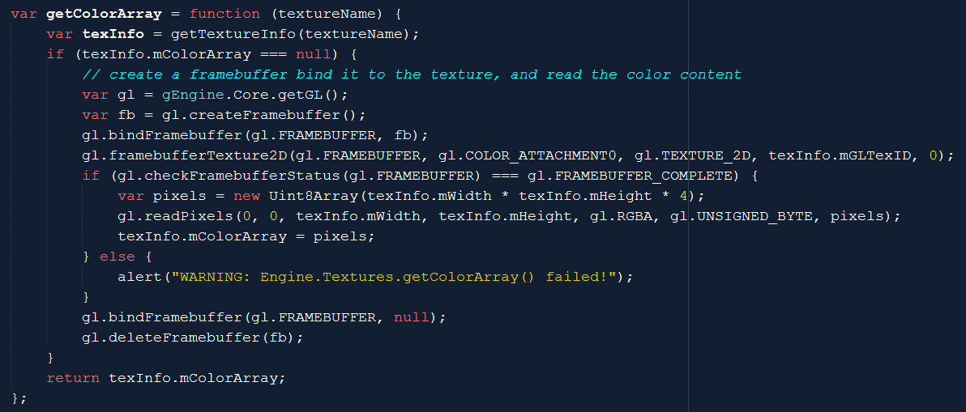
Store color in CPU:
Engine_Texture.js

Slide 15
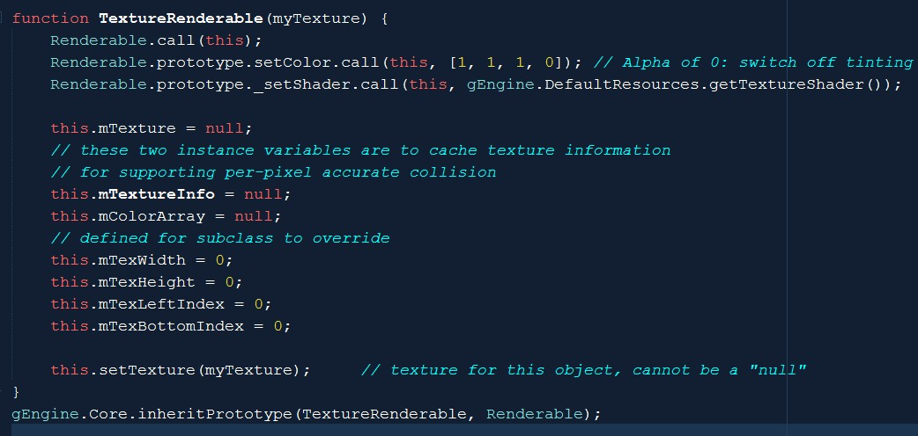
TextureRenderable: caching info

Slide 16
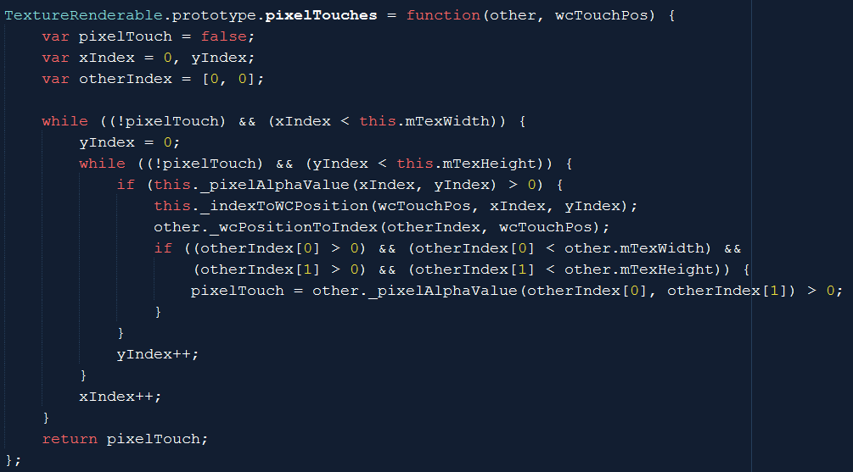
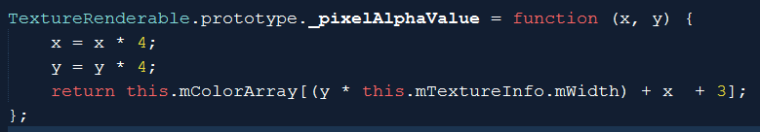
TextureRenderable_PixelCollision.js
First detected position: no other meaning!
First detected position: no other meaning!

Slide 17
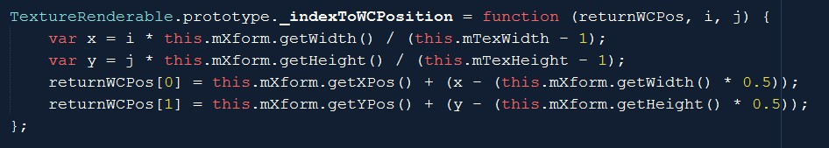
Index (Image Space) to WC
Image: Resolution: TexWidth x TexHeight
WC size: Xform.getWidth() x Xform.getHeight()
Pixel width in WC = TexWith / Xform.getWidth()
WC location for pixel (i, j):
LowerLeft.x + i * Pixel-Width-in-WC
LowerLeft.x = Xform.getXPos() – (Xform.getWidth() * 0.5)

Slide 18
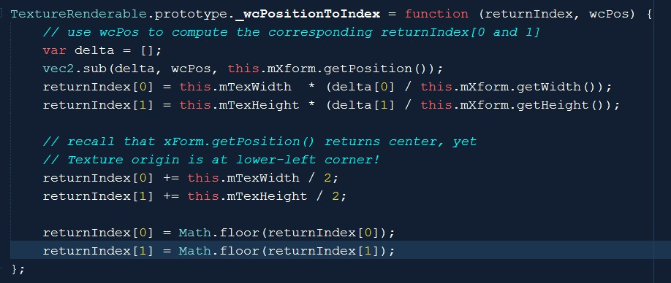
WC position to Image pixel
normalizeSize: delta / WC-Size
Pixel-x = Image resolution * normalizeSize
wcPos
delta
Xform.getPosition()
(center of obj)

Slide 19
Remember, the algorithm

Slide 20
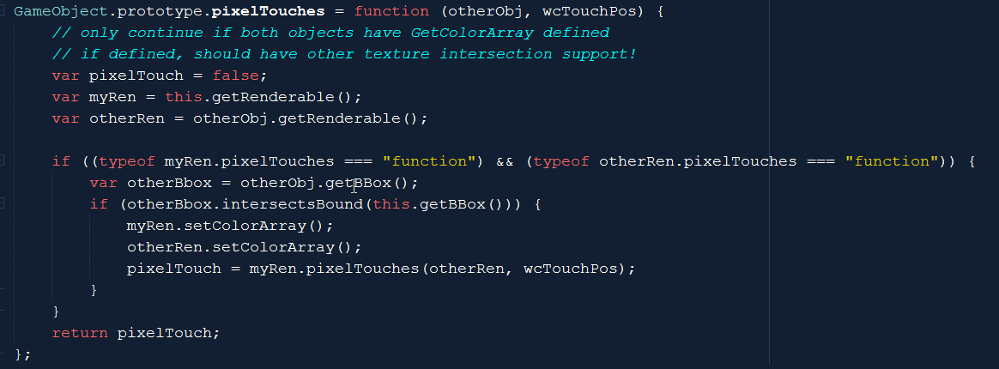
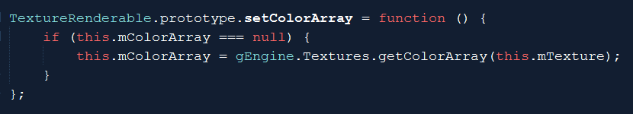
GameObject_PixelCollision.js
TextureRenderable_PixelCollision.js

Slide 21
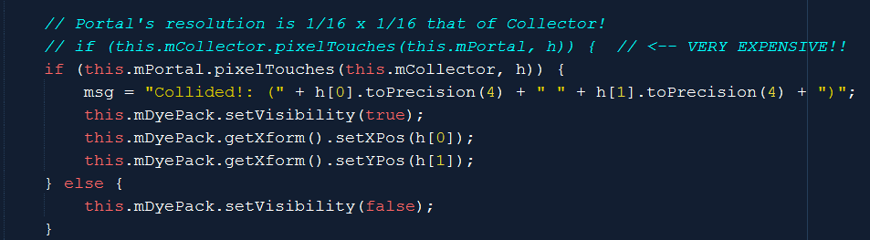
Testing: per-pixel
Choice of the Image-A
Try changing “image-A”
MyGame.js update()

Slide 22
Per-Pixel Collision
Accurate Yes/No result
Cannot tell where (not well at least)
Computation cost:
O(Smaller image resolution)
Memory cost
O(Larger image resolution)
Can be costly!
Problem:
Does not support rotated image!

Slide 23
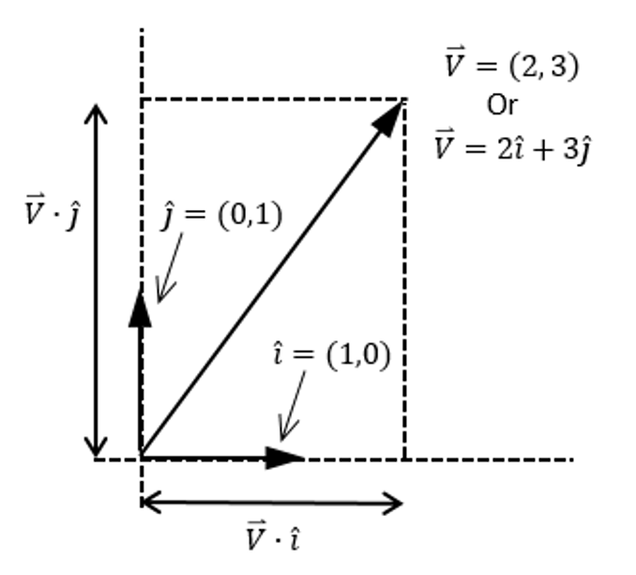

Vector Review: component & decomposition
Vector: $\overset{⃑}{V}$
Perpendicular component vectors:
$\hat{i}$ and $\hat{j}$
Decompose $\overset{⃑}{V}$ for components of $\hat{i}$ and $\hat{j}$
Component of $\hat{i}=\left(\overset{⃑}{V}∙\hat{i}\right)$
Component of $\hat{j}=\left(\overset{⃑}{V}∙\hat{j}\right)$
Always true:
$\overset{⃑}{V}=\left(\overset{⃑}{V}∙\hat{i}\right)\hat{i}+\left(\overset{⃑}{V}∙\hat{j}\right)\hat{j}$

Slide 24
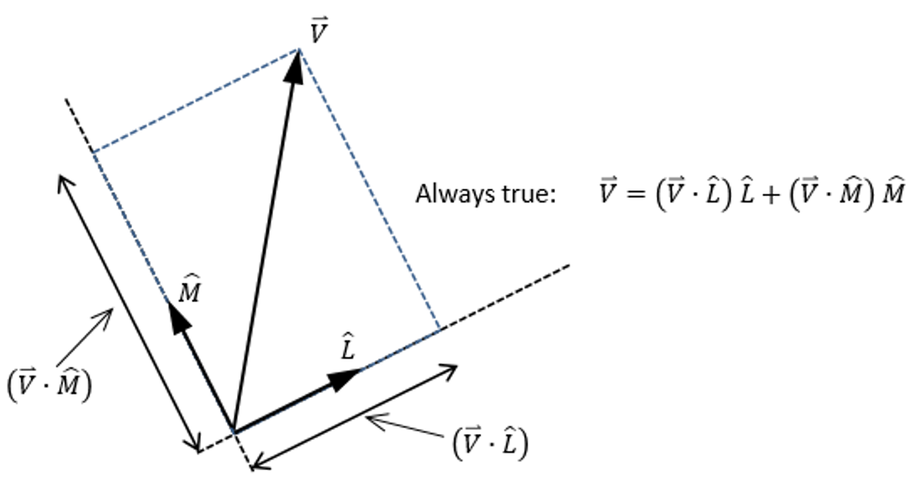
With rotated component vectors …

Slide 25
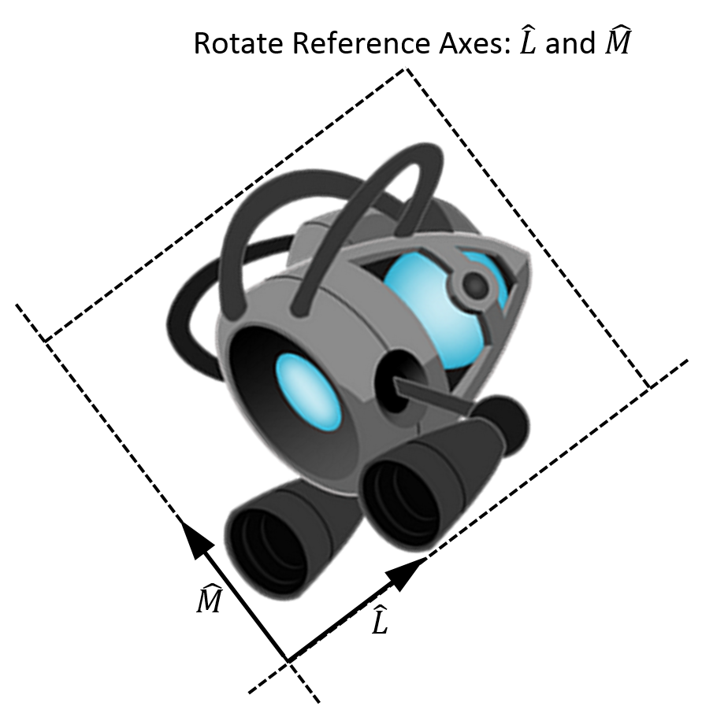
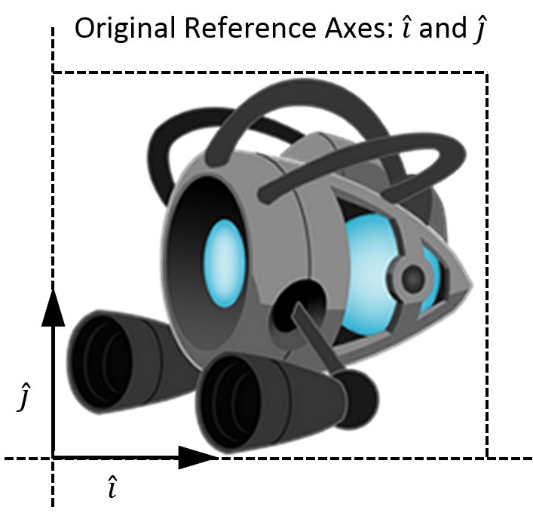
In our case:

Slide 26
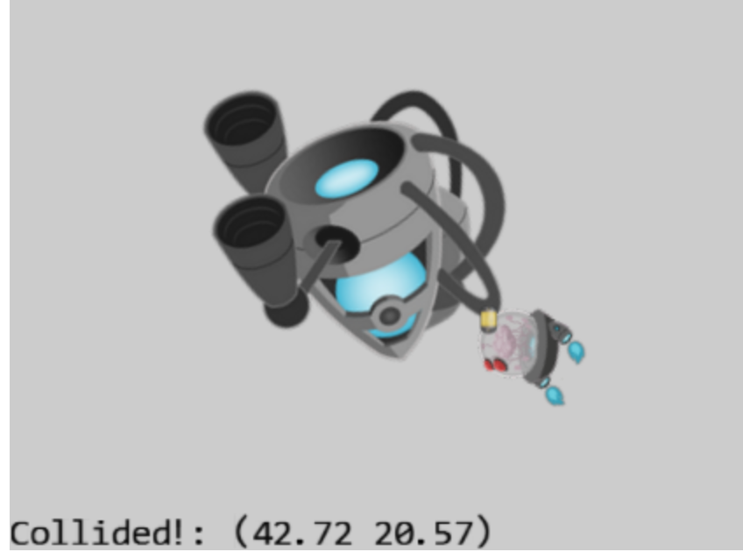
6.5: General Pixel Collisions Project

Slide 27
6.5: Goals
Apply vector component and decomposition concepts to access pixels in rotated image
Derive and solve per-pixel collisions for rotated textured objects

Slide 28
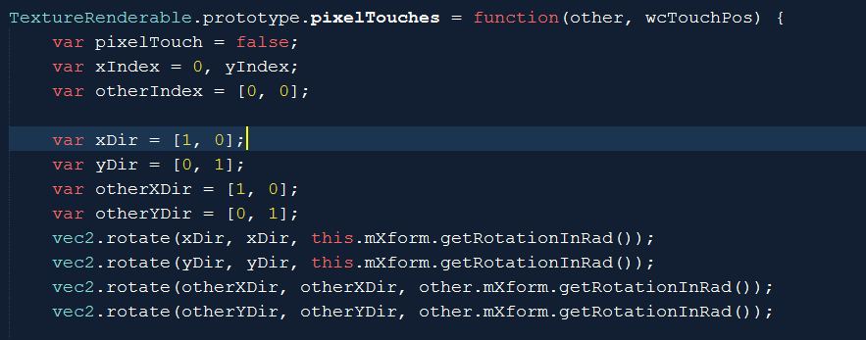

The new pixelTouches function
Compute the rotated components: $\hat{L}$ and $\hat{M}$
By rotating the default X and Y component vectors: $\hat{i}$ and $\hat{j}$

Slide 29
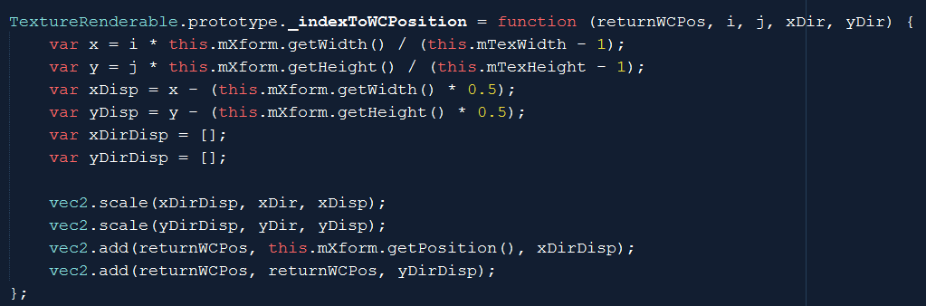

Index (image space) to WC
(i, j)
xDir, yDir: $\hat{L}$ and $\hat{M}$
yDir
xDir
x y : (i,j) * pixel size in WC
xDisp/yDisp: distance to the center of object
Offset from center of object along xDir/yDir

Slide 30
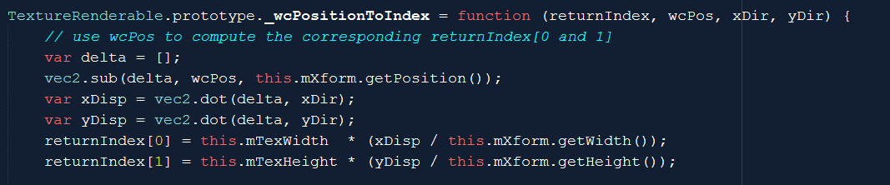
WC to image space (index):
wcPos
Old way: decompose assuming x/y components
yDir
xDir
New way: decompose explicitly with dot products
No change!

Slide 31
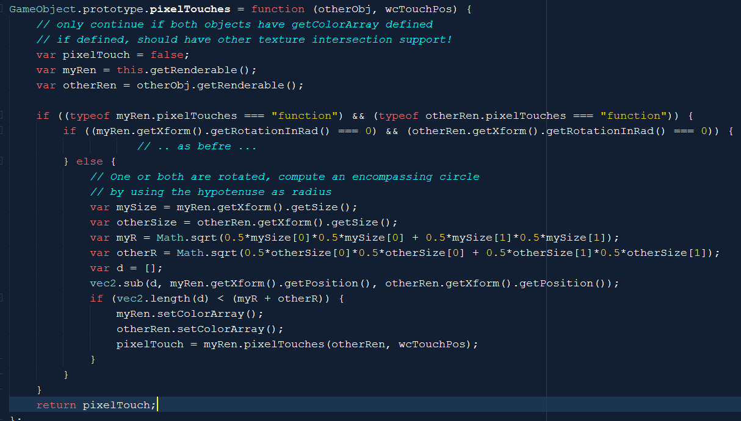

GameObject: Bbox test!
myR
myR
mySize[0] [1]

Slide 32
Where are we?
Per-pixel accurate collision algorithm implemented
Reviewed vector component and decomposition concept
Support rotated textures for per-pixel accurate collision
Last refinement: Support for Sprite Elements

Slide 33
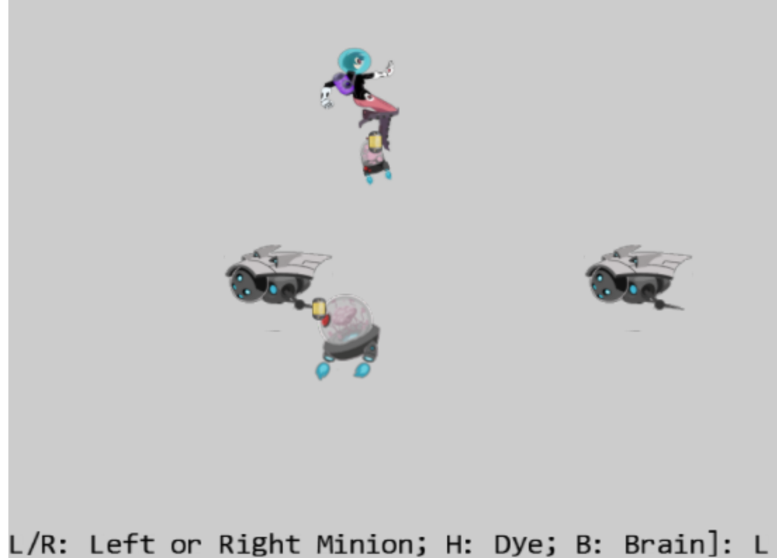
6.6: Sprite Pixel Collisions Project
Goal: generalize per-pixel for sprite elements

Slide 34
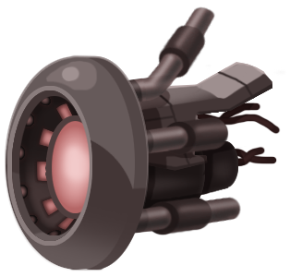
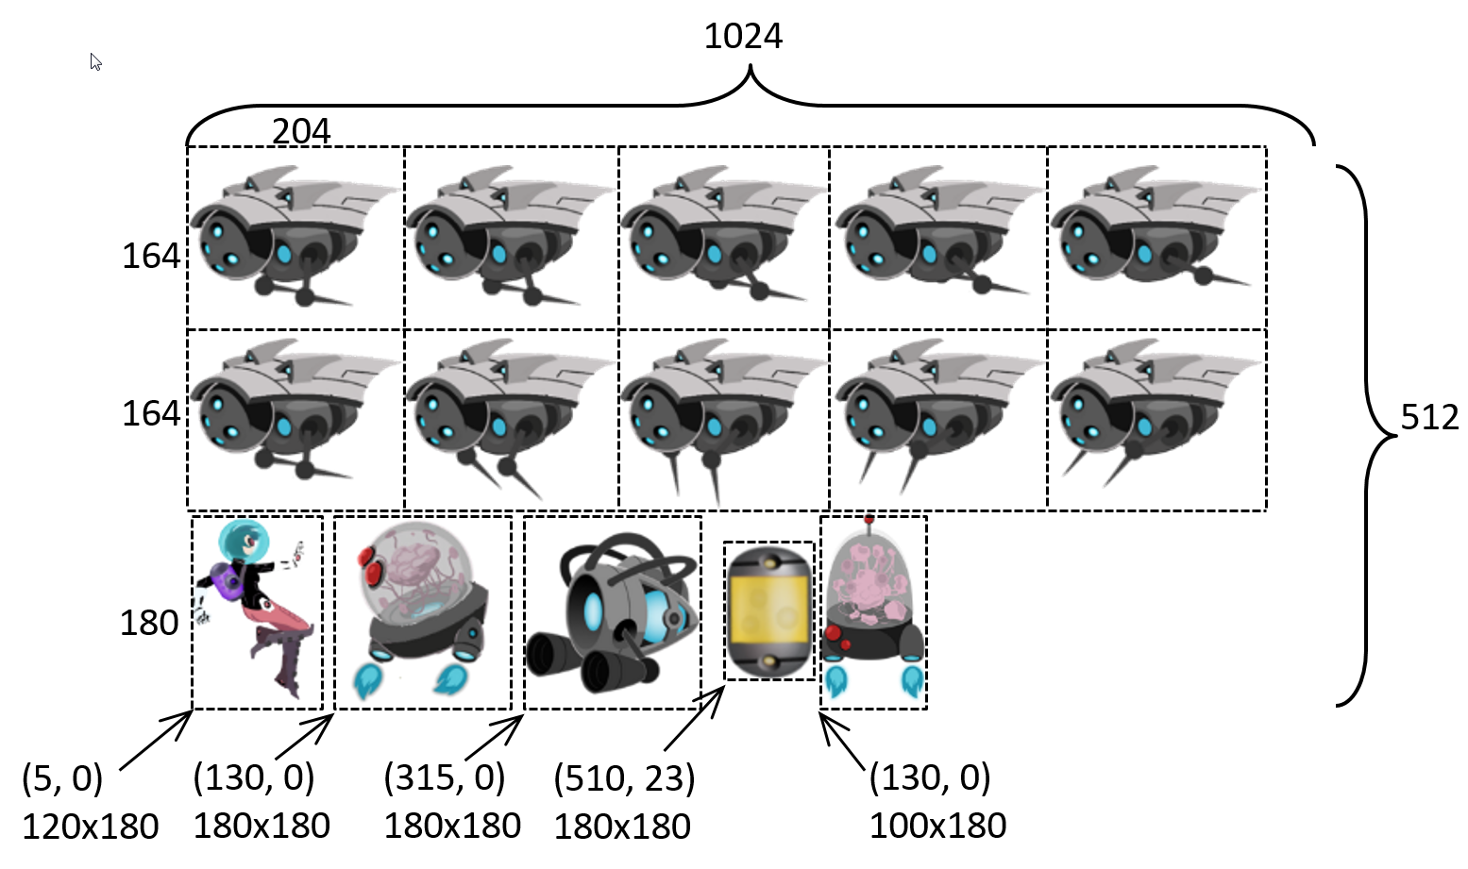
All a matter of reference position: the origin
A Texture
Given index (i, j): offset from the “Origin”
For TextureRenderable: Offset
Offset reference is: (0,0)
For SpriteRenderable:
Offset reference is lower-left corner
Index (i, j)
i-^{th} and j-^{th} pixel with respect to lower-left corner, or (0, 0)
A Sprite Element
A Sprite Sheet
Index (i, j): identifies a pixel with respect to the lower-left corner of element and not (0,0)

Slide 35
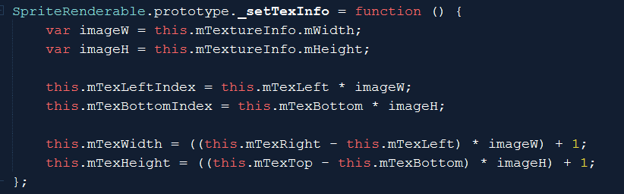
SpriteRenderable_PixelCollision.js
Record sprite information: lower-left corner and size
Index of lower-left corner of current sprite element
mTexWidth/Height: size of sprite element (instead of the entire texture).
mTexWidth and mTexHeight: are used throughout TextureRenderable, SpriteRenderable, and SpriteAnimateRenderable.

Slide 36
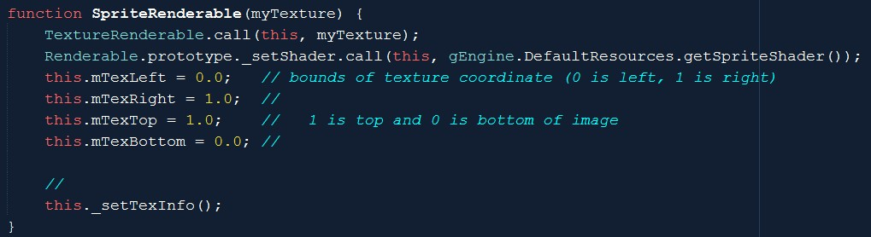
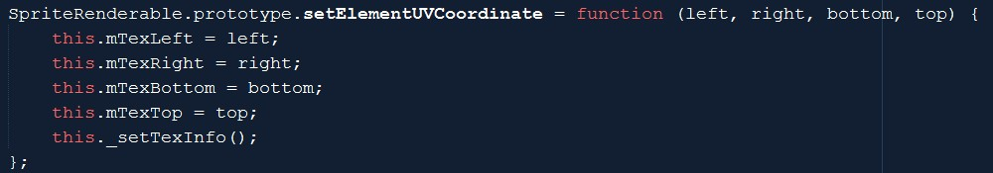
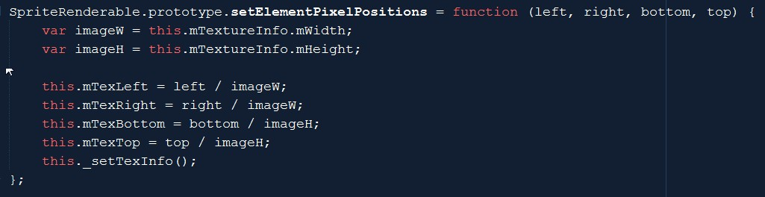
Ensure to use sprite lower-left corner and size

Slide 37
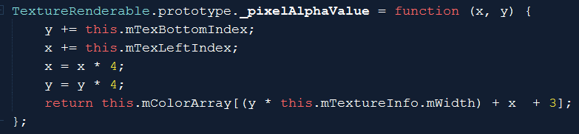
Use the information during color lookup!
Index of texel for alpha look up
mTexBottomIndex/LeftIndex: are initialized to (0,0) for TextureRenderables

Slide 38
Ultimate test of per-pixel collision:
Hero/Brain:
SpriteRenderable
SpriteRenderable
Test for support of all Texture sub-classes
L/R/H/B: Colide with Portal
Brain: chase Hero
Minions: SpriteAnimateRenderable
Portal: TextureRenderable

Slide 39
Chapter 6: What did we learn?
Review vectors: size, direction, dot/cross, component, decomposition
Applying simple vector concepts
Chasing, Position calculation for pixels on rotated textures
Importance of GameObject
MyGame clear of specific object updates
MyGame can focus on inter-object relationships
Boundingbox: cheap, lousy accuracy, useful as a rough test
Per-Pixel accurate collision detection
For rotated images, for sprites,

Slide 40
Per-Pixel Accurate Collision
Costly: both computationally and memory-wise
Computation: O(smaller image)
Memory: O(larger image)
Functionality:
Yes/No answer to collision: very accurate! (at pixel level!)
Does not provide much insights into collision position
e.g., no support for first point of contact (difficult problem in general)

