Slide 1
Chapter 7
Manipulating the Camera

Slide 2
This Chapter
Make the camera easier to work with
Define default manipulation functionality
Interpolate values to support smooth transitions
Use of math in describing behaviors
Program with multiple views
Already know this
Transform between Canvas (Device) Coordinate to World Coordinate
Support mouse input

Slide 3
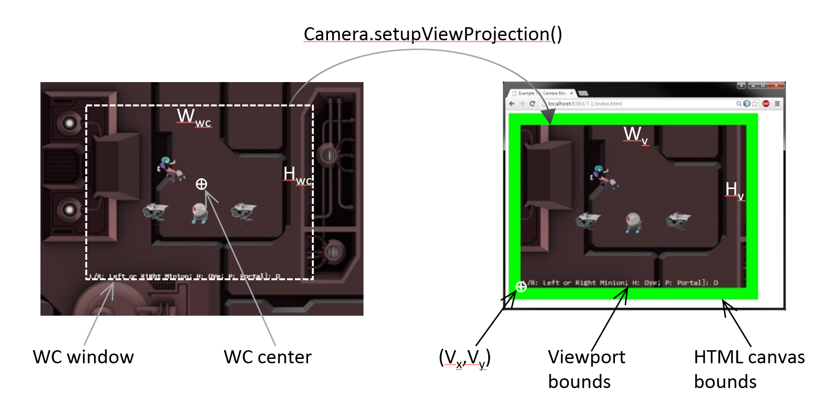
Review
Encoded in ViewProjection matrix

Slide 4
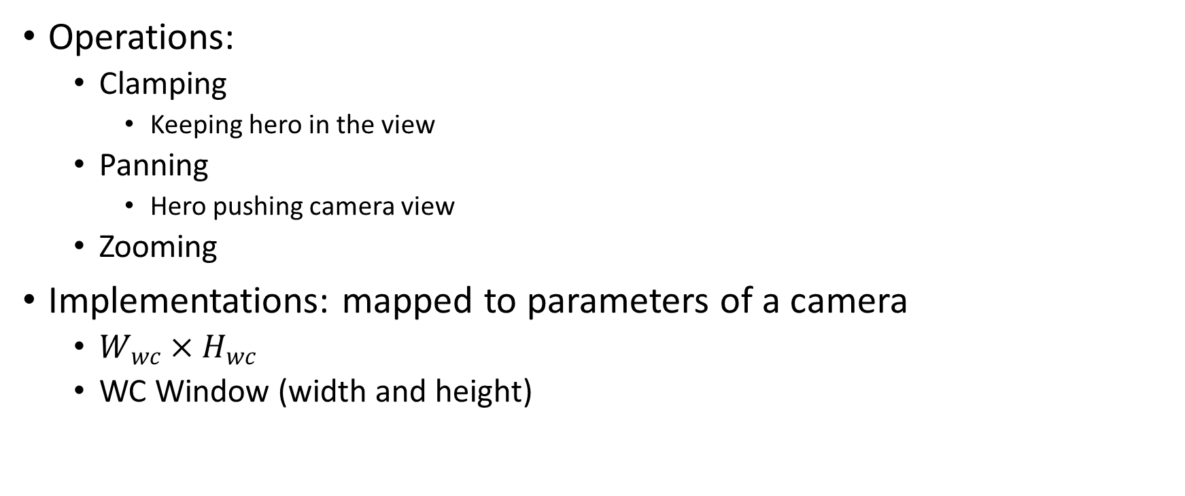
Camera Manipulations
Operations:
Clamping
Keeping hero in the view
Panning
Hero pushing camera view
Zooming
Implementations: mapped to parameters of a camera
$W_{wc}×H_{wc}$
WC Window (width and height)

Slide 5
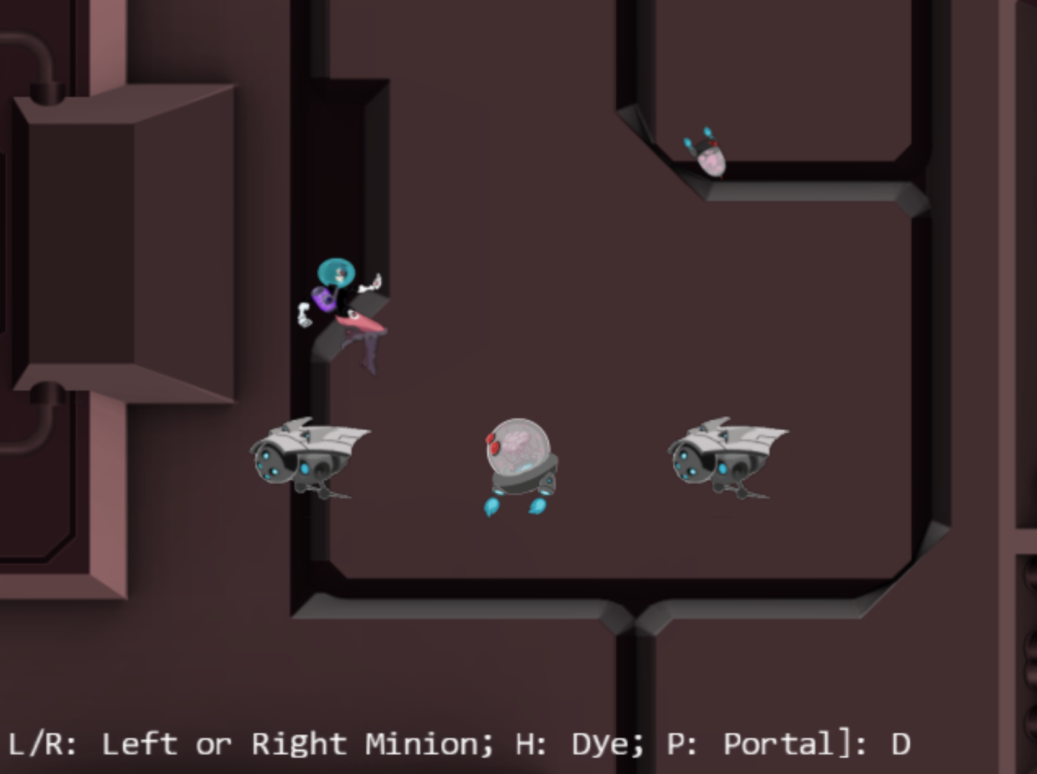
7.1: Camera Manipulations Project

Slide 6
7.1: Goals
Experience common camera manipulation operations
Understand the mapping from manipulation operations to camera parameters
Implement the manipulation operations

Slide 7
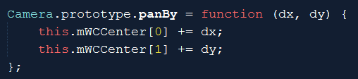

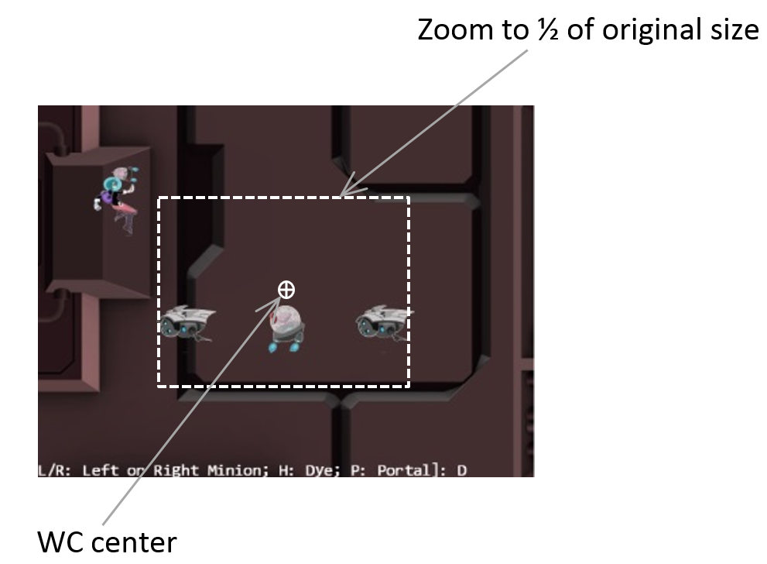
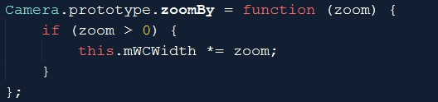
Camera_Manipulation.js: opeations
Translate WC window
Zoom with respect to center

Slide 8
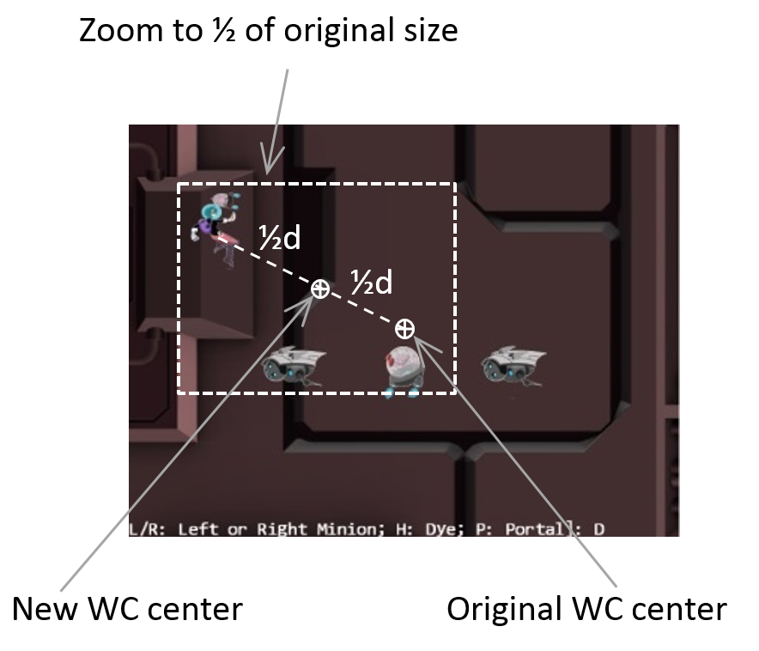
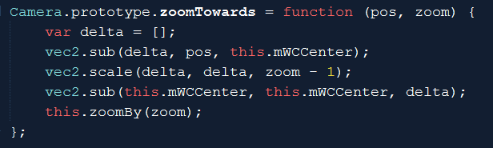
Zoom towards a fix location
Zoom wrt pos (Dye)
Delta: from wcCenter towards pos
If zoom > 1
wcCenter moves away from pos (see more world)
If zoom < 1
wcCenter moves towards pos (see less world)
After moved wcCenter, change wcWidth as usual
delta: from wcCenter towards pos

Slide 9
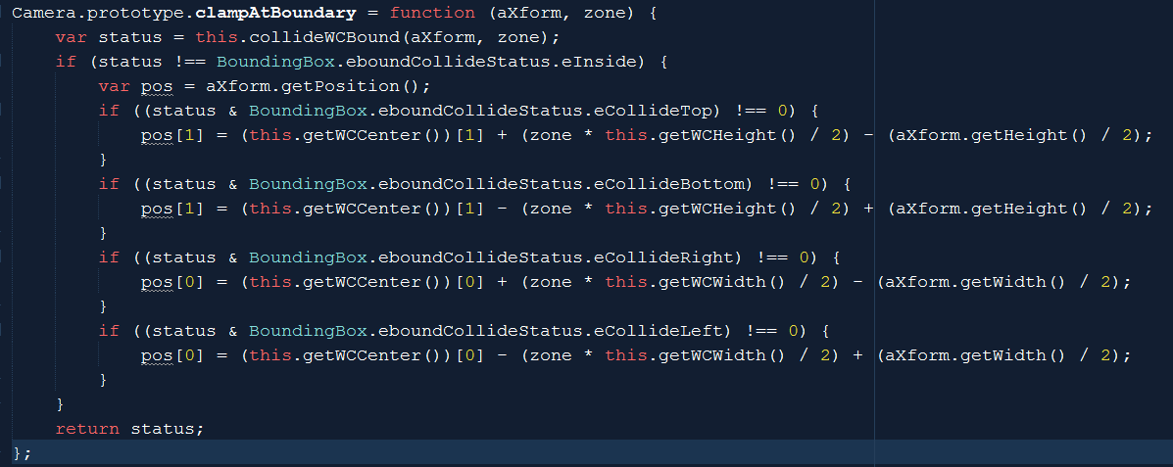
Clamp Obj (xform) to Camera WC Bounds

Slide 10
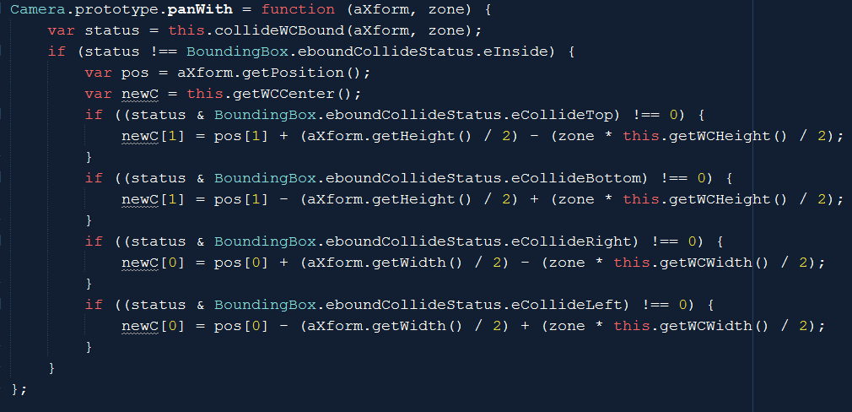
Opposite of clamp: Pan Camera with Obj
Camera_Manipulation.js

Slide 11
Testing:
WASD: move hero to pan camera (90%)
Arrow: move portal clamped (80%)
L/R: Camera pan to Left/Right
N/M: Zoom wrt center
L/R/P/H: Select Left/Right/Portal/Hero
J/K: zoom wrt to selected position
Put finger over selected object and zoom
Object does not change relative position

Slide 12
Powerful functionality, bad user experience
Sudden changes resulting from manipulation (e.g., panTo())
May seem incoherent (whole world jumped)
Gradual changes (in real life) would be nice

Slide 13
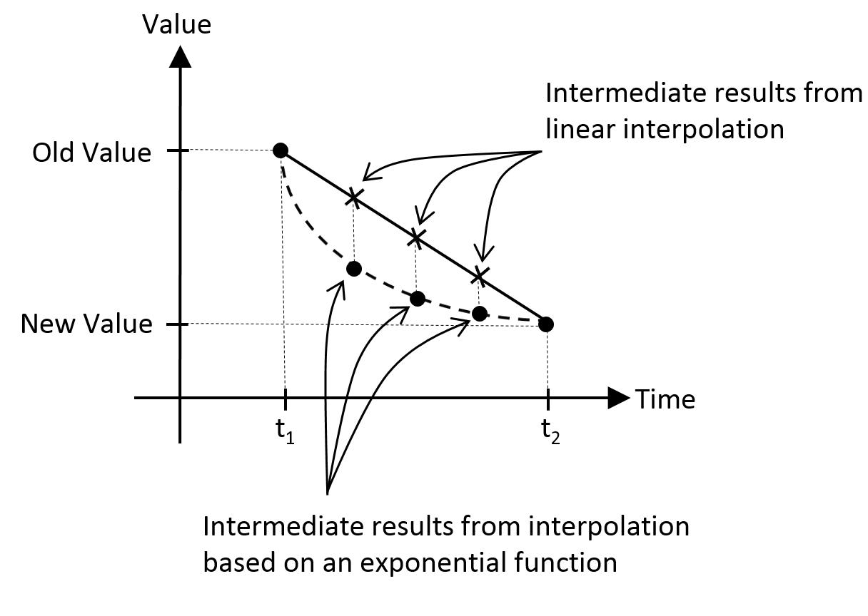
Need for interpolation
Gradual change of values: over time in this case
Example: two types of interpolations
Linear: change with fix rate
Exponential: change based on ratio of current value (our turn towards function)

Slide 14
7.2: Camera Interpolation Project

Slide 15
7.2: Goals
Understand and work with interpolated results
Implement interpolation to support gradual camera parameter changes
Understand keys to implementing interpolation
Keeping track of and separating: current from final values
Support access to current values
Need update() to trigger interpolation computation to take current value closer to final value

Slide 16
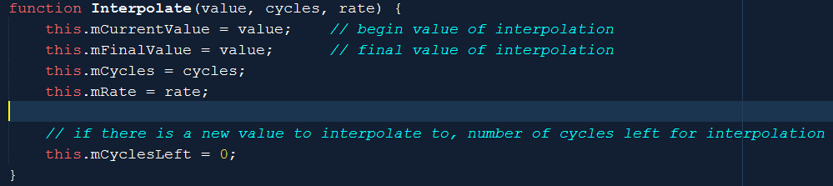
Interpolate.js: A Utility
From: mCurrentValue, Change to: mFinalValue
In: mCycles, changes at mRate
mCyclesLeft: keeps track of how many left

Slide 17
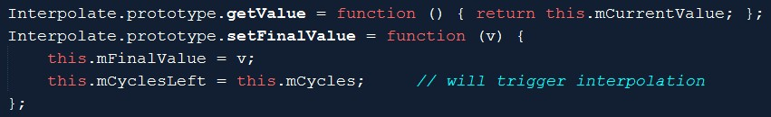

Interpolate.js: get/set/configure
Get current interpolated result
setFinalValue() triggers new interpolation
Stiffness: how quickly values change
Duration: how long to change from initial to final

Slide 18
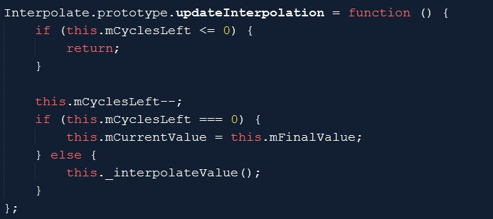
Interpolate.js: compute intermediate value
If cycles left
compute
Each iteration: linearly changing from current to final
Overall: exponential function from initial to final

Slide 19
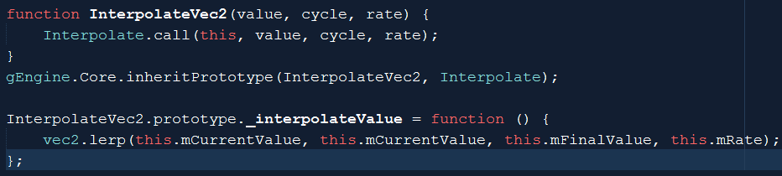
InterpolateVec2.js
Need to interpolate vec2 objects!
Vec2.lerp() implements the same interpolate._interpolateValue()
For each of the x/y components

Slide 20
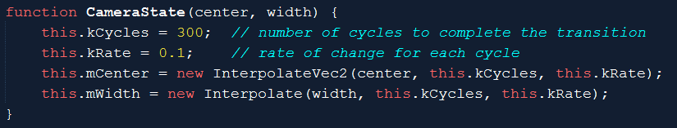
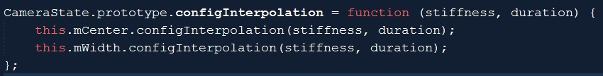
CameraState.js: current and final values
Notice the references to: Interpolate and InterpolateVec2
Configuration:

Slide 21
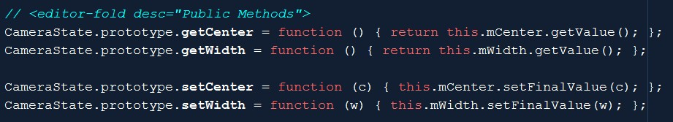
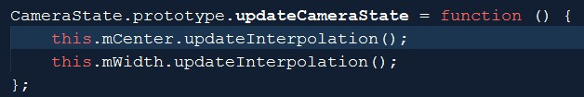
CameraState.js: set/get, trigger interpolation
Get current values
Set: sets final value for interpolation
Triggers actual interpolation

Slide 22
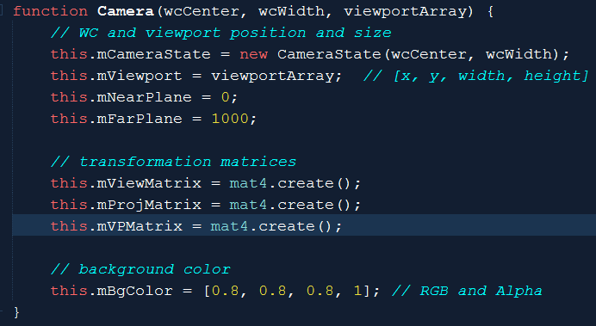
Integrate CameraState
Camera only reference to CameraState
All set/get to wcCenter and wcWidth now refers to CameraState

Slide 23

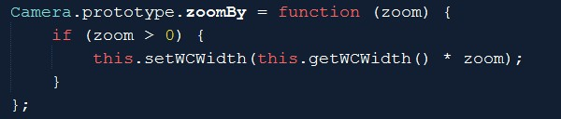
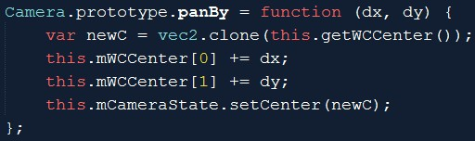
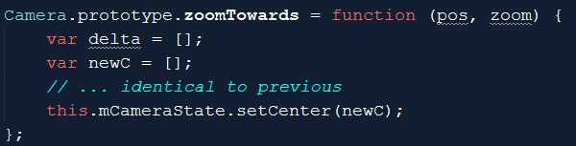
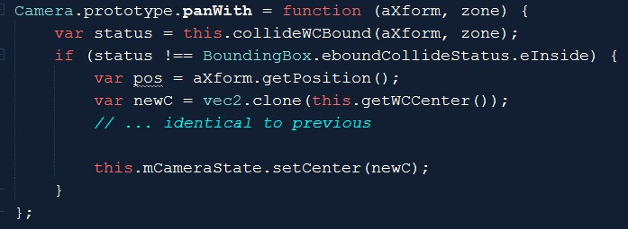
Camera manipulation: to CameraState

Slide 24


Camera_Manipulate: update + config

Slide 25
Testing interpolated manipulation
Notice the much smoother transitions
MyGame.update() → calls camera.update()!!
Stiffness:
Large values (e.g., 0.8, or 0.9):
degenerates to sudden changes
Very smaller values (e.g., 0.01):
Slow motion effect
Duration:
Very large values (e.g., 500)
Seems to never reach stable value (tiny movements towards the end)
Very small values (e.g., 10)
Unable to complete the function smoothly
Degenerates to sudden jumps at the end

