Slide 1
Chapter 4
Implementing Common Components of Video Games

Slide 2
This Chapter
Control the Renderable object’s position, size, and rotation to construct complex movements and animations
Receive keyboard input from the player and animate Renderable objects
Work with asynchronous loading and unloading of external assets
Define, load, and execute a simple game level from a scene file
Change game levels by loading a new scene
Work with sound clips for background music and audio cues

Slide 3
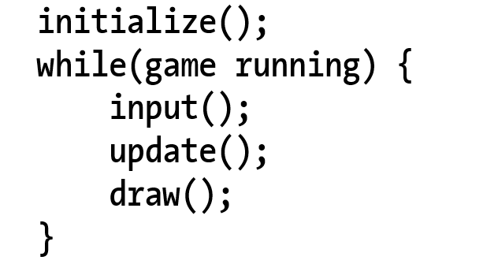
Game Loop
Typical structure
Notice: the input() update!

Slide 4
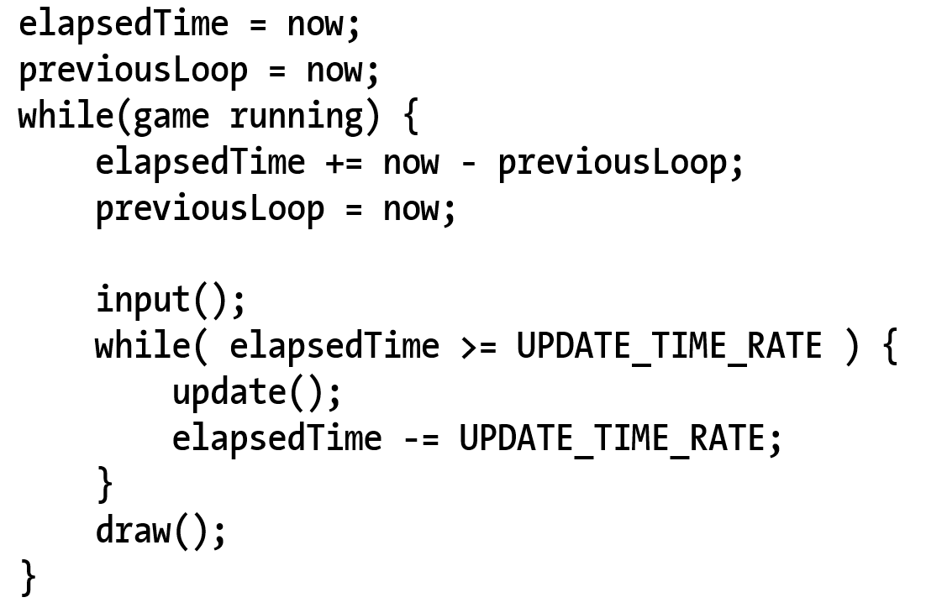
Game Loop: Implementation
Input() inside vs outside of the real-time loop?
Responsiveness when game is lagging
Fixed update rate:
Simple physics implementation (later in Chapter 9)

Slide 5
Questions
What is Frame/Second?
Is it possible to have the following, and why?
Multiple update() calls per draw()
Multiple input() calls per draw()
Multiple draw() calls per update()
Multiple draw() calls per input()
Look at MP1 assignment spec
http://faculty.washington.edu/ksung/CSS490D/MP/MP1/mp1.htm
Think about from where to call these functions

Slide 6
Questions
What is Frame/Second? ➔1/elapsedTime-ms or 1000/elapsedTime
Is it possible to have the following, and why?
Multiple update() calls per draw() YES!
When takes too much time to update/draw/input
Multiple input() calls per draw()
When elapsedTime is short (<UPDATE_TIME_RATE)
Multiple draw() calls per update()
Multiple draw() calls per input()
NO for the above two!!

Slide 7

4.1: Game Loop Project

Slide 8
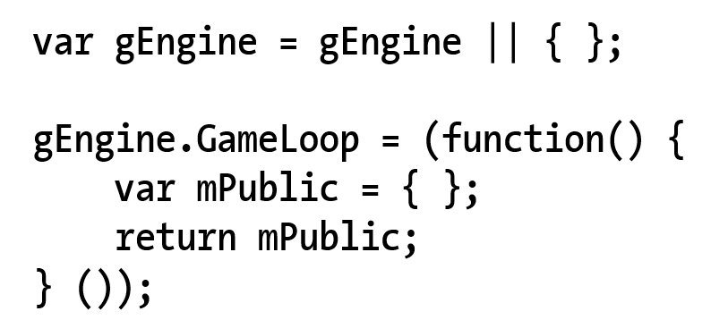
4.1: New Engine Component
New Engine component (similarity to gEngine.VertexBuffer!!)

Slide 9
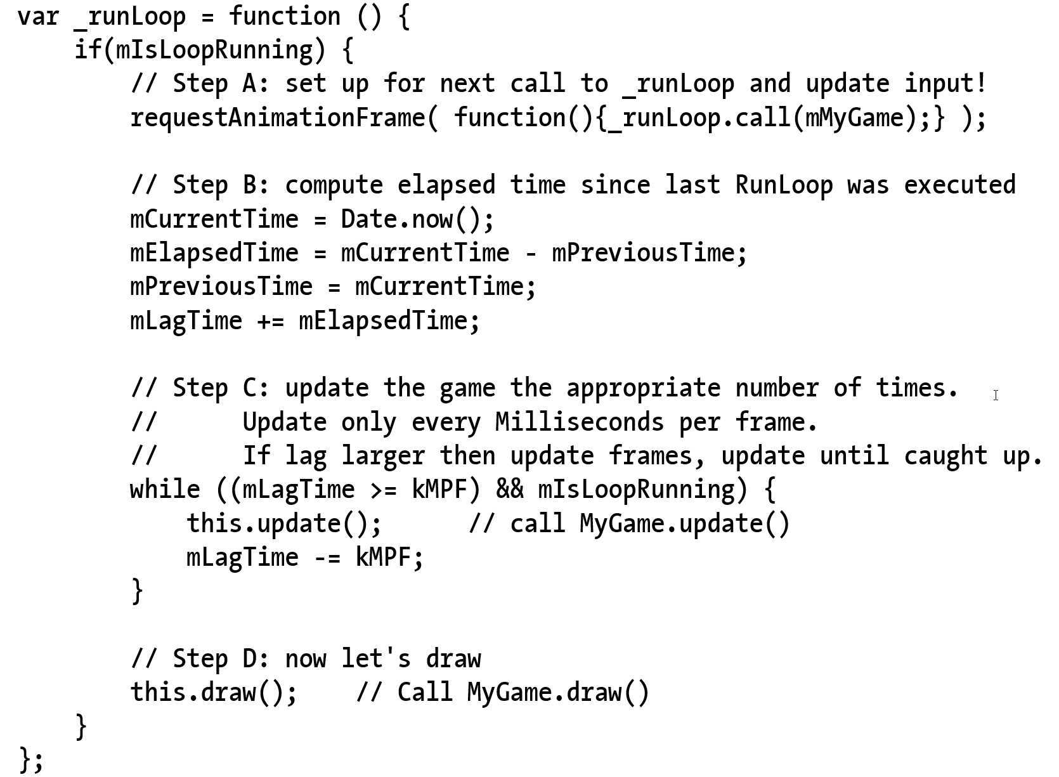
4.1: _runLoop()
Engine_GameLoop.js
requestAnimationFrame()
.call(class) ← syntax!
mIsLoopRunning not checked
Will do so later
No input() checking yet
update() and draw()
Separated!!
No update in draw
No draw in update!!

Slide 10
4.1: _runLoop()
Engine_GameLoop.js
requestAnimationFrame()
.call(class) ← syntax!
mIsLoopRunning not checked
Will do so later
No input() checking yet
update() and draw()
Separated!!
No update in draw
No draw in update!!

Slide 11
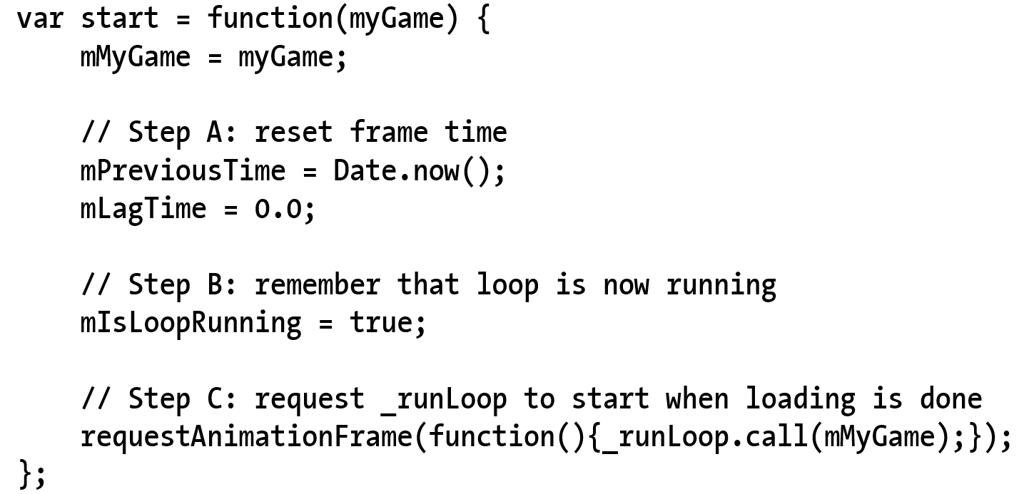
4.1: Trigger to start the loop
Note the initializations

Slide 12
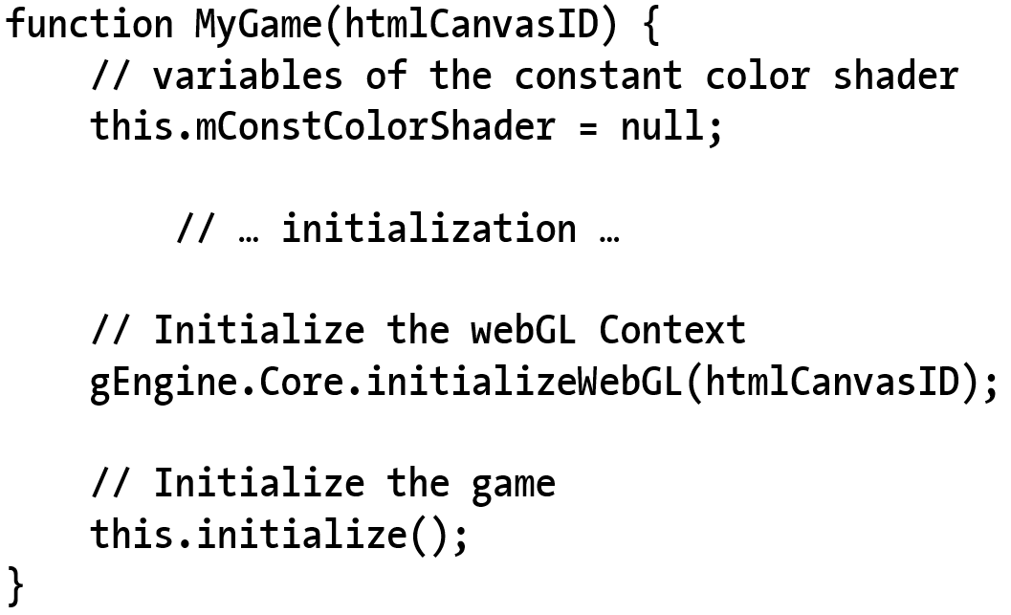
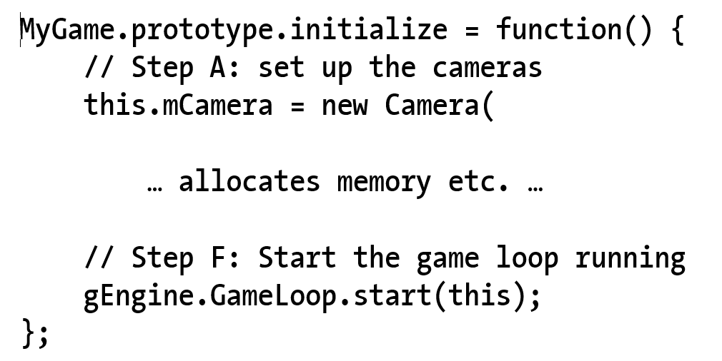
4.1: Starting the loop: MyGame.Initialize()

Slide 13
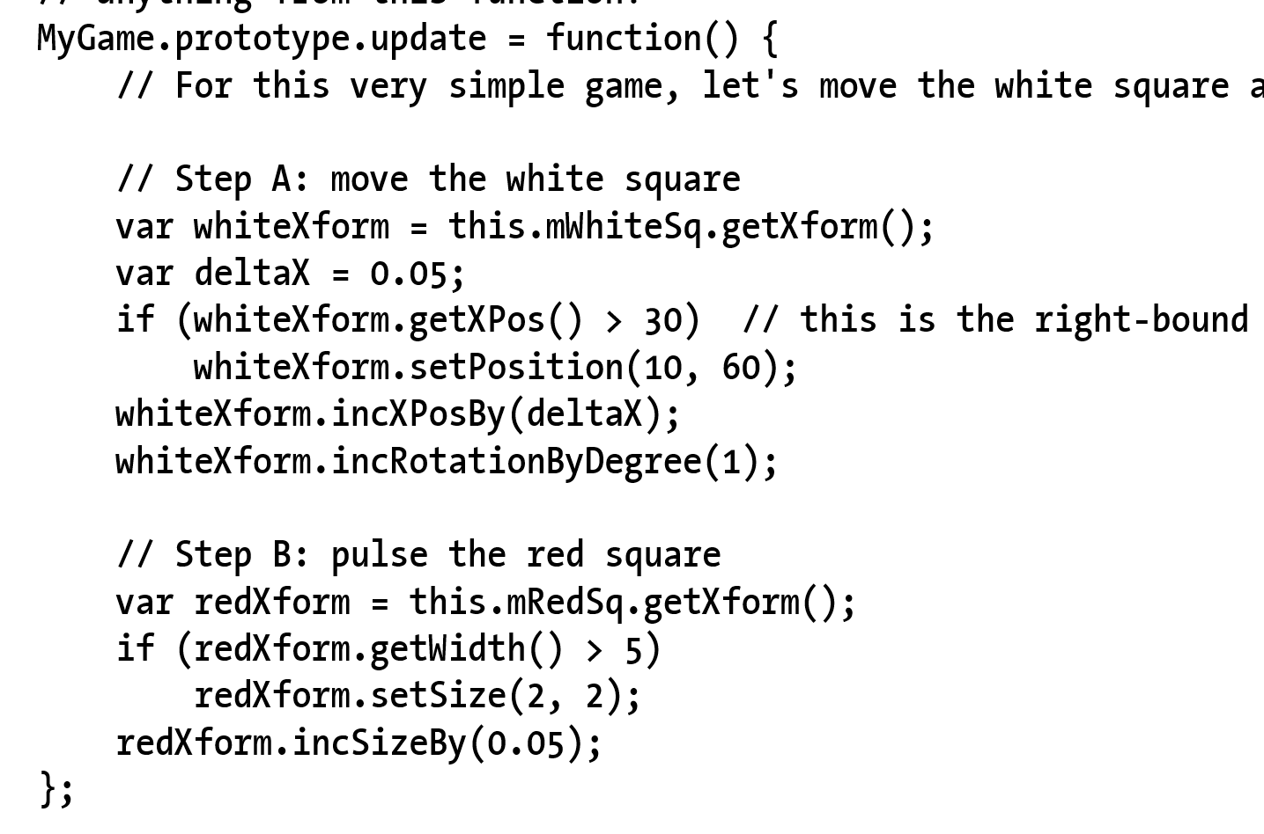
4.1: MyGame: update()

Slide 14
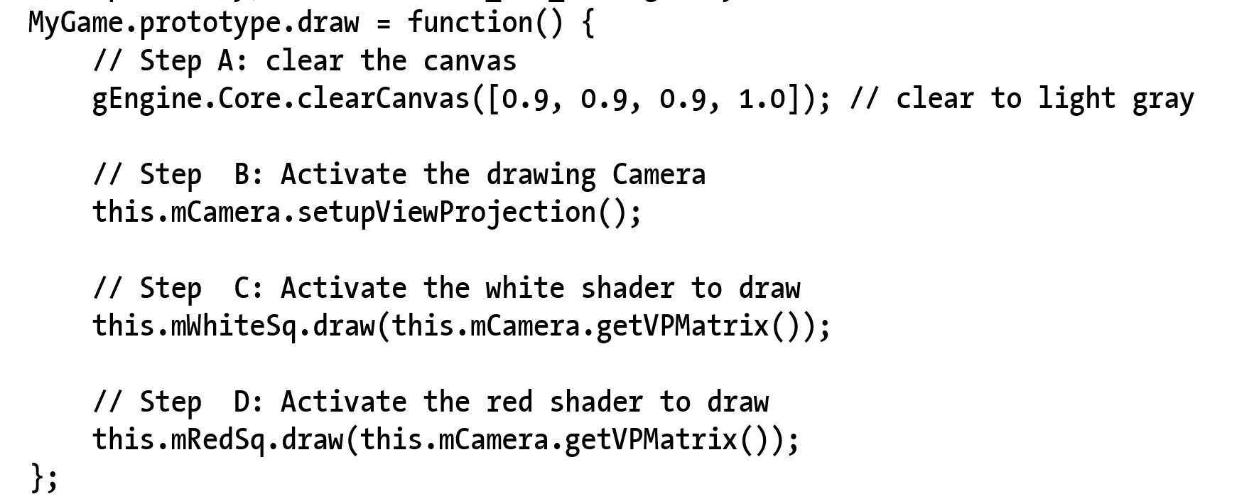
4.1: MyGame: draw()

Slide 15
Questions
If there is no lagging …
whiteXform
What is the linear speed of its movement?
What is the angular speed of its rotation?
redXform
What is the speed of its size change?

Slide 16
Questions
whiteXform
What is the linear speed of its movement?
0.05/(1/60) units/sec or
0.05*60 units/sec = 3 unit/sec
In this case, width of world = 20units
Takes about 20/3 to cover the width
A little more than 6 seconds
What is the angular speed of its rotation?
1-degree/(1/60 sec) or 60-degrees/sec
Or exactly 6 seconds for a complete revolution
redXform
What is the speed of its size change?

Slide 17

4.2: Keyboard Input

Slide 18
4.2: Event and Keycodes
Events and event handlers
HTML5 Event registration and handlers
window.addEventListener(“Event”, handler)
Keycodes:
‘A’ = xx
‘B’ = xx+1
…

Slide 19
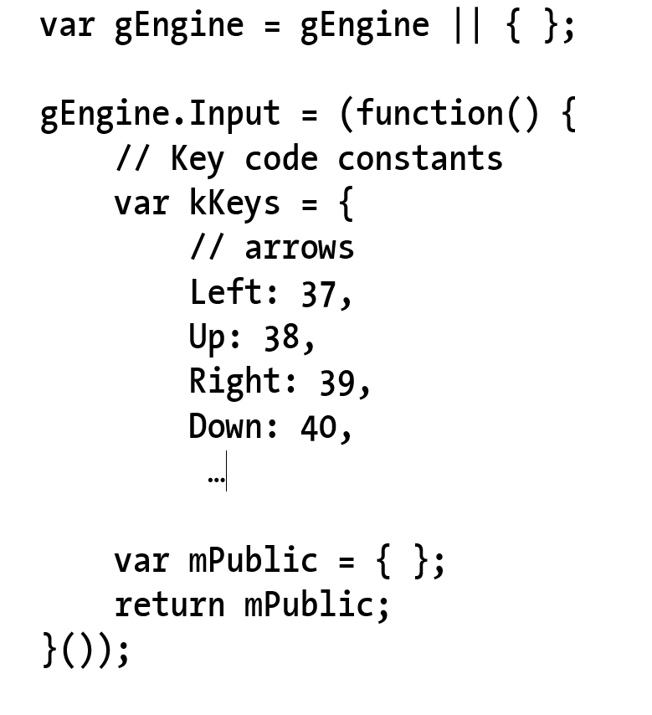
4.2: The Engine.Input component

Slide 20
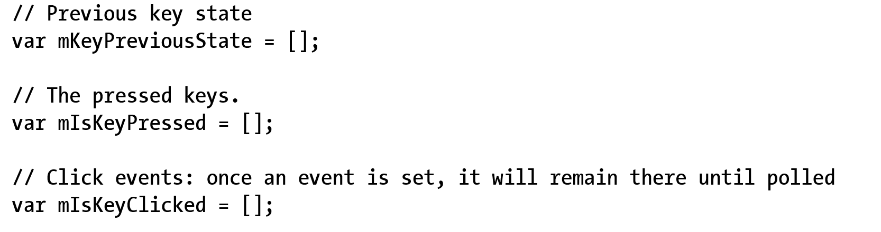
4.2: Input: variables for key states

Slide 21
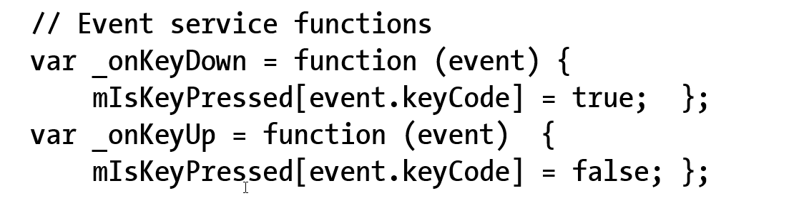
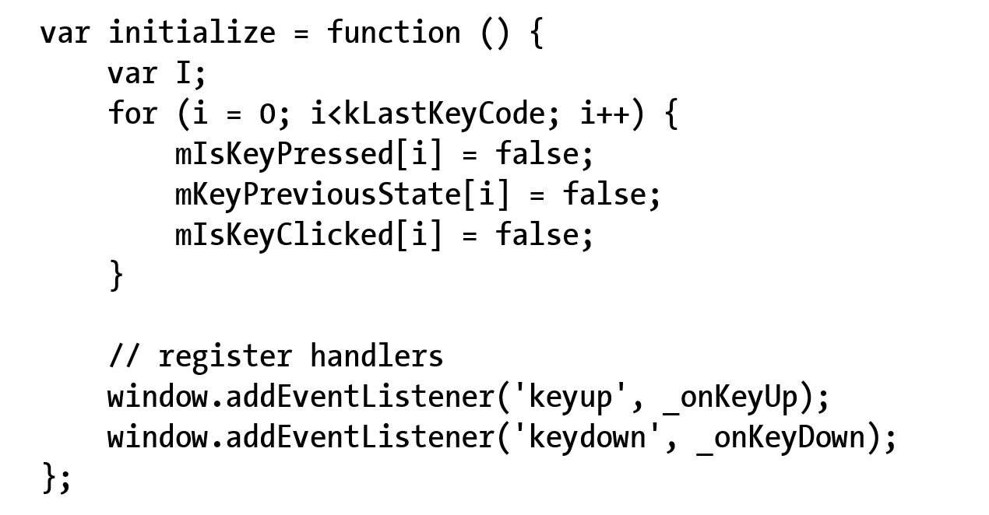
4.2: Event handlers and initialization

Slide 22
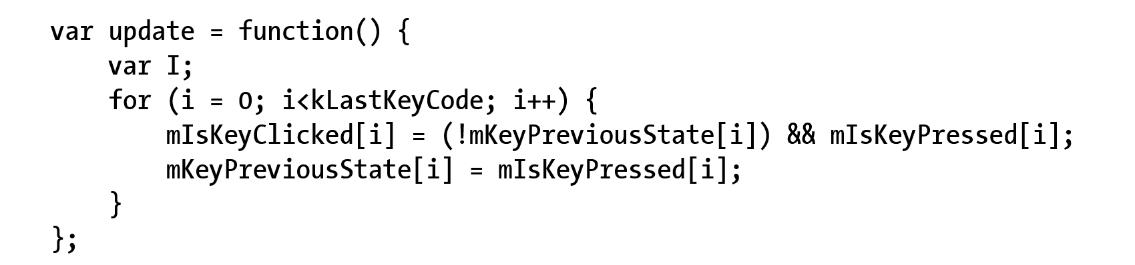
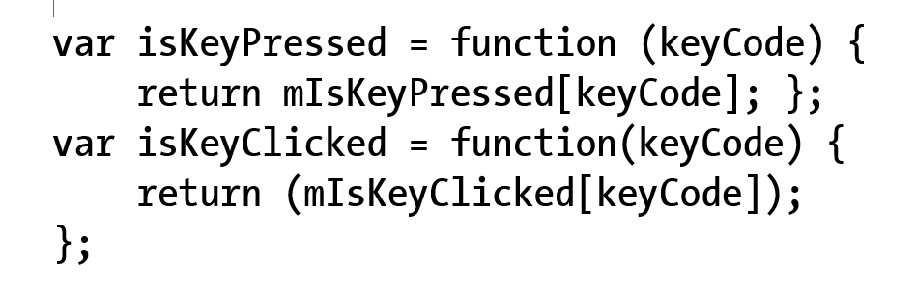
4.2: Keyboard update() and support

Slide 23
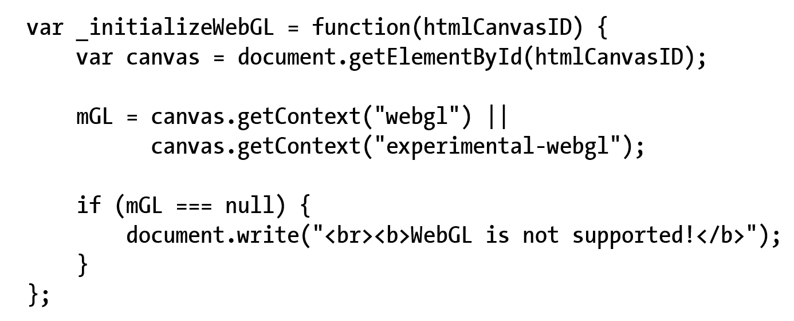
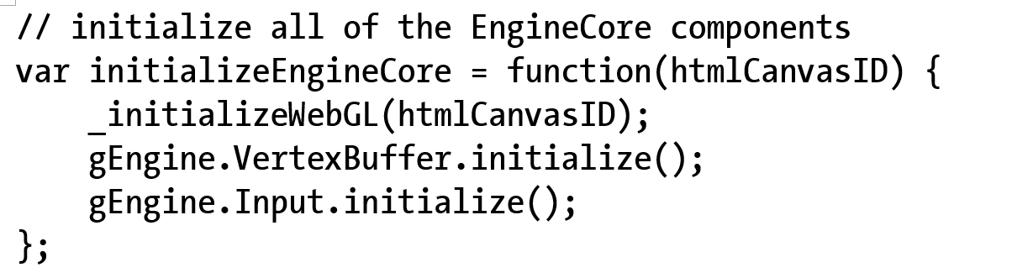
4.2: Engine.Core: to init Input

Slide 24
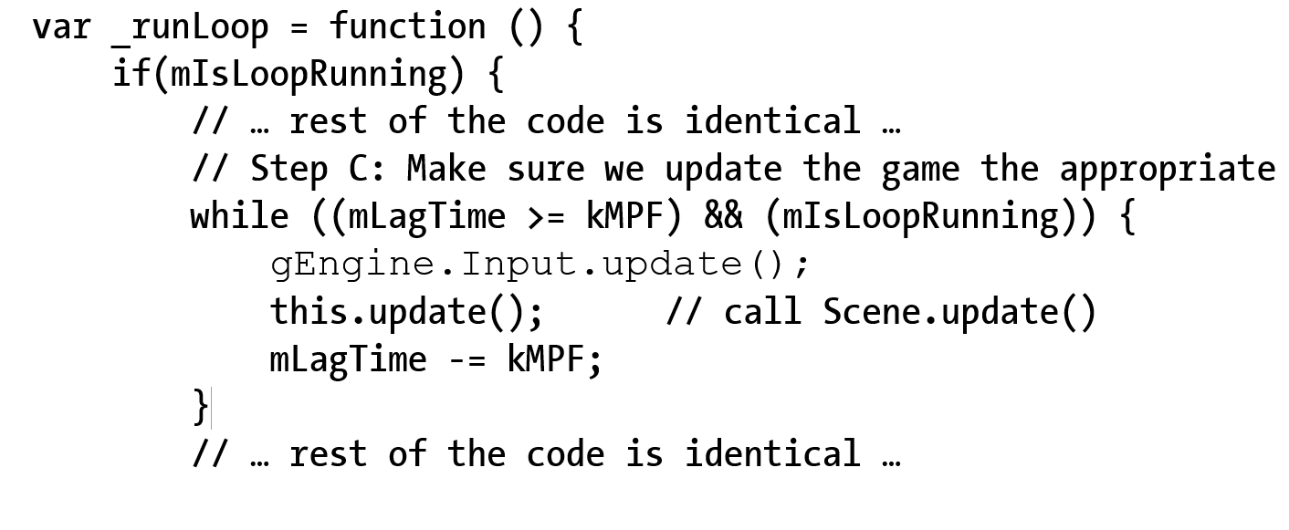
4.2: Engine.Loop: to update input

Slide 25
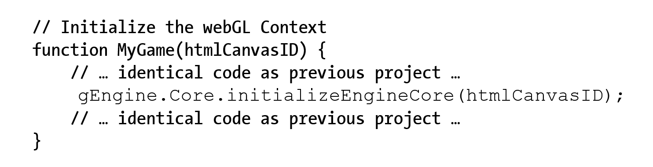
4.2: Engine initialization (from MyGame)

Slide 26
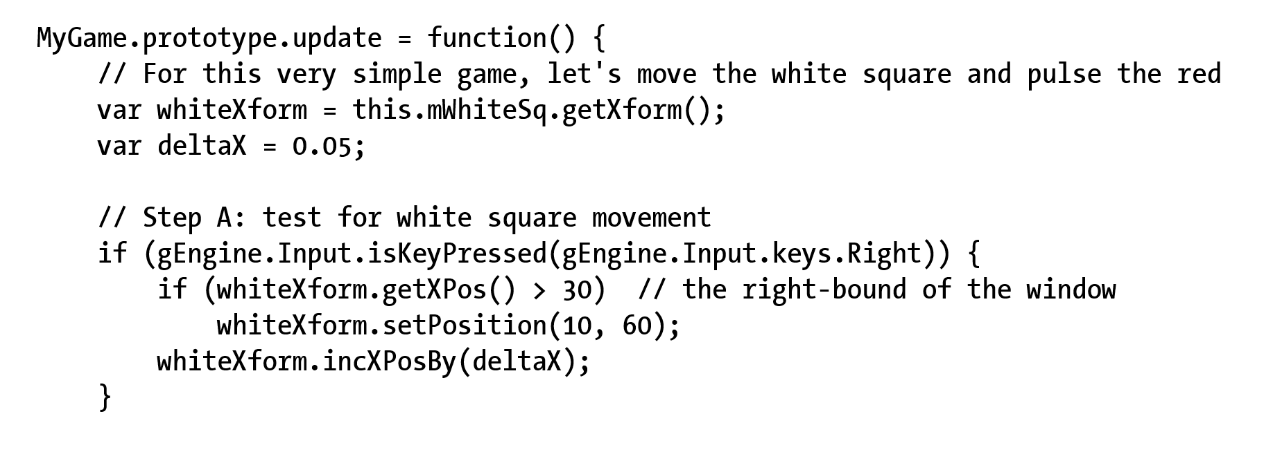
4.2: Testing Keyboard MyGame.update()

Slide 27
Questions
What is the runtime complexity of Input.update()?
How would you implement a “isKeyUp()” function?
To detect the key-up event
Will the runtime complexity change?

Slide 28
Resource Management
Synchronous load: (SimpleShader._loadAndCompileShader())
Issue load and wait
Stops web browser!!
May seem “hang” to user
Asynchronous load:
Issue load, provide “Callback” and continue
“Callback” is called when load is completed
Pro:
Efficient, support interactivity
Con:
Complex, requires synchronization

Slide 29

4.3: Resource Management Project

Slide 30
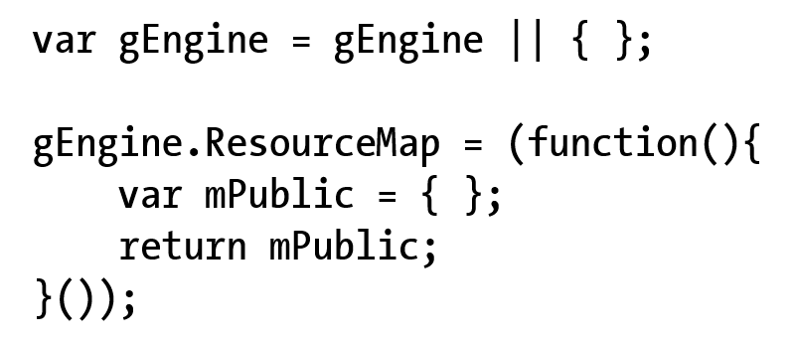
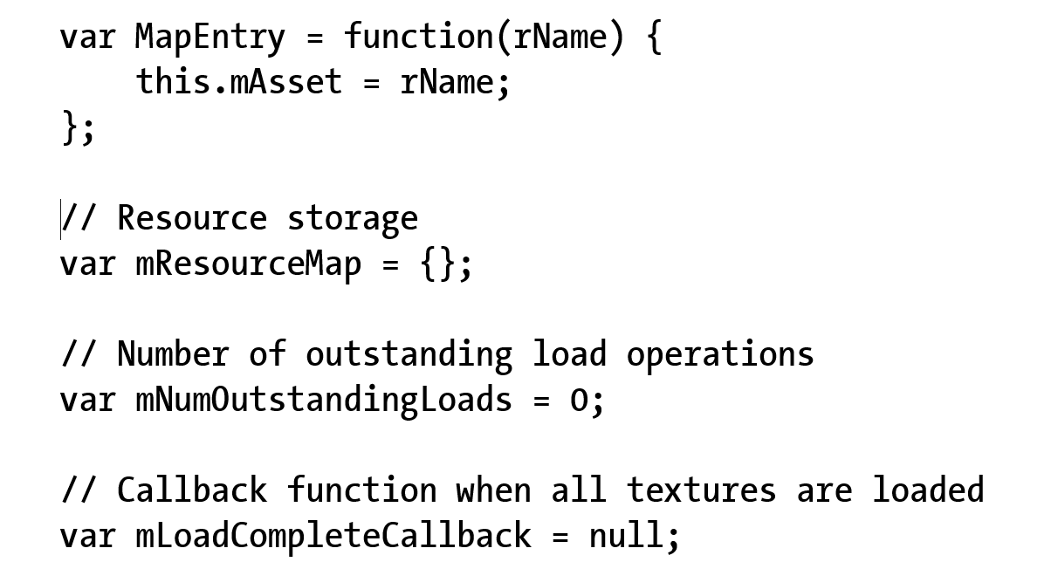
4.3: ResourceMap
ResourceMap:
Key-value pair of “string=id” and resource
E.g., file name and content of file

Slide 31
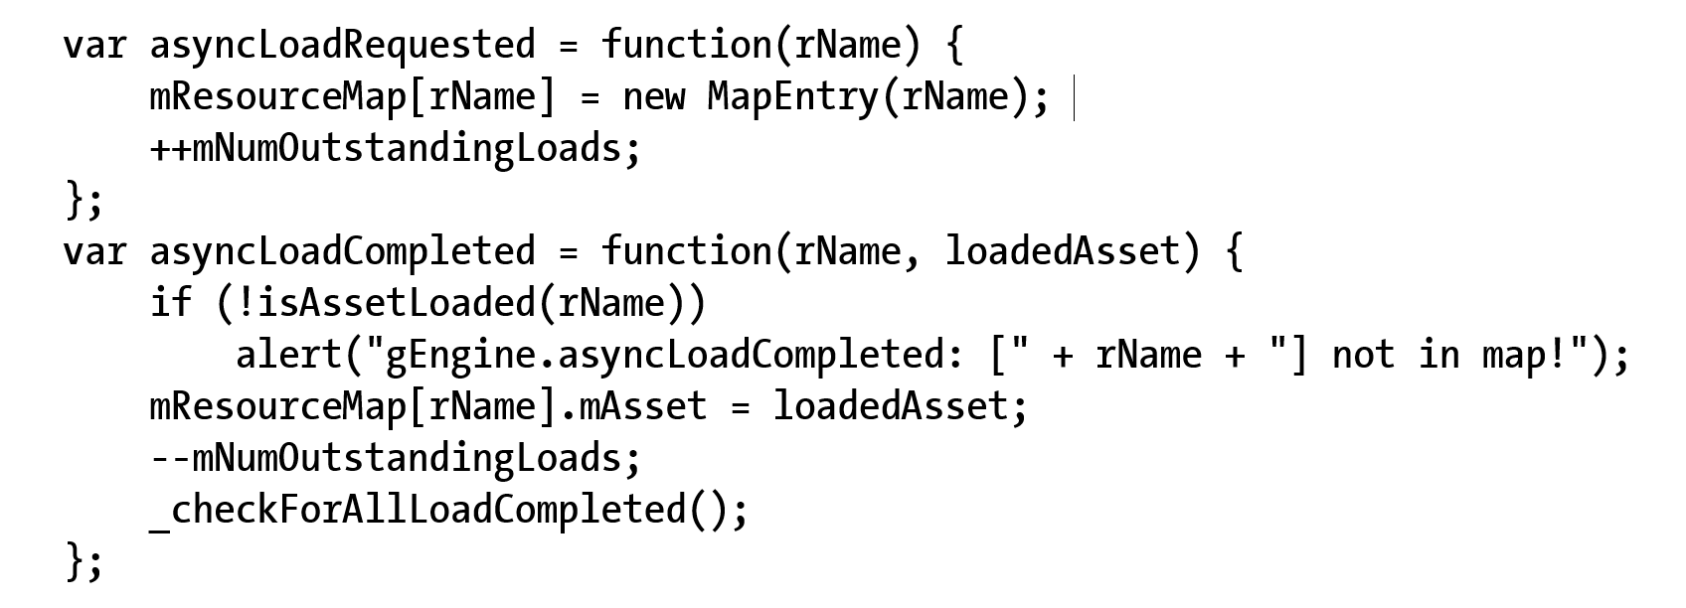
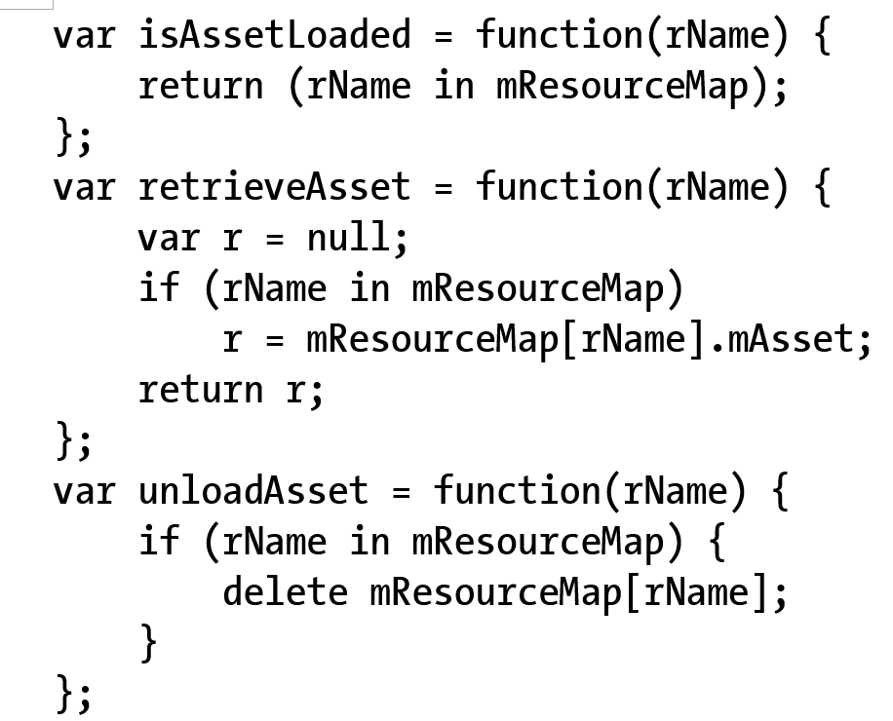
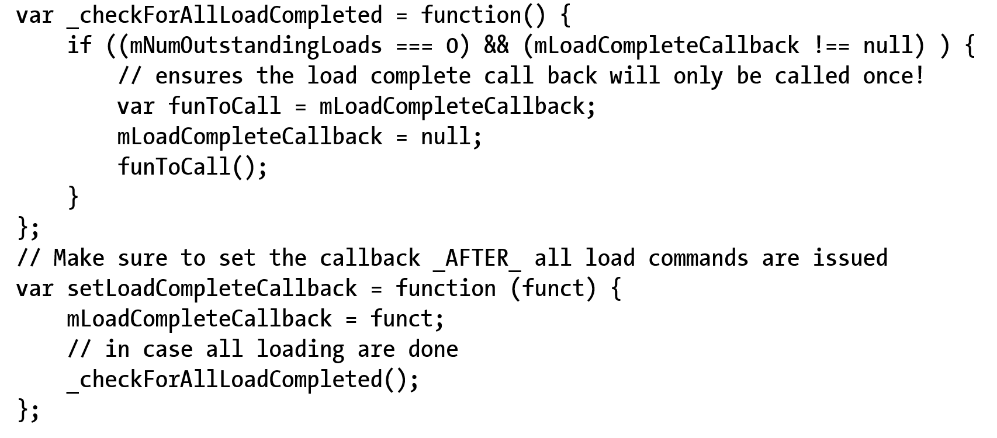
4.3: ResourceMap: functions
Load synchronization support
Create/Store-to EntryMap
Nothing else!
Asset assessing support
Check and retrieve
Misc support (e.g., call back)

Slide 32
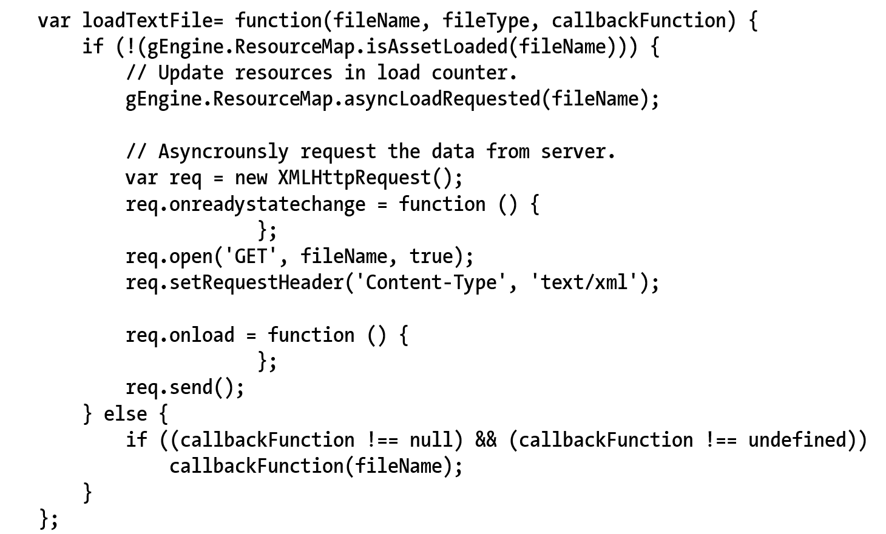
4.3: TextFileLoader: An Engine Component
Working with ResourceMap
isAssetLoaded():
Check before (re)-load!
Call to: asyncLoadRequest()
Filename (path) as ID
onreadystatechange()
Status report: next slide
onLoad()
When loaded: next slides

Slide 33
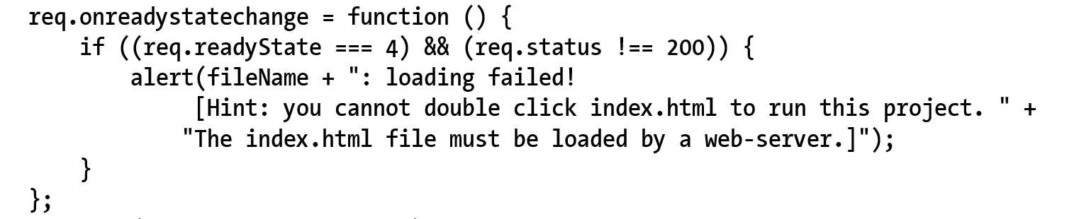
4.3: TextFileLoader: status check
Status check!

Slide 34
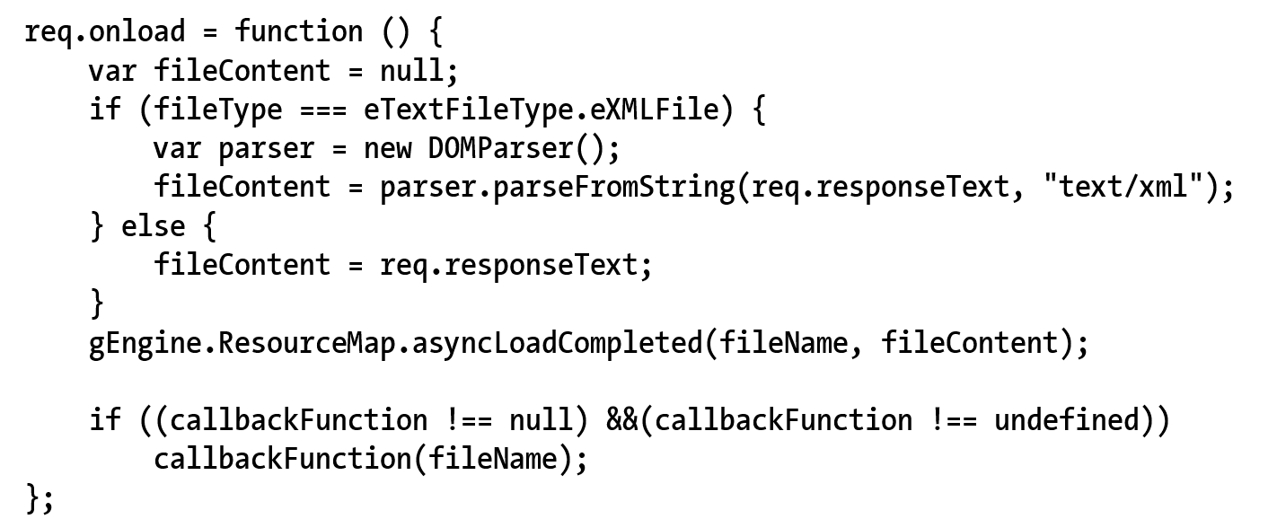
4.3: TextFileLoader: onLoad()
Successful loaded
If loading XML
Create DOMParser()
If plain textfile
Return the entire text source
Work with ResourceMap
asyncLoadCompleted()

Slide 35
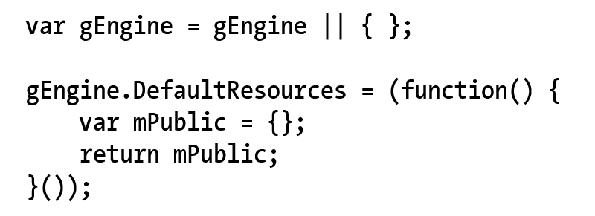
4.3: Engine DefaultResoruces
Notice SimpleShader is shared by all Renderables!!
There will be many other examples
Define DefaultResources engine component

Slide 36
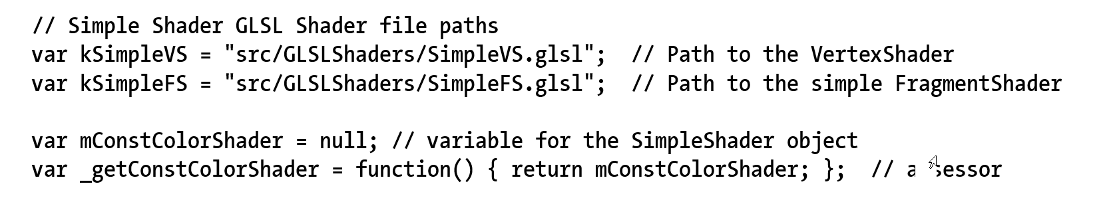
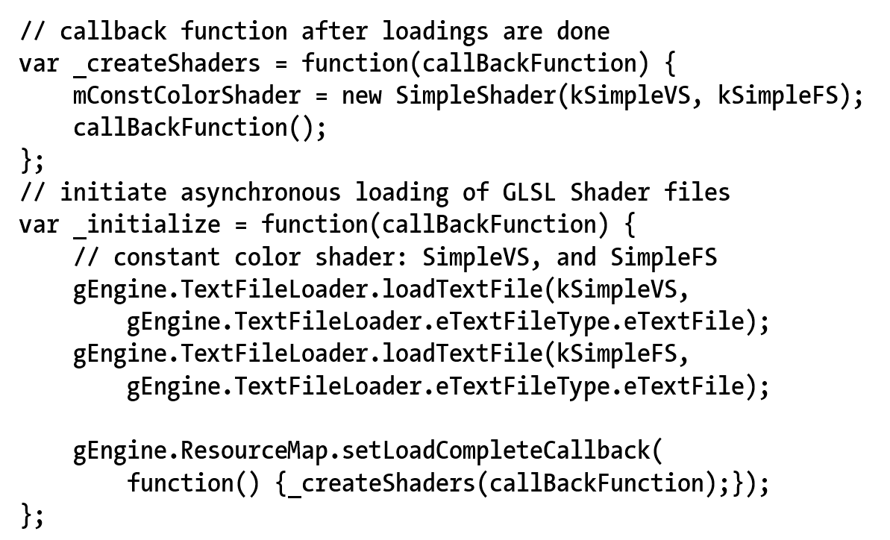
4.3: Default SimpleShader engine resource

Slide 37
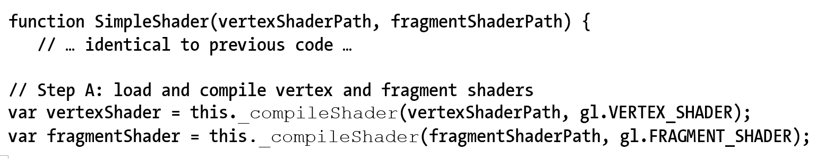
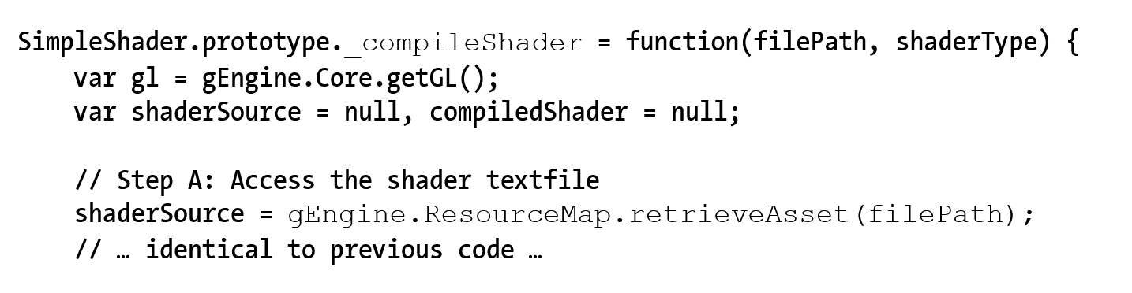
4.3: SimpleShader: user default resource

Slide 38
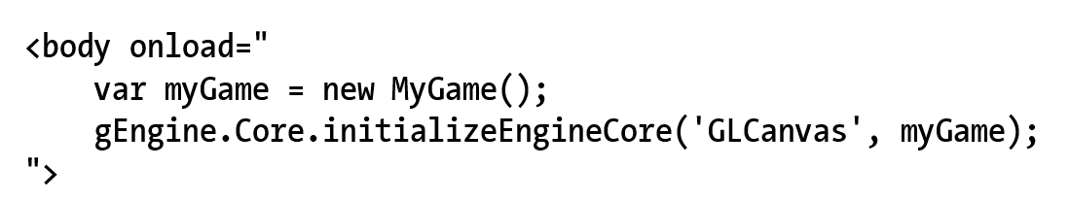
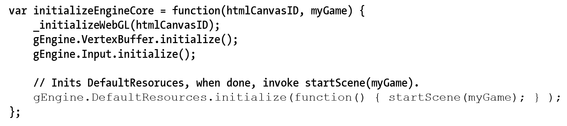
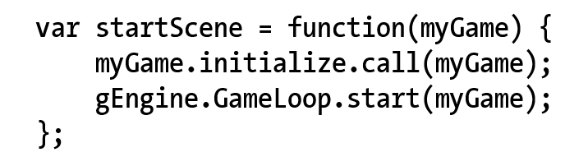
4.3: Engine: starting sequence
Index.html
Engine_Core.js

Slide 39
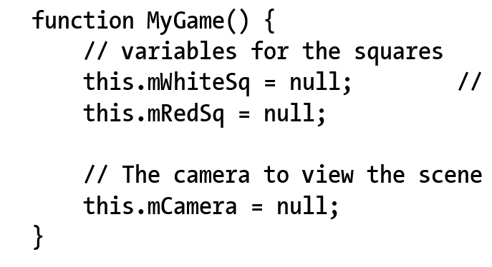
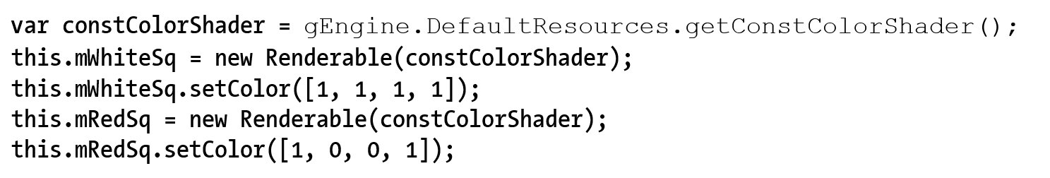
4.3: Testing async loading: MyGame
No need to worry about initialization Game Engine Core (good!)
MyGame Constructor simple again!
Access shader from default resource

Slide 40
Questions
gEngine_TextFileLoadder
What format does the loader support?
How would you implement a JSON loader?

Slide 41
Questions: Assume an empty ResourceMap
If I issue the following function calls one after the other [very quickly]
gEngine.TextFileLoader.loadTextFile(“aFile.txt”, eXMLFile);
gEngine.TextFileLoader.loadTextFile(“aFile.txt”, eXMLFile);
What is the value of
gEngine.ResourceMap.mNumOutstandingLoads()?
How many entries are in
gEngine.ResourceMap.mResourceMap[]?
How many actual OS file read are issued?
If mLoadCompleteCallBack is properly initialized
How many times will _checkForAllLoadCompleted() be called?
How many times will mLoadCompleteCallback() be called?

Slide 42
Questions: Assume an empty ResourceMap
If I issue the following function calls one after the other [very quickly]
gEngine.TextFileLoader.loadTextFile(“aFile.txt”, eXMLFile);
gEngine.TextFileLoader.loadTextFile(“aFile.txt”, eXMLFile);
What is the value of
gEngine.ResourceMap.mNumOutstandingLoads()? ➔ 1
How many entries are in
gEngine.ResourceMap.mResourceMap[]? ➔ 1 (second overrided first)
How many actual OS file read are issued? ➔ 1
If mLoadCompleteCallBack is properly initialized
How many times will _checkForAllLoadCompleted() be called? 1 (once for each read)
How many times will mLoadCompleteCallback() be called? Once, when all read are returned

Slide 43

4.4: Scene File Project

Slide 44
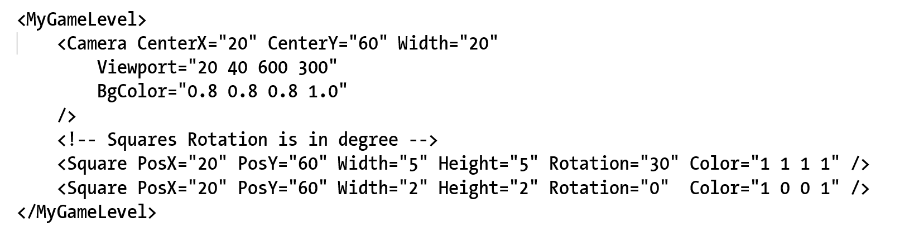
4.4: Scene File
The “assets” folder
A convention for ourselves (NOT defined by anything!!)
XML format and parsing (not cover here)

Slide 45
4.4: MyGame class
Constructor: declaring var and defining constants
Game specific resources (assets) MAY NOT be there!!
Initialize(): allocate and instantiate, setting up states
Game specific resources are loaded!!
update()/draw(): Seen this before … again:
update(): DO NOT try to draw anything
draw(): DO NOT make any changes to game state!
loadScene()/unloadScene(): loading/unloading of scene specific information!!

Slide 46
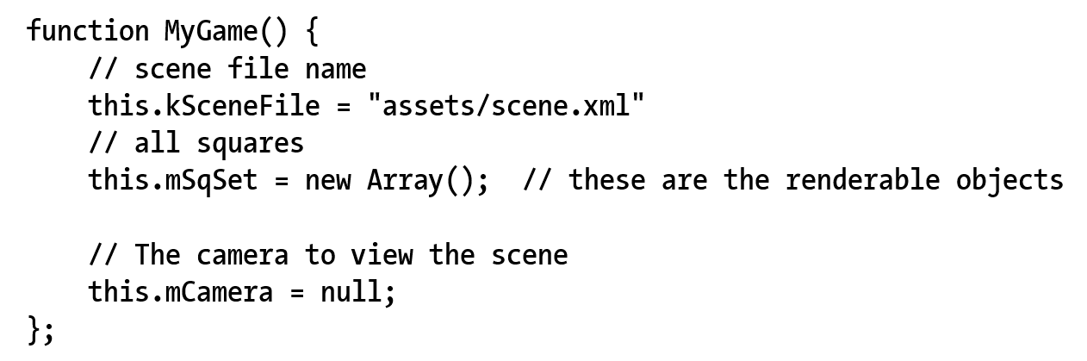
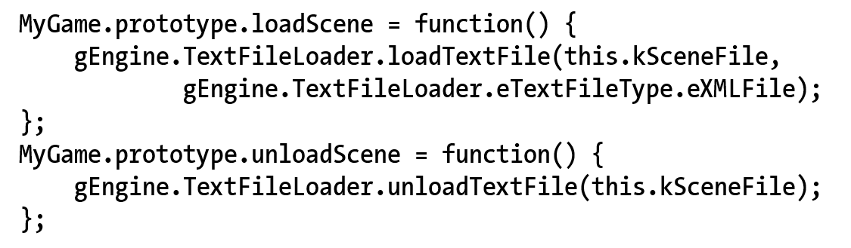
4.4: MyGame: construct and load!

Slide 47
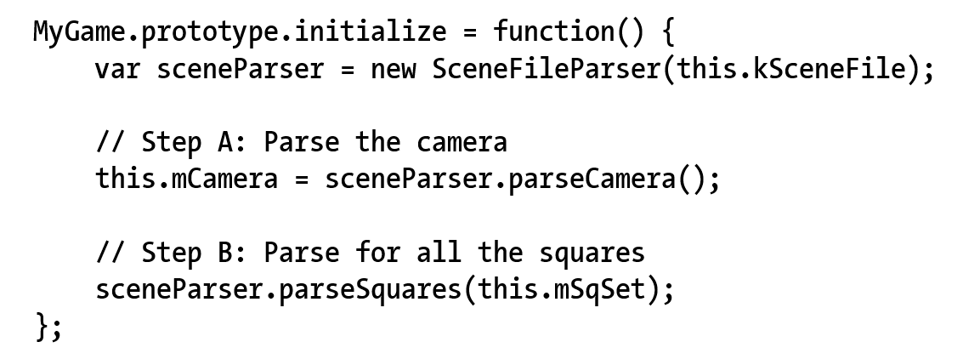
4.4: MyGame:initialize()
Game specific resources are now loaded!!

Slide 48
4.4: Engine: starting sequence with new MyGame
Index.html
Engine_Core.js

Slide 49
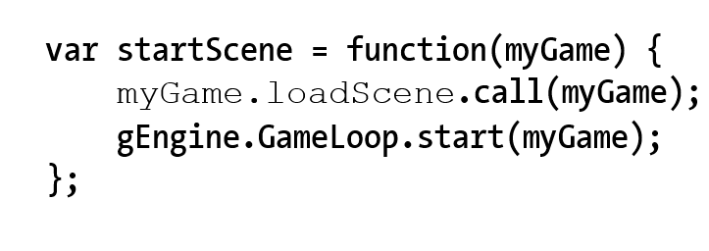
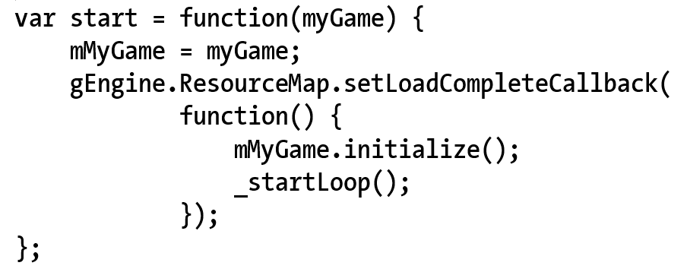
4.4: Engine Core: startScene()
Engine_Core.js
Engine_Loop.js

Slide 50

4.5: Scene Objects Project

Slide 51
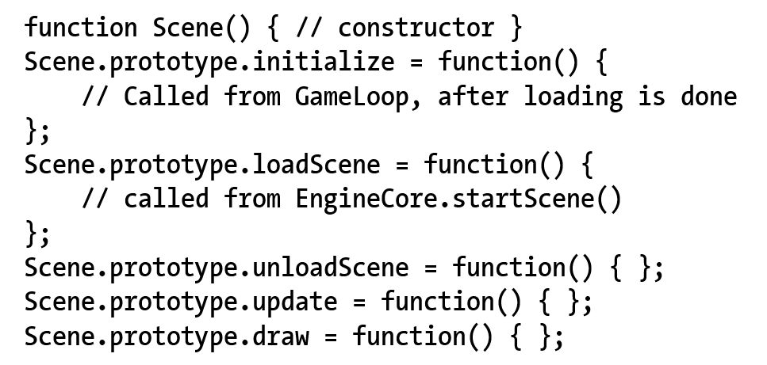
4.5: Scene Objects
Define GameEngine (Core and Loop) interface protocol with game developer (our API user)
Abstract class for subclass by clients

Slide 52
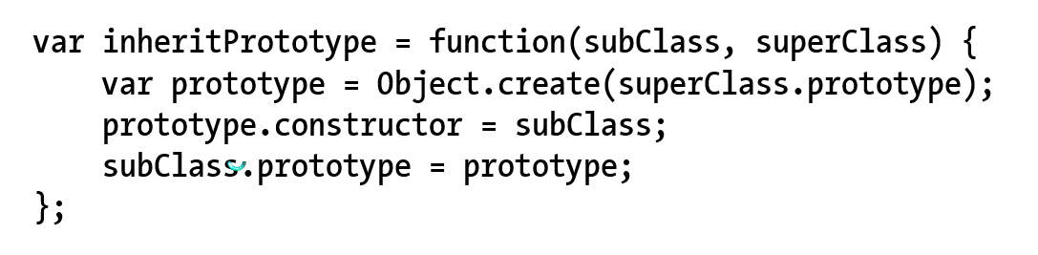
4.5: Support for “sub-classing”
Engine_Core.js

Slide 53
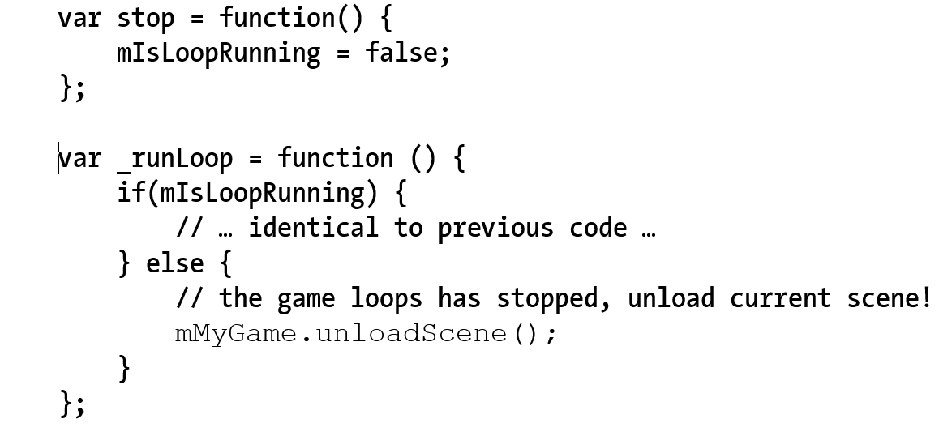
4.5: Game Loop: stop to unload resources
Engine_Loop.js

Slide 54
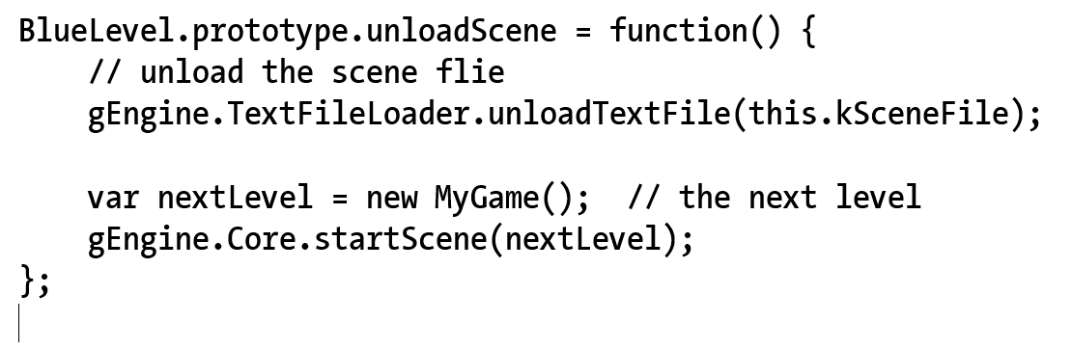
4.5: Loading the next Scene …

Slide 55
Questions
Given MyGame: Constructor(), init(), load(), unload(), draw(), update()
What is the sequence that the above functions are called?
First is:?
Second is:?
Use our engine as an example, explain
why that in addition to Constuctor(), there is the init() function?
Which object is calls the
myGame.initialize() function?

Slide 56
Questions
Given MyGame: Constructor(), init(), load(), unload(), draw(), update()
Constructor(), load(), init() … loops of update() + draw() … unload()
Note: unload() is called from Loop!!
Use our engine as an example, explain
why that in addition to Constuctor(), there is the init() function?
At the end of loading DefaultResources,
Engine.Core needs to know what to do
➔ in our case, EngineCore calls Scene.loadScene()
at this point, system init is done, Scene object can safely load
➔Scene.init() is only called _AFTER_ Scene’s load is done (in Loop)
Which object is calls the
myGame.initialize() function?

Slide 57
4.6: Audio support
Audio: files
Just another example of external resource!
Support for mp3 and wav formats
HTML5: AudioContext
Load/Decode audio resources
Play audio resources!!
Two important categories
Audio as music: e.g., background
Continuous playing, need control
Audio as cue:
Short, no need for control

Slide 58
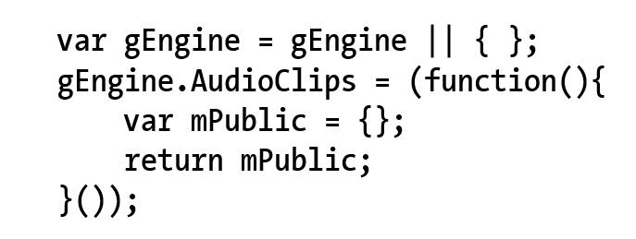
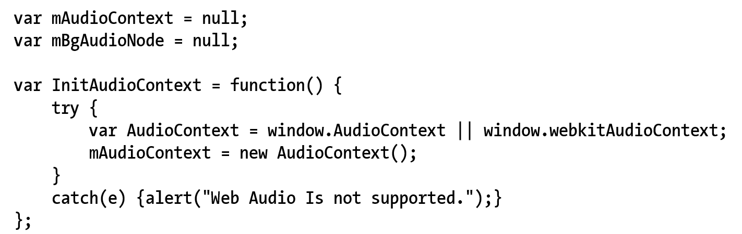
4.6: Engine_AudioClip: Component

Slide 59

4.6: Loading of AudioClips
Exact same structure as TextFile loader
Work with ResourceMap
isAssetLoaded()
asyncLoadRequested()
NEW: incAssetRefCount()
In case loaded multiple times!!
req.onLoad() … next slide

Slide 60

4.6: req.onLoad(): once loaded …
Store the entire file content to ResourceMap
asyncLoadCompleted()!

Slide 61

4.6: Audio as Cue
Each Cue must be a separate file!
Start and no more control!

Slide 62


4.6: Background music support
Keep reference for future control

Slide 63
Chapter 4: Learned?
Game loop
Keyboard input: event and keycodes
Resource management and asynchronous loading
Game level and scene files
How to subclass with JavaScript
Audio support

