Slide 1
Chapter 6
Examples 1, 2, and 3
Defining Behaviors and Detecting Collisions

Slide 2
This Chapter
Start thinking about behavior
Implement autonomous, controlled, gradual turning and target-locked chasing behaviors
Needs for collision detection
Simple: Axis-Aligned BBOX
Collide textured objects accurately
Per-Pixel-accurate collision
Understand algorithm and efficiency
Derive and implement general solution

Slide 3
Review: Where are we?
Chapter 2+3: Hides Drawing
GLSL Shader, SimpleShader, Renderable
Chapter 4: Utility components
Loop, Keyboard input
Scene object: API interface
Resources management, Audio
Chapter 5: Drawing of “objects” as textures and animation
TextutreShader and TextureRenderable
Sprite animation
Font
Need: Abstract behavior wrapping

Slide 4
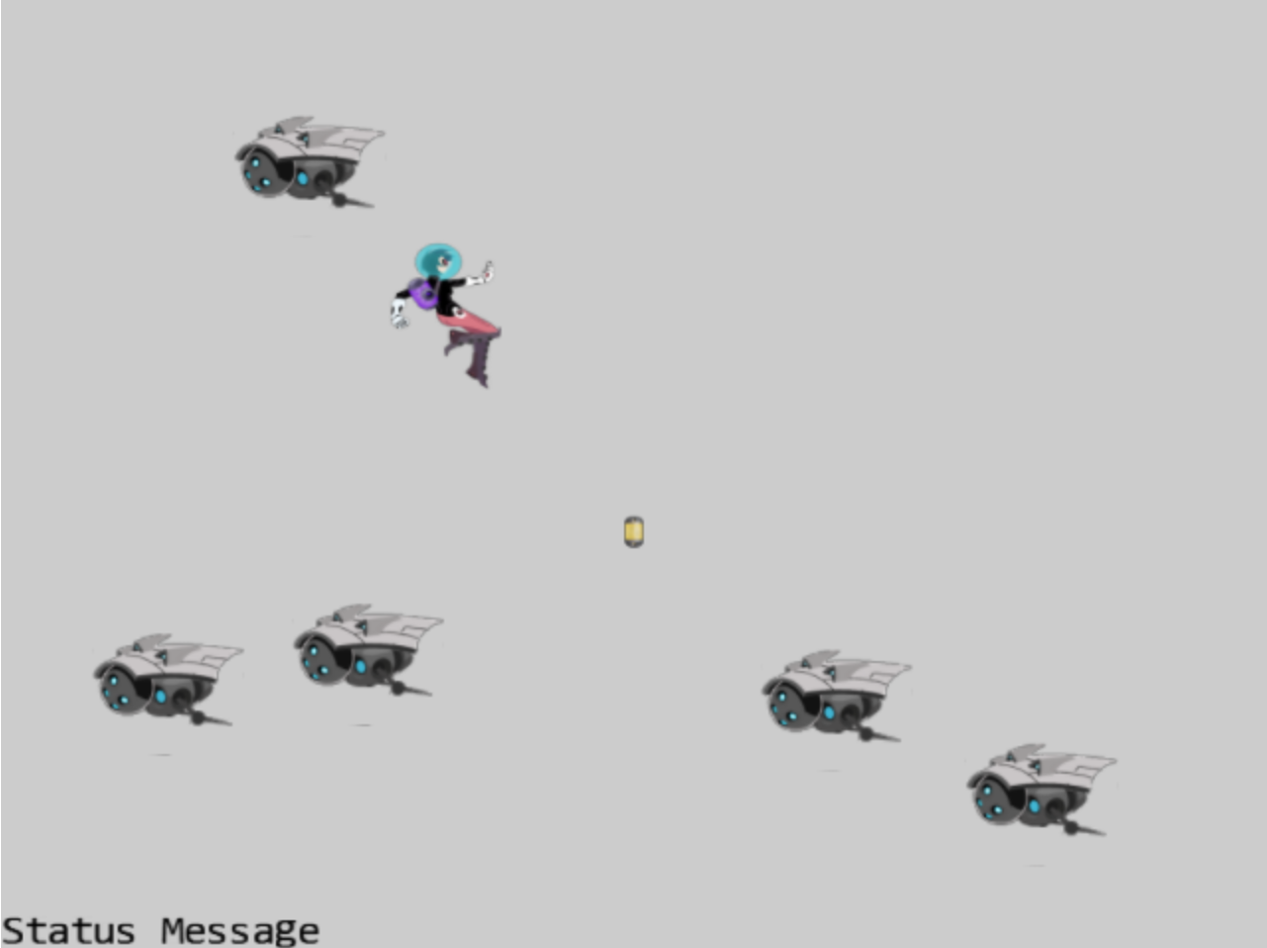
6.1: GameObjects Project

Slide 5
6.1: Goals
Define the GameObject:
To begin abstract/hide behavior implementation
Clean up drawing interface: should pass in Camera

Slide 6
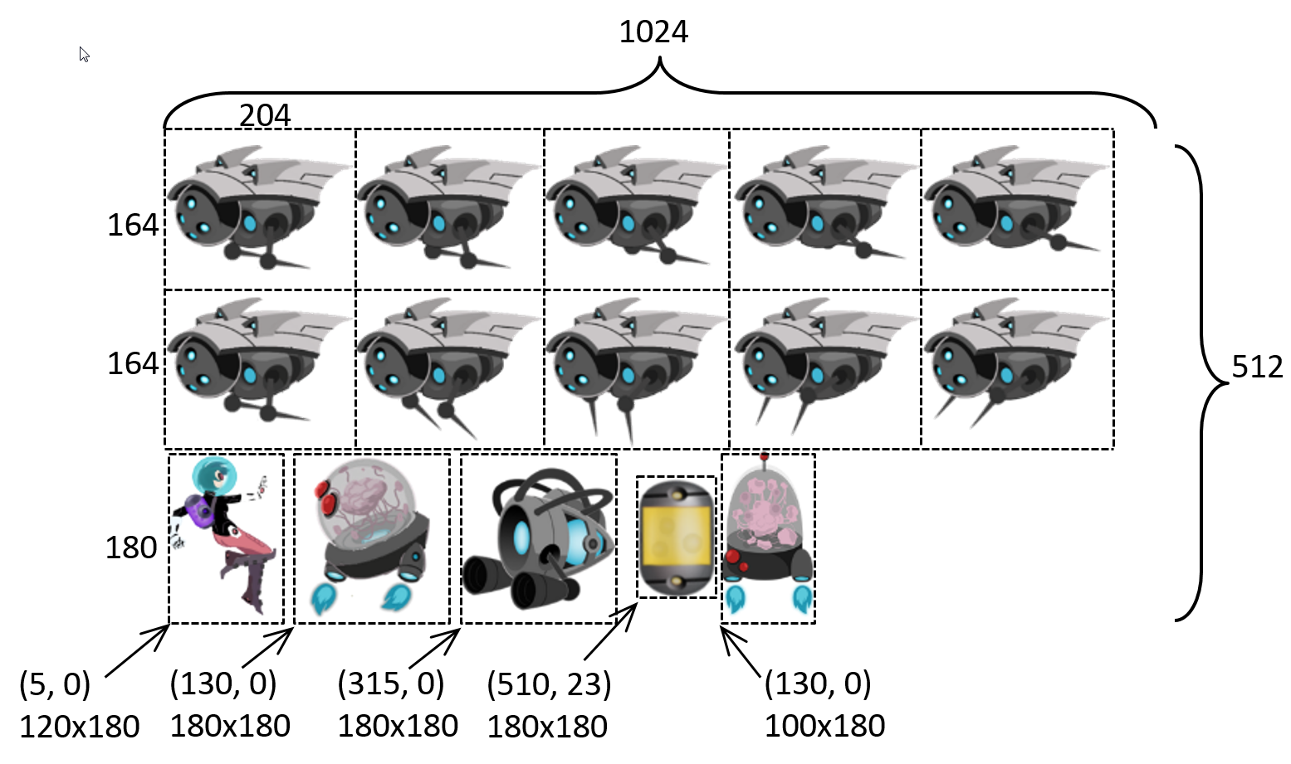
New sprite element

Slide 7
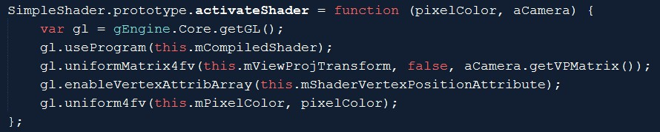
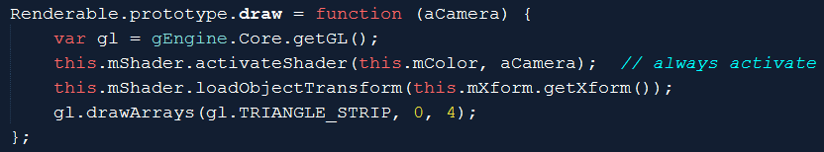
Draw: with a Camera (instead of vpMatrix)

Slide 8
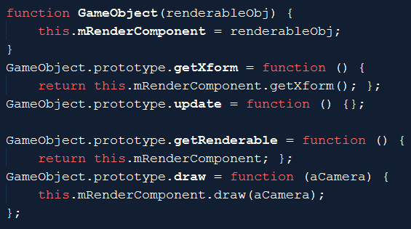
GameObject: capturing behaviors!
update()
Implements object behaviors
Has a renderable
Can be drawn
Has a xform
Can be maniuplated

Slide 9
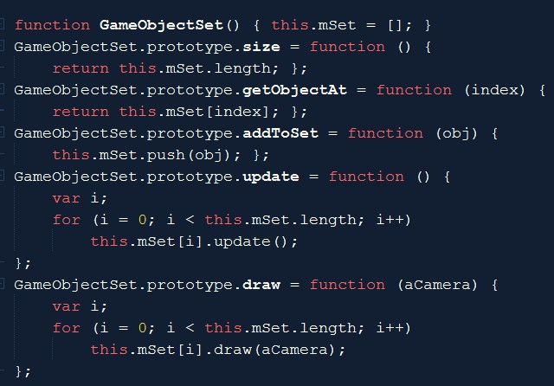
GameObjectSet:
Set of GameObjects
Set maintenance
Add/Size/Access
GameObjects support
update/draw

Slide 10
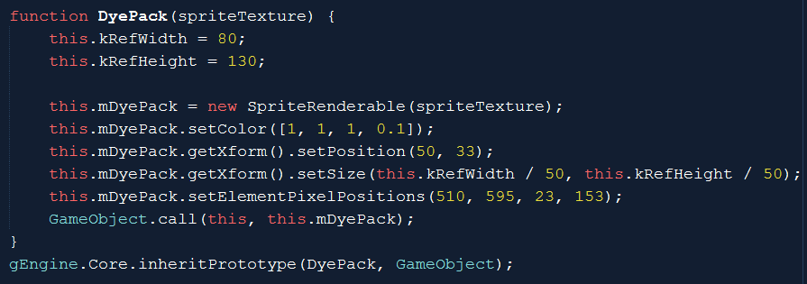
Work with GameObject
Custom object: DyePack

Slide 11
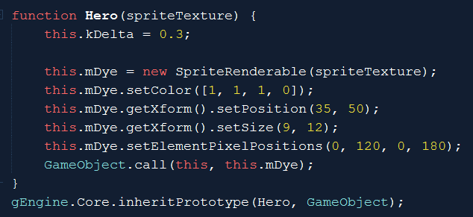
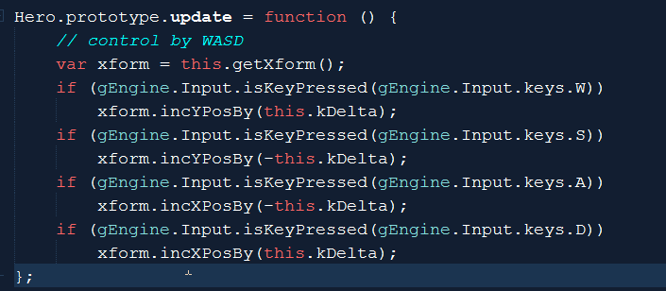
The Hero
The Definition
Behavior!
Hidden from MyGame
Avoid code clustering in MyGame

Slide 12
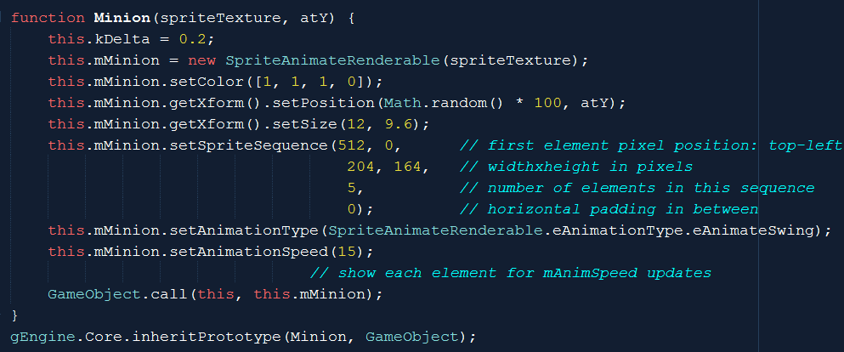
Minion

Slide 13
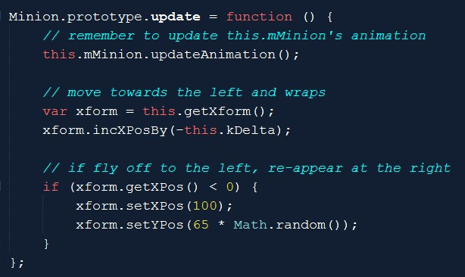
Minion’s interesting behavior
MyGame: no need to have any knowledge of how minion’s behave!

Slide 14
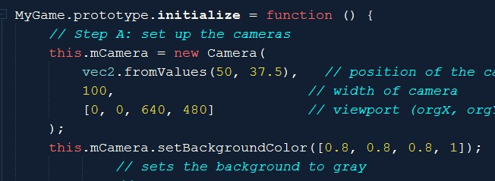
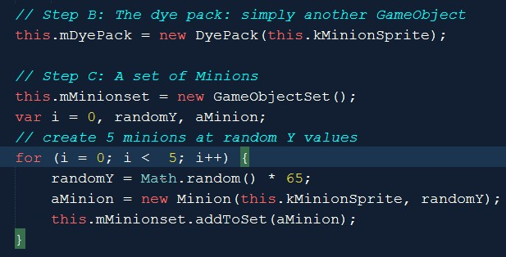

MyGame::initialization()

Slide 15
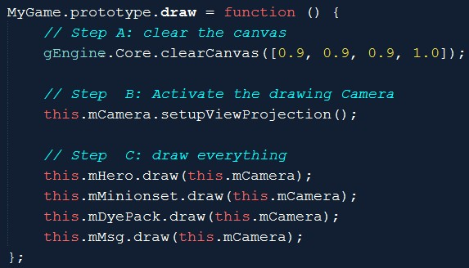
MyGame draw()
draw()
Init camera
Pass camera to GameObjects

Slide 16
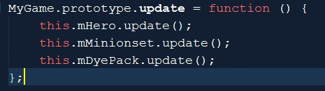
MyGame update()
Core of game logic:
Each object updates state
No object interact:
So, that’s that!
Notice:
MyGame does not know anything about each object
Control/Behavior: all hidden inside each object
MyGame: will take care of interaction of objects (to come)!
For objects to interact: need to be aware of other objects!

Slide 17
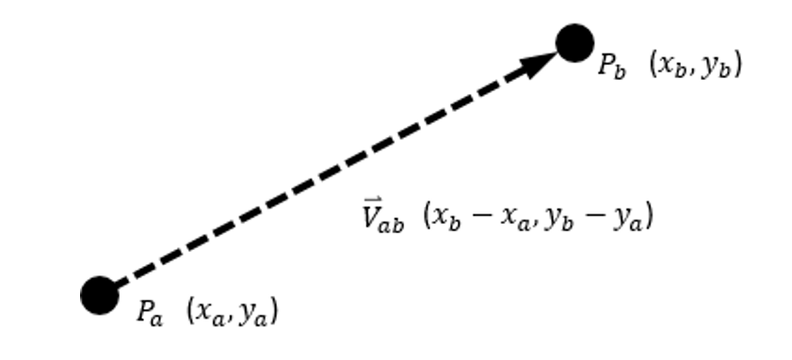
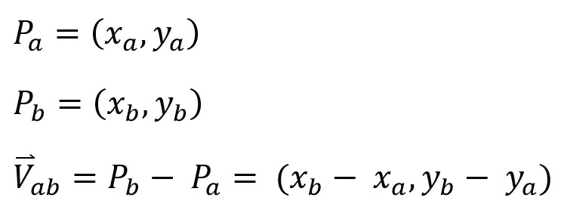
Vectors: Review
From point to point
Has a size
Magnitude, length, distance

Slide 18
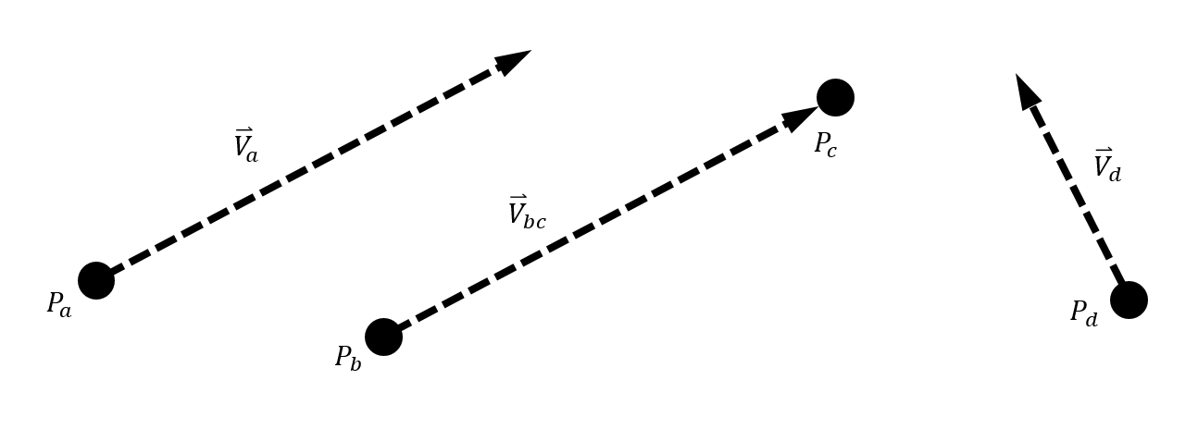

Vectors: direction and size
Point + Direction (${\overset{⃑}{V}}_{a}$)
Two points (${\overset{⃑}{V}}_{bc}$)
${\overset{⃑}{V}}_{a}=={\overset{⃑}{V}}_{bc}$

Slide 19
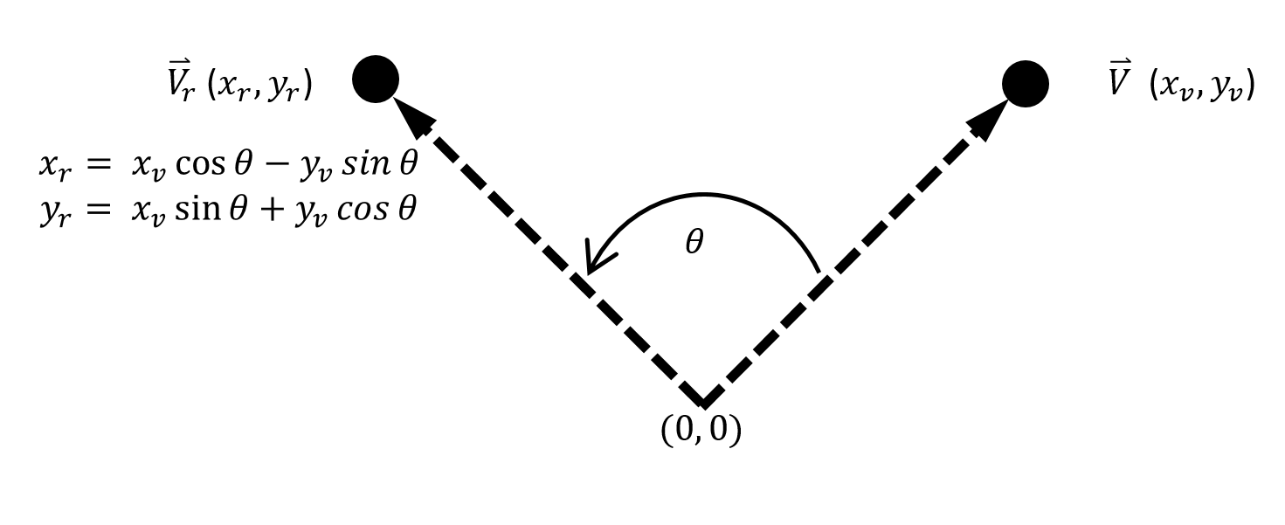

Vector: rotation
Add to gl_matrix library: vec2.rotate(${\overset{⃑}{V}}_{r}\text{,} \overset{⃑}{V}$, $θ$)
$θ$ in radian

Slide 20
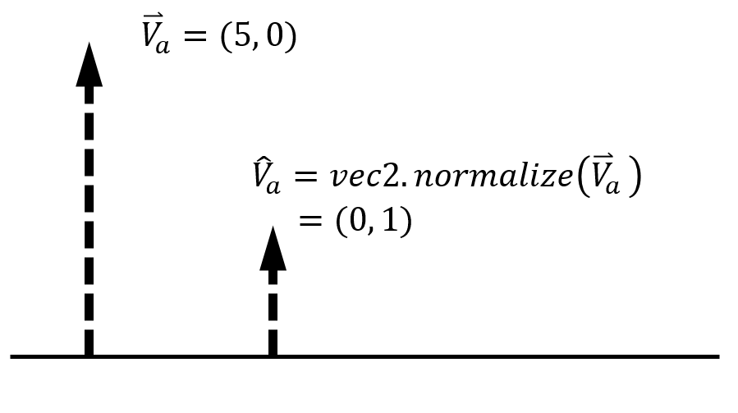
Vectors: normalization

Slide 21

Vectors: normalization
${\overset{⃑}{V}}_{a}=size({\overset{⃑}{V}}_{a})×{\hat{V}}_{a}$

Slide 22

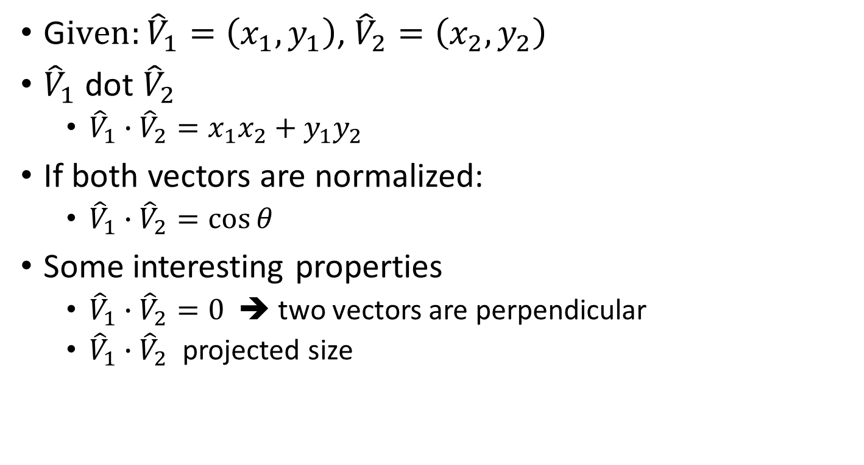


Vector: dot product
$${\hat{V}}_{1}$$
G$iven:{\hat{V}}_{1}=\left(x_{1},y_{1}\right)$, ${\hat{V}}_{2}=\left(x_{2},y_{2}\right)$
${\hat{V}}_{1}$ dot ${\hat{V}}_{2}$
${\hat{V}}_{1}∙{\hat{V}}_{2}={x_{1}x}_{2}+y_{1}y_{2}$
If both vectors are normalized:
${\hat{V}}_{1}∙{\hat{V}}_{2}=\cos{θ}$
Some interesting properties
${\hat{V}}_{1}∙{\hat{V}}_{2}=0$ ➔ two vectors are perpendicular
${\hat{V}}_{1}∙{\hat{V}}_{2}$ projected size
$${\hat{V}}_{2}$$
$$θ$$

Slide 23
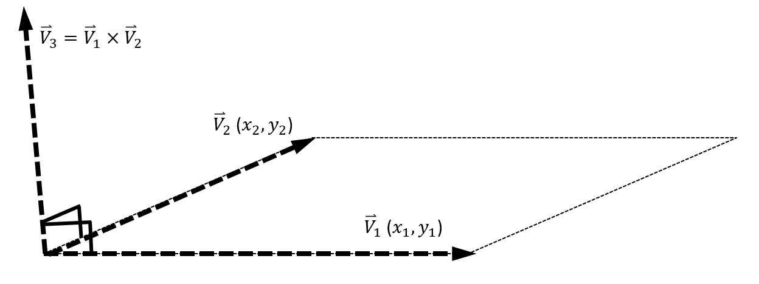
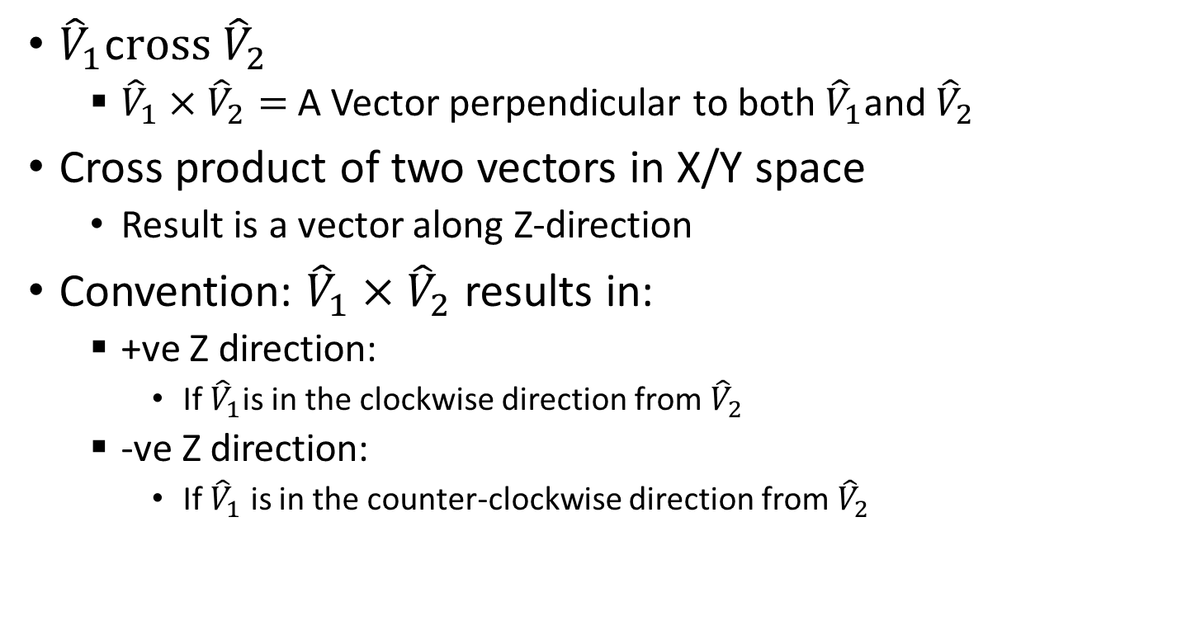
Vector: cross product
${\hat{V}}_{1}$c$ross {\hat{V}}_{2}$
${\hat{V}}_{1}×{\hat{V}}_{2}=$ A Vector perpendicular to both ${\hat{V}}_{1}$and${\hat{V}}_{2}$
Cross product of two vectors in X/Y space
Result is a vector along Z-direction
Convention: ${\hat{V}}_{1}×{\hat{V}}_{2}$ results in:
+ve Z direction:
If ${\hat{V}}_{1}$is in the clockwise direction from${\hat{V}}_{2}$
-ve Z direction:
If ${\hat{V}}_{1}$ is in the counter-clockwise direction from${ \hat{V}}_{2}$

Slide 24
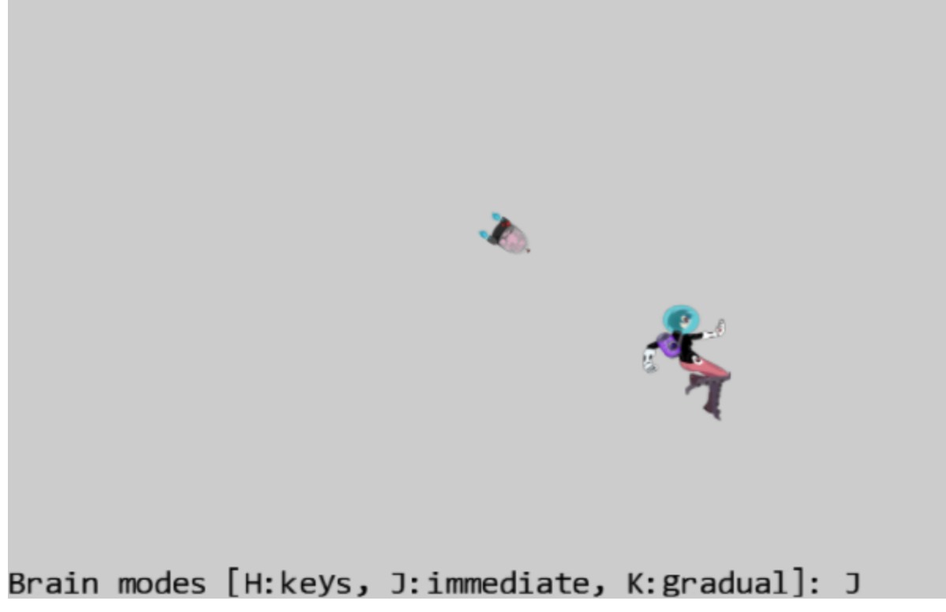
6.2: Front and Chase Project

Slide 25
6.2: Goals
work with velocity: as speed and direction
practice traveling along a predefined direction
implement chasing or home-in behavior

Slide 26
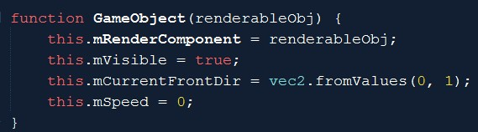

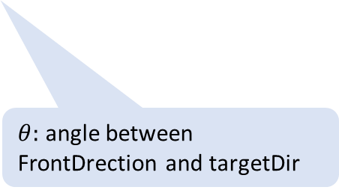
GameObject: initial state
$θ:$ angle between FrontDrection and targetDir
Initial front direction

Slide 27
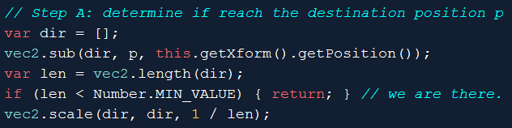
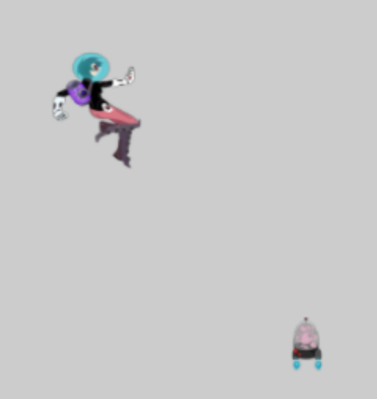
GameObject::rotateObjPointTo(p)
Position: p
dir: towards p
len (length of dir)
this.getXform().getPosition()

Slide 28
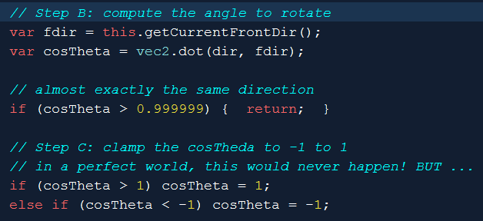
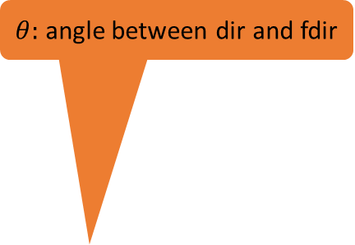
GameObject::rotateObjPointTo(p)
Position: p
$θ:$ angle between dir and fdir
dir: towards p
fdir: front of object
len (length of dir)
this.getXform().getPosition()

Slide 29
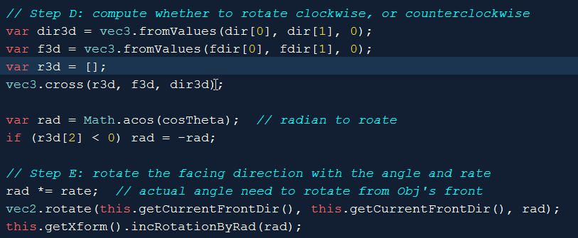
GameObject::rotateObjPointTo(p) cont …
this.getXform(): set rotation

Slide 30
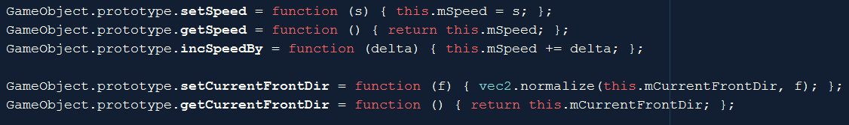
MyGame: set/get
Update speed
Set Front Dir: maintain normalized vector!

Slide 31
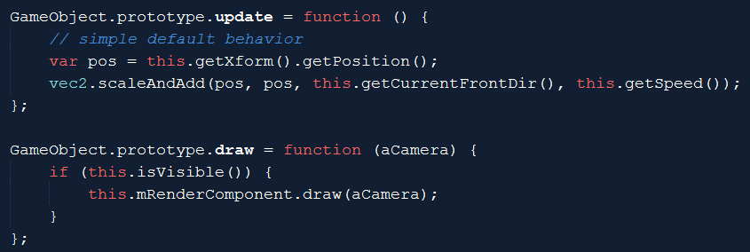
GameObject: update and draw

Slide 32
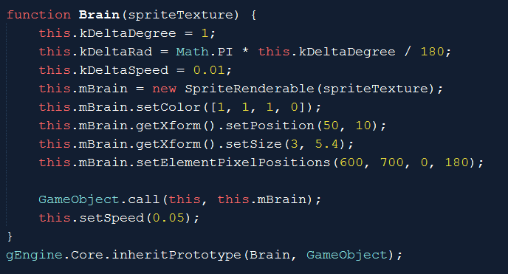
Testing rotate towards object: the Brain

Slide 33
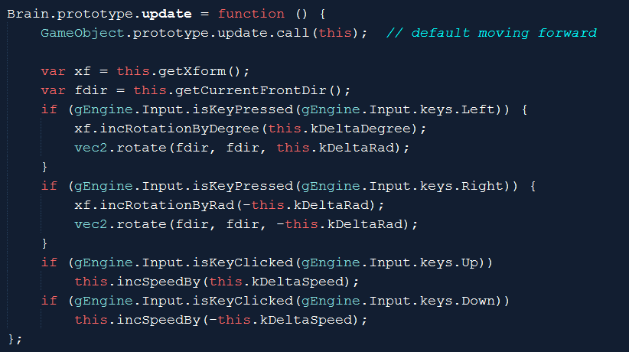
Brian: private behavior
Drive the brain
Change speed
Direction and Speed are independent

Slide 34
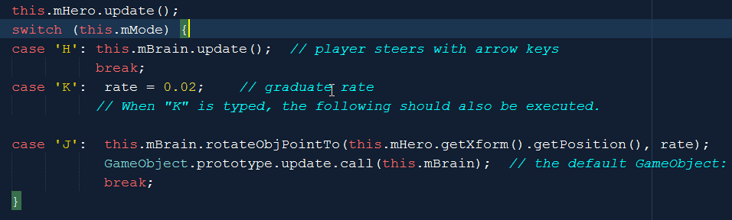
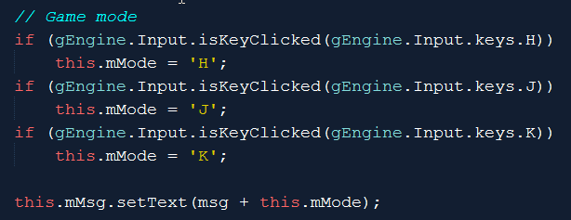
MyGame::update
Default is: 1.0

Slide 35
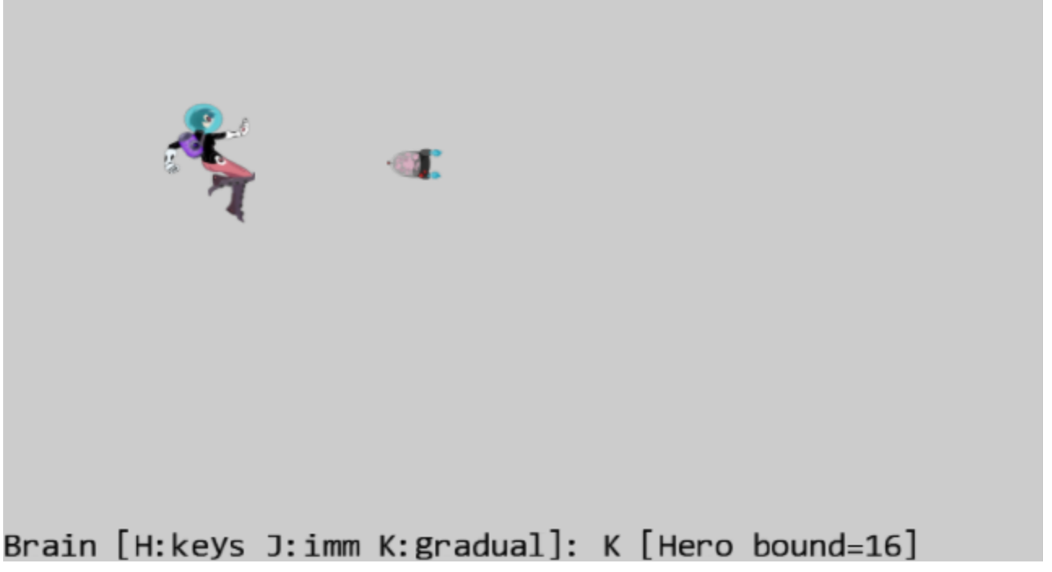
6.3: BBOX and Collision Project

Slide 36
6.3: Goals
understand bounding box and its implementation
experience working with bounding box of a GameObject
compute and work with the bounds of a Camera WC window
program with collisions

Slide 37
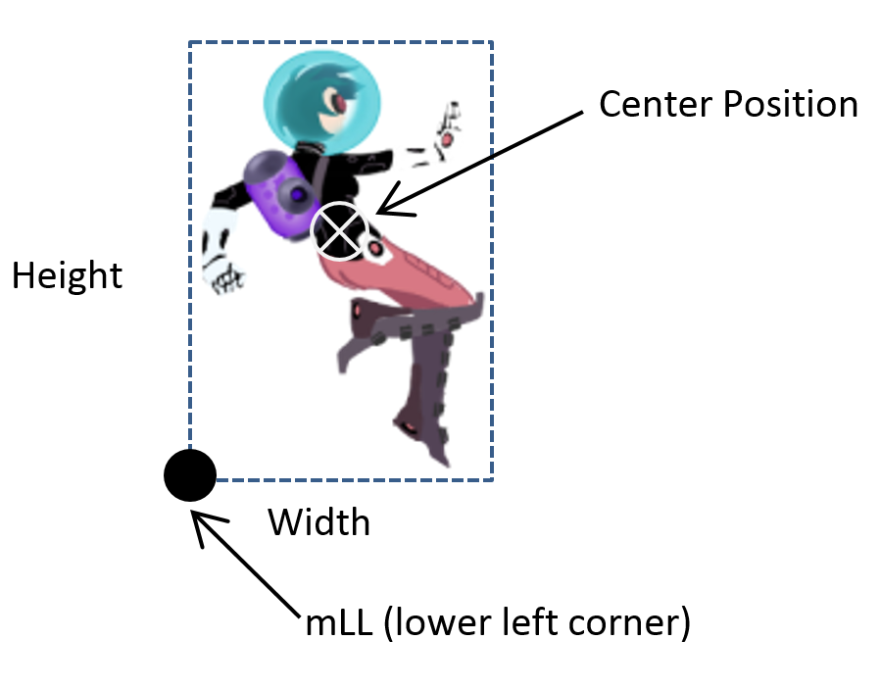
Bounding Box
Always major-axis aligned
4 floats in 2D
Point + Dimension
Center + W x H
Lower Left + W x H
2 points
Lower Left + Upper Right
“Easy” (efficient) to compute overlaps!!

Slide 38
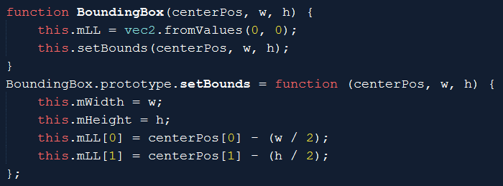
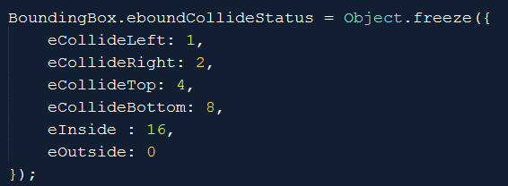
BoundingBox class

Slide 39
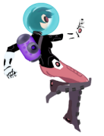
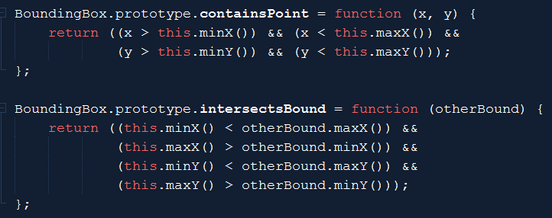
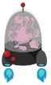
Bounds tests
(maxX, maxY)
(minX, minY)

Slide 40
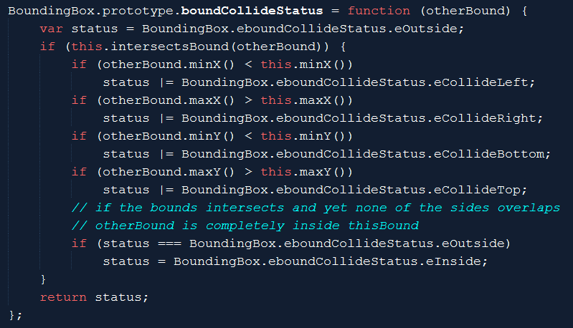
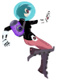
Bbox: Collision status
eCollideRight
eCollideTop
eCollideLeft
eCollideLeft | eCollideBottom
eCollideBottom
eOutside

Slide 41
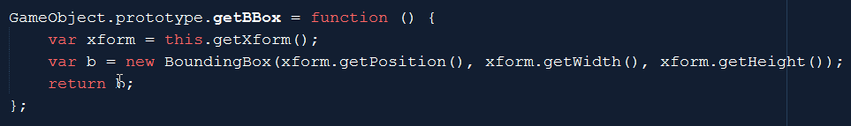
Using Bbox in GameObject
Design decision: compute on the fly!
Good:
No state to maintain (no need to update after xform change)!
Bad:
Not free to create
Bbox inquiry should be done no more than once per object per update

Slide 42

Using Bbox in Camera
Collide a xform with WCBounds
Zone: a percentage of WC Bounds
WC Center
eCollideLeft
Camera WC Bounds
zone
eOutside

Slide 43

Testing Bbox
Stop brain
Print status as a number:

Slide 44
Try
Hero bound status:
16 is outside
What is 6? = 2 + 4
How about 12? = 4 + 8
Try change the bound % from 0.8 to 0.2
rate in MyGame
Try change from 0.02 to something much slower (like 0.001)
Notice the tendency/potentials of “orbiting”
Increase/decrease Brain speed (Up/Down arrows)
To see different orbiting behaviors

Slide 45

Important limitation of Bbox
Axis aligned
Void space
Our implementation no support for rotation!

