Slide 1
Chapter 4
Implementing Common Components of Video Games

Slide 2
This Chapter
Control the Renderable object’s position, size, and rotation to construct complex movements and animations
Receive keyboard input from the player and animate Renderable objects
Work with asynchronous loading and unloading of external assets
Define, load, and execute a simple game level from a scene file
Change game levels by loading a new scene
Work with sound clips for background music and audio cues

Slide 3
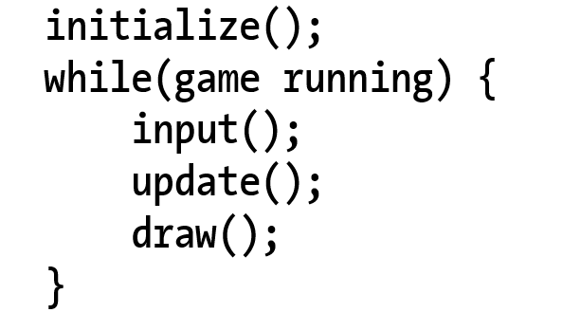
Game Loop
Typical structure
Notice: the input() update!

Slide 4
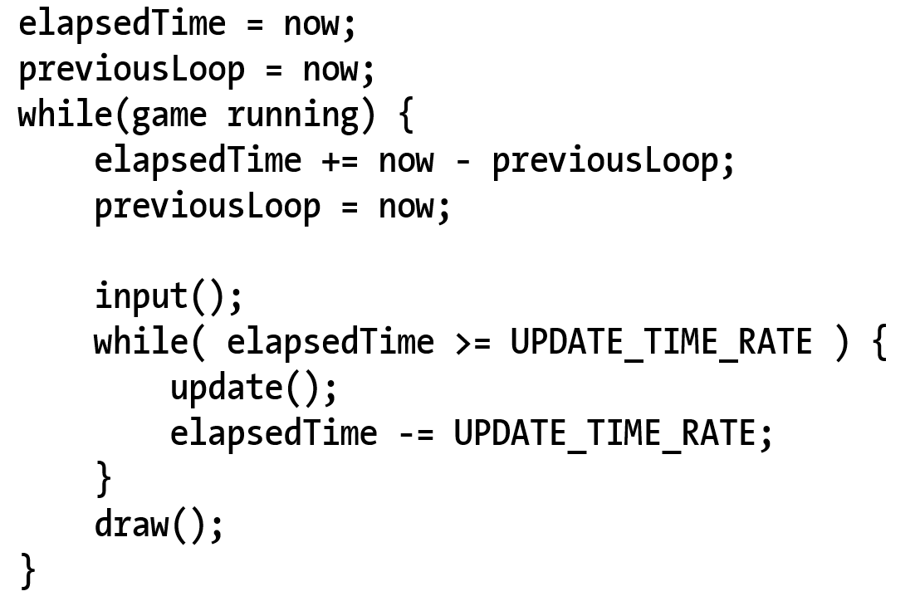
Game Loop: Implementation
Input() inside vs outside of the real-time loop?
Responsiveness when game is lagging
Fixed update rate:
Simple physics implementation (later in Chapter 9)

Slide 5
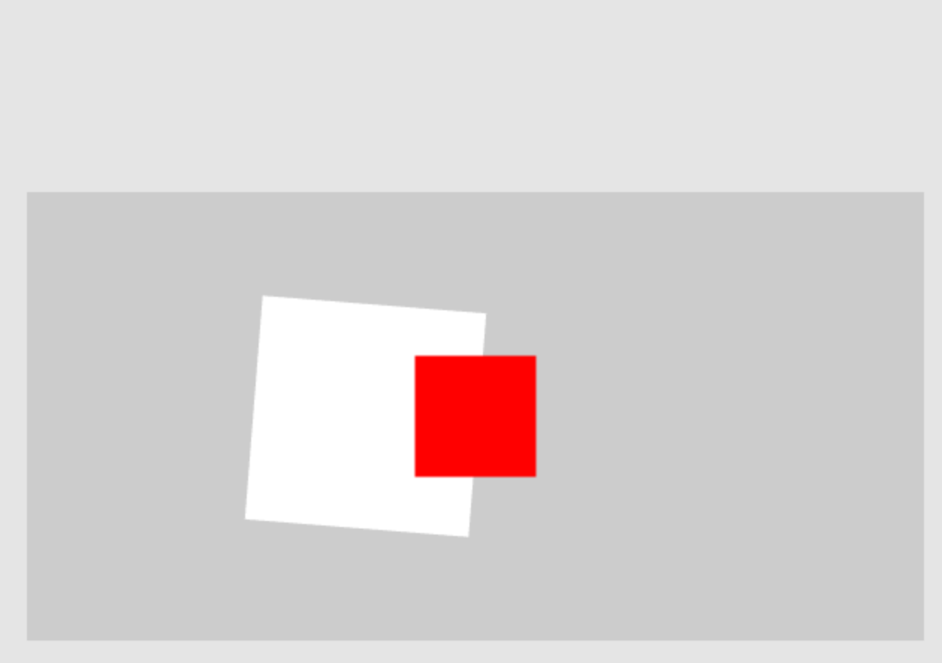
4.1: Game Loop Project

Slide 6
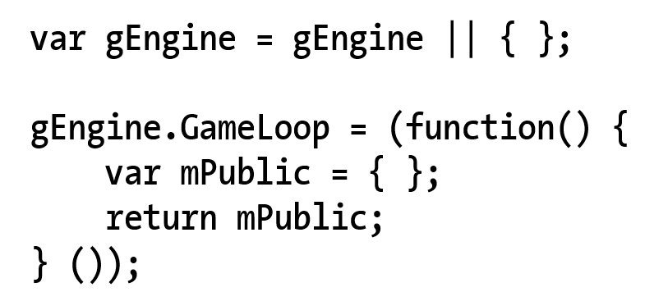
4.1: New Engine Component
New Engine component (similarity to gEngine.VertexBuffer!!)

Slide 7
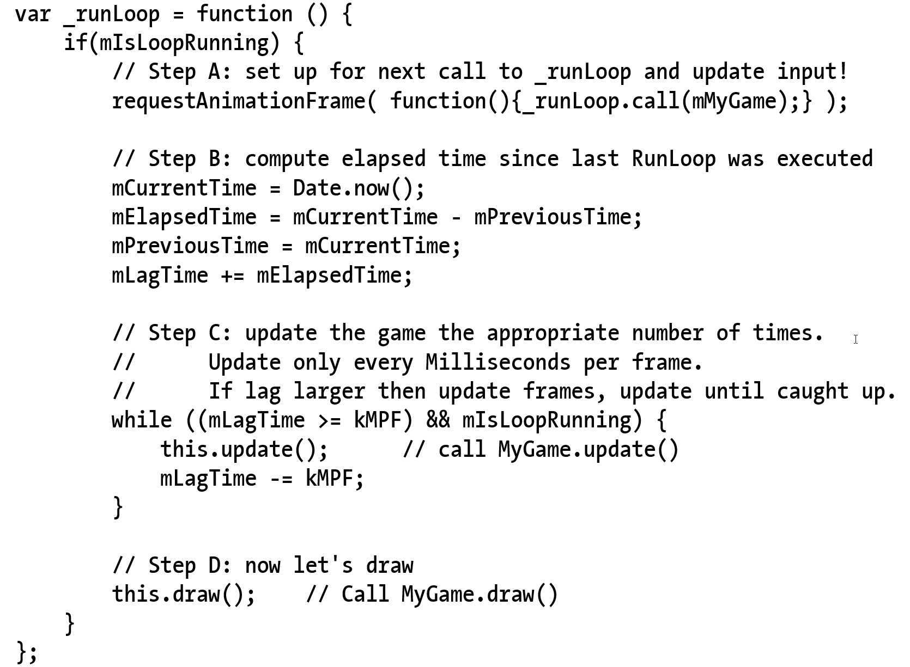
4.1: _runLoop()
Engine_GameLoop.js
requestAnimationFrame()
.call(class) ← syntax!
mIsLoopRunning not checked
Will do so later
No input() checking yet
update() and draw()
Separated!!
No update in draw
No draw in update!!

Slide 8
4.1: _runLoop()
Engine_GameLoop.js
requestAnimationFrame()
.call(class) ← syntax!
mIsLoopRunning not checked
Will do so later
No input() checking yet
update() and draw()
Separated!!
No update in draw
No draw in update!!

Slide 9
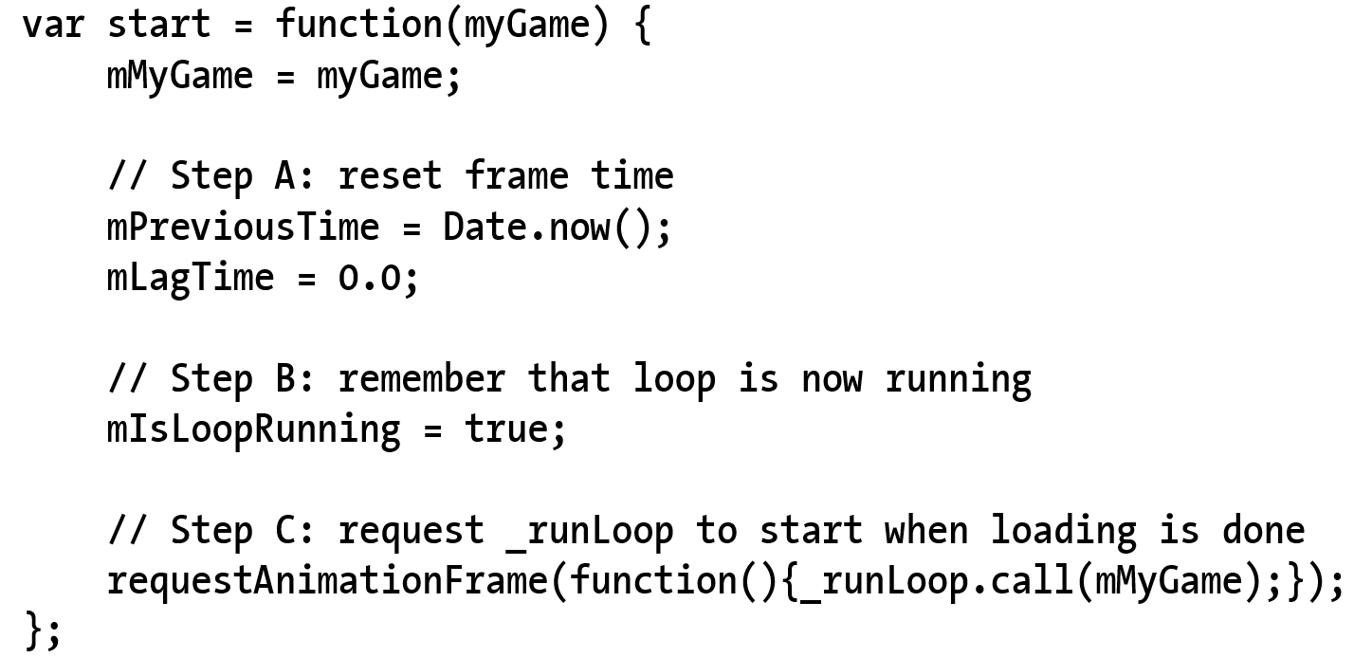
4.1: Trigger to start the loop
Note the initializations

Slide 10
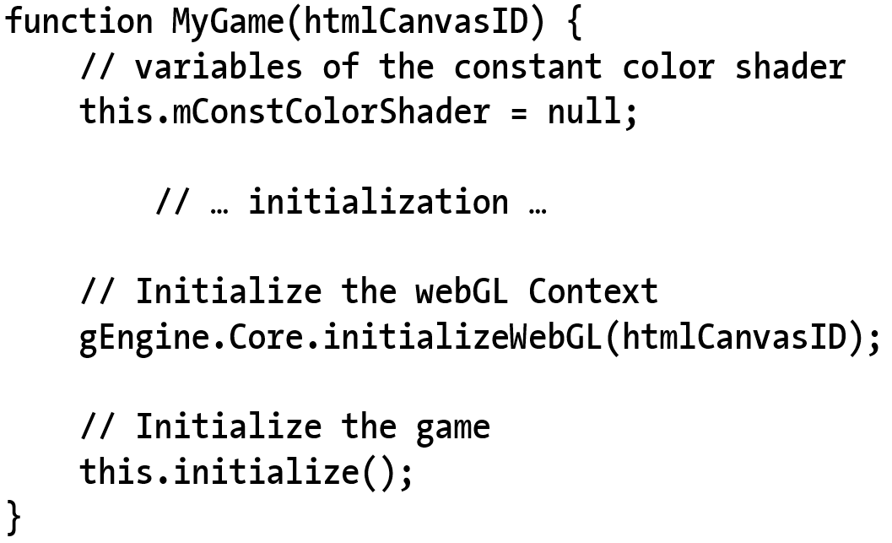
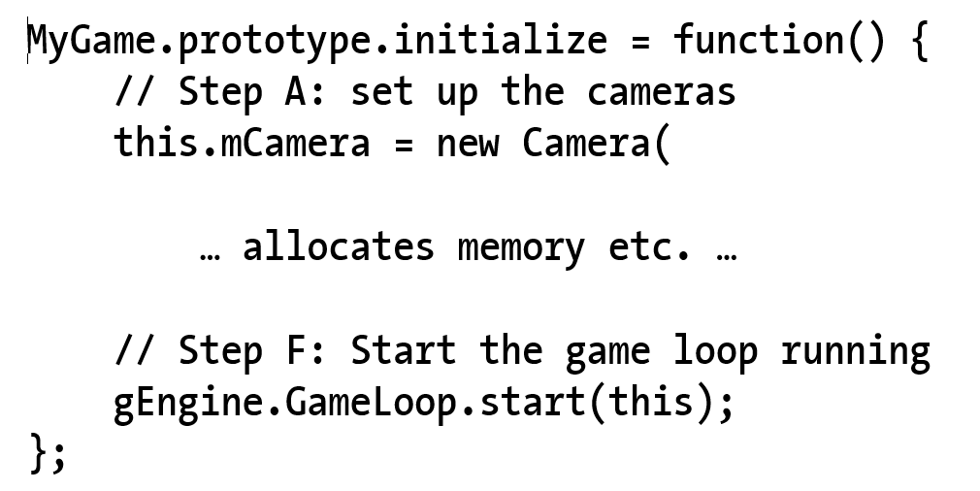
4.1: Starting the loop: MyGame.Initialize()

Slide 11
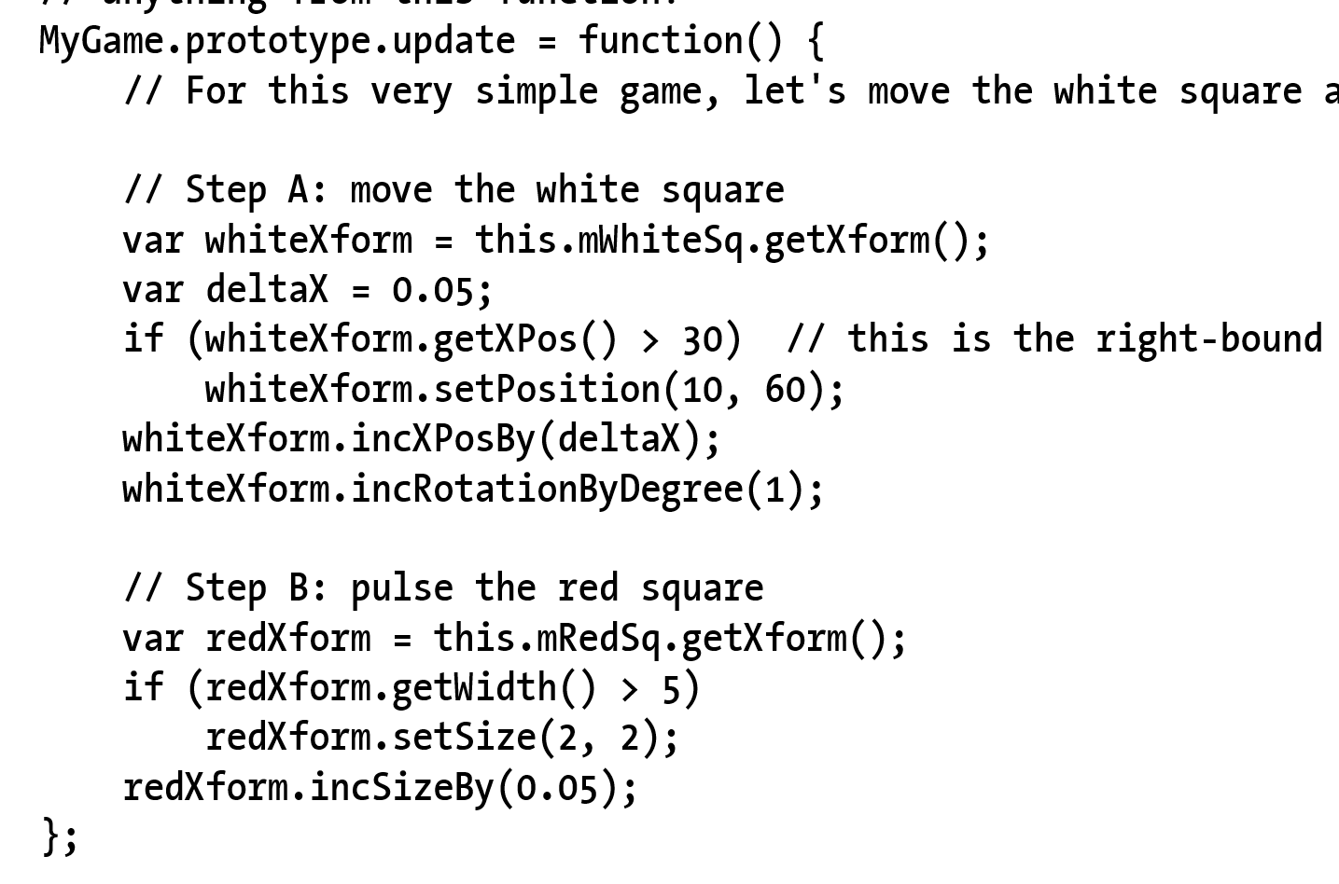
4.1: MyGame: update()

Slide 12
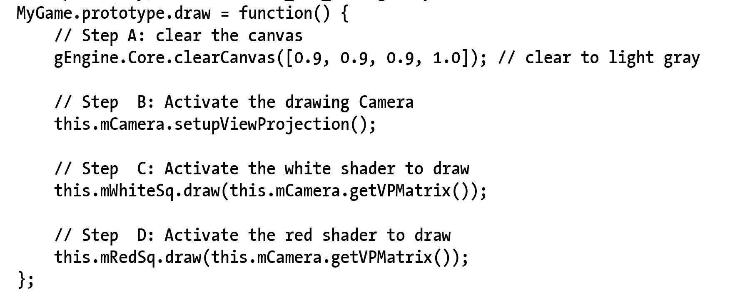
4.1: MyGame: draw()

Slide 13

4.2: Keyboard Input

Slide 14
4.2: Event and Keycodes
Events and event handlers
HTML5 Event registration and handlers
window.addEventListener(“Event”, handler)
Keycodes:
‘A’ = xx
‘B’ = xx+1
…

Slide 15
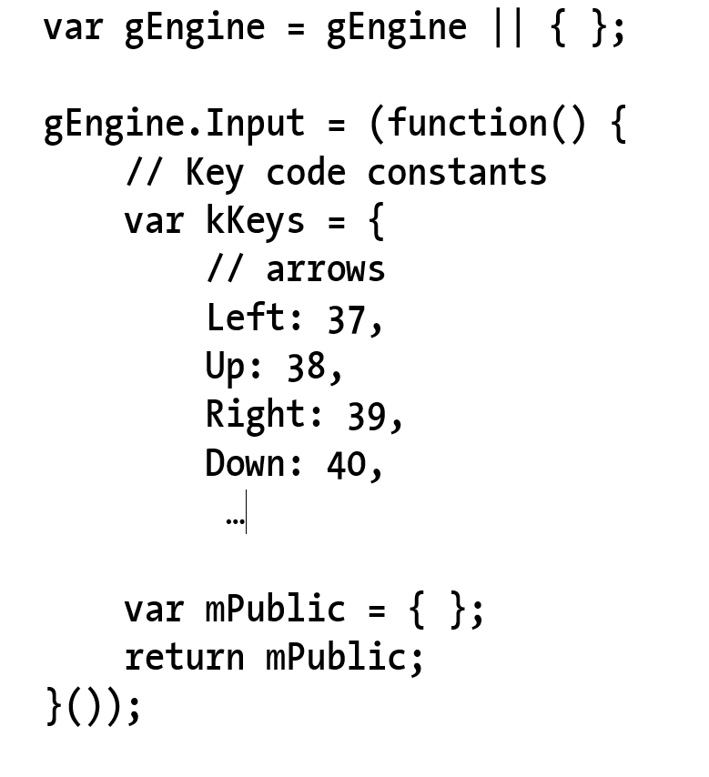
4.2: The Engine.Input component

Slide 16
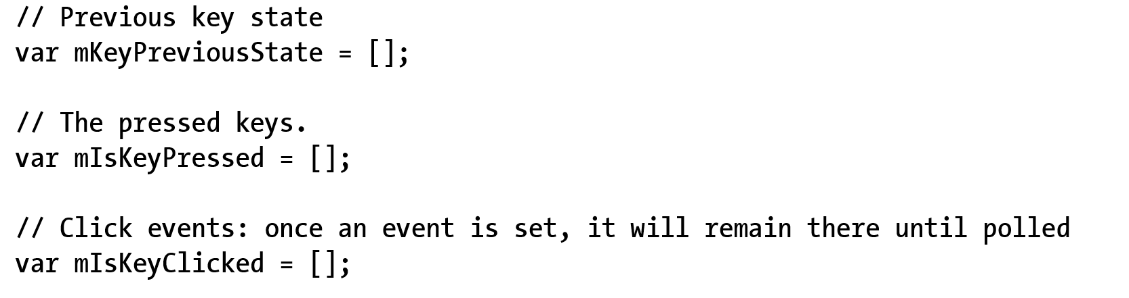
4.2: Input: variables for key states

Slide 17
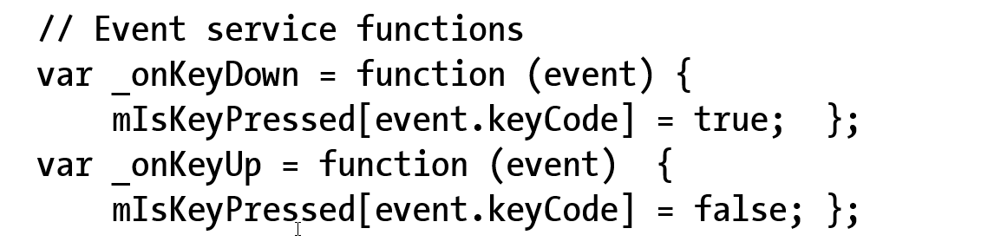
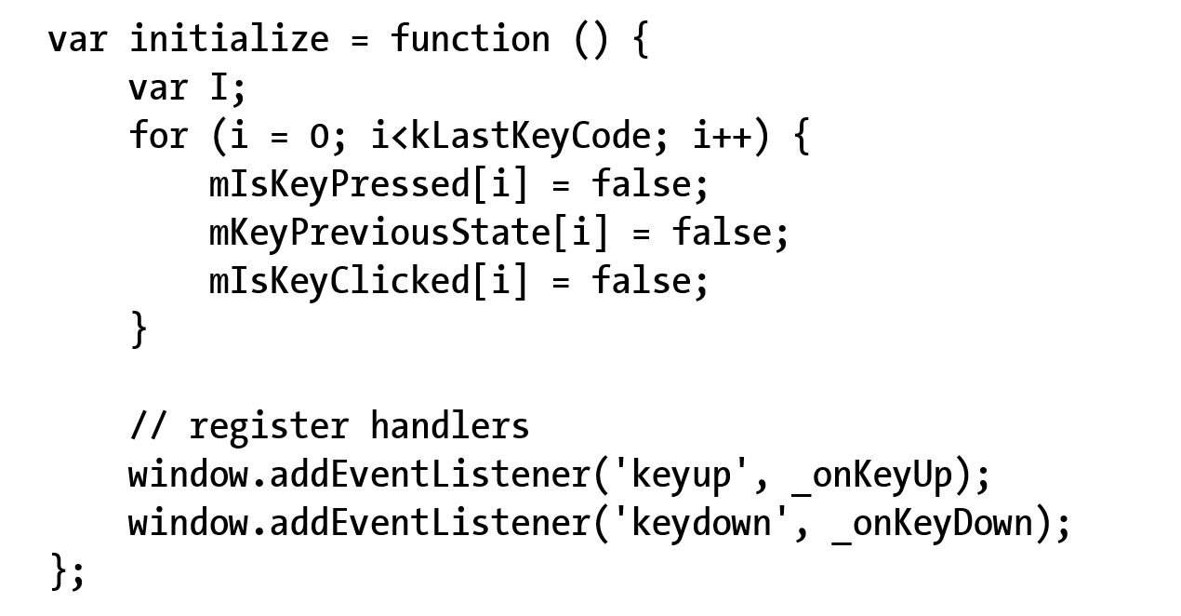
4.2: Event handlers and initialization

Slide 18
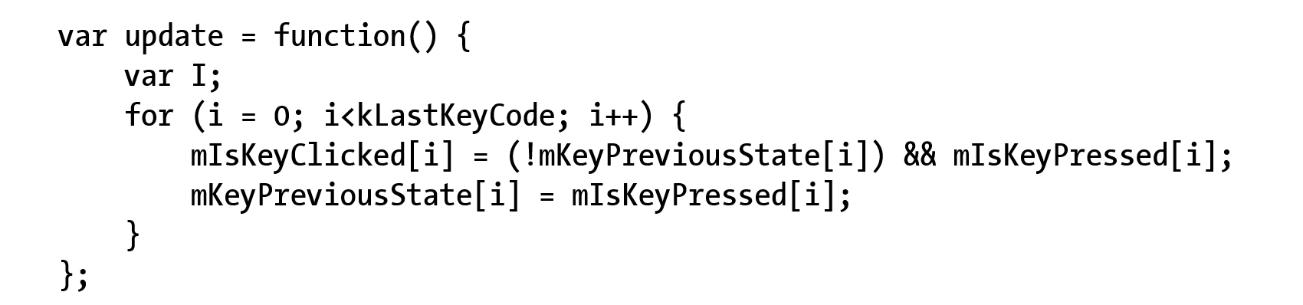
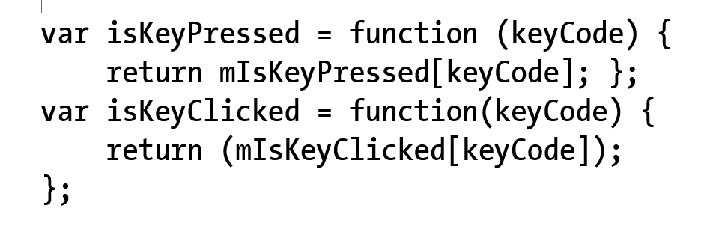
4.2: Keyboard update() and support

Slide 19
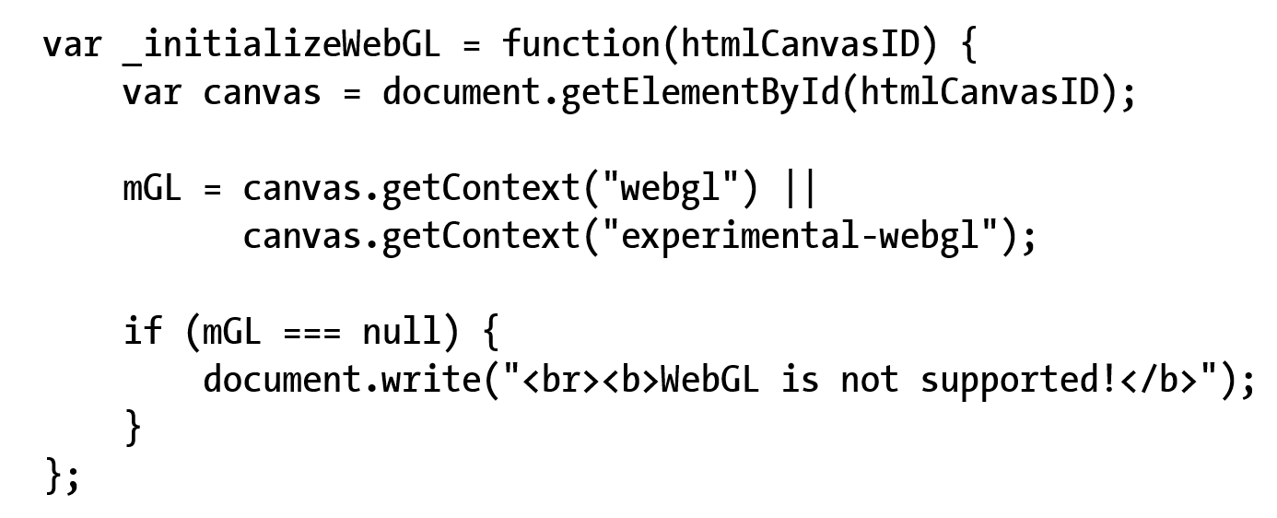
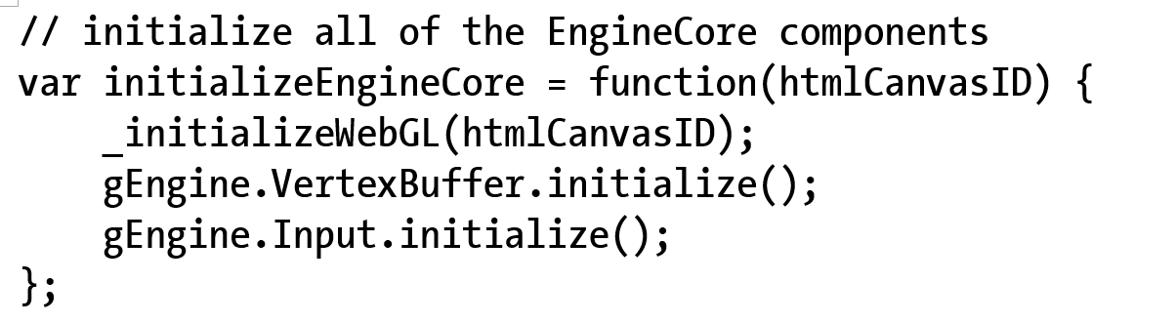
4.2: Engine.Core: to init Input

Slide 20
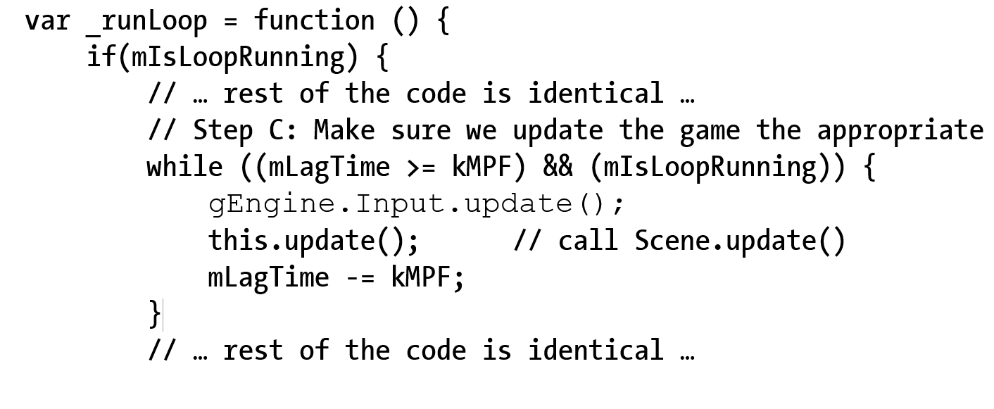
4.2: Engine.Loop: to update input

Slide 21
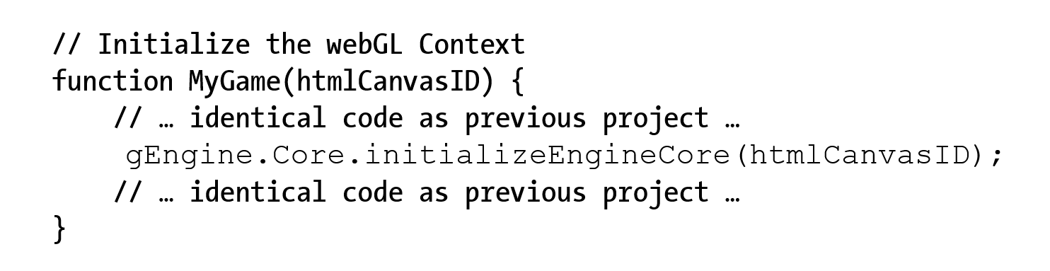
4.2: Engine initialization (from MyGame)

Slide 22
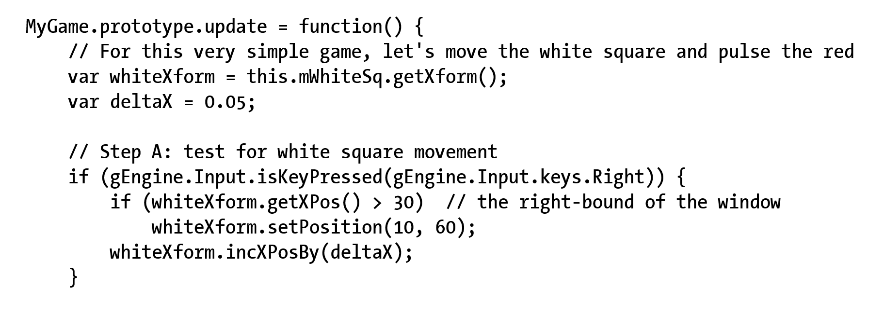
4.2: Testing Keyboard MyGame.update()

Slide 23
Resource Management
Synchronous load:
Issue load and wait
Stops web browser!!
May seem “hang” to user
Asynchronous load:
Issue load, provide “Callback” and continue
“Callback” is called when load is completed
Pro:
Efficient, support interactivity
Con:
Complex, requires synchronization

Slide 24

4.3: Resource Management Project

Slide 25
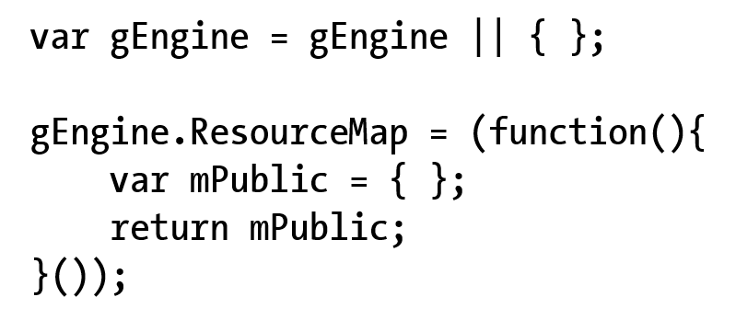
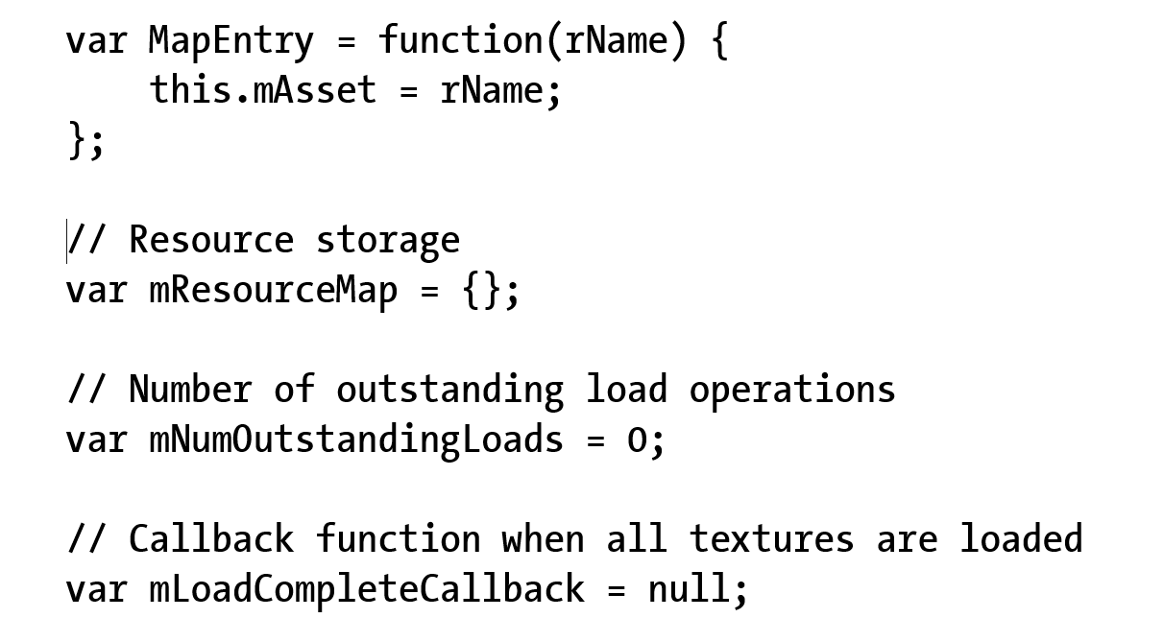
4.3: ResourceMap
ResourceMap:
Key-value pair of “string=id” and resource
E.g., file name and content of file

Slide 26
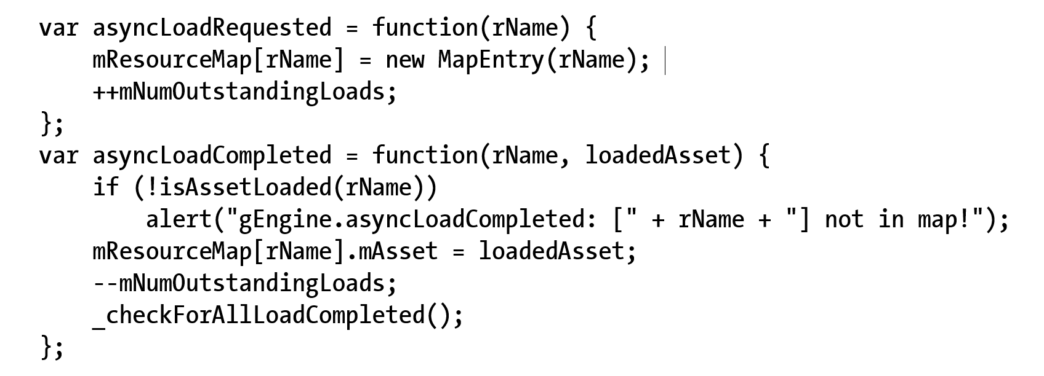
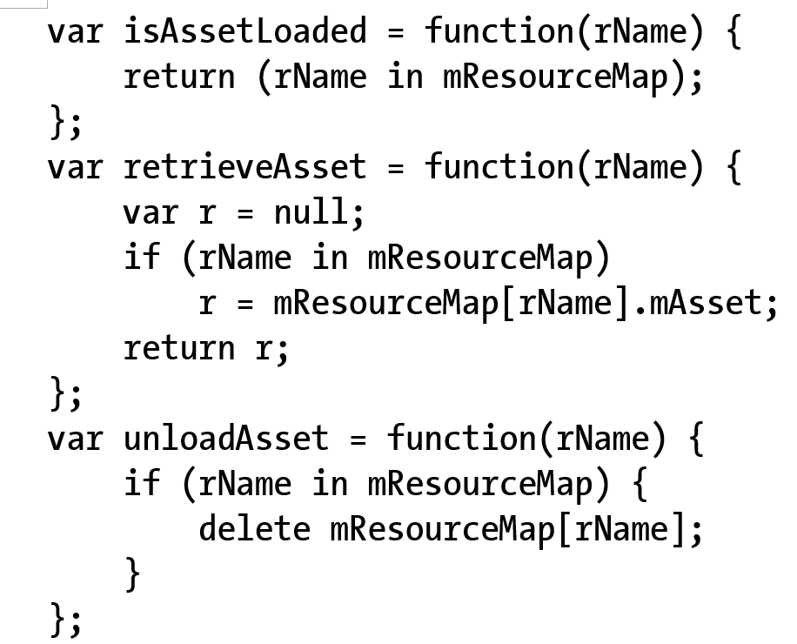
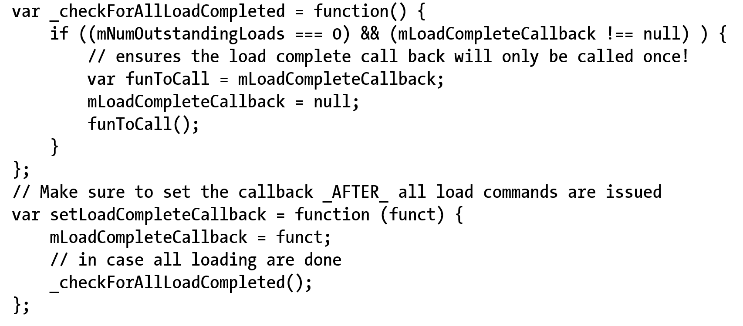
4.3: ResourceMap: functions
Load synchronization support
Create/Store-to EntryMap
Nothing else!
Asset assessing support
Check and retrieve
Misc support (e.g., call back)

Slide 27
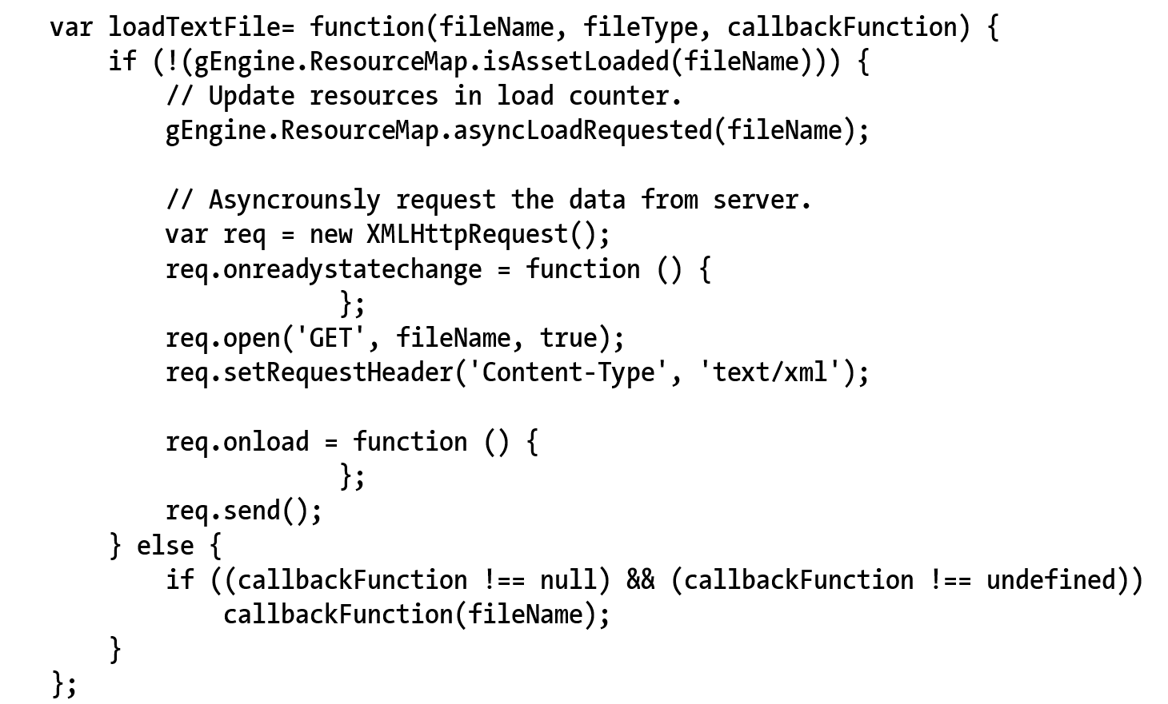
4.3: TextFileLoader: An Engine Component
Working with ResourceMap
isAssetLoaded():
Check before (re)-load!
Call to: asyncLoadRequest()
Filename (path) as ID
onreadystatechange()
Status report: next slide
onLoad()
When loaded: next slides

Slide 28
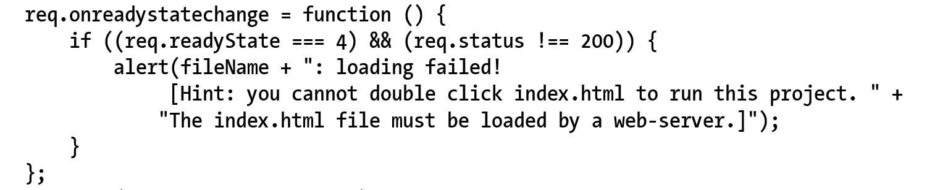
4.3: TextFileLoader: status check
Status check!

Slide 29
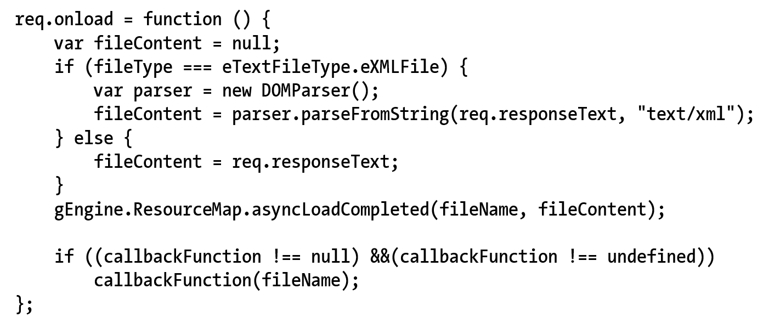
4.3: TextFileLoader: onLoad()
Successful loaded
If loading XML
Create DOMParser()
If plain textfile
Return the entire text source
Work with ResourceMap
asyncLoadCompleted()

Slide 30
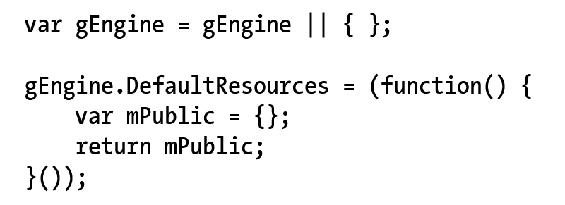
4.3: Engine DefaultResoruces
Notice SimpleShader is shared by all Renderables!!
There will be many other examples
Define DefaultResources engine component

Slide 31
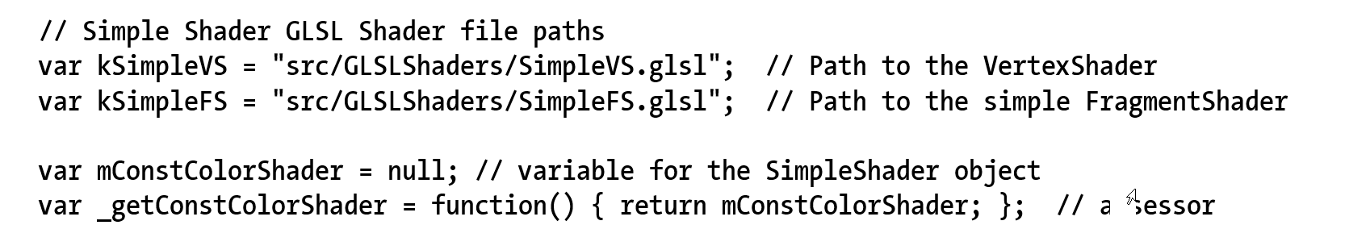
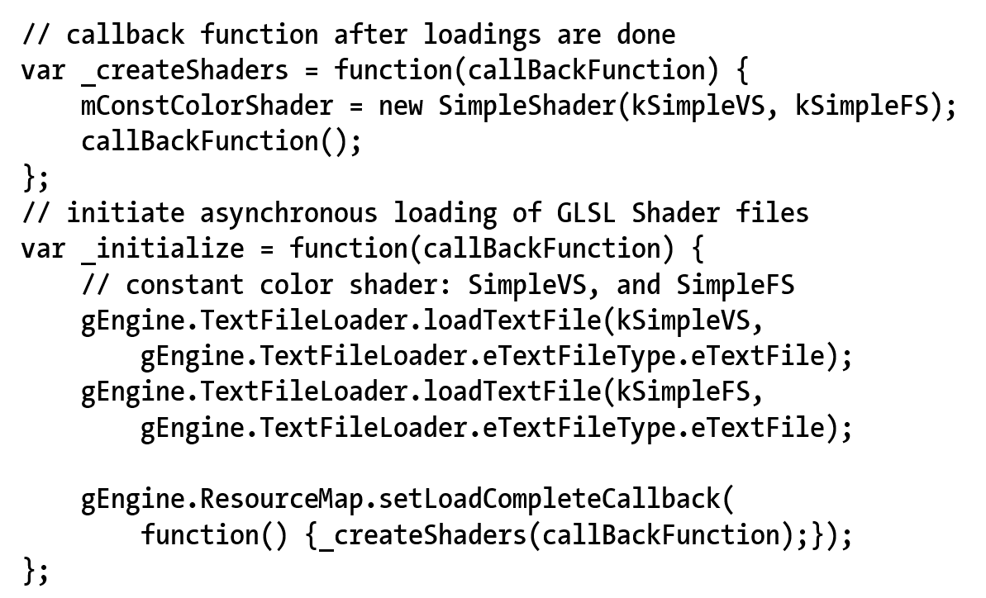
4.3: Default SimpleShader engine resource

Slide 32
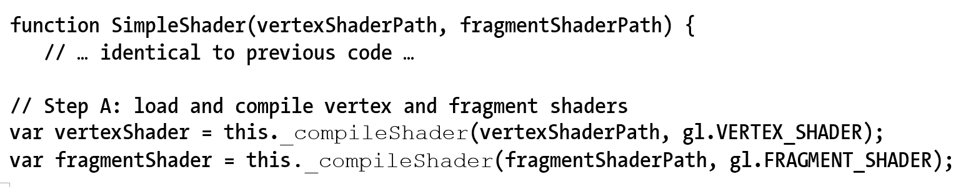
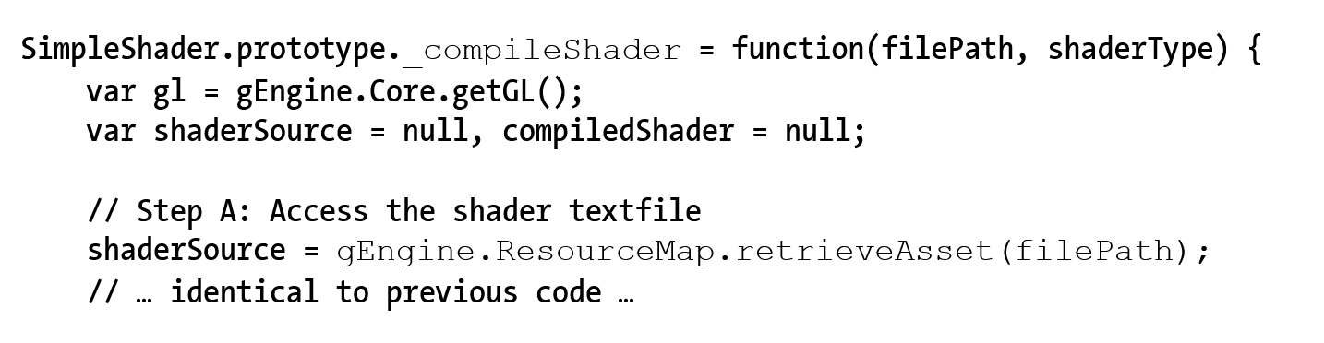
4.3: SimpleShader: user default resource

Slide 33
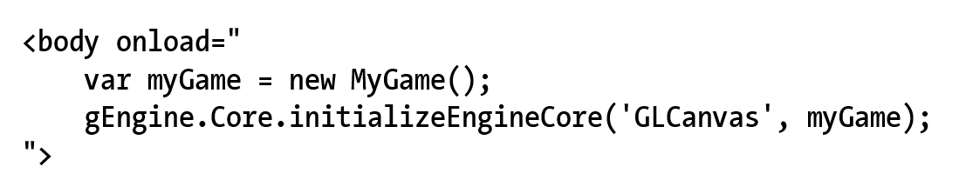
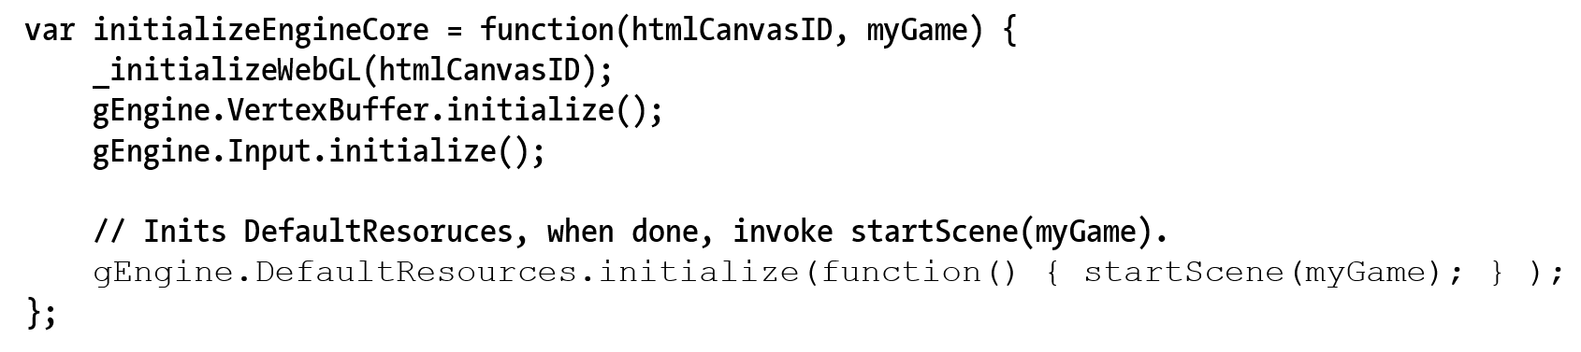
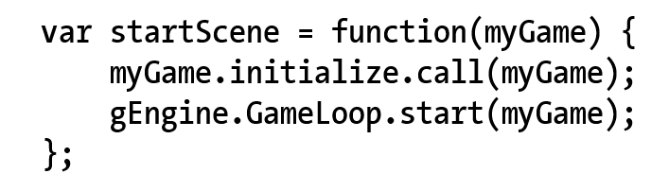
4.3: Engine: starting sequence
Index.html
Engine_Core.js

Slide 34
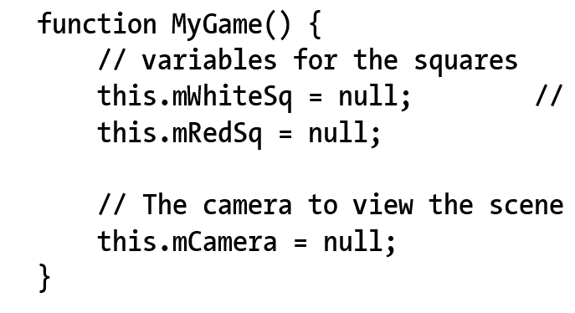
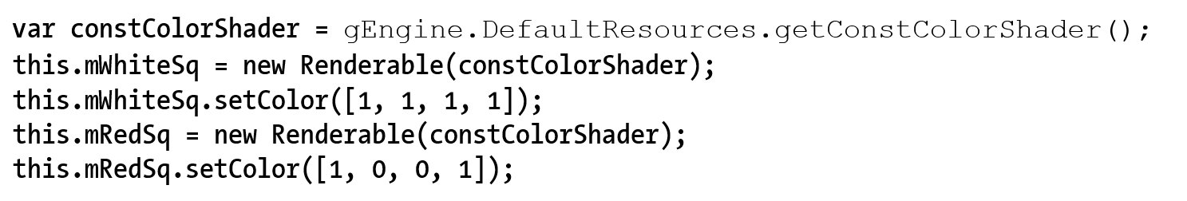
4.3: Testing async loading: MyGame
No need to worry about initialization Game Engine Core (good!)
MyGame Constructor simple again!
Access shader from default resource

Slide 35

4.4: Scene File Project

Slide 36
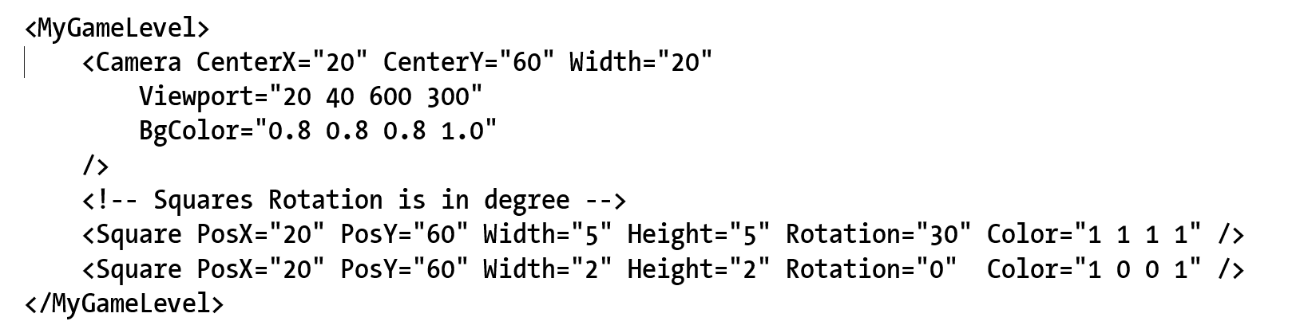
4.4: Scene File
The “assets” folder
A convention for ourselves (NOT defined by anything!!)
XML format and parsing (not cover here)

Slide 37
4.4: MyGame class
Constructor: declaring var and defining constants
Game specific resources (assets) MAY NOT be there!!
Initialize(): allocate and instantiate, setting up states
Game specific resources are loaded!!
update()/draw(): Seen this before … again:
update(): DO NOT try to draw anything
draw(): DO NOT make any changes to game state!
loadScene()/unloadScene(): loading/unloading of scene specific information!!

Slide 38
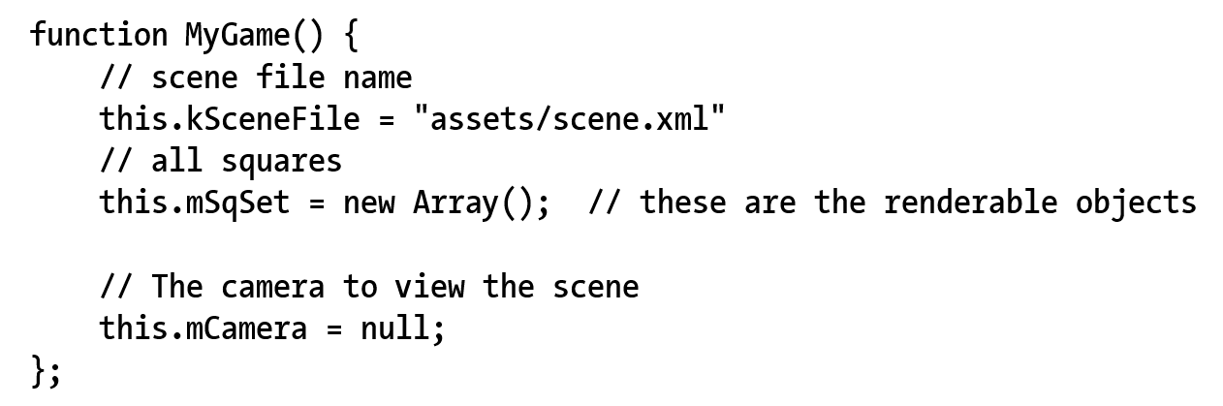
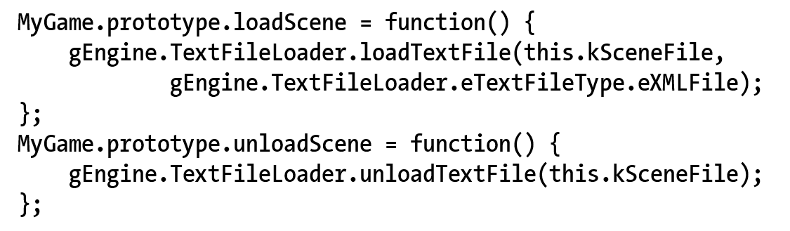
4.4: MyGame: construct and load!

Slide 39
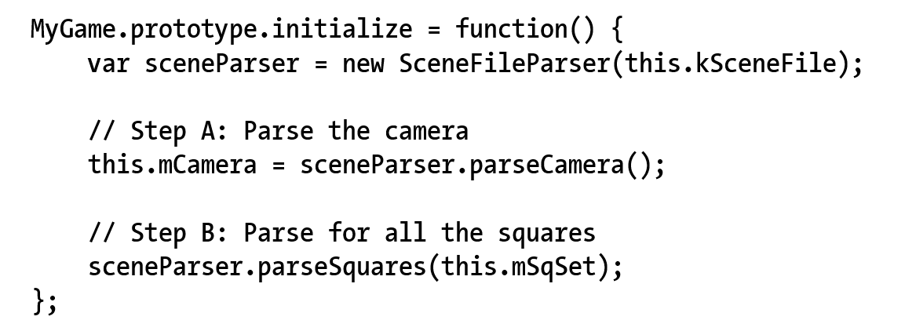
4.4: MyGame:initialize()
Game specific resources are now loaded!!

Slide 40
4.4: Engine: starting sequence with new MyGame
Index.html
Engine_Core.js

Slide 41
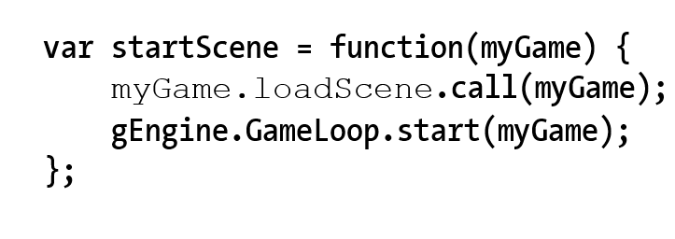
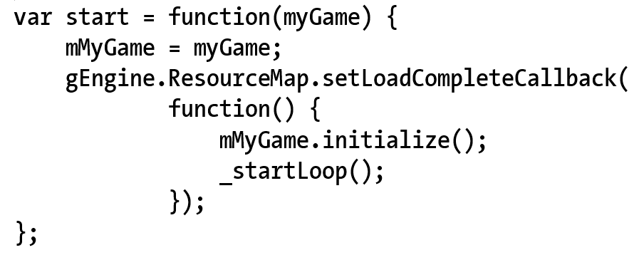
4.4: Engine Core: startScene()
Engine_Core.js
Engine_Loop.js

Slide 42
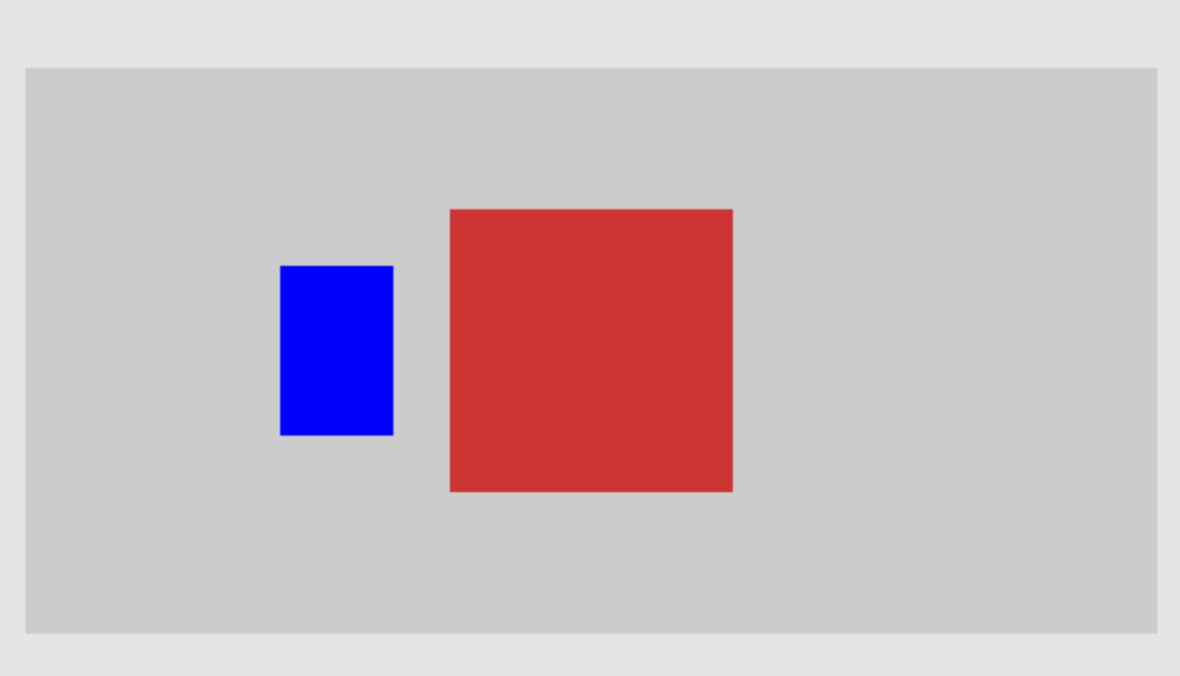
4.5: Scene Objects Project

Slide 43
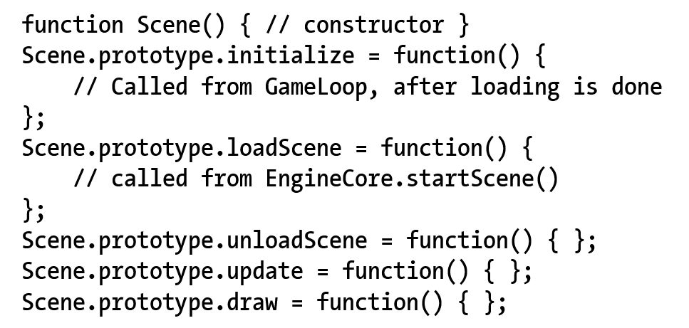
4.5: Scene Objects
Define GameEngine (Core and Loop) interface protocol with game developer (our API user)
Abstract class for subclass by clients

Slide 44
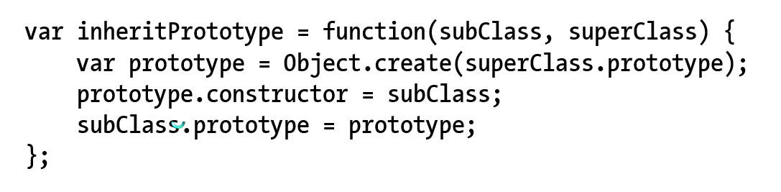
4.5: sSupport for “sub-classing”
Engine_Core.js

Slide 45
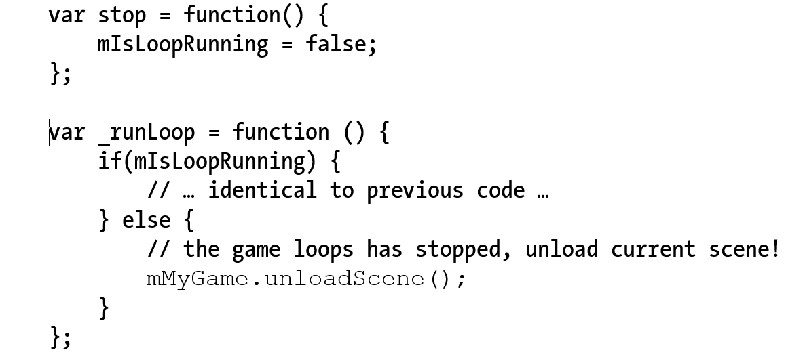
4.5: Game Loop: stop to unload resources
Engine_Loop.js

Slide 46
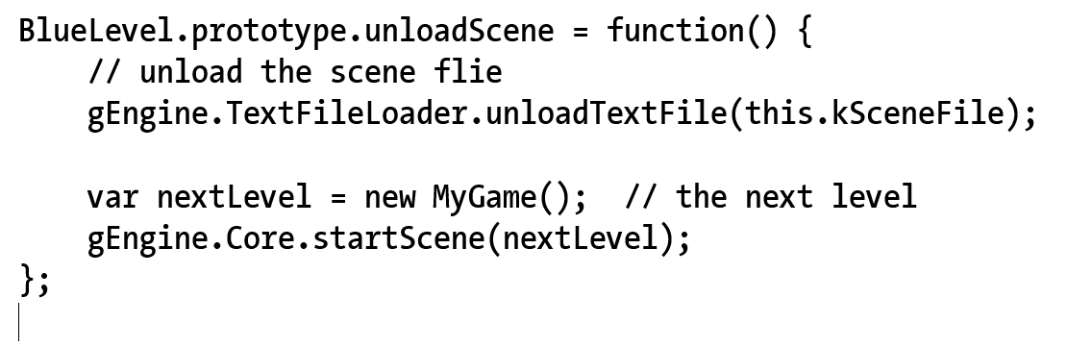
4.5: Loading the next Scene …

Slide 47
4.6: Audio support
Audio: files
Just another example of external resource!
Support for mp3 and wav formats
HTML5: AudioContext
Load/Decode audio resources
Play audio resources!!
Two important categories
Audio as music: e.g., background
Continuous playing, need control
Audio as cue:
Short, no need for control

Slide 48


4.6: Engine_AudioClip: Component

Slide 49

4.6: Loading of AudioClips
Exact same structure as TextFile loader
Work with ResourceMap
isAssetLoaded()
asyncLoadRequested()
NEW: incAssetRefCount()
In case loaded multiple times!!
req.onLoad() … next slide

Slide 50

4.6: req.onLoad(): once loaded …
Store the entire file content to ResourceMap
asyncLoadCompleted()!

Slide 51

4.6: Audio as Cue
Each Cue must be a separate file!
Start and no more control!

Slide 52


4.6: Background music support
Keep reference for future control

Slide 53
Chapter 4: Learned?
Game loop
Keyboard input: event and keycoodes
Resource management and asynchronous loading
Game level and scene files
Audio support

