Slide 1
Chapter 5
Examples 1 and 2
Textures, Sprites, and Fonts

Slide 2
This Chapter
What is textures, why textures
How to map and control
Addressing efficiency: loading and memory
Faking animation with textures
Displaying fonts (text) with textures
This is our text solution

Slide 3



Texture Mapping
A Texture: Fancy word for “an image”
Texture Mapping:
Fancy word for pasting an “image” on a geometry
Texel: pixels of a texture
WARNING: for WebGL (and many hardware)
Texture resolution must be of powers of 2
E.g., 16 x 32, or 2 x 512, or 512x512
1023x1025: is a BAD resolution for WebGL

Slide 4
Why Texture Mapping
Represent “objects”
Cheap, easy, with high quality
Typically: specifically drawn by artists
Ease of control/manipulate
We know how to control a geometry
Control of “objects” can be simply
modifying the corresponding transform (Renderable!)

Slide 5

Texture Mapping Considerations
Texture external to the engine:
Loading must occur
When to load, what happens when done?
Textures with Transparency
The Alpha channel
File format: jpg and png
Memory concerns (lots of textures)
Size of image file (texture)
Sharing of the same texture

Slide 6
A Word about “Transparency” or Alpha
Color = [R, G, B, A] (e.g., [1, 0, 0, 1] for red)
A: the Alpha Channel
Typically for Alpha Blending
Colors C1 = [R1, G1, B1, A1], C2 = [R2, G2, B2, A2]
Blending the colors:
Result = C1 * A1 + C2 * (1 – A1) ←This is the default WebGL blending
Or
Result = C1 * (1 – A1) + C2 * A1

Slide 7
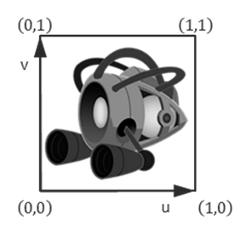
How to texture map?
Map: from one coordinate system to another!
Texture Coordinate System (UV Coordinate)
Just as NDC and WC, independent of pixel (or texel resolution)
Constant range
0 < U < 1
0 < V < 1
Always cover the entire texture

Slide 8
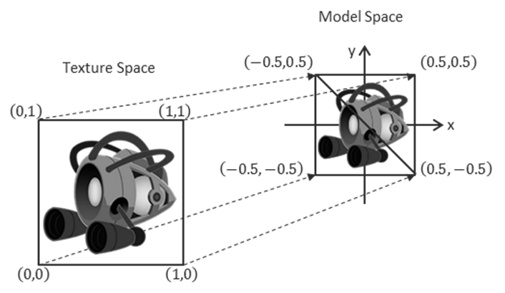
Mapping UV to the Model
Texture mapping:
Associate UV positions with corresponding geometric positions
Define UV values at vertices in Model Space!!
Communicate this association to the WebGL

Slide 9
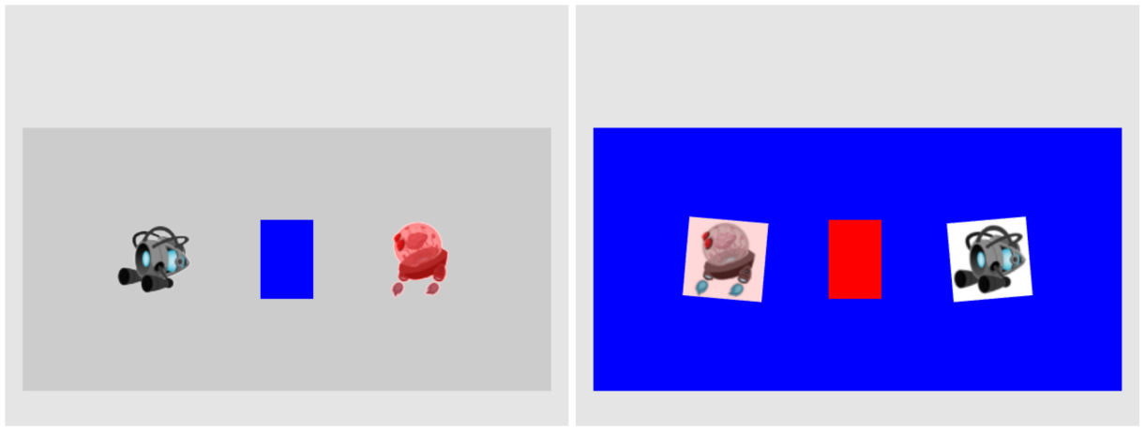
5.1: TextureShader Project

Slide 10
5.1: Goals
define uv coordinates for geometries with WebGL
create a texture coordinate buffer in WebGL
build GLSL shaders to render the textured geometry
define the texture engine component to load and process an image into a texture and to unload a texture
implement simple texture tinting, a modification of all texels with a programmer-specified color

Slide 11
Texture Implementation overview
GLSL Shaders: TextureVS.glsl + TextureFS.glsl
Support UV coordinate at vertex positions
Engine_VertexBuffer.js:
Define UV buffer to load into WebGL
TextureShader.js:
Allow programmer access to the GLSL Shaders
Engine_DefaultResources:
New instance of sharable TextureShader object
TextureRenderable.js:
Allows multiple textureShader objects to be drawn (at different locations)
Engine_Textures.js:
Allows loading of texture files

Slide 12
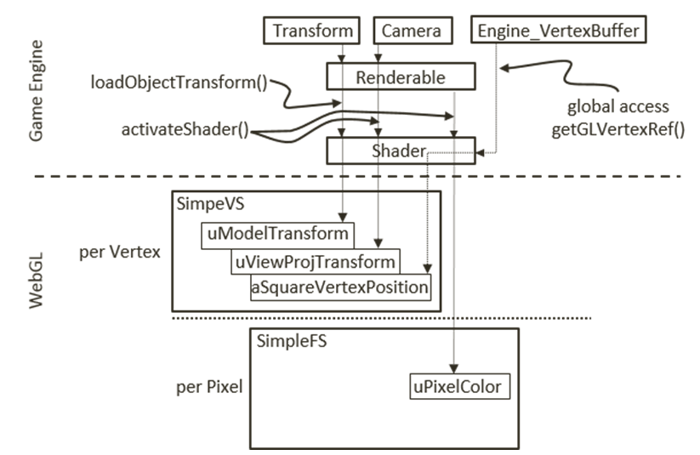
Review: SimpleShader and GLSL Shaders
Attribute: aSquareVertexPosition
Per vertex change
Fed via gl.ARRAY_BUFFER
uniform: transforms and pixelColor
Per render update
Stay constant for all vertices
SimpleShader:
Interfaces JavaScript to GLSL variables
Renderable:
Supports our clients to work with SimpleShader

Slide 13
Texture Implementation overview
GLSL Shaders: TextureVS.glsl + TextureFS.glsl
Support UV coordinate at vertex positions
Engine_VertexBuffer.js:
Define UV buffer to load into WebGL
TextureShader.js:
Allow programmer access to the GLSL Shaders
Engine_DefaultResources:
New instance of sharable TextureShader object
TextureRenderable.js:
Allows multiple textureShader objects to be drawn (at different locations)
Engine_Textures.js:
Allows loading of texture files

Slide 14
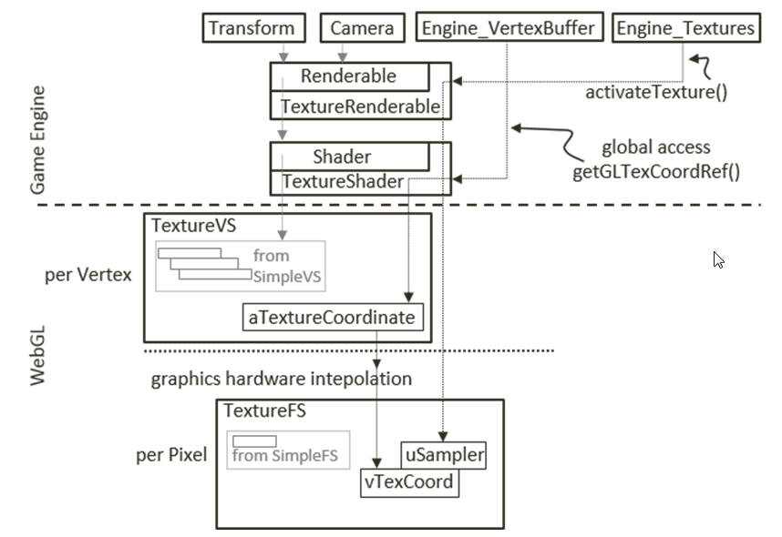
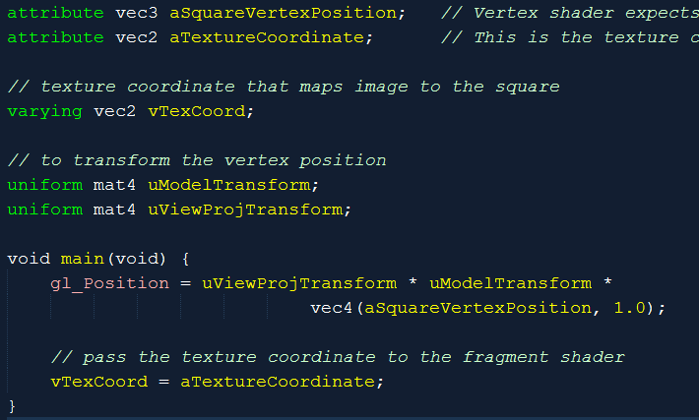
TextureVS (Vertex Shader)
varying: changes per pixel
Feeds into Fragment Shader
aTextureCoordinate:
from Engine_VertexBuffer (later)

Slide 15
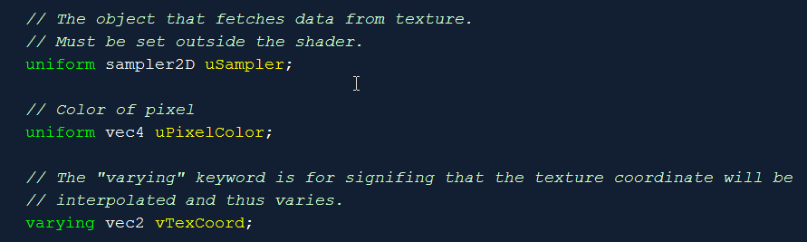
TextureFS (Fragment Shader): Variables
Note the varying (vTexCoord)
Same name as in TextureVS!
sampler2D datatype!

Slide 16
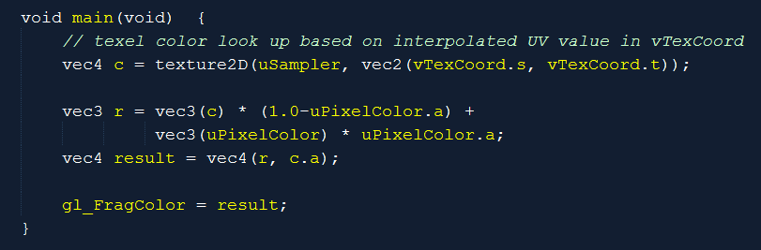
TextureFS (Fragment Shader): code
Note the texture2D() GLSL function
Using of vTexCoord!
(s, t): interpolated (u, v)
What does r compute?

Slide 17
Texture Implementation overview
GLSL Shaders: TextureVS.glsl + TextureFS.glsl
Support UV coordinate at vertex positions
Engine_VertexBuffer.js:
Define UV buffer to load into WebGL
TextureShader.js:
Allow programmer access to the GLSL Shaders
Engine_DefaultResources:
New instance of sharable TextureShader object
TextureRenderable.js:
Allows multiple textureShader objects to be drawn (at different locations)
Engine_Textures.js:
Allows loading of texture files

Slide 18
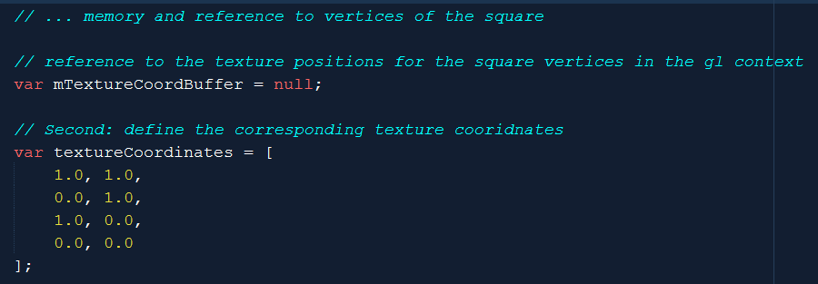
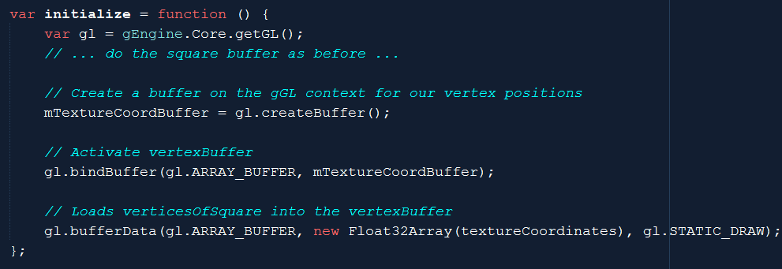
VertexBuffer support for UV Coordinate
Engine_VertexBuffer.js

Slide 19
Texture Implementation overview
GLSL Shaders: TextureVS.glsl + TextureFS.glsl
Support UV coordinate at vertex positions
Engine_VertexBuffer.js:
Define UV buffer to load into WebGL
TextureShader.js:
Allow programmer access to the GLSL Shaders
Engine_DefaultResources:
New instance of sharable TextureShader object
TextureRenderable.js:
Allows multiple textureShader objects to be drawn (at different locations)
Engine_Textures.js:
Allows loading of texture files

Slide 20
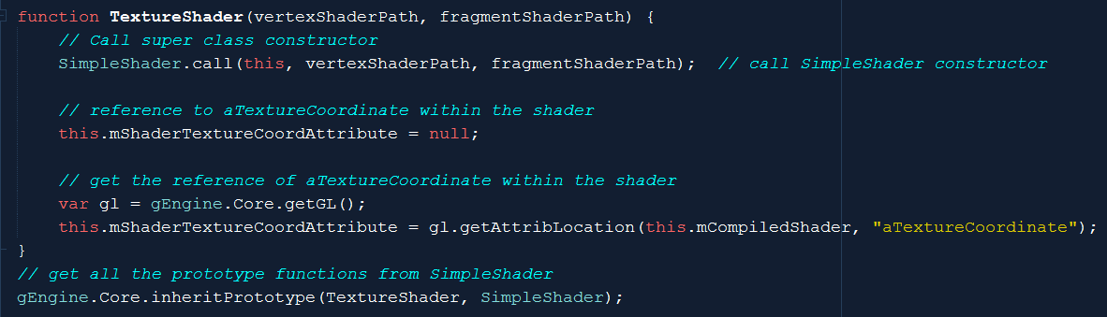
TextureShader
A SimpleShader (access to all instance var)
With new attribute reference
mShaderTextureCoordAttribute to aTextureCoordinate

Slide 21
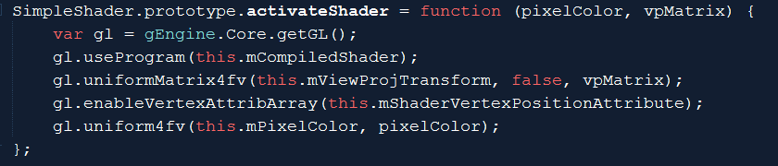
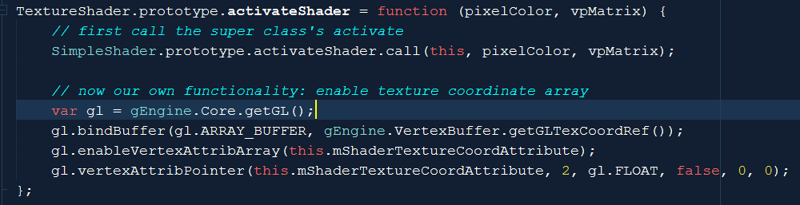
TextureShader::activateShader()
Send square vertex positions
SimpleShader::activateShader()
In addition: binds and connects texture coordinates
Binds gl.ARRAY_BUFFER to mShaderTextureCoordAttribute
To Engine_VertexBuffer::mTexCoordBuffer (getGLTexCoordRef())

Slide 22
Texture Implementation overview
GLSL Shaders: TextureVS.glsl + TextureFS.glsl
Support UV coordinate at vertex positions
Engine_VertexBuffer.js:
Define UV buffer to load into WebGL
TextureShader.js:
Allow programmer access to the GLSL Shaders
Engine_DefaultResources:
New instance of sharable TextureShader object
TextureRenderable.js:
Allows multiple textureShader objects to be drawn (at different locations)
Engine_Textures.js:
Allows loading of texture files

Slide 23
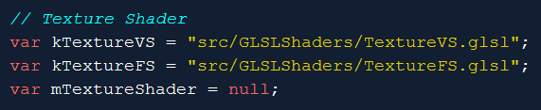
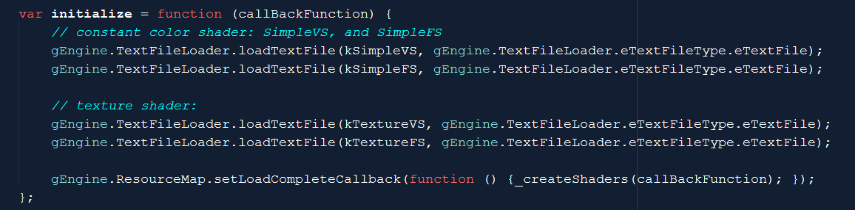
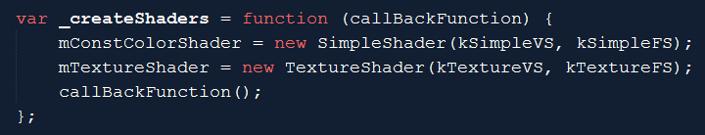
gEngine_DefaultResources: Enable sharing
Engine_DefaultResources.js

Slide 24
Texture Implementation overview
GLSL Shaders: TextureVS.glsl + TextureFS.glsl
Support UV coordinate at vertex positions
Engine_VertexBuffer.js:
Define UV buffer to load into WebGL
TextureShader.js:
Allow programmer access to the GLSL Shaders
Engine_DefaultResources:
New instance of sharable TextureShader object
TextureRenderable.js:
Allows multiple textureShader objects to be drawn (at different locations)
Engine_Textures.js:
Allows loading of texture files

Slide 25
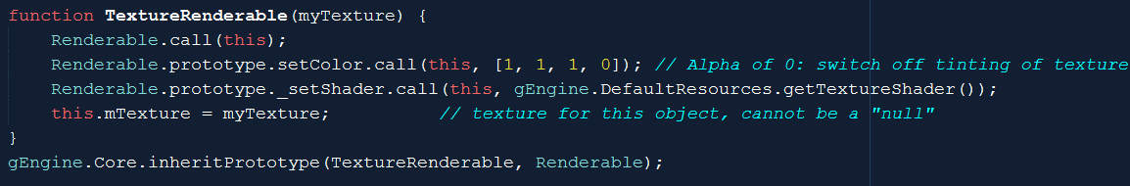
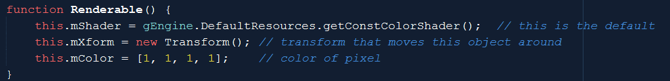
TextureRenderable: Controllable game objects
A Renderable object with
reference to TextureShader and
A loaded texture map

Slide 26
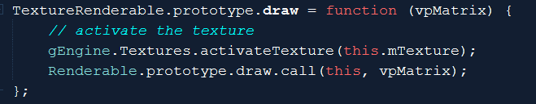
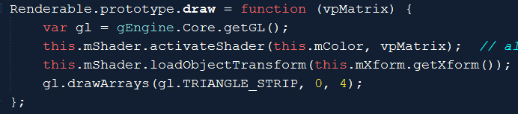
TextureRenderable: draw()
Textures.activateTexture(): [to come]
Activates and connects
uSampler in TextureFS to current texture image
Renderable.draw():
SimpleShader::activateShader()
Connects and loads square vertex
TextureShader::activateShader()
Connects and loads UV coordinate
TextureFS.glsl
Renderable.js

Slide 27
Texture Implementation overview
GLSL Shaders: TextureVS.glsl + TextureFS.glsl
Support UV coordinate at vertex positions
Engine_VertexBuffer.js:
Define UV buffer to load into WebGL
TextureShader.js:
Allow programmer access to the GLSL Shaders
Engine_DefaultResources:
New instance of sharable TextureShader object
TextureRenderable.js:
Allows multiple textureShader objects to be drawn (at different locations)
Engine_Textures.js:
Allows loading of texture files

Slide 28
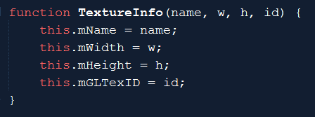
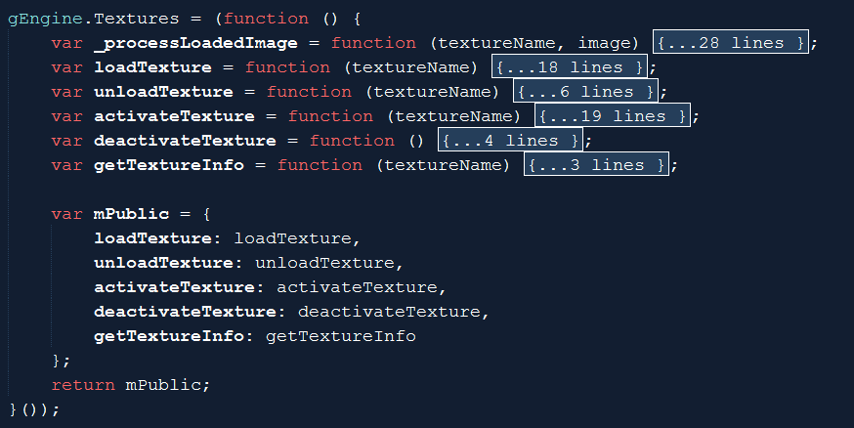
Engine Texture component
TextureInfo object: for ResourceMap
Engine_Textures.js

Slide 29
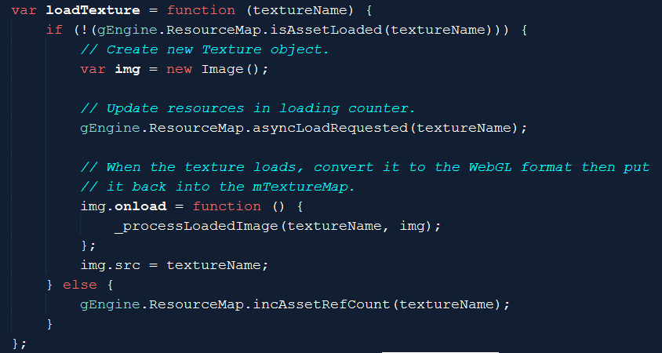
Engine_Texture::loadTexture()
Work with ResourceMap like previous async loads
calls _processLoadedImage() when ready

Slide 30
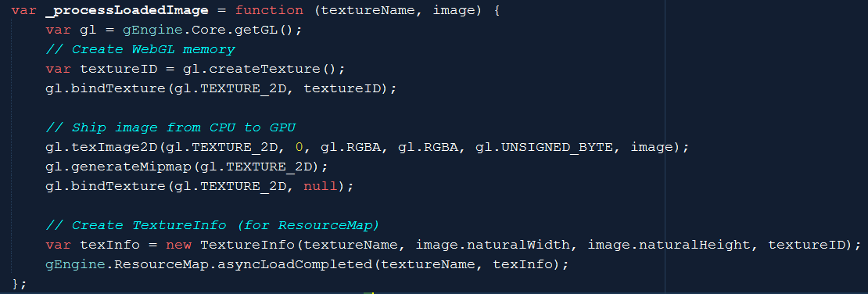
Engine_Texture::_processLoadedImage()
Ship loaded image from CPU to GPU
Create TextureInfo object for ResrouceMap to keep track (textureID)

Slide 31
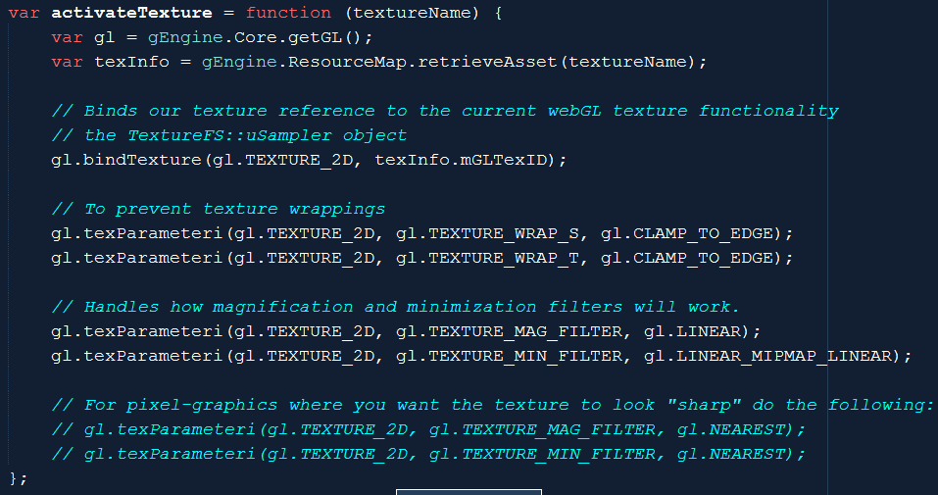
Engine_Texture::activateTexture()
ResourceMap:: stores TextureInfo!!
Binds textureInfo.mGLTexID to uSampler in TextureFS.glsl
Texture Wrapping and Filtering

Slide 32
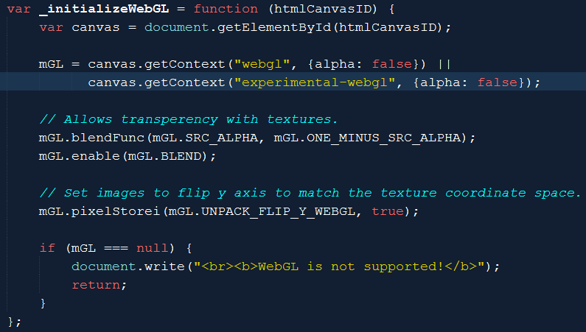
Engine configuration changes
Engine_Core.js
Canvas: opaque
Blending support in TextureFS.glsl!
C1*A + C2*(1 – A)
Texture Map y increases upwards

Slide 33
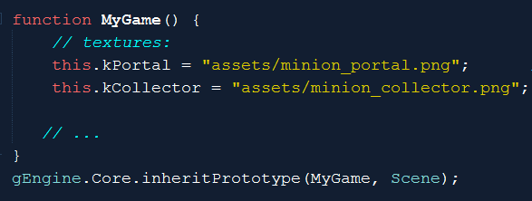
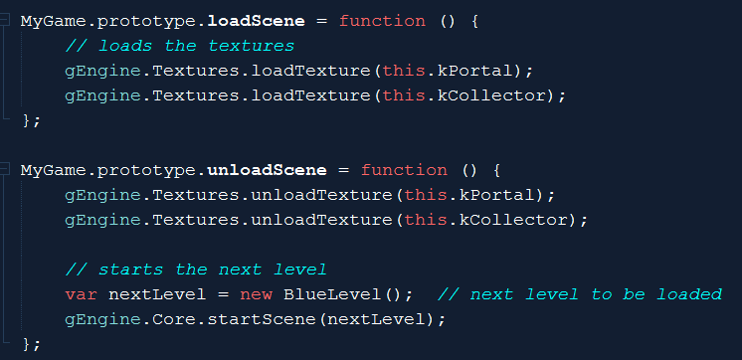


Testing Texture map …
Define and load textures

Slide 34
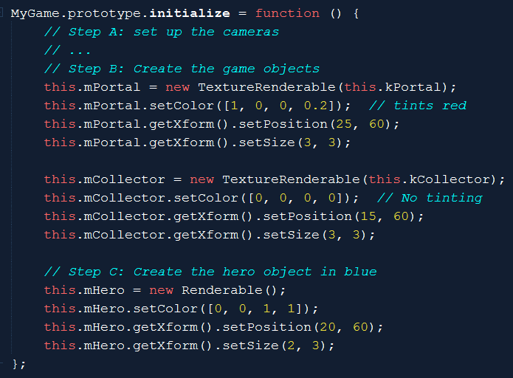
Creating texture objects (TextureRenderable)
Color’s Alpha values
Remember the “r”
In TextureFS?
Texture tinting
TextureFS.glsl

Slide 35
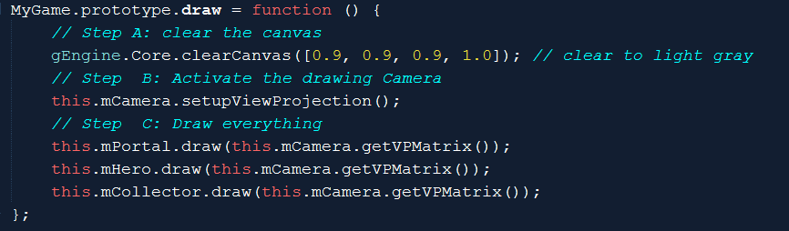
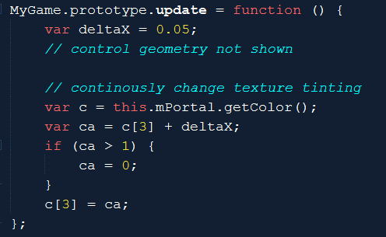
Drawing/Updating with texture
Draw as before
Update tint …
C[3] is alpha

Slide 36
Texture Implementation overview
GLSL Shaders: TextureVS.glsl + TextureFS.glsl
Support UV coordinate at vertex positions
Engine_VertexBuffer.js:
Define UV buffer to load into WebGL
TextureShader.js:
Allow programmer access to the GLSL Shaders
Engine_DefaultResources:
New instance of sharable TextureShader object
TextureRenderable.js:
Allows multiple textureShader objects to be drawn (at different locations)
Engine_Textures.js:
Allows loading of texture files

Slide 37
Learning from Example 5.1
Texture Mapping: UV to texel mapping
Associate vertex positions and UV coordinates
Implement: create and associate a second buffer in WebGL
Images are loaded as textures into WebGL
ResoruceMap reference to TextureInfo (defined in Engine_Textures.js)
CPU only has a textureID
GPU stores the actual texture
Binds TextureID to uSampler in TextureFS
Engine_Textures::activateTexture()

Slide 38
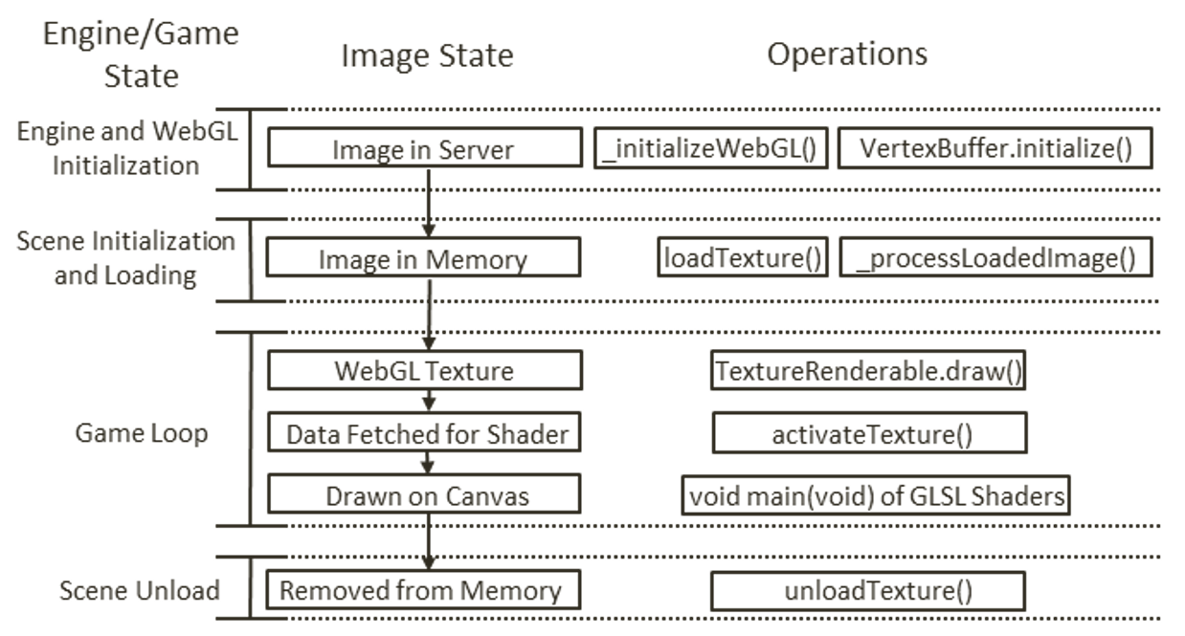
Image File, State, and WebGL

Slide 39


Sprite Sheets: Collection of object images
2^{n} x 2^{m} can be overly restrictive
E.g, 260x130: stored in 512x256!
Optimize load time
Loading many 16x16 images vs
Loading single 128x128 image
Organization: all objects in a level
A single 1Kx1K file
50 files of 128x128

Slide 40
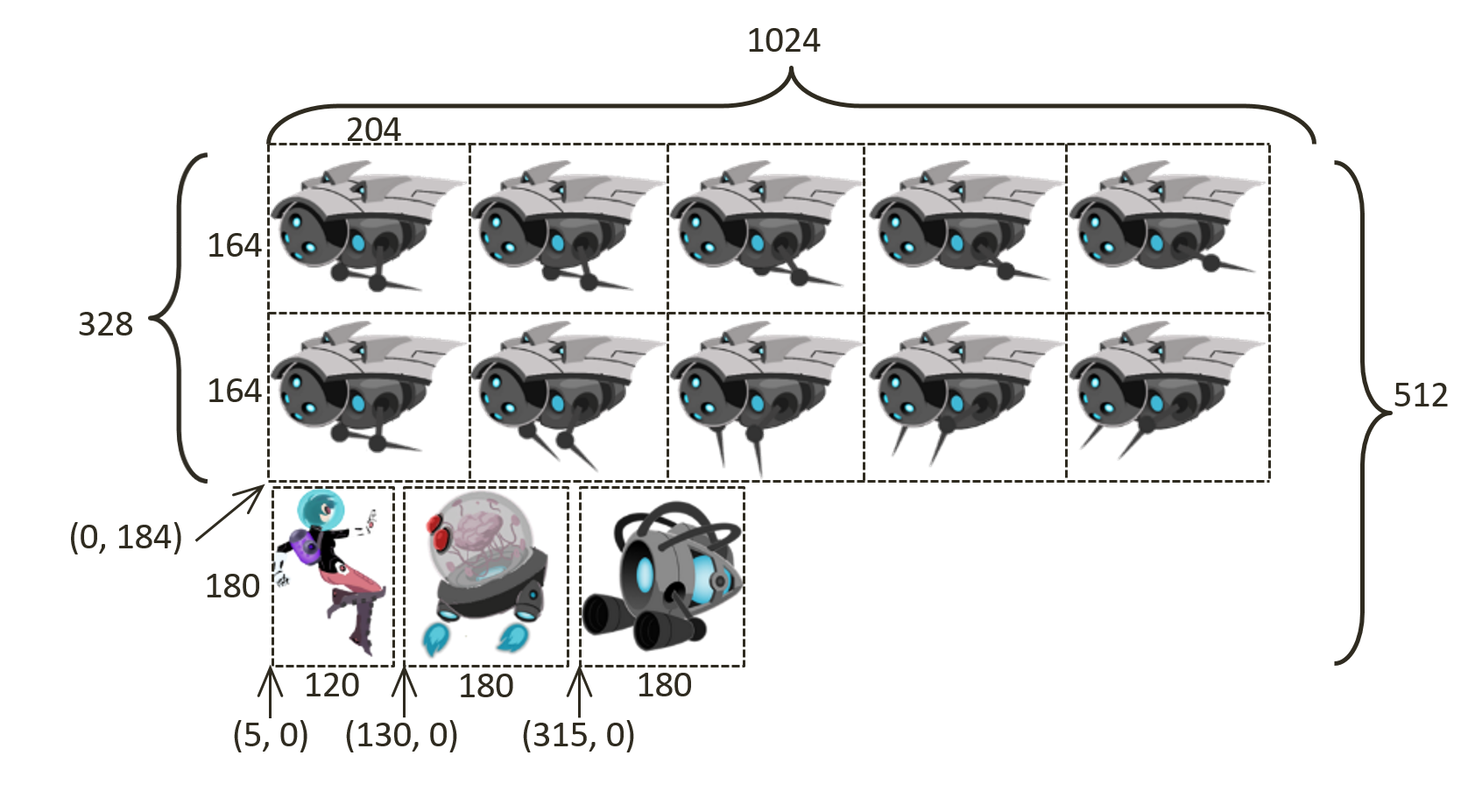
Sprite Sheet:
Artists create, communicate to developers

Slide 41
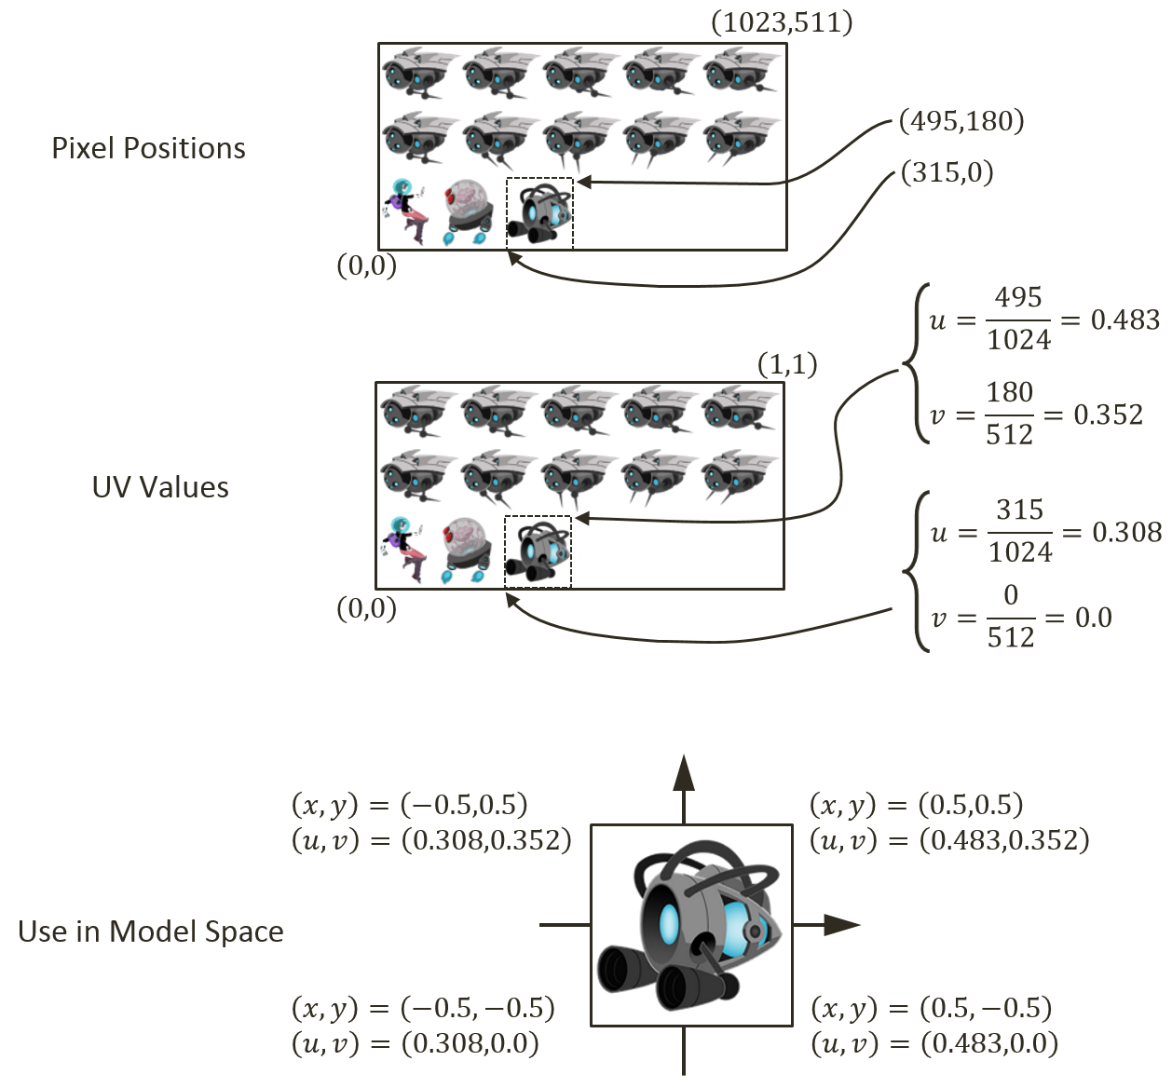
Drawing with Sprite Sheets
Figure out pixel positions of an object
Portal as example
Receive info from artists
Compute UV values of the object
Recall 0 to 1 covers the entire image
Map UV values to vertex positions

Slide 42
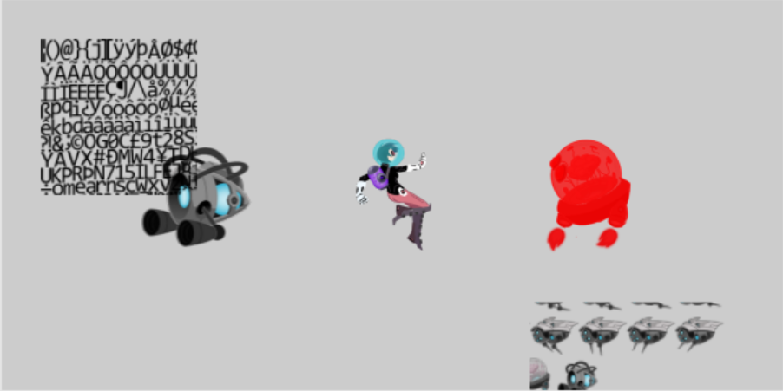
5.2: Sprite Shaders Project

Slide 43
5.2 Goals:
gain understanding for texture coordinate (UV)
experience defining sub-regions within an image for texture mapping
draw squares by mapping from sprite sheet elements
prepare for working with sprite animation and bitmap fonts

Slide 44
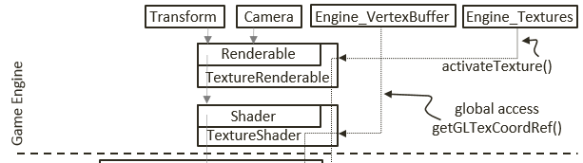
Recall: TextureShader …
Engine_VertexBuffer::
getGLTexCoordRef()
Refers to a static WebGL Buffer
Defined once, shared by all TextureShaders!
UV values in the buffer are bounds of UV space and cannot be changed!
Need per-shader Texture coordinate UV buffer for Sprite support
Engine_VertexBuffer.js

Slide 45
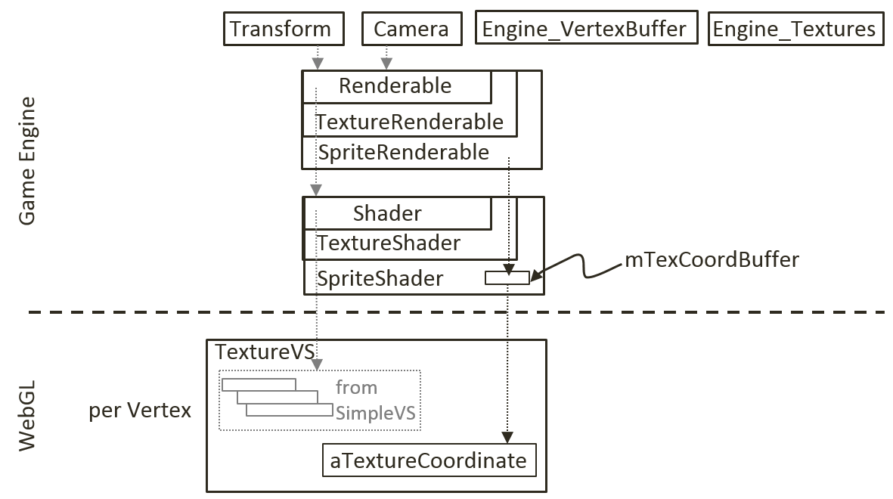
SpriteShader:
A TextureShader which defines its own Texture Coordinate Buffer!

Slide 46
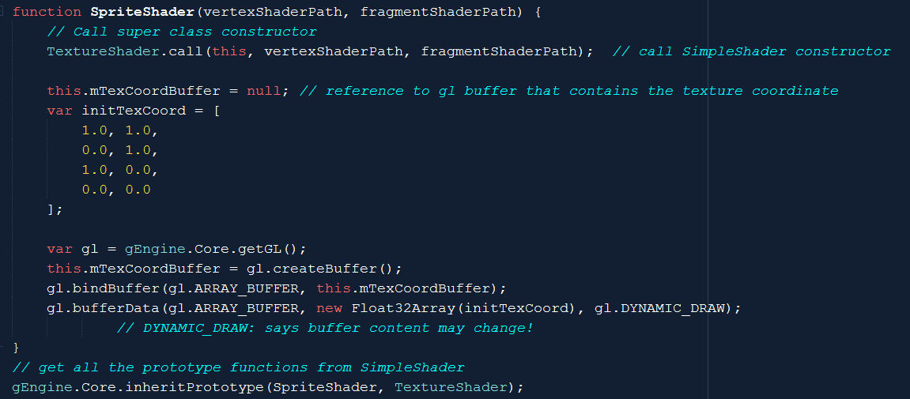
SpriteShader
Defines and loads a Dynamic texture coordinate buffer!

Slide 47
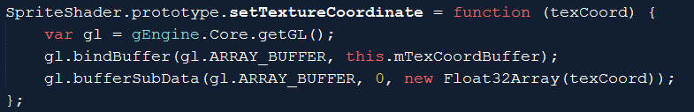
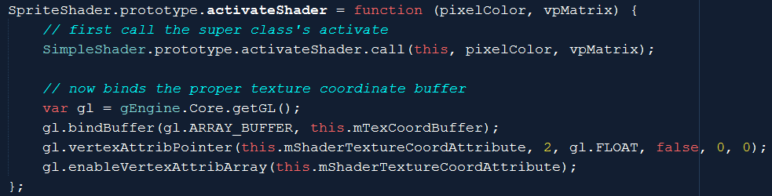
SpriteShader: custumn texture coordinate
Set texture coordinate (into WebGL)!
bufferSubData(): pushes array to WebGL!
Draw with its own texture coordinate buffer
Call to SimpleShader::activateShader (not TextureShader!)

Slide 48
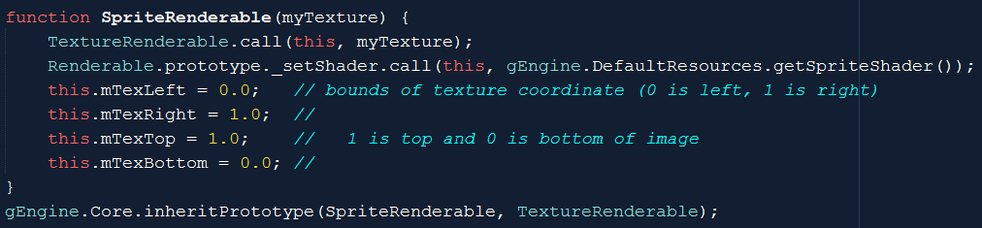
SpriteRenderable:
A TextureRenderable which remembers UV values for each vertices (instead of the default UV bounds)
DefualtResources: creates a default SpriteShader

Slide 49
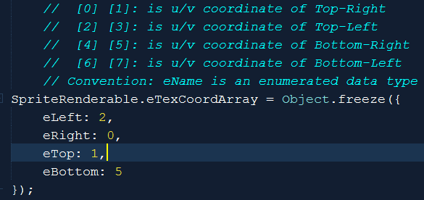
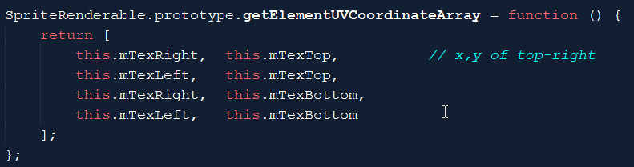
SpriteRenderable: UV to WebGL format

Slide 50
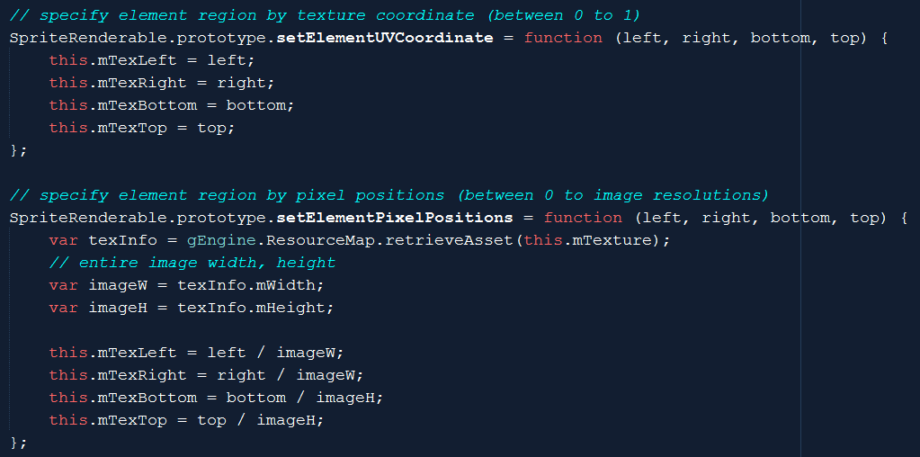
SpriteRenderable: UV setting functions
In UV
In pixel values (must convert to UV)
Notice: image resolution from ResourceMap (TextureInfo)

Slide 51
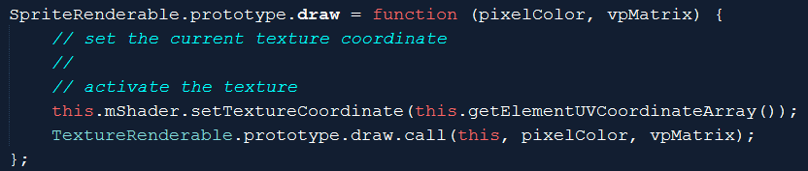
SpriteRenderable: draw
Calls SpriteShader::setTextureCooridnate()
Loads UV to WebGL!
SpriteRenderable.js
SpriteShader.js

Slide 52
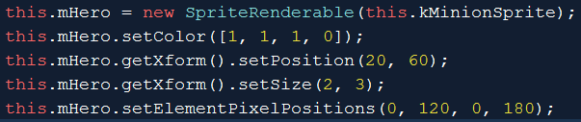
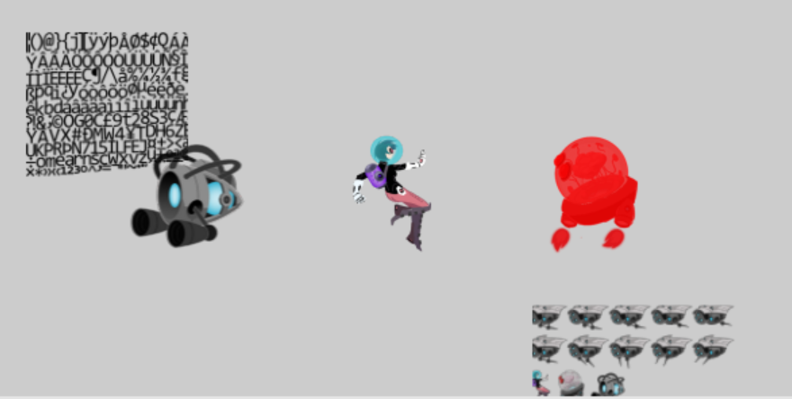
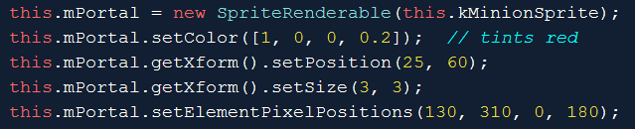
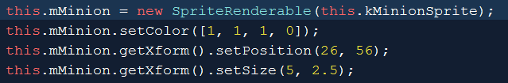
Testing SpriteRenderable
Same TextureMap!!
TextureMap is shared
SpriteShader is shared
Unique SpriteRenderables!

Slide 53
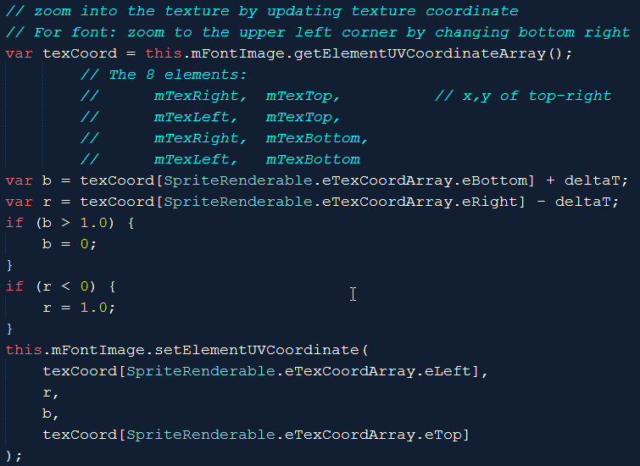

Changing UV in Update

