Slide 1
Chapter 5
Examples 3 and 4
Sprite Animations, and Fonts

Slide 2
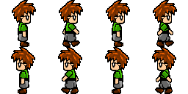
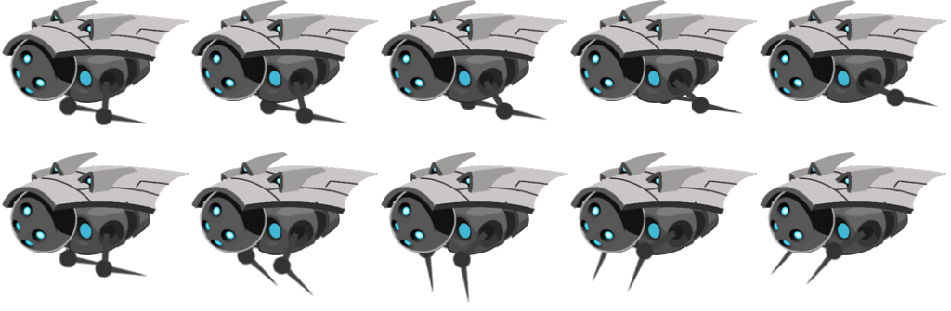
Sprite Animations
Strategically drawn Sprite Sheets
Sequence through elements strategically
Similar to stop-frame animations
Explicit communications with creating artists are required to decode

Slide 3
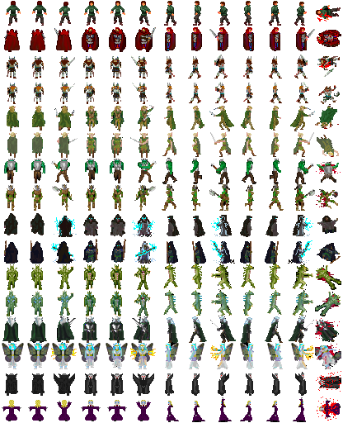
Organization Conventions
Not “laws,” something people seem to follow
Rows x Columns:
Fixed size on a sheet m-pixels by n-pixels
Paddings around each elements
Single row (or part of a row) defines action
Almost never cross rows

Slide 4
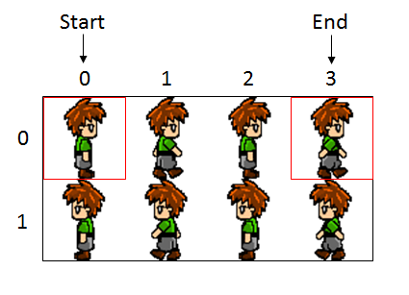
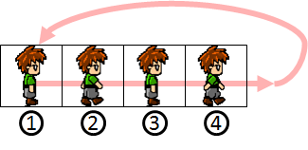
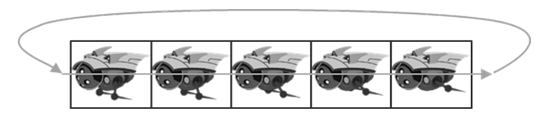
Parameters of Sprite Animation
Direction:
Forward (Left towards right)
Backward (Right towards left)
Swing
Speed: rate at which to change

Slide 5
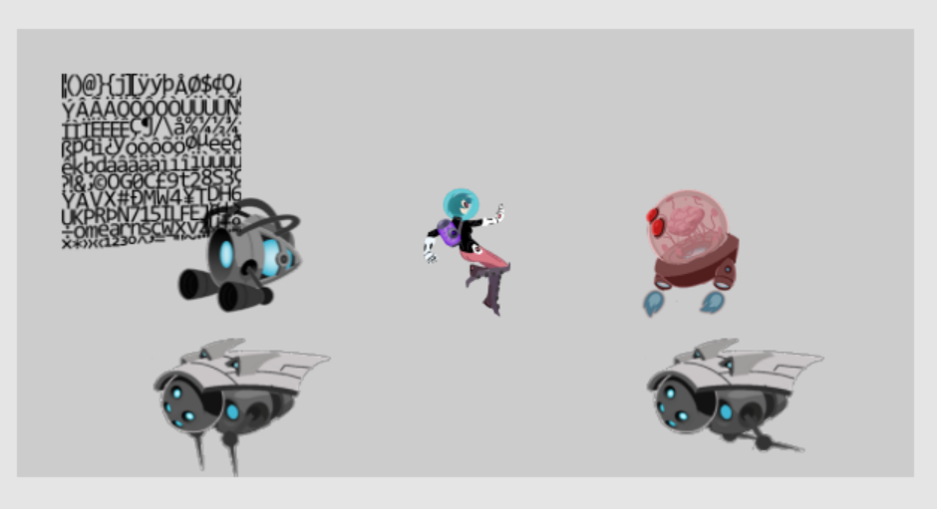
5.3: Sprite Animation Project

Slide 6
5.3: Goals
gain understanding of animated sprite sheets
experience the creation of sprite animations
define abstractions for implementing sprite animations

Slide 7
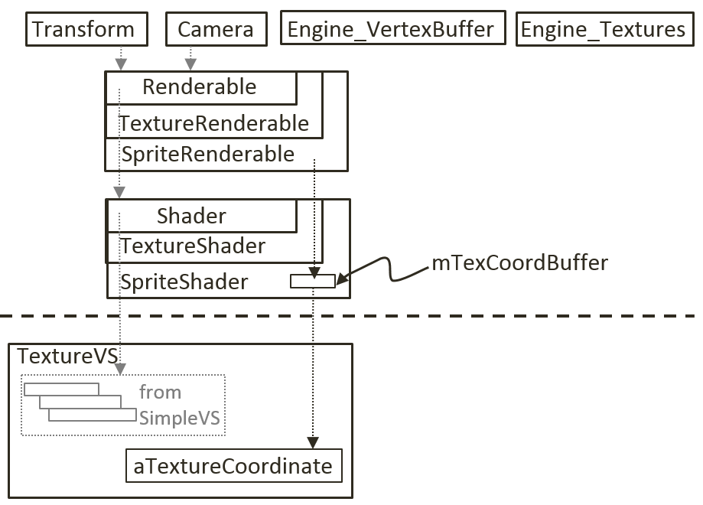
Implementation consideration
New shader?
NO!!
Access/update SpriteShader’s
mTexCoordBuffer
Change per animation update!

Slide 8
SpriteAnimateRenderable:
Define animation type/speed
Support defining and moving of sprite elements UV-area

Slide 9
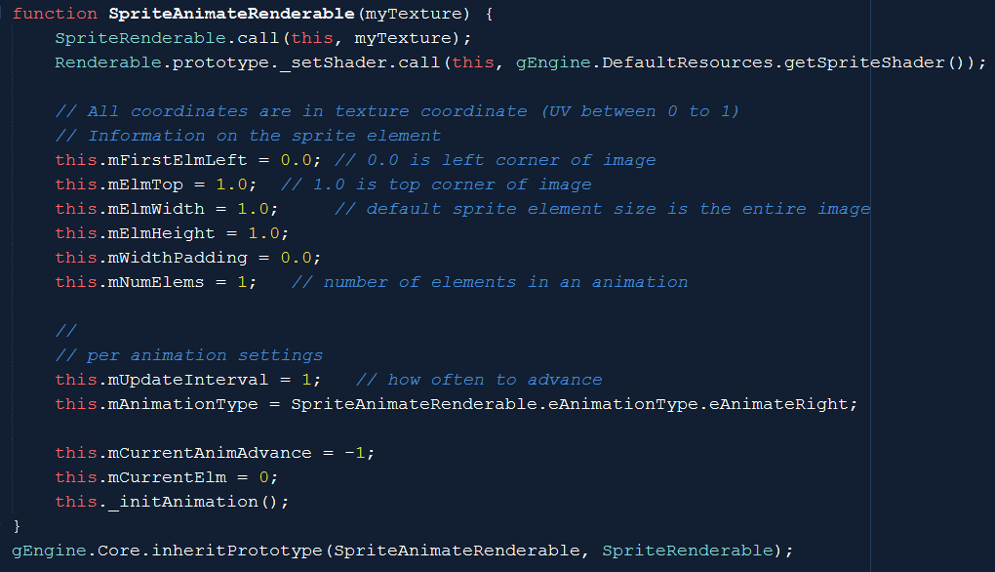
SpriteAnimateRenderable: constructor

Slide 10
SpriteAnimateRenderable: constructor
Using SpriteShader!!
no need for anything new from the shader!

Slide 11
SpriteAnimateRenderable: constructor

Slide 12
SpriteAnimateRenderable: constructor
UV-area for first sprite element
AND
Padding information (so that it is possible to advance)
Number of sprite elements in the animation

Slide 13
SpriteAnimateRenderable: constructor

Slide 14
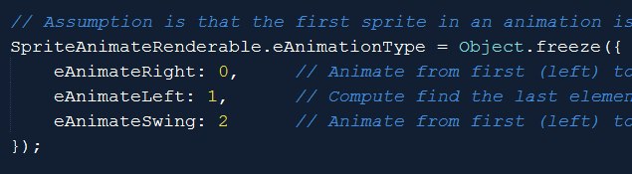
SpriteAnimateRenderable: constructor
Animation characteristics
Type: Left-ward, Right-ward, or Swing
How fast is the animation (unit in “update()” calls! Or 1/60 second)

Slide 15
SpriteAnimateRenderable: constructor

Slide 16
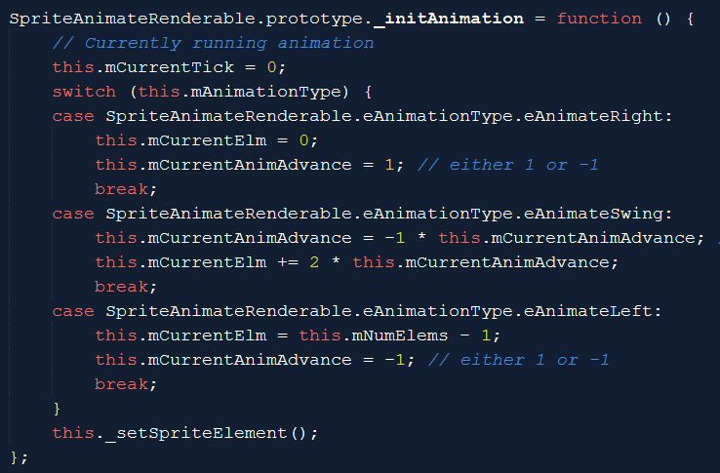
SpriteAnimateRenderable: constructor
Animation-time state variables

Slide 17
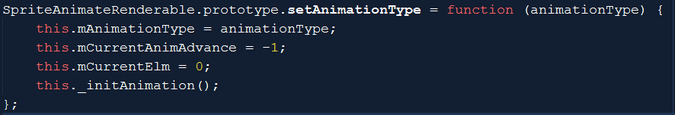
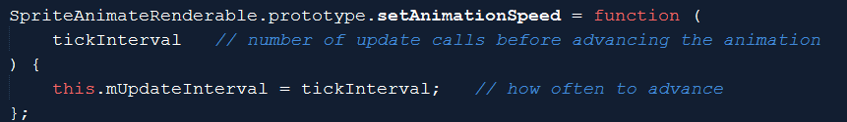
SpriteAnimateRenderable: utilities

Slide 18
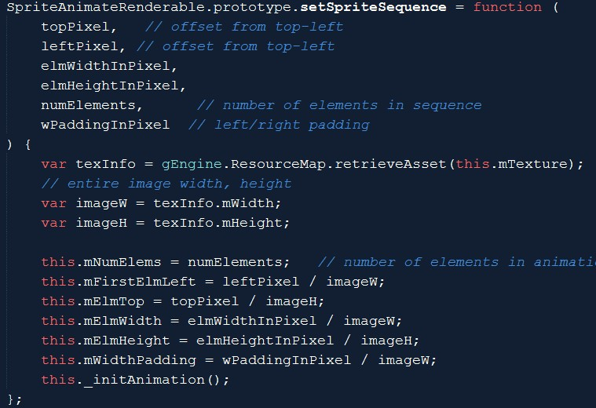
SpriteAnimateRenderable: utilities
Defines a sequence
In pixel space
Notice, must convert to UV

Slide 19
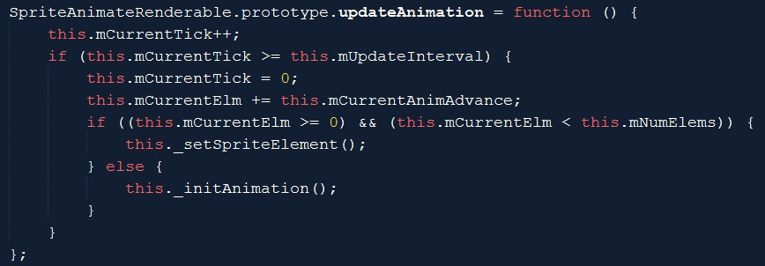
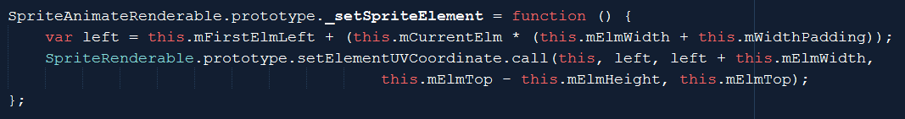
SpriteAnimateRenderable: animate!
Update reference
Re-computes UV
Sends new UV

Slide 20
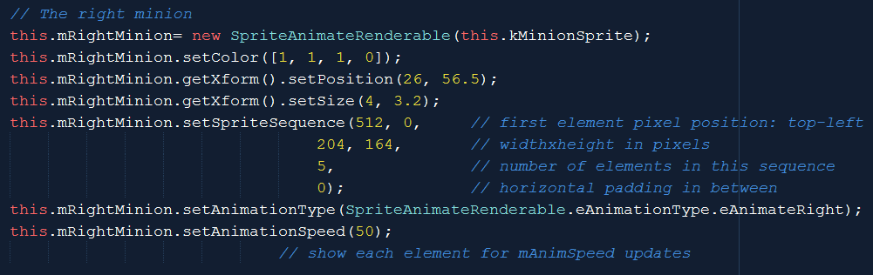
Testing Sprite Animation
To create

Slide 21
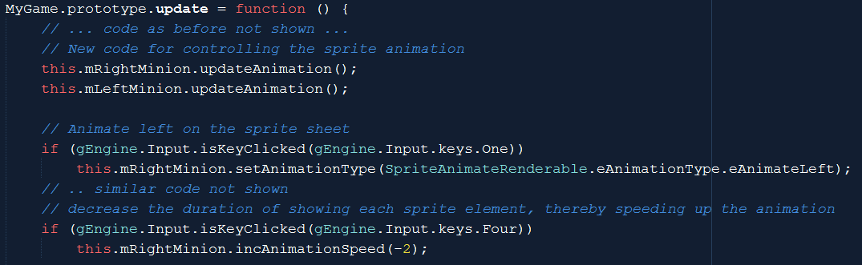
Testing Sprite Animation
To change and update (in MyGame.js::update())
NOTE: must call obj.updateAnimation() to see animation!

Slide 22
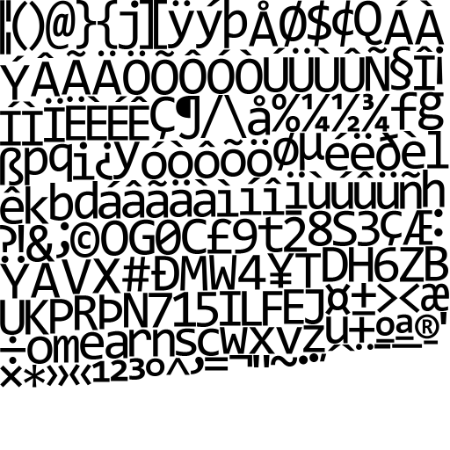
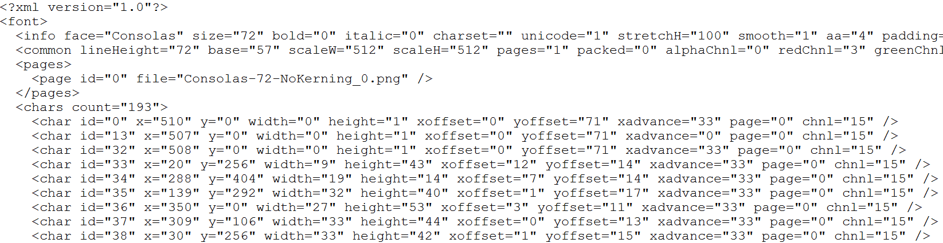
Fonts
Can be important in games
Especially for debug output
Pain to support
Hack: Bitmap fonts
Image + Instruction (to decode)

Slide 23
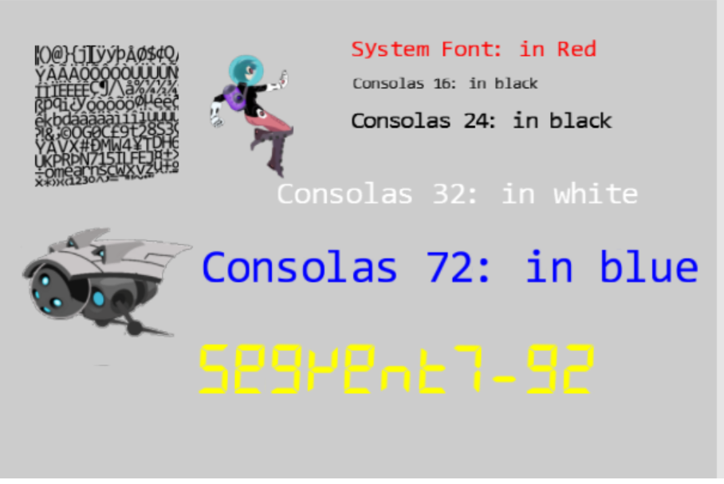
5.4: Font Support

Slide 24
5.4: Goal
Drawing text is not as interesting as the problem at hand
Designing a text solution based on what we have
Given a “string”:
find UV for first character from the bitmap font image
Set the sprite element UV values of a SpriteRenderable
draw the SpriteRenderable: one character
Compute space to skip
Repeat for next character
Abstract the above: FontRenderable

Slide 25
Procedure of working with fonts
Similar to _ALL_ external resources
Load:
DefaultResources: default system font
Per game scene font (if you have any)
Create a Renderable to draw with it
Slightly different …

Slide 26
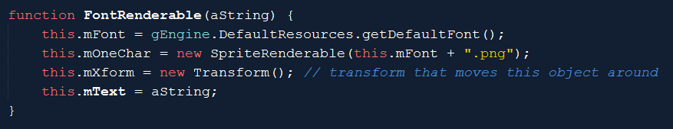
FontRenderable:
NOT a subclass or Renderable
Instead: has an instance of SpriteRenderable: mOneChar
mText: is the string we want to draw
Note:
FontRenderable: has a transform (this.mXform)
mOneChar: has a separate transform!!

Slide 27
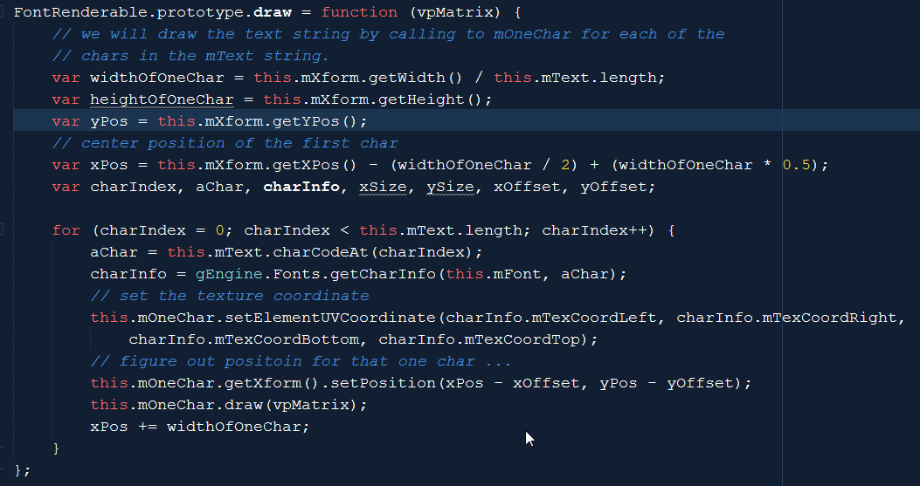
FontRenderable::draw()

Slide 28
FontRenderable::draw()
xPos: x Position of the first character
yPos: y position of _all_ of the characters
Limitation!: Cannot span more than one line!

Slide 29
FontRenderable::draw()

Slide 30
FontRenderable::draw()
For each character
Compute the xform of the character (mOneChar.xForm)
Draw the character
Limitation: String is not an entity (e.g., cannot rotate the string)!

Slide 31
Font rotation
In FontRenderable.draw()
Must pass rotation
from FontRenderable.mXform
to mOneChar.mXform

Slide 32
Chapter 5: learned?
Use resource manager
Texture mapping
UV Coordinate System
Sprite elements in a Texture
Drawing with sprites
Sprite Sheet for animation
Sprite Animation
Bitmap font
Next: Simple behavior (collision)!

