Slide 1
Chapter 7
Examples 3 to 6
Manipulating the Camera

Slide 2
Shaking the camera
Interesting way to convey “SOMETHING IMPORTANT” has occurred
Boss appear/defeated
Large object collision
Parallel goal: examine another example of controlling with math
Reflection of real-life example
Aiming the camera and knocked off the target
Return “quickly”, and adjust to stop at target

Slide 3
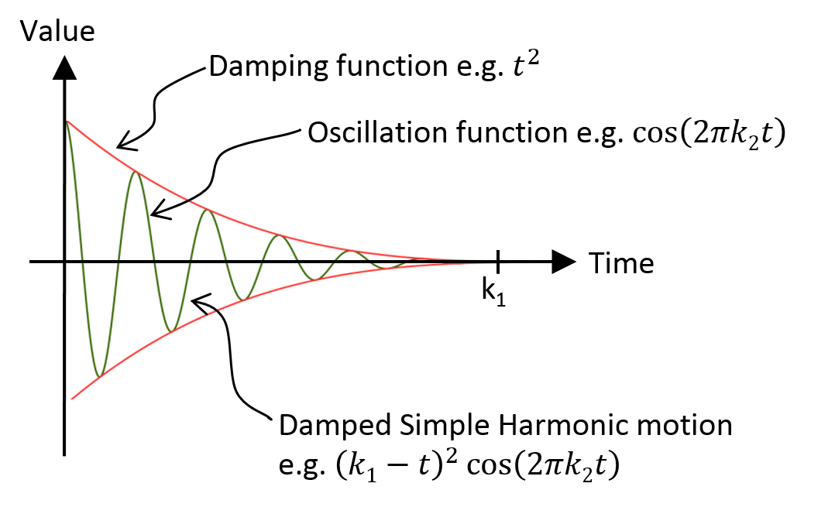
Damped Harmonic Motion

Slide 4
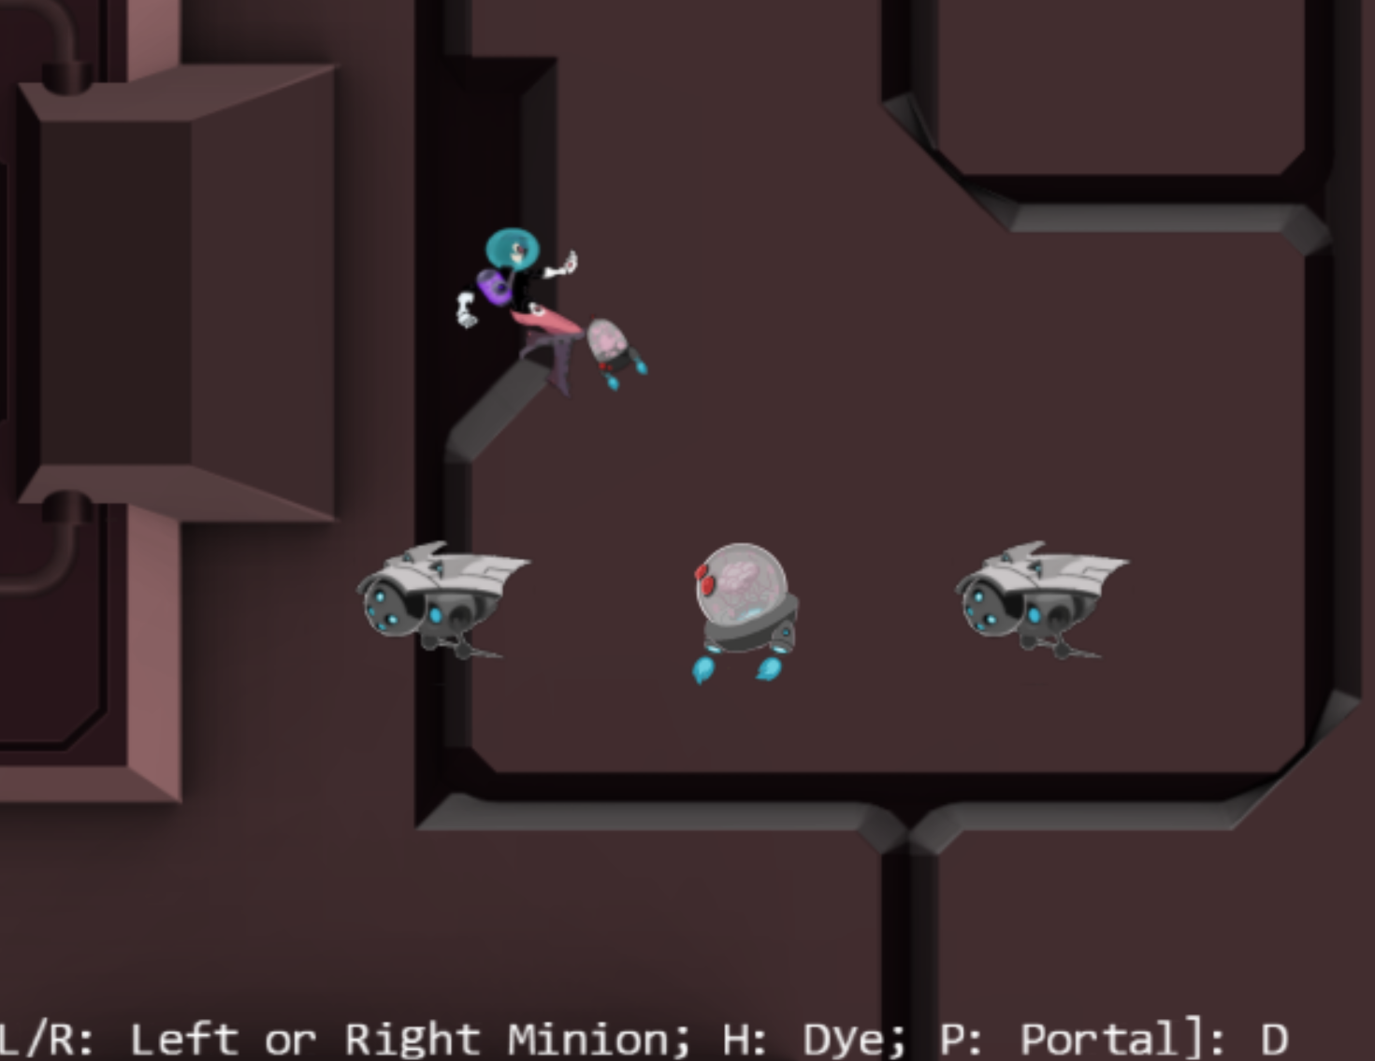
7.3: Camera Shake Project

Slide 5
7.3: Goals
Additional insights into modeling displacements with simple mathematical functions
Experience with the camera shake effect
Implement camera shake as a pseudorandom damped simple harmonic motion

Slide 6
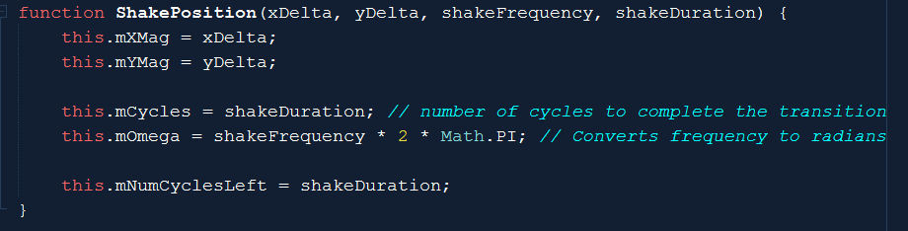
ShakePosition.js (Utility)
mXMag/mYMag: initial displacement
mCycles: how long to settle back
mOmega: how much “back-and-forth”

Slide 7
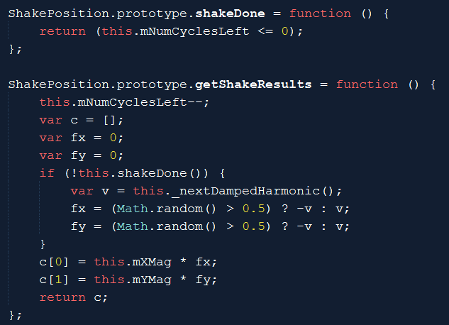
Update shake position

Slide 8
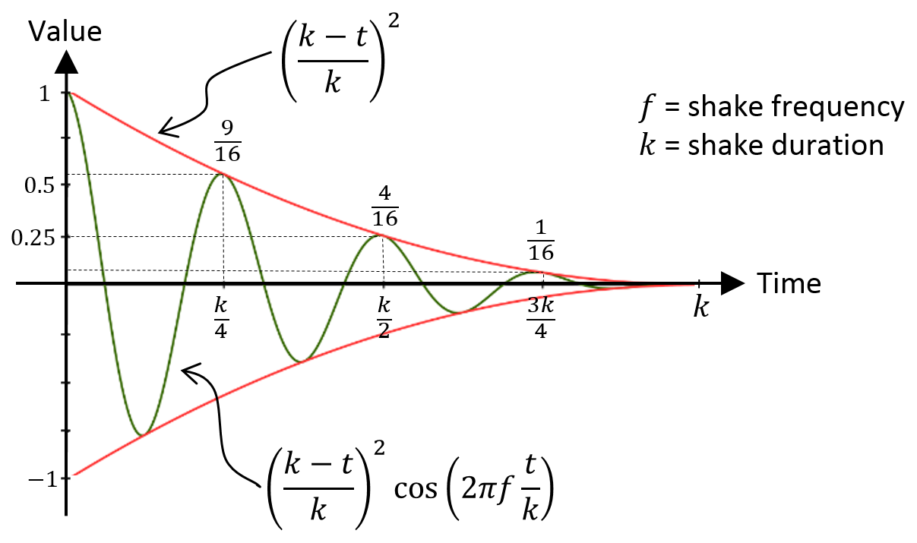
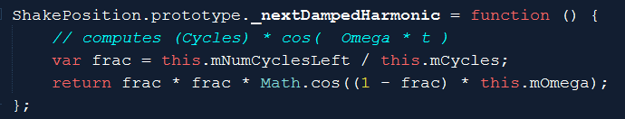
fact:
between 0 to 1
fact*fact:
To decrease the sinusoidal more rapidly than a line
Result is a displacement!

Slide 9
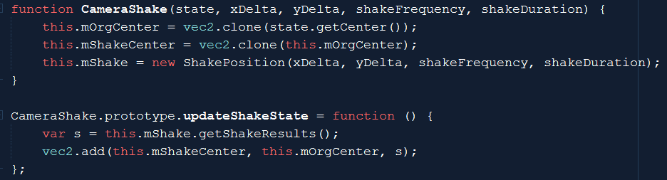
CameraShake.js: Integrate shake into
Shaking the CameraState’s center
Change the center by ShapePosition’s displacement (s)
Adding the offset to the origin (without changing the origin)
Offset becomes smaller over time

Slide 10
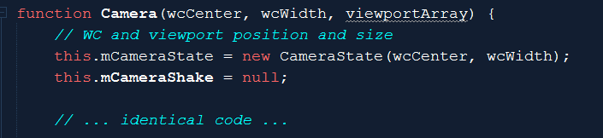
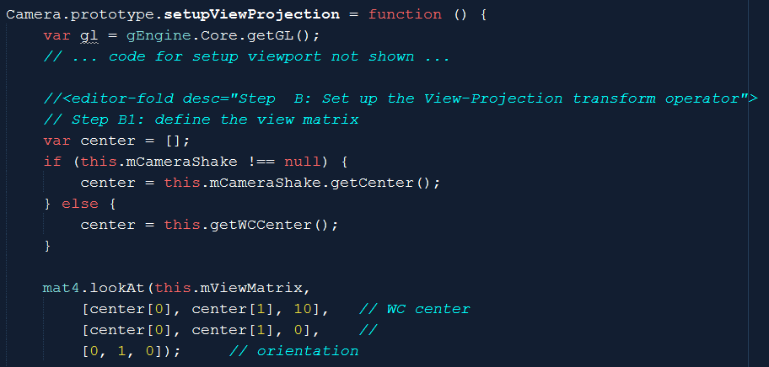
Modify the Camera

Slide 11
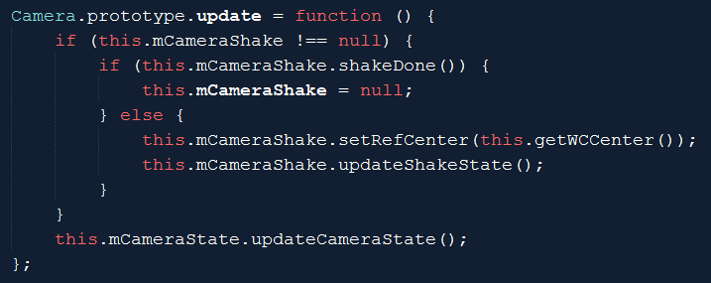
Set and update Shake (Camera_Manipulation)

Slide 12

Testing camera shake
xyDelta:
Large (200): earth quake! Small (0.1): can’t see anything!
Frequency:
Only observable with large xyDelta, larger values tend to “softens” the shake
Duration:
Large duration (300): annoying? Short duration (3): subtle, seem like error!

Slide 13
7.4: Multiple Camera and Viewport
We have done this in MPs!

Slide 14
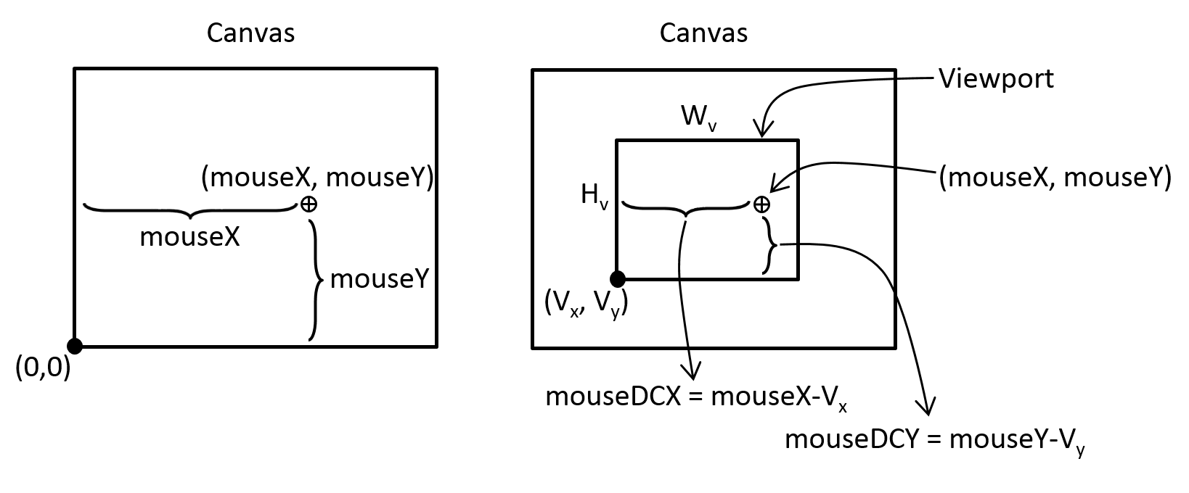
Working with Mouse Input (Selection!)
Mouse positions: Canvas coordinate!
GameObjects are in WC!
Canvas to Viewport

Slide 15
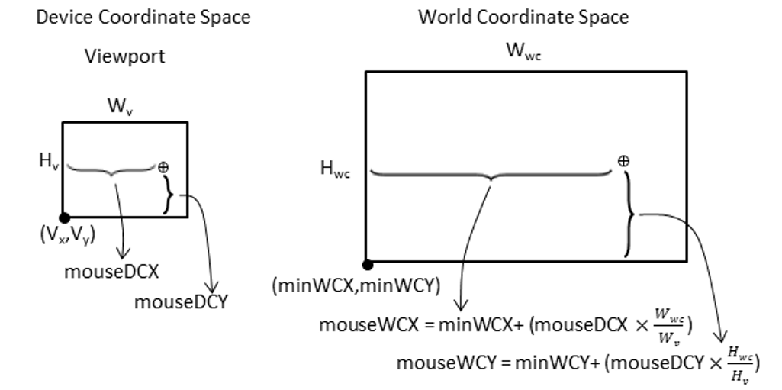
Viewport (device) to World Coordinate!

Slide 16
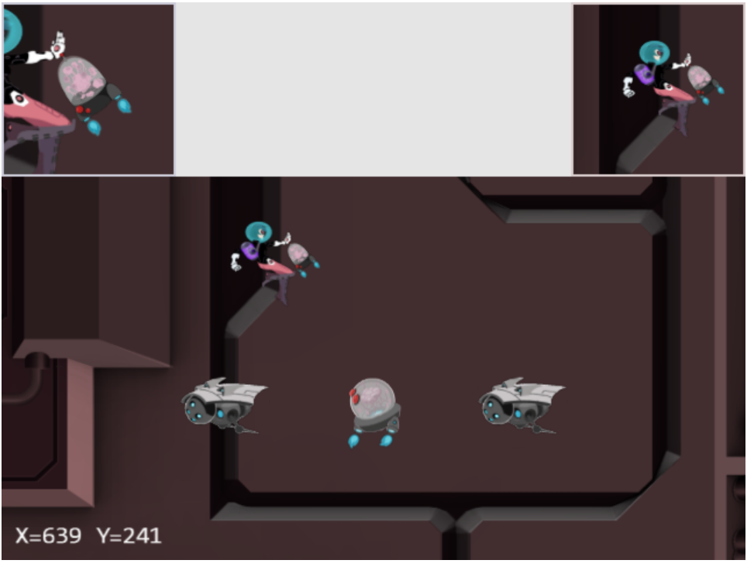
7.5: Mouse Input Project

Slide 17
7.5: Goals
To understand the Canvas Coordinate space to WC space transform
To appreciate mouse clicks are specific to individual viewports
To implement transformation between coordinate spaces and support mouse input

Slide 18
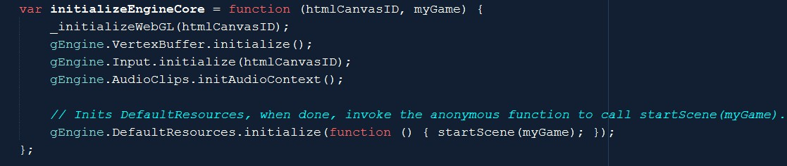
Implementation: Input needs access to canvas
Engine_Core.js

Slide 19
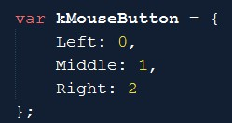
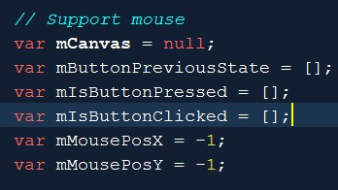
Engine_Input.js
Arrays: to support left/mid/right
Press/Click (just like keyboard)
mMousePosX/Y
In canvas coordinate

Slide 20
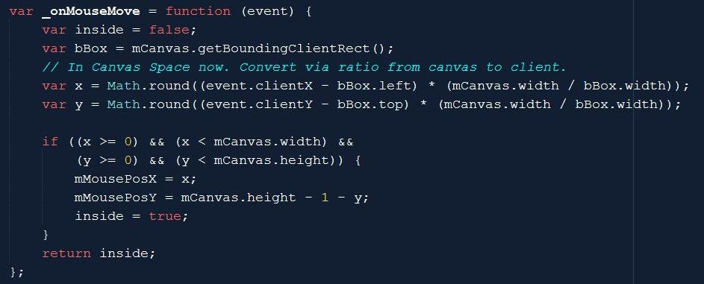
Engine_Input:: event handlers
Transform from web-page to canvas

Slide 21
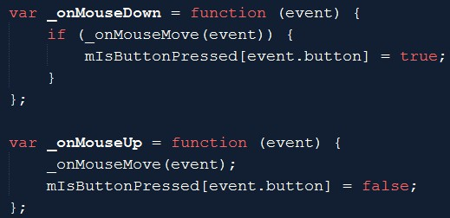
Engine_Input:: mouse clicks
event.button: 0, 1, or 2

Slide 22
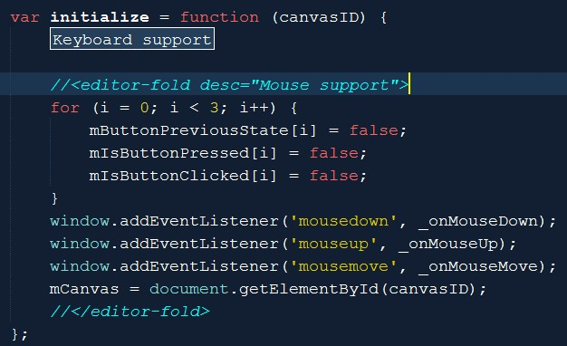
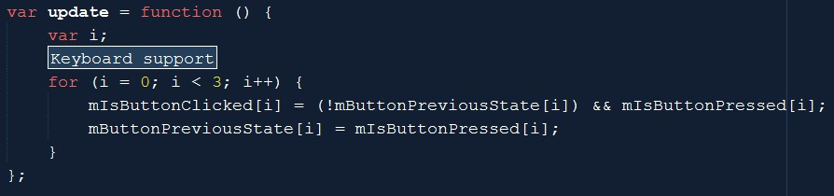
Engine_Input: init and update

Slide 23
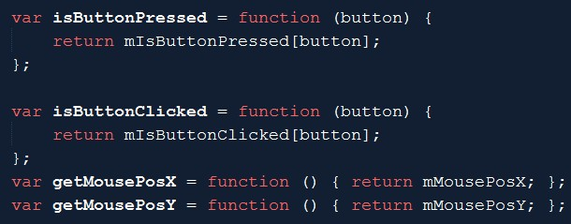
Engine_Input:: query
mousPos X/Y: in canvas coordinate
Must transform to WC before can be used for selection!!
DC is Viewport coordinate

Slide 24
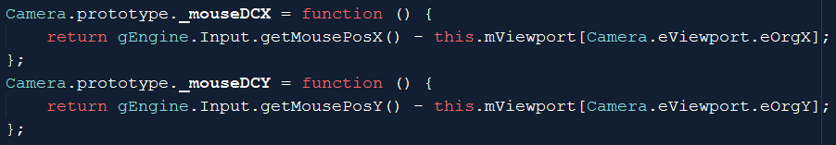
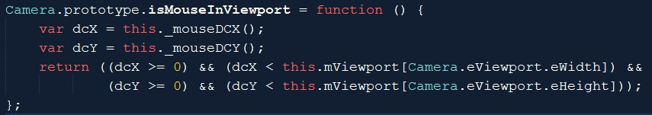
Camera_Input.js: Canvas to DC
DC is Viewport’s coordinate
If mouse click is in the viewport of a camera

Slide 25
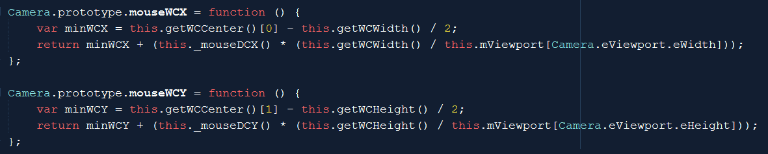
Camera_Input.js:: DC to WC

Slide 26
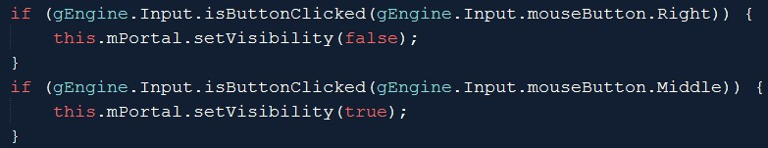
MyGame.update(): Testing Mouse Input
Examine dcXY:
Test button clicks:

Slide 27
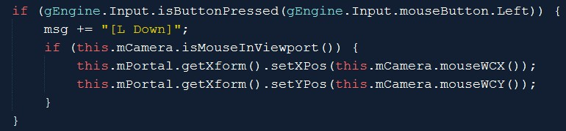
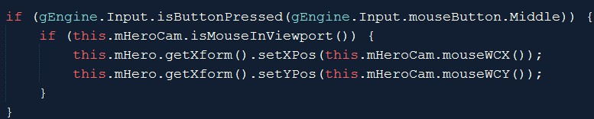
MyGame.update(): Testing Mouse Input
Test WC coordinate value and Button pressed (draggin)
Note: isMouseInViewport() function call!

Slide 28
Mouse input: notice
Can differentiate mouse click by viewport (camera)
The actual interaction code should be hidden from MyGame
Define a MyCamera to subclass from Camera
Implement mouse events in MyCamera.update()
Right-mouse-click
Browser hijacked this event!

Slide 29
Chapter 7: Learned
Camera manipulation:
Manipulation of wcCenter, wcWidth
Either change GameObject, or change camera values
Math operation/expression
For controlling smoothness
For controlling movement
Positional input device (mouse)
Ability to support multiple views
Coordinates:
Canvas, Viewport (DC), World
Image (pixels), UV (texture),
NDC

Slide 30
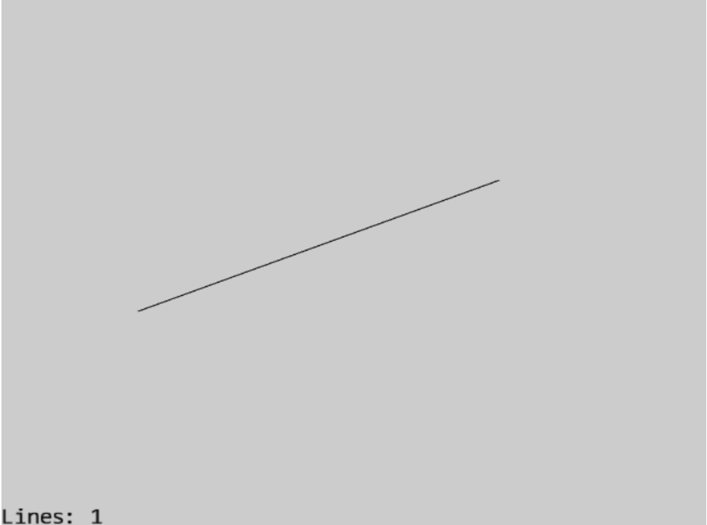
7.6: You can draw lines! ☺

