Slide 1
Chapter 8
Illumination
Examples 1 to 3

Slide 2
This Chapter
Understand the parameters of simple illumination models
Define infrastructure supports for working with multiple light sources
Understand the basics of diffuse reflection and normal mapping
Understand the basics of specular reflection and the Phong illumination model
Implement GLSL shaders to simulate diffuse and specular reflection and the Phong illumination model
Create and manipulate point, directional, and spotlights
Simulate shadows with the WebGL stencil buffer

Slide 3
Illumination Model
Math formulation: of energy transfer
to compute final color for an scene
Direct illumination: energy received from the source (light source)
Indirect (global) illumination: energy received from reflection
Important for games:
Basic aesthetic
Support dramatic effects:
Sense of Horror: Dark surrounding with only a torch light
Sense of Danger: flickering of red emergency lights
Realism: Only as important as games required
Surreal: e.g., negative light source (possible)!

Slide 4
Pathway of learning
Ambient Light: background light (secondary illumination)
Simple light sources: how energy leaves sources
Reflection models: how energy is reflected to the eye
Diffuse and Specular reflection models
Introduce the idea of “material property”
Light source types:
How to model different ways of energy leaving a source
Shadows: inter-object occlusion
A first pass approximation

Slide 5
Ambient Light
Objects are visible: even when all lights are switched off
Reason? Secondary illumination
Light sources that are not directly visible to the eye
Objects inter-reflect lights from sources
Characteristics
Smooth illuminated results (no sharp boundaries)
Color bleeds
Solution
Global illumination (Radiosity): Expensive
Our solution: approximate with constant! ☹

Slide 6
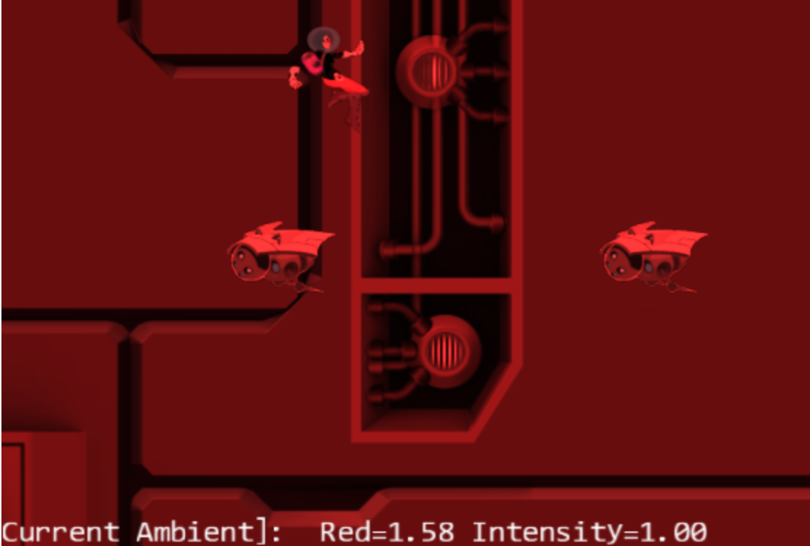
8.1: Global Ambient Project
LMB: Increases global red ambient
MMB: Decreases global red ambient
Left/right arrow keys: Decrease/increase global ambient intensity

Slide 7
8.1: Goals
experience the effects of ambient lighting
understand how to implement a simple global ambient across a scene
refamiliarize with the Shader/Renderable pair structure to interface to GLSL shaders and the game engine

Slide 8
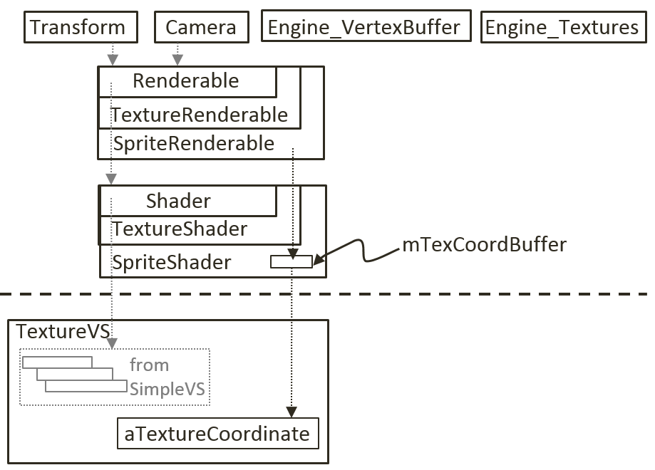
Review our GLSL Shader implementation
CPU to VS: transform to NDC
Vertex and Texture coordinates
Model + ViewProject Xforms
CPU to FS: compute pixel colors
Pixel Color + texture sampler
VS to FS
What is “varying”?
gl_Position + vTexCoord
Shader hierarchy
Interface (pass information) to GLSL
Renderable hierarchy
Allows game programmer to associate per-instance parameters
e.g., xform, texture, sprite info

Slide 9
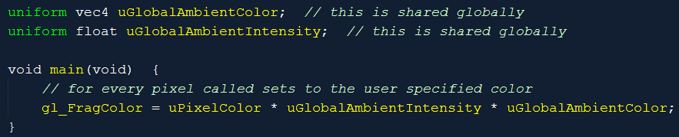
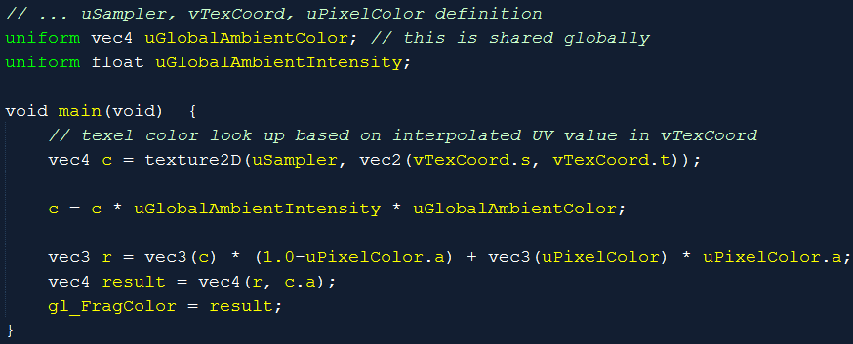
Fragment Shaders: SimpleFS/TextureFS
Separate intensity and color (for convenience)

Slide 10
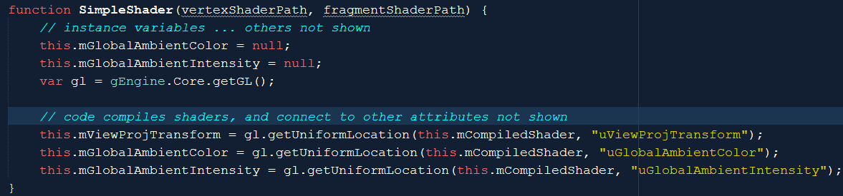
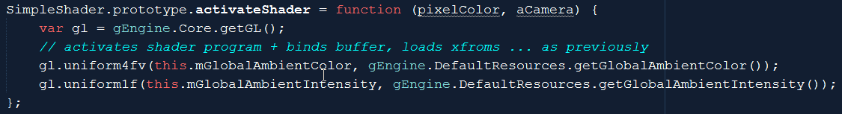
SimpleShader: to pass global intensity/color
Values: load directly from DefaultResources! GLOBAL!

Slide 11
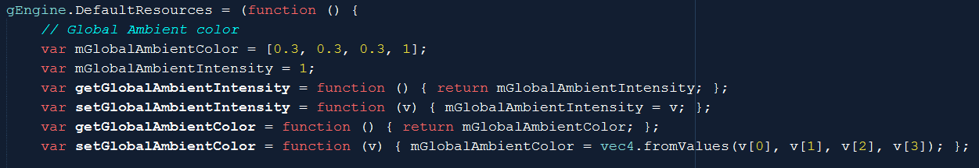
Engine component modifications
Engine_DefaultResources.js:

Slide 12
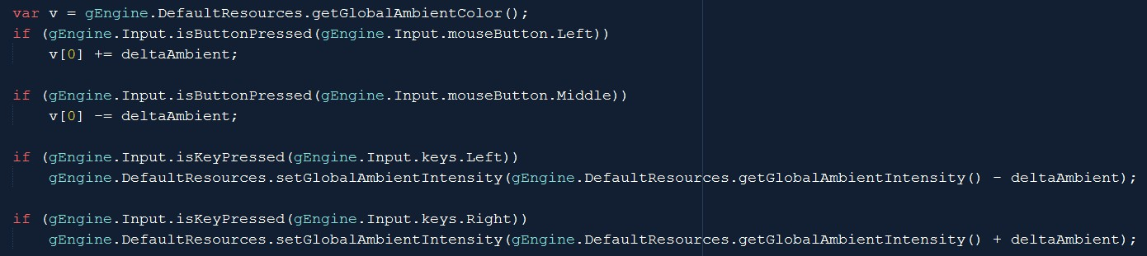
Testing
Left mouse button: Increases the global red ambient
Middle mouse button: Decreases the global red ambient
Left/right arrow keys: Decrease/increase the global ambient intensity
MyGame.update()

Slide 13
Observations
Color and Intensity (multiplied)
Values:
0 to 1 range is “legal”
BUT: can change to anything
Saturation and Over-saturation

Slide 14
Light Source: Source of energy!
Observe the lights around us
How to describe
Geometry of the source can be complex!
For now, focus on a light bulb (the simplest light source?)
A point light source
Later:
The Sun (directional light)
Desk lamp: Spotlight

Slide 15
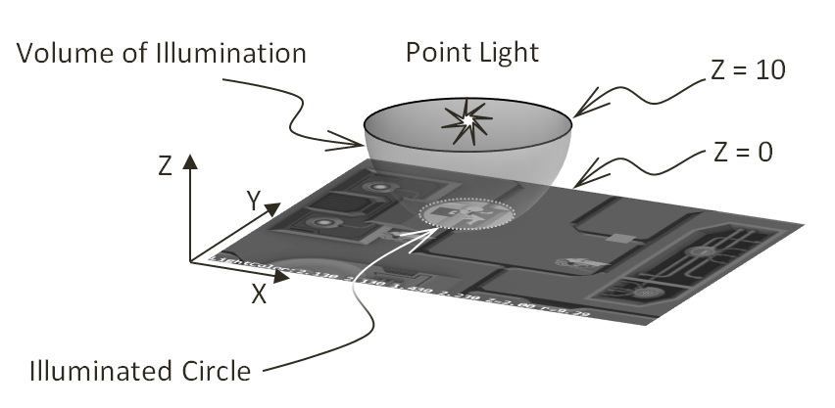
Point Light
Must work in 3D!
Illumination volume
A Sphere
Inside: On
Outside: Off
On 2D plane
Illuminates a circle

Slide 16
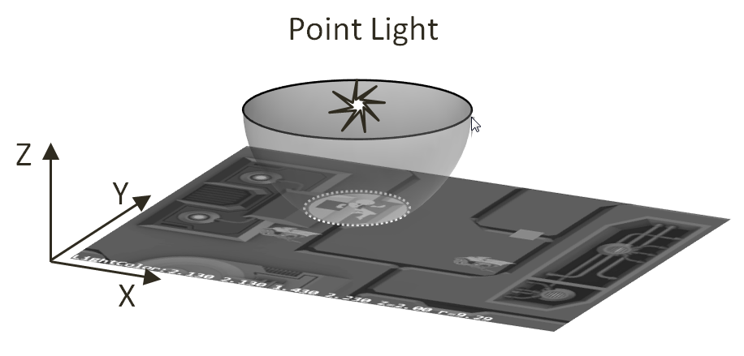
Parameters of a light:
Light On or Off
Light Radius
Light position:
In 3D! (with Z! ☺)
Z-value is important
Z == 0 is our world!
Light Color
All in Fragment Shader!
Only changes pixel value!

Slide 17
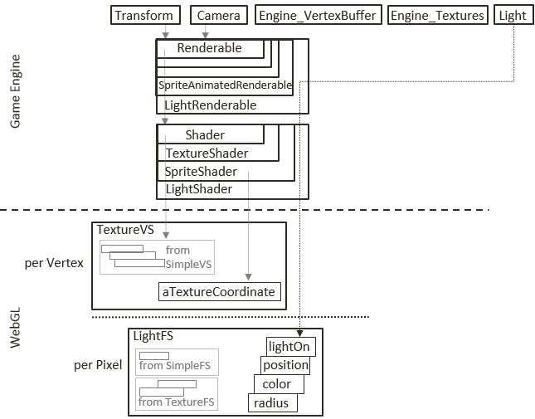
Implementation of light
Light parameters in Fragment Shader only
Use same TextureVS (why not SimpleVS?)
LightShader/LightRenderable to support light parameters

Slide 18
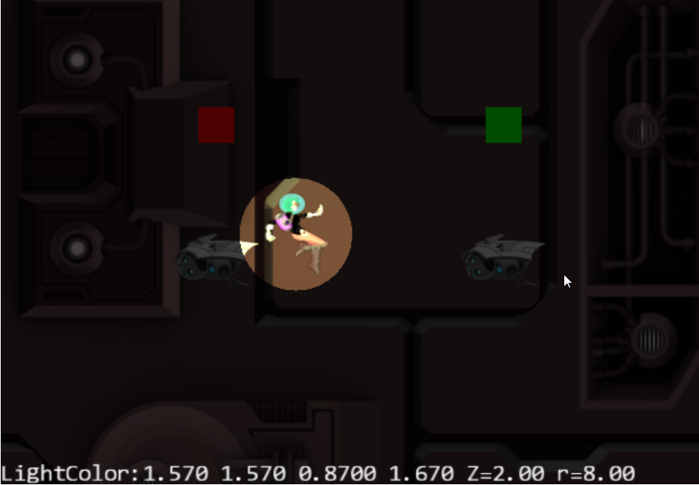
8.2: Simple Light Shader Project
WASD keys: hero
WASD keys + LMB: hero and light
Left/right arrow key: light intensity
Z/X key: light Z position
C/V key: light radius

Slide 19
8.2: Goals
understand how to simulate the illumination effects from a point light
experience illumination results from a point light
implement a GLSL shader that supports point light illumination

Slide 20
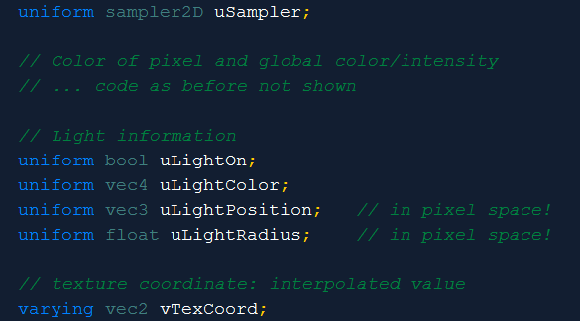
GLSL Fragment Shader: LightFS
The parameters
WATCH OUT!!
Position and radius
Values in pixel space!!?
You will see later!

Slide 21
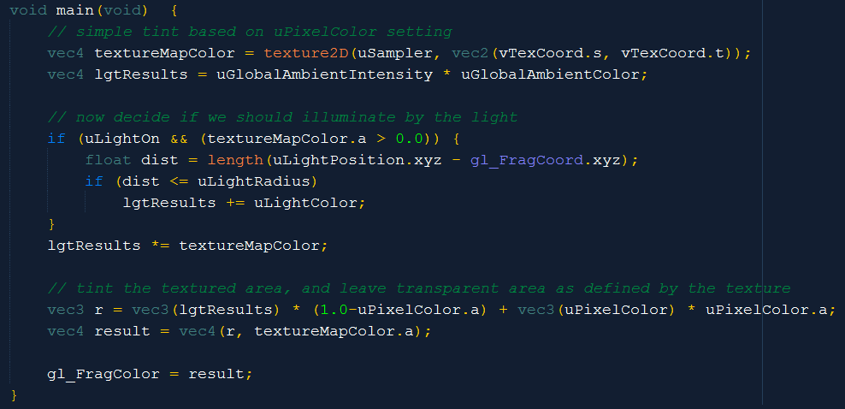
LightFS: the main()
Current pixel
Results in units of pixels

Slide 22
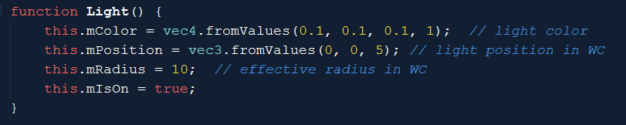
Define the Light object
One-to-one of the Fragment Shader parameters
Define: LightShader.js to
pass this information to the Fragment Shader
Boring: setter/getter not shown

Slide 23
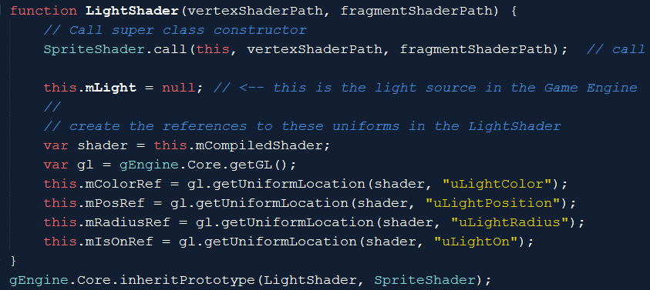
LightShader.js
Job: send the content to the Fragment Shader!
Connection to the attributes in the FS!
Connection to the attributes in the FS!

Slide 24
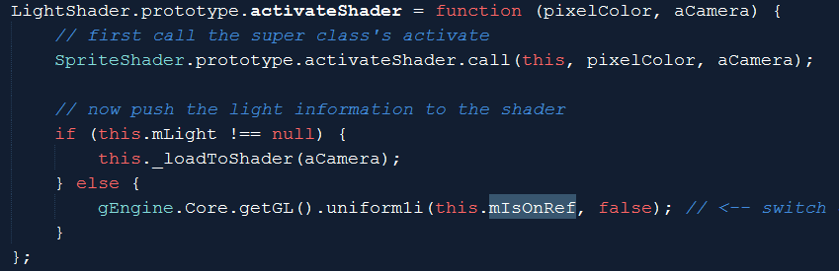
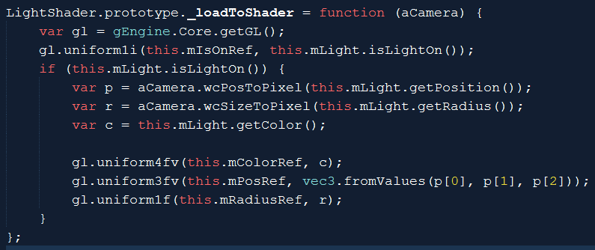
LightShader.activateShader
All positions and size in pixel space!

Slide 25
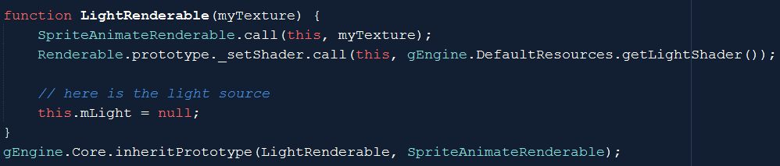
LightRenderable: for Game Programmer
mLight: is the only addition to SpriteAnimateRenderable

Slide 26
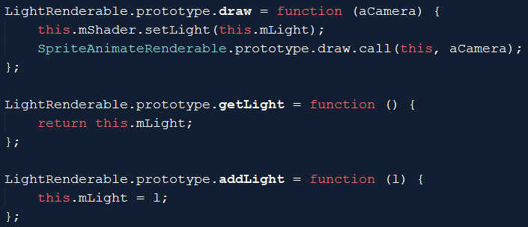
LightRenderable: draw and setLight
Draw: sets renderable light to the LightShader!
Remember: LightShader is shared!

Slide 27

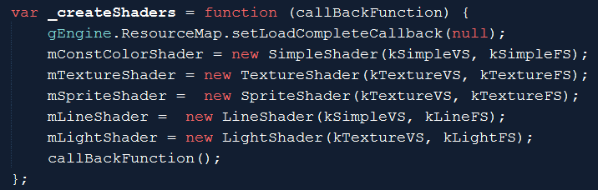
DefaultResources.js: default LightShader
Note: use kTextureVS!

Slide 28
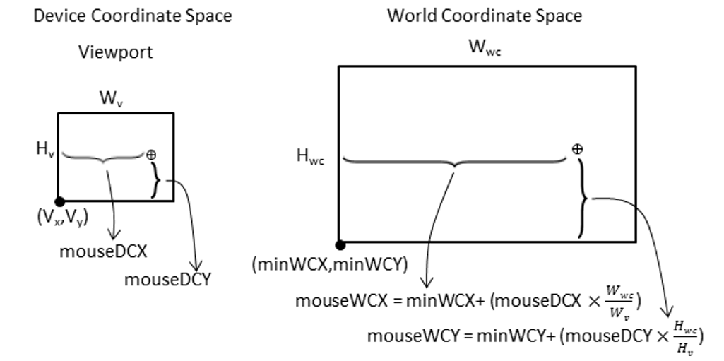

Pixel Space!! (From WC)
Invert: ${DC}_{x}=({WC}_{x}−{minWC}_{x})×\frac{W_{v}}{W_{wc}}$
$${DC}_{y}=({WC}_{y}−{minWC}_{y})×\frac{H_{v}}{H_{wc}}$$

Slide 29
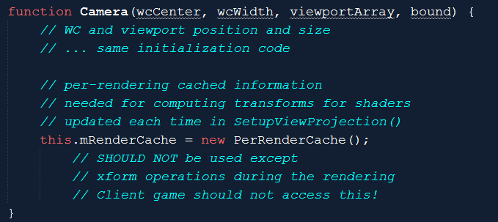
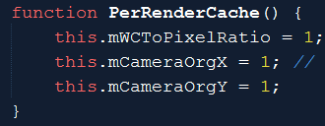
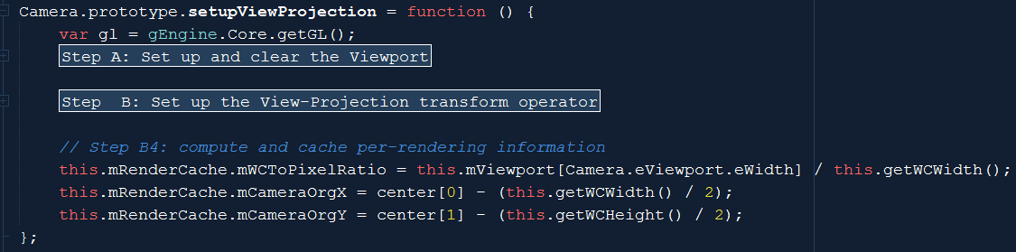

Computation in Pixel Space!
Avoid per-object re-computation
Camera.js
$${DC}_{x}=({WC}_{x}−{minWC}_{x})×\frac{W_{v}}{W_{wc}}$$
$${DC}_{y}=({WC}_{y}−{minWC}_{y})×\frac{H_{v}}{H_{wc}}$$

Slide 30
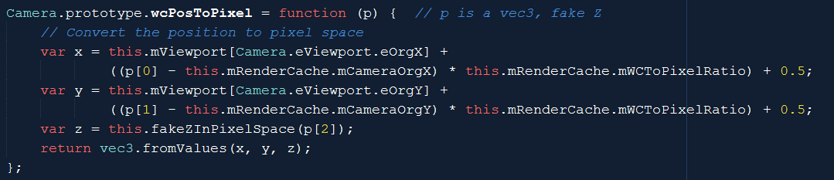


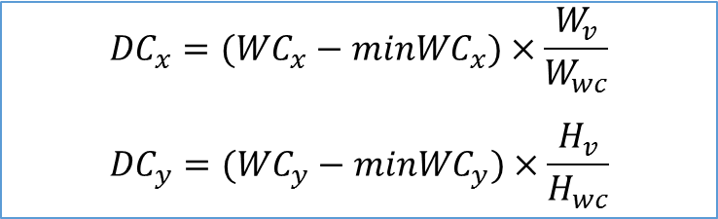
Camera_Xform.js: transform support
$${DC}_{x}=({WC}_{x}−{minWC}_{x})×\frac{W_{v}}{W_{wc}}$$
$${DC}_{y}=({WC}_{y}−{minWC}_{y})×\frac{H_{v}}{H_{wc}}$$

Slide 31
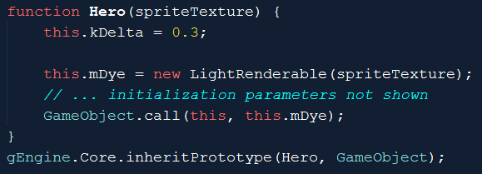
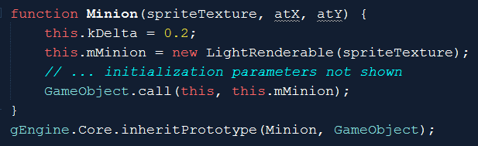
Objects in MyGame …
Hero: reference to LightRenderable
Minion: also reference to LightRenderable
LightRenderable: subclass from SpriteAnimateRenderable
➔Light shine on animated object!

Slide 32
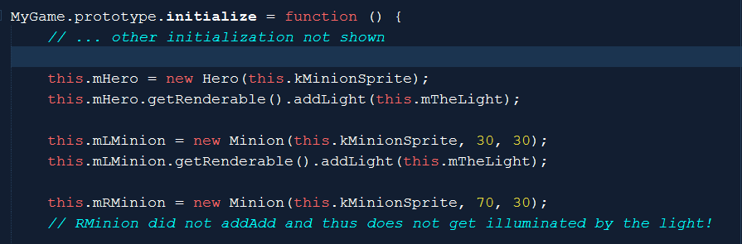
Testing the light with MyGme
Add the light to Hero and Left-Minion
BUT not Right-Minion

Slide 33
Observe:
WASD keys + LMB:
Move to Left-Minion➔ Illuminated!
Move to Right-Minion, not illuminated (no light)!
Left/right arrow key: observe light increase/decrease
Z/X key: light Z position
Can move light to the negative plane!
There is a max illuminated circle size (radius of the light)
C/V key: light radius
Illuminated circle size can grow to anything!

Slide 34
More observation
Cool?
Light illumination is pretty cool?
No Cool!
Very restrictive, only one light!
Light does not model a light bulb?!

Slide 35
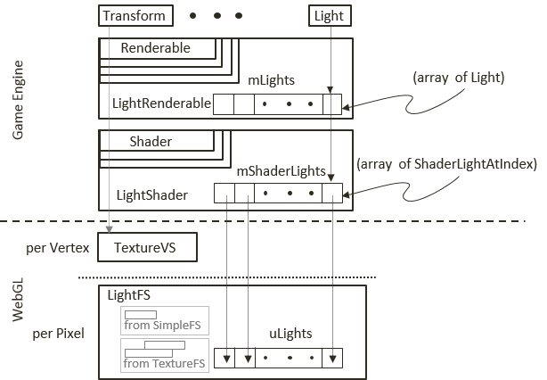
Multiple Light Sources
Fragment shader with an Array of Light!

Slide 36
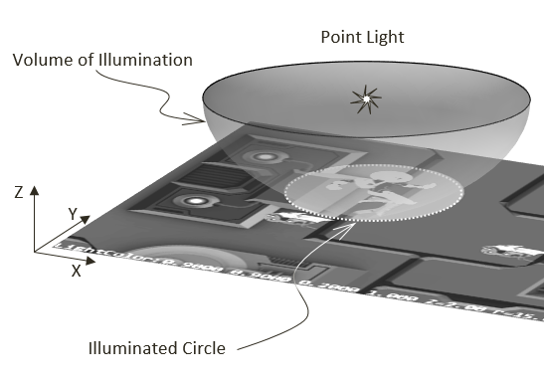
Compare to a light bulb:
Illuminated circle boundary
Should be soft (gradual) light energy dies off according to distance
Distance Attenuation
Implementation:
Near/Far cutoff
<Near: all illuminate
>Far: no illuminate
In between: drops of gradually

Slide 37
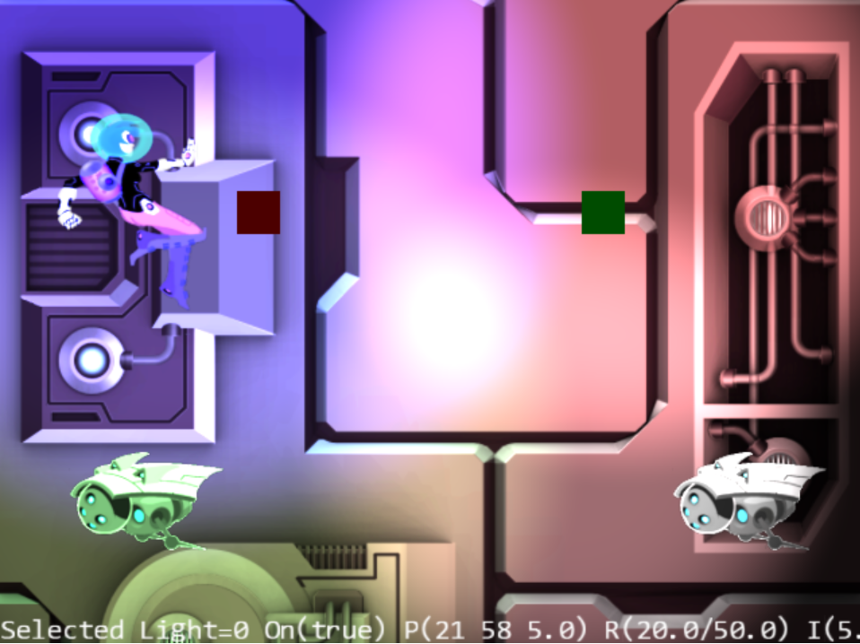
8.3: Multiple Lights Project
WASD: hero
0-3: Select light
Arrow: Selected light
Z/X: light z position
C/V: near cut-off
B/N: far cut-off
K/L: intensity
H: Toggles on/off

Slide 38
8.3: Goals
build infrastructure to support multiple light sources
in the engine and in GLSL shaders
understand and examine the distance attenuation effects of light
experience controlling and manipulating multiple light sources in a scene

Slide 39
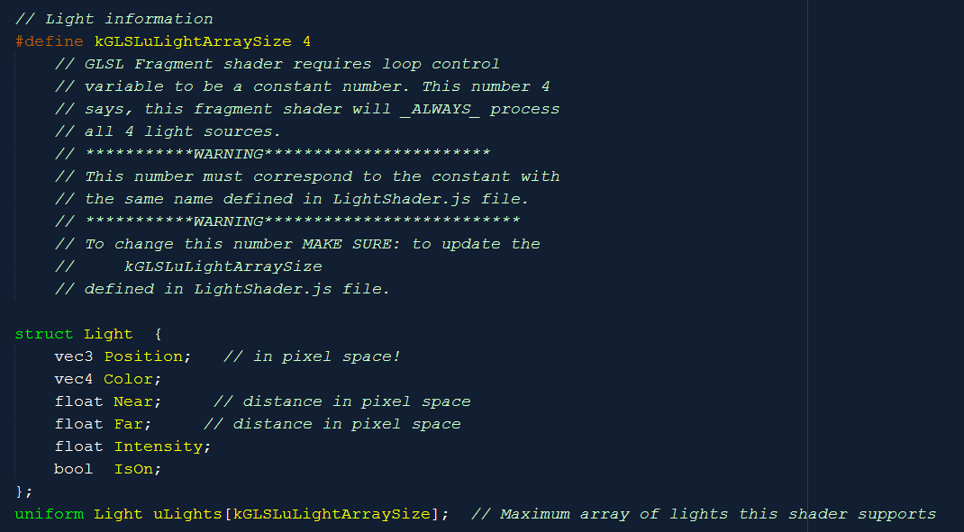
LightFS.glsl: Array support!
Must be the same size!
Must be the same size!
Must be the same size!

Slide 40
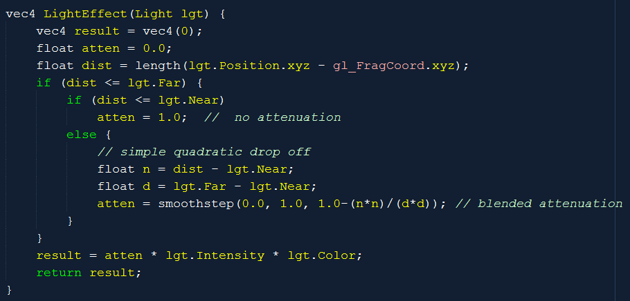
Compute lightEffect

Slide 41
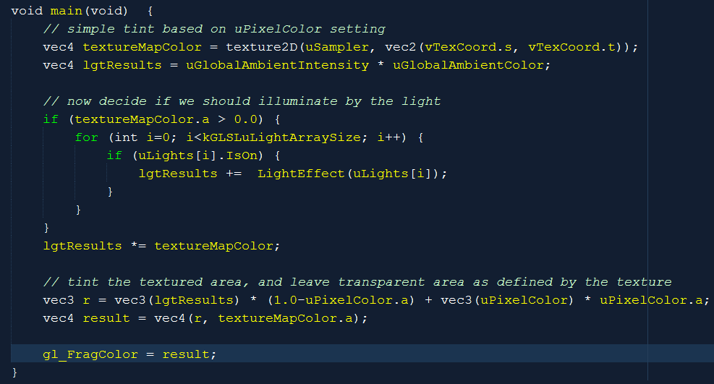
LightFS: The Light Fragment Shader
Loop control must be a constant!
At runtime, cannot decide how many to loop over! Must loop over lights even if they are switched-off!

Slide 42
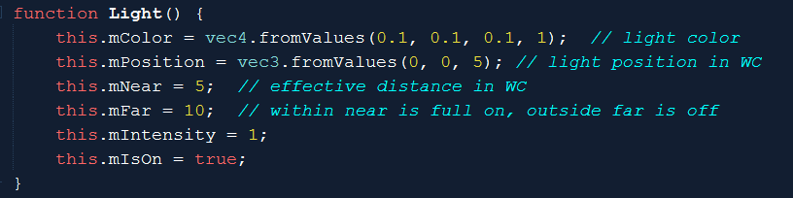
Light.js: with cut-offs
Boring setter/getter: not shown

Slide 43
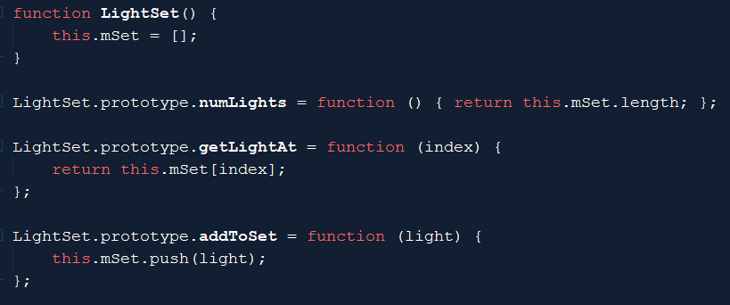
LightSet

Slide 44
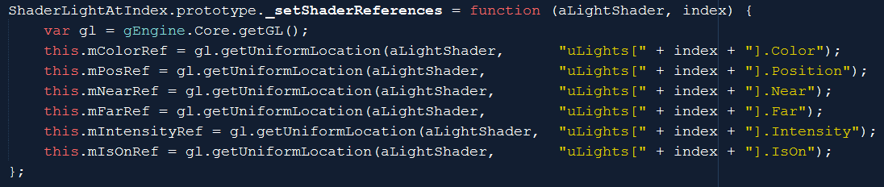
ShaderLightAtIndex
To communicate to LightFS
Each ShaderLightAtIndex is connected to one uLights[] array element!

Slide 45
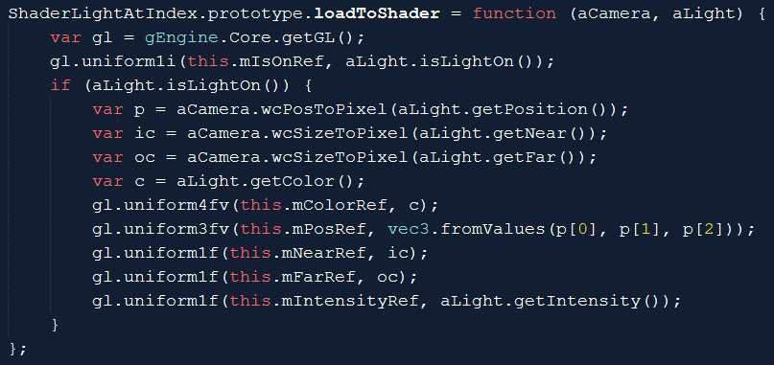
ShaderLightAtIndex.loadtoShader

Slide 46
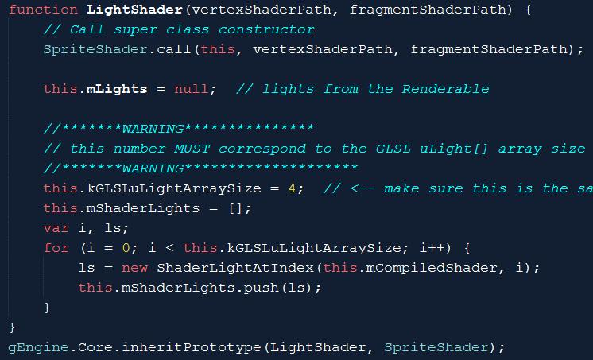
LightShader.js

Slide 47
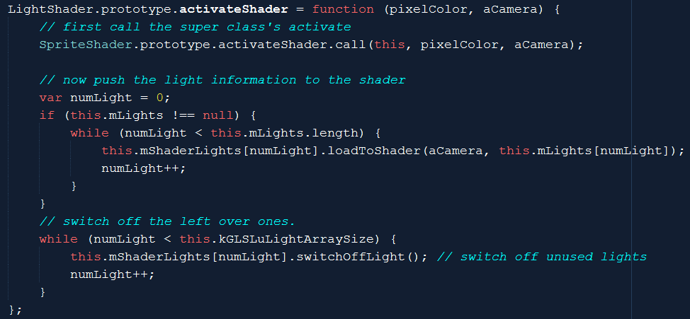
LightShader.activateShader
Must switch-off un-used lights!
LightFS will loop through all uLights[] for each pixel!

Slide 48
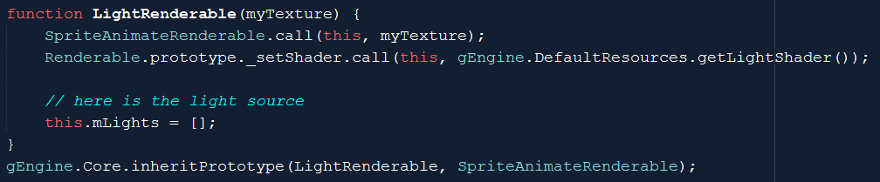
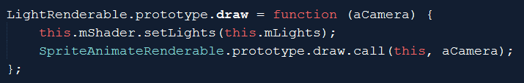
LightRenderable

Slide 49
Observation:
Multiple lights
Cool!?
Distance attenuation: softer more gentle effects
More like real world?
The entire world appears flat!?
Lack of sense of object geometric shape/contour?

