Slide 1
ALADIN goes OPAL (OPALADIN)
Tasks and solution(-hint)s generator in the field of Informatics and adjacent disciplines goes OPAL

Slide 2
Outline
1. Motivation for the development of (OP)ALADIN
2. Objectives of (OP)ALADIN
3. Generation of semantically plausible exercises and exercise types in (OP)ALADIN
4. Learning management and didactics in (OP)ALADIN
5. Summary and outlook

Slide 3
Outline
1. Motivation for the development of (OP)ALADIN
2. Objectives of (OP)ALADIN
3. Generation of semantically plausible exercises and exercise types in (OP)ALADIN
4. Learning management and didactics in (OP)ALADIN
5. Summary and outlook

Slide 4



1. Motivation for the development of (OP)ALADIN
Low availability of…
…exercises and mock exams
…unknown exercises for independent practice
No motivating impulses for individual learning processes
Teaching process is tied to location and time slots
No individualization of exercises in terms of complexity
No self-organized and self-activated learning
High expenditure regarding the…
…creation of new exercies
…creation of new exercise types
…correction of…
…tutorials
…laboratory practicals
…exams
…creation of solution hints
Individual tutoring requires synchronous communication

Slide 5
Outline
1. Motivation for the development of (OP)ALADIN
2. Objectives of (OP)ALADIN
3. Generation of semantically plausible exercises and exercise types in (OP)ALADIN
4. Learning management and didactics in (OP)ALADIN
5. Summary and outlook

Slide 6
2. Objectives of (OP)ALADIN
Adaption of exercise complexity to individual performance capability
Learn in their own speed
Promoting of high problem-solving competence ➔ higher success rates
Generation of exercises is parametrizable ➔ Teaching content can be actively co-designed
Promoting student networking
Asynchronous feedback to/from teachers
Generation of competence-oriented exercises for heterogeneous target groups
Generation of online self-tests and electronic mock exams ➔ Immediate automatic and performance-based feedback
Reusability is unrestricted by time and subject matter
Flexible applicability in terms of time, space and institution
Extensible by new exercise types
Reduction of effort with regard to generating exercises and solution aids and their correction

Slide 7
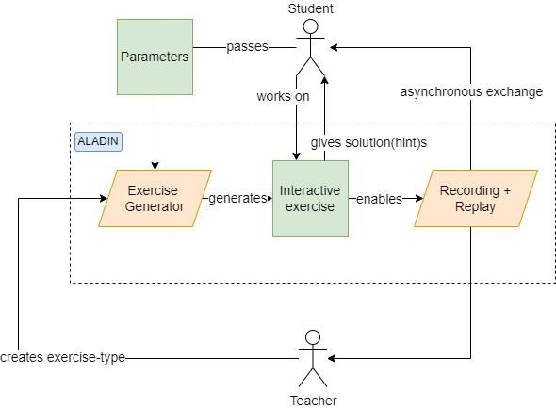
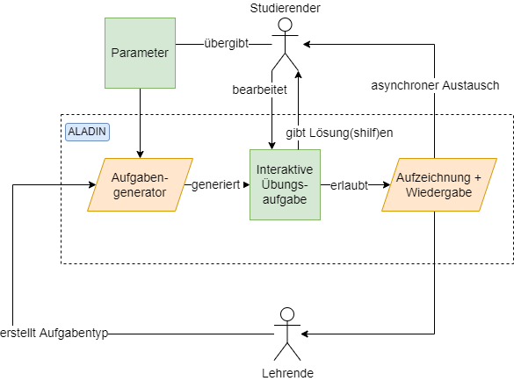
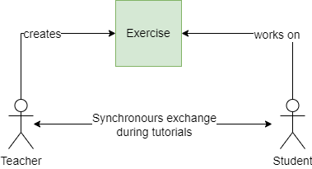
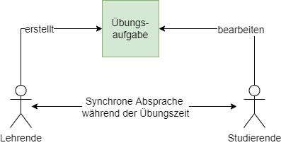
2.1 Learning and teaching with and without ALADIN
Teaching process without ALADIN
Teaching process with ALADIN
Notes:
Noch mal kurz zusammenfassen, was ALADIN macht und wie es prinzipiell arbeitet; vielleicht sogar anhand eines Diagramms?!

Slide 8
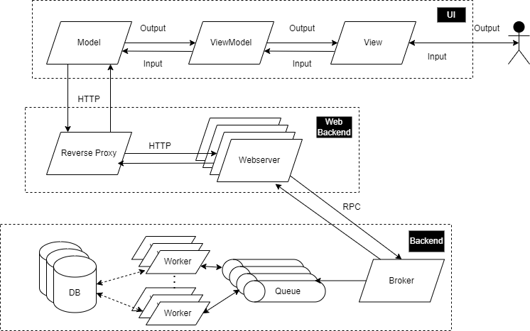
2.2 Software architecture of ALADIN
Notes:
JSON, Beispiel auf nächster Folie
MVVM – Model ViewModel View
Abwandlung von MVC Entwurfsmuster – Model View Controller
Nutzer denkt er kommuniziert mit Oberfläche, Oberfläche aktualisiert ViewModel, Interaktion mit Backend über Model, und Propagierung der Daten über ViewModel zurück an View;
Schnittstelle/Web kümmert sich um Load Balancing, Reverse Proxy implementiert Round Robin Verfahren, langlaufende Prozesse über RPC an Message Queue
Backend hält Broker und vordefinierte Queues, Worker können skaliert werden, nach Bedarf/Menge an Tasks in Queues.

Slide 9
Outline
1. Motivation for the development of (OP)ALADIN
2. Objectives of (OP)ALADIN
3. Generation of semantically plausible exercises and exercise types in (OP)ALADIN
4. Learning management and didactics in (OP)ALADIN
5. Summary and outlook

Slide 10



3.1 Exercise types for modeling exercises in (OP)ALADIN
Exercise type
Model syntax
Model semantics
Subject semantics
Model elements and linking rules
Exercises:
Multiple choice questions
Detection of syntactical errors
Meaning of model elements and linking rules
Exercises:
Completion of the model
Detection of semantical errors
Modelling of the subject matter
Exercises:
Model translation: Natural language <-> Model

Slide 11
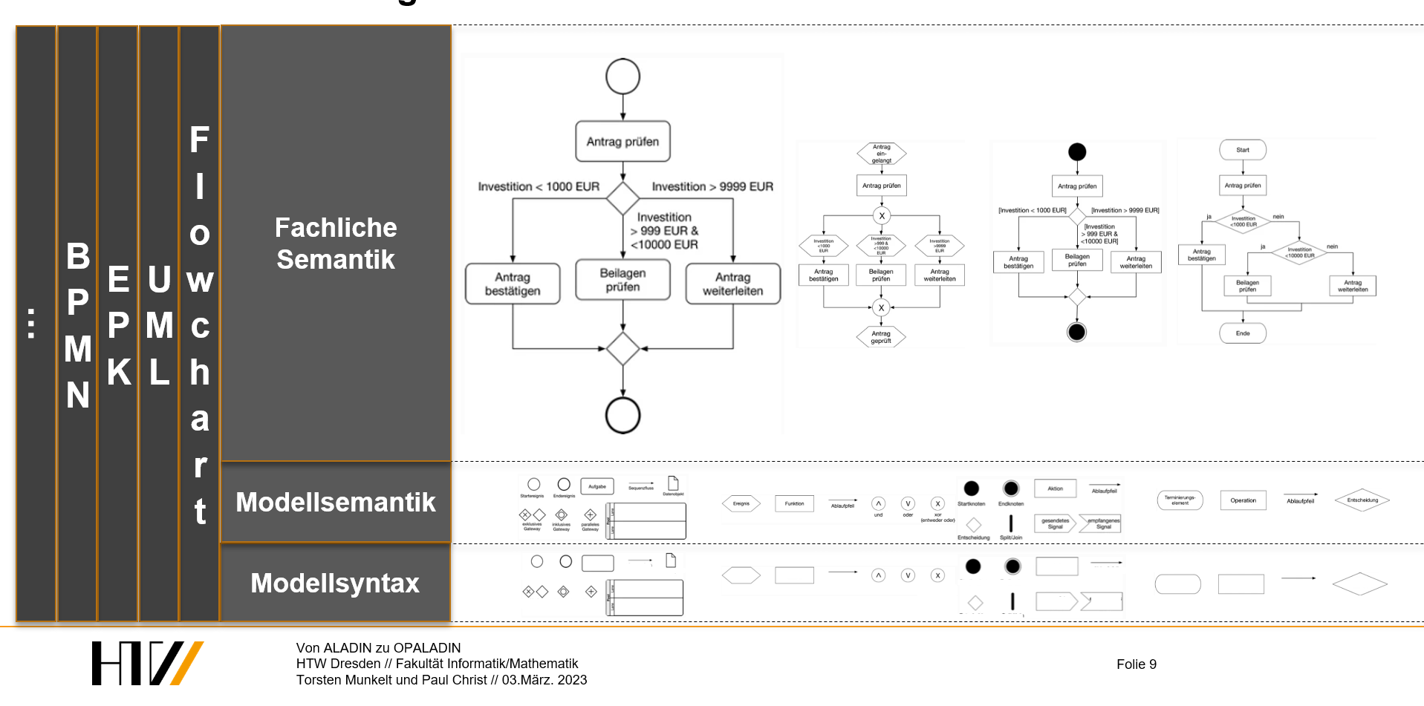
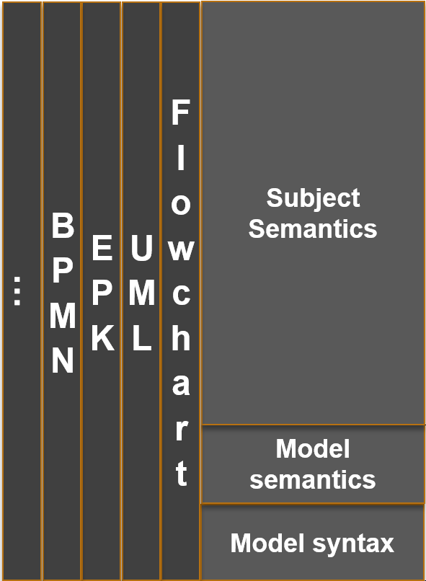
3.2 Generalisation of the exercise generation for behavioral diagrams

Slide 12
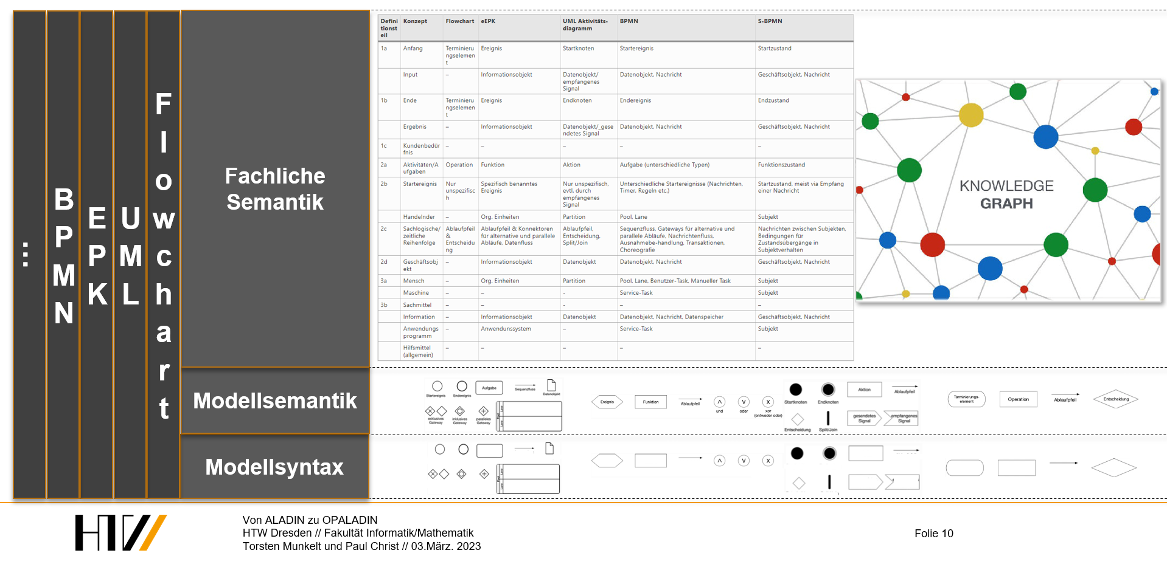
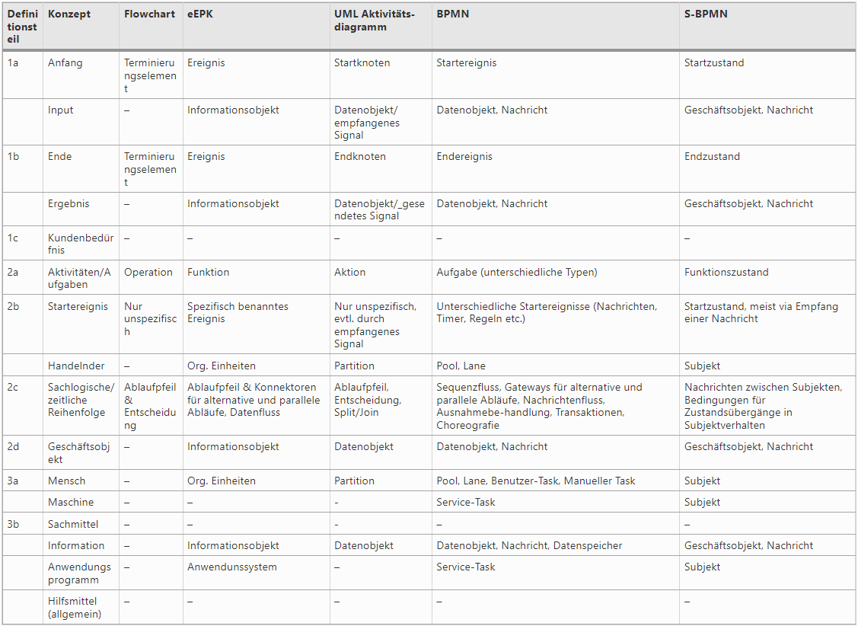
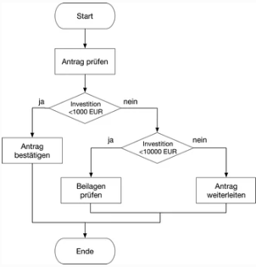
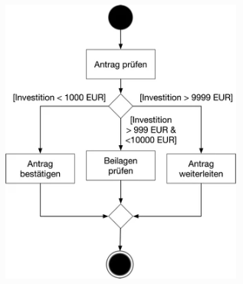
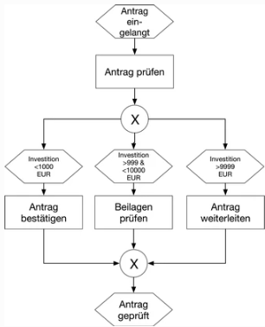
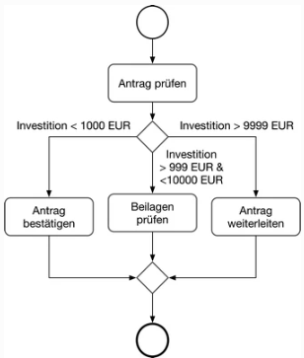
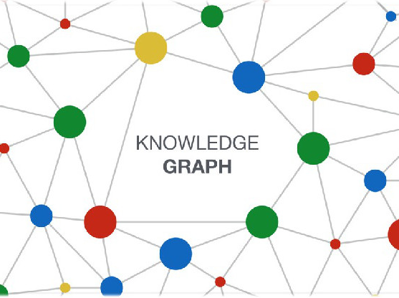
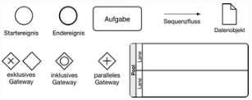
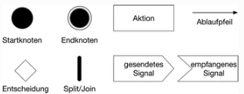


3.2 Generalisation of the exercise generation for behavioral diagrams
…
BPMN
EPK
UML
Flowchart
Fachliche Semantik
Meta-model
Modellsemantik
Modellsyntax
Notes:
Quelle: https://link.springer.com/chapter/10.1007/978-3-658-22648-0_3#citeas

Slide 13
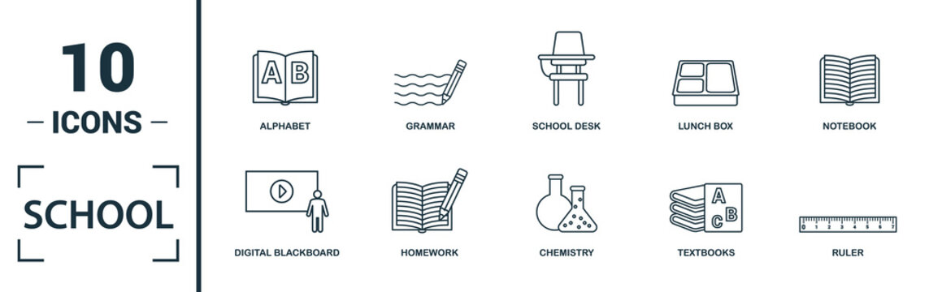


3.4 Implementation of modeling exercise generators in (OP)ALADIN
Modell
Model
ALADIN
Syntaktisch und modellsemantisch korrekt
Syntactically and model-semantically correct
Semantically plausible (subject matter)
KNOWLEDGE GRAPH

Slide 14
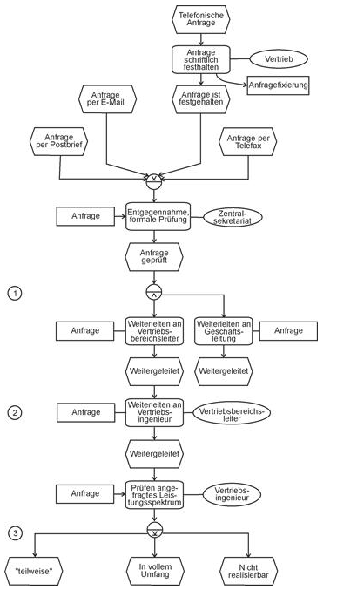
3.5 Requirements for a meaningful EPC modeling exercise
Exercise definition:
Model an event-driven process chain that represents the business process described in the text.
Natural language description:
The business process is started on the basis of a customer inquiry. This can be received by mail, fax, e-mail or telephone. If it is received by phone, the sales department prepares a written document that records the request (request fixation). Regardless of the type of receipt, the central secretariat receives the request, checks it for formal correctness and then forwards it to the responsible sales area manager and the management.
The sales area manager passes the request on to one of his sales engineers, who checks the feasibility of the offer. This initially concerns the requested range of services. If this is not within the company's range of services, a rejection will be made. If only parts of the requested services can be provided, partner companies are asked for support and involved either as cooperation partners or subcontractors. If no suitable partners are found, the request is rejected.
Notes:
Quelle: http://www.staud.info/epk/ep_f_9.htm

Slide 15
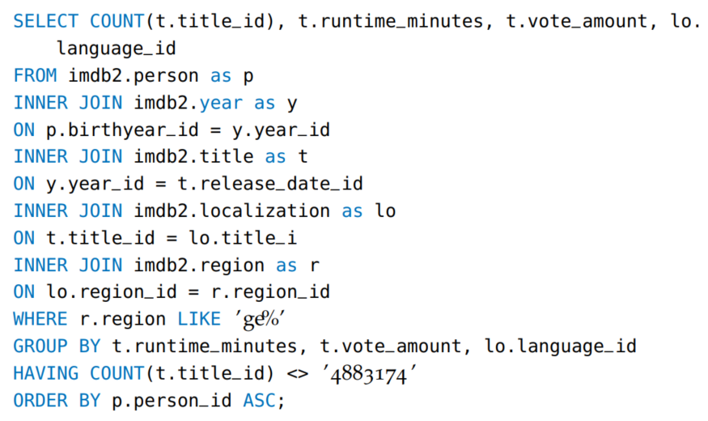

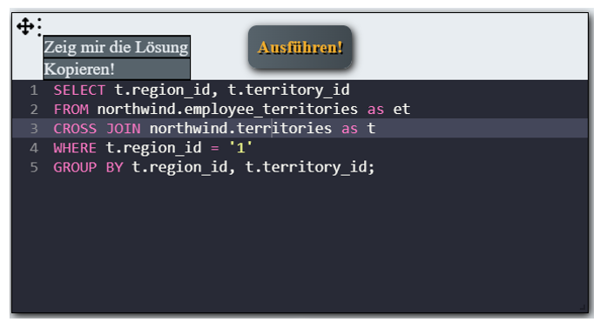
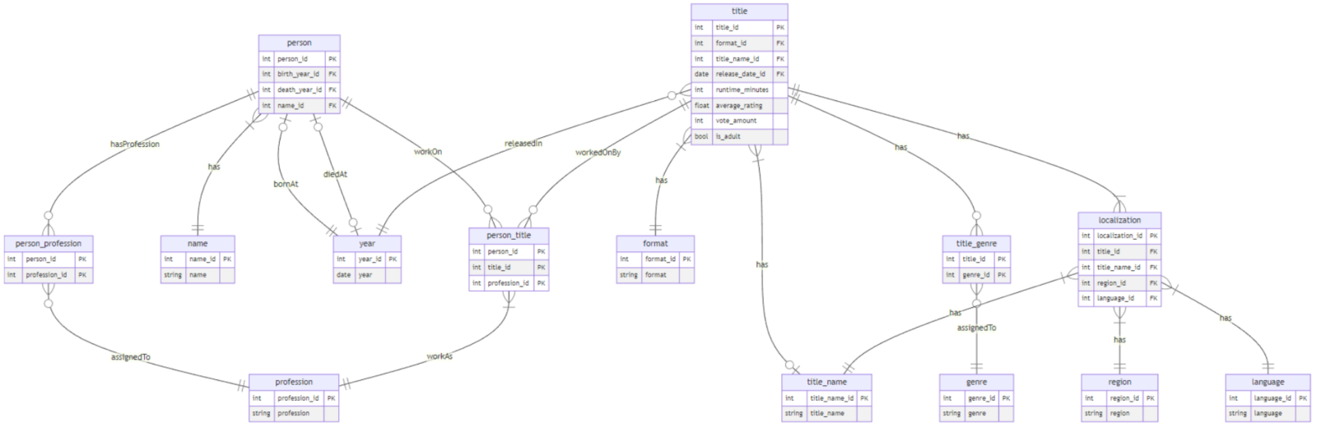
3.6.1 Requirements for a meaningful SQL-query exercise
Exercise definition:
Write an SQL query that extracts the information
described in the text from the database shown below.
Natural language description:
Database schema:

Slide 16
Digression - Limitations on semantic level 1.1
PatientCondition
ID | PatientID | Status | Entry date
0 | 0 | Recovered | 14.04.2020
1 | 1 | Vaccinated | 01.06.2021
2 | 2 | Vaccinated | 21.08.2021
3 | 3 | Infected | 05.12.2020
4 | 1 | Infected | 01.01.2022
Patient
ID | Surname | Name | Date of birth | Gender
0 | Mustermann | Max | 01.01.2000 | m
1 | Decker | Dirk | 31.12.1999 | m
2 | Räubertochter | Ronja | 03.02.1952 | f
3 | Lustig | Lea | 04.05.1965 | f
<
1
n
Which patients were infected, despite being vaccinated?
SQL-Abfrage:
SELECT p.Surname, p.Name FROM Patient AS p
JOIN PatientCondition AS pz ON p.ID = pz. PatientID
WHERE pz.Status = ‘Infected‘
AND pz.PatientID IN
(SELECT PatientID FROM PatientenCondition
WHERE Status = ‘Vaccinated‘ AND „Entry date“ < pz.„Entry date“);
Result
Surname | Name
Decker | Dirk

Slide 17
Digression - Limitations on semantic level 1.2
Create the intersection that contains the corresponding entries of the two tables "Patient" and "Patient condition". Output the columns "Name" and "First name". Only data for which "State" is "Infected" and the values of "ID" are in a subset, for which "State" is "Vaccinated" and "Entry date" is smaller than "Entry date" of the superset are to be output.
SELECT p.Name, p.Vorname FROM Patient AS p
JOIN Patientenzustand AS pz ON p.ID = pz.PatientenID
WHERE pz.Status = ‘Infiziert‘
AND pz.PatientenID IN
(SELECT PatientenID FROM Patientenzustand
WHERE Status = ‘Geimpft‘
AND Erfassungsdatum < pz.Erfassungsdatum);
AND Erfassungsdatum < pz.Erfassungsdatum
Find the surname and first name of the patients who have the status 'Vaccinated' and subsequently the status 'Infected'.
Not sufficiently inferable information
Cardinality
Semantic relation
Which patients were infected despite vaccination?
Notes:
SQL-Statement wird generiert
-> daraus wird NLP übersetzt

Slide 18
Digression - Limitations on semantic level 1.3
Find the name and first name of the patients who have the status 'Vaccinated' and subsequently the status 'Infected' and are treated by 'Quentin Quacksalber'.
PatientCondition
ID | PatientID | Status | Entry date
0 | 0 | Recovered | 14.04.2020
1 | 1 | Vaccinated | 01.06.2021
2 | 2 | Vaccinated | 21.08.2021
3 | 3 | Infected | 05.12.2020
4 | 1 | Infected | 01.01.2022
Patient | ---Treatment --- | Doctor
Recipient | <-------Action-------- | Acteur
1
Patient
ID | Surname | Name | Date of birth | Gender
0 | Mustermann | Max | 01.01.2000 | m
1 | Decker | Dirk | 31.12.1999 | m
2 | Räubertochter | Ronja | 03.02.1952 | f
3 | Lustig | Lea | 04.05.1965 | f
<
1
n
Treatment
PatientID | DoctortID
0 | 1
0 | 2
3 | 0
Doctor
ID | Surname | Name
0 | Quacksalber | Quentin
1 | Wunderheiler | Wilfried
2 | Knochenbrecher | Kurt
<
<
n
m
1

Slide 19
Digression - Limitations on semantic level 1.4: Projection of a knowledge graph onto a relational database schema
m
…
hasGender
hasName
Dirk
isA
0
Decker
…
1
Patient
isA
hasSurname
Patient
31.12.1999
hasStatus
bornAt
Vaccinated
enteredAt
Infected
01.06.2021
enteredAt
isInTreatmentWith
PatientCondition
ID | PatientID | Status | Entry date
0 | 0 | Recovered | 14.04.2020
1 | 1 | Vaccinated | 01.06.2021
2 | 2 | Vaccinated | 21.08.2021
3 | 3 | Infected | 05.12.2020
4 | 1 | Infected | 01.01.2022
01.01.2022
1
Patient
ID | Surname | Name | Date of birth | Gender
0 | Mustermann | Max | 01.01.2000 | m
1 | Decker | Dirk | 31.12.1999 | m
2 | Räubertochter | Ronja | 03.02.1952 | w
3 | Lustig | Lea | 04.05.1965 | w
Wilfried
isInTreatmentWith
hasName
0
isA
<
hasSurname
1
n
Doctor
Wunderheiler
Treatment
PatientID | DoctortID
0 | 1
0 | 2
3 | 0
Doctor
ID | Surname | Name
0 | Quacksalber | Quentin
1 | Wunderheiler | Wilfried
2 | Knochenbrecher | Kurt
hasName
1
<
<
Quentin
isA
n
m
1
hasSurname
Quacksalber
Doctor
Notes:
Inferenz von 1-n Beziehung
Und n-m Beziehung über Auslesen der tatsächlich vorhanden Datenkardinalitäten
Semantische Beziehung und Interaktionsrichtung liegt vor

Slide 20





3.6.2 Requirements for a system for generating meaningful SQL query tasks
Parameterization of
the SQL query
Conclusive
SQL components (e.g. WHERE clause)
SQL components (e.g. WHERE clause)
Number of components (e.g. 3-5 constraints)
Complete
Natural language description
Syntactically correct
Semantically plausible
SQL-Query
SQL query task generation system
Evaluation of solution attempts

Slide 21
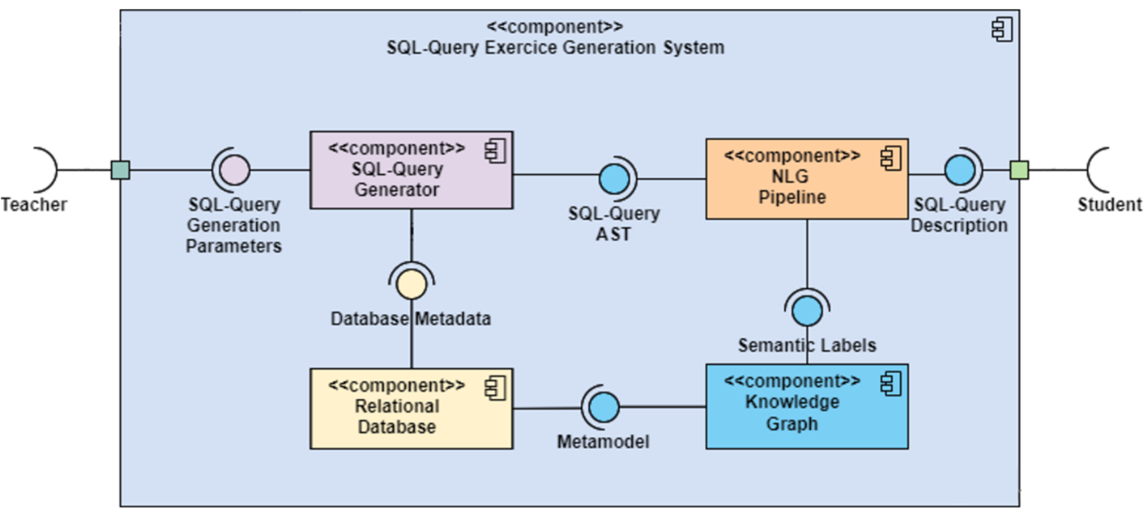
3.6.3 Overview of a system for generating meaningful SQL query tasks

Slide 22
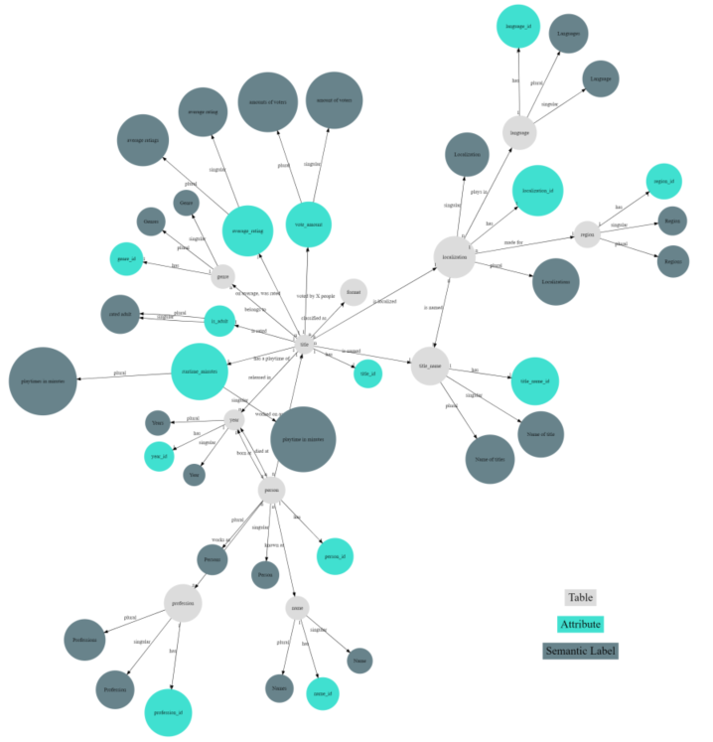





3.6.4 Creating metamodels and knowledge graphs for SQL query tasks
(Partially) Automated generation
Manual generation
Knowledge Graph:
Entities
Instances
Hyperonymy structure
Meronymy structure
Limitations:
Automatic derivation of table structures either too specific or too generic
Attribute assignment unclear, because on instance level instead of class level
When is entity a class/instance? Context is not modeled in Wikidata
…
Film- and media database

Slide 23

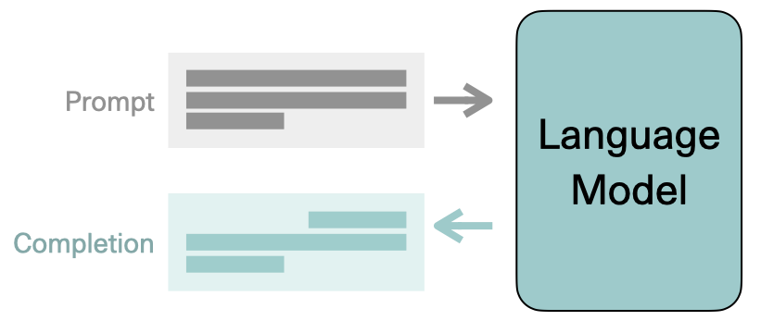
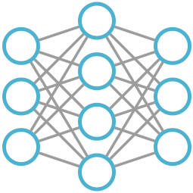
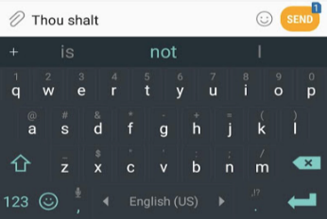

Digression - Dynamic generation of knowledge graphs 2.1
Generative creation of the knowledge database according to the requirements profile of the respective task type, with minimum effort
Define relations (isA, hasA, hasEffect, requires…)
Manually create a small sample
Natural language representation
Small amount of examples
Human labour
Large amount
of examples
Notes:
Am Schluss auf Colab wechseln und Beispiel zeigen

Slide 24
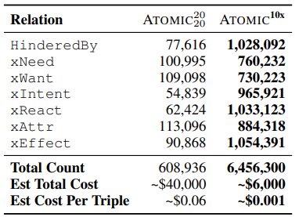
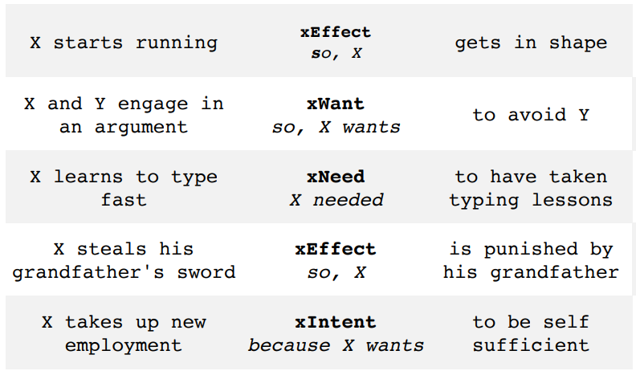
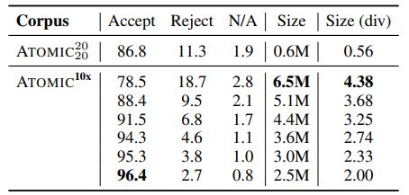

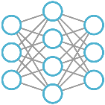
Digression - Dynamic generation of knowledge graphs 2.2: Symbolic Knowledge Distillation [1]
Event | Relation | Inference
100 manually
crafted examples
Defined target relations
100 manually
crafted examples
per target relation
In sets of 10 examples
In sets of 10 examples
Cutoffs of the „Critic“-model
Teilmenge
Introduction of the "Critic“-model Classification model trained on 10K random tuples evaluated by crowdsourcing.
176K
Events
6.5M
Inferenzen
[1] Symbolic Knowledge Distillation: from General Language Models to Commonsense Models
Notes:
Vergleich zwischen menschlich generierten und maschinell generierten KnowledgeGraph
Domäne: CommonSense Knowledge

Slide 25
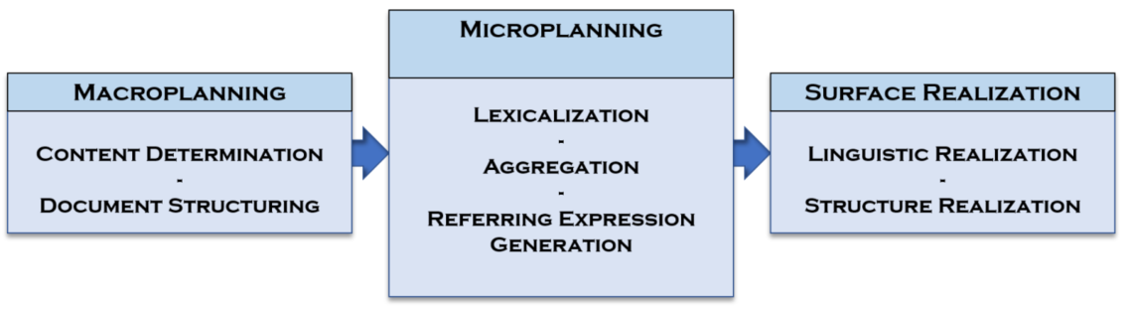
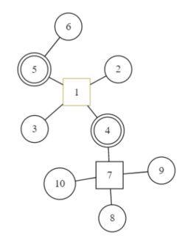
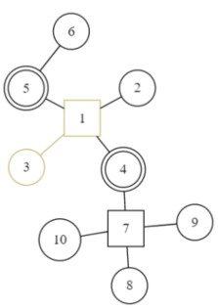
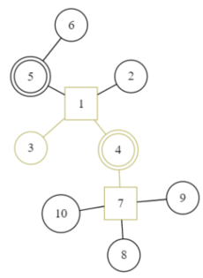
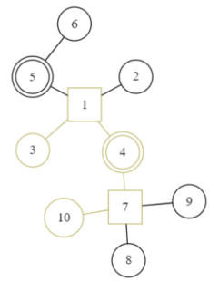
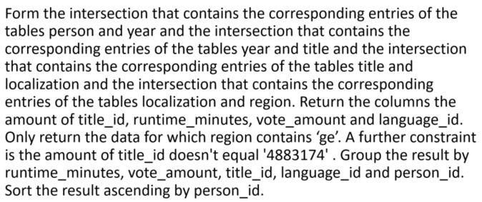
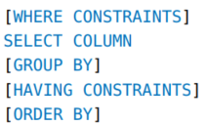
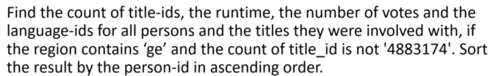
3.6.5 Generators for SQL queries and associated natural language descriptions
SQL-query generation
Generation of a natural language description
What?
How?
Correct form
1. FROM CLAUSE
Isomorphic Translation
2.
3.
4.
5.
6.
Homomorph Translation

Slide 26
Outline
1. Motivation for the development of (OP)ALADIN
2. Objectives of (OP)ALADIN
3. Generation of semantically plausible exercises and exercise types in (OP)ALADIN
4. Learning management and didactics in (OP)ALADIN
5. Summary and outlook

Slide 27
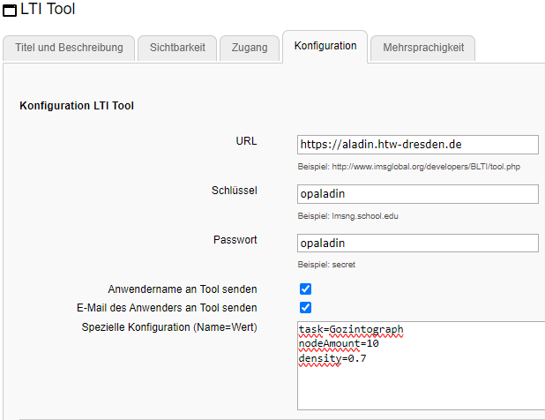
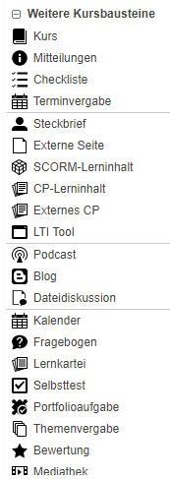
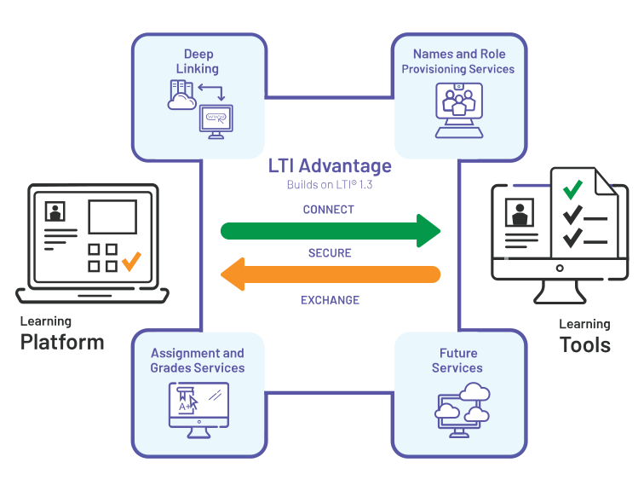
4.1 Integration into OPAL
Publicly accessible hosting of ALADIN
Embedding into OPAL via the LTI-Tool-Course-Module
Transmission of ALADIN configurations via the "Special Configuration", for the selection of the exercise type and the parameterization of the exercises to be generated
Transmission of student specific grading information via the „Assignment und Grades Service“-extension of the LTI-standard
Notes:
Hinweis an der Stelle:
Sie erreichen eine limitierte Version von ALADIN unter aladin.htw-dresden.de, zukünftig werden dort Dokumentation, Beispiele und eine vollwertige Installation von OPALADIN gehostet

Slide 28

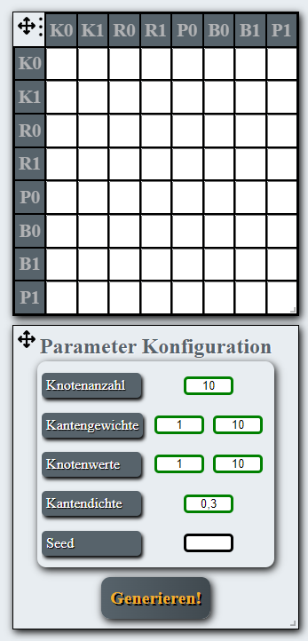
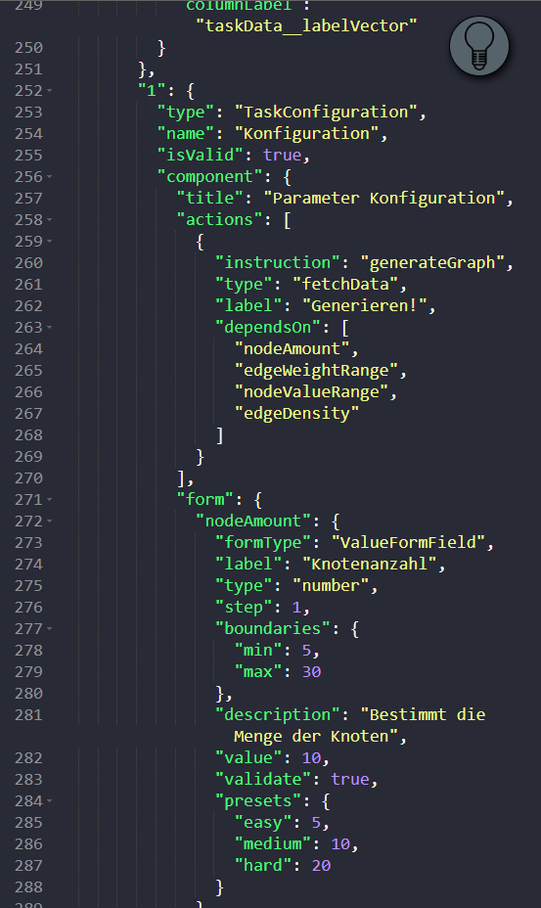
4.2 Declarative Exercise type authoring tool
UI
Exercise generator
…
Ansicht 1
Ansicht 1
…
Exercise generator configuration
Exercise artefact generator
Exercise artefact transformer
0..*
Solution generator
Hint generator
Validation function
1..*
Exercise generator
Notes:
UI
n Arbeitsflächen mit Raster in dem sich vordefinierte UI-Widgets beliebig anordnen lassen
Aufgabengenerator
setzt sich zusammen aus Teilkomponenten
wobei eine Teilkomponente wiederverwendbar ist und ein Aufgabengenerator beliebig viele dieser Teilkomponenten verwenden kann
die Teilkomponenten sind parametrisierbar auf Klassenebene
Ausführungsgraph, was in welcher Reihenfolge ausgeführt werden soll

Slide 29
4.2 Declarative Exercise type authoring tool
UI
Exercise generator
…
Ansicht 1
Ansicht 1
…
Task Data Generator Configuration
Task Artefact Generator
Task Artefact Transformer
0..*
Solution Generator
Hint Generator
Validation Function
1..*
Task Data Generator
Notes:
UI
n Arbeitsflächen mit Raster in dem sich vordefinierte UI-Widgets beliebig anordnen lassen
Aufgabengenerator
setzt sich zusammen aus Teilkomponenten
wobei eine Teilkomponente wiederverwendbar ist und ein Aufgabengenerator beliebig viele dieser Teilkomponenten verwenden kann
die Teilkomponenten sind parametrisierbar auf Klassenebene
Ausführungsgraph, was in welcher Reihenfolge ausgeführt werden soll

Slide 30
4.2 Declarative Exercise type authoring tool
UI
Exercise generator
…
Ansicht 1
Ansicht 1
…
Assessment generator configuration
Assessment artefact generator
Assessment artefact transformer
0..*
Solution generator
Hint generator
Validation function
1..*
Assessment generator
Notes:
UI
n Arbeitsflächen mit Raster in dem sich vordefinierte UI-Widgets beliebig anordnen lassen
Aufgabengenerator
setzt sich zusammen aus Teilkomponenten
wobei eine Teilkomponente wiederverwendbar ist und ein Aufgabengenerator beliebig viele dieser Teilkomponenten verwenden kann
die Teilkomponenten sind parametrisierbar auf Klassenebene
Ausführungsgraph, was in welcher Reihenfolge ausgeführt werden soll

Slide 31
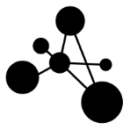





4.2 Declarative Exercise type authoring tool
UI
Exercise generator
…
Ansicht 1
Ansicht 1
…
Graph generator
Matrix generator
Computational graph
Gozintographartefact transformator
Solution generator
Hint generator
Validation function
Notes:
UI
n Arbeitsflächen mit Raster in dem sich vordefinierte UI-Widgets beliebig anordnen lassen
Aufgabengenerator
setzt sich zusammen aus Teilkomponenten
wobei eine Teilkomponente wiederverwendbar ist und ein Aufgabengenerator beliebig viele dieser Teilkomponenten verwenden kann
die Teilkomponenten sind parametrisierbar auf Klassenebene
Ausführungsgraph, was in welcher Reihenfolge ausgeführt werden soll

Slide 32
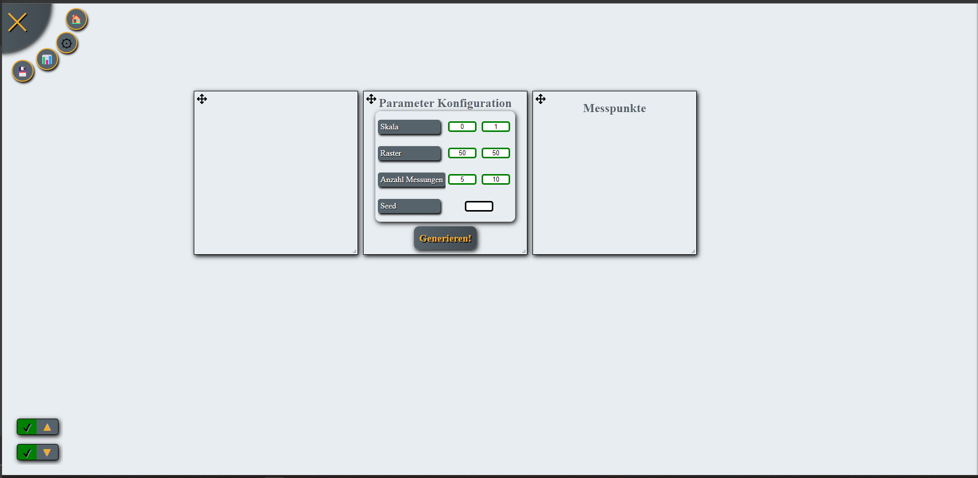
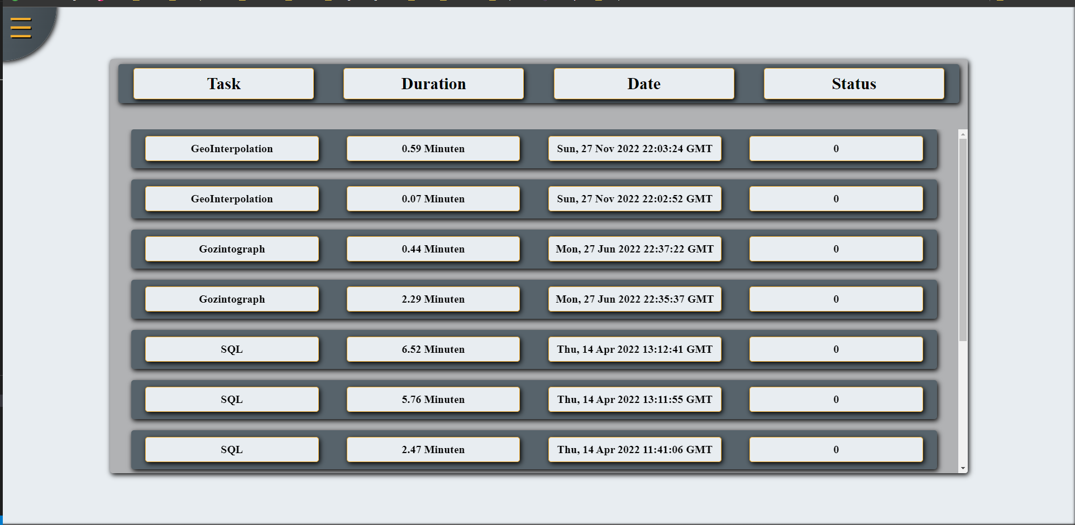
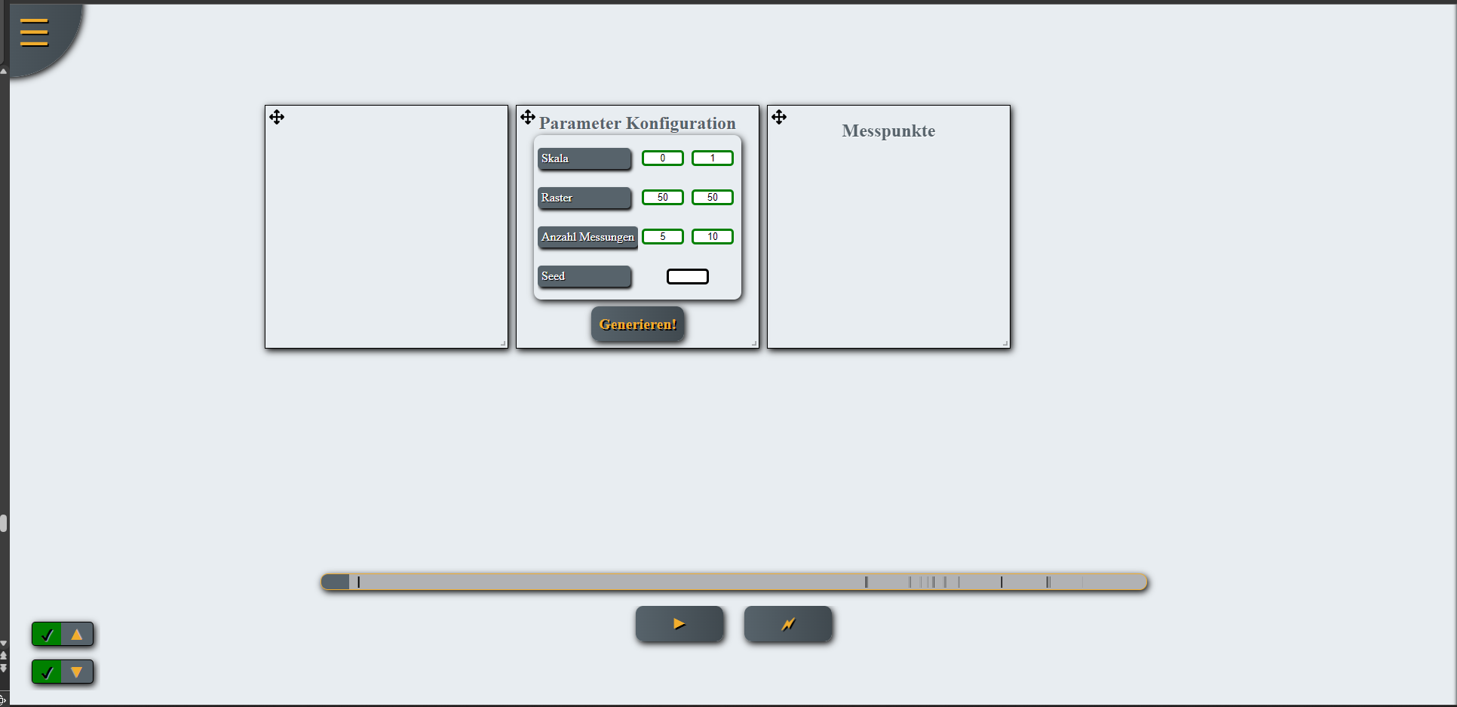
4.3 The 4R-principle (+A) in (OP)ALADIN
1. Record
2. Redirect
Annotation of the solution attempt…
…by the students
…by the teaching staff
Permits…
…concrete exercise related questions
…specific individual feedback
3. Replay
4. Resume
Notes:
4R Prinzip für einen asynchronen Austausch Illustriert anhand von Screenshots

Slide 33
Outline
1. Motivation for the development of (OP)ALADIN
2. Objectives of (OP)ALADIN
3. Generation of semantically plausible exercises and exercise types in (OP)ALADIN
4. Learning management and didactics in (OP)ALADIN
5. Summary and outlook

Slide 34
5. Summary and Outlook
Summary
Integration of graph replacement systems for declarative creation of exercise type generators
4R-principle for asynchronous exchange
Generation of technically meaningful…
…SQL query exercises
…EPC modeling exercises
Prototypical integration into OPAL using the LTI interface
Modularization of the exercise generation functionalities analogous to the interface modularization
Outlook
Exercises on nomenclature of molecules and chemical reaction equations
Declarative task type authoring tool
Spaced Repetition and Gamification
Extensive experiments and tests on Spaced Repetition and Gamification (follow-up application ALADIN-X)
Metamodel and knowledge graph generation (follow-up application METALADIN)

