Slide 1
DJINN: Declarative Joint Authoring Tool for Instructional Design and (Assessment | Task Data) Generator Modeling
https://github.com/HTW-ALADIN/DJINN
https://aladin.htw-dresden.de/docs

Slide 2
DJINN: Declarative Joint Authoring Tool for Instructional Design and Assessment Generator Modeling
Instructional Design:
“Instructional design (ID) […] is the practice of systematically designing, developing and delivering instructional materials and experiences, both digital and physical, in a consistent and reliable fashion toward an efficient, effective, appealing, engaging and inspiring acquisition of knowledge. The process consists […] of determining the state and needs of the learner, defining the end goal of instruction, and creating some "intervention" to assist in the transition. The outcome of this instruction may be directly observable and scientifically measured […].”
Declarative (Low-Code | Flow-based)
“[…] flow-based programming (FBP) is a programming paradigm that defines applications as networks of "black box" processes, which exchange data across predefined connections by message passing, where the connections are specified externally to the processes. These black box processes can be reconnected endlessly to form different applications without having to be changed internally.”
Authoring System
“An authoring system is a program that has pre-programmed elements for the development of interactive multimedia software titles. In the development of educational software, an authoring system is a program that allows a non-programmer, usually an instructional designer or technologist, to easily create software with programming features […] that are built in behind buttons and other tools, so the author does not need to know how to program.“

Slide 3
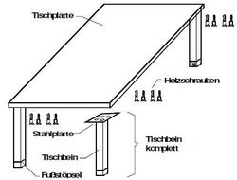
Stücklistenauflösung - Lernender
Gozintograph
Direktbedarfsmatrix D
Stückliste für 1 Tisch
1 Tischplatte
4 Tischbeine komplett
1 Tischbein
1 Fußstöpsel
16 Holzschrauben
T
 | T | TP | TBK | HS | TB | FS
T | 0 | 0 | 0 | 0 | 0 | 0
TP | 1 | 0 | 0 | 0 | 0 | 0
TBK | 4 | 0 | 0 | 0 | 0 | 0
HS | 16 | 0 | 0 | 0 | 0 | 0
TB | 0 | 0 | 1 | 0 | 0 | 0
FS | 0 | 0 | 1 | 0 | 0 | 0
1
4
16
TP
TBK
HS
1
1
D
TB
FS
 | T | TP | TBK | HS | TB | FS
T | 0 | 0 | 0 | 0 | 0 | 0
TP | 1 | 0 | 0 | 0 | 0 | 0
TBK | 4 | 0 | 0 | 0 | 0 | 0
HS | 16 | 0 | 0 | 0 | 0 | 0
TB | 0 | 0 | 1 | 0 | 0 | 0
FS | 0 | 0 | 1 | 0 | 0 | 0
 | PB
T | 5
TP | 2
TBK | 3
HS | 12
TB | 0
FS | 7
*
*
Primärbedarf
Direktbedarfsmatrix D
=
D^2
E
Gesamtbedarfsmatrix
=
 | T | TP | TBK | HS | TB | FS
T | 0 | 0 | 0 | 0 | 0 | 0
TP | 1 | 0 | 0 | 0 | 0 | 0
TBK | 4 | 0 | 0 | 0 | 0 | 0
HS | 16 | 0 | 0 | 0 | 0 | 0
TB | 0 | 0 | 1 | 0 | 0 | 0
FS | 0 | 0 | 1 | 0 | 0 | 0
 | T | TP | TBK | HS | TB | FS
T | 0 | 0 | 0 | 0 | 0 | 0
TP | 0 | 0 | 0 | 0 | 0 | 0
TBK | 0 | 0 | 0 | 0 | 0 | 0
HS | 0 | 0 | 0 | 0 | 0 | 0
TB | 4 | 0 | 0 | 0 | 0 | 0
FS | 4 | 0 | 0 | 0 | 0 | 0
 | T | TP | TBK | HS | TB | FS
T | 1 | 0 | 0 | 0 | 0 | 0
TP | 0 | 1 | 0 | 0 | 0 | 0
TBK | 0 | 0 | 1 | 0 | 0 | 0
HS | 0 | 0 | 0 | 1 | 0 | 0
TB | 0 | 0 | 0 | 0 | 1 | 0
FS | 0 | 0 | 0 | 0 | 0 | 1
 | T | TP | TBK | HS | TB | FS
T | 1 | 0 | 0 | 0 | 0 | 0
TP | 1 | 1 | 0 | 0 | 0 | 0
TBK | 4 | 0 | 1 | 0 | 0 | 0
HS | 16 | 0 | 0 | 1 | 0 | 0
TB | 4 | 0 | 1 | 0 | 1 | 0
FS | 4 | 0 | 1 | 0 | 0 | 1
 | SB
T | 5
TP | 7
TBK | 23
HS | 92
TB | 23
FS | 30
+
+
=

Slide 4
Stücklistenauflösung - Generierung
Gozintograph
T
1
4
16
TP
TBK
HS
1
1
TB
FS
D
 | T | TP | TBK | HS | TB | FS
T | 0 | 0 | 0 | 0 | 0 | 0
TP | 1 | 0 | 0 | 0 | 0 | 0
TBK | 4 | 0 | 0 | 0 | 0 | 0
HS | 16 | 0 | 0 | 0 | 0 | 0
TB | 0 | 0 | 1 | 0 | 0 | 0
FS | 0 | 0 | 1 | 0 | 0 | 0
 | PB
T | 5
TP | 2
TBK | 3
HS | 12
TB | 0
FS | 7
*
*
Primärbedarf
Direktbedarfsmatrix D
=
D^2
E
Gesamtbedarfsmatrix
=
 | T | TP | TBK | HS | TB | FS
T | 0 | 0 | 0 | 0 | 0 | 0
TP | 1 | 0 | 0 | 0 | 0 | 0
TBK | 4 | 0 | 0 | 0 | 0 | 0
HS | 16 | 0 | 0 | 0 | 0 | 0
TB | 0 | 0 | 1 | 0 | 0 | 0
FS | 0 | 0 | 1 | 0 | 0 | 0
 | T | TP | TBK | HS | TB | FS
T | 0 | 0 | 0 | 0 | 0 | 0
TP | 0 | 0 | 0 | 0 | 0 | 0
TBK | 0 | 0 | 0 | 0 | 0 | 0
HS | 0 | 0 | 0 | 0 | 0 | 0
TB | 4 | 0 | 0 | 0 | 0 | 0
FS | 4 | 0 | 0 | 0 | 0 | 0
 | T | TP | TBK | HS | TB | FS
T | 1 | 0 | 0 | 0 | 0 | 0
TP | 0 | 1 | 0 | 0 | 0 | 0
TBK | 0 | 0 | 1 | 0 | 0 | 0
HS | 0 | 0 | 0 | 1 | 0 | 0
TB | 0 | 0 | 0 | 0 | 1 | 0
FS | 0 | 0 | 0 | 0 | 0 | 1
 | T | TP | TBK | HS | TB | FS
T | 1 | 0 | 0 | 0 | 0 | 0
TP | 1 | 1 | 0 | 0 | 0 | 0
TBK | 4 | 0 | 1 | 0 | 0 | 0
HS | 16 | 0 | 0 | 1 | 0 | 0
TB | 4 | 0 | 1 | 0 | 1 | 0
FS | 4 | 0 | 1 | 0 | 0 | 1
 | SB
T | 5
TP | 7
TBK | 23
HS | 92
TB | 23
FS | 30
+
+
=

Slide 5
Assessment Structure in ALADIN
Assessment
Assessment Generator
Assessment Design

Slide 6
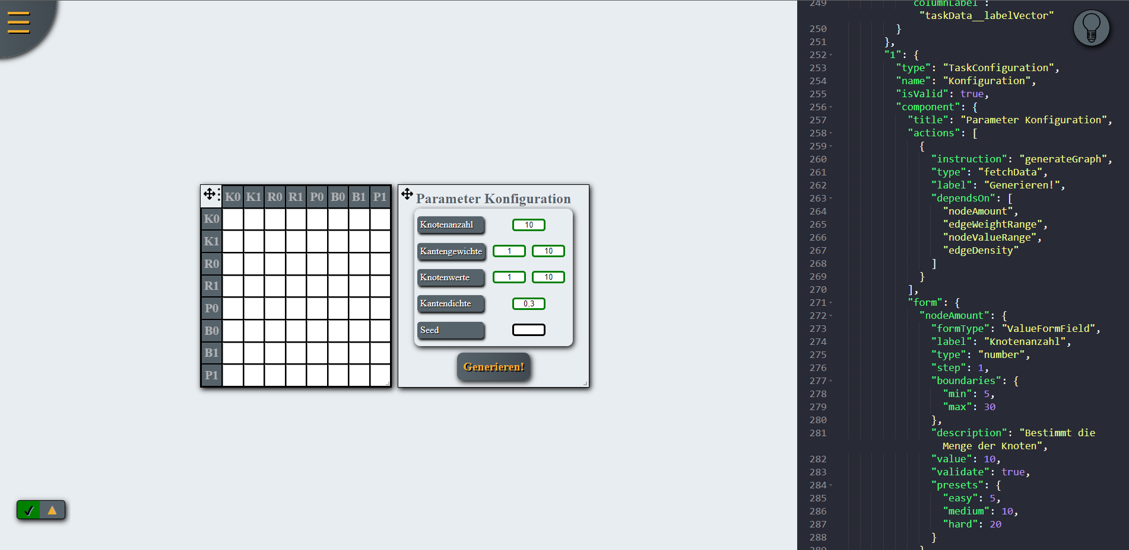
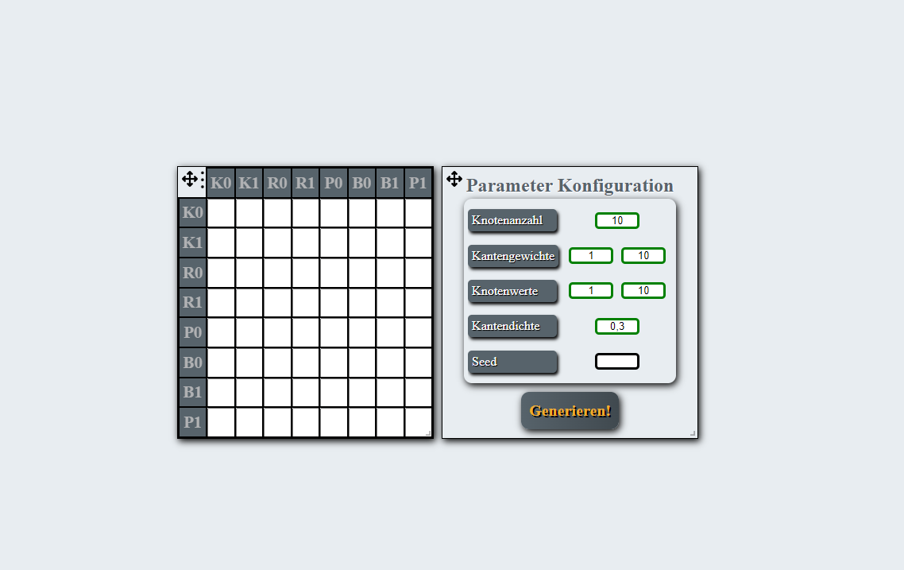
Current Declaration of Assessment Design

Slide 7
Assessment Design/Generator Declaration with Authoring System

Slide 8
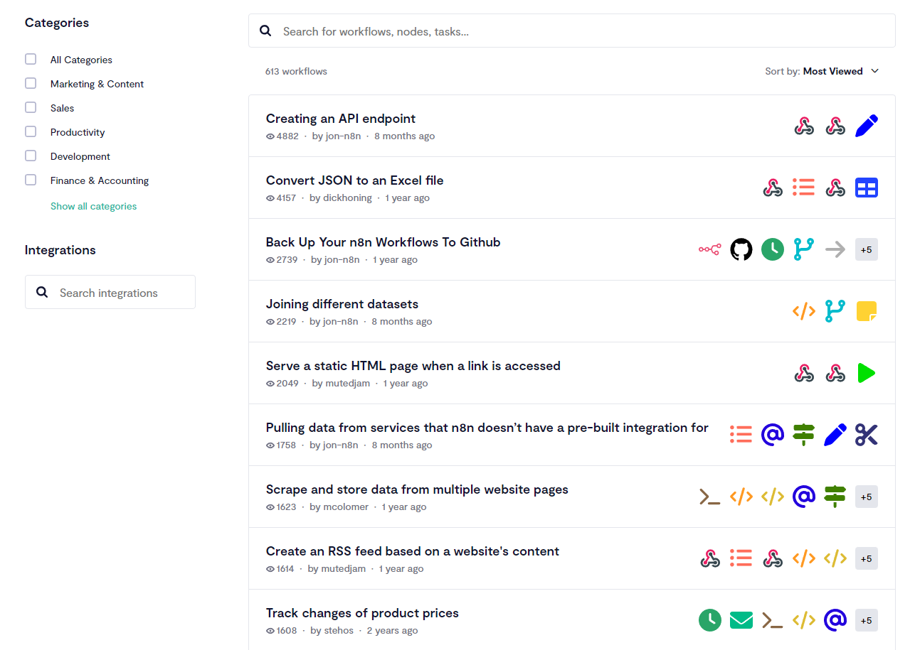
Assessment Design/Generator Sharing/Reusability

Slide 9
Assessment Definition
Didactic Assessment Types [Definition 1], [Definition 2]
Diagnostic assessments
Formative assessments
Summative assessments
…
Assessment Designs
Multiple Choice
Multiple Choice with TextfieldMultiple Choice
Single Choice
Cloze
Hotspot (identify region on image)
…
Assessment Types
BOM-Explosion
Chemistry
Assessment Instances
Assessment Type has an Assessment Design and an Assessment Generator
Assessment Instance is of an Assessment Type

Slide 10
Generates numbers for addition
Assessment Content Generator – Assessment Subject Matter – Assessment Design
Case <-> Subject Matter <-> Design
Number Generator <-> Addition <-> Equal
2, 4, 6 <-> 2+4 <-> 2+4 =
Assessment Instance

Slide 11
Assessment Structure
Assessment Type
Assessment Design
Assessment Generator
Assessment Generator

Slide 12
Flow Component
Interactive Component
Static Component
Custom Component
Assessment Design
Assessment Data
Assessment Generator
Artefact Generator
Artefact Transformer
Solution Generator
Hint Generator
Validation Function
Custom Function

Slide 13

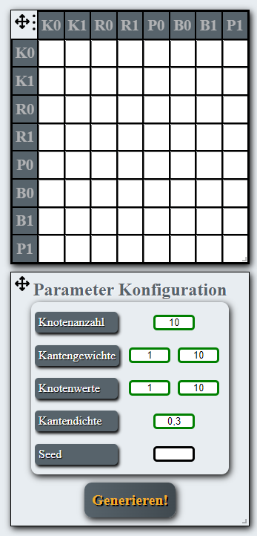

Declarative Exercise type authoring tool
UI
Exercise generator
…
Ansicht 1
Ansicht 1
…
Exercise generator configuration
Exercise artefact generator
Exercise artefact transformer
0..*
Solution generator
Hint generator
Validation function
1..*
Exercise generator
Notes:
UI
n Arbeitsflächen mit Raster in dem sich vordefinierte UI-Widgets beliebig anordnen lassen
Aufgabengenerator
setzt sich zusammen aus Teilkomponenten
wobei eine Teilkomponente wiederverwendbar ist und ein Aufgabengenerator beliebig viele dieser Teilkomponenten verwenden kann
die Teilkomponenten sind parametrisierbar auf Klassenebene
Ausführungsgraph, was in welcher Reihenfolge ausgeführt werden soll

Slide 14






Declarative Exercise type authoring tool
UI
Exercise generator
…
Ansicht 1
Ansicht 1
…
Graph generator
Matrix generator
Computational graph
Gozintographartefact transformator
Solution generator
Hint generator
Validation function
Notes:
UI
n Arbeitsflächen mit Raster in dem sich vordefinierte UI-Widgets beliebig anordnen lassen
Aufgabengenerator
setzt sich zusammen aus Teilkomponenten
wobei eine Teilkomponente wiederverwendbar ist und ein Aufgabengenerator beliebig viele dieser Teilkomponenten verwenden kann
die Teilkomponenten sind parametrisierbar auf Klassenebene
Ausführungsgraph, was in welcher Reihenfolge ausgeführt werden soll

Slide 15

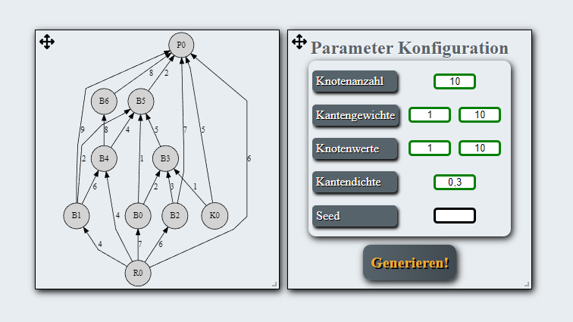
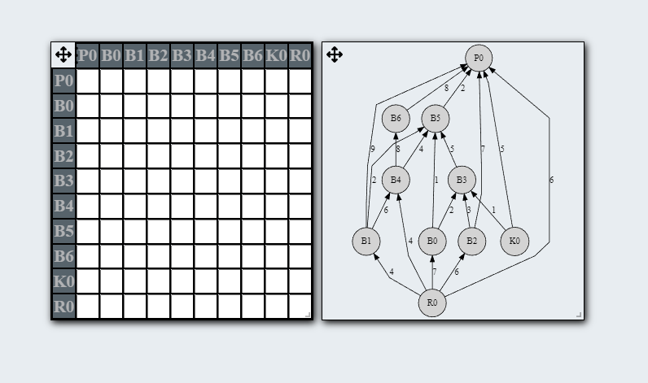
s

Slide 16

Problems:
Manuallly developing assessment pools
Assessments parts are not easily reusable
Assessment templates | Exercise types are too coarse
No automatic solving for complex assessments
No automatic creation of individual hints

Slide 17
cARPeT (Frontend – Instruction Interpreter)
Assessement Interpretation Engine Solution Attempt Tracker
Optical Assessment Runtime and personal education centre
Assessment Runtime and solution attemPt Tracker
Pool of UI Widgets that can be composed for Instructional Design Models
ALADIN (Backend – Assessment Generator (Generation Interpreter))
Pool of Generation/Transformation Operations
LAMP (personaLized Assistant for Monitoring and steering indivudal educational Progression)
Chatbot
Tutor

Slide 18
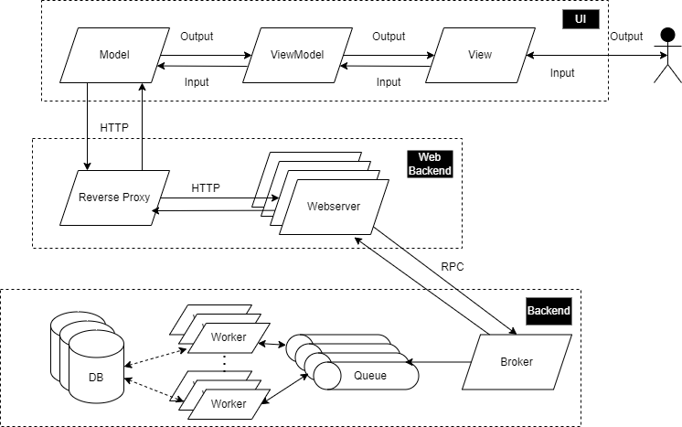
Software architecture of ALADIN
Notes:
JSON, Beispiel auf nächster Folie
MVVM – Model ViewModel View
Abwandlung von MVC Entwurfsmuster – Model View Controller
Nutzer denkt er kommuniziert mit Oberfläche, Oberfläche aktualisiert ViewModel, Interaktion mit Backend über Model, und Propagierung der Daten über ViewModel zurück an View;
Schnittstelle/Web kümmert sich um Load Balancing, Reverse Proxy implementiert Round Robin Verfahren, langlaufende Prozesse über RPC an Message Queue
Backend hält Broker und vordefinierte Queues, Worker können skaliert werden, nach Bedarf/Menge an Tasks in Queues.

Slide 19



Exercise types for modeling exercises in (OP)ALADIN
Exercise type
Model syntax
Model semantics
Subject semantics
Model elements and linking rules
Exercises:
Multiple choice questions
Detection of syntactical errors
Meaning of model elements and linking rules
Exercises:
Completion of the model
Detection of semantical errors
Modelling of the subject matter
Exercises:
Model translation: Natural language <-> Model

Slide 20
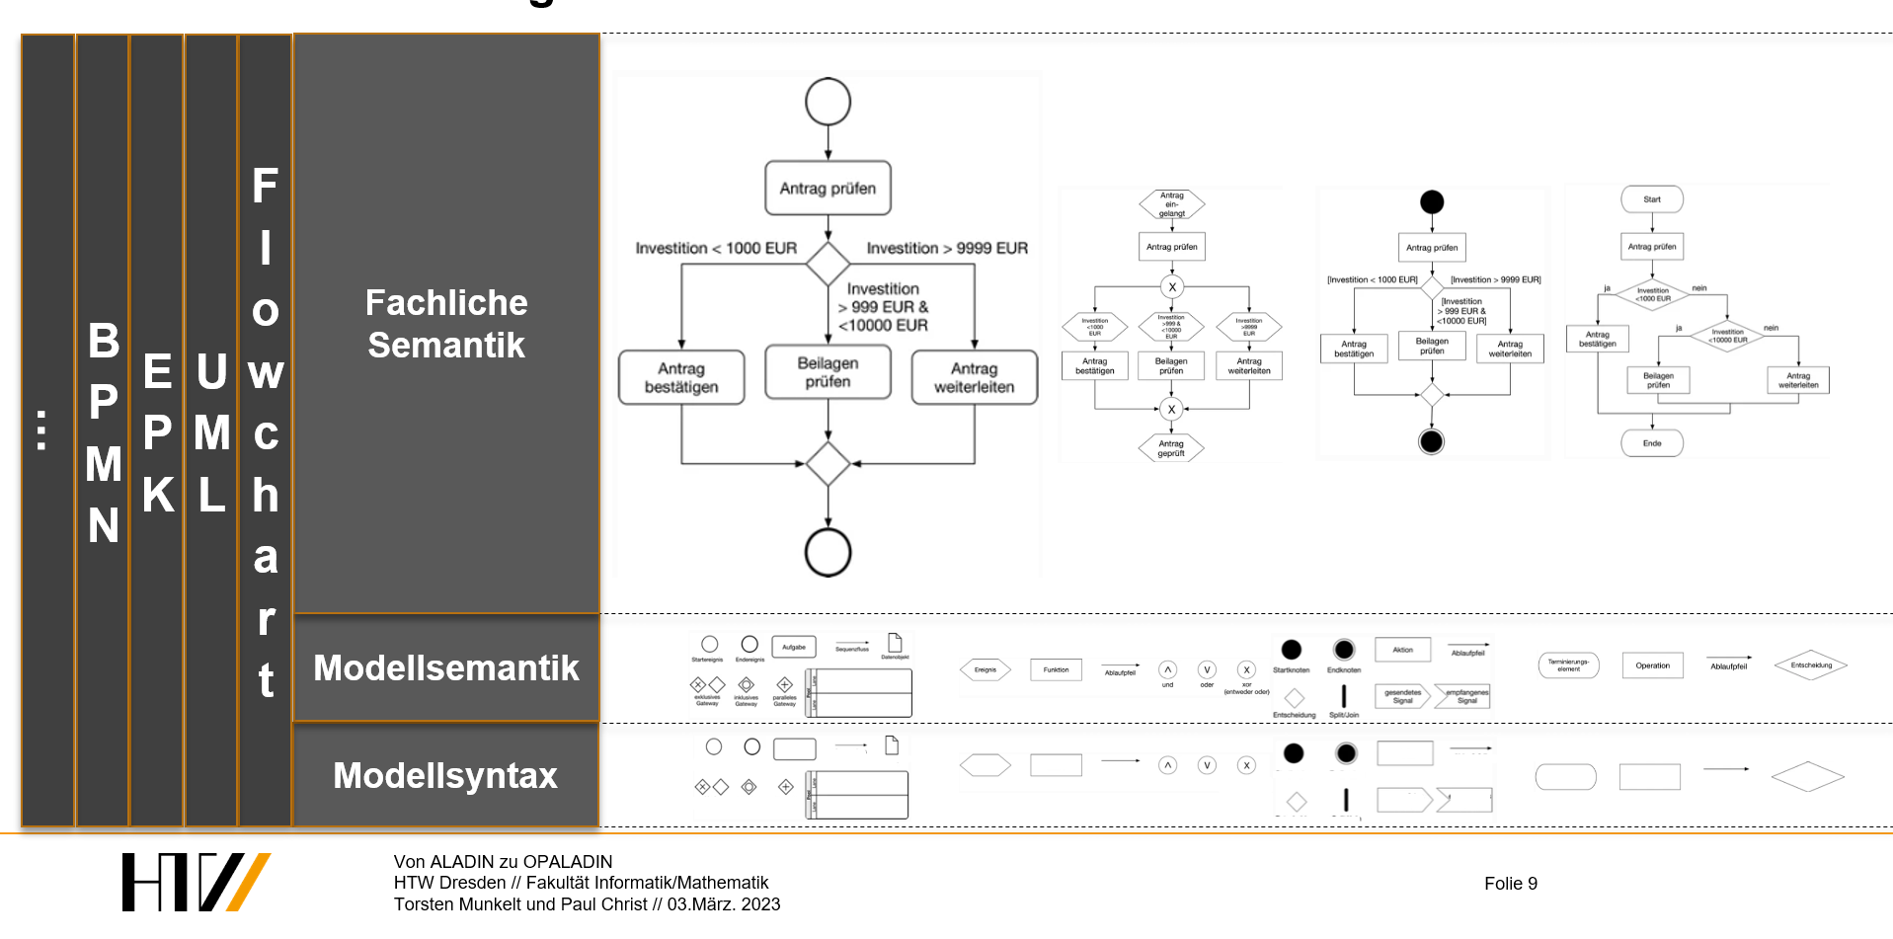
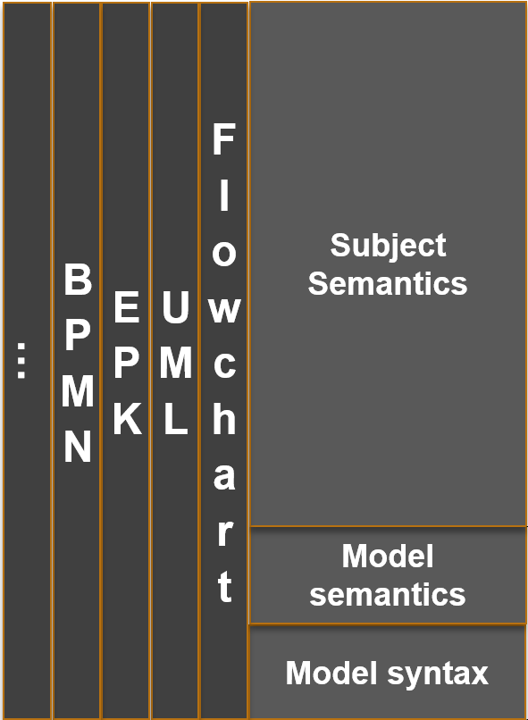
Generalisation of the exercise generation for behavioral diagrams

Slide 21
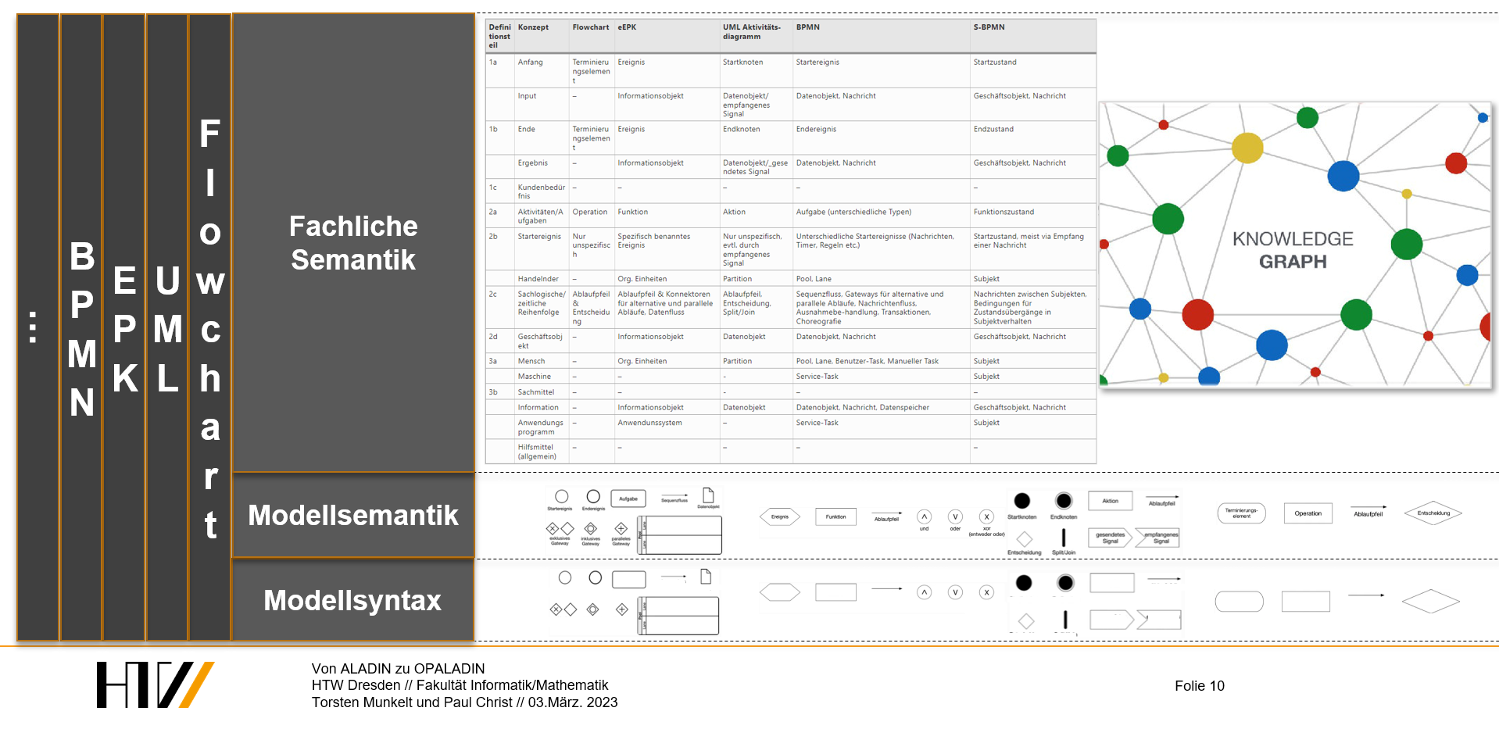
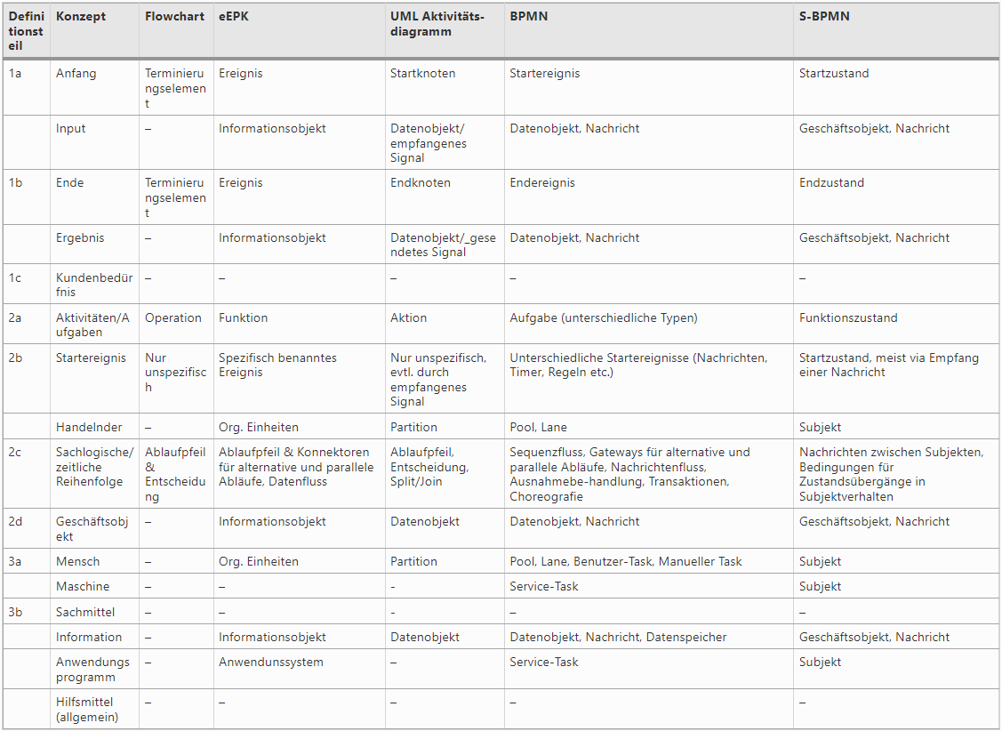
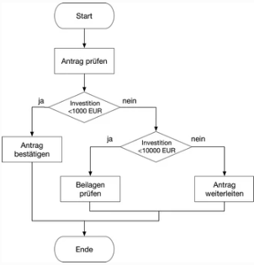
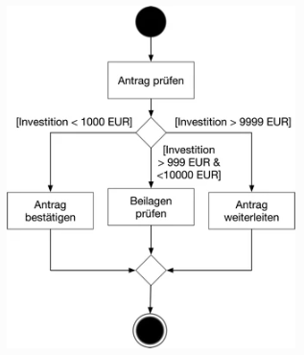
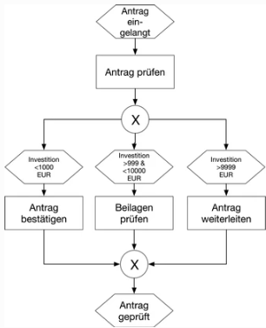
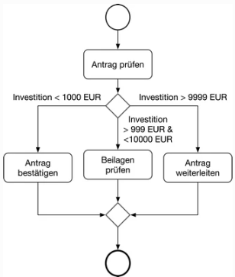

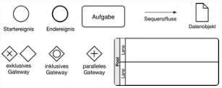
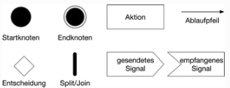


Generalisation of the exercise generation for behavioral diagrams
…
BPMN
EPK
UML
Flowchart
Fachliche Semantik
Meta-model
Modellsemantik
Modellsyntax
Notes:
Quelle: https://link.springer.com/chapter/10.1007/978-3-658-22648-0_3#citeas

Slide 22




Implementation of modeling exercise generators in (OP)ALADIN
Modell
Model
ALADIN
Syntaktisch und modellsemantisch korrekt
Syntactically and model-semantically correct
Semantically plausible (subject matter)
KNOWLEDGE GRAPH

Slide 23
Example: Destructuring the Gozintograph Generation FE/UI
Task Generation
Solution selection
Matrix 1
Matrix 2
Graph

Slide 24
Example: Destructuring the Gozintograph Generation BE
Graph Generation
Graph to Matrix Transformation
…

