Slide 1
Stacks and Queues

Slide 2
Contents
Stacks
Queues
Circular Queues
A Maze Problem

Slide 3
Stack
Definition
An ordered list in which insertions and deletions are made at one end called the top
Given a stack S=(a₀,…,a_{n-1})
a₀ is bottom element
a_{n-1} is top element
a_{i} is on top of element a_{i-1}, 0<i<n
Last-In-First-Out (LIFO)
Insert the new element into the stack on the top end
We can only delete and get the top element of the stack
a₃
a₂
a₁
a₀

Slide 4
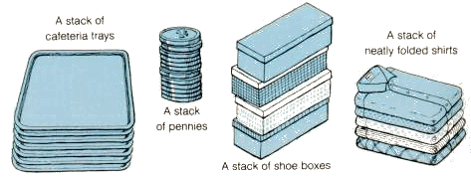
Examples of Stack
top
A stack of cafeteria trays
top
top
A stack of neatly folded shirts
top
A stack of pennies
A stack of store boxes

Slide 5
Examples of Stack
A thin box
Process stack
Push B
Push C
Pop
C
top
B
top
B
B
top
A
top
A
bottom
A
A
previous frame pointer
fp
return address
a1()
local variables
previous frame pointer
fp
previous frame pointer
return address
main()
return address
main()

Slide 6
Stack Abstract Data Type
ADT Stack is
objects: A finite ordered list with zero or more elements
functions: for all stack ∈Stack,item ∈ element,
max_stack_size ∈ positive integer
Stack CreateS(maxStackSize) ::= create an empty stack whose
maximum size is maxStackSize
Boolean IsFull(stack, maxStackSize) ::= …
Stack Push(stack, item) ::=
if (isFull(stack)) stackFull
else insert item into top of stack and return
Boolean IsEmpty(stack) ::=
Element Pop(stack) ::=
if (isEmpty(stack)) return
else remove and return the element at the top of the stack

Slide 7
Stack Implementation (1)
#define MAX_STACK_SIZE 100 /*maximum stack size */
typedef struct {
int key;
/* other fields may be added*/
} element;
element stack[MAX_STACK_SIZE];
int top = -1;
void push (element item)
{
/* add an item to the global stack */
if (top >= MAX_STACK_SIZE-1) {
stackFull();
return;
}
stack[++top] = item;
}

Slide 8
Stack Implementation (2)
element pop ()
{
/* return the top element from the stack, so called ‘pop’ */
if (top == -1)
return stackEmpty();/*returns an error key */
return stack[top--];
}
main()
{
element e,f;
e.key=3; push(e);
e.key=2; push(e);
f=pop();
printf (“%d %d\n”, top, f.key);
}

Slide 9
Queue Abstract Data Type
Definition
An ordered list in which all insertions take place at one end (rear) and all deletions take place at the opposite end (front)
Given a queue Q=(a₀,…, a_{n-1})
a₀ is front element
a_{n-1} is rear element
a_{i} is behind a_{i-1},0<i<n
First-In-First-Out (FIFO)
Insert the new element into the queue on the rear side
We can only delete/get the front element of the queue

Slide 10
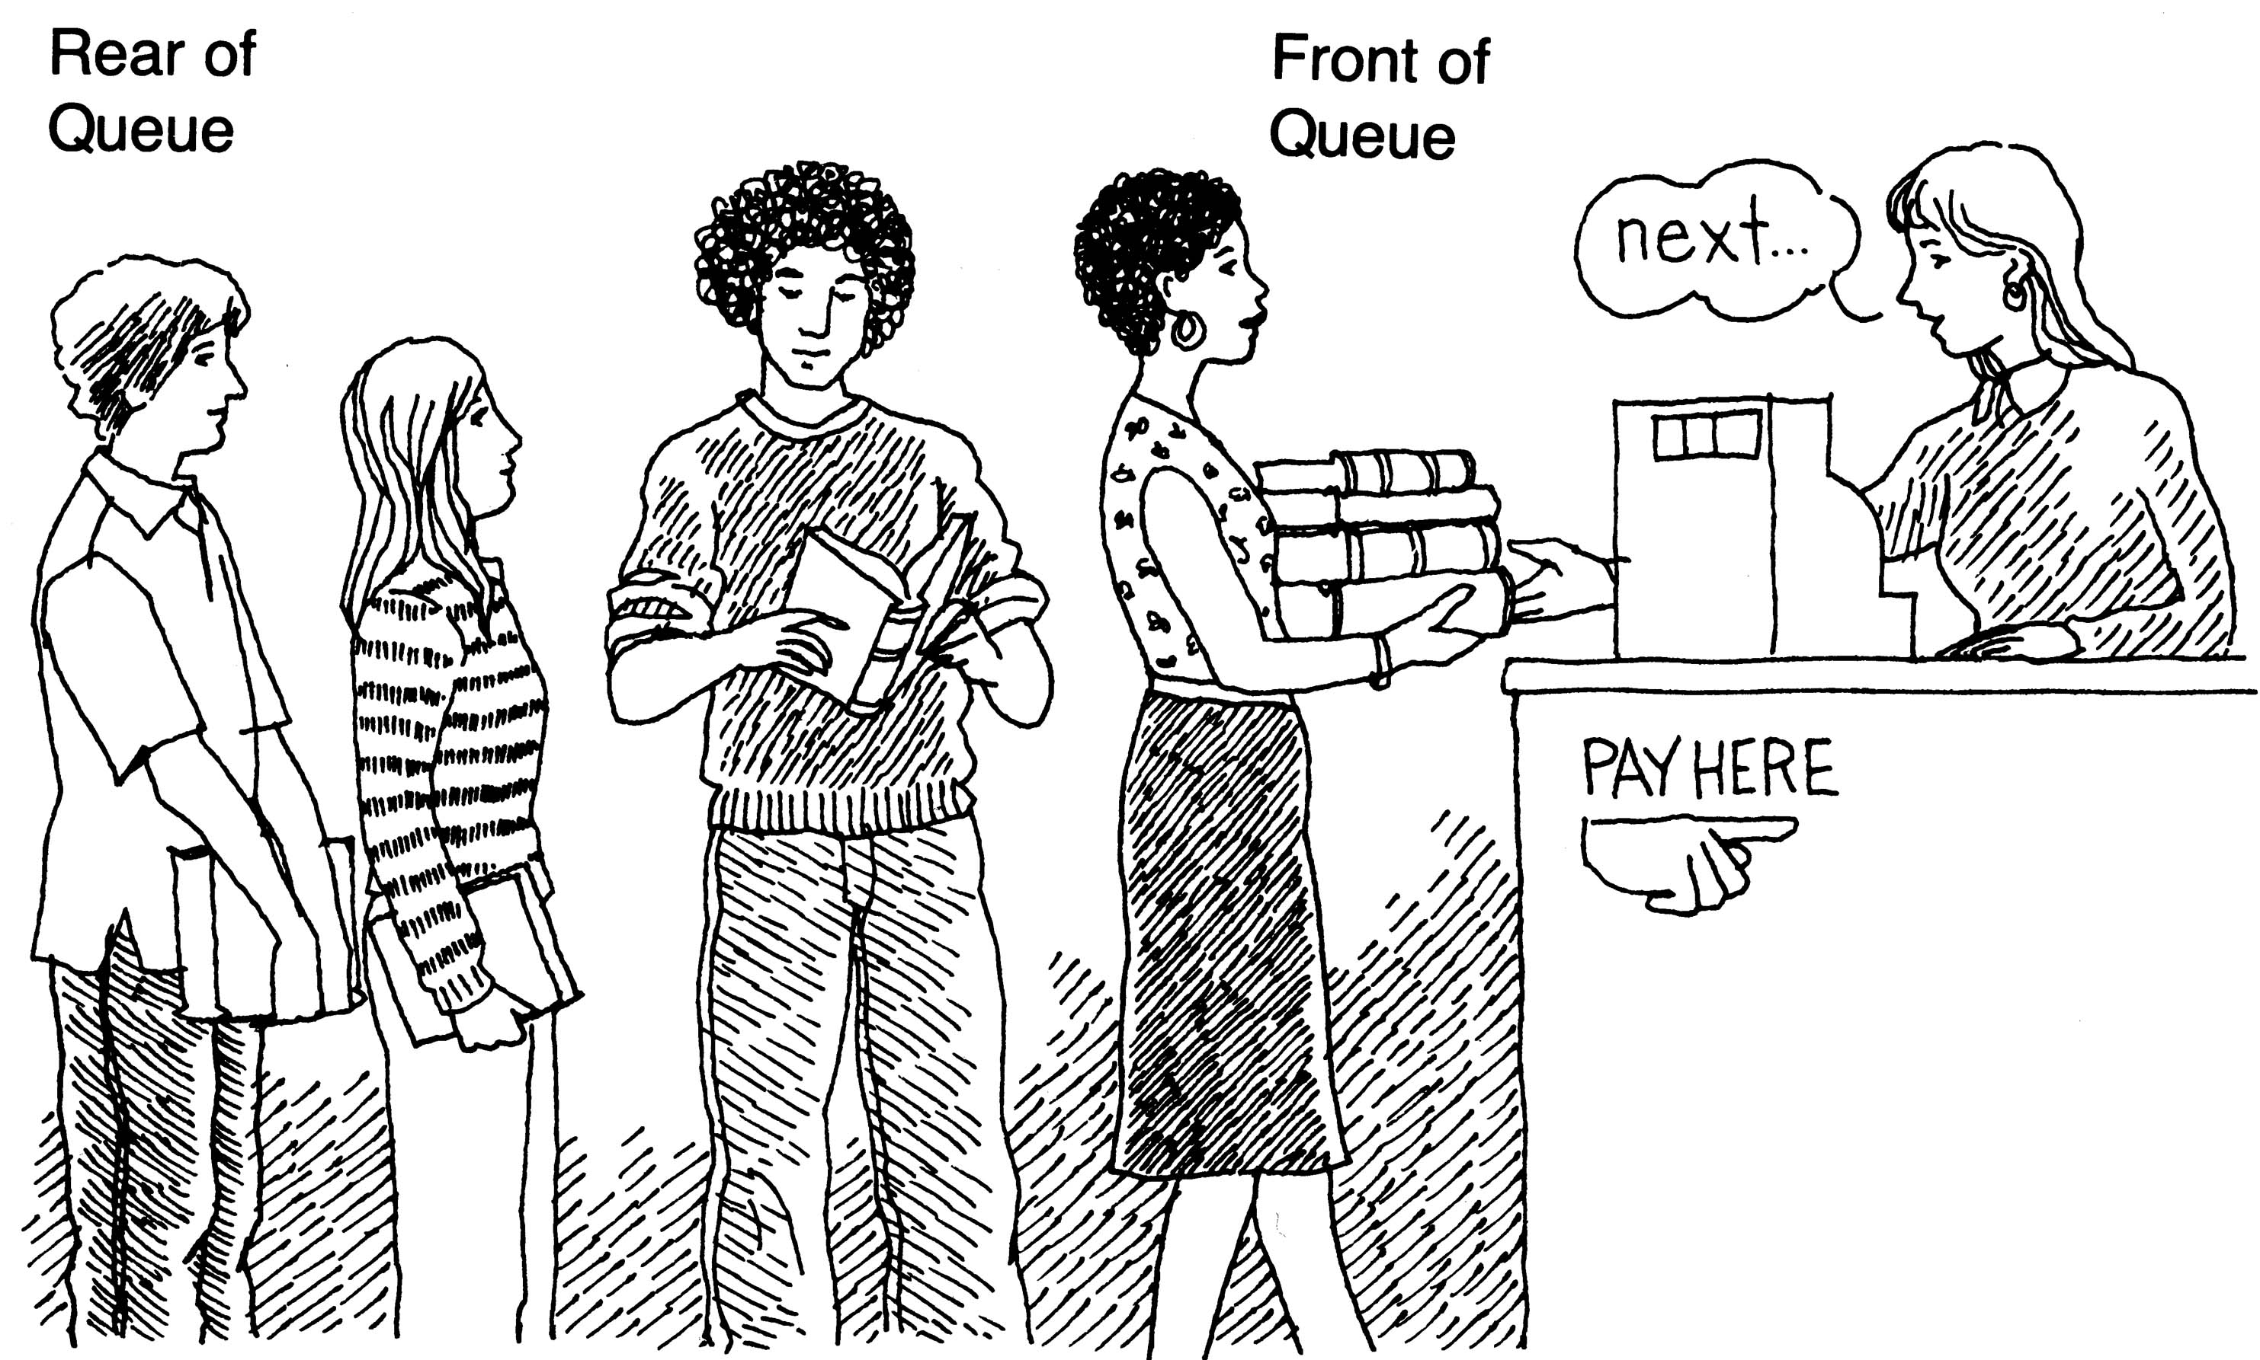
Example of Queue
In a shop
Job scheduling
Frequently used in computer programming
Job queue by an operating system
The jobs are processed in the order they enter the system

Slide 11
Queue Abstract Data Type
ADT Queue is
objects: A finite ordered list with zero or more
elements
functions: for queue ∈Queue,item ∈ element,
maxQueueSize ∈ positive integer
Queue CreateQ(queue, maxQueueSize)::= …
Boolean IsFullQ(queue)::=…
Queue AddQ(queue,item)::=
if (IsFullQ(queue)) queueFull
else insert item at rear or queue and return queue
Boolean IsEmptyQ(queue) ::= …
Element DeleteQ(queue) ::=
if (IsEmpty(queue)) return
else remove item and return the item at the front of queue

Slide 12
Queue Implementation (1)
#define MAX_QUEUE_SIZE 100 /*maximum queue size */
typedef struct {
int key;
/* other fields may be added*/
} element;
element queue[MAX_QUEUE_SIZE];
int rear = -1; int front=-1;
void addq(element item)
{
/* insert an item into a queue, so called ‘enqueue’ */
if (rear == MAX_QUEUE_SIZE-1)
queueFull();
queue[++rear] = item;
}

Slide 13
Queue Implementation (2)
element deleteq()
{
/* delete an item at the front of the queue, so called ‘dequeue’ */
if (front == rear)
return queueEmpty(); /* return an error key */
return queue[++front];
}
main()
{
element e,f;
e.key=3; addq(e);
e.key=2; addq(e);
f=deleteq();
printf(“%d %d %d\n”, front, rear, f.key);
}

Slide 14
Job Scheduling Example
Insertion and deletion from a sequential queue
front | rear | Q[0] | Q[1] | Q[2] | Q[3] | Comments
-1 | -1 |  |  |  |  | Queue is empty
-1 | 0 | J1 |  |  |  | Job1 is added
-1 | 1 | J1 | J2 |  |  | Job2 is added
-1 | 2 | J1 | J2 | J3 |  | Job3 is added
0 | 2 |  | J2 | J3 |  | Job1 is deleted
1 | 2 |  |  | J3 |  | Job2 is deleted
→ The queue gradually shifts to the right
No available space to add a new item when rear is
(MAX_QUEUE_SIZE – 1)
→ Circular representation is more efficient to avoid the problem

Slide 15
Circular Queue (1)
A queue wraps around the end of the array
Array positions are arranged in a circle rather than in a straight line
The position next to position MAX_QUEUE_SIZE-1 is 0
The position precedes 0 is MAX_QUEUE_SIZE-1
if (rear==MAX_QUEUE_SIZE-1) rear = 0;
else rear++;
→ rear = (rear + 1) % MAX_QUEUE_SIZE
index
0
1
. . .
MAX_QUEUE_SIZE-1

Slide 16
Circular Queue (2)
element queue[MAX_QUEUE_SIZE];
int front=0, rear=0;
void addq(element item)
{
rear = (rear+1) % MAX_QUEUE_SIZE;
if (front == rear)
queueFull(rear); /* print error and exit */
queue[rear] = item;
}
element deleteq(){
if (front == rear)
return queueEmpty();
front = (front+1) % MAX_QUEUE_SIZE;
return queue[front];
}

Slide 17
Circular Queue Operation
[3]
[4]
[3]
[4]
C
D
[2]
[5]
[2]
[5]
B
A
front=0
rear=0
[1]
[6]
front=0
rear=4
[1]
[6]
[0]
[7]
[0]
[7]
[3]
[4]
[3]
[4]
C
D
C
D
[2]
[5]
[2]
[5]
B
B
E
F
[1]
[6]
[1]
[6]
front=1
rear=4
front=1
rear=0
H
G
[0]
[7]
[0]
[7]

Slide 18
Circular Queue Operation Example
[0] | [1] | [2] | [3]
queue
front=0
rear=0
[0] | [1] | [2] | [3]
Add 3
3
front=0
rear=1
[0] | [1] | [2] | [3]
Add 5
3
5
front=0
rear=2
[0] | [1] | [2] | [3]
front=0
Add 7
3
5
7
rear=3
Add 8
Error:Queue is full!!!
front=0
rear=0
[0] | [1] | [2] | [3]
Delete
5
7
front=1
rear=3
[0] | [1] | [2] | [3]
Add 10
10
5
7
front=1
rear=0

Slide 19
Applications of Stack
Many application areas use stacks:
Line editing
Bracket matching
Maze problem
Expression evaluation

Slide 20
A Maze Problem
Problem
A value 1 implies a blocked path, and 0 means one can walk right on through.
Find the way to go out
0 1 0 0 0 1 1 0 0 0 1 1 1 1 1
1 0 0 0 1 1 0 1 1 1 0 0 1 1 1
0 1 1 0 0 0 0 1 1 1 1 0 0 1 1
1 1 0 1 1 1 1 0 1 1 0 1 1 0 0
1 1 0 1 0 0 1 0 1 1 1 1 1 1 1
0 0 1 1 0 1 1 1 0 1 0 0 1 0 1
0 1 1 1 1 0 0 1 1 1 1 1 1 1 1
0 0 1 1 0 1 1 0 1 1 1 1 1 0 1
1 1 0 0 0 1 1 0 1 1 0 0 0 0 0
0 0 1 1 1 1 1 0 0 0 1 1 1 1 0
Entrance
Exit

Slide 21
Strategy
We may have the chance to go in several directions
Pick one and save our current position and the direction of the next move in the list (stack)
If we have taken a false path, we can return and try another direction by getting the top element of the stack

Slide 22
Allowable Moves (1)
Allowable moves
NW [i-1][j-1] | N [i-1][j] | NE [i-1][j+1]
W [i][j-1] | X [i][j] | E [i][j+1]
SW [i+1][j-1] | S [i+1][j] | SE [i+1][j+1]
typedef struct {
short int vert; /* -1, 0, +1 */
short int horiz; /* -1, 0, +1 */
} offsets;

Slide 23
Allowable Moves (2)
Table of moves
offsets move[8];
nextRow = row + move[dir].vert;
nextCol = col + move[dir].horiz;
Name | Dir | Move[dir].vert | Move[dir].horiz
N | 0 | -1 | 0
NE | 1 | -1 | 1
E | 2 | 0 | 1
SE | 3 | 1 | 1
S | 4 | 1 | 0
SW | 5 | 1 | -1
W | 6 | 0 | -1
NW | 7 | 1 | -1

Slide 24
Movement history
#define MAX_STACK_SIZE 100
typedef struct {
short int row; /* current position */
short int col; /* current position */
short int dir; /* direction of next move */
} element;
element stack[MAX_STACK_SIZE]
Pick one and save our current position and the direction of the next move in the list (stack).
If we have taken a false path, we can return and try another direction by getting the top element of the stack

Slide 25
Initial Maze Algorithm
Initialize a stack to the maze's entrance coordinates and direction to north;
while (stack is not empty) {
}
printf("No path found");
<rol, col, dir> = delete from top of stack;
while (there are more moves from current position) {
}
dir = direction of move;
<nextRow, nextCol> = coordinate of next move;
if((nextRow==EXIT_ROW)&&(nextCol==EXIT_COL))
success;
if (maze[nextRow][nextCol] == 0) &&
mark[nextRow][nextCol] == 0) {
}
mark[nextRow][nextCol] = 1;
add <row, col, next dir> to the top of the stack;
row = nextRow; col = nextCol; dir = north;

Slide 26
Maze(Examined)
ENTRY = (1,1), EXIT = (5,5)
[1]
[2]
[3]
[4]
[5]
position
mark[1][1]=1
[1]
0
0
1
1
0
(1,1)
PUSH (1,1,ES)
mark[1][2]=1
[2]
0
0
1
(1,2)
PUSH (1,2,S)
mark[2][3]=1
(2,3)
PUSH (2,3,ES)
mark[2][4]=1
[3]
0
1
1
(2,4)
PUSH (2,4,E)
mark[1][5]=1
[4]
0
1
(1,5)
POP (2,4,E)
[5]
0
(2,4)
PUSH (2,4,W)
mark[3][3]=1
(3,3)
PUSH (3,3,S)
mark[4][4]=1
Maze (Original)
(4,4)
FOUND!!!
[1]
[2]
[3]
[4]
[5]
[1]
0
0
1
1
0
(1,1)
(1,2)
(2,3)
(2,4)
(3,3)
(4,4)
(5,5)
[2]
1
1
0
0
1
[3]
1
1
0
1
1
1
0
1
0
1
[4]
[5]
0
1
1
0
0

Slide 27
Maze Search Function (1)
elements stack[MAX_STACK_SIZE];
offset move[8];
int maze[MAX_ROWS][MAX_COLS];
int mark[MAX_ROWS][MAX_COLS];
int top;
void path(void)
{/* output a path through the maze if such a path exists*/
int i; int row; int col; int nextRow; int nextCol; int dir; int found=FALSE;
element position;
mark[1][1]=1; top=0;
stack[0].row=1; stack[0].col=1; stack[0].dir=1;
while (top>-1 && !found) {
position = pop();
row = position.row;
col = position.col;
dir = position.dir;

Slide 28
Maze Search Function (2)
while (dir < 8 && !found) {
/* move in direction dir*/
nextRow = row + move[dir].vert;
nextCol = col + move[dir].horiz;
if (nextRow==EXIT_ROW && nextCol==EXIT_COL)
found = TRUE;
else if ( !maze[nextRow][nextCol]
&& !mark[nextRow][nextCol]) {
mark[nextRow][nextCol]) = 1;
position.row = row; position.col = col;
position.dir = ++dir;
push(position);
row = nextRow; col = nextCol; dir = 0;
}
else ++dir;
} /* while (dir < 8 & !found)
} /* while (top>-1 && !found) */

Slide 29
Maze Search Function (3)
if (found) {
printf("The path is:\n");
printf("row col\n");
for (i=0; i<=top; i++)
printf("%2d%5d", stack[i].row, stack[i].col");
printf("%2d%5d\n", row, col);
printf("%2d%5d\n", EXIT_ROW, EXIT_COL);
}
else printf("The maze does not have a path\n");
}

