Slide 1
Sorting

Slide 2
Contents
Motivation
Insertion sort
Bubble sort
Selection sort
Quick sort
Merge sort
Heap sort
Radix sort
List sort
Summary of Internal Sortings

Slide 3
Searching and List Verification
Why efficient sorting is so important?
Efficient Search
Sequential search
Binary search
Efficient List verification
Compare lists to verify that they are identical or different
Repeatedly searching one list using each key in the other list as the search key
→ Using binary search is much faster
Binary search needs sorted list
Over 25 percent of all computing time is spent on sorting
Some organizations spend more than 50 percent of their computing time sorting list

Slide 4
Definitions
Given a list of records (R₀, R₁, …, R_{n-1})
R_{i} has a key value, K_{i}
There is an ordering relation (<) on the keys s.t. for any two key values x and y, either x = y or x < y or y < x
This ordering relation is transitive:
if x < y and y < z, then x < z
Sorting problem is
Finding a permutation σ(i), s.t. K_{σ(i-1)} < K_{σ(i)} , 0 < i ≤ n-1
A sorting algorithm is stable,
if i < j and K_{i} = K_{j} in the input list, R_{i} precedes R_{j} in the sorted list

Slide 5
Example of Sorting
R1
R2
R3
R4
R5
학번
이름
소속
2012345
가가멜
컴퓨터
2012355
파파
산업정보
2012415
주책이
화학
2012315
투덜이
전자
2012357
익살이
전자
If key is “이름”,
R1
R5
R3
R4
R2
If key is “학번”,
R4
R1
R2
R5
R3
If key is “소속”,
R2
R4
R5
R1
R3

Slide 6
Classification of Sorting
Internal sorting
The information to be ordered can be contained in a computer's memory
External sorting
Any sort algorithm that uses external memory, such as tape or disk, during the sort
When the values to be sorted don't fit in main memory

Slide 7
Decision Tree
Describes the sorting process
Each vertex of a tree represents a key comparison
The branches indicate the result
A path through a decision tree represents a sequence of computation that an algorithm could produce
[R₀,R₁,R₂]
K₀ ≤ K₁
Yes
No
[R₀,R₁,R₂]
[R₁,R₀,R₂]
K₁ ≤ K₂
K₀ ≤ K₂
Yes
No
Yes
No
[R₀,R₂,R₁]
[R₁,R₂,R₀]
Stop
[R₀,R₁,R₂]
K₀ ≤ K₂
Stop
[R₁,R₀,R₂]
K₁ ≤ K₂
Yes
No
Yes
No
Stop
[R₀,R₂,R₁]
Stop
[R₂,R₀,R₁]
Stop
[R₁,R₂,R₀]
Stop
[R₂,R₁,R₀]

Slide 8
Properties of Decision Tree
Theorem) Any decision tree that sorts n distinct elements has a height of at least log₂(n!) + 1
→ decision tree of n elements have n! leaves
→ number of leaves of a binary tree of height k ≤ 2^{k-1}
height of the decision tree ≥ log₂(n!) + 1
Corollary) Any algorithm that sorts by comparisons only must have a worst case computing time of Ω(n⋅log₂n)
n! = n·(n-1) ·(n-2) ·…·3·2·1 ≥ (n/2)^{n/2}
log₂(n!) ≥ (n/2) ·log₂(n/2) = Ω(n·log₂n)
Lower bound of sorting algorithm

Slide 9
Internal Sorting
The list to be sorted is small enough so that the entire sort can be carried out in main memory
Insertion sort
Bubble sort
Selection sort
Quick sort
Heap sort
Merge sort
Radix sort

Slide 10
Insertion Sort
For each j between 1 and n-1, insert list[j] into already sorted subfile list[0] ,…, list[j-1]
Move all keys > list[j] to the right
Time complexity
best case: O(n)
worst case: O(n²)
It does little work if the list is nearly sorted
Left out of order (LOO)
R_{i} is LOO iff
The insertion step is executed only for those records that are LOO
If number of LOOs = k,
Computing time: O((k+1)·n)
Worst case time : O(n²)

Slide 11
Codes for Insertion Sort
void insert(element e, element a[], int i)
{
a[0] = e;
while(e.key < a[i].key) {
a[i+1] = a[i];
i--;
}
a[i+1] = e;
}
void insertionSort(element a[], int n)
{
int j;
for(j = 2; j <= n; j++) {
element temp = a[j];
insert(temp, a, j-1);
}
}

Slide 12
Insertion Sort Example (1)
n = 5
input sequence: (26, 5, 37, 1, 19)
LOOs = R₁, R₂, R₄, R₅
[0] | [1] | [2] | [3] | [4] | [5]
void insertionSort(element a[],
int n)
{
int j;
for(j = 2; j <= n; j++) {
element temp = a[j];
insert(temp, a, j-1);
}
}
26
5
37
1
19
j=2
5
5
26
37
1
19
j=3
37
5
26
37
1
19
j=4
1
1
5
26
37
19
j=5
19
1
5
19
26
37

Slide 13
Insertion Sort Example (1)
n = 5
input sequence: (37, 26, 19, 5, 1)
LOOs = R₁, R₂, R₄, R₅
[0] | [1] | [2] | [3] | [4] | [5]
void insertionSort(element a[],
int n)
{
int j;
for(j = 2; j <= n; j++) {
element temp = a[j];
insert(temp, a, j-1);
}
}
37
26
19
5
1
j=2
26
26
37
37
5
1
j=3
19
19
26
37
5
1
j=4
5
5
19
26
37
1
j=5
1
1
5
19
26
37

Slide 14
Bubble Sort
The simplest way sort an array of objects
The basic idea
To compare two neighboring objects
To swap them if they are in the wrong order.
Codes for bubble sort
void bubbleSort (element a[], int n)
{
element tmp; int i, j;
for (i=0; i<n-1; i++) {
for (j=0; j<n-1-i; j++)
if (a[j+1] < a[j]) {
tmp = a[j];
a[j] = a[j+1]; a[j+1] = tmp;
}
}
}

Slide 15
Example of Bubble Sort
[0] | [1] | [2] | [3] | [4] | [5]
Original list
23
78
45
8
32
36
unsorted
After pass 1
23
45
8
32
36
78
unsorted
sorted
After pass 2
45
78
23 | 8
32
36
unsorted
sorted
45
78
After pass 3
8 | 23 | 32
36
unsorted
sorted
After pass 4
8
23
32
36
56
78
unsorted
sorted

Slide 16
Bubble Sort Example
[0]
[1]
[2]
[3]
[4]
[5]
[6]
[7]
5
26
i=0, j=0
26
5
37
1
61
11
59
15
5
26
37
1
61
11
59
15
i=0, j=1
5
26
37
i=0, j=2
1
37
1
61
11
59
15
5
26
1
37
61
11
59
15
i=0, j=3
5
26
1
37
11
i=0, j=4
61
61
11
59
15
5
26
1
37
11
59
i=0, j=5
61
59
61
15
5
26
1
37
11
59
15
i=0, j=6
61
15
61
5
26
1
37
11
59
15
61
i=1, j=0
26
1
i=1, j=1
1
26

Slide 17
Selection Sort
Algorithm
for (i=0;i<n;i++){
Examine a[i] to a[n-1] and suppose that the smallest integer is at a[min];
Interchange a[i] and a[min];
}
Programming in C
void sort(int a[], int n){
int i,j,min,temp;
for (i=0;i<n-1;i++) {
min=i;
for (j=i+1;j<n;j++){
if (a[j]<a[min]) min=j;
}
temp=a[i]; a[i]=a[min]; a[min]=temp;
}
}

Slide 18
Example of Selection Sort
[0] | [1] | [2] | [3] | [4] | [5]
26
5
37
1
19
24
j=1
1
5
37
26
19
24
j=2
1
5
37
26
19
24
j=3
1
5
19
26
37
24
j=4
1
5
19
24
37
26
j=5
1
5
19
24
26
37

Slide 19
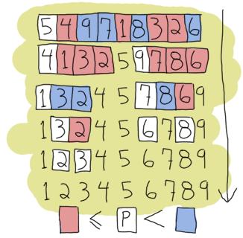
Quick Sort (1)
Divide and conquer
Two phase
Split and control
Use recursion : stack is needed
Best average time : O(n·log₂n)
http://franzejr.wordpress.com/2011/08/28/a-quick-analysis-about-quicksort/

Slide 20
Quick Sort (2)
the first element greater than pivot
the first element smaller than pivot
0
1
n-1
X
swap
(pivot)
new pivot
X’
X
X’
X
·
·
.
sorted
X
sorted
X
X’’
sorted
X
X’’
·
.
·
sorted
X
sorted

Slide 21
Quick Sort Example
p. 342
[1]
[2]
[3]
[4]
[5]
[6]
[7]
[8]
[9]
[10]
left
right
26
5
37
1
61
11
59
15
48
19
1
10
11
5
19
1
15
26
59
61
48
37
1
5
1
5
11
19
15
26
59
61
48
37
1
2
1
5
11
19
15
26
59
61
48
37
4
5
1
5
11
15
19
26
59
61
48
37
7
10
1
5
11
15
19
26
48
37
59
61
7
8
1
5
11
15
19
26
37
48
59
61
10
10
1
5
11
15
19
26
37
48
59
61

Slide 22
Quick Sort Example – Worst Case
[1]
[2]
[3]
[4]
[5]
[6]
[7]
[8]
[9]
[10]
left
right
61
59
48
37
26
19
15
11
5
1
1
10
1
59
48
37
26
19
15
11
5
61
1
9
1
59
48
37
26
19
15
11
5
61
2
9
1
5
48
37
26
19
15
11
59
61
2
8
1
5
48
37
26
19
15
11
59
61
2
7
1
5
11
37
26
19
15
48
59
61
2
6
1
5
11
37
26
19
15
48
59
61
4
7
.
.
.

Slide 23
Codes for Quick Sort
void quicksort (element a[], int left, int right)
{
int pivot, i, j; element temp;
if (left < right) {
i = left; j = right + 1;
pivot = a[left].key;
do {
do i++; while (a[i].key < pivot); /*&& i<right*/
do j--; while (a[j].key > pivot); /*&& j>left */
if (i < j) SWAP(a[i], a[j], temp);
} while (i < j);
SWAP (a[left], a[j], temp);
quicksort(a, left, j - 1);
quicksort(a, j + 1, right);
}
}

Slide 24
Quick Sort Example – Step 1
[1]
[2]
[3]
[4]
[5]
[6]
[7]
[8]
[9]
[10]
i
j
26
5
37
1
61
11
59
15
48
19
1
11
i
j
26
5
19
1
61
11
59
15
48
37
4
9
i
j
26
5
19
1
15
11
59
61
48
37
6
7
i
j
26
5
19
1
15
11
59
61
48
37
7
6
11
5
19
1
15
26
59
61
48
37

Slide 25
Quick Sort Example – Worst Case (Step 1)
[1]
[2]
[3]
[4]
[5]
[6]
[7]
[8]
[9]
[10]
[11]
left
right
61
59
48
37
26
19
15
11
5
1
1000
1
10
i
j
1
59
48
37
26
19
15
11
5
61
1
9
i
j
1
0
1
59
48
37
26
19
15
11
5
61
2
9
i
j
1
5
48
37
26
19
15
11
59
61
2
8

Slide 26
Time Complexity of Quick Sort
Average case: O(n·log₂n)
Split into “equal size” T(n): average time to sort n records
T(n) ≤ c·n + 2·T(n/2)
≤ c·n + 2(c·n/2 + 2·T(n/4))
≤ 2·c·n + 4·T(n/4)
···
≤ c·n·log₂n + n·T(1)
= O(n·log₂n)
Worst case: O(n²)
Split into one with (n-1) records and one with 0 records
T(n) ≤ c·n + T(n-1) + T(0)
≤ c·n + c·(n-1) + T(n-2)
…
= O(n²)

Slide 27
How to Improve Quick Sort
Quick sort needs stack space to implement the recursion
If the lists split evenly, the maximum recursion depth would be log₂n
Space complexity of O(log₂n)
The worst case occurs when the list is split into a left sublist of size n-1 and a right sublist of size 0 at each level of recursion
Space complexity of O(n)
An asymptotic reduction is stack space can be achieved by sorting smaller sublist first
Space complexity of O(log₂n)
A better choice for the pivot is the median of the first, middle, and last keys in the current sublist

Slide 28
Merge Sort
If n < 2 then the array is already sorted. Stop now.
Otherwise, n > 1, and perform the following three steps in sequence:
Sort the left half of the array
Sort the right half of the array
Merge the now-sorted left and right halves
Time complexity
T(n) = 0, if n < 2.
T(n) = T(n/2) + T(n/2) + Θ(n), if n > 1. (similar to quick sort)

Slide 29
Example of Merge Sort
p. 347
[0]
[1]
[2]
[3]
[4]
[5]
[6]
[7]
[8]
[9]
length
a
61
59
48
37
26
19
15
11
5
1
1
extra
59
61
37
48
19
26
11
15
1
5
2
a
37
48
59
61
11
15
19
26
1
5
4
extra
11
15
19
26
37
48
59
61
1
5
8
a
1
5
11
15
19
26
37
48
59
61

Slide 30
Codes for Merge Sort (1)
void merge(element initList[], element mergedList[], int i, int m, int n)
{
int j,k,t; j = m+1; k = i;
while( i <= m && j <= n) {
if (initList[i].key <= initList[j].key)
mergeList[k++] = initList[i++];
else
mergeList[k++] = initList[j++];
}
if (i > m) /* mergedList[k:n] = initList[j:n]*/
for(t = j; t <= n; t++) mergeList[t] = initList[t];
else /* mergedList[k:n] = initList[i:m] */
for(t = i; t <= m; t++)
mergeList[k+t-i] = initList[t];
}

Slide 31
Codes for Merge Sort (2)
void mergePass(element initList[], element resultList[], int n, int s)
{
for (i = 1; i <= n-2*s+1; i+= 2*s)
merge(initList, mergedList, i, i+s-1, i+2*s-1);
if((i+s-1)<n)
merge(initList, mergedList, i, i+s-1, n);
else
for(j=i; j <= n; j++)
mergedList[j] = initList[j];
}

Slide 32
Codes for Merge Sort (3)
void mergeSort(element a[], int n)
{
int s = 1;
element extra[MAX_SIZE];
while (s<n) {
mergePass(a, extra, n, s);
s *= 2;
mergePass(extra, a, n, s);
s *= 2;
}
}

Slide 33
Heap Sort
Utilize the max heap structure
Average case : O(n·log₂n)
Worst case : O(n·log₂n)
Adjust the binary tree to establish the heap
→ O(d), where d: depth of tree

Slide 34
Codes for Heap Sort (1)
void adjust(element list[], int root, int n)
{ int child, rootkey;
element temp;
temp = list[root];
rootkey = list[root].key;
child = 2 * root; /* left child */
while(child <= n){
if (child < n && list[child].key < list[child+1].key)
child++;
if (rootkey > list[child].key)
break;
else {
list[child/2] = list[child];
child *= 2;
} /* else */
} /* while */
list[child/2] = temp;
}
Time Complexity: ⎣log₂n⎦

Slide 35
Codes for Heap Sort (2)
void heapsort(element list[], int n)
{ /* perform a heapsort on the array */
int i, j;
element temp;
for (i = n/2; i > 0; i--)
adjust(list, i, n);/* initial heap construction */
for (i = n - 1; i > 0; i--) /* heap adjust */
{
SWAP(list[1], list[i+1], temp);
adjust(list, 1, i);
}
}
Time Complexity: ⎣log₂n⎦ + ⎣ log₂(n-1) ⎦ + … + ⎣ log₂2 ⎦ = O(n·log₂n)

Slide 36
Example of Heap Sort (1)
Input list : (26, 5, 77, 1, 61, 11, 59, 15, 48, 19)
Output list: (1, 5, 11, 15, 19, 26, 48, 59, 61, 77)
Initial state
[1]
[1]
26
26
5
[2]
77
[3]
5
77
1
61
[4]
[5]
[6]
[7]
11
1
61
11
59
59
15
[8]
[9]
[10]
48
15
48
19
19

Slide 37
Example of Heap Sort (2)
Step 1: Build a max heap
[1]
77
[1]
77
[2]
61
[2]
[3]
[3]
59
61
59
[4]
48
[5]
19
[4]
[5]
[6]
[7]
[6]
11
48
19
11
26
[7]
26
[8]
15
[8]
[9]
[10]
[9]
1
15
1
5
[10]
5

Slide 38
Example of Heap Sort (3)
Step 2: Swap the root node with the last node
Adjust the heap excluding the last node
[1]
[1]
61
61
[2]
48
[2]
[3]
59
[3]
48
59
[4]
15
[5]
19
[4]
[5]
[6]
[7]
[6]
11
15
19
11
26
[7]
26
[8]
5
[8]
[9]
[10]
[9]
1
5
1
77
[10]
77

Slide 39
Heap Sort – Step 2
[1]
5
77
Sorting scope = n - 1
[2]
[3]
5
59
61
[4]
[5]
[6]
[7]
5
48
19
11
26
[8]
[9]
[10]
15
1
5

Slide 40
Example of Heap Sort (4)
Step 3: Swap the root node with the node before the last.
Adjust the heap excluding the two last nodes, which are sorted
[1]
[1]
59
59
[2]
48
[2]
[3]
26
[3]
48
26
[4]
15
[5]
19
[4]
[5]
[6]
[7]
[6]
11
15
19
11
1
[7]
1
[8]
5
[8]
[9]
[10]
[9]
61
5
61
77
[10]
77
Repeat the steps till there is a node left

Slide 41
Example of Heap Sort (5)
Last step
[1]
1
[1]
1
[2]
5
[2]
[3]
11
[3]
5
11
[4]
15
[5]
19
[4]
[5]
[6]
[7]
[6]
26
15
19
26
48
[7]
48
[8]
59
[8]
[9]
[10]
[9]
61
59
61
77
[10]
77
Figure 7.8 in p.355~356

Slide 42
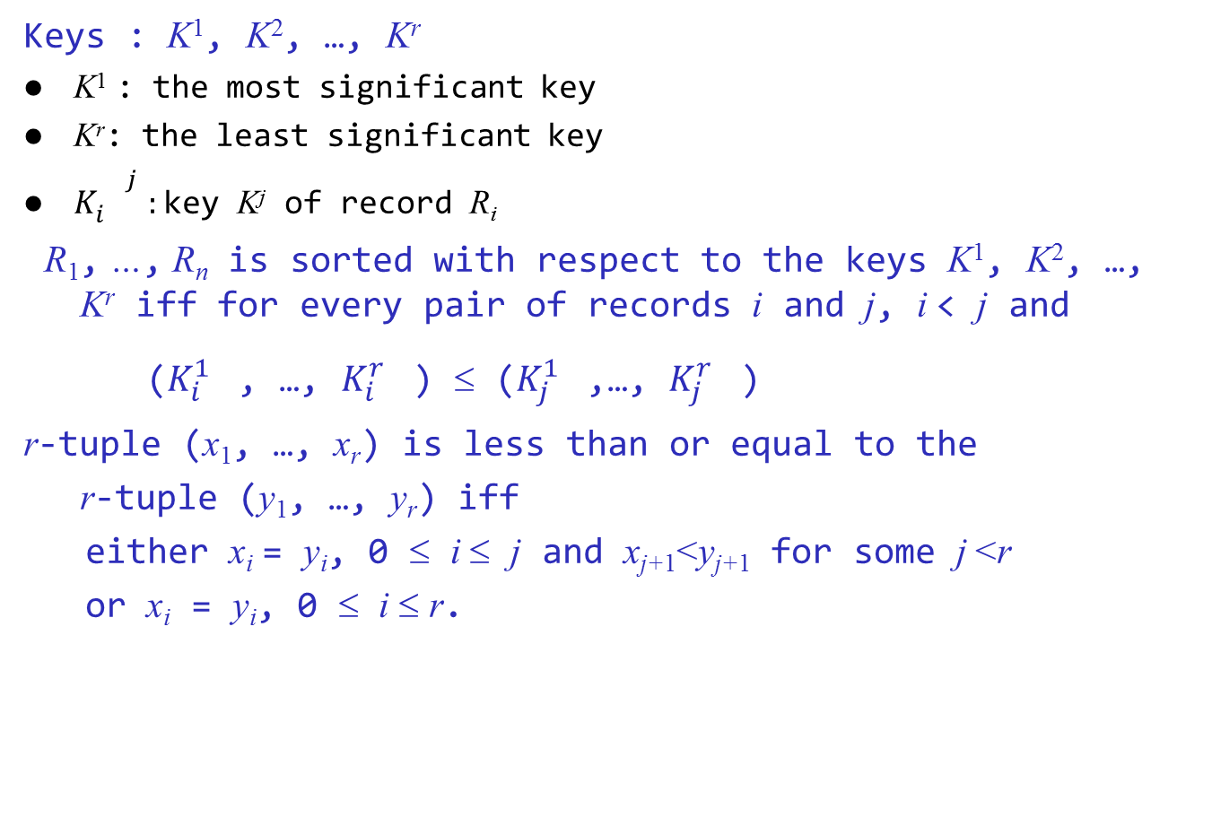
Sorting Records with Several Keys (1)
Keys : K¹, K², …, K^{r}
K¹ : the most significant key
K^{r}: the least significant key
${K_{i}^{}}_{}^{j}:$key K^{j} of record R_{i}
R₁, …, R_{n} is sorted with respect to the keys K¹, K², …, K^{r} iff for every pair of records i and j, i < j and
(${K_{i}^{1}}_{}^{}$, …, ${K_{i}^{r}}_{}^{}$) ≤ (${K_{j}^{1}}_{}^{}$,…, ${K_{j}^{r}}_{}^{}$)
r-tuple (x₁, …, x_{r}) is less than or equal to the
r-tuple (y₁, …, y_{r}) iff
either x_{i} = y_{i}, 0 ≤ i ≤ j and x_{j+1}<y_{j+1} for some j <r
or x_{i} = y_{i}, 0 ≤ i ≤ r.

Slide 43
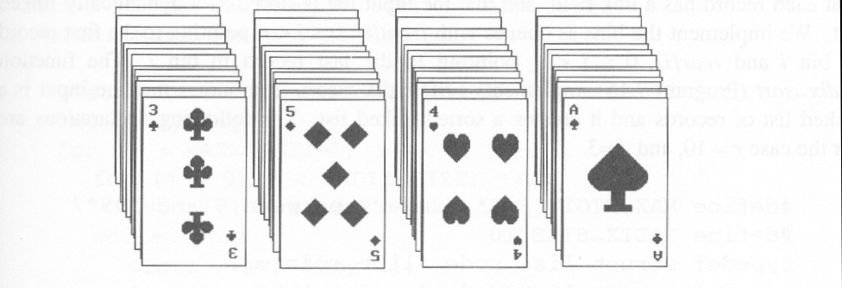
Sorting Records with Several Keys (2)
Suits: ♣ < ♦ < ♥ < ♠
Face values: 2 < 3 < 4 < … < J < Q < K < A
(1) MSD sort first, e.g., bin sort, four bins ♣ ♦ ♥ ♠
LSD sort second, e.g., insertion sort
(2) LSD sort first, e.g., bin sort, 13 bins
2, 3, 4, …, 10, J, Q, K, A
MSD sort, e.g., bin sort four bins ♣ ♦ ♥ ♠

Slide 44
Sorting Records with Several Keys (3)
MSD (Most Significant Digit) sort
Begin by sorting on the most significant key K¹
Each of these piles is independently sorted on K²
We need r bins (r is the number of possible key values)
LSD (Least Significant Digit) sort
LSD sort typically has less overhead than an MSD sort
Repeat the following 3 steps
Comparison (least-significant digit → most-significant digit)
Distribution
Merge

Slide 45
Example of MSD Sort
Input sequence: 746 515 246 214 324
(7, 4, 6) (5, 1, 5) (2, 4, 6) (2, 1, 4) (3, 2, 4)
(2, 4, 6) (2, 1, 4) (3, 2, 4) (5, 1, 5) (7, 4, 6)
(2, 1, 4) (2, 4, 6)
(3, 2, 4)
(5, 1, 5)
(7, 4, 6)
Output sequence: 214 246 324 515 746

Slide 46
Example of LSD Sort
Input sequence: 746 515 246 214 324
(7, 4, 6) (5, 1, 5) (2, 4, 6) (2, 1, 4) (3, 2, 4)
(2, 1, 4) (3, 2, 4) (5, 1, 5) (7, 4, 6) (2, 4, 6)
(2, 1, 4) (5, 1, 5) (3, 2, 4) (7, 4, 6) (2, 4, 6)
(2, 1, 4) (2, 4, 6) (3, 2, 4) (5, 1, 5) (7, 4, 6)
Output sequence: 214 246 324 515 746

Slide 47
Example of LSD Sort - Detail
Input sequence: 746 515 246 214 324
(7, 4, 6)
(5, 1, 5)
(2, 4, 6)
(2, 1, 4)
(3, 2, 4)
(5, 1, 5)
(7, 4, 6)
(2, 4, 6)
(2, 1, 4)
(5, 1, 5)
(7, 4, 6)
(2, 4, 6)
(2, 1, 4)
(3, 2, 4)
(5, 1, 5)
(7, 4, 6)
(2, 4, 6)
(2, 1, 4)
(3, 2, 4)
(5, 1, 5)
(7, 4, 6)
(2, 4, 6)
(2, 1, 4)
(5, 1, 5)
(3, 2, 4)
(7, 4, 6)
(2, 4, 6)
(2, 1, 4)
(5, 1, 5)
(3, 2, 4)
(7, 4, 6)
(2, 4, 6)
(2, 1, 4)
(3, 2, 4)
(5, 1, 5)
(7, 4, 6)
(2, 1, 4)
(2, 4, 6)
(3, 2, 4)
(5, 1, 5)
(7, 4, 6)

Slide 48
Radix Sort
Radix-sort is a specialization of lexicographic-sort
Radix-sort decompose the sort key using some radix r
Bucket-sort as the stable sorting algorithm in each dimension
Applicable to tuples where the keys in each dimension i are integers in the range [0, r−1]
Radix-sort runs in time O(d·(n+r)), where d is the dimension of the tuple
LSD sort

Slide 49
Codes for Radix Sort
int radixSort(element a[], int link[], int d, int r, int n)
{
int front[r], rear[r];
int i, bin, current, first, last;
first = 1;
for(i = 1; i < n; i++) link[i] = i+1;
link[n] = 0;
for(i=d-1; i >=0; i--) {
for(bin = 0; bin < r; bin++) front[bin] = 0;
for(current = first; current; current = link[current]){
bin = digit(a[current], i, r);
if(front[bin] == 0) front[bin] = current;
else link[rear[bin]] = current;
rear[bin] = current;
}
for(bin=0; !front[bin]; bin++);
first=front[bin]; last=rear[bin];
for(bin++; bin < r; bin++)
if(front[bin])
{link[last] = front[bin]; last = rear[bin]; }
link[last] = 0;
}
return first;
}

Slide 50
Example of Radix Sort (1)
Initial Input
a[1]
a[2]
a[3]
a[4]
a[5]
a[6]
a[7]
a[8]
a[9]
a[10]
179
208
306
93
859
984
55
9
271
33
 | [0] | [1] | [2] | [3] | [4] | [5] | [6] | [7] | [8] | [9] | [10]
link |  | 2 | 3 | 4 | 5 | 6 | 7 | 8 | 9 | 10 | 0
front | 0 | 0 | 0 | 0 | 0 | 0 | 0 | 0 | 0 | 0 | 0
rear | 0 | 0 | 0 | 0 | 0 | 0 | 0 | 0 | 0 | 0 | 0

Slide 51
Example of Radix Sort
179
208
306
93
859
984
55
9
271
33
 | [0] | [1] | [2] | [3] | [4] | [5] | [6] | [7] | [8] | [9] | [10]
link |  | 2 | 3 | 4 | 5 | 6 | 7 | 8 | 9 | 10 | 0
front | 0 | 0 | 0 | 0 | 0 | 0 | 0 | 0 | 0 | 0 | 0
rear | 0 | 0 | 0 | 0 | 0 | 0 | 0 | 0 | 0 | 0 | 0
5
1
2
10
8
7
3
0
4
6
9
4
6
7
3
2
1
First-pass queue
9
10
4
6
7
3
2
1
5
8
rear
e[0]
e[1]
e[2]
e[3]
e[4]
e[5]
e[6]
e[7]
e[8]
e[9]
9[8]
first=9
last=10
last=9
last=6
last=7
last=3
last=2
last=8
33[10]
859[5]
271[9]
93[4]
984[6]
55[7]
306[3]
208[2]
179[1]
front
f[0]
f[1]
f[2]
f[3]
f[4]
f[5]
f[6]
f[7]
f[8]
f[9]

Slide 52
Example of Radix Sort (2)
2nd pass input
271
93
33
984
55
306
208
179
859
09
2nd-pass queue
e[0]
e[1]
e[2]
e[3]
e[4]
e[5]
e[6]
e[7]
e[8]
e[9]
09
208
859
179
306
33
55
271
984
93
f[0]
f[1]
f[2]
f[3]
f[4]
f[5]
f[6]
f[7]
f[8]
f[9]
Resulting chain
306
208
9
33
55
859
271
179
984
93

Slide 53
Example of Radix Sort (3)
306
208
009
033
055
859
271
179
984
093
3rd-pass queue
e[0]
e[1]
e[2]
e[3]
e[4]
e[5]
e[6]
e[7]
e[8]
e[9]
093
055
033
271
009
179
208
306
859
984
f[0]
f[1]
f[2]
f[3]
f[4]
f[5]
f[6]
f[7]
f[8]
f[9]
Resulting chain
9
33
55
93
179
208
271
306
859
984

Slide 54
Example of Radix Sort - MSD Sort
Input sequence: 246 121 746 324 515 243 214
(2,4,6) (1,2,8) (7,4,6) (3,2,4) (5,1,5) (2,4,3),(2,1,4)
Key | Records
0
1 | (1,2,8)
2 | (2,4,6), (2,4,3), (2,1,4)
3 | (3,2,4)
4
5 | (5,1,5)
6
7 | (7,4,6)
8
9
Key | Records
0
1 | (2,1,4)
2
3
4 | (2,4,6) (2,4,3)
5
6
7
8
9
Key | Records
0
1
2
3 | (2,4,3)
4
5
6 | (2,4,6)
7
8
9
(2,1,4), (2,4,3), (2,4,6)
(2,4,3), (2,4,6)
Output sequence: 128 214 243 246 324 515 746

Slide 55
List Sort (1)
Many sorting algorithms require excessive data movement since we must physically move records following some comparisons
If the records are large, this slows down the sorting process
We can reduce data movement by using a linked list representation
However, in some applications we must physically rearrange the records so that they are in the required order
We can achieve considerable savings by first performing a linked list sort and then physically rearranging the records according to the order specified in the list

Slide 56
List Sort (2)
i
[1]
[2]
[3]
[4]
[5]
[6]
[7]
[8]
[9]
[10]
key
26
5
77
1
61
11
59
15
48
19
linka
9
6
0
2
3
8
5
10
7
1
By performing linked list sorting
Linked list, first=4
[4]
[6]
[10]
[9]
[5]
1
11
19
48
61
[2]
[8]
[1]
[7]
[3]
5
15
26
59
77
i
[1]
[2]
[3]
[4]
[5]
[6]
[7]
[8]
[9]
[10]
key
1
5
11
15
19
26
48
59
61
77

Slide 57
List Sort (3)
Linked list, first=4
i
[1]
[2]
[3]
[4]
[5]
[6]
[7]
[8]
[9]
[10]
key
26
5
77
1
61
11
59
15
48
19
linka
9
6
0
2
3
8
5
10
7
1
4
linkb
Pointer to previous record

Slide 58
Rearranging Records using a Doubly Linked List
void listSort1(element a[], int linka[], int n, int first)
{
int linkb[MAX_SIZE];
int i, current, prev = 0;
element temp;
for (current = first; current; current = linka[current]){
linkb[current] = prev;
prev = current;
}
for(i = 1; i < n; i++){
if(first != i) {
if (linka[i]) linkb[linka[i]] = first;
linka[linkb[i]] = first;
SWAP(a[first], a[i], temp);
SWAP(linka[first], linka[i], temp);
SWAP(linkb[first], linkb[i], temp);
}
first = linka[i];
}
}

Slide 59
Example of ListSort1 (1)
Input list : (26, 5, 77, 1, 61, 11, 59, 15, 48, 19)
i
[1]
[2]
[3]
[4]
[5]
[6]
[7]
[8]
[9]
[10]
key
26
5
77
1
61
11
59
15
48
19
linka
9
6
0
2
3
8
5
10
7
1
Linked list following a list sort, first=4
i
[1]
[2]
[3]
[4]
[5]
[6]
[7]
[8]
[9]
[10]
key
26
5
77
1
61
11
59
15
48
19
linka
9
6
0
2
3
8
5
10
7
1
linkb
10
4
5
0
7
2
9
6
1
8
Corresponding doubly linked list, first=4

Slide 60
Example of ListSort1 (2)
i
[1]
[2]
[3]
[4]
[5]
[6]
[7]
[8]
[9]
[10]
key
1
5
77
26
61
11
59
15
48
19
linka
2
6
0
9
3
8
5
10
7
4
linkb
0
4
5
10
7
2
9
6
4
8
Configuration after 1st iteration of the for loop, first=2
R₁
R₂
R₃
R₄
R₅
R₆
R₇
R₈
R₉
R₁₀
[1]
[2]
[3]
[4]
[5]
[6]
[7]
[8]
[9]
[10]
key
1
5
77
26
61
11
59
15
48
19
linka
2
6
0
9
3
8
5
10
7
4
linkb
0
4
5
10
7
2
9
6
4
8
Configuration after 2nd iteration of the for loop, first=6

Slide 61
Example of ListSort1 – 1st Step
for(i = 1; i < n; i++){
if(first != i) {
if (linka[i]) linkb[linka[i]] = first;
linka[linkb[i]] = first;
SWAP(a[first], a[i], temp);
SWAP(linka[first], linka[i], temp);
SWAP(linkb[first], linkb[i], temp);
}
first = linka[i];
}
[1]
[2]
[3]
[4]
[5]
[6]
[7]
[8]
[9]
[10]
i=1
R₁
R₂
R₃
R₄
R₅
R₆
R₇
R₈
R₉
R₁₀
R₄
1
2
0
R₁
26
9
10
first=4
key
26
5
77
1
61
11
59
15
48
19
linka
9
6
0
2
3
8
5
10
7
1
4
linka[linkb[1]]
linkb
10
4
5
0
7
2
9
6
1
8
4
linkb[linka[1]]

Slide 62
Example of ListSort1 – 3rd Step
for(i = 1; i < n; i++){
if(first != i) {
if ( linka[i]) linkb[linka[i]] = first;
linka[linkb[i]] = first;
SWAP(a[first], a[i], temp);
SWAP(linka[first], linka[i], temp);
SWAP(linkb[first], linkb[i], temp);
}
first = linka[i];
}
i=2
[1]
[2]
[3]
[4]
[5]
[6]
[7]
[8]
[9]
[10]
1
R₂
R₆
11
8
2
R₃
R₄
R₅
R₆
R₇
R₈
R₉
R₁₀
R₃
77
0
5
first=2
key
1
5
77
26
61
11
59
15
48
19
i=3
linka
2
6
0
9
3
8
5
10
7
4
6
first=6
linkb
0
4
5
10
7
2
9
6
4
8
linka[linkb[3]]

Slide 63
Example of ListSort1 (3)
4th
R₁
R₂
R₃
R₄
R₅
R₆
R₇
R₈
R₉
R₁₀
[1]
[2]
[3]
[4]
[5]
[6]
[7]
[8]
[9]
[10]
key
1
5
11
26
61
77
59
15
48
19
linka
2
6
8
9
6
0
5
10
7
4
linkb
0
4
2
10
7
5
9
6
4
8
Configuration after 3rd iteration of the for loop, first=8
5th
R₁
R₂
R₃
R₄
R₅
R₆
R₇
R₈
R₉
R₁₀
[1]
[2]
[3]
[4]
[5]
[6]
[7]
[8]
[9]
[10]
key
1
5
11
15
61
77
59
26
48
19
linka
2
6
8
10
6
0
5
9
7
8
linkb
0
4
2
6
7
5
9
10
8
4
Configuration after 4th iteration of the for loop, first=10

Slide 64
Rearranging Records using only One Link Field
void listSort2(element a[], int link[], int n, int first)
{
int i;
element temp;
for(i=1; i<n; i++)
{
while(first < i) first = link[first];
int q = link[first];
if(first != i)
{
SWAP(a[i], a[first], temp);
link[first] = link[i];
link[i] = first;
}
first = q;
}
}

Slide 65
Example of ListSort2 (1)
Input list : (26, 5, 77, 1, 61, 11, 59, 15, 48, 19)
i
[1]
[2]
[3]
[4]
[5]
[6]
[7]
[8]
[9]
[10]
R₁
R₂
R₃
R₄
R₅
R₆
R₇
R₈
R₉
R₁₀
key
1
5
77
26
61
11
59
15
48
19
link
4
6
0
9
3
8
5
10
7
1
Configuration after 1st iteration of the for loop, first=2
i
[1]
[2]
[3]
[4]
[5]
[6]
[7]
[8]
[9]
[10]
R₁
R₂
R₃
R₄
R₅
R₆
R₇
R₈
R₉
R₁₀
key
1
5
77
26
61
11
59
15
48
19
link
4
6
0
9
3
8
5
10
7
1
Configuration after 2nd iteration, first=6

Slide 66
Example of ListSort2 – Step 1
while(first < i) first = link[first];
int q = link[first];
if(first != i)
{
SWAP(a[i], a[first], temp);
link[first] = link[i];
link[i] = first;
}
first = q;
i
[1]
[2]
[3]
[4]
[5]
[6]
[7]
[8]
[9]
[10]
i=1
key
26
5
77
1
61
11
59
15
48
19
first=4
q=2
link
9
6
0
2
3
8
5
10
7
1
4
9
first=2
i
[1]
[2]
[3]
[4]
[5]
[6]
[7]
[8]
[9]
[10]
i=3
first=6
key
1
5
77
26
61
11
59
15
48
19
q=8
11
77
link
4
6
0
9
3
8
5
10
7
1
6
0
first=8

Slide 67
Example of ListSort2 (2)
i
R₁
[1]
R₂
[2]
R₃
[3]
R₄
[4]
R₅
[5]
R₆
[6]
R₇
[7]
R₈
[8]
R₉
[9]
R₁₀
[10]
key
1
5
11
26
61
77
59
15
48
19
link
4
6
6
9
3
0
5
10
7
1
Configuration after 3rd iteration, first=8
i
R₁
R₂
R₃
R₄
R₅
R₆
R₇
R₈
R₉
R₁₀
[1]
[2]
[3]
[4]
[5]
[6]
[7]
[8]
[9]
[10]
key
1
5
11
15
61
77
59
26
48
19
link
4
6
6
8
3
0
5
9
7
1
Configuration after 4th iteration, first=10
i
[1]
[2]
[3]
[4]
[5]
[6]
[7]
[8]
[9]
[10]
key
1
5
11
15
19
77
59
26
48
61
link
4
6
6
8
10
0
5
9
7
3
Configuration after 5th iteration, first=1

Slide 68
Example of ListSort2 (3)
i
[1]
[2]
[3]
[4]
[5]
[6]
[7]
[8]
[9]
[10]
key
1
5
11
15
19
77
59
26
48
61
link
4
6
6
8
10
0
5
9
7
3
Configuration after 5th iteration, first=1
first = 1
while(first < i) first = link[first];
int q = link[first];
if(first != i)
{
SWAP(a[i], a[first], temp);
link[first] = link[i];
link[i] = first;
}
first = q;
first = 4
first = 8

Slide 69
Summary of Internal Sorting (1)
Insertion sort
Good when the list is already partially sorted
The best sorting method for “small” n
Merge sort
The best worst-case behavior but requires more storage than heap
Quick sort
The best average-case behavior
The worst-case behavior is O(n²)
Radix sort
Depends on the size of the keys and the choice or r

Slide 70
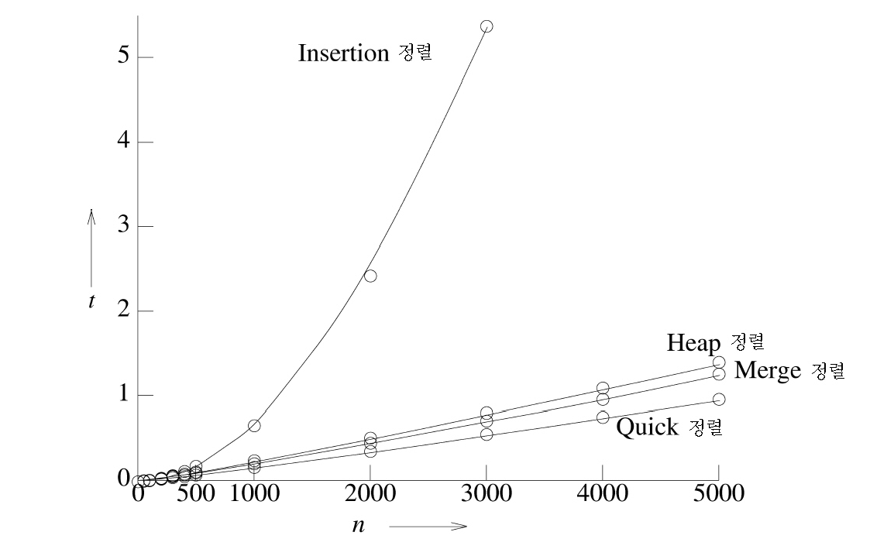
Summary of Internal Sorting (2)
Method | Worst | Average
Insertion sort | n² | n²
Heap sort | n·log₂n | n·log₂n
Merge sort | n·log₂n | n·log₂n
Quick sort | n² | n·log₂n
Average time
Insertion sort
Heap sort
Merge sort
Quick sort

