Slide 1

Signals and Systems
Second Edition
Simon Haykin
Barry Van Veen
Notes:
신호 및 시스템

Slide 2
1. Introduction
1.1 What is a signal? ----------------------------------------------4
1.2 What is a system? ---------------------------------------------5
1.3 Overview of specific systems --------------------------------7
1.4 Classification of signals -------------------------------------28
1.5 Basic operation on signals ----------------------------------40
1.6 Elementary signals
1.7 Systems viewed as interconnections of operations
1.8 Properties of systems
1.9 Noise
1.10 Theme examples

Slide 3
1. Introduction (Part 1)
1.1 What is a signal?
1.2 What is a system?
1.3 Overview of specific systems
  1.3.1 Communication systems
  1.3.2 Control systems
  1.3.3 Micro-electro-mechanical systems (MEMS)
  1.3.4 Remote sensing
  1.3.5 Biomedical signal processing
  1.3.6 Auditory system
  1.3.7 Analog versus digital signal processing
1.4 Classification of signals
1.5 Basic operation on signals
  1.5.1 Operations performed on dependent variables
  1.5.2 Operations performed on the independent variable
  1.5.3 Precedence rule for time shifting and time scaling

Slide 4
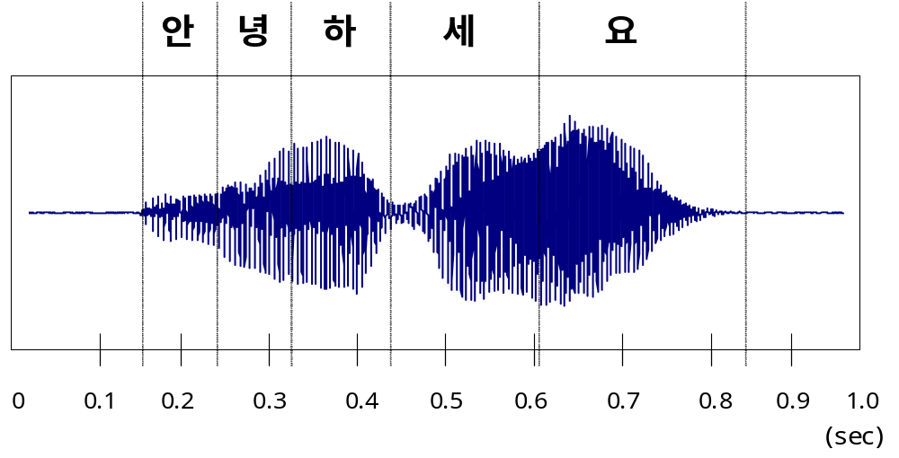
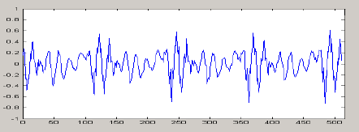
1.1 What is a signal?
What is a signal?
  Formally defined as a function of one or more variables that conveys information on the nature of a physical phenomenon.
  (one variable → 1-D, or multidimensional)
  Fig. An example of voice signal

Slide 5

1.2 What is a system?
Formally defined as an entity that manipulates one or more signals to accomplish a function, thereby yielding new signals.
  Figure 1.1 (P.2)
  Block diagram representation of a system.

Slide 6
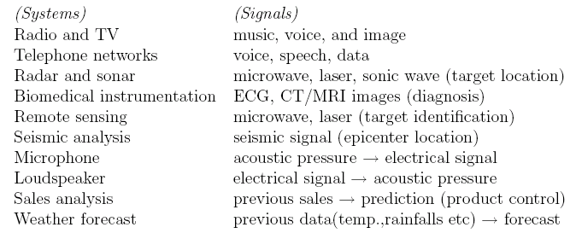
Examples of signals and systems

Slide 7

1.3 Overview of specific systems
1.3.1 Communication systems
  The transmitter changes the message signal into a form suitable for transmission over the channel.
  The receiver processes the channel output (i.e., the received signal) to produce an estimate of the message signal.
Figure 1.2 (p. 3)
Elements of a communication system.

Slide 8
1.3 Overview of specific systems (Cont.)
1.3.1 Communication systems (Cont.)
  Analog communication system
    Transmitter: Modulator
    Receiver: Demodulator
    Modulation: Amplitude, Phase, Frequency
      The process of converting the message signal into a form that is compatible with the transmission characteristics of the channel.
  Digital communication system
    Sampling : message signal  a sequence of numbers
    Quantization
      비가역적  정보손실
      level수 증가  손실감소, 코드의 길이 증가
    Coding : codeword로 표현
      Data compression
      Channel encoding
불필요한 정보 제거->bit, sample수 감소->채널효율
부가적인 symbol 추가-> 에러검출, 정정

Slide 9
1.3 Overview of specific systems (Cont.)
1.3.1 Communication systems (Cont.)
  Two basic modes of communication
    Broadcasting
    Point-to-point communication
  Deep-space communication
    Channel noise
    For reliable operation
      large antennas
      error control
        channel encoder, channel decoder
Outer space com.

Slide 10
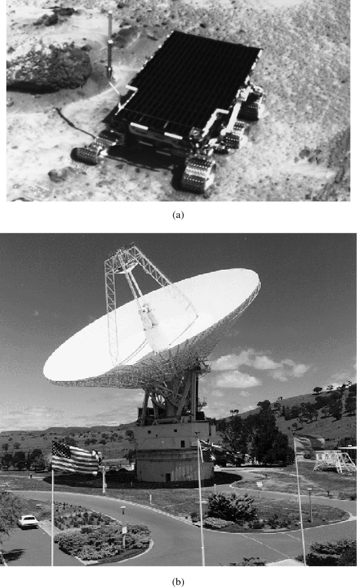
Deep-space communication
Figure 1.3 (p. 5)
  Snapshot of Pathfinder exploring the surface of Mars.
  The 70-meter (230-foot) diameter antenna located at Canberra, Australia. The surface of the 70-meter reflector must remain accurate within a fraction of the signal’s wavelength. (Courtesy of Jet Propulsion Laboratory.)

Slide 11
1.3.2 Control systems
Widely spread in industry.
Plant: Object to be controlled
Reasons for using control system
  To attain a satisfactory response and robust performance
  Response
    The output of the plant follows a specified reference input.
    Regulation : plant 출력을 기준 입력에 가깝게 유지
  Robustness
    External disturbances가 있어도 만족할 만한 regulation
Require Feedback to attain desirable response and robustness.
  Feedback control system or closed loop system
Single-input, single-output (SISO) system
Multiple-input, multiple-output (MIMO) system
Digital control system
  The controller may be in the form of a digital computer or microprocessor.

Slide 12
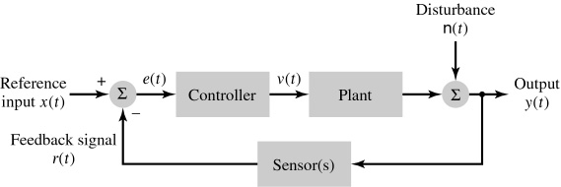
1.3.2 Control systems (Cont.)
Figure 1.4 (p. 7)
Block diagram of a feedback (closed loop) control system.
  The controller drives the plant, whose disturbed output drives the sensor(s).
  The resulting feedback signal is subtracted from the reference input to produce an error signal e(t), which, in turn, drives the controller.
  The feedback loop is thereby closed.
예, 난방제어 등

Slide 13
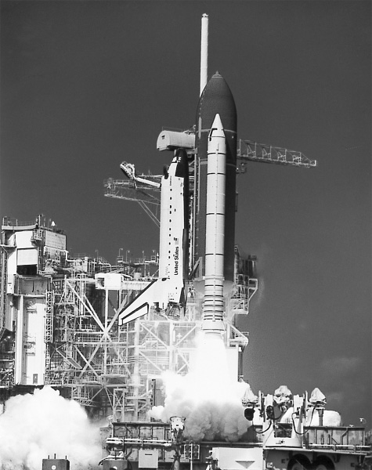
1.3.2 Control systems (Cont.)
The use of digital computer for space shuttle control
Figure 1.5 (p. 8)
NASA space shuttle launch.
(Courtesy of NASA.)

Slide 14
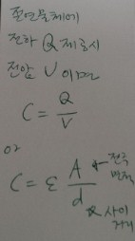
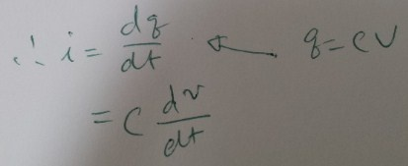
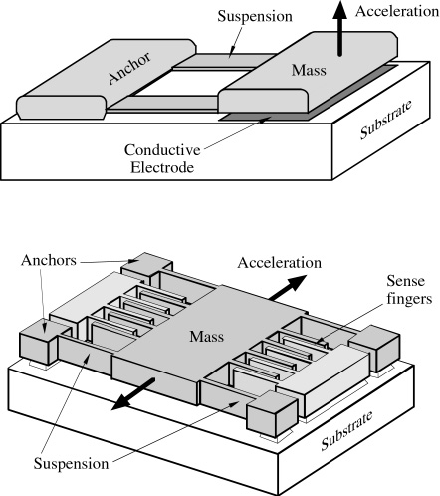
1.3.3 Micro-electro-mechanical systems (MEMS)
MEMS merges mechanical systems with microelectronic control circuits on a silicon chip.
Figure 1.6a (p. 8)
Structure of lateral
capacitive accelerometers.
(Taken from Yazdi et al.,
Proc. IEEE, 1998)

Slide 15
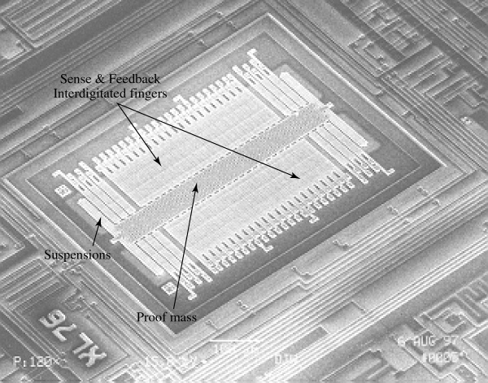
1.3.3 MEMS (Cont.)
Figure 1.6b (p. 9)
SEM view of Analog Device’s ADXLO5 surface-micromachined polysilicon accelerometer.
(Taken from Yazdi et al., Proc. IEEE, 1998)
Notes:
신호 및 시스템

Slide 16
1.3.4 Remote sensing
Remote sensing is defined as the process of acquiring information about an object interest without being in physical contact with it.
물체가 주변의 장(field)에 나타내는 변화를 감지, 측정
  electromagnetic, acoustic, magnetic, gravitational 등의 field 이용
방식
  passive 방식
  active 방식
Multiple sensors
  radar sensors : 표면의 물리적 성질 정보
  infrared sensors : 온도 정보
  visible and near-infrared sensors: 화학적 정보
  X-ray sensors : 방사성 물질 정보

Slide 17
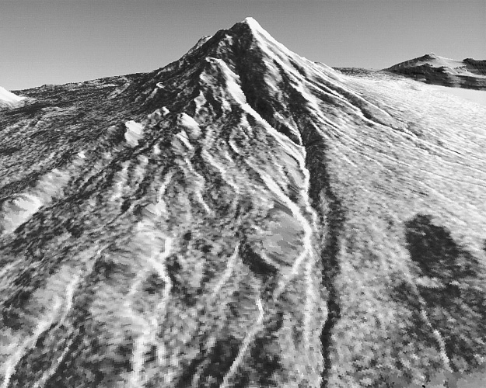
1.3.4 Remote sensing (Cont.)
Figure 1.7 (p. 11)
Perspectival view of Mount Shasta (California), derived from a pair of stereo radar images acquired from orbit with the shuttle Imaging Radar (SIR-B). (Courtesy of Jet Propulsion Laboratory.)

Slide 18
1.3.5 Biomedical signal processing
The goal of biomedical signal processing is to extract information from a biological signal.
Biological signals can be represented as electrical signals.
  ECG(electrocardiogram), EEG(electroencephalogram), etc.

Slide 19
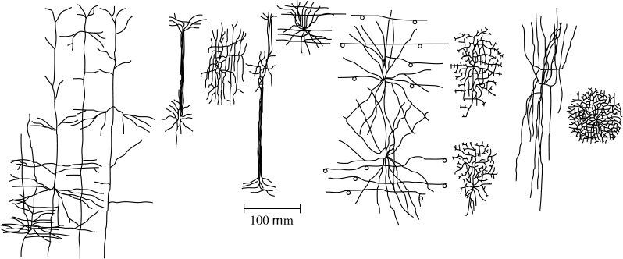
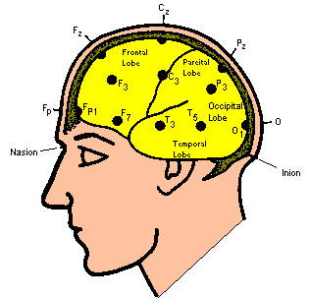
1.3.5 Biomedical signal processing (Cont.)
Figure 1.8 (p. 12)
Morphological types of nerve cells (neurons) identifiable in monkey cerebral cortex, based on studies of primary somatic sensory and motor cortices. (Reproduced from E. R. Kande, J. H. Schwartz, and T. M. Jessel, Principles of Neural Science, 3d ed., 1991; courtesy of Appleton and Lange.)
원숭이 대뇌의
여러 형태 뉴런
micro
Notes:
신호 및 시스템

Slide 20
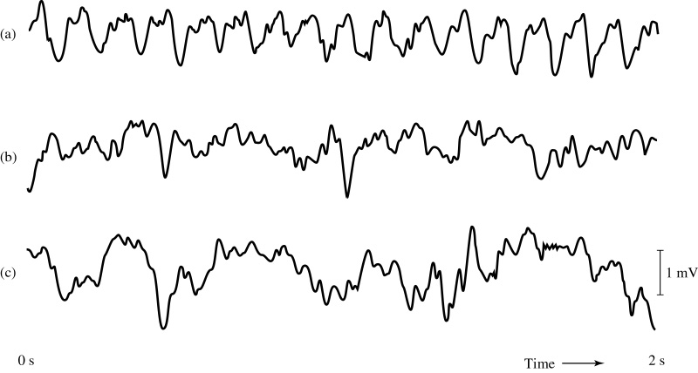
1.3.5 Biomedical signal processing (Cont.)
Figure 1.9 (p. 13)
The traces shown in (a), (b), and (c) are three examples of EEG signals recorded from the hippocampus of a rat. Neurobiological studies suggest that the hippocampus plays a key role in certain aspects of learning and memory.
쥐, 해마상 융기의 세가지 뇌파신호

Slide 21
1.3.5 Biomedical signal processing (Cont.)
Artifact 문제
  instrumental artifacts
    계기 사용시 60Hz
  biological artifacts
    생물학적 신호와 간섭(예, 뇌파+심장)
  analysis artifacts
    관심사 추정을 위해 생물학적 신호처리 과정에서 …
Artifact 방지책
  해상도가 좋은 quantizer 사용 (quantization 문제)
  filtering
필터링
필터링
양자화 시 반올림 등.
Level 증가로 해결

Slide 22
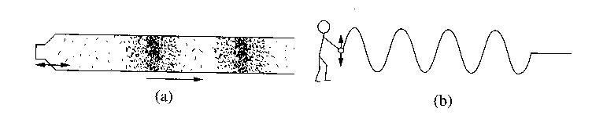
1.3.6 Auditory system
Acoustic wave
  진동 -> 공기의 소밀파

Slide 23
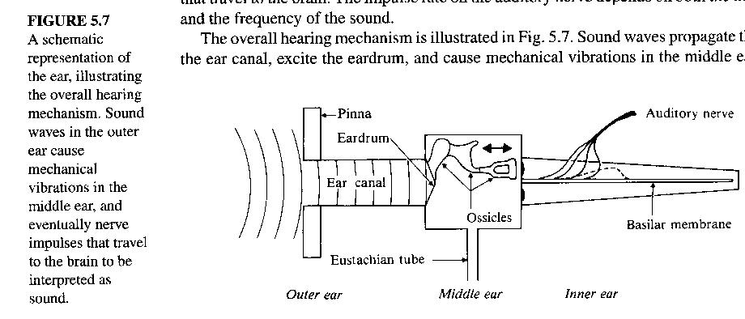
1.3.6 Auditory system (Cont.)
청각기관
  외이 : 소리 모음
  중이 : 청각 임피던스 정합(공기-액체)
  내이 : 전기 화학적 신경신호로 변환

Slide 24
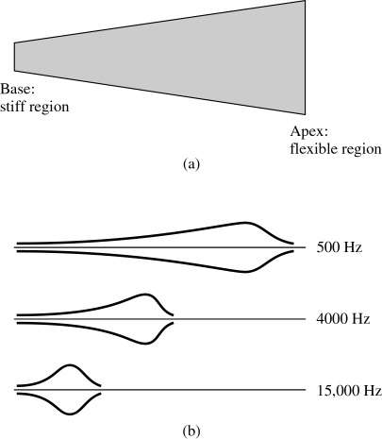
1.3.6 Auditory system (Cont.)
Figure 1.10 (p. 14)
  In this diagram, the basilar membrane in the cochlea is depicted as if it were uncoiled and stretched out flat; the “base” and “apex” refer to the cochlea, but the remarks “stiff region” and “flexible region” refer to the basilar membrane.
  This diagram illustrates the traveling waves along the basilar membrane, showing their envelopes induced by incoming sound at three different frequencies.

Slide 25
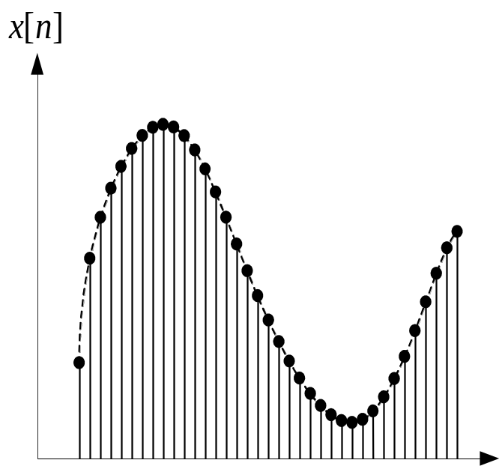
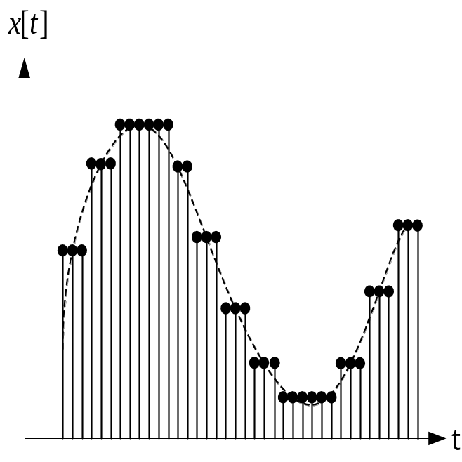
1.3.7 Analog versus digital signal processing
(a) 이산(discrete) 신호
(b) 디지털(digital) 신호
그림 1.11 이산 신호(a), 디지털 신호(b)의 비교

Slide 26
1.3.7 Analog versus digital signal processing(con’t)
Analog 신호처리
  실시간
  analog circuit elements - R, L, C, OP Amp, Tr., Diode 등
Digital 신호처리
  비 실시간
  digital computer elements : adder, multiplier, memory 등
Digital 장점
  flexibility  프로그램 수정
  repeatability  몇 번이든 반복
Digital approach
Require more complex circuit  DSP chips

Slide 27
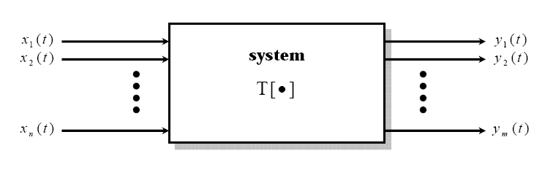
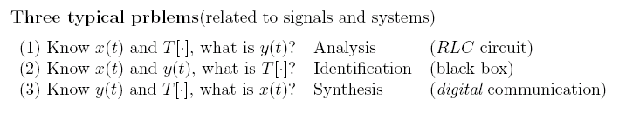
x(t)
h(t)
y(t)
X(ω)
H(ω)
Y(ω)

Slide 28
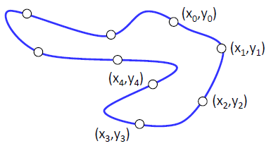
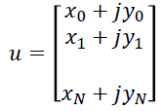
1.4 Classification of signals
1-D signals : single-valued functions of time
  “single valued”
  “real-valued signal”
  “complex-valued signal”
Five methods of classifying signals
  Continuous-time & discrete-time signals
  Even & odd signals
  Periodic signals & nonperiodic signals
  Deterministic signals & random signals
  Energy signal & power signals

Slide 29
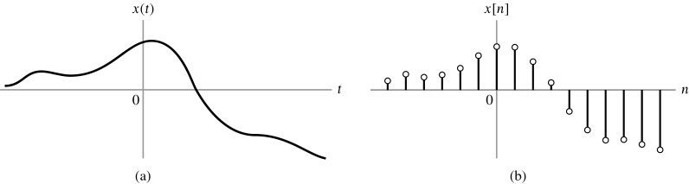
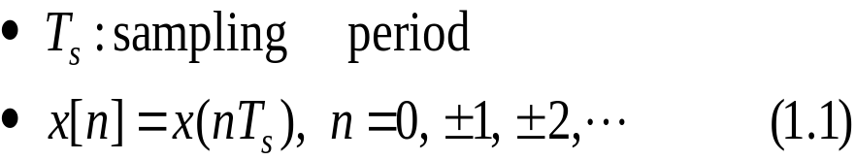
1.4 Classification of signals (Cont.)
1. Continuous-time & discrete-time signals
Figure 1.12 (p. 17)
(a) Continuous-time signal x(t).
(b) Representation of x(t) as a discrete-time signal x[n].

Slide 30
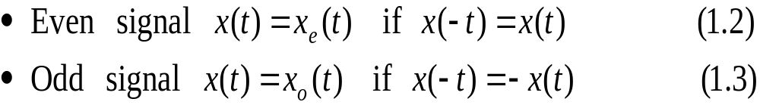
1.4 Classification of signals (Cont.)
2. Even and odd signals
  Example 1.1 even, odd 판정

Slide 31
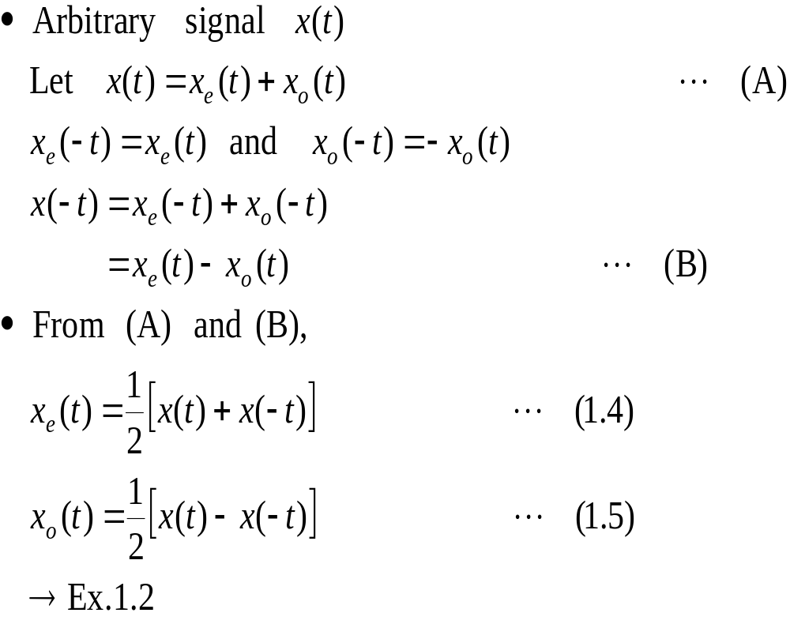
1.4 Classification of signals (Cont.)
2. Even and odd signals (Cont.)
Even-odd decomposition
Even, odd 분해
Notes:
신호 및 시스템

Slide 32
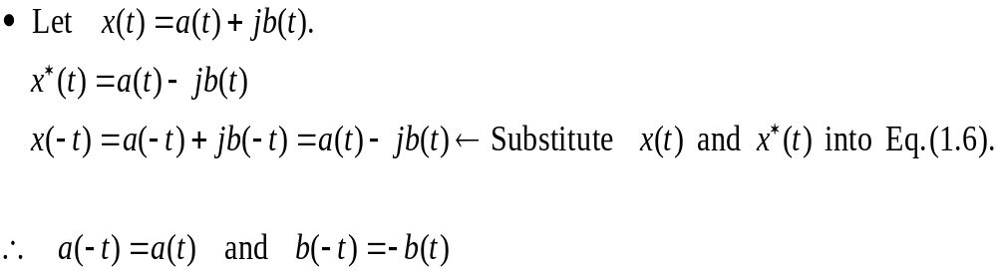
1.4 Classification of signals (Cont.)
2. Even and odd signals (Cont.)
Complex-valued signal x(t)
  Conjugate symmetric if
Notes:
신호 및 시스템

Slide 33
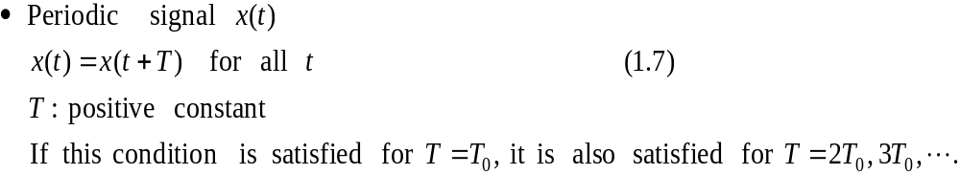
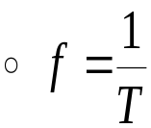
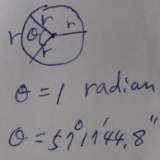
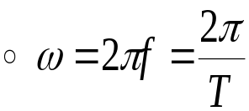
1.4 Classification of signals (Cont.)
3. Periodic signals & nonperiodic signals
  The smallest value of T: fundamental period
  Fundamental frequency f
  Angular frequency ω
Aperiodic, or nonperiodic signal x(t)
  Any signal x(t) has no value of T satisfying the condition Eq. (1.7).

Slide 34
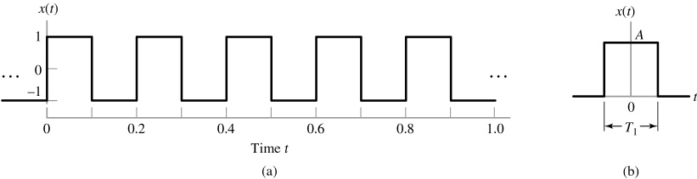
1.4 Classification of signals (Cont.)
3. Periodic signals & nonperiodic signals (Cont.)
Figure 1.14 (p. 21)
  (a) Square wave with amplitude A = 1 and period T = 0.2s.
  (b) Rectangular pulse of amplitude A and duration T₁.

Slide 35
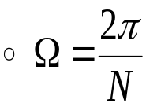
1.4 Classification of signals (Cont.)
3. Periodic signals & nonperiodic signals (Cont.)
Discrete-time signal
  periodic :
    if x[n] = x[n+N] for integer n (1.10)
    N : positive integer
    Fundamental period
      The smallest integer for which Eq. (1.10) is satisfied
  Fundamental (angular) frequency Ω
: rad/sample
Notes:
신호 및 시스템

Slide 36
1.4 Classification of signals (Cont.)
4. Deterministic signals & random signals
Deterministic signal
  Be a signal which there is no uncertainty with respect to its value at any time.
  May be modeled as completely specified functions of time.
Random signal
  Be a signal about which there is uncertainty before it occurs.
  Random process
    Related course: ‘Probability and Random Processes’
  E.g., electric noise in TV receiver

Slide 37
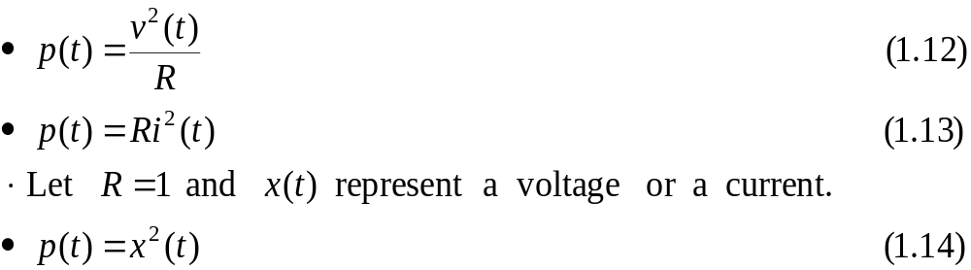
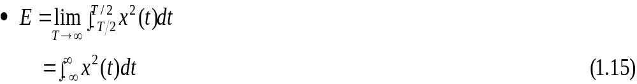
1.4 Classification of signals (Cont.)
5. Energy signal & power signals
Instantaneous power p(t)
  Voltage v(t), Current i(t), and Resistor R
Total energy of the continuous-time signal x(t)

Slide 38
1.4 Classification of signals (Cont.)
5. Energy signal & power signals: Continuous-time signal x(t)
Average (=time-averaged) power P
  In case of a periodic signal x(t) with fundamental period T
Root mean-square (rms) value of the periodic signal x(t)
  Square root of the average power

Slide 39


1.4 Classification of signals (Cont.)
5. Energy signal & power signals: Discrete-time signal x[n]
Total energy of x[n]
Average power
  In case of a periodic signal x[n] with fundamental period N
Energy signal if and only if (iff) the total energy of the signal satisfies the condition.
Power signal iff the average power of the signal satisfies the condition.

Slide 40



1.5 Basic operation on signals
1.5.1 Operations performed on dependent variables
Amplitude scaling
  (e.g.) electronic amplifier
Discrete-time signals
Addition
  (e.g.) audio mixer: music and voice signals
Discrete-time signals
Multiplication
  (e.g.) AM radio signal: audio + DC component and carrier wave
Discrete-time signals

Slide 41
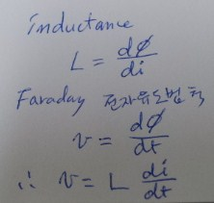
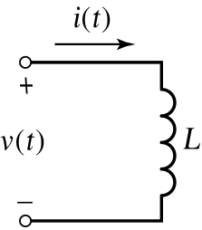
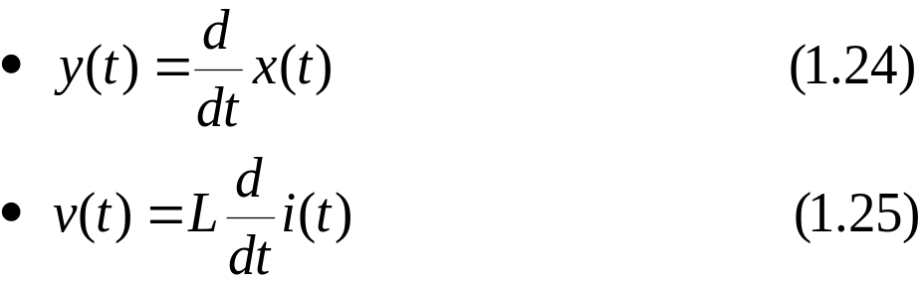
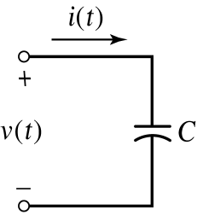
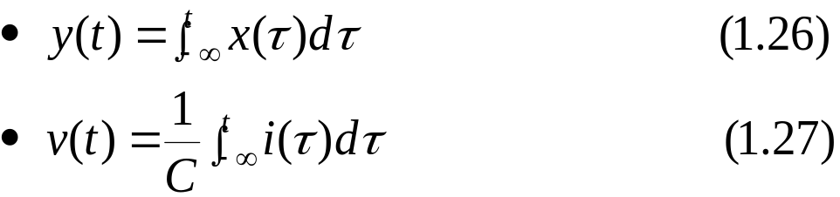
1.5 Basic operation on signals (Cont.)
1.5.1 Operations performed on dependent variables (Cont.)
Differentiation
  L: inductance
Integration
  C: capacitance

Slide 42
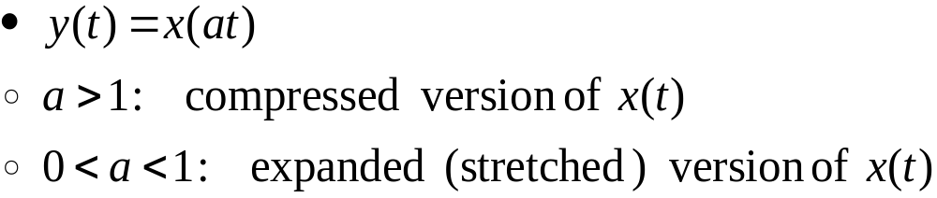
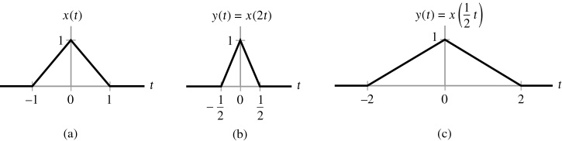
1.5 Basic operation on signals (Cont.)
1.5.2 Operations performed on the independent variable
Time scaling

Slide 43

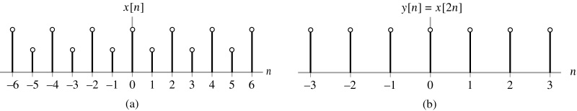
1.5 Basic operation on signals (Cont.)
1.5.2 Operations performed on the independent variable (Cont.)
Time scaling (Cont.)
Discrete-time signal
인 정수 k
Notes:
신호 및 시스템

Slide 44


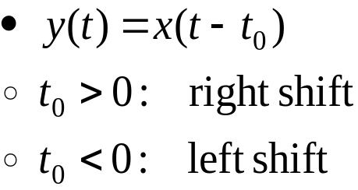
1.5 Basic operation on signals (Cont.)
1.5.2 Operations performed on the independent variable (Cont.)
Reflection
  Special interest: even signal, odd signal
For discrete-time signal
  Ex. 1.3
Time shifting
For discrete-time signal
  Ex. 1.4

Slide 45
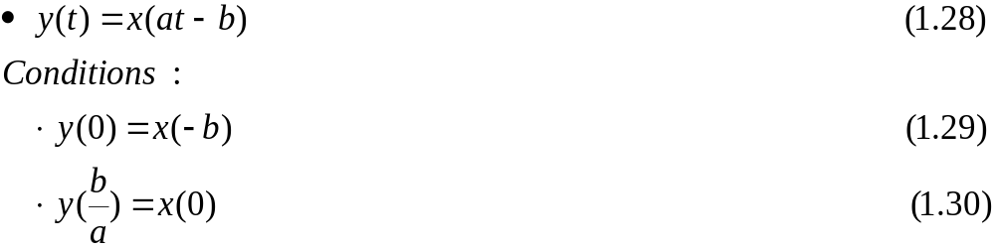


1.5 Basic operation on signals (Cont.)
1.5.3 Precedence rule for time shifting and time scaling
Combination of time shifting and time scaling
Time-shifting and time-scaling operations
  The order affects the results.
  First, time-shifting operation: t  t - b
  Next, time-scaling operation: t  at

Slide 46
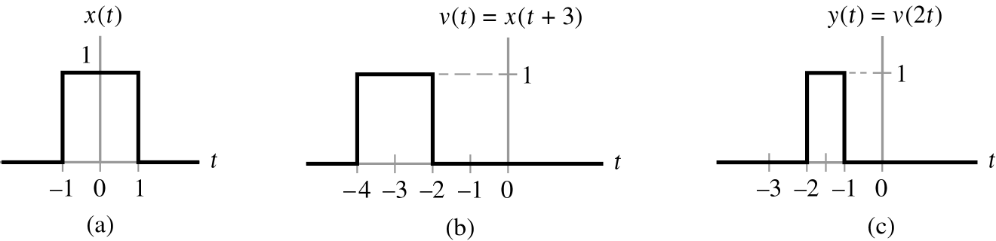
1.5 Basic operation on signals (Cont.)
1.5.3 Precedence rule for time shifting and time scaling (Cont.)
Ex. 1.5
  y(t) = x(2t+3)
Figure 1.24 (p. 31)
The proper order in which the operations of time scaling and time shifting should be applied in the case of the continuous-time signal of Example 1.5.
  Rectangular pulse x(t) of amplitude 1.0 and duration 2.0, symmetric about the origin.
  Intermediate pulse v(t), representing a time-shifted version of x(t).
  Desired signal y(t), resulting from the compression of v(t) by a factor of 2.

Slide 47
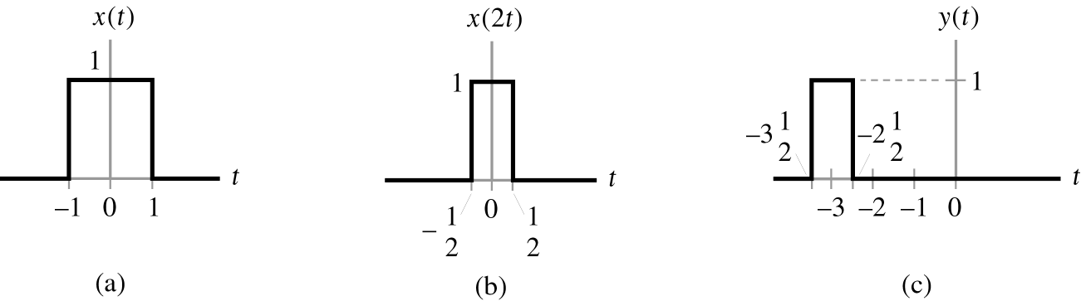
1.5 Basic operation on signals (Cont.)
1.5.3 Precedence rule for time shifting and time scaling (Cont.)
Ex. 1.5: (Cont.)
  y(t) = x(2t+3)
  Figure 1.25 (p. 31)
  The incorrect way of applying the precedence rule.
  Signal x(t).
  Time-scaled signal v(t) = x(2t).
  Signal y(t) obtained by shifting v(t) = x(2t) by 3 time units, which yields y(t) = x(2(t + 3)).

Slide 48
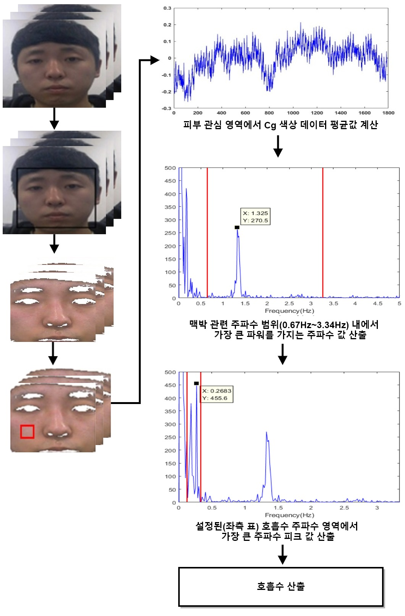
Q & A
Thank you …
(맥박수)
Notes:
신호 및 시스템

