Slide 1
1. Introduction(cont.)
1.1 What is a signal?
1.2 What is a system?
1.3 Overview of specific systems
1.4 Classification of signals
1.5 Basic operation on signals
1.6 Elementary signals ----------------------------------------------3
1.7 Systems viewed as interconnections of operations ------22
1.8 Properties of systems ------------------------------------------24
1.9 Noise --------------------------------------------------------------34
1.10 Theme examples ----------------------------------------------38
Notes:
신호 및 시스템

Slide 2
1. Introduction (Part 2)
1.6 Elementary signals
  1.6.1 Exponential signals 1.6.2 Sinusoidal signals
  1.6.3 Relation between sinusoidal and complex
  1.6.4 Exponentially damped sinusoidal signals
  1.6.5 Step function 1.6.6 Impulse function
  1.6.7 Derivatives of the impulse 1.6.8 Ramp function
1.7 Systems viewed as interconnections of operations
1.8 Properties of systems
  1.8.1 Stability 1.8.2 Memory
  1.8.3 Causality 1.8.4 Invertibility
  1.8.5 Time invariance 1.8.6 Linearity
1.9 Noise
  1.9.1 Thermal noise
  1.9.2 Other sources of electrical noise
1.10 Theme examples
  1.10.1 Differentiation and integration: RC circuits
  1.10.2 MEMS accelerometer
  1.10.3 Radar range measurement
  1.10.4 Moving-average systems
  1.10.5 Multipath communication channels
  1.10.6 Recursive discrete-time computation

Slide 3
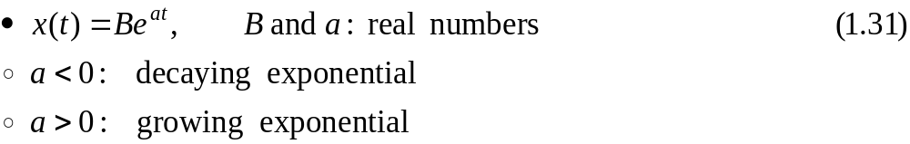
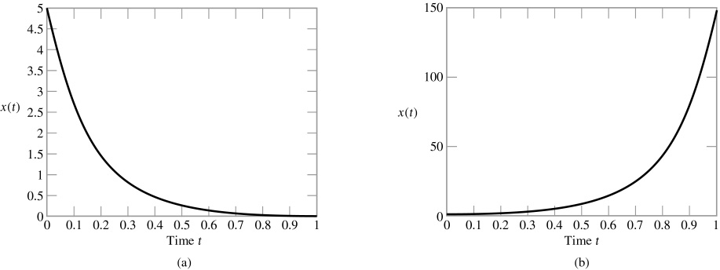
1.6 Elementary signals
1.6.1 Exponential signals
e=2.71828
Figure 1.28 (p. 34)
(a) Decaying exponential form of continuous-time signal. (a= -6, B=5)
(b) Growing exponential form of continuous-time signal. (a=5, B=1)
오전 2시 6분
Notes:
신호 및 시스템

Slide 4
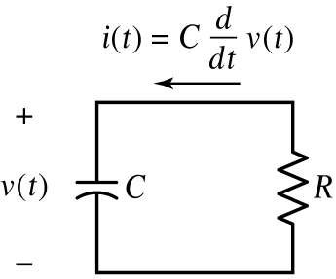
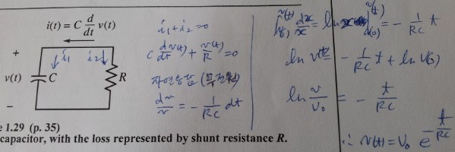
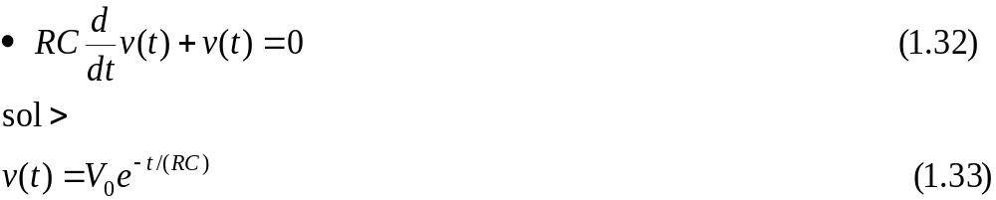
1.6.1 Exponential signals (Cont.)
Figure 1.29 (p. 35)
Lossy capacitor, with the loss represented by shunt resistance R.
오전 2시 6분

Slide 5
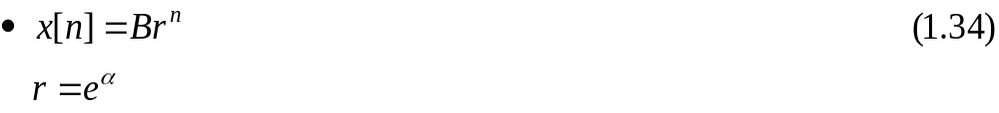
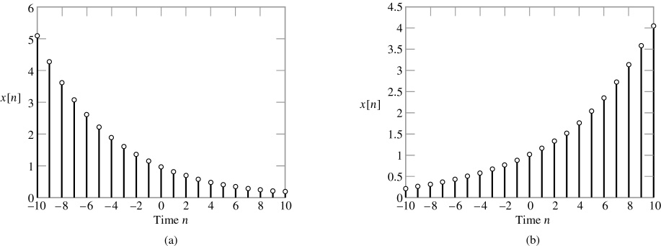
1.6.1 Exponential signals (Cont.)
For discrete-time signals
  Real exponential signal
Figure 1.30 (p. 35)
(a) Decaying exponential form of discrete-time signal. (0<r<1)
(b) Growing exponential form of discrete-time signal. (r>1)
오전 2시 6분

Slide 6
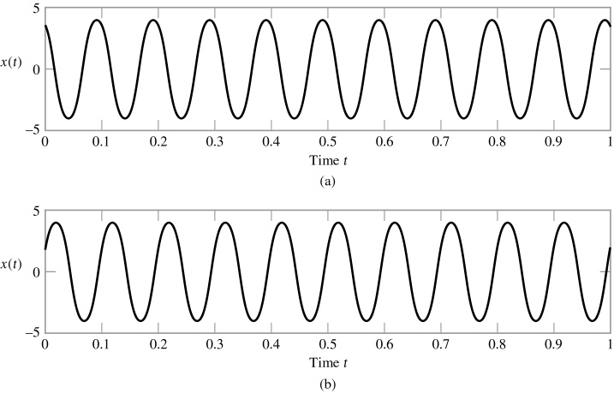

1.6.2 Sinusoidal signals
Figure 1.31 (p. 36)
(a) Sinusoidal signal Acos(ωt + Φ) with phase Φ = +π/6 radians.
(b) Sinusoidal signal Asin(ωt + Φ) with phase Φ = +π/6 radians.
오전 2시 6분

Slide 7
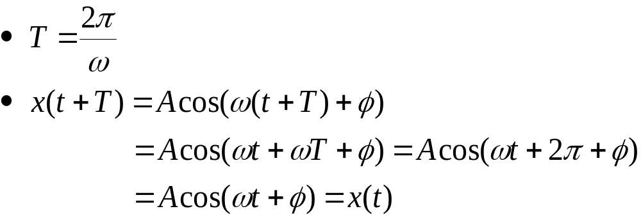
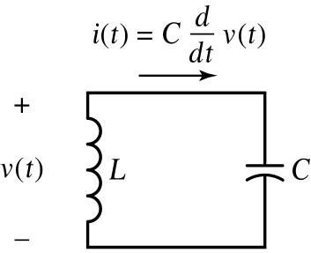
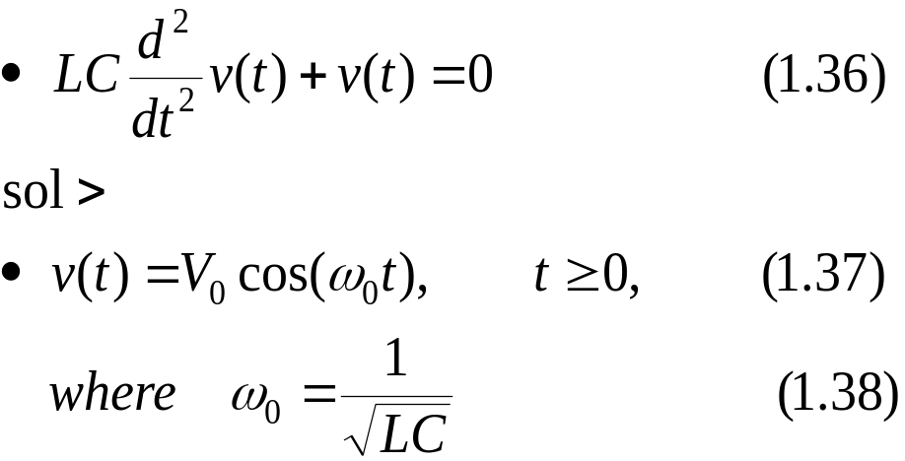
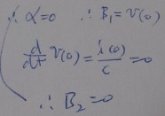
1.6.2 Sinusoidal signals (Cont.)
오전 2시 6분
Notes:
신호 및 시스템

Slide 8
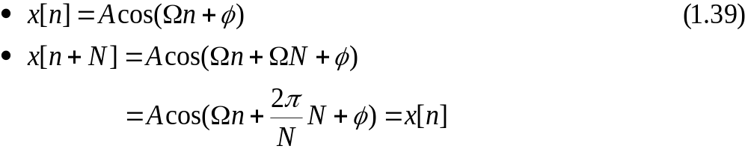
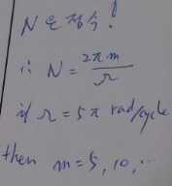
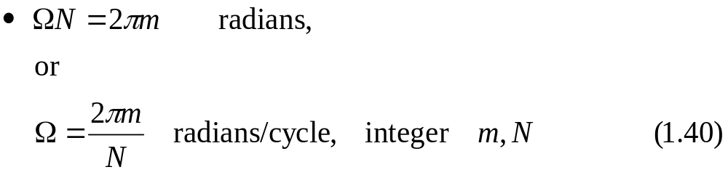
1.6.2 Sinusoidal signals (Cont.)
For discrete-time signals
In general,
: (연속신호와 달리 이산신호의 특수성으로 인해
모든 m에서 주기성은 아님)
오전 2시 6분
Notes:
신호 및 시스템

Slide 9

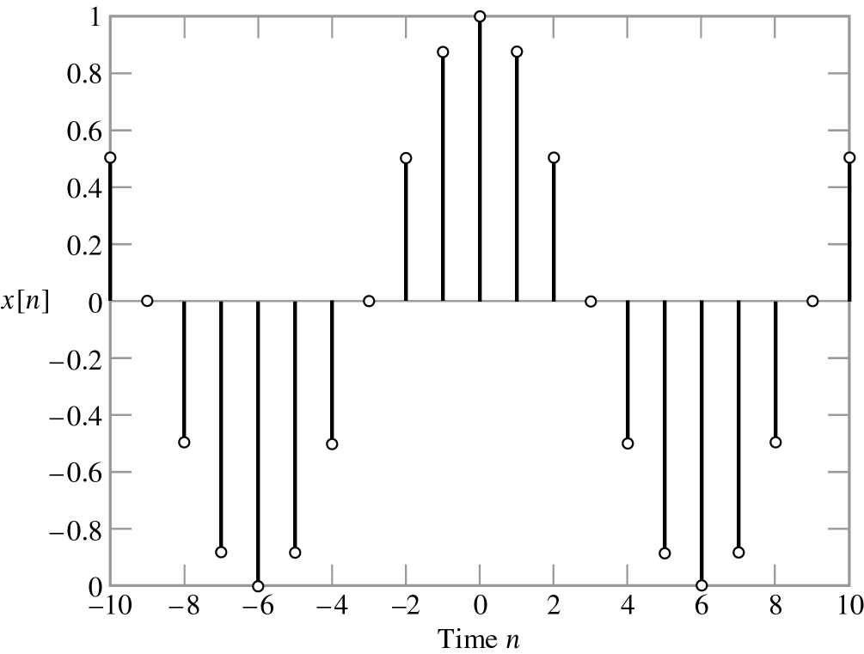
1.6.2 Sinusoidal signals (Cont.)
Figure 1.33 (p. 38)
Discrete-time sinusoidal signal. A=1, φ=0, and N=12
오전 2시 6분

Slide 10
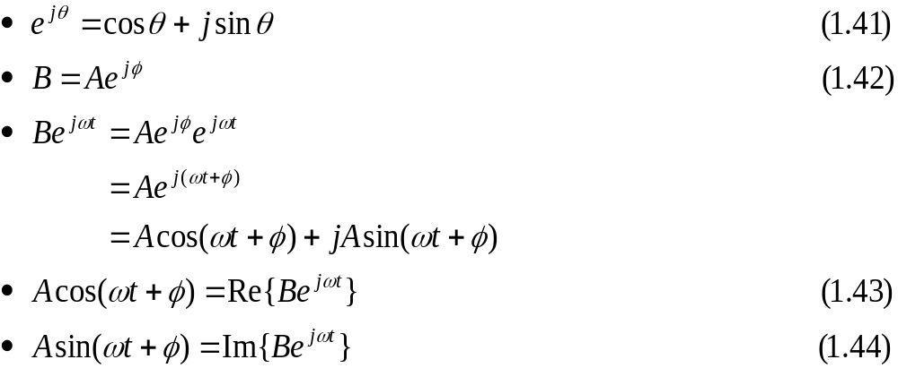
1.6.3 Relation between sinusoidal and complex exponential signals
Using Euler’s identity
오전 2시 6분

Slide 11
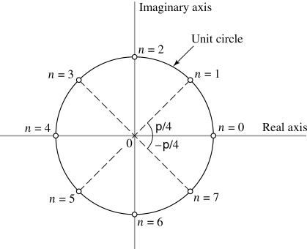
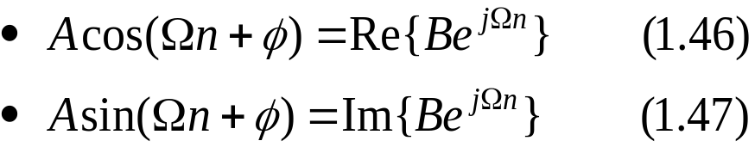


1.6.3 Relation between sinusoidal and complex exponential signals (Cont.)
In the discrete-time case
Figure 1.34 (p. 41)
Complex plane, showing eight
points uniformly distributed on
the unit circle. Ω=π/4 and n=0,1,2,…,7

Slide 12
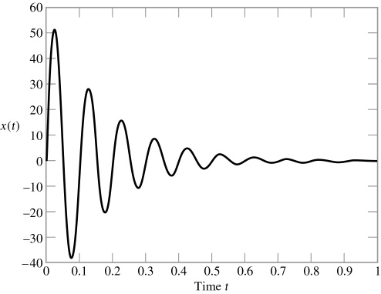
1.6.4 Exponentially damped sinusoidal signals
Figure 1.35 (p. 41)
Exponentially damped sinusoidal signal Ae^{-αt} sin(ωt), with A = 60 and α = 6 and φ=0.

Slide 13
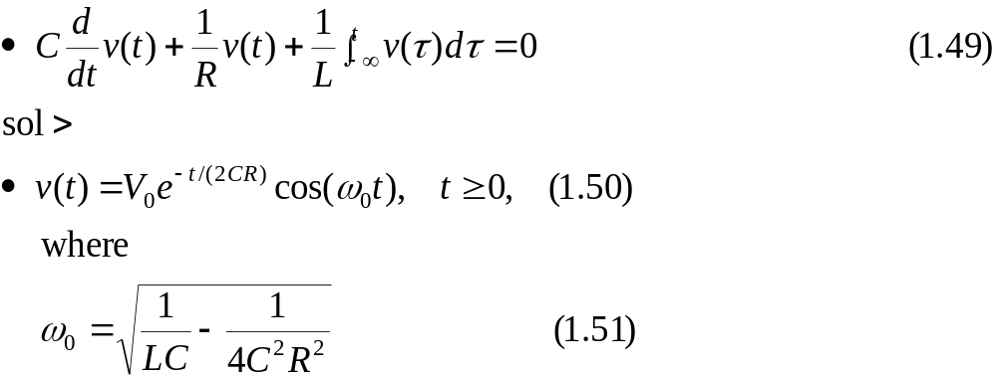
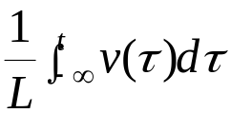
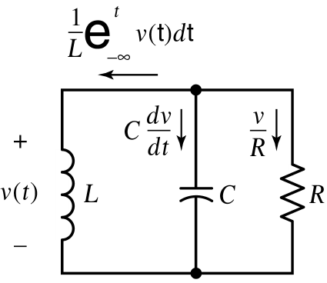
1.6.4 Exponentially damped sinusoidal signals (Cont.)
Figure 1.36 (p. 42)
Parallel LRC circuit, with inductor L, capacitor C, and resistor R
all assumed to be ideal.
Discrete-time version

Slide 14
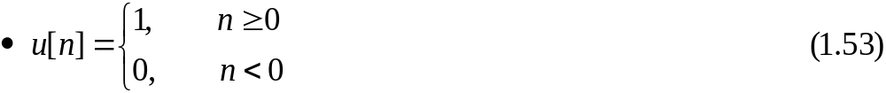
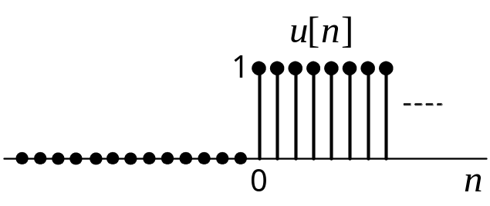
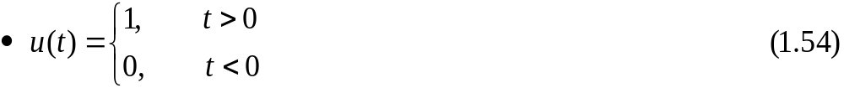
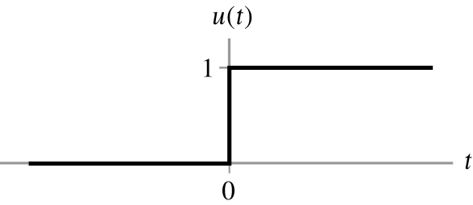
1.6.5 Step function
Unit-step
Figure 1.37 (p. 43)
Discrete-time version of step function of unit amplitude.
Figure 1.38 (p. 44)
Continuous-time version of the unit-step function of unit amplitude.
Ex. 1.8 Rectangular pulse
오전 2시 6분

Slide 15
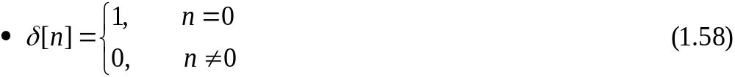
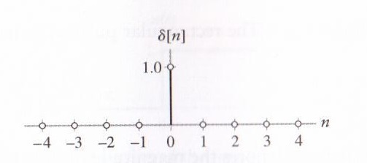
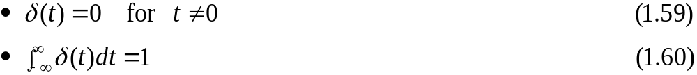
1.6.6 Impulse function
Unit impulse
Figure 1.41 (p. 46)
Discrete-time form of impulse.
Dirac delta function
오전 2시 6분

Slide 16
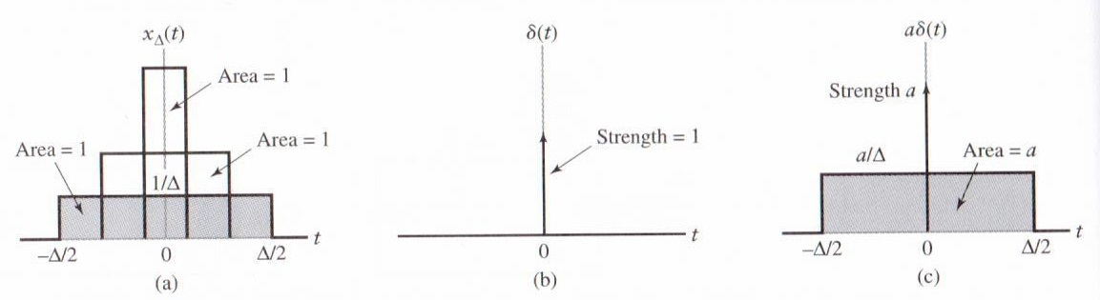
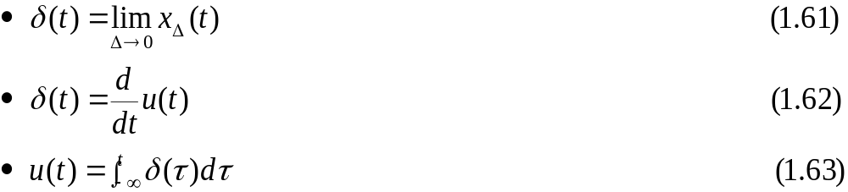
1.6.6 Impulse function (Cont.)
Figure 1.42 (p. 46)
(a) Evolution of a rectangular pulse of unit area into an impulse of unit strength (i.e., unit impulse).
(b) Graphical symbol for unit impulse.
(c) Representation of an impulse of strength a that results from allowing the duration Δ of a rectangular pulse of area a to approach zero.
δ(t) and u(t)
오전 2시 6분

Slide 17
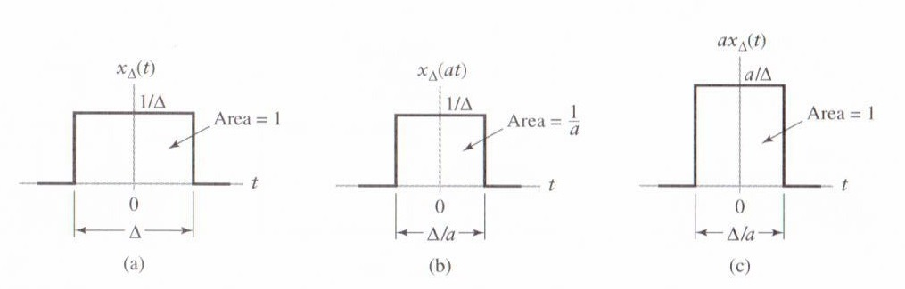
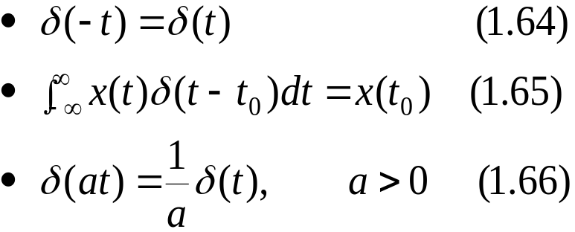
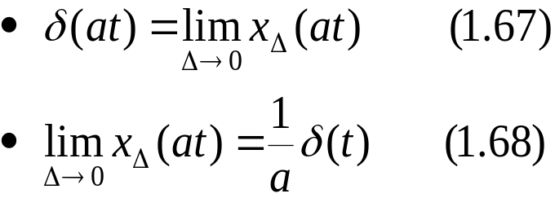
1.6.6 Impulse function (Cont.)
at)
Figure 1.44 (p. 48)
Steps involved in proving the time-scaling property of the unit impulse.
(a) Rectangular pulse x_{Δ}(t) of amplitude 1/Δ and duration Δ, symmetric about the origin.
(b) Pulse x_{Δ}(t) compressed by factor a.
(c) Amplitude scaling of the compressed pulse, restoring it to unit area.
오전 2시 6분
Notes:
신호 및 시스템

Slide 18

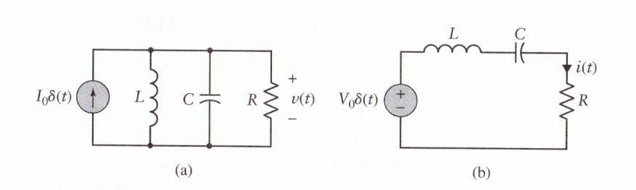
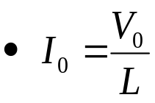
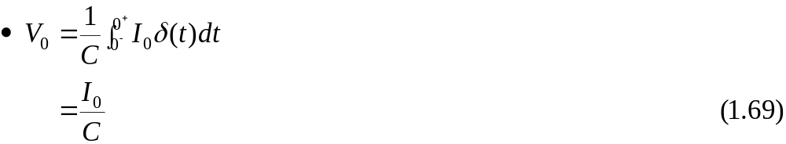
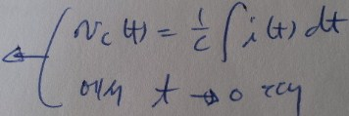
1.6.6 Impulse function (Cont.)
Figure 1.45 (p. 49)
(a) Parallel LRC circuit driven by an impulsive current signal.
(b) Series LRC circuit driven by an impulsive voltage signal.
In Fig. 1.45 (a), at t = 0, L:open, C:short
* 병렬-직렬 쌍대성
C <--> L
I <--> V
R <-- > 1/R(=G)
오전 2시 6분
Notes:
신호 및 시스템

Slide 19
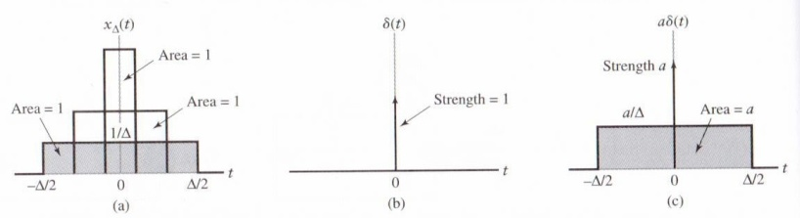
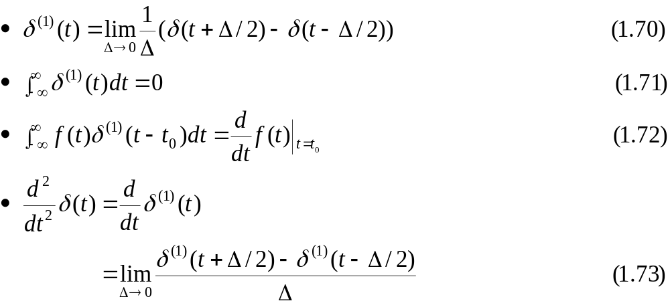
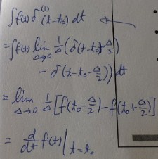
1.6.7 Derivatives of the impulse
From Fig.1.42(a)
(1/Δ)u(t+Δ/2)- (1/Δ)u(t-Δ/2)  미분
오전 2시 6분

Slide 20
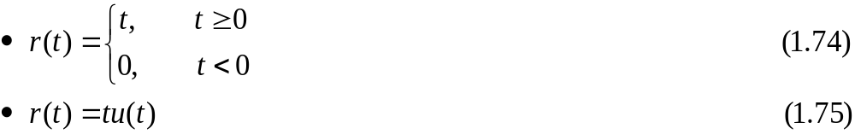
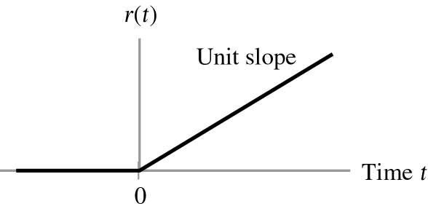
1.6.8 Ramp function
Continuous-time version
Figure 1.46 (p. 51)
Ramp function of unit slope.
: 단위계단 함수를 적분해도 됨
오전 2시 6분
Notes:
신호 및 시스템

Slide 21
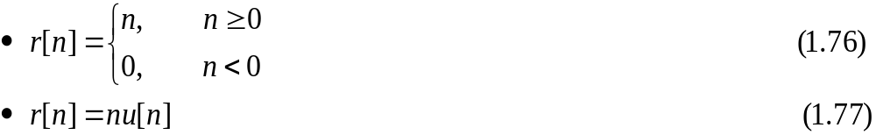
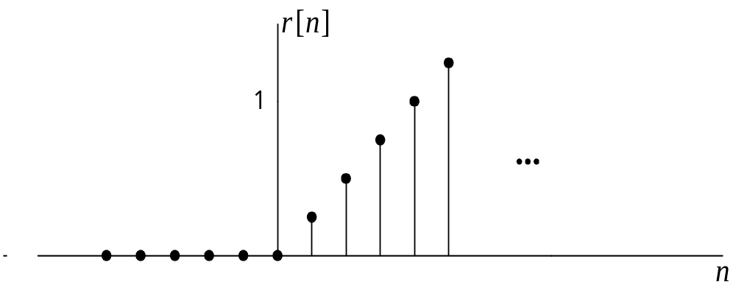

1.6.8 Ramp function (Cont.)
Discrete-time version
Figure 1.47 (p. 52)
Discrete-time version of the ramp function.
오전 2시 6분

Slide 22
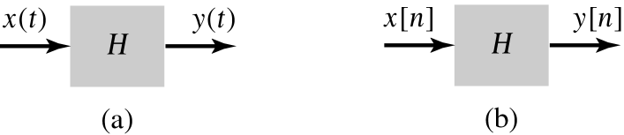

1.7 Systems viewed as interconnections of operations
Operator H
Figure 1.49 (p. 53)
Block diagram representation of operator H for (a) continuous time and
(b) discrete time.
Figure 1.50 (p. 54)
Discrete-time-shift operator S^{k}, operating on the discrete-time signal x[n] to produce x[n – k].
오전 2시 6분

Slide 23
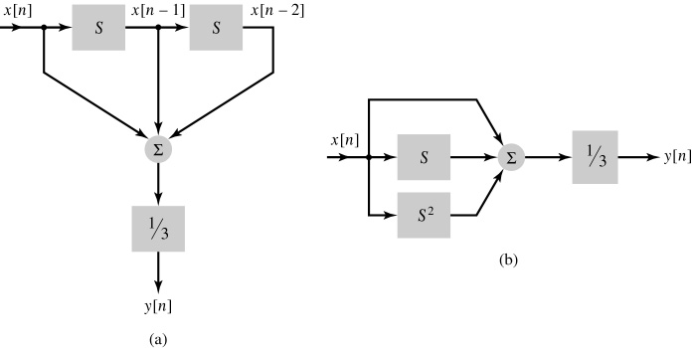
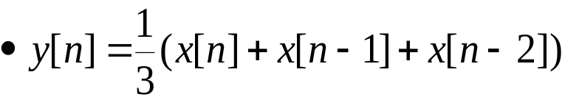
1.7 Systems viewed as interconnections of operations (Cont.)
Figure 1.51 (p. 54)
Two different (but equivalent) implementations of the moving-average system: (a) cascade form of implementation and (b) parallel form of implementation.
오전 2시 6분
Notes:
신호 및 시스템

Slide 24
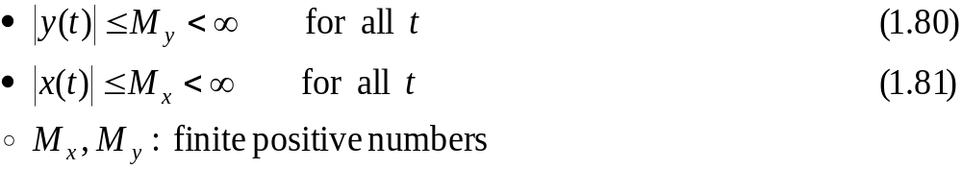
1.8 Properties of systems
1.8.1 Stability
Bounded-input, bounded-output (BIBO) stable
Unstable system : Fig. 1.52
: 유한 입력에 대한 유한 출력
Notes:
신호 및 시스템

Slide 25

1.8 Properties of systems (Cont.)
1.8.1 Stability (Cont.)
Figure 1.52 (p. 56)
Dramatic photographs showing the collapse of the Tacoma Narrows suspension bridge on November 7, 1940.
(a) Photograph showing the twisting motion of the bridge’s center span just before failure.
(b) A few minutes after the first piece of concrete fell, this second photograph shows a 600-ft section of the bridge breaking out of the suspension span and turning upside down as it crashed in Puget Sound, Washington. Note the car in the top right-hand corner of the photograph.
(Courtesy of the Smithsonian Institution.)

Slide 26



1.8 Properties of systems (Cont.)
1.8.2 Memory
Memory : output signal depends on past or future values of the input signal
  R : memoryless
  L : memory
Moving average system : memory
Memoryless

Slide 27

1.8 Properties of systems (Cont.)
1.8.3 Causality
Causal
  Present value of the output signal depends only on the present or past values of the input signal
Noncausal
  Present value of the output signal depends on one or more future values of the input signal
The causality is required for a system to be capable of operating in real time.
오전 2시 6분
Notes:
:
신호 및 시스템

Slide 28


1.8 Properties of systems (Cont.)
1.8.4 Invertibility
Invertible : input of the system can be recovered from the output
  ex) equalizer
Figure 1.54 (p. 59)
The notion of system invertibility. The second operator H^{inv} is the inverse of the first operator H. Hence, the input x(t) is passed through the cascade correction of H and H^{inv} completely unchanged.
오전 2시 6분

Slide 29


1.8 Properties of systems (Cont.)
1.8.5 Time invariance
Time-invariant : if time delay or time advance of the input signal leads to an identical time shift in the output signal
Figure 1.55 (p. 61)
The notion of time invariance. (a) Time-shift operator S^{t0} preceding operator H. (b) Time-shift operator S^{t0} following operator H. These two situations are equivalent, provided that H is time invariant.
오전 2시 6분

Slide 30

1.8 Properties of systems (Cont.)
1.8.5 Time invariance (Cont.)
Figure 1.55 (p. 61)
The notion of time invariance. (a) Time-shift operator S^{t0} preceding operator H. (b) Time-shift operator S^{t0} following operator H. These two situations are equivalent, provided that H is time invariant.
Fig. 1.55 (b)
From Eqs. (1.83) and (1.84)
: 교환법칙
오전 2시 6분
Notes:
신호 및 시스템

Slide 31




1.8 Properties of systems (Cont.)
1.8.6 Linearity
Linear: Satisfies the two properties of superposition and homogeneity
  system input :
  output :
  linear system :

Slide 32



1.8 Properties of systems (Cont.)
1.8.6 Linearity (Cont.)
From Eqs. (1.87) and (1.88)
오전 2시 6분

Slide 33


1.8 Properties of systems (Cont.)
1.8.6 Linearity (Cont.)
Figure 1.56 (p. 64)
The linearity property of a system. (a) The combined operation of amplitude scaling and summation precedes the operator H for multiple inputs. (b) The operator H precedes amplitude scaling for each input; the resulting outputs are summed to produce the overall output y(t). If these two configurations produce the same output y(t), the operator H is linear.
오전 2시 6분

Slide 34

1.9 Noise
Unwanted signals
  External sources of noise : atmospheric, galactic, human-made noise, etc.
  Internal sources of noise : electrical noise
    Figure 1.60 (p. 68)
    Sample waveform of electrical noise generated by a thermionic diode with a heated cathode. Note that the time-averaged value of the noise voltage displayed is approximately zero.
Inability of complete descriptions of noiselike phenomena
  Insufficient knowledge about the physical laws responsible for the generation of noise
  Complicate mechanisms responsible for the generation of noise
  Using an average characterization of the noiselike phenomenon
오전 2시 6분

Slide 35

1.9 Noise (Cont.)
1.9.1 Thermal noise
Arise from the random motion of electrons in a conductor
  Let v(t) denote the thermal noise voltage
  time-averaged value
   2T : total interval observed v(t)
  time-average-squared value
   k : Boltzmann’s constant (1.38x10⁻²³ joule per degree kelvin)
  T_{abs}: absolute temperature
  Δf : width of the frequency band

Slide 36



1.9 Noise (Cont.)
1.9.1 Thermal noise (Cont.)
Figure 1.61 (p. 70)
(a) Thévenin equivalent circuit of a noisy resistor.
(b) Norton equivalent circuit of the same resistor.
From (b)
 G=1/R
오전 2시 6분

Slide 37

1.9 Noise (Cont.)
1.9.2 Other sources of electrical noise
Shot noise
  Arise in electronic devices such as diodes or transistors because of the discrete nature of current flow in those devices
  In a photodetector circuit
    total current
      h(t-τ_{k}) : current pulse generated at time τ_{k}
1/f noise
  Be always present when an electric current is flowing
  It’s time-averaged power at a given frequency is inversely proportional to the frequency
오전 2시 6분

Slide 38






1.10 Theme examples
1.10.1 Differentiation and integration: RC circuits
Differentiator -sharpening-
Figure 1.62 (p. 71)
Simple RC circuit with small time constant, used as an approximator to a differentiator.
If RC is small relative to the rate of change of the v₁(t)
오전 2시 6분

Slide 39





1.10 Theme examples (Cont.)
1.10.1 Differentiation and integration: RC circuits (Cont.)
Integrator -smoothing-
Figure 1.63 (p. 72)
Simple RC circuit with large time constant used as an approximator to an integrator.
If RC is large relative to the average value of the v₂(t)
오전 2시 6분

Slide 40





1.10 Theme examples (Cont.)
1.10.2 MEMS accelerometer
Second-order mass-damper-spring system
  Sum of three forces to the force due to external acceleration Mx(t)
Figure 1.64 (p. 73)
Mechanical lumped model of an accelerometer.
- natural frequency -quality factor
F=Ma
관성에너지
감쇄에너지
스프링에너지
M : [grams]
K : [g/s²]
D : [g/s]
: RLC회로와 유사
Notes:
신호 및 시스템

Slide 41

1.10 Theme examples (Cont.)
1.10.3 Radar range measurement
Radar signal
Figure 1.65 (p. 74)
Periodic train of rectangular RF pulses used for measuring the range of a target. (MHz, GHz)
  c : speed of light
  d : meters from the radar
  τ : round-trip time
  Range resolution : d_{min}=cT₀/2 (smallest target range)
  Range ambiguity : d_{max}=cT/2 (largest target range)
Notes:
신호 및 시스템

Slide 42

1.10 Theme examples (Cont.)
1.10.4 Moving-average systems
N-point moving average system
General moving average system with unequal weighting
Figure 1.66a (p. 75)
(a) Fluctuations in the closing stock price of Intel over a three-year period.

Slide 43


1.10 Theme examples (Cont.)
1.10.4 Moving-average systems (Cont.)
N-point moving average system (Cont.)
Figure 1.66b (p. 76)
(b) Output of a four-point moving-average system. N=4
Figure 1.66c (p. 76)
(c) Output of an eight-point moving-average system. N=8

Slide 44

1.10 Theme examples (Cont.)
1.10.5 Multipath communication channels
  ISI (intersymbol interference) baseband model
Figure 1.67 (p. 77)
Example of multiple propagation paths in a wireless communication environment.
http://www.ktword.co.kr/abbr_view.php?nav=&m_temp1=699&id=712

Slide 45


1.10 Theme examples (Cont.)
1.10.5 Multipath communication channels (Cont.)
Figure 1.68 (p. 78)
Tapped-delay-line model of a linear communication channel, assumed to be time-invariant.

Slide 46

1.10 Theme examples (Cont.)
1.10.5 Multipath communication channels (Cont.)
Common baseband model
T_{diff} : represents the smallest detectable time difference between difference paths
- if P=1
- discrete-time system
- normalized version of the case with P=1
: linearly weighted moving average system
Notes:
신호 및 시스템

Slide 47

1.10 Theme examples (Cont.)
1.10.6 Recursive discrete-time computation
First-order recursive discrete-time filter
Figure 1.69 (p. 79)
Block diagram of first-order recursive discrete-time filter. The operator S shifts the output signal y[n] by one sampling interval, producing y[n – 1]. The feedback coefficient ρ determines the stability of the filter.
Notes:
신호 및 시스템

Slide 48




1.10 Theme examples (Cont.)
1.10.6 Recursive discrete-time computation (Cont.)
First-order recursive discrete-time filter (Cont.)
For k-1=l
- Using Eqs. (1.118) and (1.116)
- Special cases
1. ρ=1 :
2. |ρ|<1 : attenuated
3. |ρ|>1 : amplified
: accumulator
: leaky accumulator
Notes:
신호 및 시스템

Slide 49
Q & A
Thank you …
Notes:
신호 및 시스템

Slide 50


7.4 A General Solution for Step and Natural Responses
[참고]
General solution for natural and step responses of RL and RC circuits
http://www.youtube.com/watch?v=eUDaZcBHO9g
오전 2시 6분
Notes:
신호 및 시스템

Slide 51


8.1 Introduction to the Natural Response of a Parallel RLC Circuit
Characteristic equation, parallel RLC circuit
p7
p13
(coefficient)
[rad/s]
360°=2π rad
1 rad=57.2958°
오전 2시 6분

Slide 52

8.1 Introduction to the Natural Response of a Parallel RLC Circuit
오전 2시 6분

Slide 53

8.2 The Forms of the Natural Response of a Parallel RLC Circuit
오전 2시 6분

Slide 54

8.3 The step response of a parallel RLC circuit
오전 2시 6분

