Slide 1
CH. 2. Time-domain representations of linear time-invariant systems
2.1 Introduction --------------------------------------------------------------------------3
2.2 The convolution sum ---------------------------------------------------------------4
2.3 Convolution sum Evaluation procedure --------------------------------------10
2.4 The convolution integral --------------------------------------------------------14
2.5 Convolution integral evaluation procedure ----------------------------------16
2.6 Interconnections of LTI systems -----------------------------------------------20
2.7 Relations between LTI system properties and the impulse response ---32
2.8 Step response
2.9 Differential and difference equation representations of LTI systems
2.10 Solving differential and difference equations
2.11 Characteristics of systems described by differential and difference equations
2.12 Block diagram representations
2.13 State-variable descriptions of LTI systems

Slide 2
CH. 2. Time-domain representations of linear time-invariant systems (Part 1)
2.1 Introduction
2.2 The convolution sum
2.3 Convolution sum Evaluation procedure
2.4 The convolution integral
2.5 Convolution integral evaluation procedure
2.6 Interconnections of LTI systems
  2.6.1 Parallel Connections of LTI systems
  2.6.2 Cascade Connections of LTI systems
2.7 Relations between LTI system properties and the impulse response
  2.7.1 Memoryless LTI systems
  2.7.2 Causal LTI systems
  2.7.3 Stable LTI systems
  2.7.4 Invertible systems and deconvolution

Slide 3
2.1 Introduction
Relationship between the input and output signals of linear time-invariant (LTI) systems
  Time domain
  Impulse response : system behavior
Output signal : a weighted superposition of time-shifted impulses
  Convolution sum for discrete-time systems
  Convolution integral for continuous-time systems
Linear constant-coefficient differential or difference equation
  Examine for characterizing the input-output behavior of LTI system
Block diagram
  scalar multiplication, addition, time shift (discrete) or integration (continuous)
State-variable description
x(t)
y(t)
h(t)

Slide 4


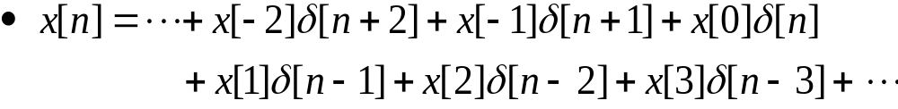
2.2 The convolution sum
Multiplication: signal x[n] and impulse δ[n]
Time shifted impulse sequence
Expression of x[n] using δ[n]
  x[n] : the entire signal
  x[k] : a specific value of x[n] at time k
Rewrite x[n]

Slide 5
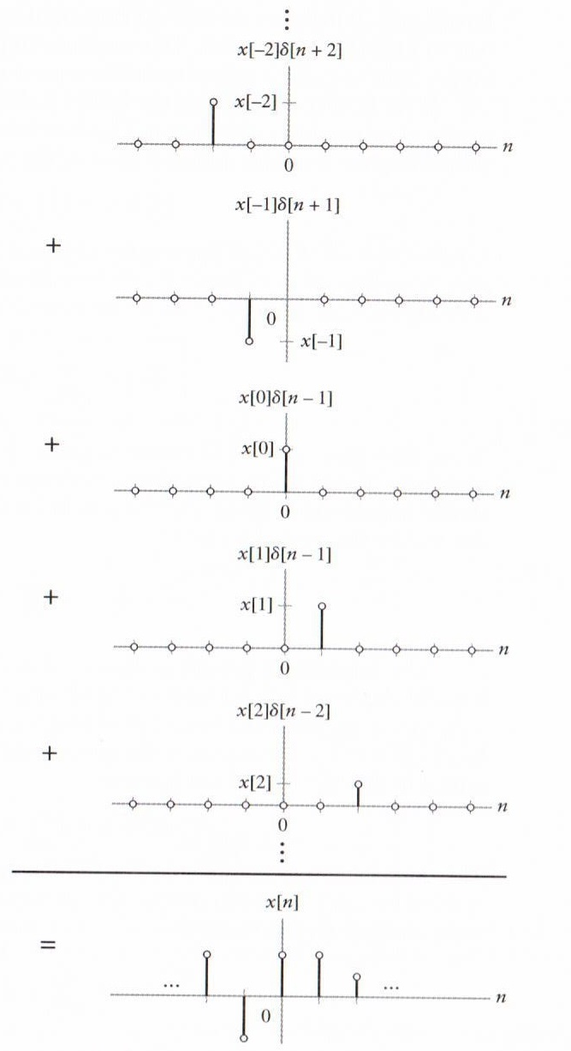
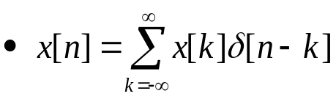
2.2 The convolution sum (Cont.)
]
]
Figure 2.1 (p. 99)
Graphical example illustrating the representation of a signal x[n] as a weighted sum of time-shifted impulses.
Notes:
신호 및 시스템

Slide 6
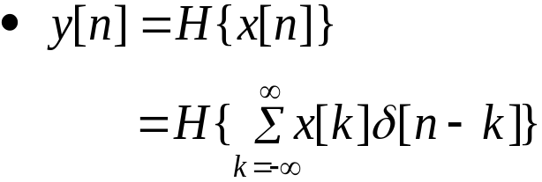
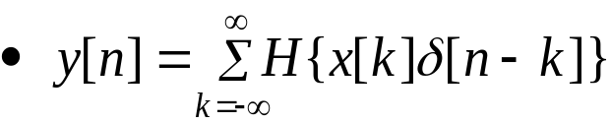
2.2 The convolution sum (Cont.)
System output
  Operator H : system
Using linear property
  n : time index
  x[k] : a constant
If the system is time invariant  LTI system H
  h[n]=H{δ[n]} : impulse response of H
x(t)
y(t)
h(t)

Slide 7

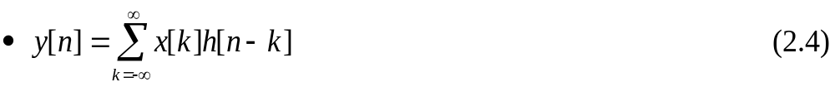

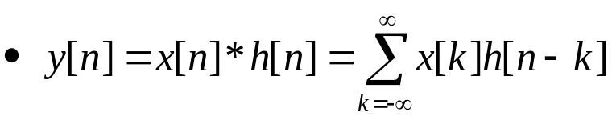
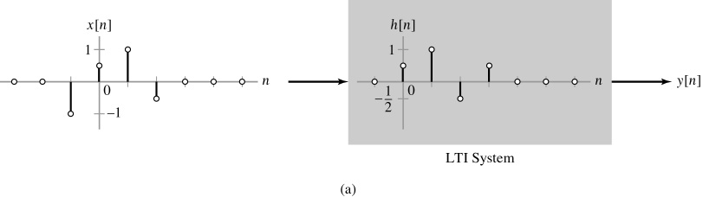
2.2 The convolution sum (Cont.)
The output of an LTI system = a weighted sum of time-shifted impulse response
Using Convolution sum
Figure 2.2a (p. 100)
Illustration of the convolution sum. (a) LTI system with impulse response h[n] and input x[n].

Slide 8
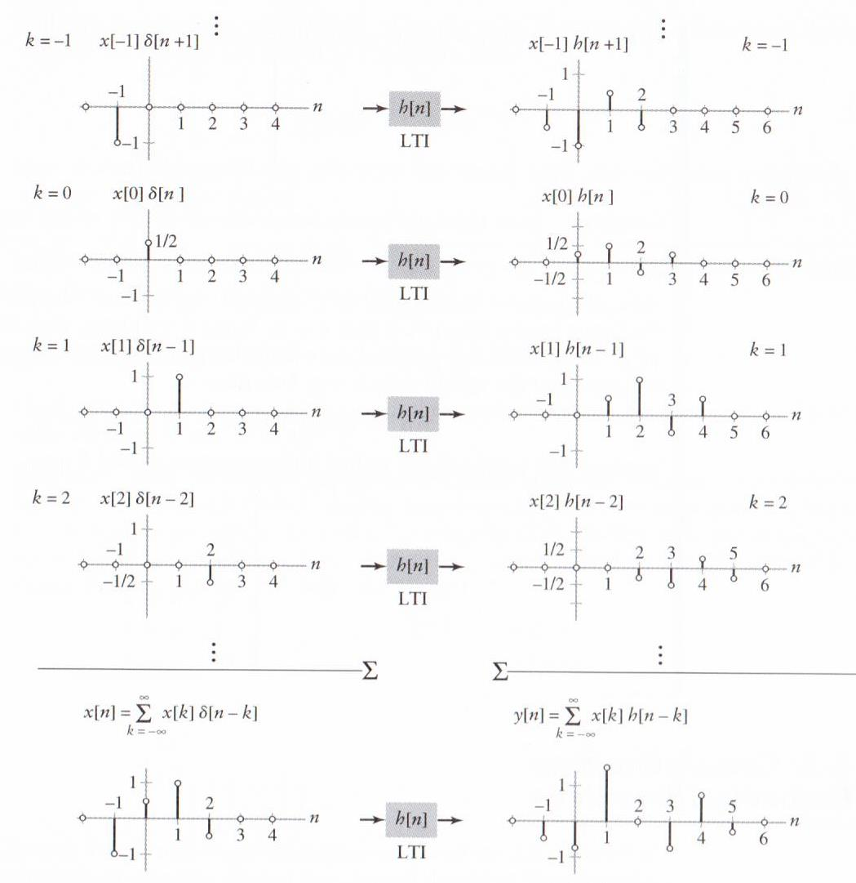
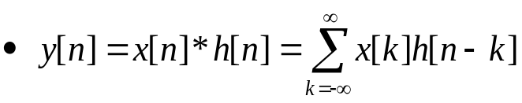
2.2 The convolution sum (Cont.)
Figure 2.2b (p. 101)
(b) The decomposition of the input x[n] into a weighted sum of time-shifted impulses results in an output y[n] given by a weighted sum of time-shifted impulse responses.

Slide 9
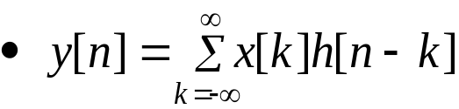
2.2 The convolution sum (Cont.)
The output of the system associated with the kth impulse input
Total output
Ex. 2.1 : multipath communication channel :
Self study
Notes:
신호 및 시스템

Slide 10

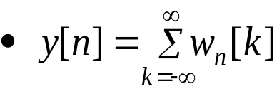
2.3 Convolution sum evaluation procedure
Convolution sum
Define the intermediate signal
Output

Slide 11
2.3 Convolution sum evaluation procedure (Cont.)
Procedure 2.1 : reflect and shift convolution sum evaluation
  Graph both x[k] and h[n-k] as a function of independent variable k. To determine h[n-k], first reflect h[k] about k=0 to obtain h[-k]. Then shift by –n.
  Begin with n large and negative. That is, shift h[-k] to the far left on the time axis.
  Write the mathematical representation for the intermediate signal w_{n}[k].
  Increase the shift n (i.e., move h[n-k] toward the right) until the mathematical represent for w_{n}[k] changes. The value of n at which the change occurs defines the end of the current interval and the beginning of a new interval.
  Let n be in the new interval. Repeats steps 3 and 4 until all intervals of time shifts and the corresponding mathematical representations for w_{n}[k] are identified. This usually implies increasing n to a very large positive number.
  For each interval of time shifts, sum all the values of the corresponding w_{n}[k] to obtain y[n] on that interval.

Slide 12
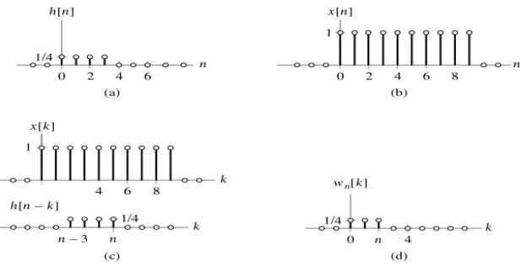
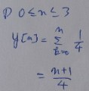
2.3 Convolution sum evaluation procedure (Cont.)
Procedure 2.1 : reflect and shift convolution sum evaluation (Cont.)
Figure 2.4 (p. 106): Evaluation of the convolution sum for Example 2.3.
(a) The system impulse response h[n].
(b) The input signal x[n].
(c) The input above the reflected and time-shifted impulse response
h[n – k], depicted as a function of k.
(d) The product signal w_{n}[k] for the interval of shifts 0 ≤ n ≤ 3.

Slide 13
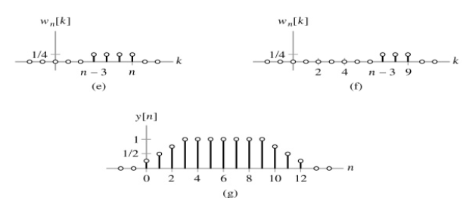
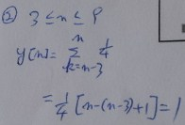
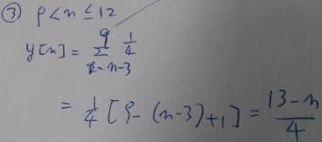
2.3 Convolution sum evaluation procedure (Cont.)
Procedure 2.1 : reflect and shift convolution sum evaluation (Cont.)
Figure 2.4 (p. 106)
Evaluation of the convolution sum for Example 2.3.
(e) The product signal w_{n}[k] for the interval of shifts 3 < n ≤ 9.
(f) The product signal w_{n}[k] for the interval of shifts 9 < n ≤ 12.
(g) The output y[n].
<
http://lpsa.swarthmore.edu/Convolution/Convolution.html
https://www.youtube.com/watch?v=_vyke3vF4Nk
Notes:
신호 및 시스템

Slide 14
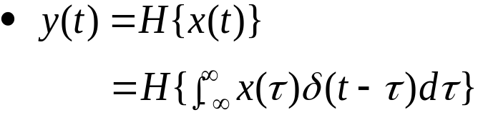
2.4 The convolution integral
Weighted superposition of time-shifted impulses:
Output
Using linearity property
Notes:
신호 및 시스템

Slide 15
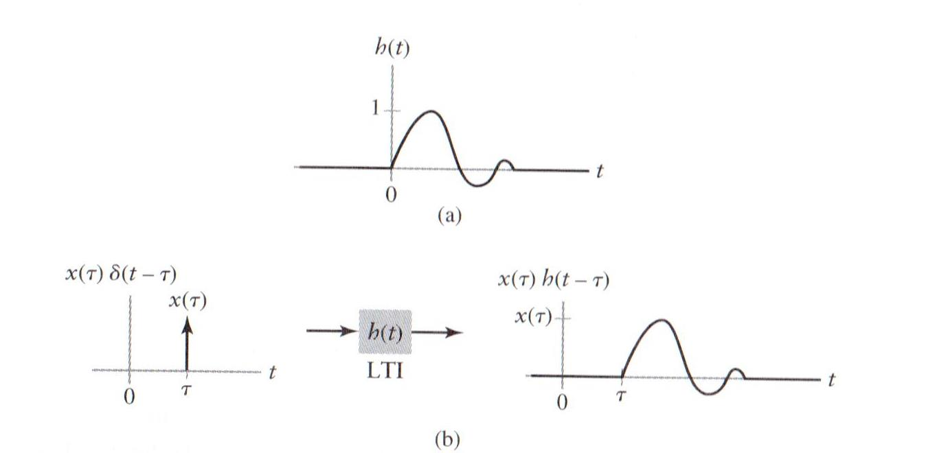


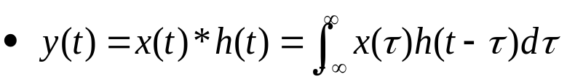
2.4 The convolution integral (Cont.)
If the system is also time-invariant
Figure 2.9 (p. 115)
(a) Impulse response of an LTI system H. (b) The output of an LTI system to a time-shifted and amplitude-scaled impulse is a time-shifted and amplitude-scaled impulse response.
Output can be found by substituting Eq. (2.11) into (2.10)
Convolution integral is denoted by the symbol *
Notes:
신호 및 시스템

Slide 16

2.5 Convolution integral evaluation procedure
Convolution integral
Intermediate signal
Output

Slide 17
2.5 Convolution integral evaluation procedure(Cont.)
Procedure 2.2 : reflect-and-shift convolution integral evaluation
  Graph both x(τ) and h(t-τ) as a function of independent variable τ. To determine h(t-τ), first reflect h(τ) about τ=0 to obtain h(-τ). Then shift h(-τ), by –t.
  Begin with the shift t large and negative, that is, shift h(-τ) to the far left on the time axis.
  Write the mathematical representation for the intermediate signal w_{t}(τ).
  Increase the shift t by moving h(t-τ) towards the right until the mathematical representation of w_{t}(τ) changes. The value of t at which the change occurs defines the end of the current set and the beginning of a new set.
  Let t be in the new interval. Repeats steps 3 and 4 until all sets of shifts t and the corresponding mathematical representations of w_{t}(τ) are identified. This usually implies increasing t to a large positive value.
  For each set of time shifts t, integrate w_{t}(τ) from τ=−∞ to τ=∞ to obtain y(t).

Slide 18
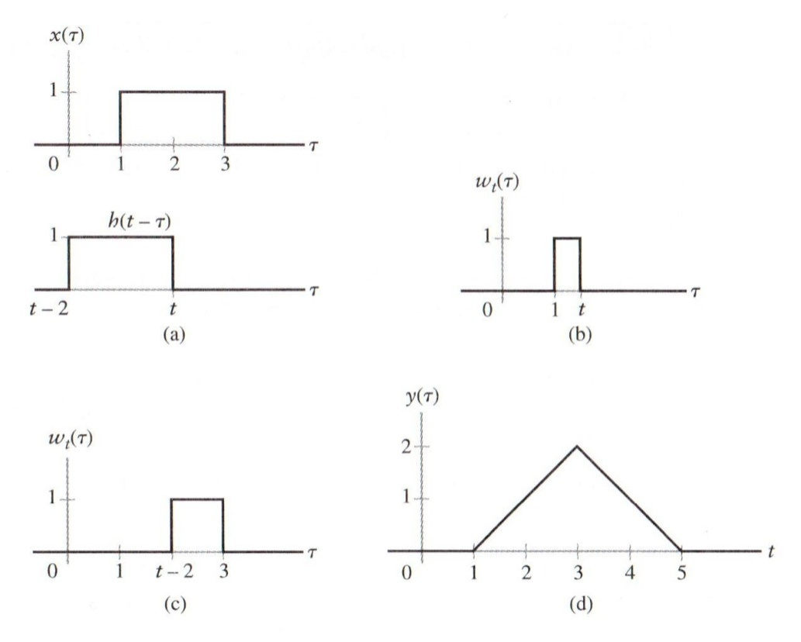
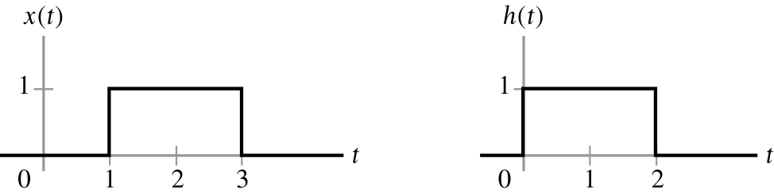


2.5 Convolution integral evaluation procedure(Cont.)
Procedure 2.2 : reflect-and-shift convolution integral evaluation (Cont.)
Figure 2.11 (p. 118)
Evaluation of the convolution integral for Example 2.6.
(a) The input x(τ) depicted above the reflected and time-shifted impulse response. (b) The product signal w_{t}(τ) for 1 ≤ t < 3. (c) The product signal w_{t}(τ) for 3 ≤ t < 5. (d) The system output y(t).

Slide 19
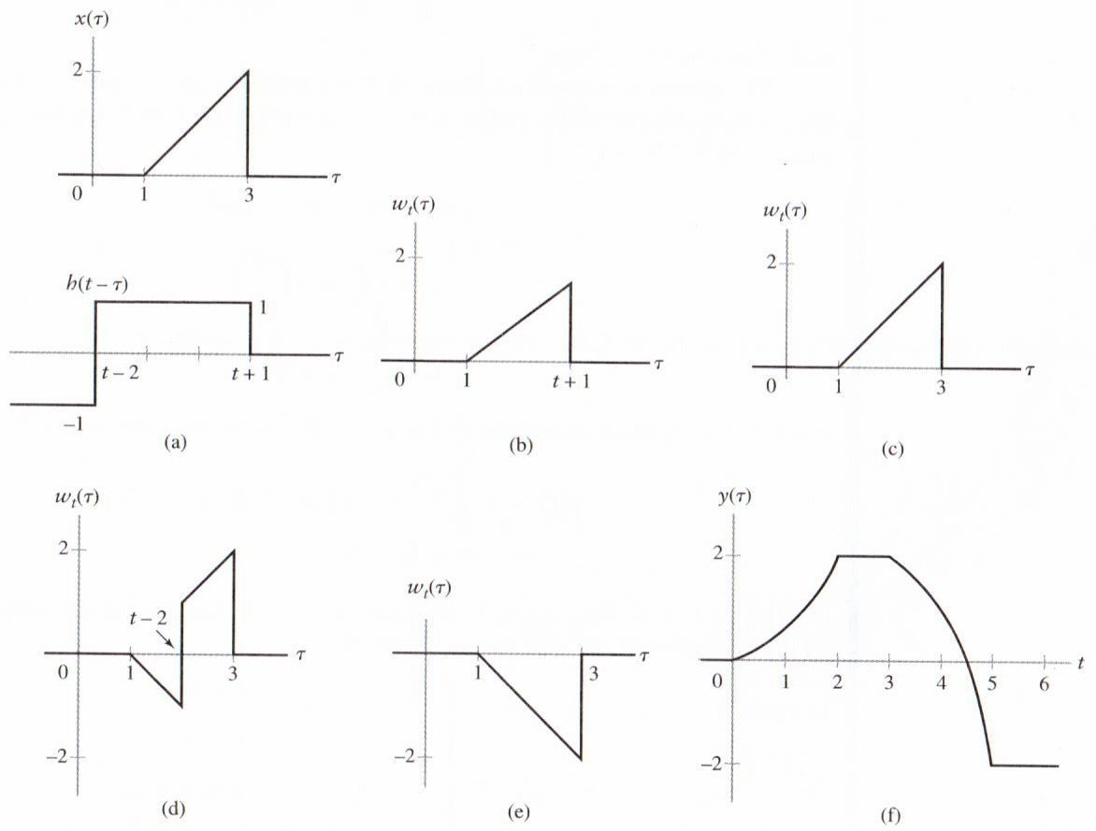
2.5 Convolution integral evaluation procedure(Cont.)
Example 2.8
Figure 2.14 (p. 121)
Evaluation of the convolution integral for Example 2.8. (a) The input x(τ) superimposed on the reflected and time-shifted impulse response h(t –τ), depicted as a function of τ. (b) The product signal w_{t}(τ) for 0 ≤ t < 2. (c) The product signal w_{t}(τ) for 2 ≤ t < 3. (d) The product signal w_{t}(τ) for 3 ≤ t < 5. (e) The product signal w_{t}(τ) for t ≥ 5. The system output y(t).
http://lpsa.swarthmore.edu/Convolution/Convolution.html

Slide 20
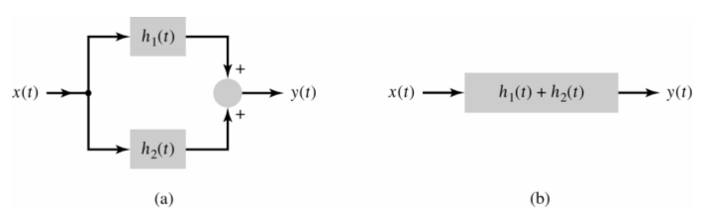

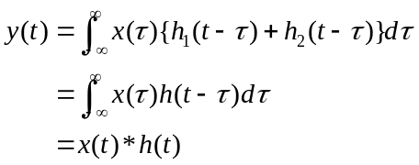
2.6 Interconnections of LTI systems
2.6.1 Parallel Connections of LTI systems
Distributive property
Figure 2.18 (p. 128)
Interconnection of two LTI systems. (a) Parallel connection of two systems. (b) Equivalent system.
The impulse response of the sum of their individual impulse response.
  Continuous-time case
  Discrete-time case
h(t )

Slide 21
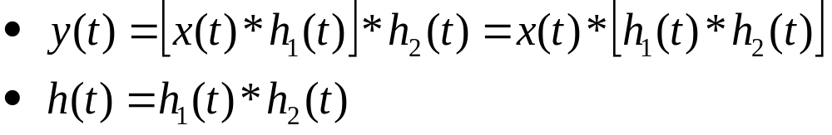
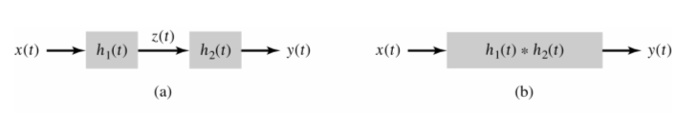
2.6 Interconnections of LTI systems (Cont.)
2.6.2 Cascade Connections of LTI systems
Associative property
  The impulse response of an equivalent system representing two LTI systems connected in cascade is the convolution of their individual impulse responses.
Figure 2.19 (p. 128)
Interconnection of two LTI systems. (a) Cascade connection of two systems. (b) Equivalent system.
  Discrete-time case

Slide 22
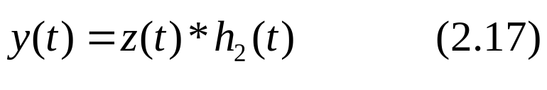
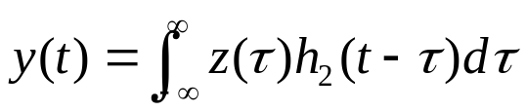
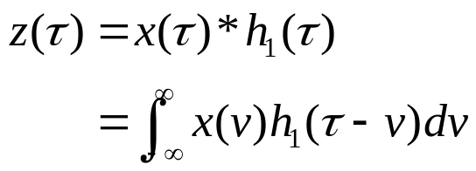
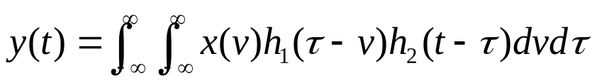

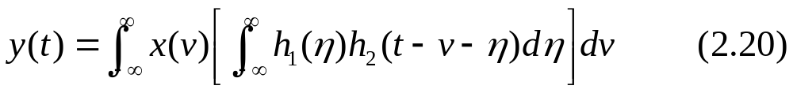
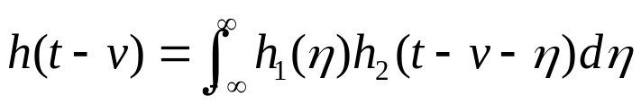
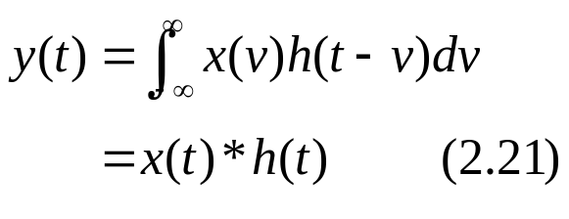
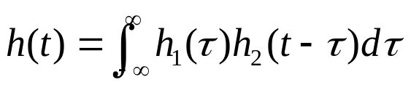

증)
Notes:
신호 및 시스템

Slide 23




2.6 Interconnections of LTI systems (Cont.)
2.6.2 Cascade Connections of LTI systems (Cont.)
Commutative property
  The output of a cascade combination of LTI systems is independent of the order in which the systems are connected.
Figure 2.19 (p. 128)
Interconnection of two LTI systems. (a) Cascade connection of two systems. (c) Equivalent system: Interchange system order.
  Discrete-time case.

Slide 24

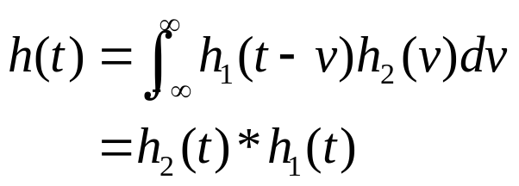

증)

Slide 25
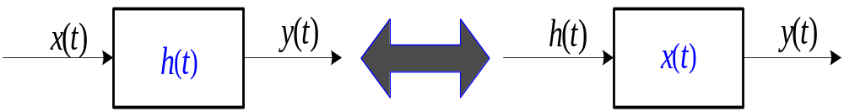

2.6 Interconnections of LTI systems (Cont.)
2.6.2 Cascade Connections of LTI systems (Cont.)
Commutative property (Cont.)
  The output of an LTI system with impulse response h(t) for the input x(t) is the same as that with impulse response x(t) for the input h(t).

Slide 26

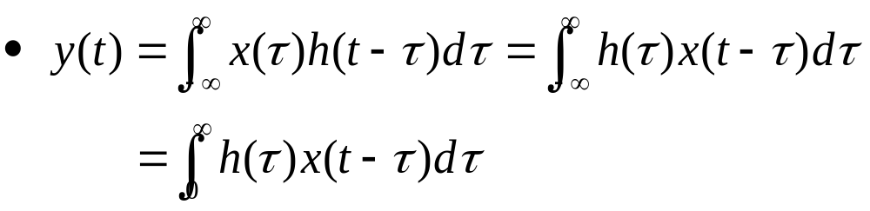
2.6 Interconnections of LTI systems (Cont.)
2.6.2 Cascade Connections of LTI systems (Cont.)
Causal LTI system
  The output of the causal system at time t₀ depends only on the input signals generated at time t ≤ t₀.
  Example of causal system
    The system with impulse response u(t)

Slide 27

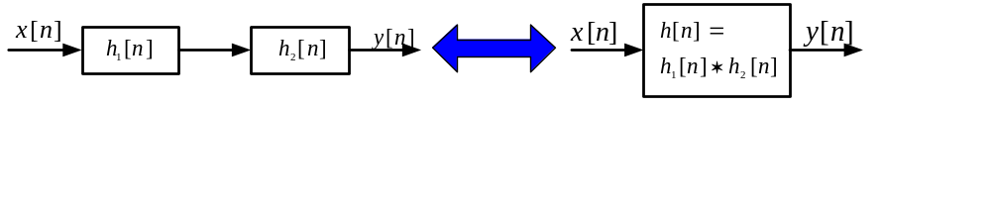
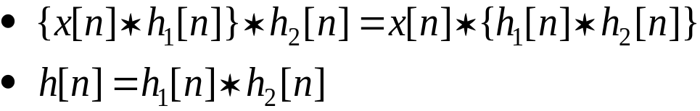
2.6 Interconnections of LTI systems (Cont.)
For Discrete-time:
  Commutative property
  Associative property

Slide 28
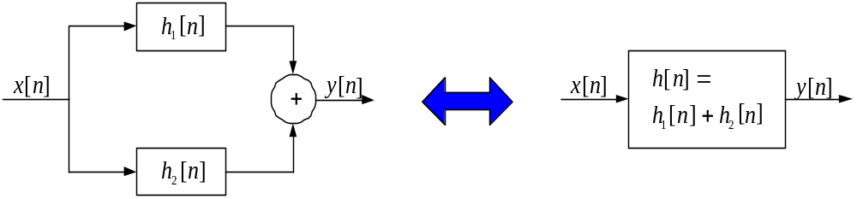
2.6 Interconnections of LTI systems (Cont.)
For Discrete-time: (Cont.)
  Distributive property

Slide 29
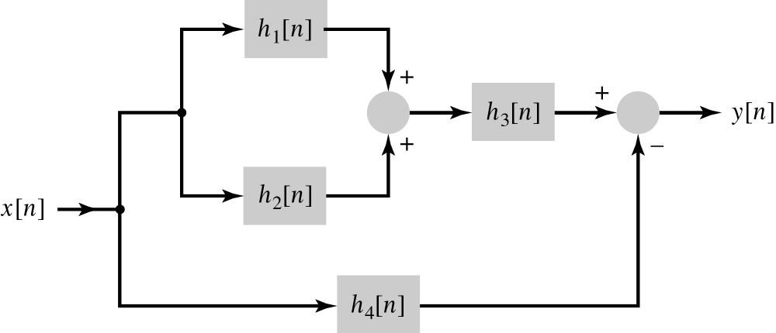
2.6 Interconnections of LTI systems (Cont.)
Example 2.11 Equivalent system to interconnected systems
Figure 2.20 (p. 131)
Interconnection of systems for Example 2.11.

Slide 30
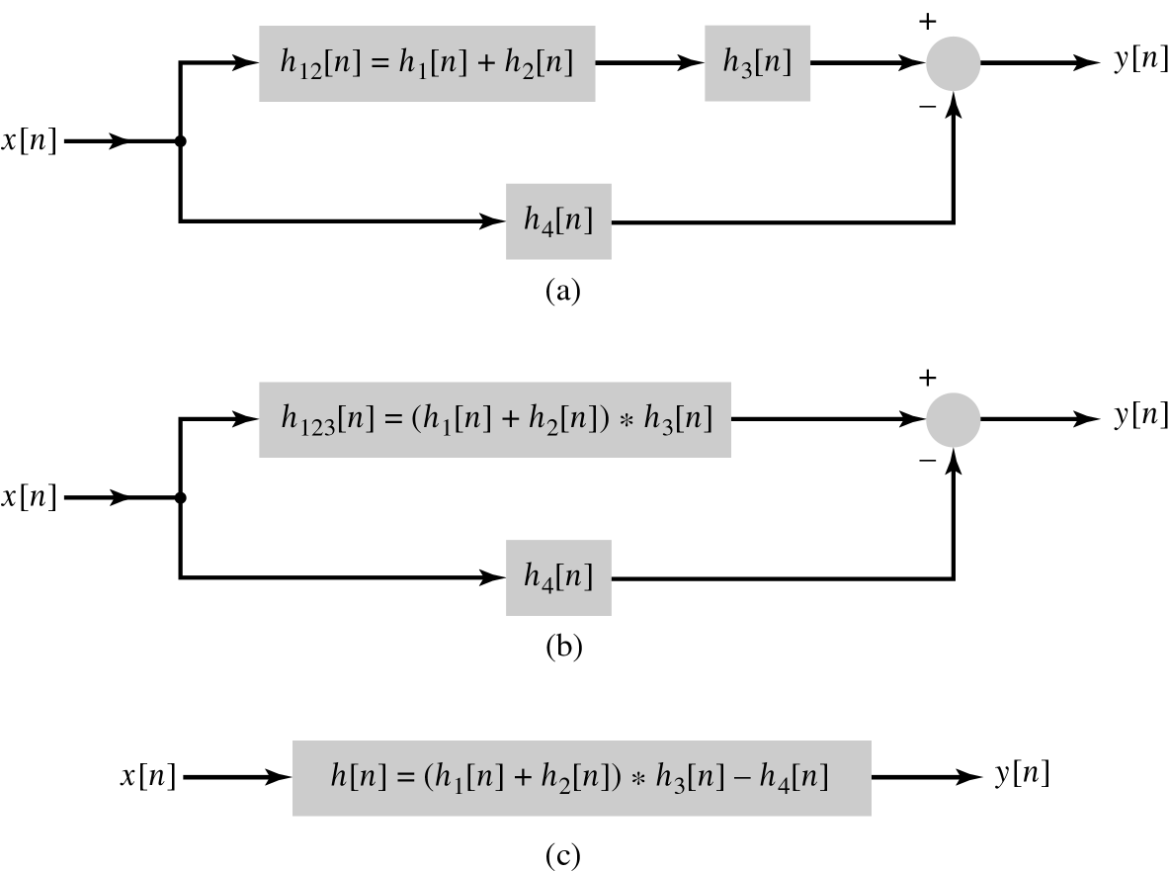
2.6 Interconnections of LTI systems (Cont.)
Example 2.11 Equivalent system to interconnected systems (Cont.)
Figure 2.20 (p. 131)
Interconnection of systems for Example 2.11.

Slide 31
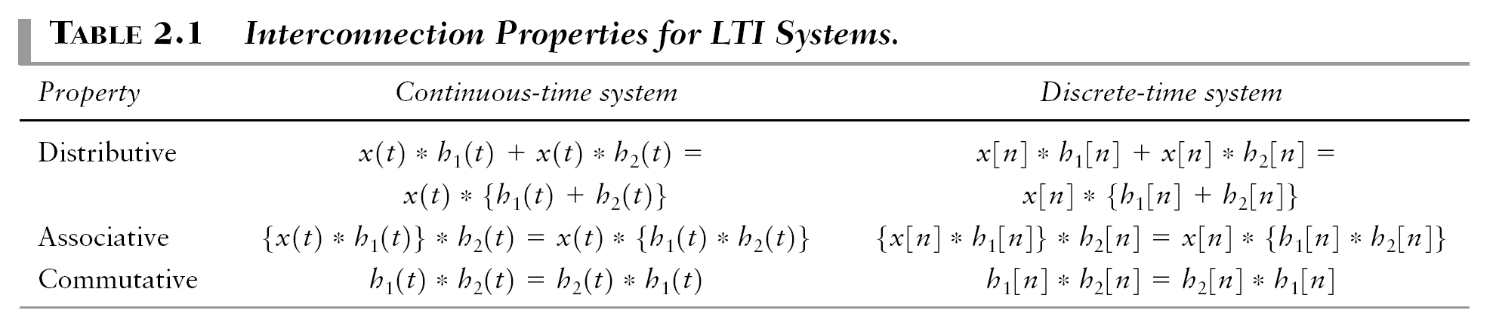
2.6 Interconnections of LTI systems (Cont.)
Table 2.1 : Interconnected properties of LTI systems

Slide 32
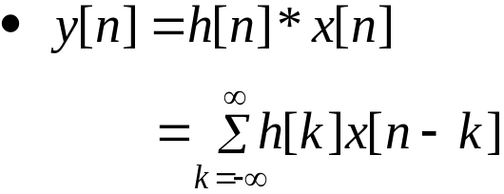
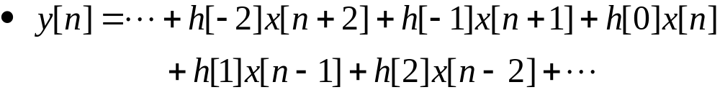



2.7 Relations between LTI system properties and the impulse response
2.7.1 Memoryless LTI systems
Output of discrete LTI system
  For the system to be memoryless system, y[n] must depend only on x[n] and therefore cannot depend on x[n-k] for k≠0 (i.e. h[k]=0 for k≠0)
For Continuous-time system
  Memoryless system

Slide 33
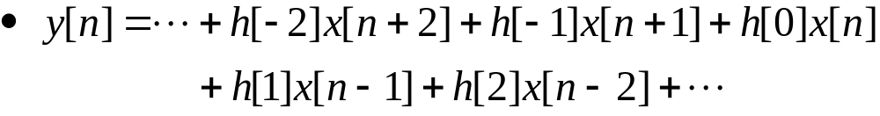
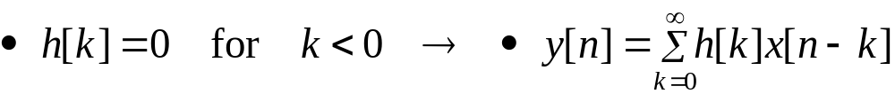
2.7 Relations between LTI system properties and the impulse response (Cont.)
2.7.2 Causal LTI systems
The output of a causal LTI system depends only on past or present values of the input
Convolution sum of a system
  For discrete-time causal system
Convolution integral of a system
  For continuous-time causal system

Slide 34

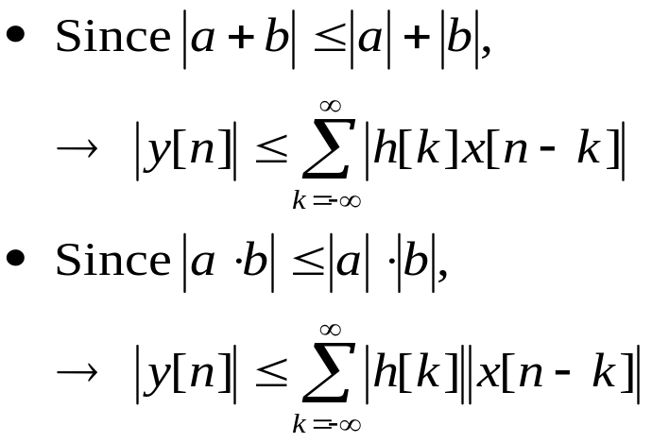
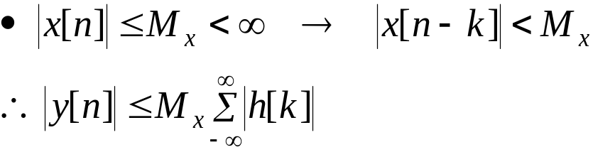
2.7 Relations between LTI system properties and the impulse response (Cont.)
2.7.3 Stable LTI systems
BIBO (bounded input-bounded output)
  The magnitude of the output

Slide 35





2.7 Relations between LTI system properties and the impulse response (Cont.)
2.7.3 Stable LTI systems (Cont.)
If the impulse response of the system is absolutely summable
The impulse response of a stable discrete-time LTI system satisfies the bound
For a continuous-time LTI system
  BIBO stable iff the impulse response is absolutely integrable
If the impulse response of a system is finite, some systems are unstable.

Slide 36


2.7 Relations between LTI system properties and the impulse response (Cont.)
2.7.3 Stable LTI systems (Cont.)
Ex. 12 : properties of the first-order recursive system
  Causal, memoryless, BIBO stable ?
Table 2.2 : Causal, memoryless, stability, invertibility
Self study

Slide 37




2.7 Relations between LTI system properties and the impulse response (Cont.)
2.7.4 Invertible systems and deconvolution
Figure 2.24 (p. 137)
Cascade of LTI system with impulse response h(t) and inverse system with impulse response h⁻¹(t).
From Fig. 2.24
From the above equation
For discrete-time system
: 예제 2.13 풀어보기 바람…
Notes:
신호 및 시스템

Slide 38
Q & A
Thank you …
y(t)=x(t)*h(t)
x(t)
h(t)
y(t)
X(ω)
H(ω)
Y(ω)
Y(ω)=X(ω)H(ω)
Notes:
신호 및 시스템

