Slide 1
CH. 2. Time-domain representations of linear time-invariant systems(cont.)
2.1 Introduction
2.2 The convolution sum
2.3 Convolution sum Evaluation procedure
2.4 The convolution integral
2.5 Convolution integral evaluation procedure
2.6 Interconnections of LTI systems
2.7 Relations between LTI system properties and the impulse response
2.8 Step response -----------------------------------------------------------------3
2.9 Differential and difference equation representations of LTI systems -------------------------------------------------------------------------4
2.10 Solving differential and difference equations ------------------------9
2.11 Characteristics of systems described by differential and difference equations -------------------------------------------------------16
2.12 Block diagram representations ----------------------------------------20
2.13 State-variable descriptions of LTI systems -------------------------26

Slide 2
CH. 2. Time-domain representations of linear time-invariant systems (Part 2)
2.8 Step response
2.9 Differential and difference equation representations of LTI systems
2.10 Solving differential and difference equations
  2.10.1 The homogeneous solution
  2.10.2 The particular solution
  2.10.3 The complete solution
2.11 Characteristics of systems described by differential and difference equations
  2.11.1 The natural response
  2.11.2 The forced response
  2.11.3 The impulse response
  2.11.4 Linearity and time invariance
  2.11.5 Roots of the characteristic equation
2.12 Block diagram representations
2.13 State-variable descriptions of LTI systems
  2.13.1 The state-variable description
  2.13.2 Transformations of the state

Slide 3
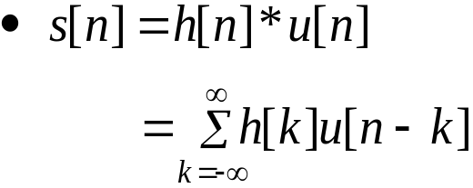
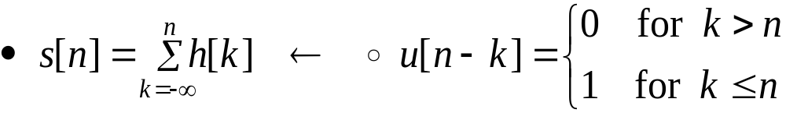


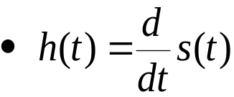
2.8 Step response
x(t)
y(t)
Let s[n] be step response.
For continuous-time system
Expression of impulse response in term of the step response
Example 2.14
h(t)
Self-study
Notes:
Self-study
신호 및 시스템

Slide 4
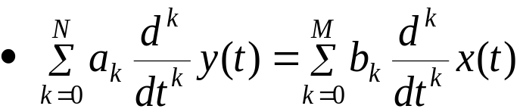
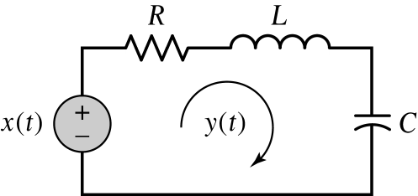
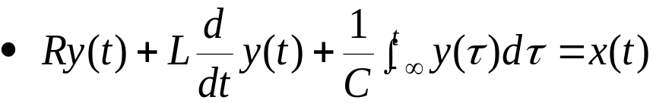
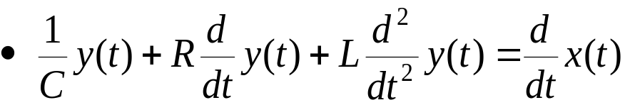
2.9 Differential and difference equation representations of LTI systems
Linear constant-coefficient differential equation
Linear constant-coefficient difference equation
Figure 2.26 (p. 141)
Example of an RLC circuit described by a differential equation.
Summing the voltage drop
Differentiating with respect to t

Slide 5
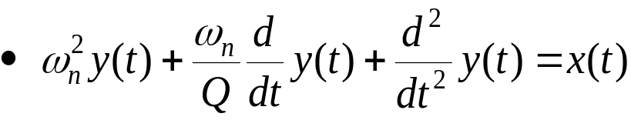

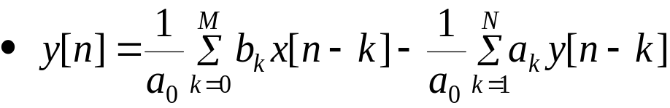
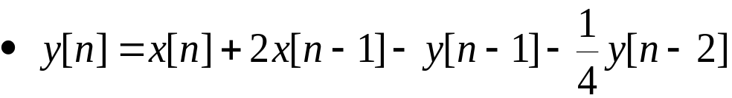
2.9 Differential and difference equation representations of LTI systems (Cont.)
MEMS accelerometer
  y(t): position of the proof mass
  x(t): external acceleration
Example of a second-order difference equation
Rewrite Eq. (2.36)
Rewrite Eq. (2.37)

Slide 6
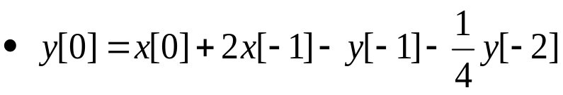
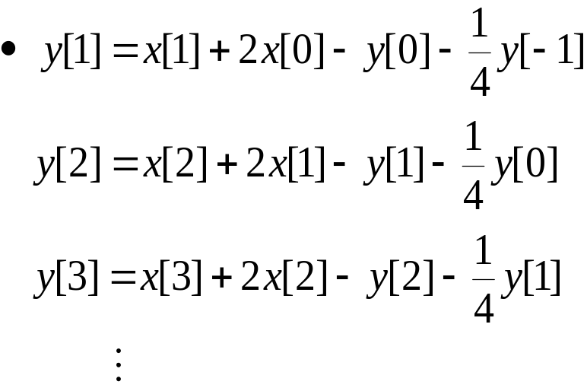

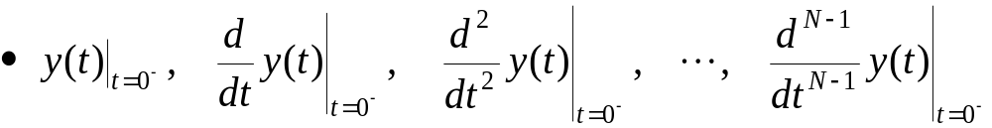
2.9 Differential and difference equation representations of LTI systems (Cont.)
Determine the output
Initial conditions for an Nth-order difference equation
Initial conditions for an Nth-order differential equation

Slide 7
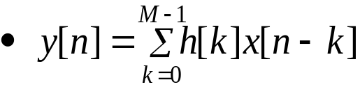
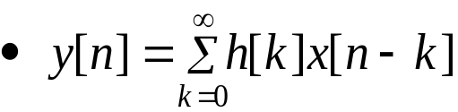
2.9 Differential and difference equation representations of LTI systems (Cont.)
Finite-duration impulse response (FIR) system
  Impulse response
  Output
Infinite-duration impulse response (IIR) system
  Output

Slide 8
2.9 Differential and difference equation representations of LTI systems (Cont.)
Difference equation types
  Recursive system
    Current output of the system depends on not only past or present values of the input but also past values of the output
  Nonrecursive system
    Current output of the system depends only on not only past or present values of the input

Slide 9
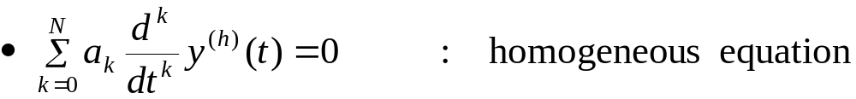
2.10 Solving differential and difference equations
Complete solution
  y= y^{(h)} +y^{(p)}
    homogeneous solution y^{(h)} and particular solution y^{(p)}
2.10.1 The homogeneous solution
  Can be obtained by setting all terms involving the input to zero
For a continuous-time system
  Homogeneous solution
    r_{i} : N roots of the system’s characteristic equation
: x(t)=0
Notes:
신호 및 시스템

Slide 10
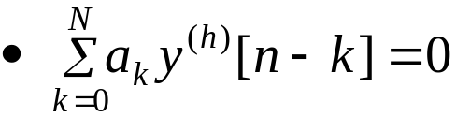
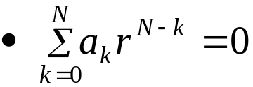


2.10 Solving differential and difference equations (Cont.)
2.10.1 The homogeneous solution(Cont.)
For a discrete-time system
  Homogeneous solution
  r_{i} : N roots
If a root r_{j} is repeated p times, then there are p distinct terms in the solution
  Continuous-time
  Discrete-time

Slide 11
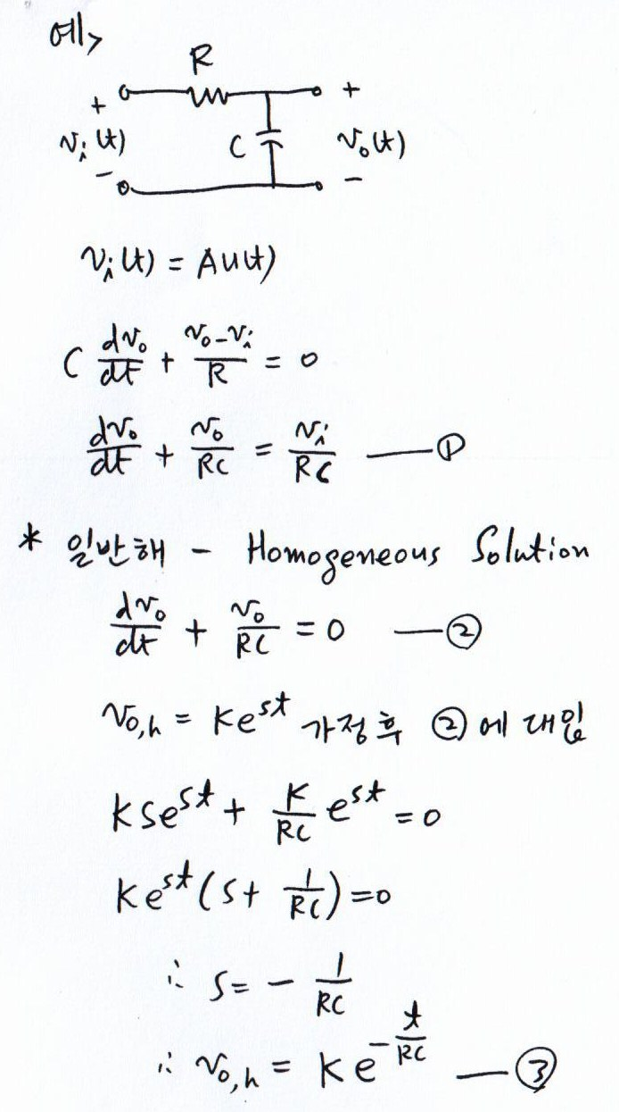
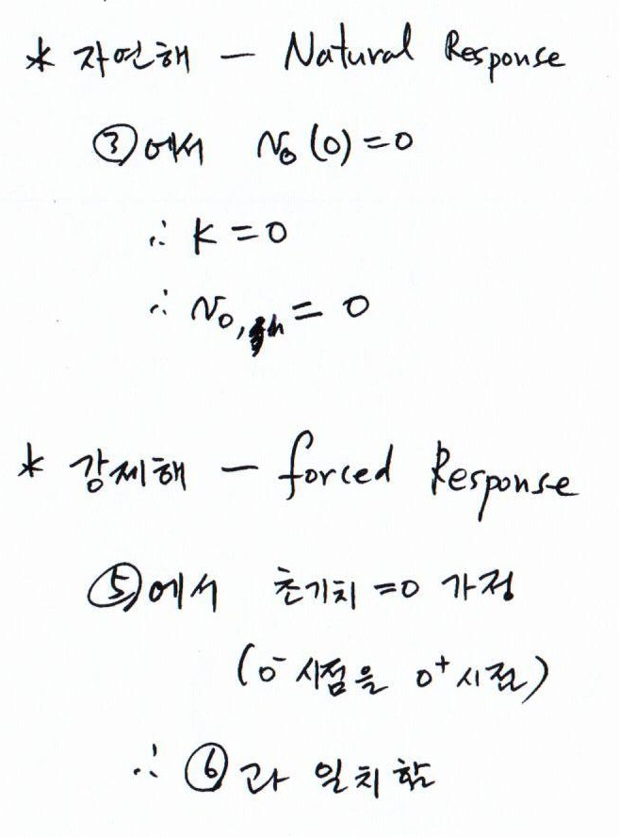
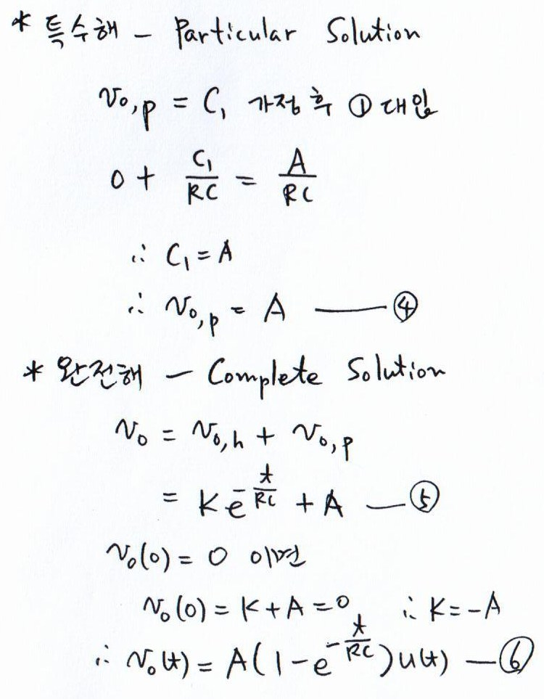
응답
: 다른 초기값
가능
n
응답
: 동차해
Notes:
신호 및 시스템

Slide 12
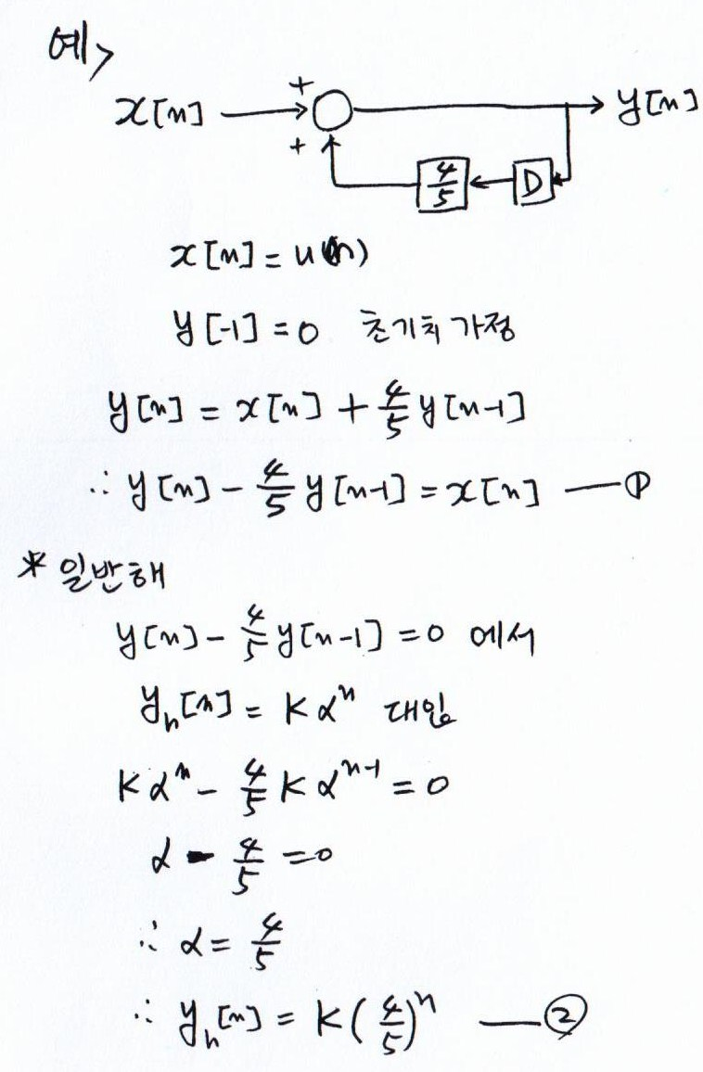
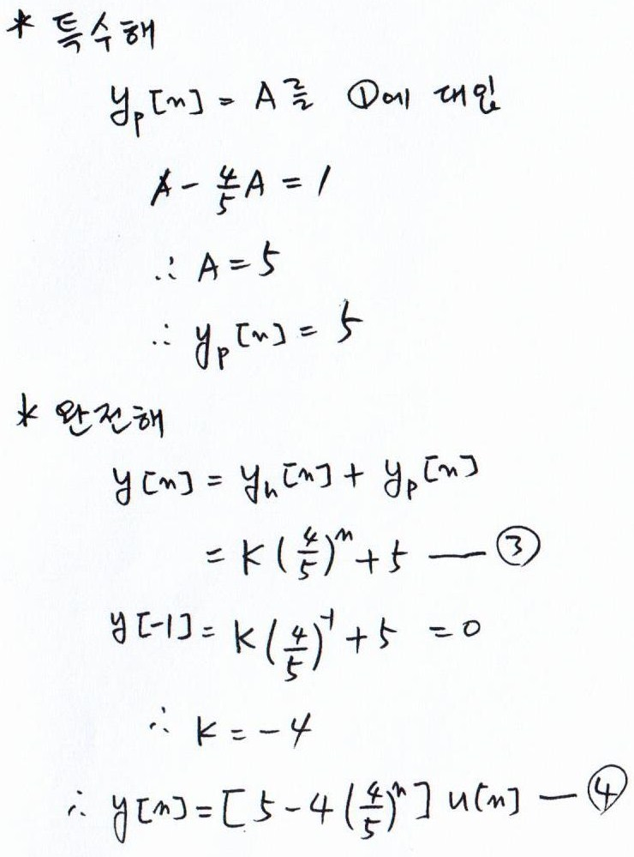
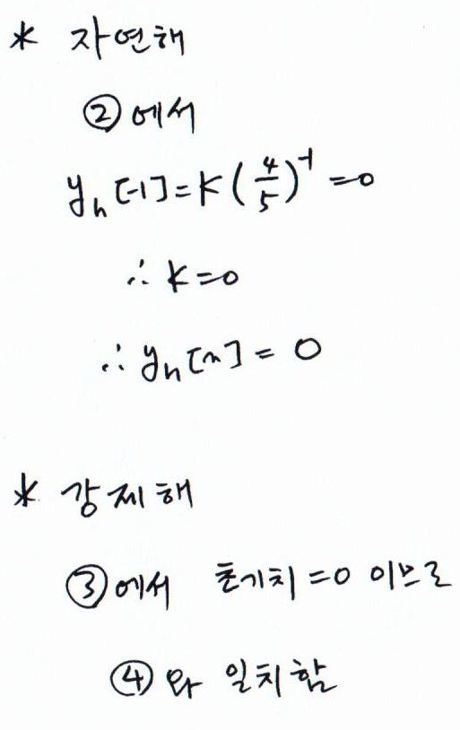
: S와 동일
응답
: 동차해
응답
Notes:
신호 및 시스템

Slide 13
2.10 Solving differential and difference equations (Cont.)
Ex. of Homogeneous solution
  Ex. 2.17
  Ex. 2.18
  Prob. 2.17
Self study
Notes:
신호 및 시스템

Slide 14
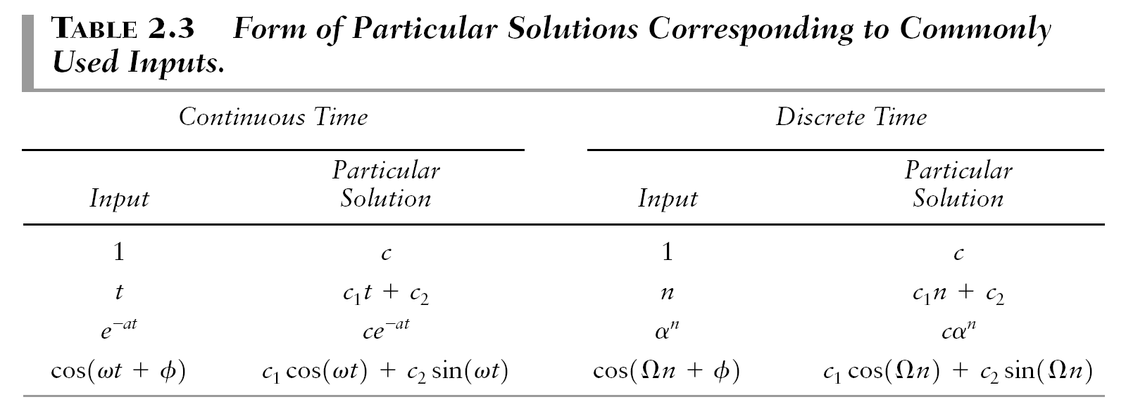
2.10 Solving differential and difference equations (Cont.)
2.10.2 The particular solution
  In general, particular solution is not unique
  A particular solution is usually obtained by assuming an output of the same general form as the input

Slide 15
2.10 Solving differential and difference equations (Cont.)
2.10.3 The complete solution
Procedure 2.3: solving a differential or difference equation
  Find the form of homogeneous solution y^{(h)} from the roots of the characteristic equation
  Find a particular solution y^{(p)} by assuming that it is of the same form as the input, yet is independent of all terms in the homogeneous solution
  Determine the coefficient in the homogeneous solution so that the complete solution y=y^{(h)}+y^{(p)} satisfies the initial condition
Ex. 2.21, Ex. 2.22, and Ex. 2.23
Problems 2.19 and 2.20
Self study

Slide 16
2.11 Characteristics of systems described by differential and difference equations
The complete output: y= y^{(h)} +y^{(p)}
2.11.1 The natural response
The natural response is the system output for zero input and thus describes the manner in which the system dissipates any stored energy or memory of the past represented by non-zero initial conditions
Ex. 2.24 and Ex 2.25
Self study

Slide 17
2.11 Characteristics of systems described by differential and difference equations (Cont.)
2.11.2 The forced response
Be the system output due to the input signal assuming zero initial conditions
Ex. 2.26 and Ex. 2.27
Self study

Slide 18

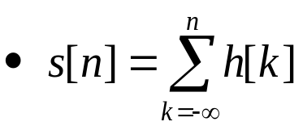

2.11 Characteristics of systems described by differential and difference equations (Cont.)
2.11.3 The impulse response
Given the step response, the impulse response may be determined by exploiting the relationship between the two responses
  Continuous-time
  Discrete-time

Slide 19
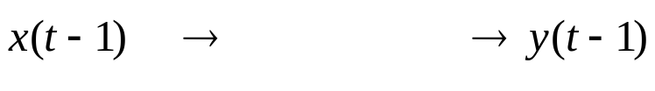
2.11 Characteristics of systems described by differential and difference equations (Cont.)
2.11.4 Linearity and time invariance
LTI systems
Time invariant?
  In general, the complete response of an LTI system described by a differential or difference equation is not time invariant, since the initial conditions will result in an output term that does not shift with a time shift of the input.
2.11.5 Roots of the characteristic equation
The basic form of the natural response is dependent entirely on the roots of the characteristic equation.
The impulse response of an LTI system also depends on the roots of the characteristic equation, since it contains the same terms as the natural response.
Forced response depends on both the input and the roots of the characteristic equation
Stability
  Directly related to the roots of the system’s characteristic equation

Slide 20


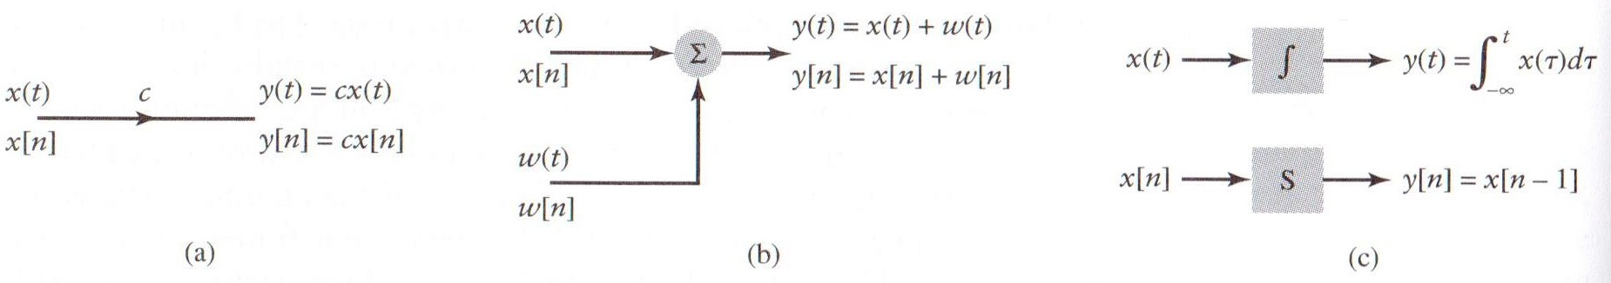
2.12 Block diagram representations
Three elementary operations on signals:
1. scalar multiplication:
2. addition:
3. integration for continuous-time LTI systems:
a time shift for discrete-time LTI systems:
Figure 2.32 (p. 162)
Symbols for elementary operations in block diagram descriptions of systems. (a) Scalar multiplication. (b) Addition. (c) Integration for continuous-time systems and time shifting for discrete-time systems.

Slide 21
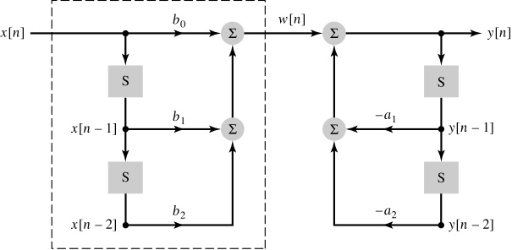
2.12 Block diagram representations (Cont.)
Figure 2.33 (p. 162)
Block diagram representation of a discrete-time LTI system described by a second-order difference equation. ( Direct form I )
From the figure
From Eqs. (2.49) and (2.50)

Slide 22
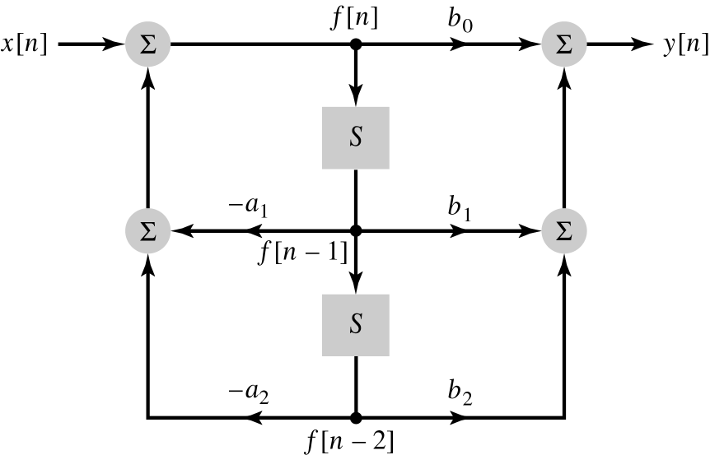
2.12 Block diagram representations (Cont.)
Let us interchange their order and denote the output of the new first system as f[n]
From Eq. (2.50) and the input x[n], the output f[n] is obtained as
Form Eq. (2.49) and f[n], the output of the second system is given by
Figure 2.35 (p. 164)
Direct form II representation of an LTI system described by a second-order difference equation

Slide 23
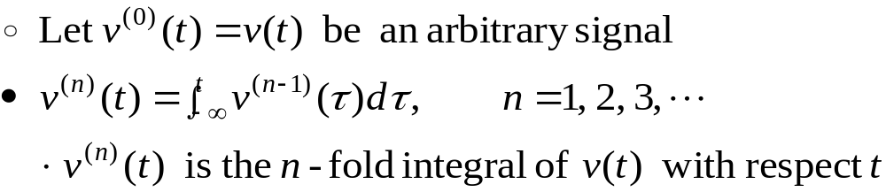
2.12 Block diagram representations (Cont.)
In order to depict the continuous-time LTI system in terms of the more easily implemented integration operation
Rewrite the differential equation as the form of an integral equation
  Rewrite it in terms of an initial condition on the integrator

Slide 24
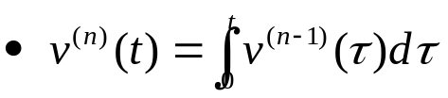
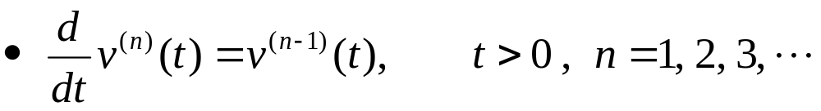
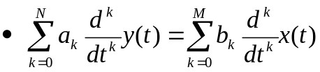
2.12 Block diagram representations (Cont.)
  Assume zero initial conditions  integration and differentiation are inverse operations
  If N≥M and we integrate Eq. (2.54) N times,

Slide 25

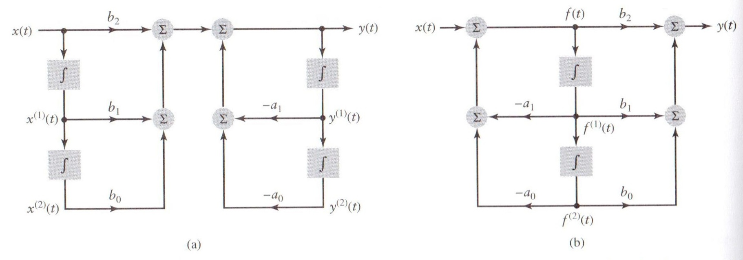
2.12 Block diagram representations (Cont.)
For second-order system with N=2, M=2, a₂ =1
An example of continuous-time LTI systems
Figure 2.37 (p. 166)
Block diagram representations of a continuous-time LTI system described by a second-order integral equation. (a) Direct form I. (b) Direct form II.

Slide 26
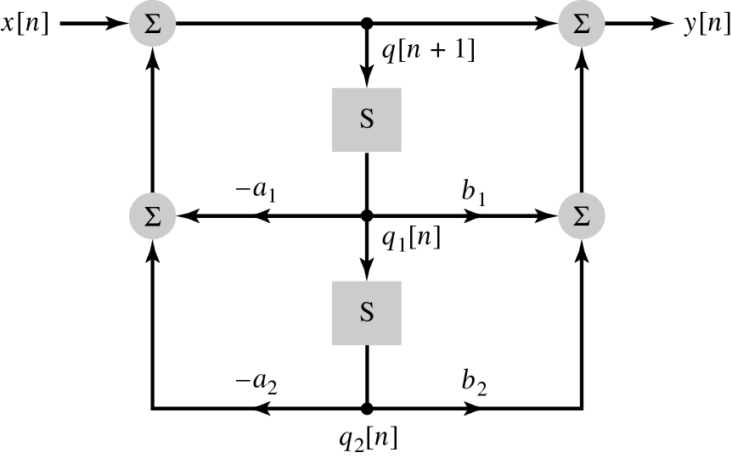
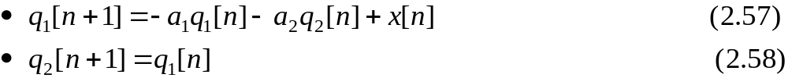
2.13 State-variable descriptions of LTI systems
The state-variable description of an LTI system consists of a series of coupled first-order differential or difference equations
The state of a system may be defined as a minimal set of signals that represent the system’s entire memory of the past
2.13.1 The state-variable description
Figure 2.39 (p. 167)
Direct form II representation of a second-order
discrete-time LTI system depicting state variables q₁[n] and q₂[n].
1
Notes:
신호 및 시스템

Slide 27
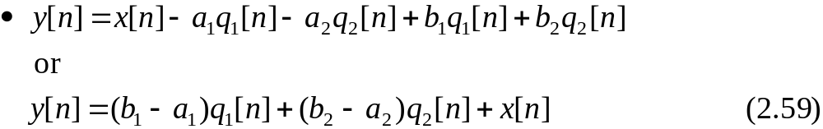

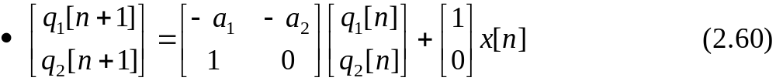
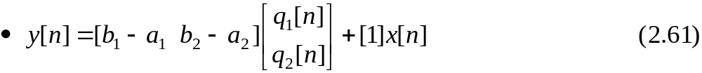
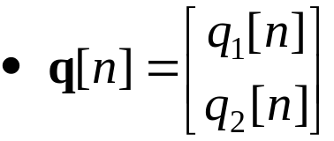
2.13 State-variable descriptions of LTI systems (Cont.)
1
The system output
Write Eqs. (2.57) and (2.58) in matrix form
Eq. (2.59) is expressed as
Define the state vector as the column vector

Slide 28

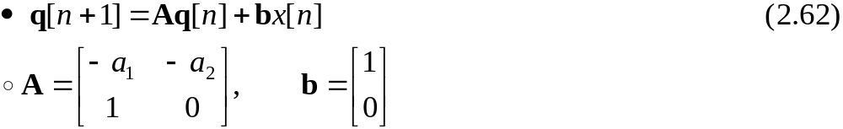

2.13 State-variable descriptions of LTI systems (Cont.)
Rewrite Eq. (2.60)
Rewrite Eq. (2.61)
State-variable description of continuous-time system is analogous to that of discrete-time systems
  State equation given by Eq. (2.62)
  Eq. (2.63)

Slide 29


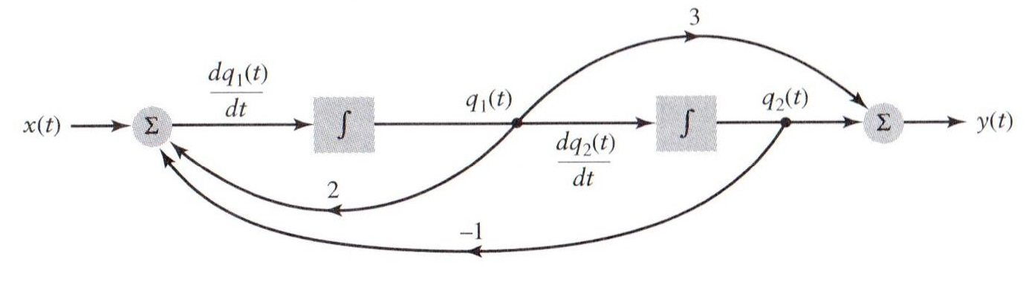
2.13 State-variable descriptions of LTI systems (Cont.)
2.13.2 Transformations of the state
Different state-variable descriptions may be obtained by transforming the state-variable
Have not changed the structure of the block diagram, so the input-output characteristic of the system remains the same
Ex. 2.30
Figure 2.44 (p. 172): Block diagram of LTI system for Example 2.30.

Slide 30
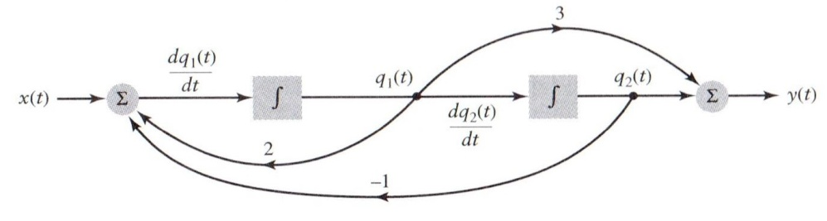
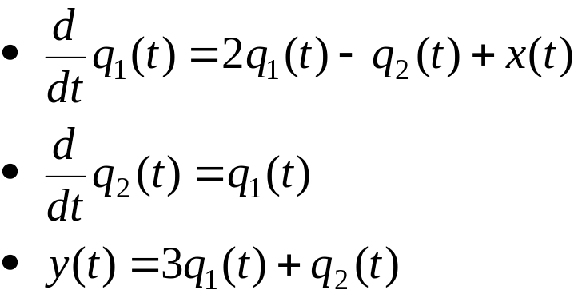
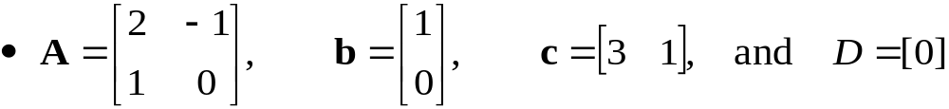
2.13 State-variable descriptions of LTI systems (Cont.)
2.13.2 Transformations of the state(Cont.)
Ex. 2.30 (Cont.)
  Block diagram
  State-variable description

Slide 31
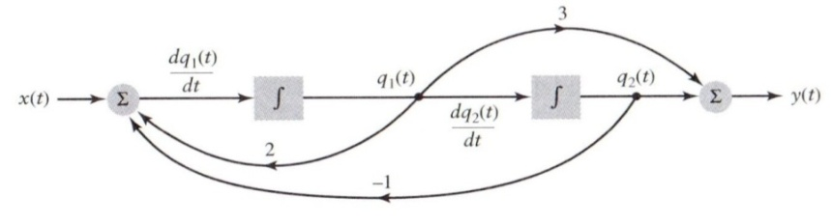
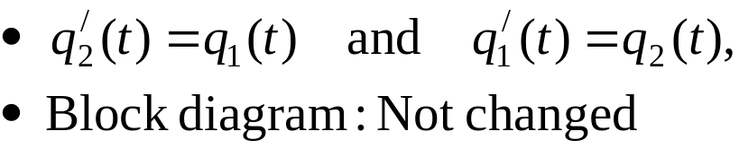
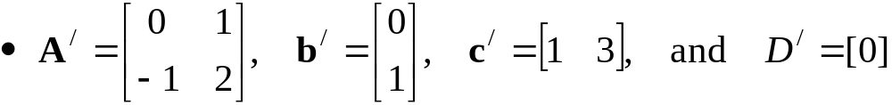
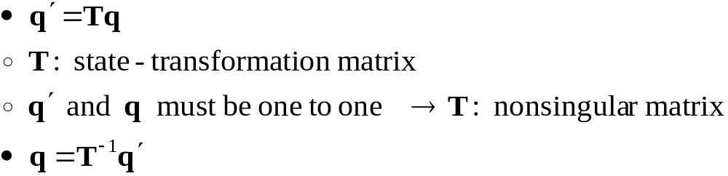
2.13 State-variable descriptions of LTI systems (Cont.)
2.13.2 Transformations of the state (Cont.)
Ex. 2.30 (Cont.)
  Define a new state vector as a transform of the original state vector

Slide 32




2.13 State-variable descriptions of LTI systems (Cont.)
2.13.2 Transformations of the state (Cont.)
Ex. 2.30 (Cont.)
  Original state-variable description
    The dot over the q denotes differentiation in continuous time or time advance ([n+1]) in discrete time
  New state-variable description

Slide 33





2.13 State-variable descriptions of LTI systems (Cont.)
2.13.2 Transformations of the state (Cont.)
Ex. 2.30 (Cont.)
  New state-variable description
  Ex.

Slide 34



Q & A
= I
Notes:
신호 및 시스템

Slide 35



[참고]
8.1 Introduction to the Natural Response of a Parallel RLC Circuit
그림의 회로( natural response)에서 node-voltage method :
위의 식을 한 번 미분한 후에 정리한 식 :
Inductor와 capacitor를 모두 포함하고 있는 회로는 2차 미분방정식이 되므로 second-order circuits
http://www.youtube.com/watch?v=3cca_It7c68
Notes:
신호 및 시스템

Slide 36




The general solution of the second-order differential equation
8.1 Introduction to the Natural Response of a Parallel RLC Circuit
앞 미분방정식의 해를 가정한 식 :
위의 전압을 미분방정식에 대입하여 상수 s를 구하자
Characteristic equation : 위의 식이 0 이기 위한 equation
Two roots of characteristic equation :

Slide 37


8.1 Introduction to the Natural Response of a Parallel RLC Circuit
Characteristic equation의 근이 두 개이므로 natural response 는
위의 식이 미분방정식의 근임을 증명하자

