Slide 1
CH. 3. Fourier Representation of Signals and Linear Time-Invariant Systems
3.1 Introduction --------------------------------------------------------------------------------------3
3.2 Complex Sinusoids and Frequency Response of LTI systems --------------------------4
3.3 Fourier Representations for Four Classes of Signals -------------------------------------9
3.4 Discrete-Time Periodic Signals: The Discrete-Time Fourier Series ------------------17
3.5 Continuous-Time Periodic Signals: The Fourier Series ---------------------------------33
3.6 Discrete-Time Nonperiodic Signals: The Discrete-Time Fourier Transform ------44
3.7 Continuous-Time Nonperiodic Signal: The Fourier Transform ----------------------56
3.8 Property of Fourier Representations -------------------------------------------------------69
3.9 Linearity and Symmetry Properties --------------------------------------------------------71
3.10 Convolution Property
3.11 Differentiation and Integration Properties
3.12 Time- and Frequency-Shift Properties
3.13 Finding Inverse Fourier Transforms by Using Partial-Fraction Expansions
3.14 Multiplication Property
3.15 Scaling Properties
3.16 Parseval Relationships
3.17 Time-Bandwidth Product
3.18 Duality

Slide 2
CH. 3. Fourier Representation of Signals and Linear Time-Invariant Systems (Part 1)
3.1 Introduction
3.2 Complex Sinusoids and Frequency Response of LTI systems
3.3 Fourier Representations for Four Classes of Signals
  3.3.1 Periodic Signals: Fourier Series Representations
  3.3.2 Nonperiodic Signals: Fourier-Transform Representations
3.4 Discrete-Time Periodic Signals: The Discrete-Time Fourier Series
3.5 Continuous-Time Periodic Signals: The Fourier Series
3.6 Discrete-Time Nonperiodic Signals: The Discrete-Time Fourier Transform
3.7 Continuous-Time Nonperiodic Signal: The Fourier Transform
3.8 Property of Fourier Representations
3.9 Linearity and Symmetry Properties
  3.9.1 Symmetry Properties: Real and Imaginary Signals
  3.9.2 Symmetry Properties: Even and Odd Signals

Slide 3
3.1 Introduction
Signal is represented as a weighted superposition of complex sinusoids
For an LTI system, its output is a weighted superposition of the system response to each complex sinusoid
크기와 위상은 변하는데 주파수영역은 변하지 않는다.
각각의 영역을 따로 처리해도 원래의 신호를 복원할 수 있다.

Slide 4
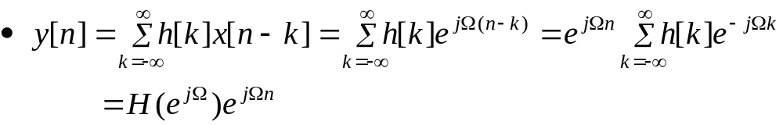
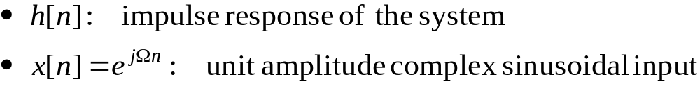

3.2 Complex Sinusoids and Frequency Response of LTI systems
For a discrete-time LTI system
Output of the system
Frequency response of the system
Figure 3.1 (p. 196): The output of a complex sinusoidal input to an LTI system is a complex sinusoid of the same frequency as the input, multiplied by the frequency response of the system.
DTFT form

Slide 5
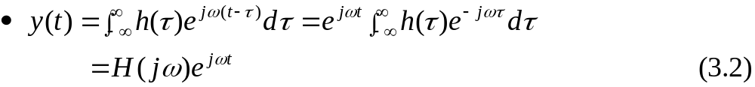
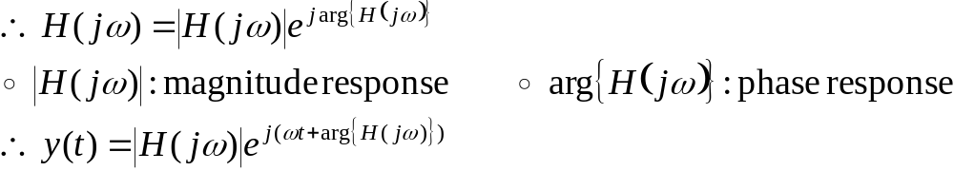
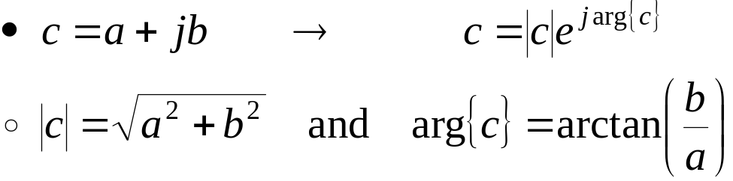
3.2 Complex Sinusoids and Frequency Response of LTI systems (Cont.)
For a continuous-time LTI system
  Output of the system
  Frequency response of the system
Remind:
impulse response
input
시간 영역을 주파수로 변환

Slide 6
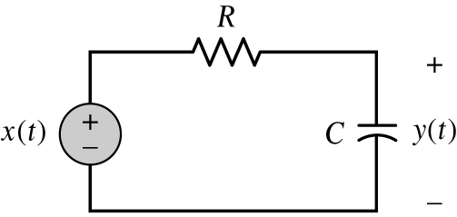
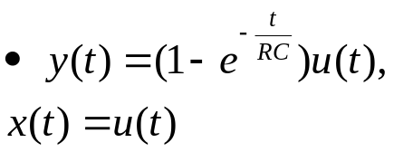

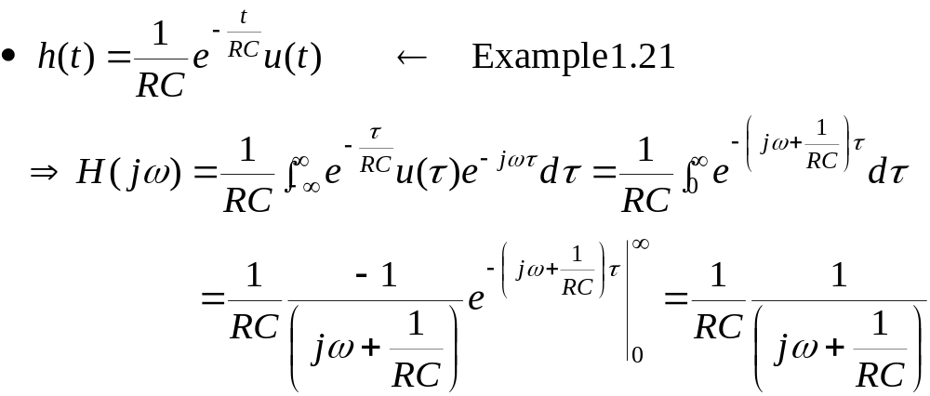

3.2 Complex Sinusoids and Frequency Response of LTI systems (Cont.)
x(t)
h(t)
y(t)
Example 3.1 RC circuit: Frequency response
X(ω)
H(ω)
Y(ω)
지수에 마이너스 붙음.

Slide 7
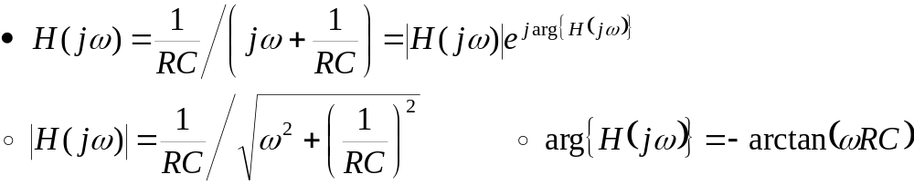
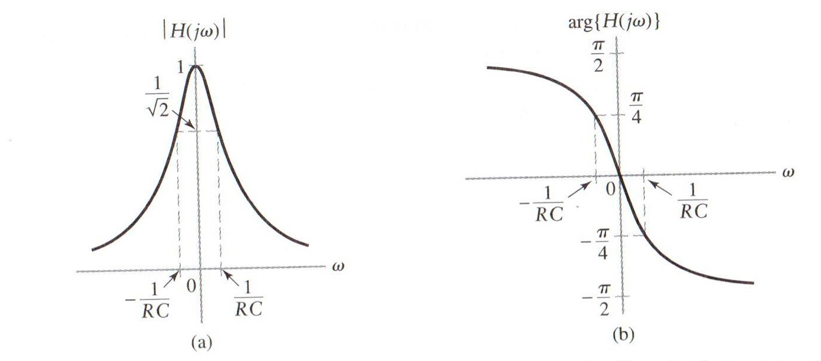
3.2 Complex Sinusoids and Frequency Response of LTI systems (Cont.)
Example 3.1 RC circuit: Frequency response (Cont.)
Figure 3.3 (p. 198)
Frequency response of the RC circuit in Fig. 3.2. (a) Magnitude response. (b) Phase response.
arctan

Slide 8









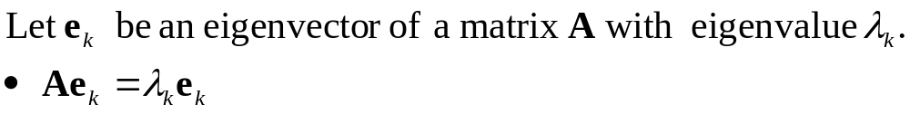
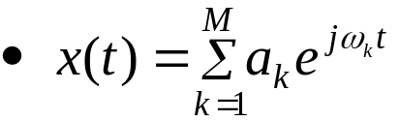
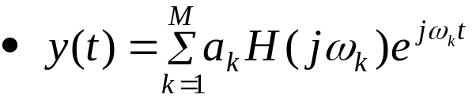
3.2 Complex Sinusoids and Frequency Response of LTI systems (Cont.)
Figure 3.4 (p. 198)
Illustration of the eigenfunction property of linear systems. The action of the system on an eigenfunction input is multiplication by the corresponding eigenvalue. (a) General eigenfunction ψ(t) or ψ[n] and eigenvalue λ. (b) Complex sinusoidal eigenfunction e^{jωt} and eigenvalue H(jω). (c) Complex sinusoidal eigenfunction e^{jΩn} and eigenvalue H(e^{jΩ} ).
LTI system input
output

Slide 9

3.3 Fourier Representations for Four Classes of Signals
Jean Baptiste Joseph Fourier: 1768-1830
푸리에의 가장 큰 업적은 19세기에 발간된 가장 중요한 책중의 하나인 "열에 관한 해석적 이론"이며, 1822년에 발간된 이 책에서 그는 유명한 푸리에 급수를 개발, 발표하였다. 그는 1807년에 프랑스 학사원에 그의 결과에 대한 논문을 제출하였었다. 그러나 그 논문은 받아들여지지 않았는데, 그 이유는 라그랑제(Lagrange)가 푸리에 급수가 수렴하는 것을 믿지 않았기 때문이었다. 거부당했던 그의 논문은 오늘날 순수 수학과 수리 물리학의 한 이정표로서 찬란히 남아 있다.

Slide 10
3.3 Fourier Representations for Four Classes of Signals (Cont.)
Table 3.1 Relationship between time properties of a signal and the application Fourier representation
Time Property | Periodic | Nonperiodic
Continuous (t) | Fourier Series (FS) | Fourier Transform (FT)
Discrete [n] | Discrete-Time Fourier Series (DTFS) | Discrete-Time Fourier Transform (DTFT)

Slide 11
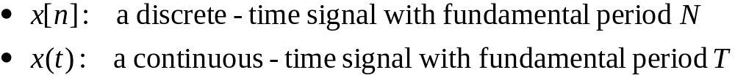
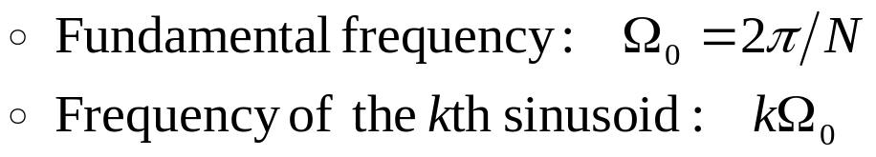
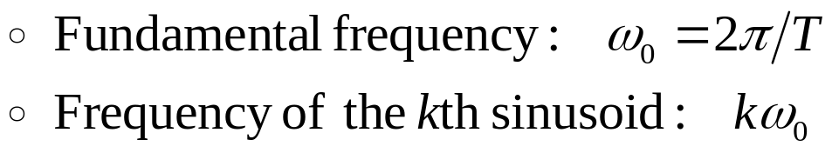
3.3.1 Periodic Signals: Fourier Series Representation
a discrete - time signal with fundamental period N
DTFS of x[n]
FS of x(t)
a continuous- time signal with fundamental period N
지수에 -이면 시간영역을 주파수 영역으로 바꿔줌.
지수에 +이면 주파수 영역을 시간영역으로 바꿔줌.
: IDTFS
: IFS

Slide 12
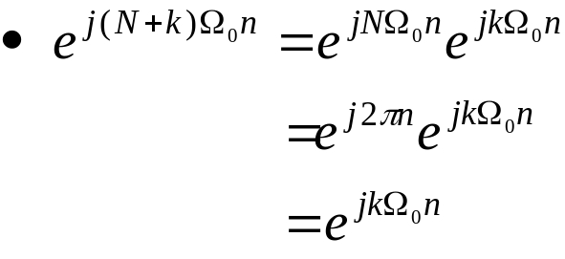
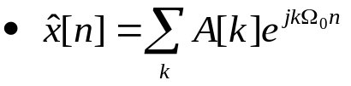
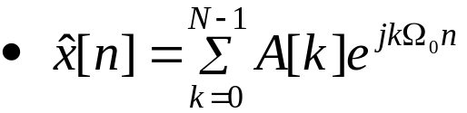
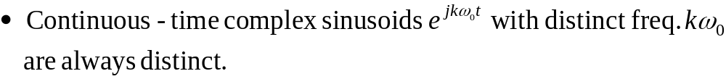

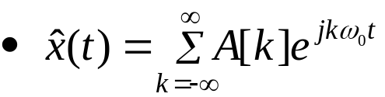
3.3.1 Periodic Signals: Fourier Series Representation (Cont.)
N-periodic in the frequency index k
Rewrite Eq. (3.4)
For a continuous-time signal, there are potentially an infinite number of distinct terms in the series of Eq. (3.5).
불연속 포인트에서 신호가 왜곡됨.

Slide 13
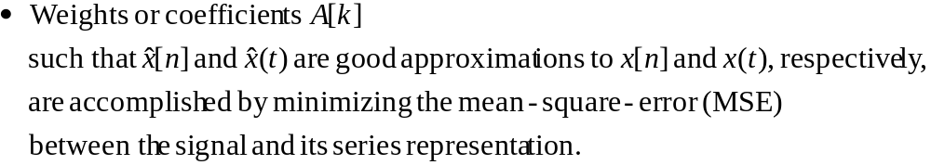
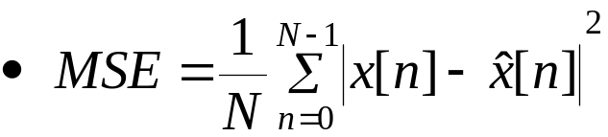
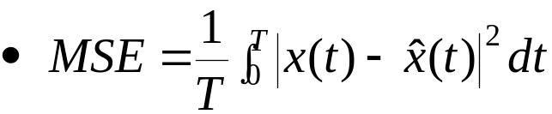
3.3.1 Periodic Signals: Fourier Series Representation (Cont.)
For a discrete-time case
For a continuous-time case

Slide 14
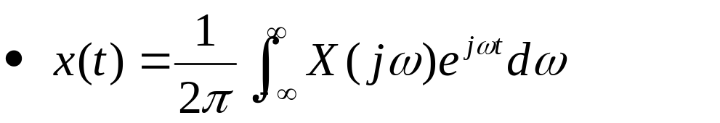
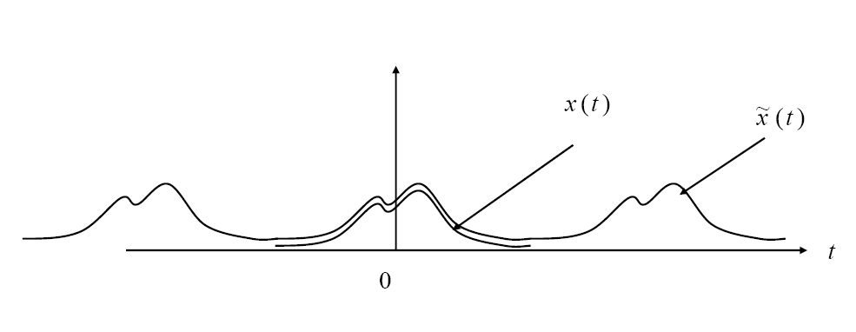
3.3.2 Nonperiodic Signals: Fourier-Transform Representations
Continuous-time system

Slide 15
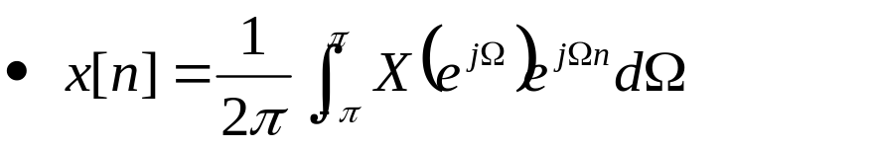
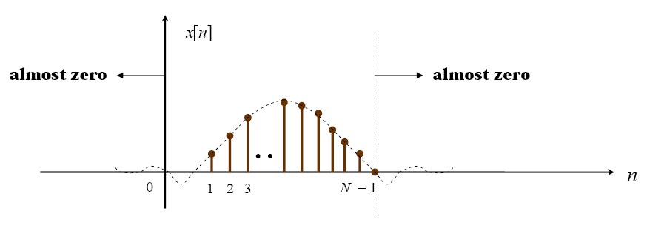
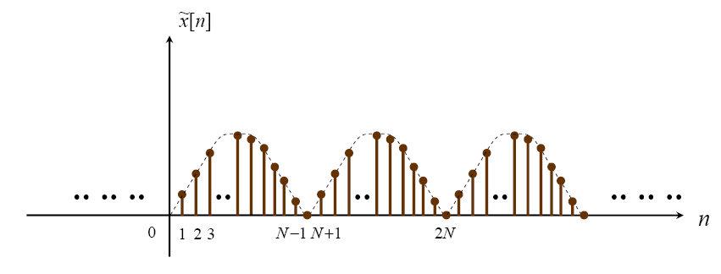
3.3.2 Nonperiodic Signals: Fourier-Transform Representations (Cont.)
Discrete-time system
주기적 신호

Slide 16
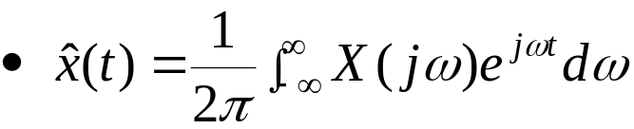
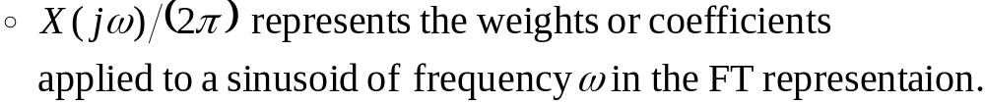
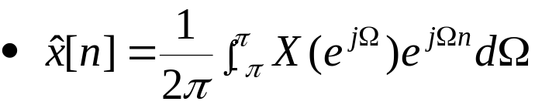
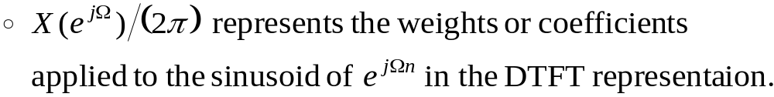
3.3.2 Nonperiodic Signals: Fourier-Transform Representations (Cont.)
For a continuous-time case: FT
For a discrete-time case: DTFT
: IFT
: IDTFT
알아야 하는 것
푸리에 표현의 기본 패턴
주기적, 비주기적 신호의 형태, 식

Slide 17
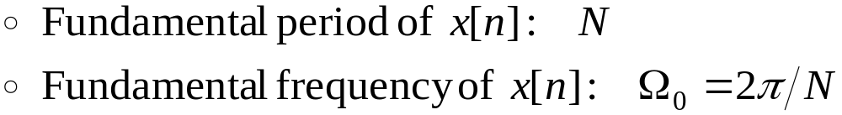
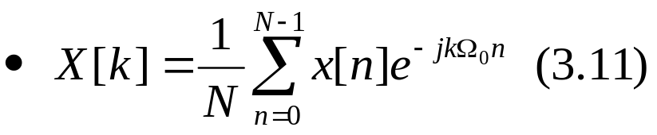
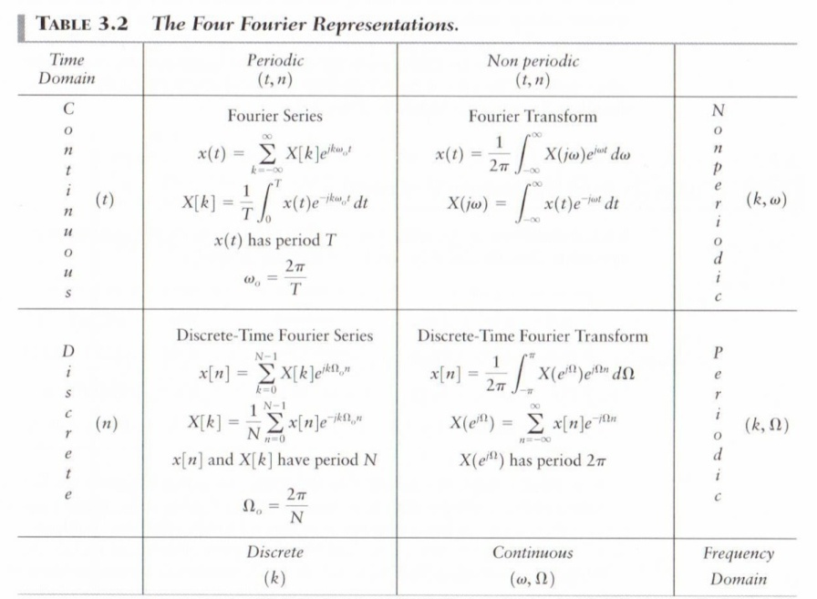

3.4 Discrete-Time Periodic Signals: The Discrete-Time Fourier Series
DTFS representation of a periodic signal x[n]
  DTFS coefficient of x[n]
  x[n] and X[k] are a DTFS pair
: IDTFS
시간 영역에서 이산신호
이것을 주파수 영역으로 넘기면
이산신호는 주기적이 된다.
연속 신호는 전부 주파수 특성이 비주기적으로 나옴.
시간 영역에서 주기적이면 주파수에서 이산
시간 영역에서 비주기적이면 주파수에서 연속
4가지 퓨리에 표현
연속, 이산, 주기, 비주기

Slide 18
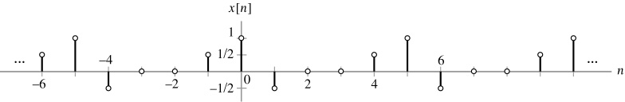
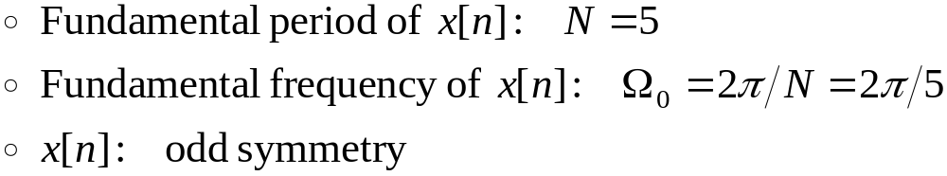
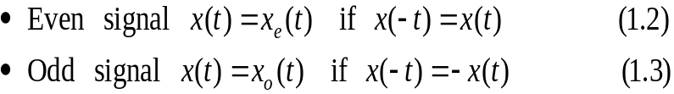
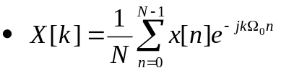
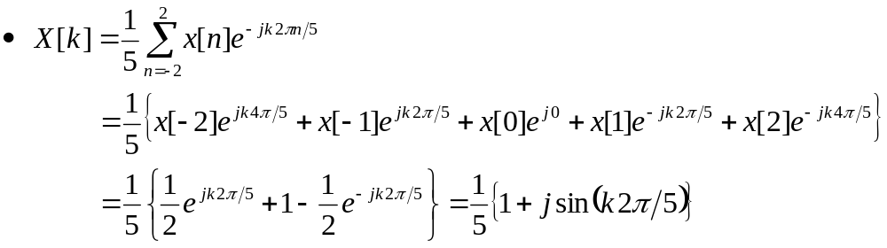
3.4 Discrete-Time Periodic Signals: The Discrete-Time Fourier Series (Cont.)
Example 3.2 Determining DTFS coefficients: Find the freq.-domain representation of the signal depicted in Fig. 3.5
Figure 3.5 (p. 203): Time-domain signal for Example 3.2.
지수 함수를 주기함수의 켤레복소수로 표현함.

Slide 19
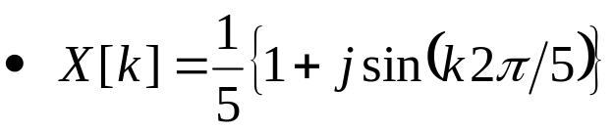
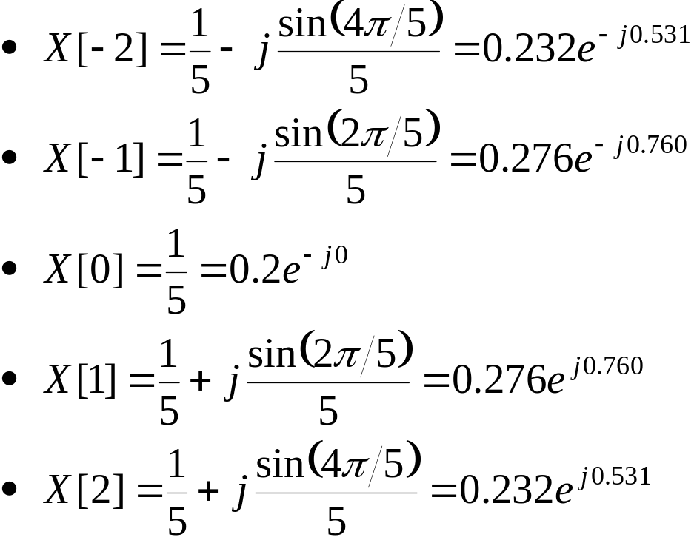
3.4 Discrete-Time Periodic Signals: The Discrete-Time Fourier Series (Cont.)
Example 3.2 Determining DTFS coefficients (Cont.)

Slide 20
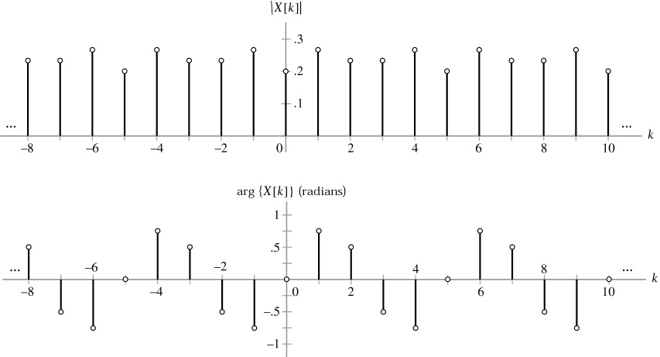
3.4 Discrete-Time Periodic Signals: The Discrete-Time Fourier Series (Cont.)
Example 3.2 Determining DTFS coefficients (Cont.)
Figure 3.6 (p. 204)
Magnitude and phase of the DTFS coefficients for the signal in Fig. 3.5.

Slide 21
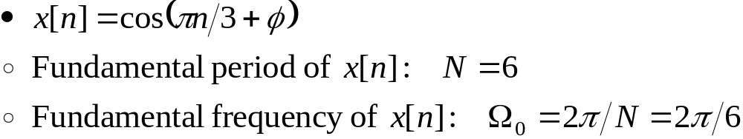
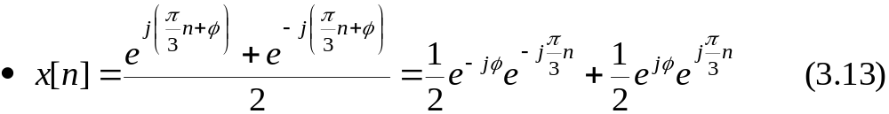
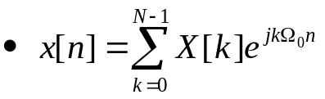
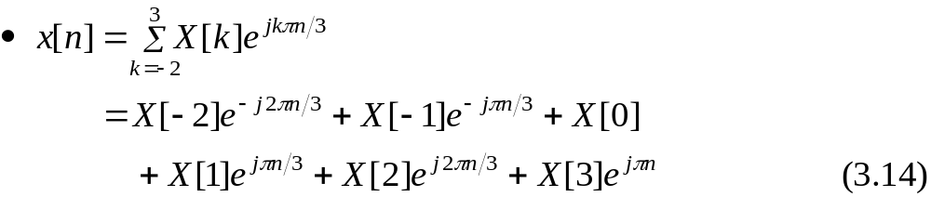
3.4 Discrete-Time Periodic Signals: The Discrete-Time Fourier Series (Cont.)
Example 3.3 Computation of DTFS coefficients by inspection
Determine the DTFS coefficients of x[n], using the method of inspection.
  Using Euler’s formula
  Using Eq. (3.10) from k= -2 to k=3
cos

Slide 22
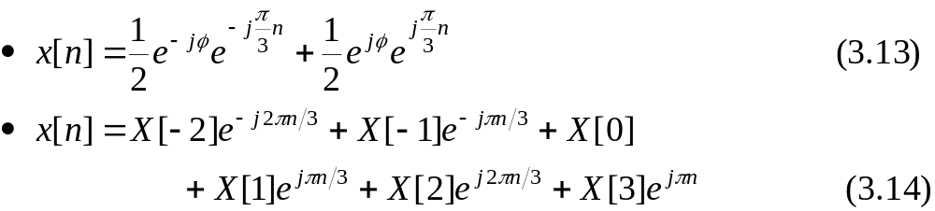
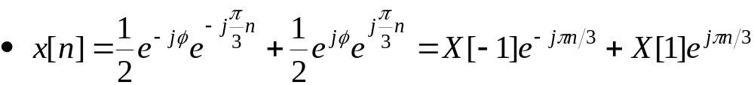

3.4 Discrete-Time Periodic Signals: The Discrete-Time Fourier Series (Cont.)
Example 3.3 Computation of DTFS coefficients by inspection (Cont.)
  Eqs. (3.13) and (3.14) have equal frequencies, kπ/3

Slide 23


3.4 Discrete-Time Periodic Signals: The Discrete-Time Fourier Series (Cont.)
Example 3.3 Computation of DTFS coefficients by inspection (Cont.)
Figure 3.8 (p. 206)
Magnitude and phase of DTFS coefficients for Example 3.3.

Slide 24





3.4 Discrete-Time Periodic Signals: The Discrete-Time Fourier Series (Cont.)
Example 3.4 DTFS representation of an impulse train
Find the DTFS coefficients of the N-periodic impulse train
Figure 3.9 (p. 207)
A discrete-time impulse train with period N.
적분할 때 델타가 들어가면 채성질?

Slide 25




3.4 Discrete-Time Periodic Signals: The Discrete-Time Fourier Series (Cont.)
Example 3.6 DTFS representation of a square wave
Find the DTFS coefficients of the N-periodic square wave
Figure 3.11 (p. 209)
Square wave for Example 3.6.

Slide 26



3.4 Discrete-Time Periodic Signals: The Discrete-Time Fourier Series (Cont.)
Example 3.6 DTFS representation of a square wave (Cont.)

Slide 27



3.4 Discrete-Time Periodic Signals: The Discrete-Time Fourier Series (Cont.)
Example 3.6 DTFS representation of a square wave (Cont.)
  The expression for X[k] is commonly written as
  : Using L’Hopital’s rule

Slide 28

3.4 Discrete-Time Periodic Signals: The Discrete-Time Fourier Series (Cont.)
실수부분만 있는 경우 굳이 magnitude로 하지 않고 주파수영역 그대로 표현함. y축 대칭임.
이 경우 위상 0보다 크면 0, 0보다 작으면 180도.
k에 0넣으면 0/0이라 로피탈 써서 하면 구할 수 있음.
Example 3.6 DTFS representation of an square wave (Cont.)
Figure 3.12 (p. 211)
The DTFS coefficients for the square wave shown in Fig. 3.11, assuming a period N = 50: (a) M = 4. (b) M = 12.

Slide 29


3.4 Discrete-Time Periodic Signals: The Discrete-Time Fourier Series (Cont.)
DTFS coefficients are even symmetry : X[k]=X[-k]
  Rewrite Eq. (3.10).
  Assume that N is even, so that, N/2 is integer, and let k range from -N/2 +1 to N/2

Slide 30


3.4 Discrete-Time Periodic Signals: The Discrete-Time Fourier Series (Cont.)
DTFS coefficients are even symmetry (Cont.)
  Define the new set of coefficients
  IDTFS for the square wave in terms of a series of harmonically related cosines as
Try to derive a similar expression for N odd.
Self-study

Slide 31



3.4 Discrete-Time Periodic Signals: The Discrete-Time Fourier Series (Cont.)
Example 3.6 참고
N=50, M=12
Example 3.7 Building a square wave from DTFS coefficients
  Approximation of x[n] using the first 2J+1 from DTFS of x[n]
Figure 3.14a (p. 213)
Individual terms in the DTFS expansion of a square wave (left panel) and the corresponding partial-sum approximations xˆ_{J}[n] (right panel). The J = 0 term is xˆ₀[n] = ½ and is not shown. (a) J = 1. (b) J = 3.
짝수 k, B[k]=0
Notes:
짝수 k, B[k]=0
신호 및 시스템

Slide 32


3.4 Discrete-Time Periodic Signals: The Discrete-Time Fourier Series (Cont.)
Example 3.7 Building a square wave from DTFS coefficients (Cont.)
Figure 3.14a (p. 213): (Cont.): (c) J = 5. (d) J = 23. (e) J = 25.

Slide 33



3.5 Continuous-Time Periodic Signals: The Fourier Series
FS representation of a periodic signal x(t)
  Exponential FS
  FS coefficient of x(t)
  x(t) and X[k] are an FS pair
: IFS
: FS

Slide 34





3.5 Continuous-Time Periodic Signals: The Fourier Series (Cont.)
The infinite series in Eq. (3.19) is not guaranteed to converge for all possible signals.
  Approximation of x(t) with the fundamental period T
  If x(t) is square integrable,
  then MSE is 0

Slide 35

3.5 Continuous-Time Periodic Signals: The Fourier Series (Cont.)
Dirichlet condition
  x(t) is bounded.
  x(t) has a finite number of maxima and minima in one period.
  x(t) has a finite number of discontinuities in one period.

Slide 36




3.5 Continuous-Time Periodic Signals: The Fourier Series (Cont.)
Example 3.13 FS for a square wave
Determine the FS representation of the square wave depicted in Fig. 3.21.
Figure 3.21 (p. 221)
Square wave for Example 3.13.

Slide 37




3.5 Continuous-Time Periodic Signals: The Fourier Series (Cont.)
Example 3.13 FS for a square wave (Cont.)
  Using L’Hopital’s rule
  FS representation of a square wave x(t)

Slide 38



3.5 Continuous-Time Periodic Signals: The Fourier Series (Cont.)
Example 3.13 FS for a square wave (Cont.)
Figure 3.22 (p. 222)
FS coefficients, X[k], –50 ≤ k ≤ 50, for three square waves. (see Fig. 3.21.) (a) T₀/T = 1/4 . (b) T₀/T = 1/16. (c) T₀/T = 1/64.

Slide 39



3.5 Continuous-Time Periodic Signals: The Fourier Series (Cont.)
Sinc function occurs sufficiently often in Fourier analysis:
  The maximum of this function is unit at u=0; The zero crossings occur at integers values of u and the amplitude dies off as 1/u.
  The portion of the function between the zero crossings at u=±1 is the mainlobe of the sinc function. The smaller ripples outside the mainlobe are termed sidelobes.
Figure 3.23 (p. 223)
Sinc function sinc(u) = sin(πu)/(πu)
  FS coefficients in Eq.(3.23)

Slide 40



3.5 Continuous-Time Periodic Signals: The Fourier Series (Cont.)
Trigonometric FS : useful for real-valued signals.
  Coefficients may be obtained from x(t), using
  B[0]=X[0] represents the time-averaged value of the signal
  Using Euler’s formula to expand the cosine and sine functions in Eq. (3.26) and comparing the result with Eq. (3.20) shows that for k≠0

Slide 41



3.5 Continuous-Time Periodic Signals: The Fourier Series (Cont.)
Substituting Eq. (3.23) into Eq. (3.27)
  x(t) is even symmetry signal
Square wave may be expressed as

Slide 42




3.5 Continuous-Time Periodic Signals: The Fourier Series (Cont.)
Example 3.13 참고
Example 3.14 Square-wave partial-sum approximation
Figure 3.25 (p. 225)
Individual terms (left panel) in the FS expansion of a square wave and the corresponding partial-sum approximations x^_{J}(t) (right panel). The square wave has period T = 1 and T₀/T = ¼. The J = 0 term is x^₀(t) = ½ and is not shown. (a) J = 1.
조건 : T = 1 and T₀/T = ¼

Slide 43


3.5 Continuous-Time Periodic Signals: The Fourier Series (Cont.)
Example 3.14 Square-wave partial-sum approximation (Cont.)
Figure 3.25 (p. 225): (b) J = 3. (c) J = 7. (d) J = 29. (e) J = 99.
불연속 값의
Ripple (최대 9%)
Gibbs phenomenon

Slide 44



3.6 Discrete-Time Nonperiodic Signals: The Discrete-Time Fourier Transform
DTFT representation of a discrete-time nonperiodic signal x[n]
  DTFT of x[n]
DTFT pair:
: IDTFT

Slide 45



3.6 Discrete-Time Nonperiodic Signals: The Discrete-Time Fourier Transform (Cont.)
The infinite sum in Eq. (3.32) converges if x[n] has finite duration and is finite valued.
If x[n] is of infinite duration, then the sum converges only for certain classes of signals.
  If x[n] is not absolutely summable, but does satisfy

Slide 46


3.6 Discrete-Time Nonperiodic Signals: The Discrete-Time Fourier Transform (Cont.)
Example 3.17 DTFT of an exponential sequence
Find the DTFT of the sequence x[n] = (α)^{n}u[n].
  Using Eq. (3.32)

Slide 47


3.6 Discrete-Time Nonperiodic Signals: The Discrete-Time Fourier Transform (Cont.)
Example 3.17 DTFT of an exponential sequence (Cont.)
  Magnitude and phase spectra

Slide 48

3.6 Discrete-Time Nonperiodic Signals: The Discrete-Time Fourier Transform (Cont.)
Example 3.17 DTFT of an exponential sequence (Cont.)
Figure 3.29 (p.232)
The DTFT of an exponential x[n] = (α)^{n}u[n]. (a) Magnitude spectrum for α = 0.5. (b) Phase spectrum for α = 0.5. (c) Magnitude spectrum for α = 0.9. (d) Phase spectrum for α = 0.9.

Slide 49



3.6 Discrete-Time Nonperiodic Signals: The Discrete-Time Fourier Transform (Cont.)
Example 3.18 DTFT of a rectangular pulse
Find the DTFT of x[n] depicted in Figure 3.30(a)
Figure 3.30 (p. 233)
Example 3.18. (a) Rectangular pulse in the time domain. (b) DTFT in the frequency domain.

Slide 50


3.6 Discrete-Time Nonperiodic Signals: The Discrete-Time Fourier Transform (Cont.)
Example 3.18 DTFT of a rectangular pulse (Cont.)

Slide 51

3.6 Discrete-Time Nonperiodic Signals: The Discrete-Time Fourier Transform (Cont.)
Example 3.18 DTFT of a rectangular pulse (Cont.)
  L’Hopital’s rule

Slide 52



3.6 Discrete-Time Nonperiodic Signals: The Discrete-Time Fourier Transform (Cont.)
Example 3.19 Inverse DTFT of a rectangular spectrum
Find the inverse DTFT of X(e ^{jΩ}) depicted in Figure 3.31(a)
Figure 3.31 (p. 234)
Example 3.19. (a) Rectangular pulse in the frequency domain. (b) Inverse DTFT in the time domain.

Slide 53


3.6 Discrete-Time Nonperiodic Signals: The Discrete-Time Fourier Transform (Cont.)
Example 3.19 Inverse DTFT of a rectangular spectrum (Cont.)

Slide 54



3.6 Discrete-Time Nonperiodic Signals: The Discrete-Time Fourier Transform (Cont.)
Example 3.20 DTFT of the unit impulse
Figure 3.32 (p. 235)
Example 3.20. (a) Unit impulse in the time domain. (b) DTFT of unit impulse in the frequency domain.

Slide 55


3.6 Discrete-Time Nonperiodic Signals: The Discrete-Time Fourier Transform (Cont.)
Example 3.21 Inverse DTFT of the unit impulse spectrum
Figure 3.33 (p. 236)
Example 3.21. (a) Unit impulse in the frequency domain. (b) Inverse DTFT in the time domain.
: 2π 주기인 경우 -> 한 주기에 대해 계산

Slide 56

3.7 Continuous-Time Nonperiodic Signal:
The Fourier Transform
FT representation of nonperiodic signal x(t)
  FT
  FT pair:
The integrals in Eqs. (3.35) and
(3.36) may not converge for all
functions x(t) and X(jω)
: IFT

Slide 57


3.7 Continuous-Time Nonperiodic Signal:
The Fourier Transform (Cont.)
Define
If x(t) is integrable, the MSE is zero
  Zero squared error does not imply piecewise convergence; it implies that there is zero energy in the difference of the terms.
  x(t) is absolutely integrable:
  x(t) has a finite number of maxima, minima, and discontinuities in any finite interval.
  The size of each discontinuity is finite.

Slide 58



3.7 Continuous-Time Nonperiodic Signal:
The Fourier Transform (Cont.)
Example 3.24 FT of a real decaying exponential
Find the FT of x(t) shown in Fig. 3.39 (a).
  FT does not converge for a≤0.
Figure 3.39 (p. 243)
Example 3.24. (a) Real time-domain exponential signal. (b) Magnitude spectrum. (c) Phase spectrum.

Slide 59


3.7 Continuous-Time Nonperiodic Signal:
The Fourier Transform (Cont.)
Example 3.24 FT of a real decaying exponential (Cont.)
  For a > 0
Figure 3.39 (p. 243)
Example 3.24. (a) Real time-domain exponential signal. (b) Magnitude spectrum. (c) Phase spectrum.

Slide 60



3.7 Continuous-Time Nonperiodic Signal:
The Fourier Transform (Cont.)
Example 3.25 FT of a rectangular pulse
Find the FT of x(t) depicted in Fig. 3.40 (a).
Figure 3.40 (p. 244)
Example 3.25. (a) Rectangular pulse in the time domain. (b) FT in the frequency domain.
o
Notes:
o
신호 및 시스템

Slide 61


3.7 Continuous-Time Nonperiodic Signal:
The Fourier Transform (Cont.)
Example 3.25 FT of a rectangular pulse (Cont.)
  L’Hopital’s rule

Slide 62




3.7 Continuous-Time Nonperiodic Signal:
The Fourier Transform (Cont.)
Example 3.25 FT of a rectangular pulse (Cont.)
  Magnitude and phase spectrum
  Using sinc function

Slide 63



3.7 Continuous-Time Nonperiodic Signal:
The Fourier Transform (Cont.)
Example 3.26 Inverse FT of a rectangular spectrum
Find the inverse FT of the rectangular spectrum depicted in Fig. 3.42 (a).
Figure 3.42 (p. 246)
Example 3.26. (a) Rectangular spectrum in the frequency domain.
(b) Inverse FT in the time domain..

Slide 64




3.7 Continuous-Time Nonperiodic Signal:
The Fourier Transform (Cont.)
Example 3.26 Inverse FT of a rectangular spectrum (Cont.)
  L’Hopital’s rule
  Using sinc function

Slide 65



3.7 Continuous-Time Nonperiodic Signal:
The Fourier Transform (Cont.)
Example 3.29 Characteristics of digital communication signals
  Possible pulse for binary phase-shift keying (BPSK) depicted in Fig. 3.44.
Figure 3.44 (p. 249)
Pulse shapes used in BPSK communications. (a) Rectangular pulse.
(b) Raised cosine pulse.

Slide 66

3.7 Continuous-Time Nonperiodic Signal:
The Fourier Transform (Cont.)
Example 3.29 Characteristics of digital communication signals (Cont.)
Figure 3.45 (p. 249)
BPSK signals constructed by using (a) rectangular pulse shapes and (b) raised-cosine pulse shapes.

Slide 67


3.7 Continuous-Time Nonperiodic Signal:
The Fourier Transform (Cont.)
Example 3.29 Characteristics of digital communication signals (Cont.)
Figure 3.46 (p. 250)
Spectrum of rectangular pulse in dB, normalized by T₀.
인접 채널 간섭 문제
- 30dB 기준
20kHz할당시
10번째 교차점을 10kHz 내로
10000=10/To
To=10⁻³
1000b/s

Slide 68


3.7 Continuous-Time Nonperiodic Signal:
The Fourier Transform (Cont.)
Example 3.29 Characteristics of digital communication signals (Cont.)
Figure 3.47 (p. 252)
The spectrum of the raised-cosine pulse consists of a sum of three frequency-shifted sinc functions.
Figure 3.48 (p. 252)
Spectrum of the raised-cosine pulse in dB, normalized by T₀.
10000=2/To
To=2x10⁻⁴
5000b/s

Slide 69

3.8 Property of Fourier Representations

Slide 70
3.8 Property of Fourier Representations (Cont.)
Table 3.3 Periodicity Properties of Fourier Representations
Time-Domain Property | Frequency-Domain Property
Continuous Discrete Periodic nonperiodic | Nonperiodic Periodic Discrete continuous

Slide 71
3.9 Linearity and Symmetry Properties
Linearity property
  The uppercase symbols denote the Fourier representation of the corresponding lowercase symbols
  In the case of FS and DTFS, the signals being summed are assumed to have the same fundamental period.

Slide 72








3.9.1 Symmetry Properties: Real and Imaginary Signals
Suppose that x(t) is real (x(t) = x*(t))
 Complex conjugate symmetric
Table 3.4 Symmetry properties for Fourier representation of real- and imaginary-valued time signals.
식 3.39
Representation | Real-Valued Time Signals | Imaginary-Valued Time Signals
FT FS DTFT DTFS

Slide 73







3.9.1 Symmetry Properties: Real and Imaginary Signals (Cont.)
Input signal:
Using Euler’s formula:
Appling Eq. (3.2) and linearity:
Exploiting the symmetry conditions:

Slide 74



3.9.1 Symmetry Properties: Real and Imaginary Signals (Cont.)
Figure 3.50 (p. 257)
A sinusoidal input to an LTI system results in a sinusoidal output of the same frequency, with the amplitude and phase modified by the system’s frequency response.
Similarly, if x[n]=Acos(Ωn-φ) is the input to a discrete-time LTI system with a real-valued impulse response h[n], then ;
x(t) is purely imaginary, x*(t)= -x(t). Substituting x*(t)= -x(t) into Eq. (3.37).

Slide 75




3.9.2 Symmetry Properties: Even and Odd Signals
x(t) is real valued and has even symmetry.
x*(t)= x(t), x(-t)= x(t)  x*(t)= x(-t)
Substituting x*(t)= x(-t) into Eq. (3.37)
Change of variable τ = -t
: 다음 페이지에 증명

Slide 76

Q & A
Thank you …
Notes:
신호 및 시스템

