Slide 1
CH. 3. Fourier Representation of Signals and Linear Time-Invariant Systems(cont.)
3.1 Introduction
3.2 Complex Sinusoids and Frequency Response of LTI systems
3.3 Fourier Representations for Four Classes of Signals
3.4 Discrete-Time Periodic Signals: The Discrete-Time Fourier Series
3.5 Continuous-Time Periodic Signals: The Fourier Series
3.6 Discrete-Time Nonperiodic Signals: The Discrete-Time Fourier Transform
3.7 Continuous-Time Nonperiodic Signal: The Fourier Transform
3.8 Property of Fourier Representations
3.9 Linearity and Symmetry Properties
3.10 Convolution Property -------------------------------------------------------------------------3
3.11 Differentiation and Integration Properties -----------------------------------------------16
3.12 Time- and Frequency-Shift Properties ----------------------------------------------------34
3.13 Finding Inverse Fourier Transforms by Using Partial-Fraction Expansions
3.14 Multiplication Property
3.15 Scaling Properties
3.16 Parseval Relationships
3.17 Time-Bandwidth Product
3.18 Duality

Slide 2
CH. 3. Fourier Representation of Signals and Linear Time-Invariant Systems (Part 2)
3.10 Convolution Property
  3.10.1 Convolution of Nonperiodic Signals
  3.10.2 Filtering
  3.10.3 Convolution of Periodic Signals
3.11 Differentiation and Integration Properties
  3.11.1 Differentiation in Time
  3.11.2 Differentiation in Frequency
  3.11.3 Integration
3.12 Time- and Frequency-Shift Properties
  3.12.1 Time-Shift Property
  3.12.2 Frequency-Shift Property

Slide 3
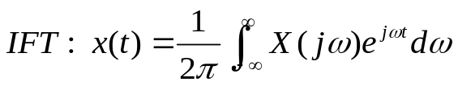
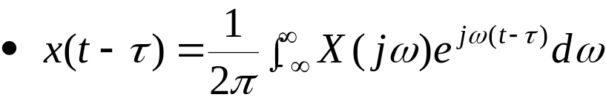
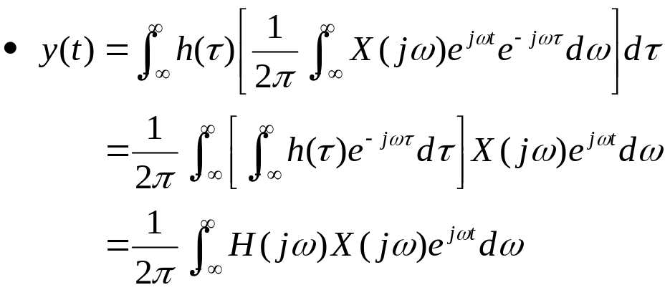
3.10 Convolution Property
3.10.1 Convolution of Nonperiodic Signals
Convolution of two nonperiodic continuous-time signals x(t) and h(t)
Expression of x(t-τ)
Substituting x(t-τ) into the convolution integral
Convolution of h(t) and x(t) in the time domain corresponds to multiplication of their FTs H(jω) and X(jω) in the freq. domain
x(t)
h(t)
y(t)
X(jω)
H(jω)
Y(jω)

Slide 4
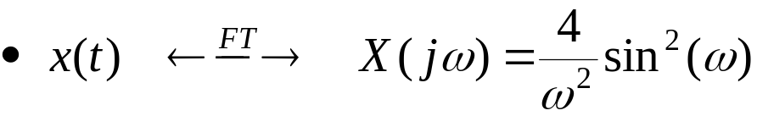
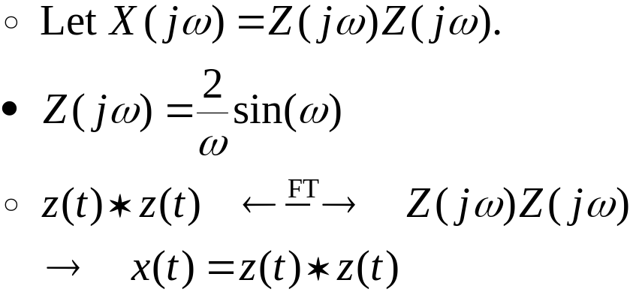
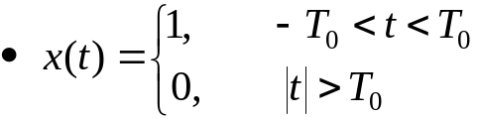

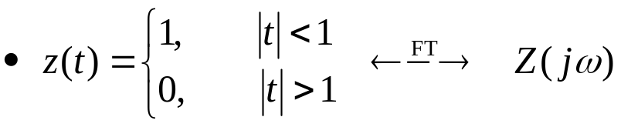
3.10.1 Convolution of Nonperiodic Signals (Cont.)
Example 3.32 Finding inverse FT’s by the convolution property
Use the convolution property to find x(t)
  x(t)?
  Use the result of Example 3.25

Slide 5
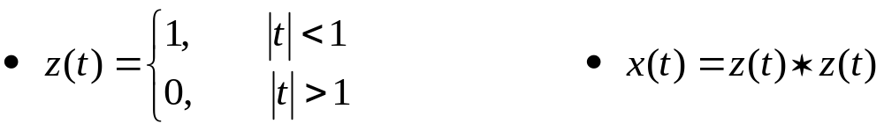
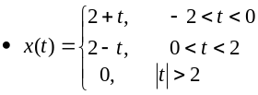
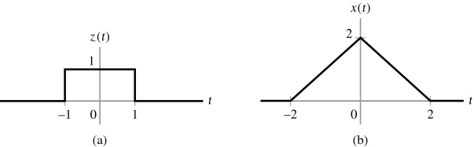
3.10.1 Convolution of Nonperiodic Signals (Cont.)
Example 3.32 Finding inverse FT’s by the convolution property (Cont.)
Figure 3.52 (p. 261)
Signals for Example 3.32. (a) Rectangular pulse z(t). (b) Convolution of z(t) with itself gives x(t).

Slide 6
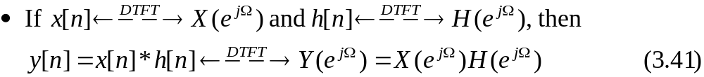
3.10.1 Convolution of Nonperiodic Signals (Cont.)
A similar property holds for convolution of discrete-time nonperiodic signals.

Slide 7
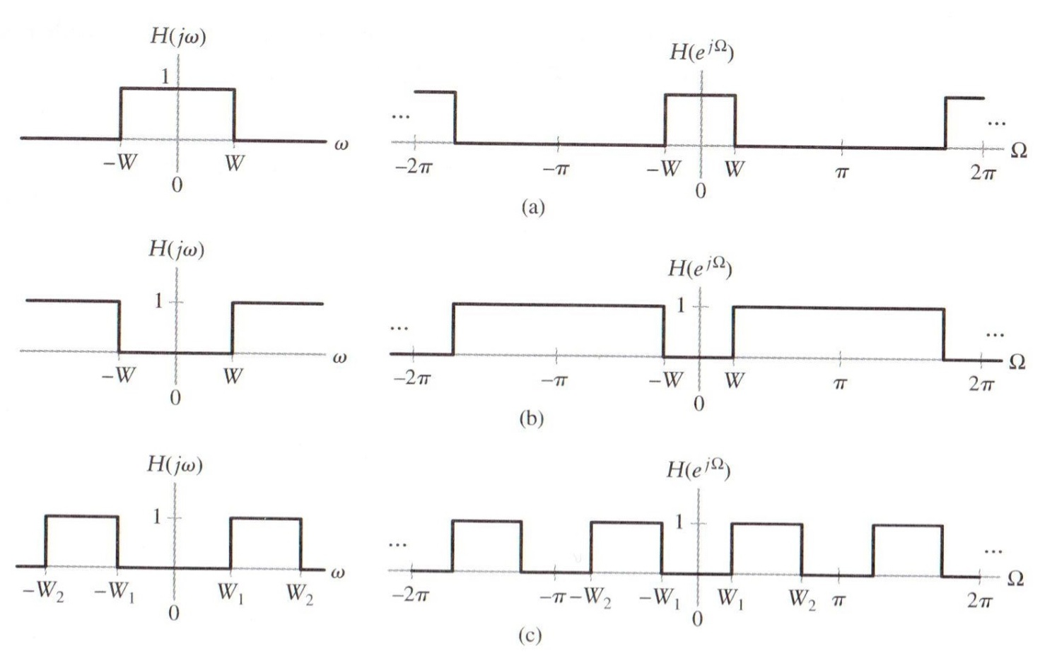
3.10.2 Filtering
X(jω)
H(jω)
Y(jω)
Ideal low-, high-, and band-pass filters:
Figure 3.53 (p. 263)
Frequency response of ideal continuous- (left panel) and discrete-time (right panel) filters. (a) Low-pass characteristic. (b) High-pass characteristic. (c) Band-pass characteristic.

Slide 8


3.10.2 Filtering (Cont.)
Magnitude response of a filter:
  Units of decibels, dB
Energy spectrum of the filter output:
  The -3 dB point corresponds to frequencies at which the filter passes only half of the input power.
  The -3dB points are usually termed the cutoff frequencies of the filter.

Slide 9
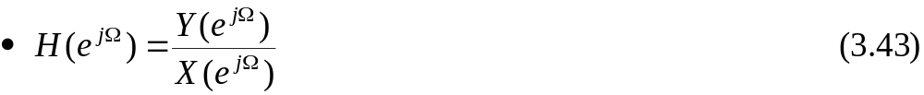
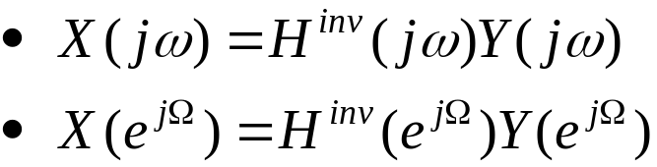
3.10.2 Filtering (Cont.)
Convolution property implies that the frequency response of a system may be expressed as the ratio of the FT or DTFT of the output to that of the input:
  For a continuous-time system:
  For a discrete-time system:
  Recover the input of the system from the output as
x(t)
h(t)
y(t)
X(jω)
H(jω)
Y(jω)

Slide 10
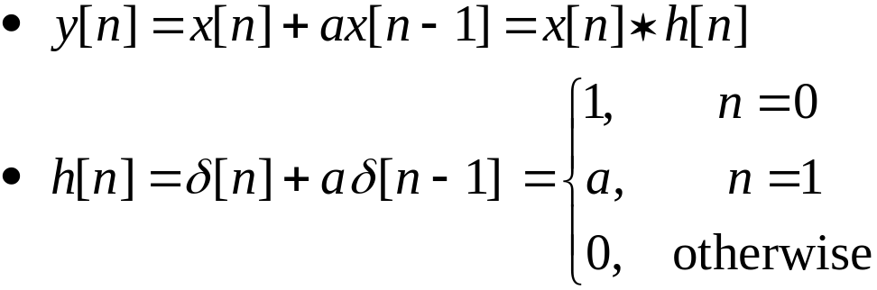
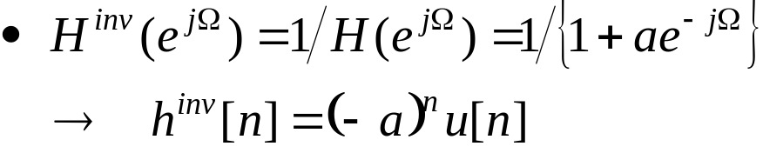

3.10.2 Filtering (Cont.)
Example 3.35: Multipath communication channel: Equalization
Consider the problem addressed in Example 2.13.
Using the convolution property to find the impulse response of an inverse system that will recover x[n] from y[n].
x[n]
h[n]
y[n]
x[n] = (α)^{n}u[n]
Notes:
신호 및 시스템

Slide 11
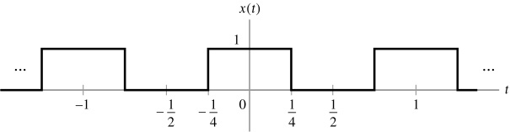
3.10.3 Convolution of Periodic Signals
Define the periodic convolution of two continuous-time signals x(t) and z(t), with each having period T.
  Substituting the FS representation of z(t) into the convolution integral leads to the property
Example 3.36 Convolution of two periodic signal
Evaluate the periodic convolution of the sinusoidal signal
with the square wave x(t) depicted in the below Figure (Fig. 3.56).
*
*

Slide 12
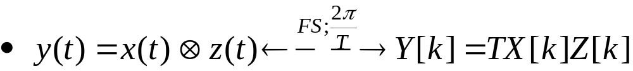
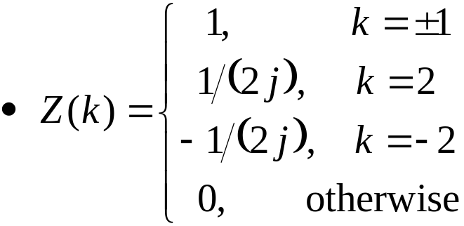
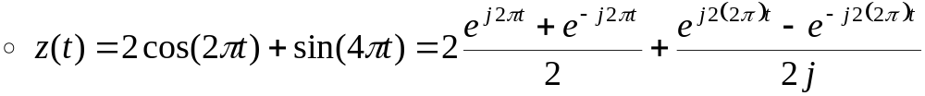
3.10.3 Convolution of Periodic Signals (Cont.)
Example 3.36 Convolution of two periodic signal (Cont.)
  Both x(t) and z(t) have fundamental period T=1.
  FS representation of z(t)
*
*

Slide 13
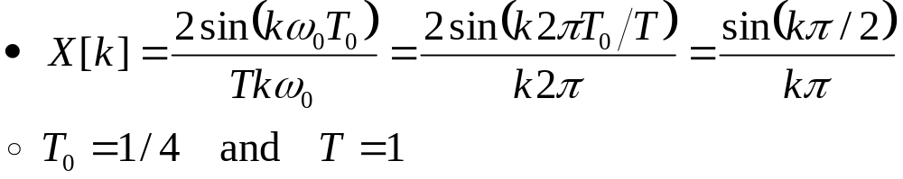
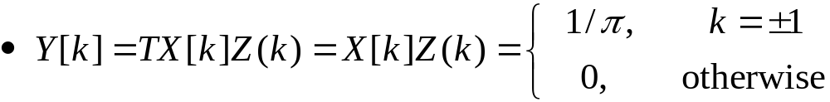
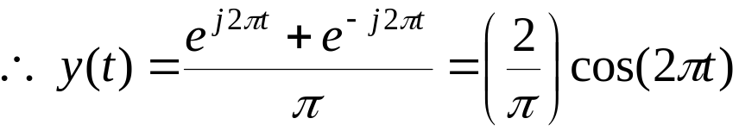
3.10.3 Convolution of Periodic Signals (Cont.)
Example 3.36 Convolution of two periodic signal (Cont.)
  FS coefficients for x(t) may be obtained from Example 3.13.
  FS coefficients for y(t)

Slide 14
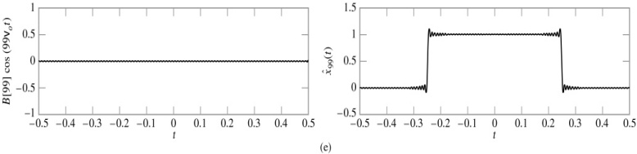

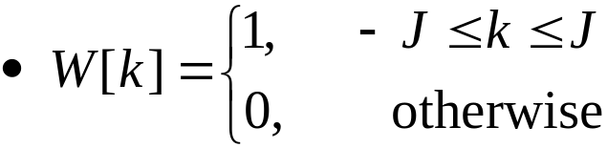
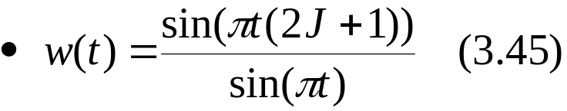
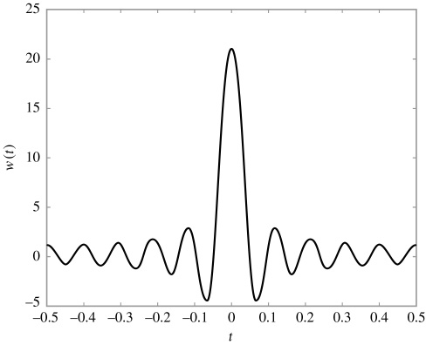
3.10.3 Convolution of Periodic Signals (Cont.)
Gibbs phenomenon in Ex.3.14
Figure 3.57 (p. 270)
The signal w(t) defined in Eq. (3.45) when J = 10.

Slide 15
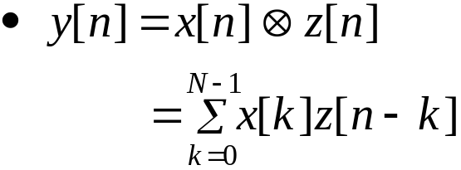
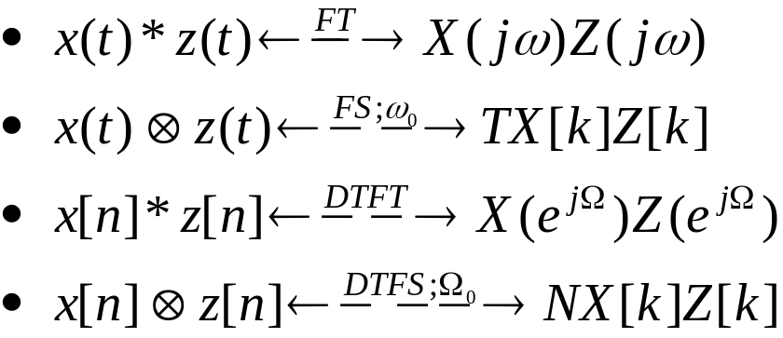
3.10.3 Convolution of Periodic Signals (Cont.)
Discrete-time convolution of two N-periodic sequences x[n] and z[n]:
Table 3.5 Convolution properties
*
*
*
*

Slide 16
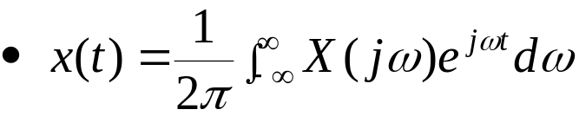
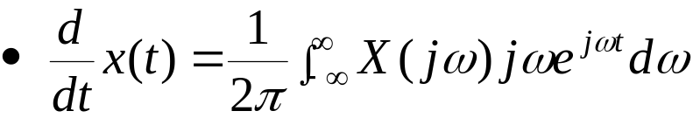
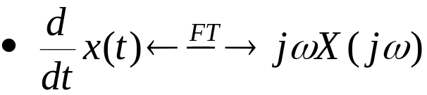
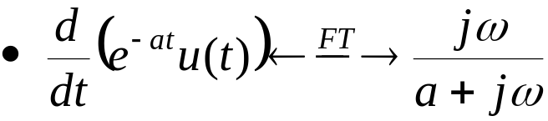
3.11 Differentiation and Integration Properties
3.11.1 Differentiation in Time
Consider the effect of differentiating a nonperiodic signal x(t):
Differentiating:
FT pair
Example 3.37 Verifying the differentiation property
Verify the result by differentiating and taking the FT of the result.
: IFT
Notes:
신호 및 시스템

Slide 17
3.11 Differentiation and Integration Properties
3.11.1 Differentiation in Time
Consider the effect of differentiating a nonperiodic signal x(t):
Differentiating:
FT pair
Example 3.37 Verifying the differentiation property
Verify the result by differentiating and taking the FT of the result.
: IFT
Notes:
신호 및 시스템

Slide 18
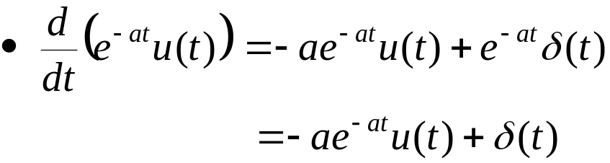
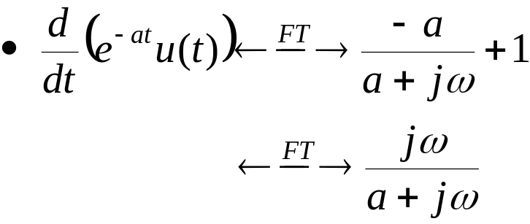
3.11 Differentiation and Integration Properties
3.11.1 Differentiation in Time (Cont.)
Example 3.37 Verifying the differentiation property (Cont.)
  Using the product rule for differentiation
  Taking the FT of each term and using linearity

Slide 19
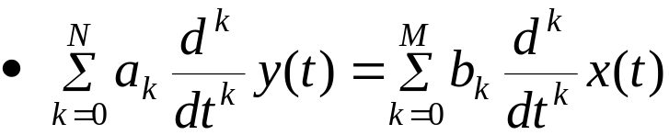
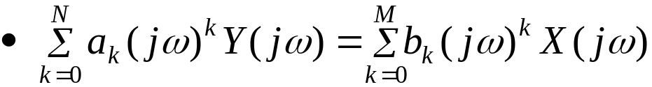
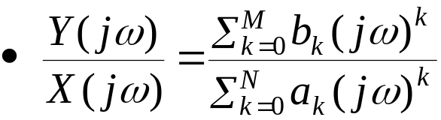

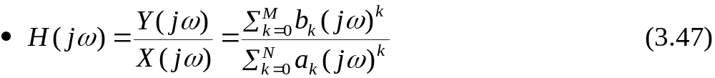
3.11.1 Differentiation in Time (Cont.)
Differentiation property may be used to find the frequency response of a continuous-time system described by the differential equation
First, take the FT and apply the differentiation property:
Rearrange :
Eq.(3.42) implies that the frequency response of the system is

Slide 20
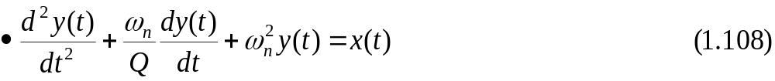
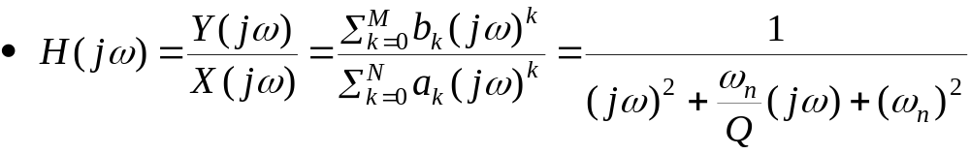
3.11.1 Differentiation in Time (Cont.)
Example 3. 38 MEMS Accelerometer: Frequency response and resonance
The MEMS accelerometer introduced in Section 1.10 is described by the differential equation
Find the frequency response of the system and plot the magnitude response in dB for ω_{n} = 10,000 rad/s, Q = 2/5, Q = 1, and Q = 200.
  Applying Eq. (3.47)

Slide 21
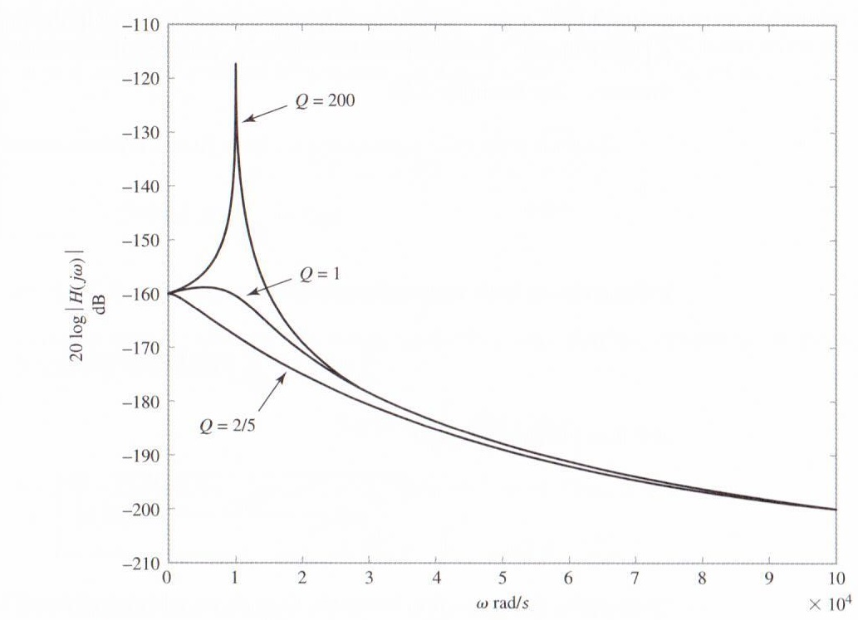
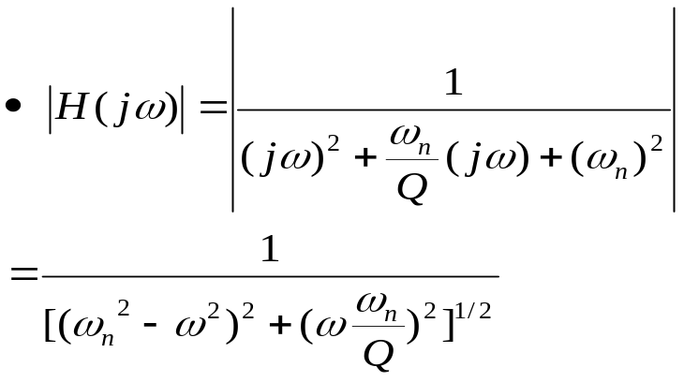
3.11.1 Differentiation in Time (Cont.)
Example 3. 38 MEMS Accelerometer: Frequency response and resonance (Cont.)
Figure 3.58 Magnitude of frequency response in dB for MEMS accelerometer for ω_{n} = 10,000 rad/s. and (a) Q = 2/5, (b) Q = 1, and (c) Q = 200.

Slide 22
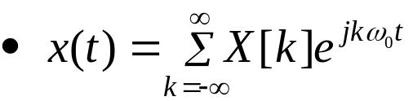
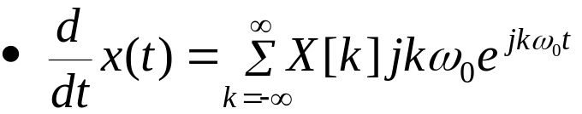
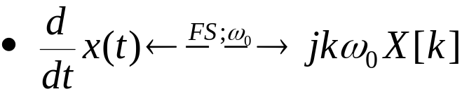
3.11.1 Differentiation in Time (Cont.)
If x(t) is a periodic signal, then we have the FS representation:
Differentiating:
FS pair
: IFS
Notes:
신호 및 시스템

Slide 23
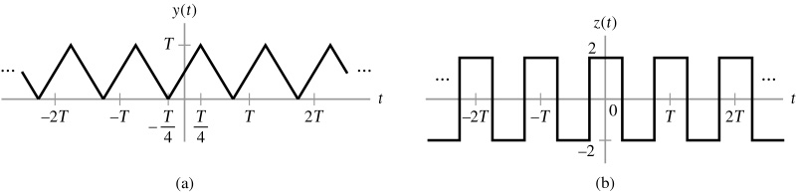
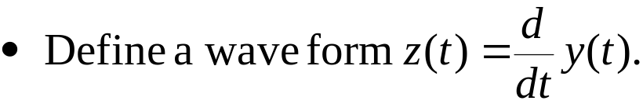

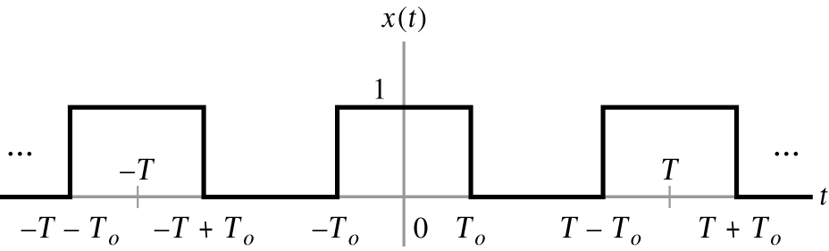

3.11.1 Differentiation in Time (Cont.)
Example 3.39 Use the differentiation property to find the FS representation of the triangular wave depicted in Fig. 3.59(a).
Figure 3.59 (p. 274)
Signals for Example 3.39. (a) Triangular wave y(t). (b) The derivative of y(t) is the square wave z(t).
  The signal z(t) corresponds to the square wave x(t) of Example 3.13 with T₀/T=1/4, provided that we first scale the amplitude of x(t) by a factor of four and then subtract a constant term of two units.

Slide 24
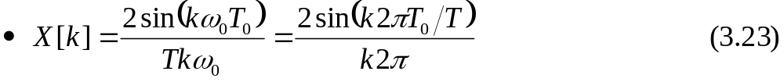


3.11.1 Differentiation in Time (Cont.)
Example 3.39 (Cont.)
  Use the result of x(t) in Example 3.13.

Slide 25



3.11.1 Differentiation in Time (Cont.)
Example 3.39 (Cont.)
  Y[0] is the average value of y(t).

Slide 26





3.11.2 Differentiation in Frequency
Consider the effect of differentiating the frequency-domain representation of a signal: FT
Differentiating:
FT pair
Frequency-differentiation property for DTFT:
DTFT pair

Slide 27


3.11.2 Differentiation in Frequency (Cont.)
Example 3.40 FT of a Gaussian Pulse
Use the differentiation-in-time and differentiation-in-frequency properties to determine the FT of the Gaussian pulse g(t) depicted in Fig. 3.60.
Figure 3.60 (p. 275) Gaussian pulse g(t).
  Derivative of g(t) with respect to t
: 평균0, 분산1인 가우시안 pdf
Notes:
신호 및 시스템

Slide 28







3.11.2 Differentiation in Frequency (Cont.)
Example 3.40 FT of a Gaussian Pulse (Cont.)
  Differentiation-in-time property
  From Eq. (3.48)
  Differentiation-in-frequency property
  From Eqs. (3.49) and (3.50)
: 식 3.48과 비교
Notes:
신호 및 시스템

Slide 29



3.11.2 Differentiation in Frequency (Cont.)
Example 3.40 FT of a Gaussian Pulse (Cont.)
: 해 가정함
Notes:
신호 및 시스템

Slide 30


3.11.3 Integration
Integrating nonperiodic signals with respect to time.
Define:
Note that
Using differentiation property
Integration property:
  The first term on the right-hand side is zero at ω=0.
  The second term on the right-hand side depends on the average value of x(t).
,ω≠0
: 32쪽에 증명
Notes:
신호 및 시스템

Slide 31





3.11.3 Integration (Cont.)
Demonstrate the integration property by deriving the FT of the unit step
To check the above result, we express the unit step as the sum of two functions
  Signum function is defined as

Slide 32



3.11.3 Integration (Cont.)
Figure 3.61 (p. 279)
Representation of a step function as the sum of a constant and a signum function.
Using the results of Example 3.28

Slide 33





3.11.3 Integration (Cont.)
S(j0)=0 because sgn(t) is an odd function and has zero average value.
Apply linearity property to Eq. (3.54)
3.53식 증명
Notes:
신호 및 시스템

Slide 34





3.11.3 Integration (Cont.)
Table 3.6 Commonly used differentiation and integration properties

Slide 35



3.12 Time- and Frequency-Shift Properties
3.12.1 Time-Shift Property
Table 3.7 Time-shift properties of Fourier representation

Slide 36


3.12 Time- and Frequency-Shift Properties
3.12.1 Time-Shift Property(Cont.)
Example 3.41 Finding an FT using the time-shift property
Use the FT of the rectangular pulse x(t) depicted in Fig. 3.62(a) to determine the FT of the time-shifted rectangular pulse z(t) depicted in Fig. 3.62(b).
Figure 3.62 (p. 281)
Application of the time-shift property for Example 3.41.

Slide 37






3.12.1 Time-Shift Property (Cont.)
Find the frequency response of a system described by a difference equation
  Consider the difference equation
  DTFT with time-shift property
  Obtain
  Rewrite :
  Identifying this ratio with Eq.(3.43):

Slide 38


3.12.1 Time-Shift Property (Cont.)
Problem 3.33
Find the difference equation corresponding to the system with frequency response.

Slide 39



3.12.2 Frequency-Shift Property
Table 3.8 Frequency-shift properties of Fourier representations

Slide 40



3.12.2 Frequency-Shift Property (Cont.)
Example 3.42 Finding an FT using the frequency-shift property
Use the frequency-shift property to determine the FT of the complex sinusoidal pulse
  Express z(t) as the product of a complex sinusoid e^{j10t} and a rectangular pulse

Slide 41
Q & A
Thank you …
Notes:
신호 및 시스템

Slide 42





참고 : 식 3.44 증명
*
Y[k]

