Slide 1
CH. 3. Fourier Representation of Signals and Linear Time-Invariant Systems(cont.)
3.1 Introduction
3.2 Complex Sinusoids and Frequency Response of LTI systems
3.3 Fourier Representations for Four Classes of Signals
3.4 Discrete-Time Periodic Signals: The Discrete-Time Fourier Series
3.5 Continuous-Time Periodic Signals: The Fourier Series
3.6 Discrete-Time Nonperiodic Signals: The Discrete-Time Fourier Transform
3.7 Continuous-Time Nonperiodic Signal: The Fourier Transform
3.8 Property of Fourier Representations
3.9 Linearity and Symmetry Properties
3.10 Convolution Property
3.11 Differentiation and Integration Properties
3.12 Time- and Frequency-Shift Properties
3.13 Finding Inverse Fourier Transforms by Using Partial-Fraction Expansions ------3
3.14 Multiplication Property -----------------------------------------------------------------------7
3.15 Scaling Properties -----------------------------------------------------------------------------14
3.16 Parseval Relationships -----------------------------------------------------------------------18
3.17 Time-Bandwidth Product --------------------------------------------------------------------21
3.18 Duality -------------------------------------------------------------------------------------------23

Slide 2
CH. 3. Fourier Representation of Signals and Linear Time-Invariant Systems (Part 3)
3.13 Finding Inverse Fourier Transforms by Using Partial-Fraction Expansions
  3.13.1 Inverse Fourier Transform
  3.13.2 Inverse Discrete-Time Fourier Transform
3.14 Multiplication Property
3.15 Scaling Properties
3.16 Parseval Relationships
3.17 Time-Bandwidth Product
3.18 Duality
  3.18.1 The Duality Property of the FT
  3.18.2 The Duality Property of the DTFS
  3.18.3 The Duality Property of the DTFT and FS

Slide 3
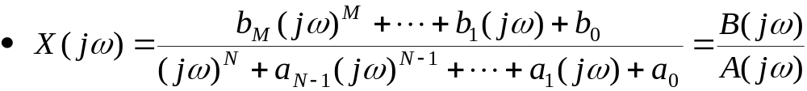
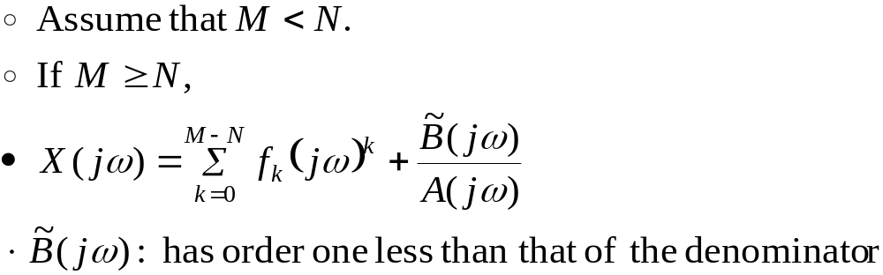
3.13 Finding Inverse Fourier Transforms by Using Partial-Fraction Expansions
3.13.1 Inverse Fourier Transform
Suppose X(jω) is expressed as a ratio of polynomials in jω:
Determine the inverse FT of such ratios by using partial-fraction expansion.

Slide 4
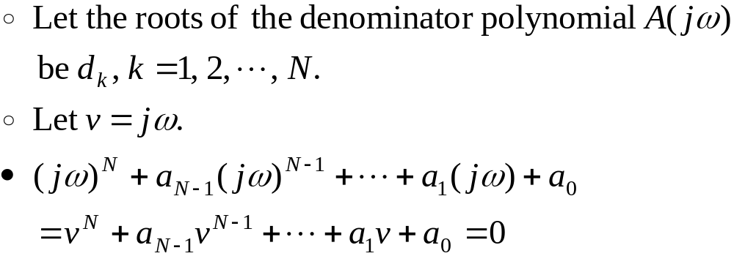

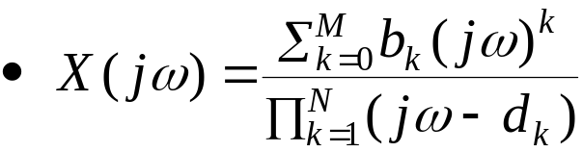
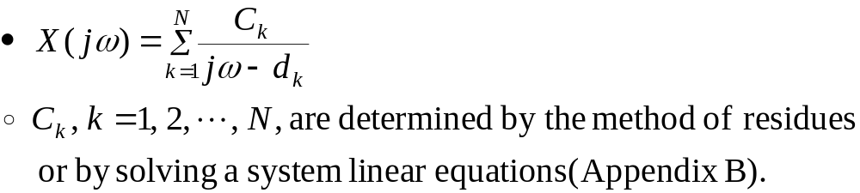
3.13.1 Inverse Fourier Transform (Cont.)
Determine the root of the polynomial (d_{k}).
Assume that the all roots are distinct.

Slide 5
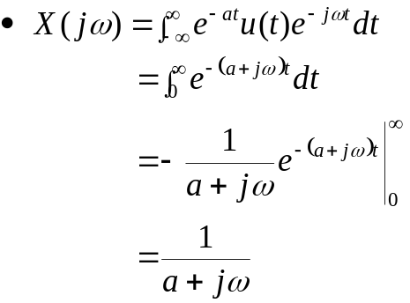
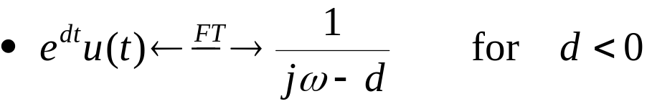
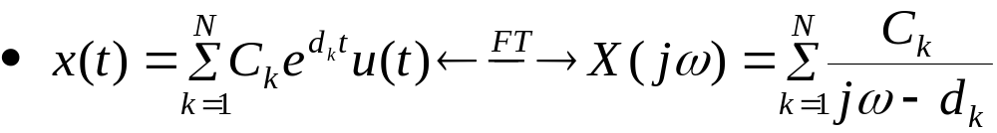
3.13.1 Inverse Fourier Transform (Cont.)
In Example 3.24
  This pair is valid if d is complex, provided that Re{d}<0.
  Assuming that the real part of each d_{k}, k = 1, 2, …, N, is negative
Read Example 3.44 (MEMS Accelerometer: Impulse response)
  ,for a > 0
Self-study

Slide 6
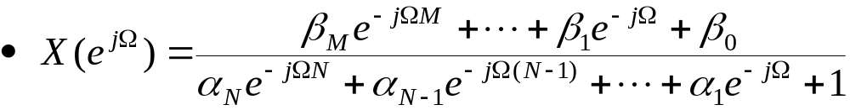

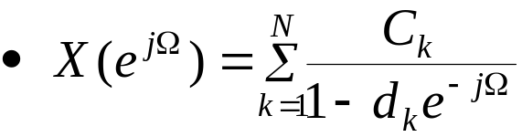
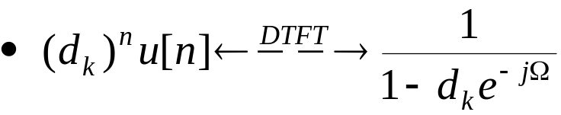

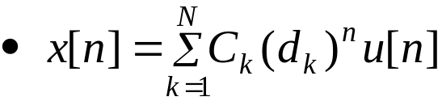
3.13.2 Inverse Discrete-Time Fourier Transform
  We factor the denominator polynomial as
  Assuming that M<N and all d_{k} are distinct.
  Linearity property implies that
: 대치하여 d_{k}구함
x[n] = (α)^{n}u[n]
Notes:
신호 및 시스템

Slide 7
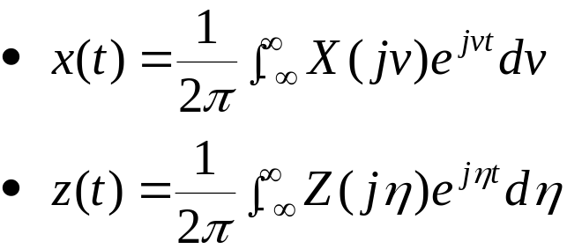
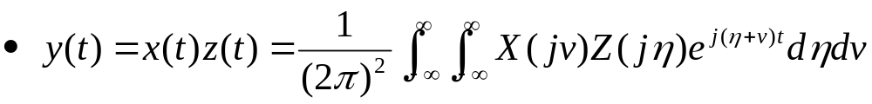

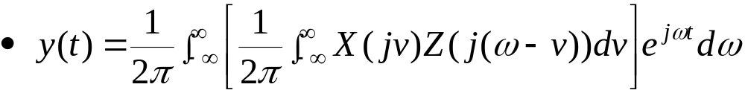
3.14 Multiplication Property
If x(t) and z(t) are nonperiodic signals
The product term, y(t), may be written in the form
  Convolution, scaled by 1/(2π)

Slide 8

3.14 Multiplication Property (Cont.)
Discrete-time nonperiodic signals x[n] and z[n]
*
*
*

Slide 9
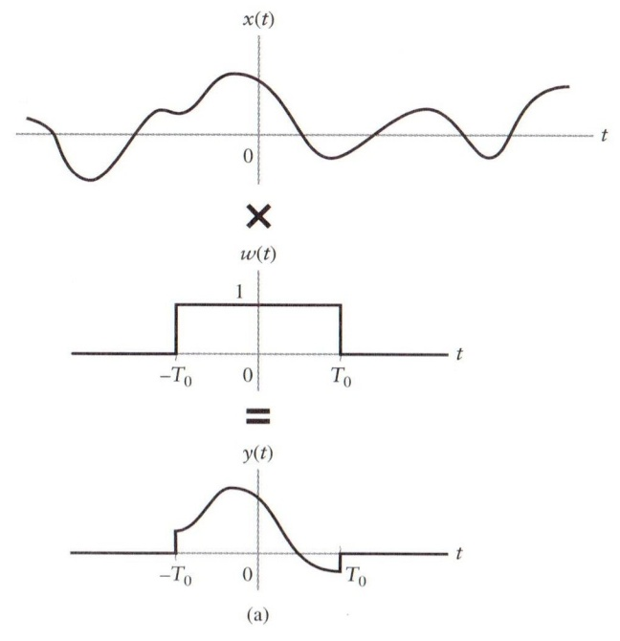
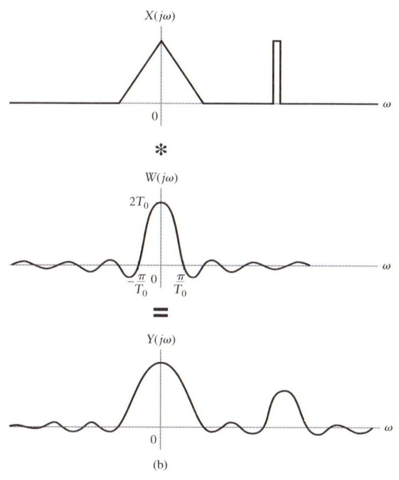
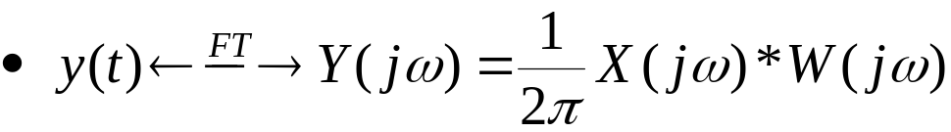
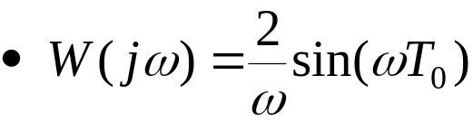
3.14 Multiplication Property (Cont.)
Figure 3.65 (p. 293) The effect of windowing. (a) Truncating a signal in time by using a window function w(t). (b) Convolution of the signal and window FT’s resulting from truncation in time.
Multiplication property:
Rectangular window depicted in fig. 3.65(a) :

Slide 10
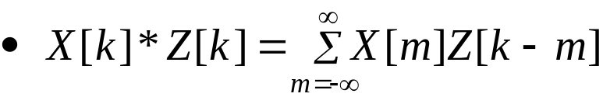
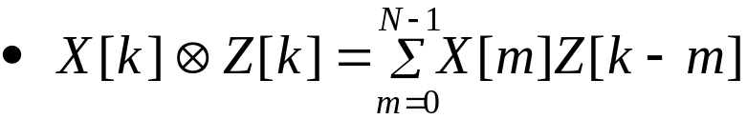
3.14 Multiplication Property (Cont.)
The multiplication property for continuous-time periodic signals
  Nonperiodic convolution of the FS coefficients.
The multiplication property for discrete-time periodic signals
  Periodic convolution of DTFS coefficients.
*
*

Slide 11
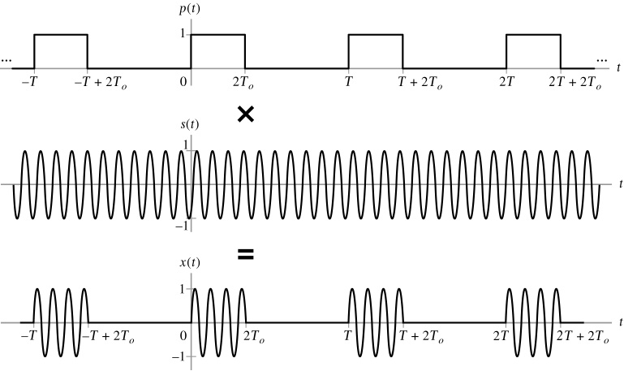
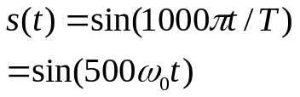

3.14 Multiplication Property (Cont.)
Example 3.47 Radar Range Measurement: Spectrum of RF Pulse Train
Figure 3.68 (p. 297)
The RF pulse is expressed as the product of a periodic square wave and a sine wave.

Slide 12
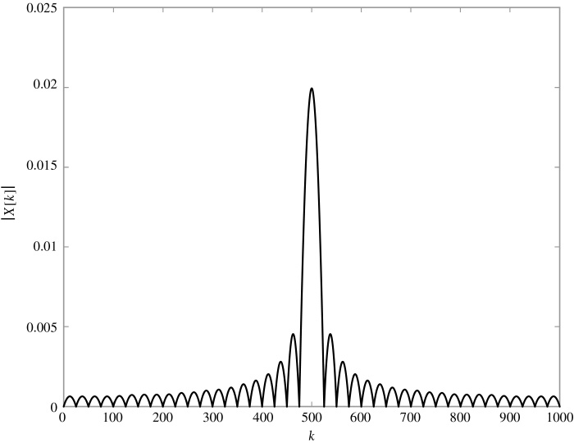
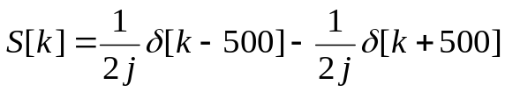
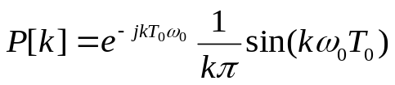
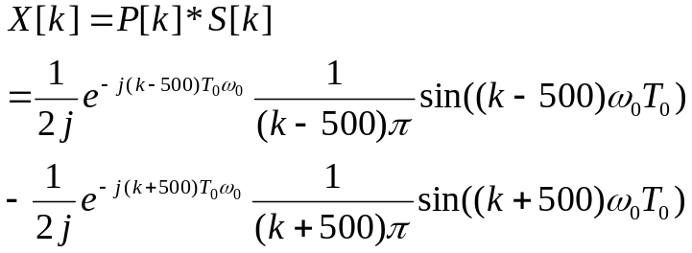
3.14 Multiplication Property (Cont.)
Example 3.47 Radar Range Measurement: Spectrum of RF Pulse Train (Cont.)
Figure 3.69 (p. 298)
FS magnitude spectrum for 0 ≤ k ≤ 1000. The result is depicted as a continuous curve, due to the difficulty of displaying 1000 stems.

Slide 13
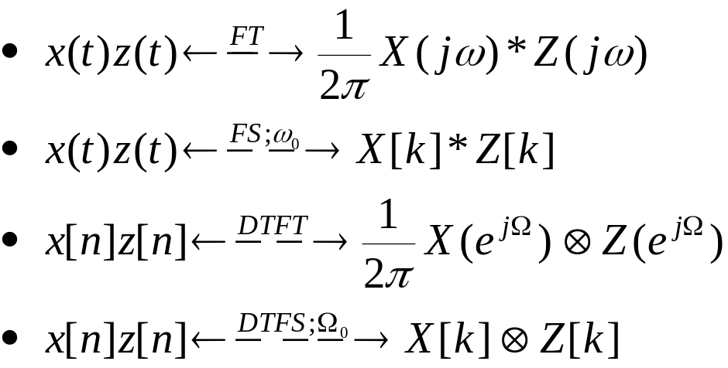
3.14 Multiplication Property (Cont.)
Table 3.9 Multiplication properties of Fourier representations.
*
*

Slide 14

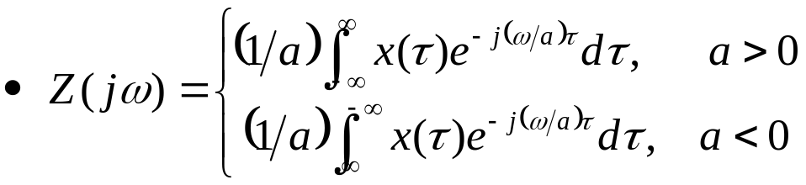
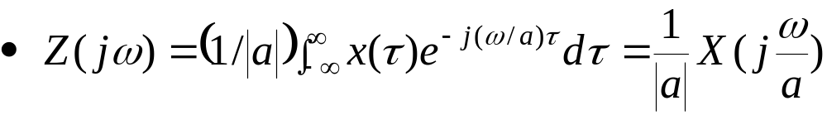
3.15 Scaling Properties
Let z(t)=x(at), where a is a constant.
Represent the single integral
Conclude that

Slide 15
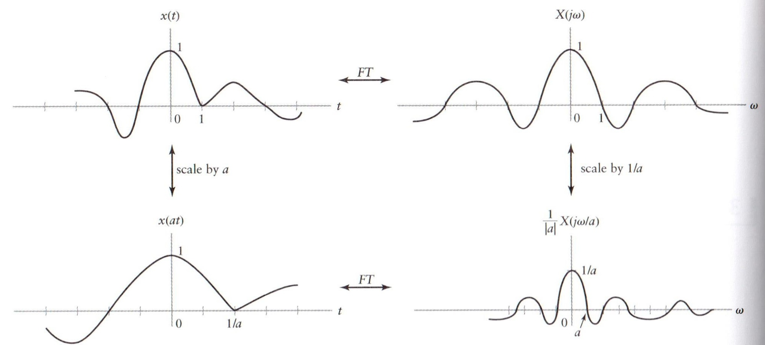

3.15 Scaling Properties (Cont.)
Figure 3.70 (p. 300)
The FT scaling property. The figure assumes that 0 < a < 1.

Slide 16
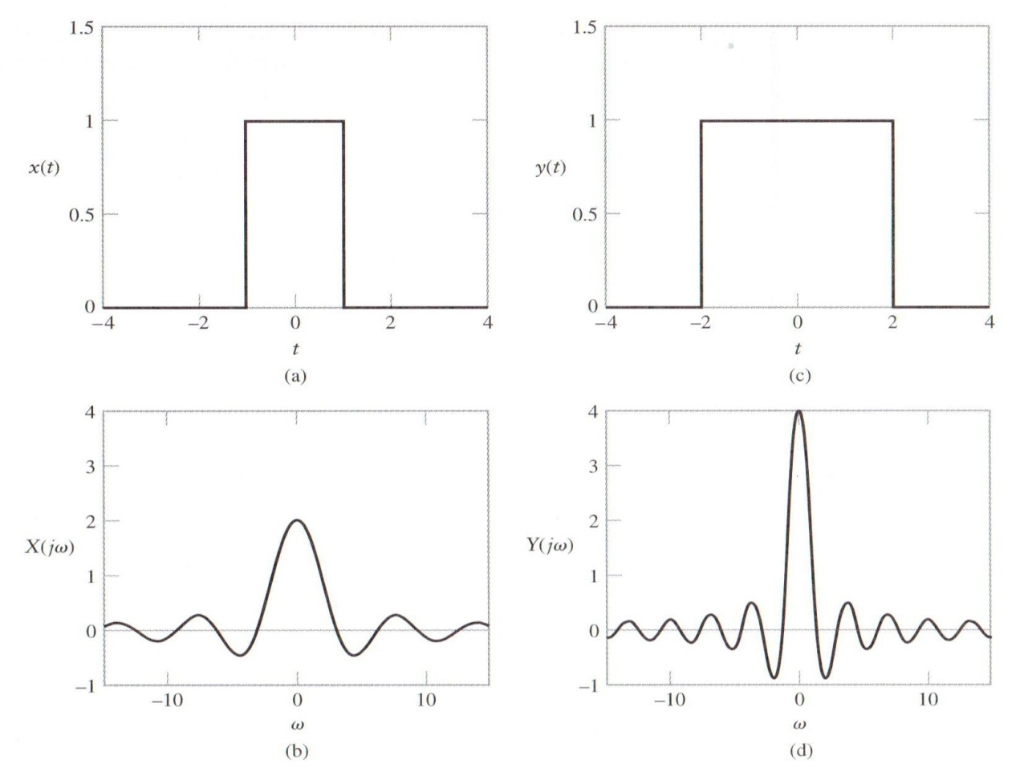
3.15 Scaling Properties (Cont.)
Example 3.48: Scaling a Rectangular Pulse
Figure 3.71 (p. 301)
Application of the FT scaling property in Example 3.48. (a) Original time signal. (b) Original FT. (c) Scaled time signal y(t) = x(t/2). (d) Scaled FT Y(jω) = 2X(j2ω).

Slide 17
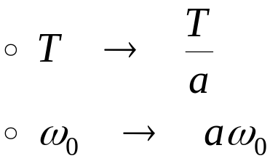
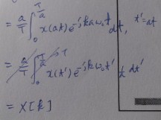
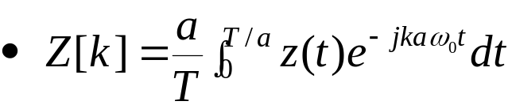
3.15 Scaling Properties (Cont.)
x(t) is a periodic signal, then z(t) = x(at) is also periodic
  FS coefficient of z(t)
  Substituting x(at) for z(t)
  The FS coefficients of x(t) and x(at) are identical.
  The scaling operation simply changes the harmonic spacing ω₀ to aω₀.

Slide 18

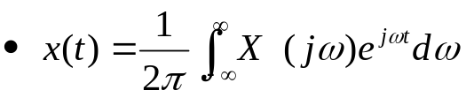
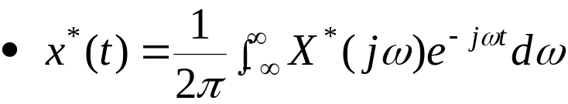
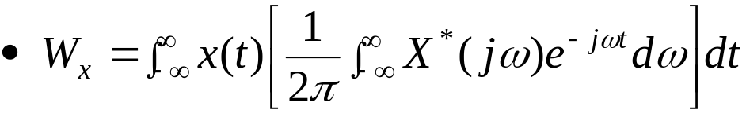
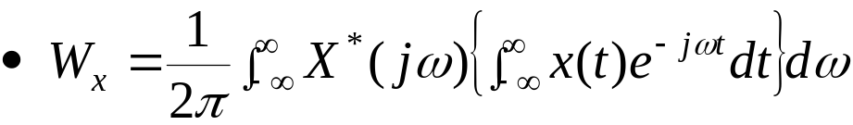
3.16 Parseval Relationships
The Parseval relationships state that the energy or power in the time-domain representation of a signal is equal to the energy or power in the frequency-domain representation.
Energy in a continuous-time nonperiodic signal
  x(t) may be complex valued in general
  Substituting this formula into the expression for W_{x}
  Interchange the order of integration

Slide 19
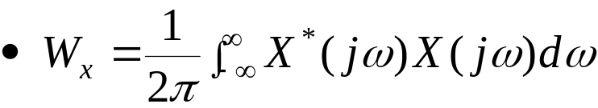
3.16 Parseval Relationships (Cont.)
  Interchange the order of integration
  Obtain
  Conclude that
Energy spectrum

Slide 20
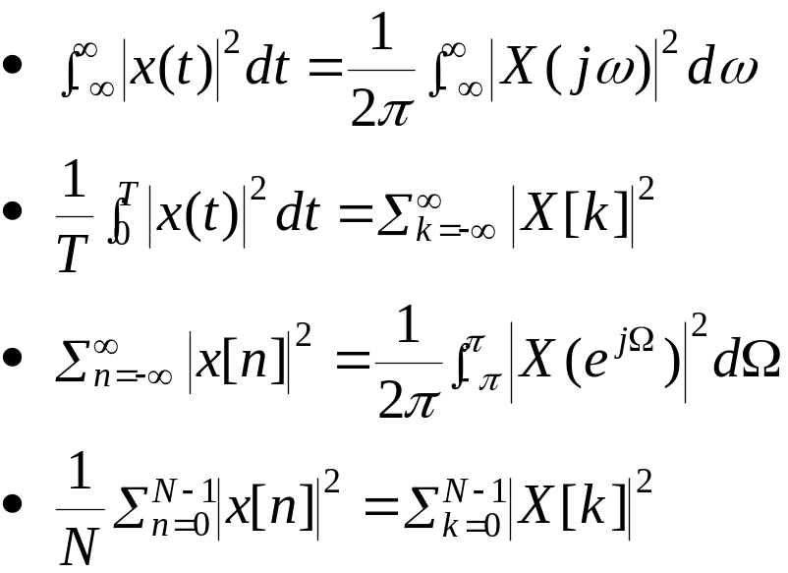
3.16 Parseval Relationships (Cont.)
Table 3.10 Parseval relationships for the four Fourier representations.
Read Example 3.50 (Calculating the Energy in a Signal)
Representation | Parseval Relation
FT FS DTFT DTFS
Self-study
Notes:
신호 및 시스템

Slide 21

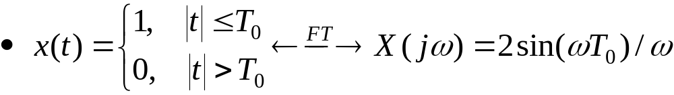
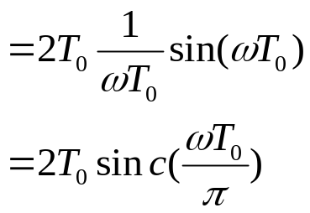
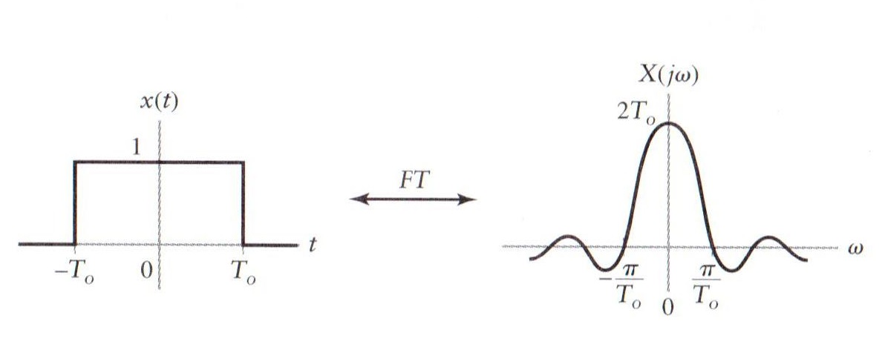
3.17 Time-Bandwidth Product
An inverse relationship between the time and frequency extent of a signal
From Example 3.25,
Figure 3.72 (p. 305)
Rectangular pulse illustrating the inverse relationship between the time and frequency extent of a signal.

Slide 22
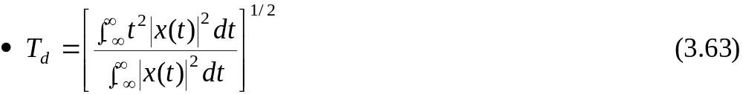
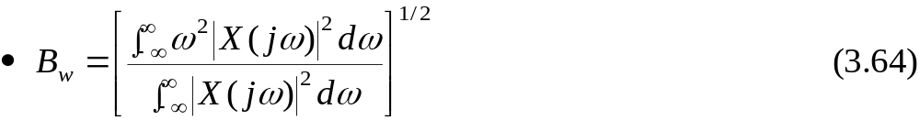
3.17 Time-Bandwidth Product (Cont.)
Define root-mean-square measures of effective duration and bandwidth
Effective duration of a signal x(t):
The effective bandwidth:
Time-bandwidth product for any signal is lower bounded:
  Uncertainty principle
  Cannot simultaneously decrease the duration and bandwidth of a signal
  Gaussian pulses are the only signals that satisfy this relationship with equality
Notes:
신호 및 시스템

Slide 23
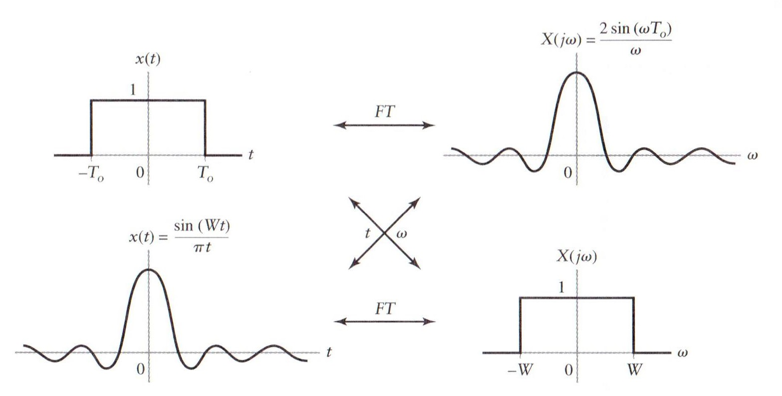
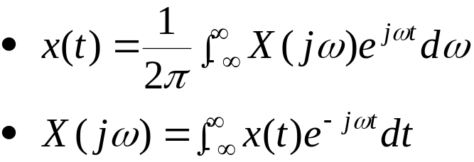
3.18 Duality
3.18.1 The Duality Property of the FT
Figure 3.73 (p. 307)
Duality of rectangular pulses and sinc functions
FT pair

Slide 24

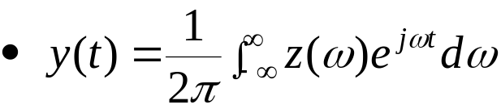
3.18.1 The Duality Property of the FT (Cont.)
General equation:
  Conclude that

Slide 25
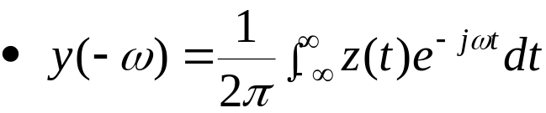


3.18.1 The Duality Property of the FT (Cont.)
Interchange the roles of time and frequency : ν=-ω, η=t
  FT pair:
Interchange the role of time and frequency:

Slide 26



3.18.1 The Duality Property of the FT (Cont.)
Duality of the FT:
Figure 3.74 (p. 309)
The FT duality property.

Slide 27


3.18.1 The Duality Property of the FT (Cont.)
Example 3.52 Applying Duality
Find the FT of
First

Slide 28


3.18.2 The Duality Property of the DTFS
DTFS process:
DTFS duality property:
k-->n, n-->-k
Notes:
신호 및 시스템

Slide 29




3.18.3 The Duality Property of the DTFT and FS
Compare:
  IFS:
  DTFT :
  Require z(t) to have the same period as X(e^{jΩ});T=2π
  ω₀=1, Ω → t, n → -k
Similarly,
  FS:
  IDTFT :
Ω → t, n → -k

Slide 30


3.18.3 The Duality Property of the DTFT and FS (Cont.)
The roles of Ω and n in the DTFT again correspond to those of t and –k in the FS.
  If
  then
Table 3.11 Duality properties of Fourier representations.
Ω → t, n → -k

Slide 31






3.18.3 The Duality Property of the DTFT and FS (Cont.)
Example 3.53 : FS-DTFT duality
Inverse X(e^{jΩ})?
Figure 3.75 (a) Triangular spectrum (b) Inverse DTFT
Ω → t, n → -k
Notes:
신호 및 시스템

Slide 32







From Ex 3.39
Notes:
신호 및 시스템

Slide 33
Q & A
Thank you . ..
Notes:
신호 및 시스템

Slide 34


: Short Time Fourier Transform
오전 5시 30분
Notes:
신호 및 시스템

Slide 35

: 앞 페이지 아래 그림 참고
오전 5시 30분

Slide 36

오전 5시 30분

Slide 37

오전 5시 30분

Slide 38

오전 5시 30분

