Slide 1
4. Applications of Fourier Representations to Mixed Signal Classes
4.1 Introduction ---------------------------------------------------------------------- 3
4.2 Fourier Transform Representations of Periodic Signals ---------------- 4
4.3 Convolution and Multiplication with Mixtures of Periodic and Nonperiodic Signals -------------------------------------------------------------12
4.4 Fourier Transform Representation of Discrete-Time Signals ---------22
4.5 Sampling --------------------------------------------------------------------------28
4.6 Reconstruction of continuous-time signals from samples --------------36
4.7 Discrete-time processing of continuous-time signals
4.8 Fourier series representations of finite-duration nonperiodic signals
4.9 The discrete-time Fourier series approximation to the Fourier transform
4.10 Efficient algorithms for evaluating the DTFS

Slide 2
4. Applications of Fourier Representations to Mixed Signal Classes (Part 1)
4.1 Introduction
4.2 Fourier Transform Representations of Periodic Signals
  4.2.1 Relating the FT to the FS
  4.2.2 Relating the DTFT to the DTFS
4.3 Convolution and Multiplication with Mixtures of Periodic and Nonperiodic Signals
  4.3.1 Convolution of Periodic and Nonperiodic Signals
  4.3.2 Multiplication of Periodic and Nonperiodic Signals
4.4 Fourier Transform Representation of Discrete-Time Signals
  4.4.1 Relating the FT and the DTFT
  4.4.2 Relating the FT to the DTFS
4.5 Sampling
  4.5.1 Sampling continuous-time signals
  4.5.2 Subsampling : sampling discrete-time signals
4.6 Reconstruction of continuous-time signals from samples
  4.6.1 Sampling theorem
  4.6.2 Ideal reconstruction
  4.6.3 A practical reconstruction : the zero-order hold

Slide 3
4.1 Introduction
DTFS, FS, DTFT, FT
Mixing:
  Periodic & nonperiodic signals
  Continuous- & discrete-time signals
Case:
  Analyze the interaction between signals & systems
  Numerically evaluate properties of signals or the behavior of a system
Build bridges between the Fourier representations of different classes of signals
  FT & DTFT
Sampling
Application :
  Communication systems ( Ch. 5)
  Filtering (Ch. 8)
  Control (Ch. 9)

Slide 4
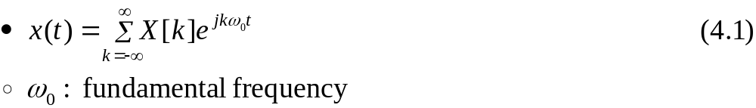
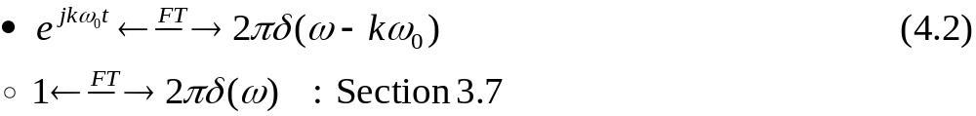
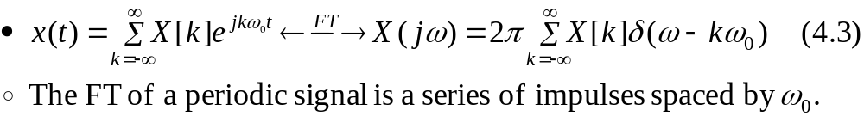
4.2 Fourier Transform Representations of Periodic Signals
4.2.1 Relating the FT to the FS
FS representation of a periodic signal x(t)
Frequency shift :
Substitute the FT pair given in Eq. (4.2) into Eq. (4.1) and use the linear property of the FT
: IFS
Notes:
신호 및 시스템

Slide 5
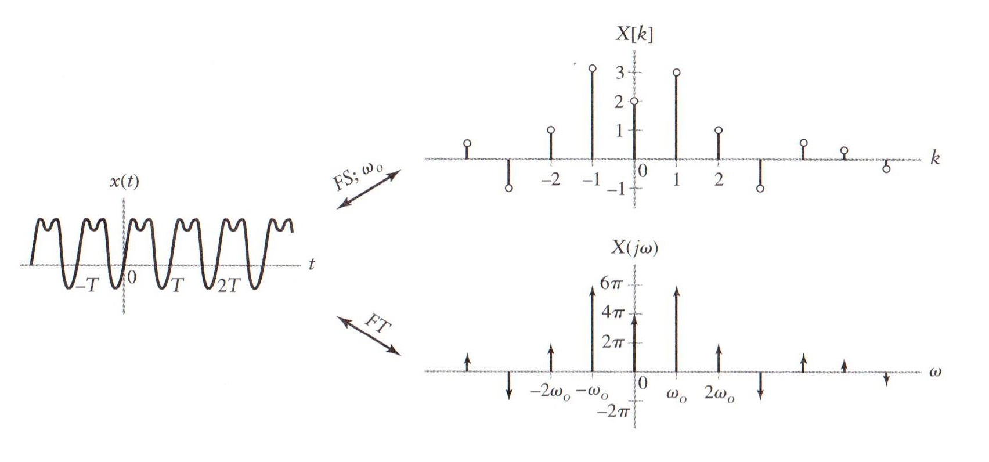
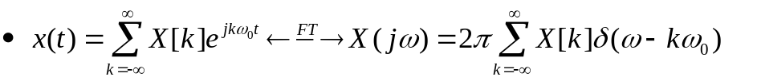
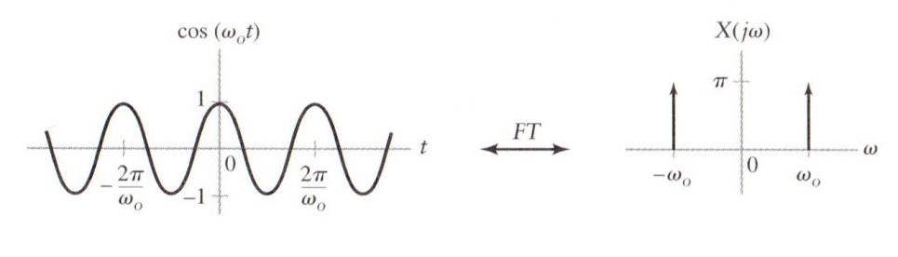
4.2.1 Relating the FT to the FS (Cont.)
Figure 4.1 (p. 343)
FS and FT representation of a periodic continuous-time signal.

Slide 6
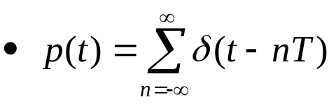
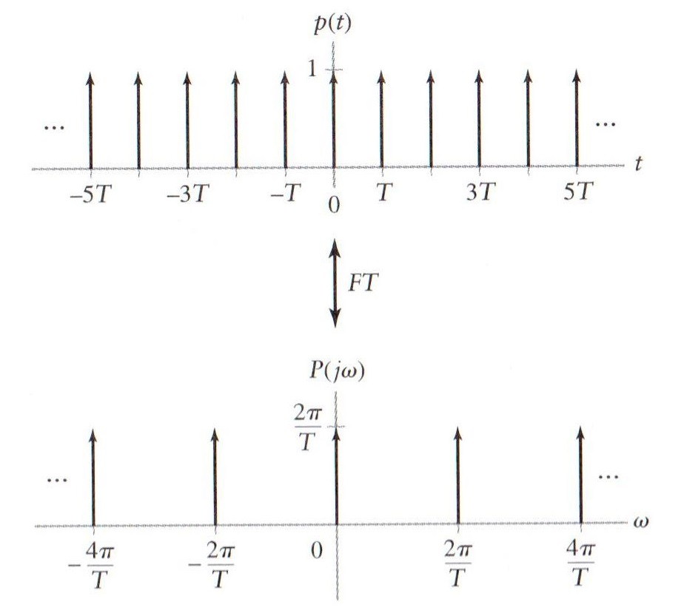
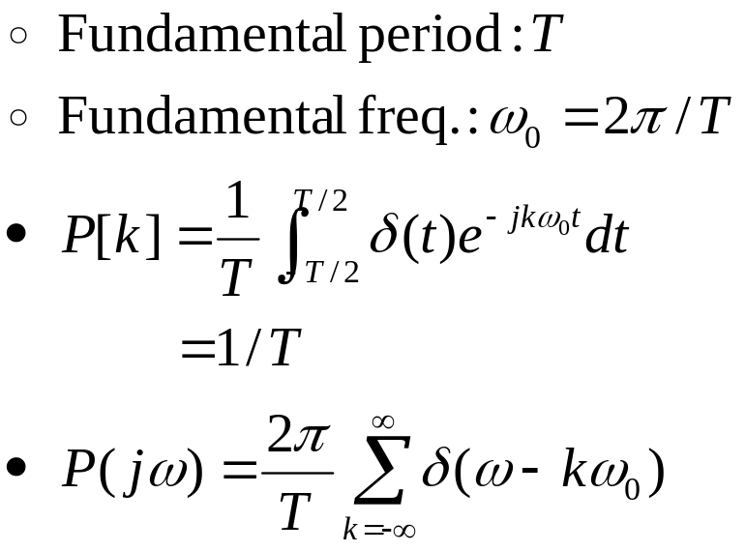

4.2.1 Relating the FT to the FS (Cont.)
Example 4.2 FT of a Unit Impulse Train
Find the FT of the impulse train.
Figure 4.3 (p. 344)
An impulse train and its FT

Slide 7

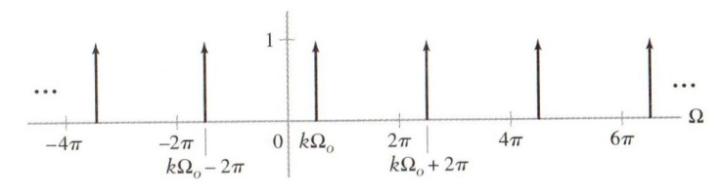
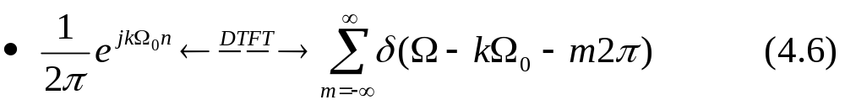

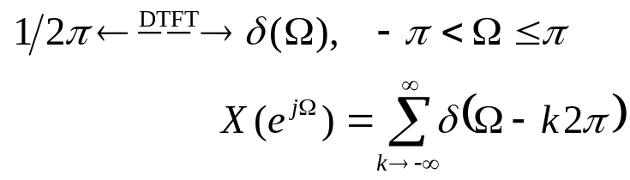
4.2.2 Relating the DTFT to the DTFS
DTFS expression for an N-periodic signal x[n]
DTFT pair
  - Refer Example 3.20 and 3.21
: IDTFS
Figure 4.5 (p. 346) Infinite series of frequency-shifted impulses that is 2π periodic in frequency Ω.
: over all Ω
Notes:
신호 및 시스템

Slide 8
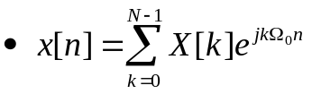
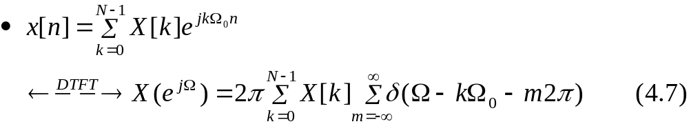

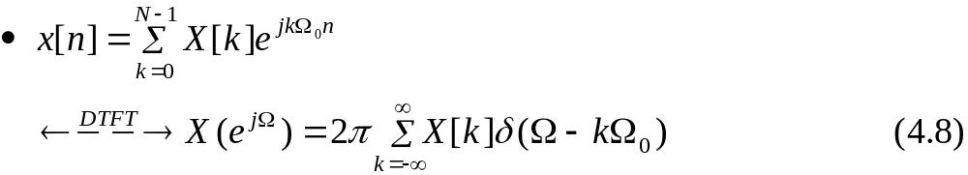
4.2.2 Relating the DTFT to the DTFS (Cont.)
Use linearity and substitute Eq. (4.6) into Eq. (4.4) to obtain the DTFT of x[n]
X[k] is N periodic and NΩ_{o}=2π

Slide 9
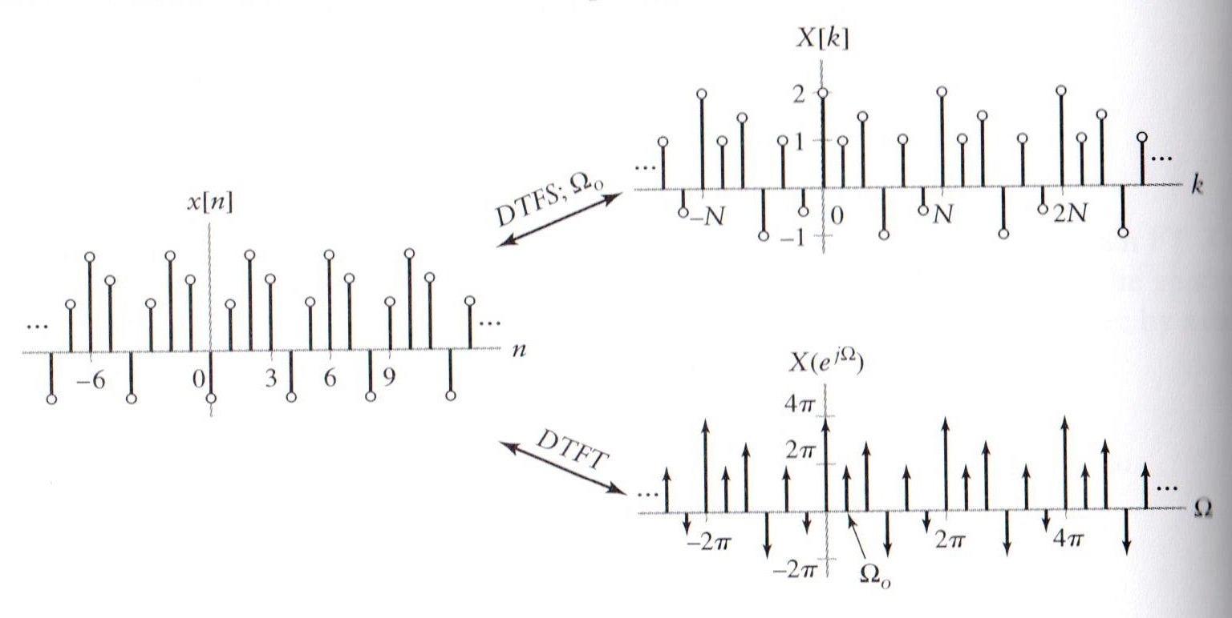
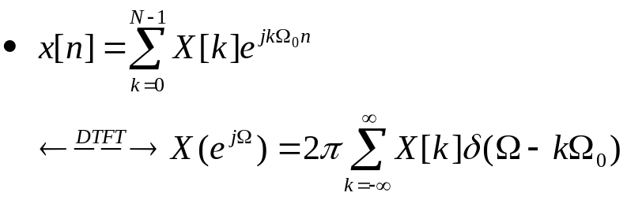
4.2.2 Relating the DTFT to the DTFS (Cont.)
Figure 4.6 (p. 346)
DTFS and DTFT representations of a periodic discrete-time signal.

Slide 10
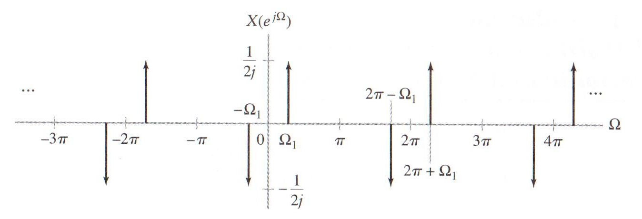
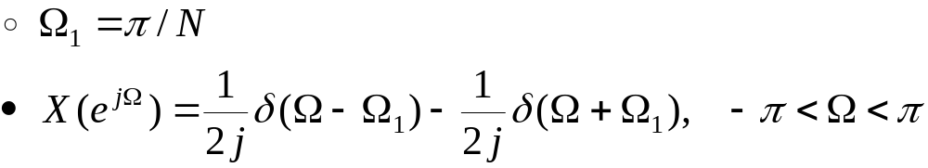
4.2.2 Relating the DTFT to the DTFS (Cont.)
Example 4.3 DTFT of a Periodic Signal
Determine the inverse DTFT of the frequency-domain representation depicted in Fig. 4.7.
Figure 4.7 (p.347)
DTFT of periodic signal for Example 4.3
: 주어짐
Notes:
신호 및 시스템

Slide 11
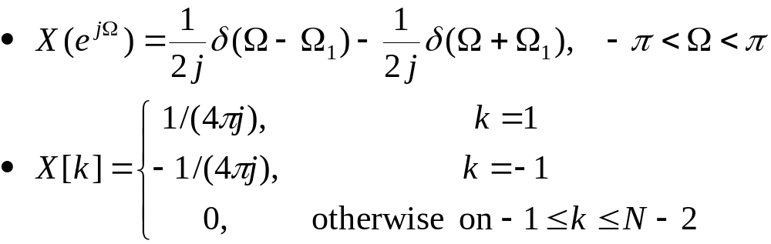
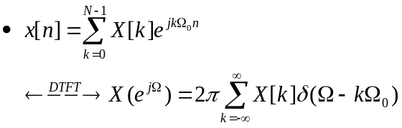
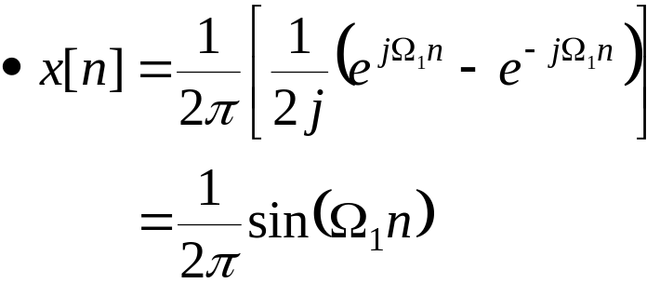
4.2.2 Relating the DTFT to the DTFS (Cont.)
Example 4.3 DTFT of a Periodic Signal (Cont.)
  Take the inverse DTFT

Slide 12

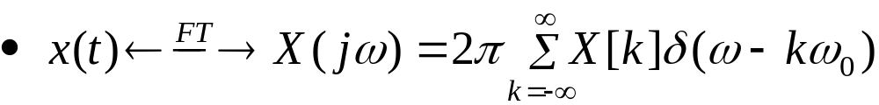
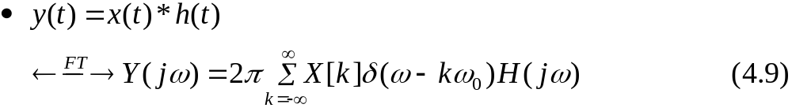
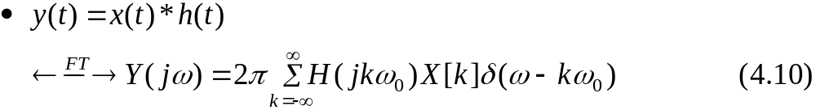
4.3 Convolution and Multiplication with Mixtures of Periodic and Nonperiodic Signals
4.3.1 Convolution of Periodic and Nonperiodic Signals
Convolution
FT representation of a periodic signal x(t)
  X[k]: FS coefficients
Substitute this representation into the convolution property
Use the sifting property of the impulse
  y(t) is periodic with the same period as x(t).

Slide 13
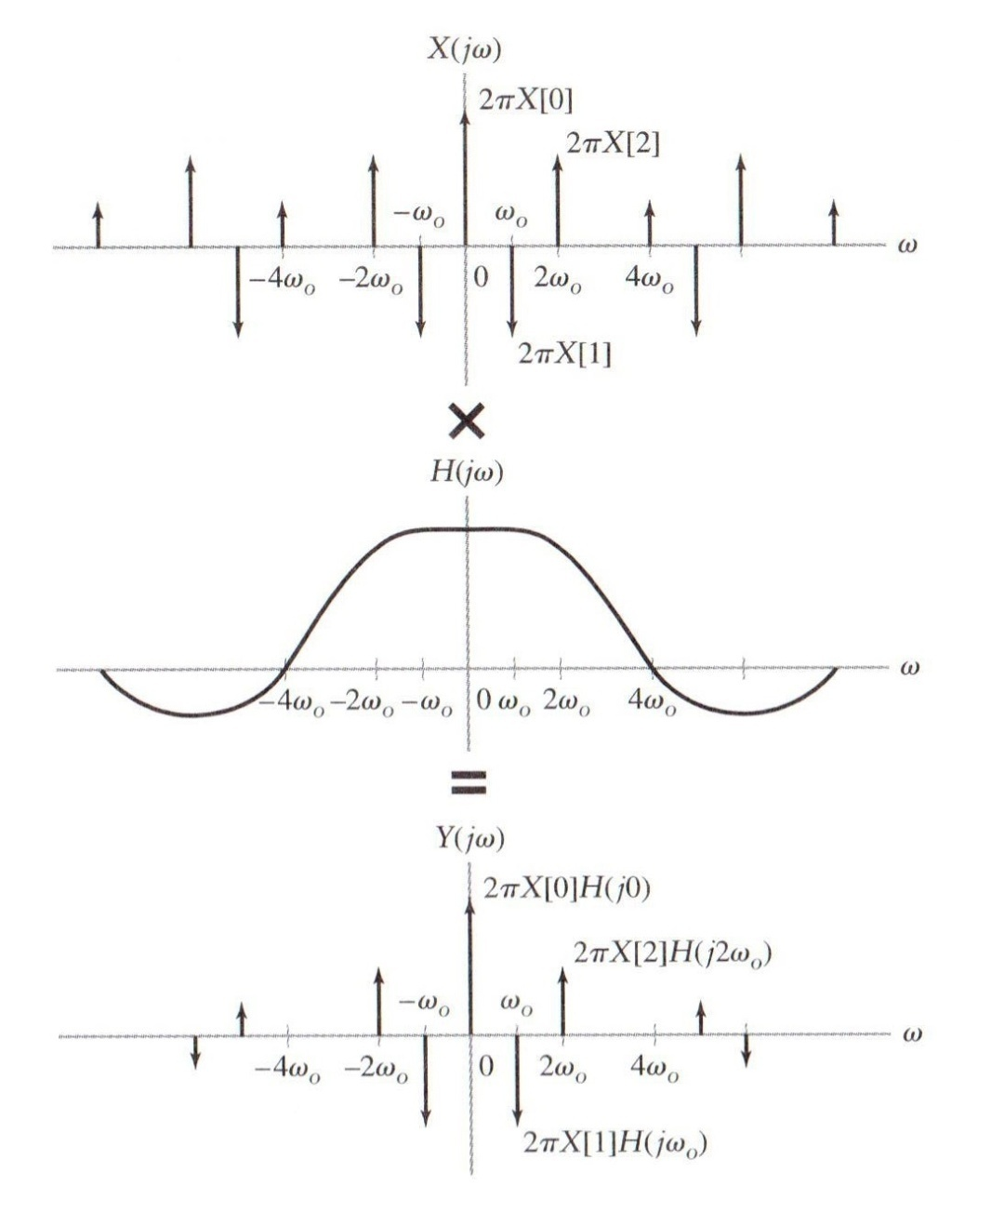
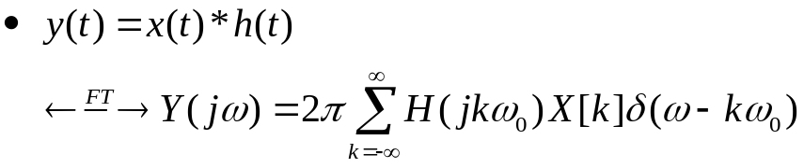
4.3.1 Convolution of Periodic and Nonperiodic Signals (Cont.)
Figure 4.8 (p. 449)
Convolution property
for mixture of periodic
and nonperiodic signals.

Slide 14
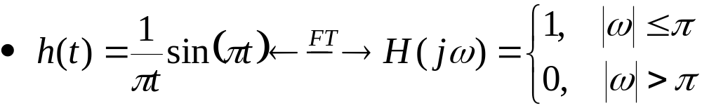
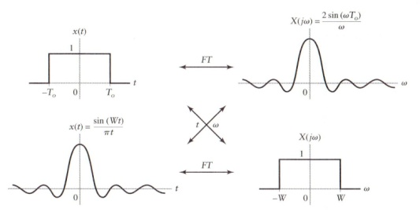
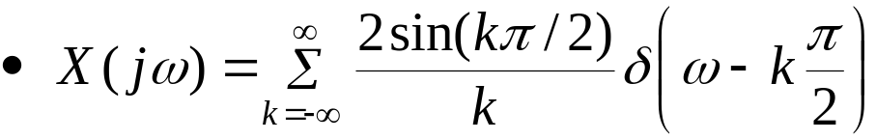
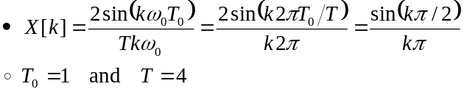
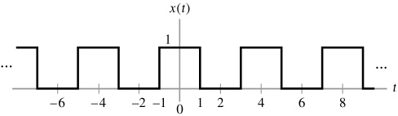
4.3.1 Convolution of Periodic and Nonperiodic Signals (Cont.)
Example 4.4 Periodic Input to an LTI System
Let the input signal applied to an LTI system with impulse response h(t)=(1/(πt))sin(πt) be the periodic square wave depicted in Fig. 4.4. Use the convolution property to find the output of the this system.
  Impulse response of an LTI system and its frequency response
  Using Eq. (4.3), rewrite the FT of the periodic square wave
Figure 4.4 (p. 345)
Square wave for Problem 4.1.

Slide 15
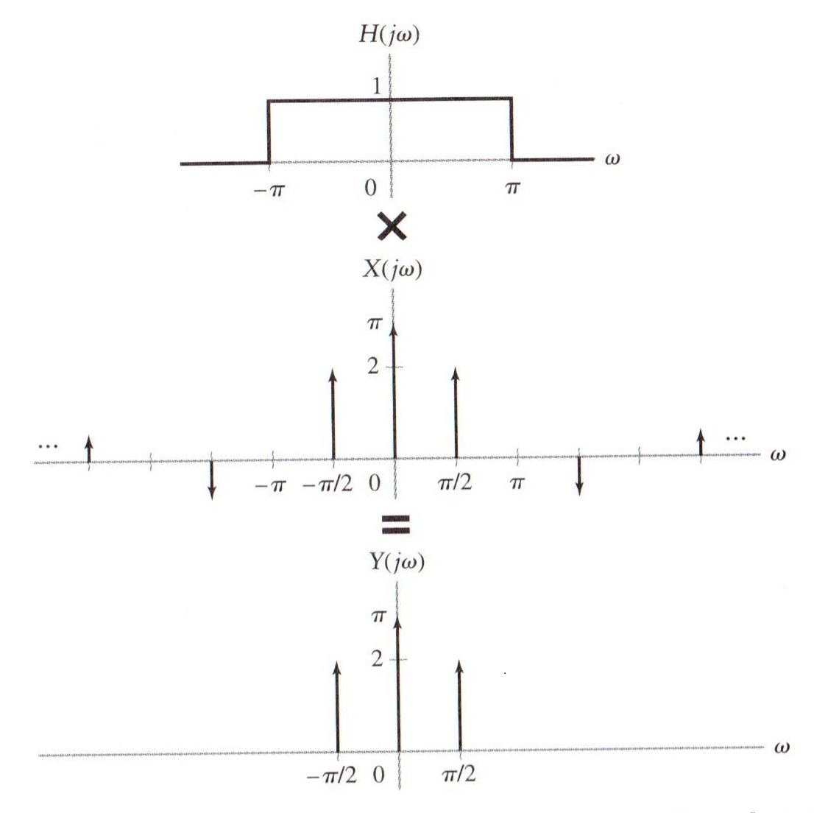
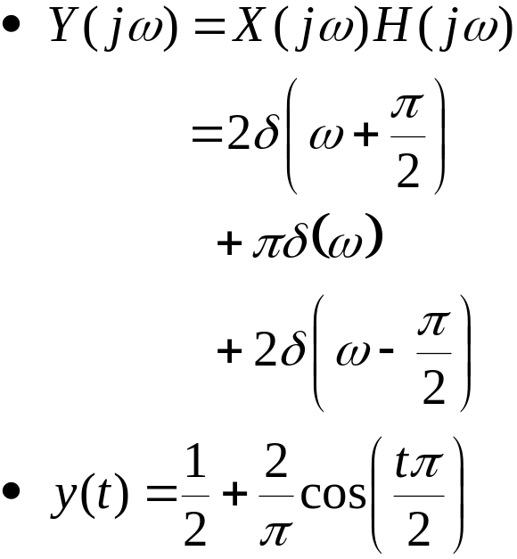
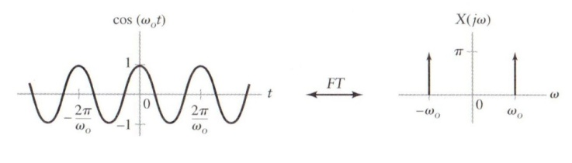
4.3.1 Convolution of Periodic and Nonperiodic Signals (Cont.)
Example 4.4 (Cont.)
Figure 4.9 (p. 350)
Application of convolution property in Example 4.4.

Slide 16
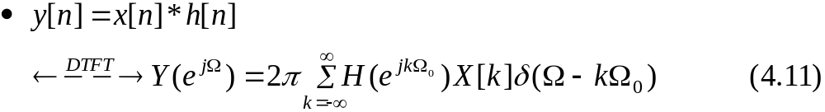
4.3.1 Convolution of Periodic and Nonperiodic Signals (Cont.)
In discrete-time case
  Discrete-time convolution property
  Using Eq. (4.8)
  y[n] is also periodic with the same period as x[n].

Slide 17
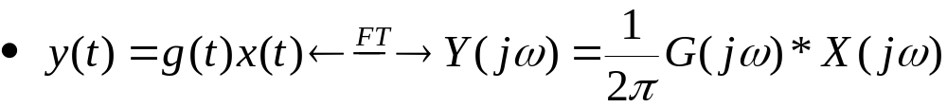
4.3.2 Multiplication of Periodic and Nonperiodic Signals
Consider again the multiplication property of the FT
x(t) is periodic → Using Eq. (4.3)
Using the sifting property of the impulse function
  Multiplication of g(t) with the periodic function x(t) gives an FT consisting of a weighted sum of shifted versions of G(jω).
  Refer Fig. 4.11
  Y(jω) corresponds to the FT of a non-periodic, since the product of periodic and non-periodic is nonperiodic.

Slide 18
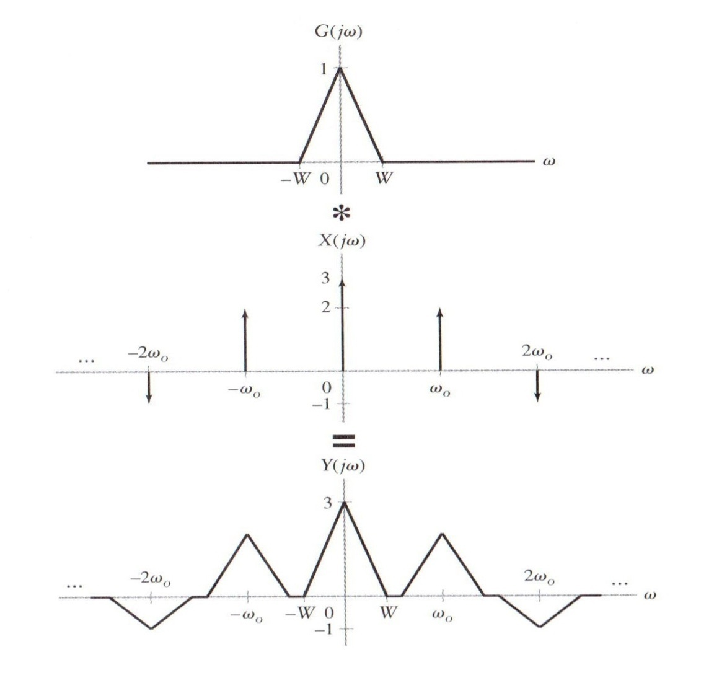
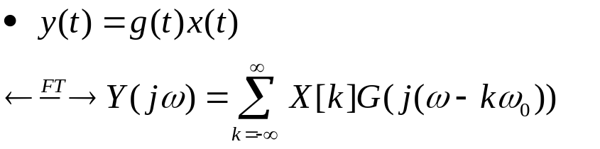
4.3.2 Multiplication of Periodic and Nonperiodic Signals (Cont.)
Figure 4.11 (p. 352)
Multiplication of periodic and nonperiodic time-domain signals corresponds to convolution of the corresponding FT representations.

Slide 19
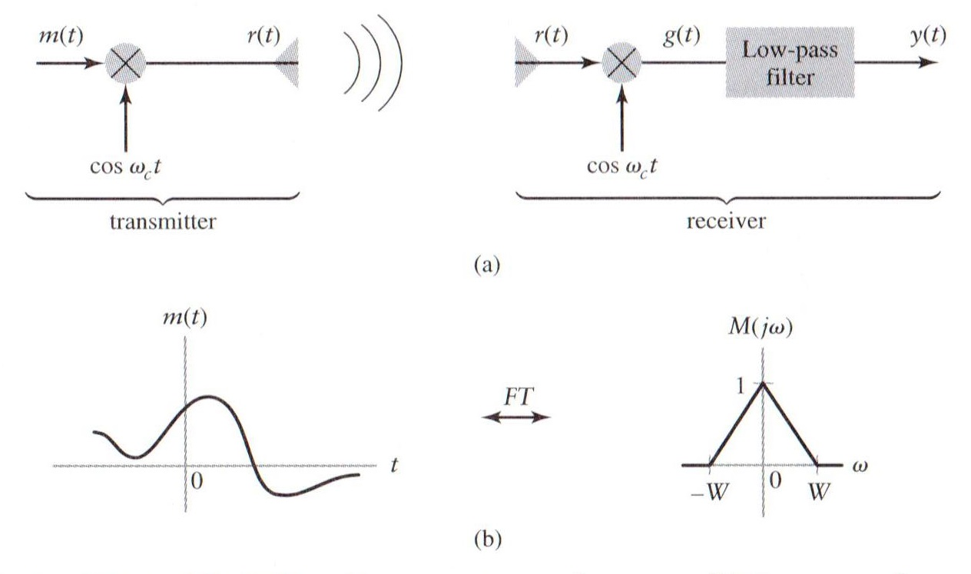

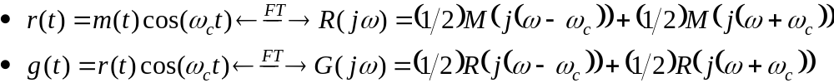
4.3.2 Multiplication of Periodic and Nonperiodic Signals (Cont.)
Example 4.6 AM Radio
Figure 4.13 (p. 353)
(a) Simplified AM radio transmitter and receiver. (b) Spectrum of message signal.

Slide 20
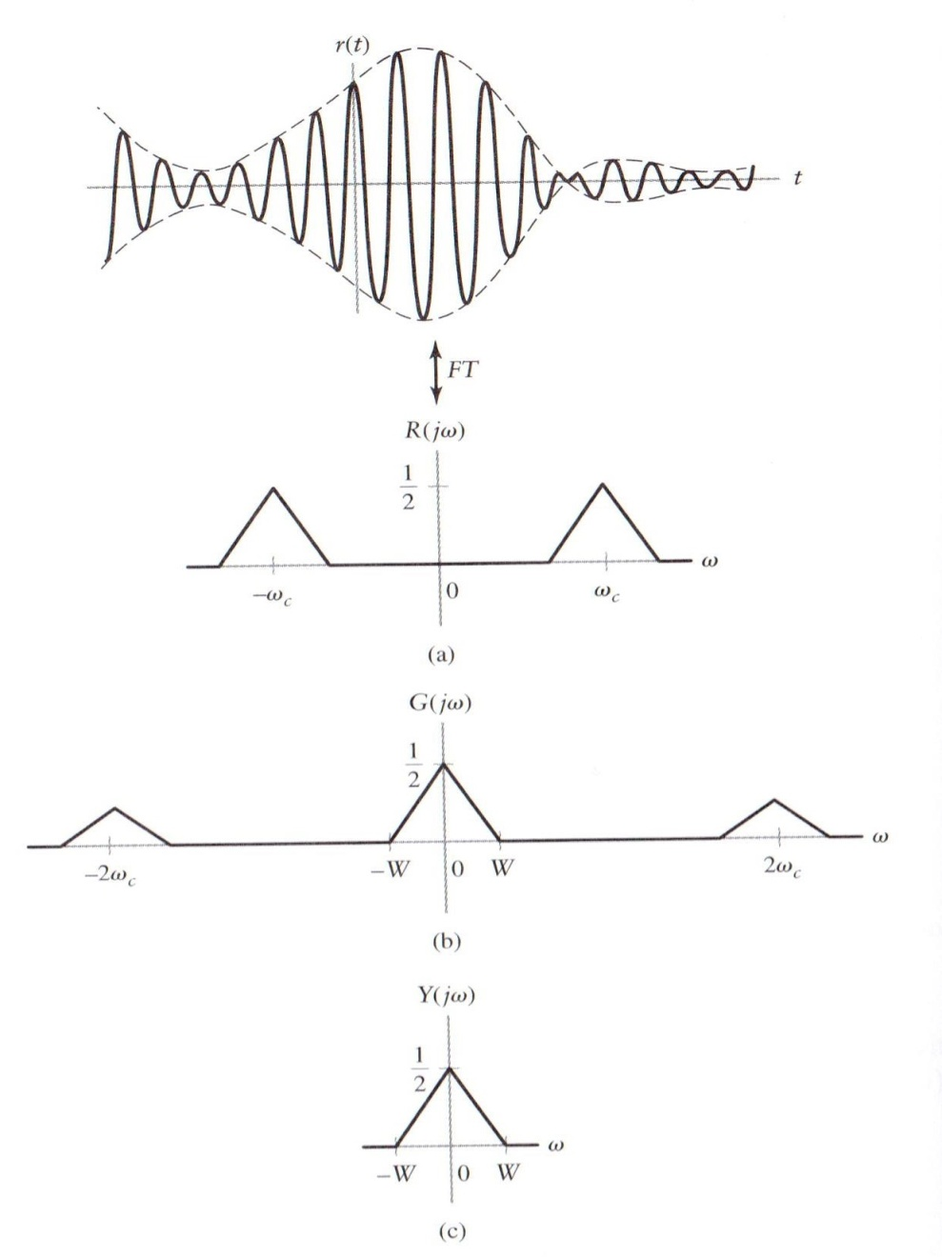
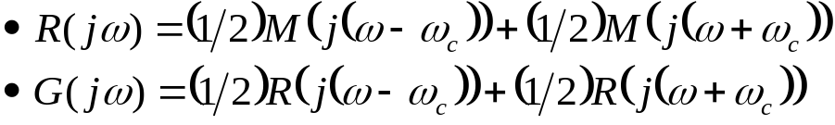
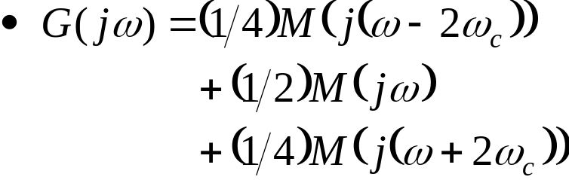
4.3.2 Multiplication of Periodic and Nonperiodic Signals (Cont.)
Example 4.6 AM Radio (Cont.)
Figure 4.14 (p. 354)
Signals in the AM transmitter
and receiver.
(a) Transmitted signal r(t)
and spectrum R(jω).
(b) Spectrum of g(t) in the receiver.
(c) Spectrum of receiver output y(t).

Slide 21

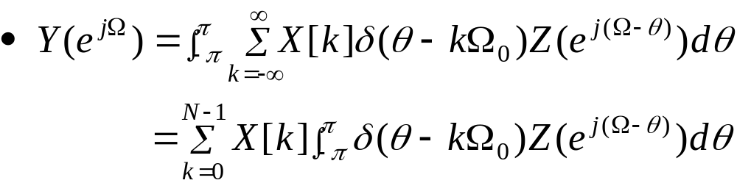
4.3.2 Multiplication of Periodic and Nonperiodic Signals (Cont.)
Discrete-time multiplication property
x[n] is periodic → Use Eq. (4.8)
  X[k]: DTFS coefficients
Substitute X(e^{jΩ}) into the definition of periodic property
Apply the sifting property of the impulse function
*
*
Notes:
신호 및 시스템

Slide 22
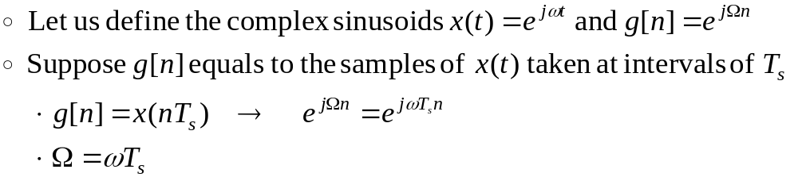
4.4 Fourier Transform Representation of Discrete-Time Signals
Derive an FT representation of discrete-time signals by incorporating impulse
Analyze problems involving mixtures of discrete- and continuous-time signals
Indicate the relationship between the FT and DTFT
Continuous-time frequency ω and discrete-time frequency Ω
  The dimensionless discrete-time frequency Ω corresponds to the continuous-time frequency ω, multiplied by the sampling interval T_{s}.

Slide 23

4.4.1 Relating the FT and the DTFT
DTFT of an arbitrary discrete-time signal x[n]:
Substitute Ω=ωT_{s} into Eq. (4.15)
Using linearity and the FT pair
Taking the inverse FT (IFT) of X_{δ}(jω)
Hence,

Slide 24
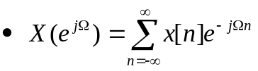
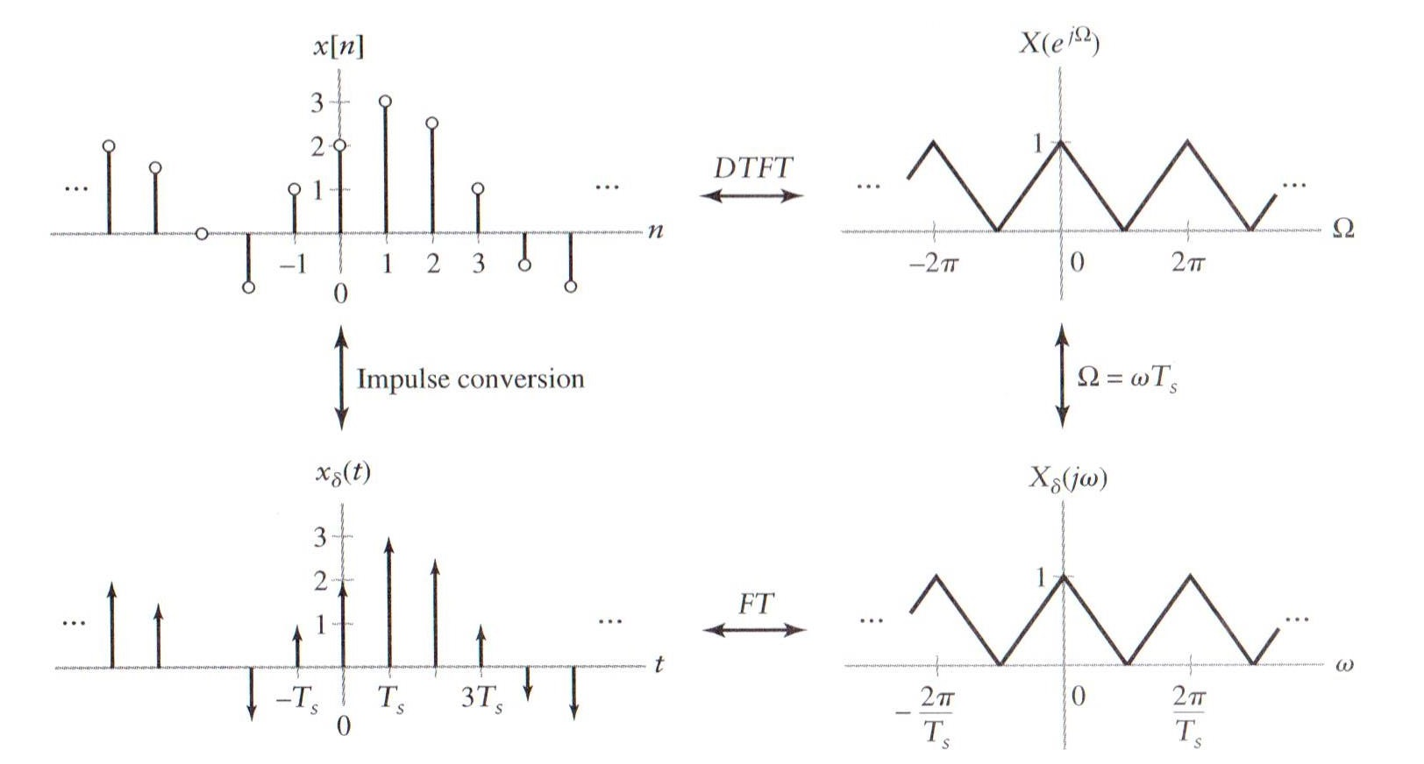

4.4.1 Relating the FT and the DTFT (Cont.)
Figure 4.18 (p. 359)
Relationship between FT and DTFT representations of a discrete-time signal.

Slide 25
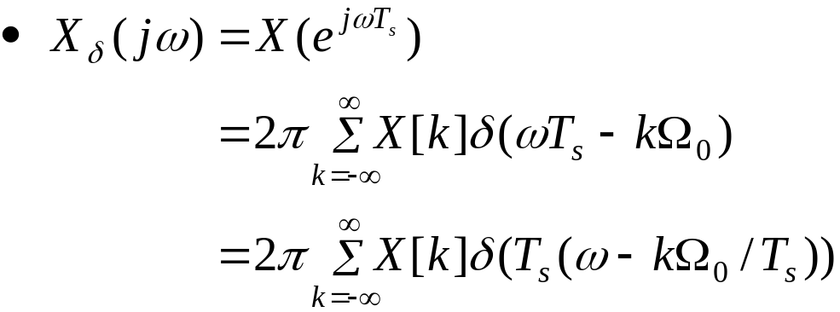
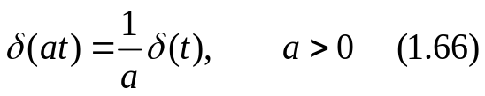

4.4.2 Relating the FT to the DTFS
Recall the DTFT representation of an N-periodic signal x[n] given in Eq. (4.8)
  X[k]: DTFS coefficients
Substitute Ω=ωT_{s} into Eq. (4.8)
Use the scaling property of the impulse

Slide 26



4.4.2 Relating the FT to the DTFS (Cont.)
Rewrite X_{δ}(jω)
Substitute the periodic signal x[n] into Eq. (4.17)

Slide 27



4.4.2 Relating the FT to the DTFS (Cont.)
Figure 4.20 (p. 362)
Relationship between FT and DTFS representations of a discrete-time periodic signal.

Slide 28


4.5 Sampling
4.5.1 Sampling continuous-time signals
Sampling
  Generate a discrete-time signal from a continuous-time signal
  Compare DTFT representation of x[n] and FT representation of x(t)
Continuous-time representation of the discrete-time signal x[n]
  The representation given Eq. (4.21) is commonly termed “impulse sampling”.

Slide 29



4.5.1 Sampling continuous-time signals (Cont.)
Impulse sampling
Figure 4.21 (p. 363)
Mathematical representation of sampling as the product of a given time signal and an impulse train.

Slide 30




4.5.1 Sampling continuous-time signals (Cont.)
FT representation of x_{δ}(t)
Use the result P(jω) determined in Example 4.2

Slide 31




4.5.1 Sampling continuous-time signals (Cont.)
Figure 4.22 (p. 364): The FT of a sampled signal for different sampling frequencies. (a) Spectrum of continuous-time signal. (b) Spectrum of sampled signal when ω_{s} = 3W. (c) Spectrum of sampled signal when ω_{s} = 2W. (d) Spectrum of sampled signal when ω_{s} = 1.5W.

Slide 32


4.5.1 Sampling continuous-time signals (Cont.)
DTFT of the sampled signal
  Using the relationship Ω=ωT_{s}
FT has period ω_{s}
DTFT has period 2π
Figure 4.23 (p. 365)
The DTFTs corresponding to the FTs depicted in Fig. 4-22 (b)-(d). (a) ω_{s} = 3W. (b) ω_{s} = 2W. (c) ω_{s} = 1.5W.

Slide 33




4.5.1 Sampling continuous-time signals (Cont.)
Example 4.9
Sampling a Sinusoid
Figure 4.24
The effect of sampling a sinusoid at different rates (Example 4.9).
(a) Original signal and FT. (b) Original signal, impulse sampled representation and FT for T_{s} = ¼. (c) Original signal, impulse sampled representation and FT for T_{s} = 1. (d) Original signal, impulse sampled representation and FT for T_{s} = 3/2. A cosine of frequency π/3 is shown as the dashed line.
겹치는 현상
교차 현상
Notes:
신호 및 시스템

Slide 34




4.5.2 Subsampling : sampling discrete-time signals
Let y[n]=x[qn] be a subsampled version of x[n]
  q: positive integer
  : Derive the result in Problem 4.42

Slide 35


4.5.2 Subsampling : sampling discrete-time signals (Cont.)
Figure 4.29 (p. 372)
Effect of subsampling on the DTFT. (a) Original signal spectrum. (b) m = 0 term, X_{q}(e^{jω}), in Eq. (4.27) (c) m = 1 term in Eq. (4.27). (d) m = q – 1 term in Eq. (4.27). (e) Y(e^{jω} ), assuming that W < π/q. (f) Y(e^{jω} ), assuming that W > π/ q.

Slide 36

4.6 Reconstruction of continuous-time signals from samples
Figure 4.31 (p. 373)
Block diagram illustrating conversion of a discrete-time signal to a continuous-time signal.

Slide 37


4.6.1 Sampling theorem
Figure 4.32 (p. 373)
Two continuous-time signals x₁(t) (dashed line) and x₂(t) (solid line) that have the same set of samples.
  The samples of a signal does not always uniquely determine the corresponding continuous-time signal

Slide 38


4.6.1 Sampling theorem (Cont.)
Sampling Theorem
  2ω_{m} : Nyquist sampling rate, Nyquist rate
  ω_{s} : Nyquist frequency
Anti-aliasing filter :
  The signal of interest is band limited to less than ω_{s}/2.

Slide 39



4.6.2 Ideal reconstruction
FT representation of the sampled signal is given in Eq. (4.23):
Figure 4.35 (p. 376)
Ideal reconstruction. (a) Spectrum of original signal. (b) Spectrum of sampled signal. (c) Frequency response of reconstruction filter.

Slide 40




4.6.2 Ideal reconstruction (Cont.)
Ideal band-limited interpolation cannot be implemented
  It is a noncausal system and the influence of each sample extends over an infinite amount of time
:자료 14쪽 참고
Notes:
신호 및 시스템

Slide 41



4.6.2 Ideal reconstruction (Cont.)
Figure 4.36 (p. 377)
Ideal reconstruction in the time domain.

Slide 42



4.6.3 A practical reconstruction : the zero-order hold
Maintain or hold the value of x[n] for T_{s} seconds
Figure 4.37 (p. 377)
Reconstruction via a zero-order hold.
Figure 4.38 (p. 378)
Rectangular pulse used to analyze zero-order hold reconstruction

Slide 43





4.6.3 A practical reconstruction : the zero-order hold (Cont.)
Output of the zero-order hold
Convolution of the impulse-sampled signal and the impulse response of the zero-order hold
Use the convolution-multiplication property of the FT
Example 3.25

Slide 44





4.6.3 A practical reconstruction : the zero-order hold (Cont.)
Figure 4.39 (p. 379) :
Effect of the zero-order hold in the frequency domain. (a) Spectrum of original continuous-time signal. (b) FT of sampled signal. (c) Magnitude and phase of H_{o}(jω). (d) Magnitude spectrum of signal reconstructed using zero-order hold.

Slide 45



4.6.3 A practical reconstruction : the zero-order hold (Cont.)
To reduce the distortion associated with modifications 2 and 3, use the continuous-time compensation filter with frequency response
  Often termed an anti-imaging filter
Figure 4.40 (p. 380) :
Frequency response of a compensation filter used to eliminate some of the distortion introduced by the zero-order hold.

Slide 46

4.6.3 A practical reconstruction : the zero-order hold (Cont.)
Figure 4.41 (p. 380)
Block diagram of a practical reconstruction system.
Oversampling
  In practical reconstruction schemes, it is common to increase the effective sampling rate of the discrete-time signal prior to the zero-order hold
  Read Example 4.13 Oversampling in CD Players

Slide 47

Q & A
Thank you …
Notes:
신호 및 시스템

Slide 48



Slide 49


Slide 50


