Slide 1
4. Applications of Fourier Representations to Mixed Signal Classes(cont.)
4.1 Introduction
4.2 Fourier Transform Representations of Periodic Signals
4.3 Convolution and Multiplication with Mixtures of Periodic and Nonperiodic Signals
4.4 Fourier Transform Representation of Discrete-Time Signals
4.5 Sampling
4.6 Reconstruction of continuous-time signals from samples
4.7 Discrete-time processing of continuous-time signals ------------------------3
4.8 Fourier series representations of finite-duration nonperiodic signals --17
4.9 The discrete-time Fourier series approximation to the Fourier transform ----------------------------------------------------------------------------22
4.10 Efficient algorithms for evaluating the DTFS -----------------------------30

Slide 2
4. Applications of Fourier Representations to Mixed Signal Classes (Part 2)
4.7 Discrete-time processing of continuous-time signals
  4.7.1 A basic discrete-time signal-processing system
  4.7.2 Oversampling
  4.7.3 Decimation
  4.7.4 Interpolation
4.8 Fourier series representations of finite-duration nonperiodic signals
  4.8.1 Relating the DTFS to the DTFT
  4.8.2 Relating the FS to the FT
4.9 The discrete-time Fourier series approximation to the Fourier transform
4.10 Efficient algorithms for evaluating the DTFS

Slide 3
4.7 Discrete-time processing of continuous-time signals
Several advantages to processing a continuous-time signal with a discrete-time system
  A broad class of signal manipulations are more easily performed by using the arithmetic operations of a computer than through the use of an analog computer
  Implementing a system in a computer only involves writing a set of instructions or program for the computer to execute
  The discrete-time system is easily changed by modifying the computer program
Oversampling
Decimation
  Reduce the effective sampling rate
Interpolation
  Increase the effective sampling rate
Judicious use of the decimation and interpolation methods can reduce the cost of the overall system

Slide 4
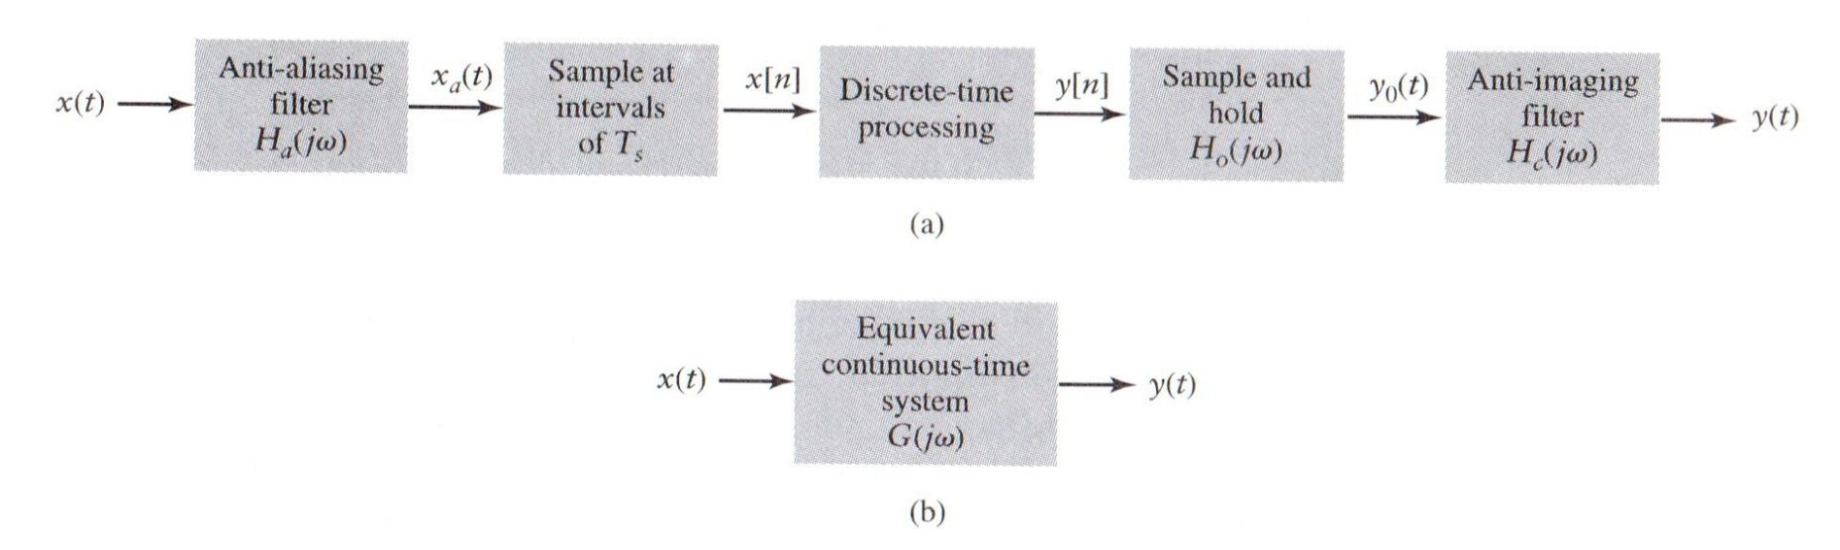
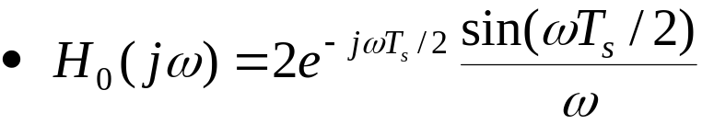
4.7.1 A basic discrete-time signal-processing system
Typical system for processing continuous-time signals in discrete time
Figure 4.43 (p.383) :
Block diagram for discrete-time processing of continuous-time signals. (a) A basic system. (b) Equivalent continuous-time system.
Frequency response associated with the zero-order-hold device

Slide 5

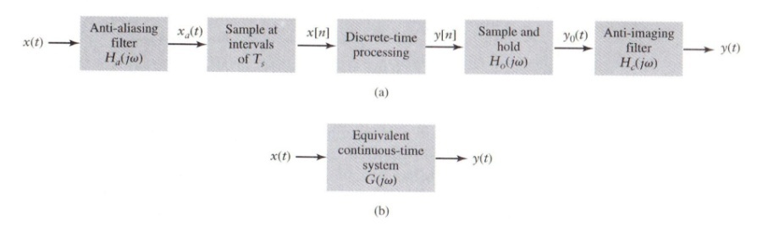

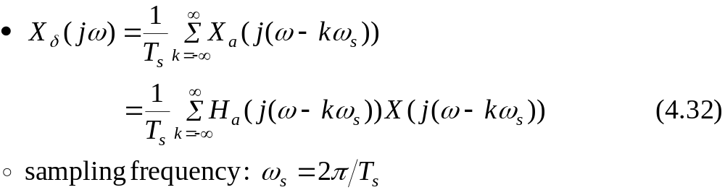
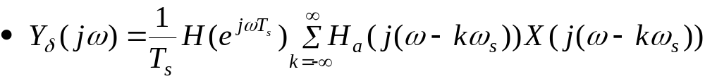
4.7.1 A basic discrete-time signal-processing system (Cont.)
FT of the output of the continuous-time anti-aliasing filter
After sampling, the FT representation for x[n]
Output of the discrete-time system

Slide 6
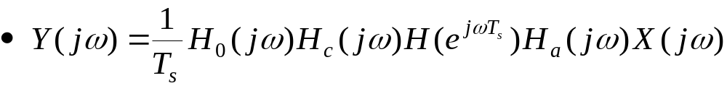
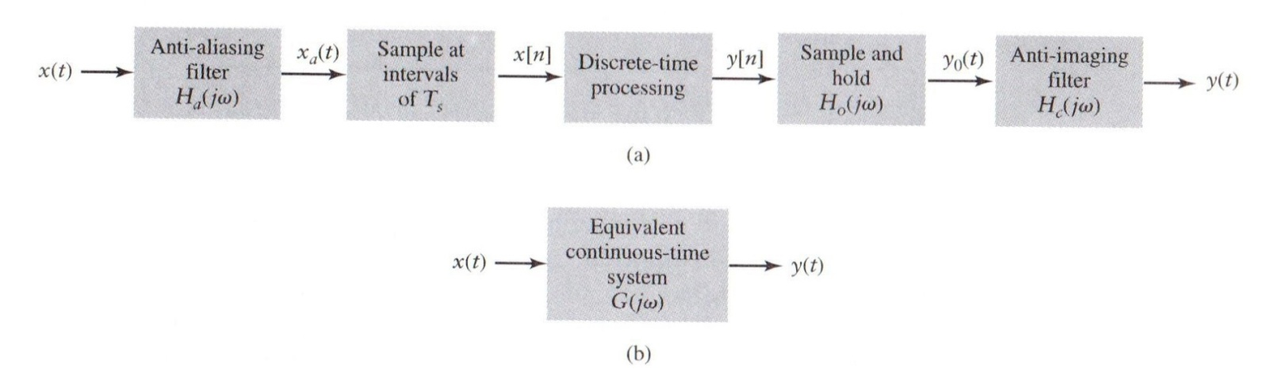
4.7.1 A basic discrete-time signal-processing system (Cont.)
Anti-imaging filter eliminates frequency components above ω_{s}/2 (except k=0)
Expression of a continuous-time LTI system

Slide 7
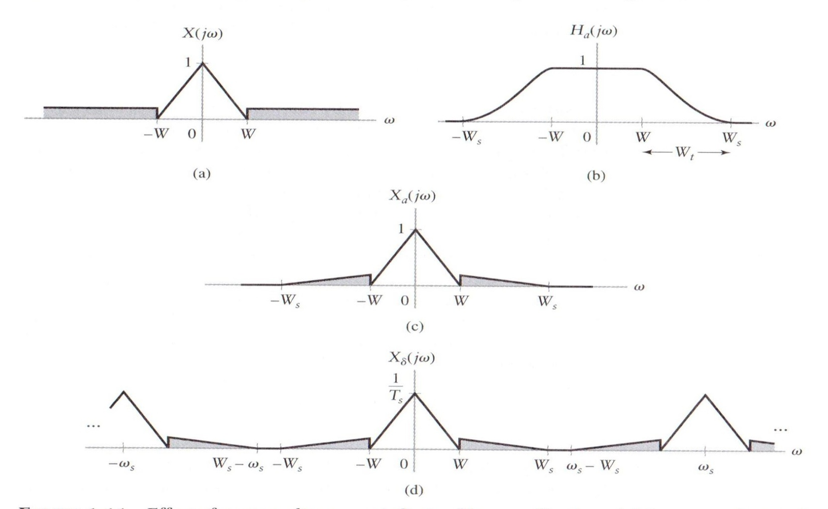
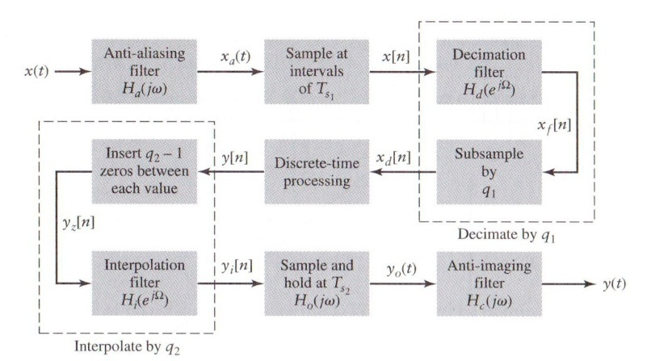
4.7.2 Oversampling
Figure 4.44 (p. 385) :
Effect of oversampling on anti-aliasing filter specifications. (a) Spectrum of original signal. (b) Anti-aliasing filter frequency response magnitude. (c) Spectrum of signal at the anti-aliasing filter output. (d) Spectrum of the anti-aliasing filter output after sampling. The graph depicts the case of ω_{s} > 2W_{s}.

Slide 8
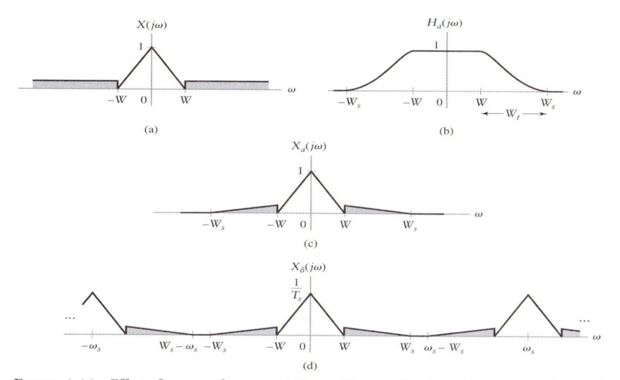


4.7.2 Oversampling (Cont.)
Transition bandwidth W_{t}=W_{s} – W
To prevent the noise from aliasing itself,
ω_{s} – W_{s} > W_{s} or ω_{s} > 2W_{s} is required
Hope to prevent the noise from aliasing back into
the signal band –W < ω < W
Filters with small transition bands are difficult to design and expensive.
By oversampling, or choosing ω_{s} >> 2W_{s}, the complexity and cost of implementing filter are reduced.
High sampling rates lead to increased discrete-time system cost due to fast computation
  Lower rate is used for discrete-time processing
  High rate is used for sampling and reconstruction

Slide 9
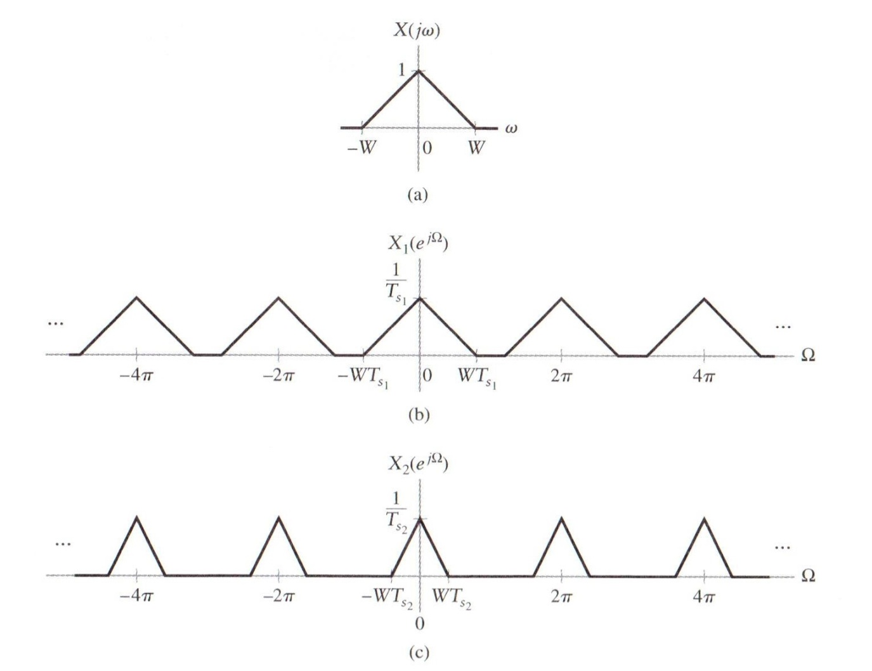
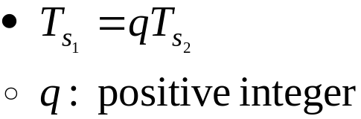

4.7.3 Decimation
Figure 4.45 (p. 387):
Effect of changing the sampling rate. (a) Underlying continuous- time signal FT. (b) DTFT of sampled data at sampling interval T_{s1}. (c) DTFT of sampled data at sampling interval T_{s2}.
Decimation
Notes:
신호 및 시스템

Slide 10
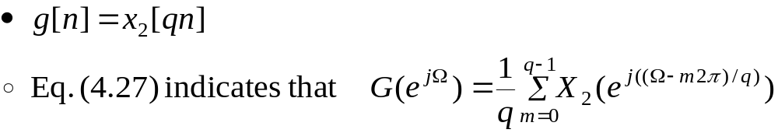
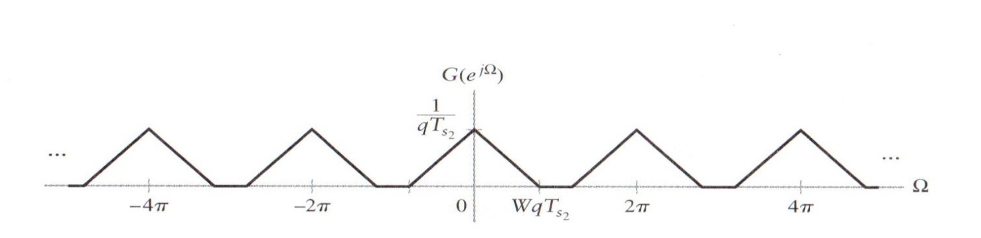
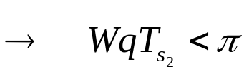

4.7.3 Decimation (Cont.)
Figure 4.46 (p. 387) :
The spectrum that results from subsampling the DTFT X₂(e^{jΩ}) depicted in Fig. 4.45 by a factor of q.
Aliasing problem is prevented by a low-pass discrete-time filter to x₂[n] prior to subsampling.
  If oversampling is used to obtain x₂[n], then noise that passed through the transition band of the anti-aliasing filter will be present at frequencies above π/q.
  If we subsample x₂[n] directly, then this noise will alias into frequencies |Ω|<WT_{s1} and distort the signal of interest.
: 위 그림 참고
Notes:
신호 및 시스템

Slide 11
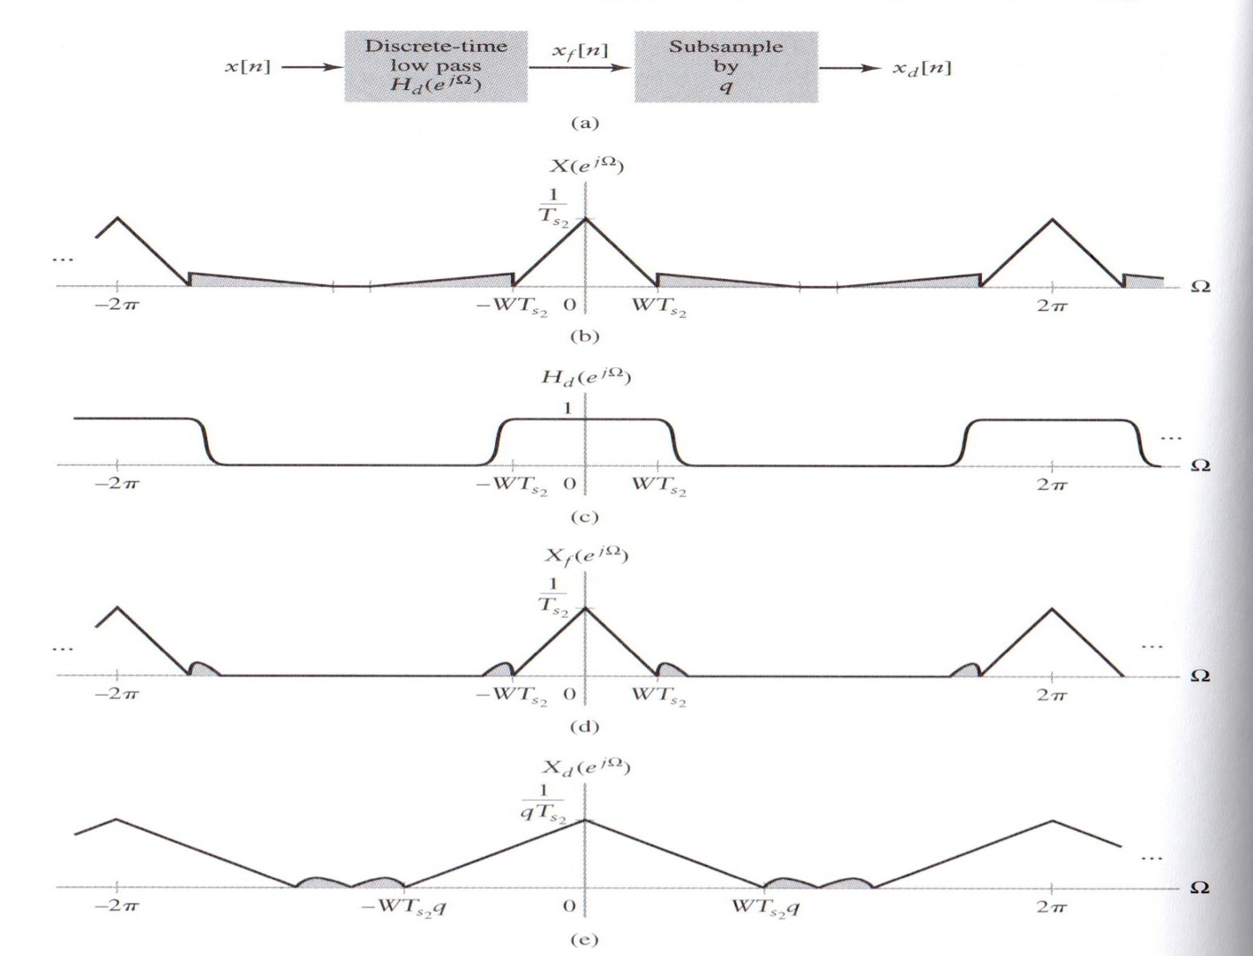
4.7.3 Decimation (Cont.)
Figure 4.47 (p. 388) :
Frequency-domain interpretation of decimation.
(a) Block diagram of decimation system. (b) Spectrum of oversampled input signal. Noise is depicted as the shaded portions of the spectrum. (c) Filter frequency response. (d) Spectrum of filter output. (e) Spectrum after subsampling.

Slide 12
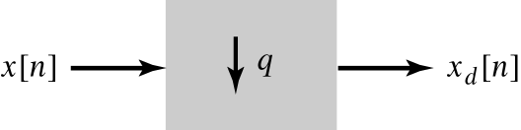
4.7.3 Decimation (Cont.)
Decimation = Downsampling
Figure 4.48 (p. 389)
Symbol for decimation by a factor of q.

Slide 13
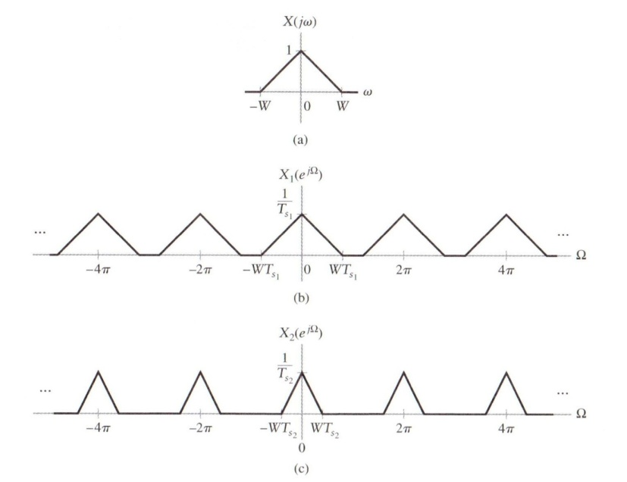
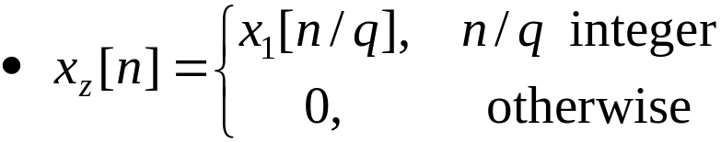
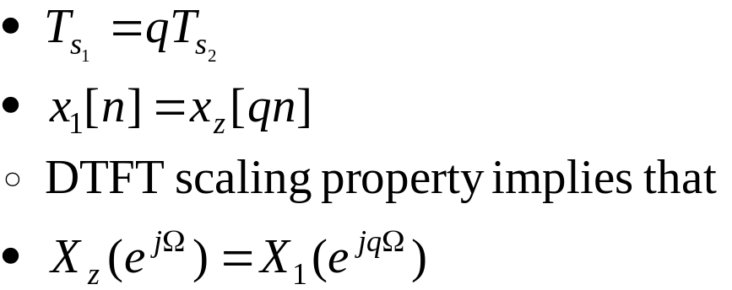
4.7.4 Interpolation
Interpolation increases the sampling rate
  upsampling
Zero padding :
Interpolation
Notes:
신호 및 시스템

Slide 14
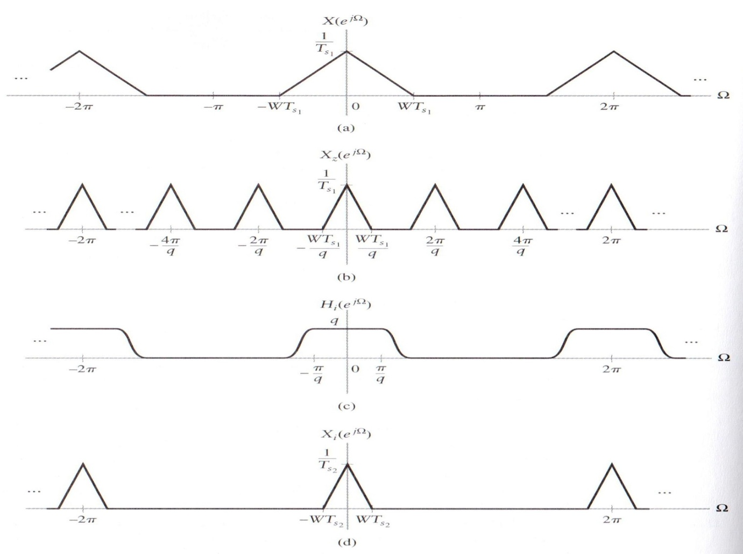
4.7.4 Interpolation (Cont.)
Figure 4.49 (p. 390) :
Frequency-domain interpretation of interpolation. (a) Spectrum of original sequence. (b) Spectrum after inserting q – 1 zeros in between every value of the original sequence. (c) Frequency response of a filter for removing undesired replicates located at ± 2π /q, ±4π/q, …, ± (q – 1)2 π/q. (d) Spectrum of interpolated sequence.

Slide 15
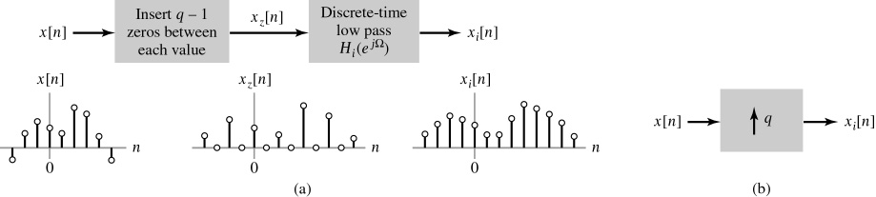
4.7.4 Interpolation (Cont.)
Interpolation by the factor q is accomplished by inserting q-1 zeros in between each sample of x₁[n] and then low-pass filtering.
Figure 4.50 (p. 390)
(a) Block diagram of an interpolation system. (b) Symbol denoting interpolation by a factor of q.

Slide 16
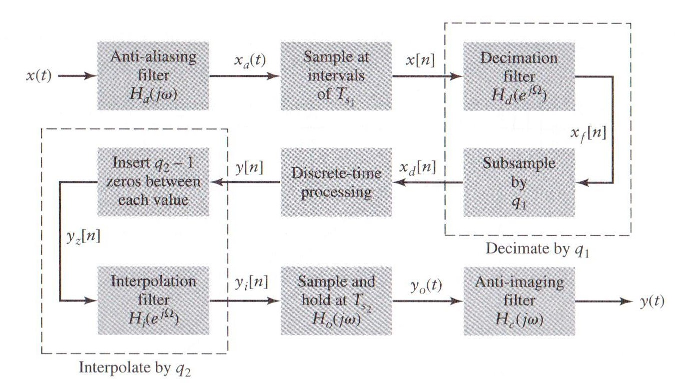
4.7.4 Interpolation (Cont.)
Figure 4.51 (p. 391):
Block diagram of a system for discrete-time processing of continuous-time signals including decimation and interpolation.

Slide 17
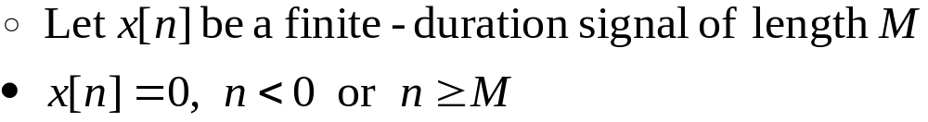
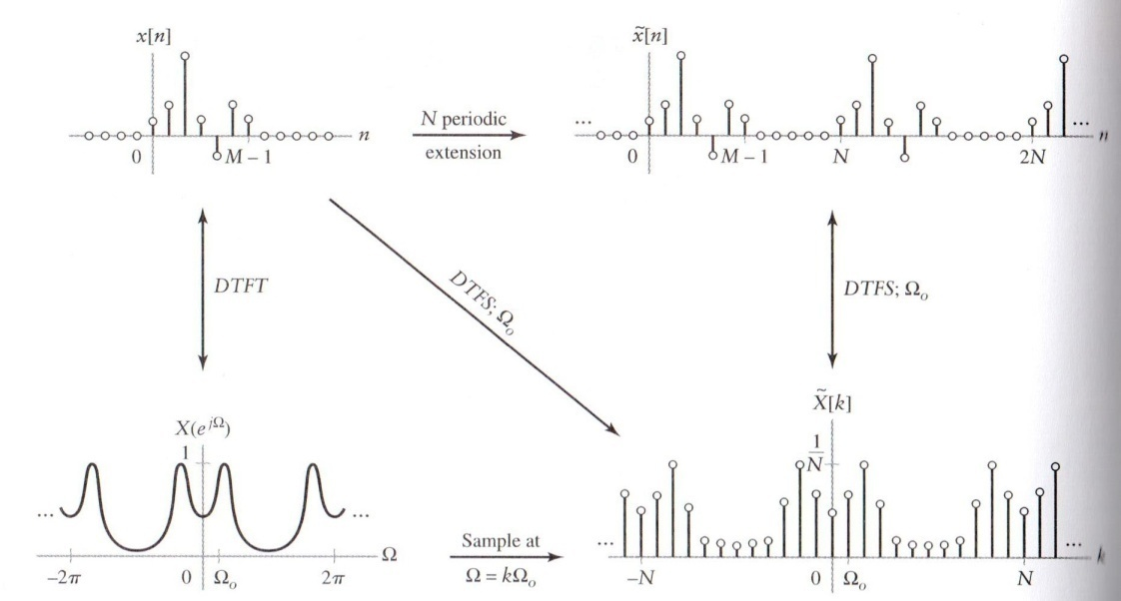
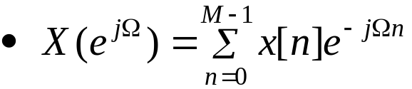
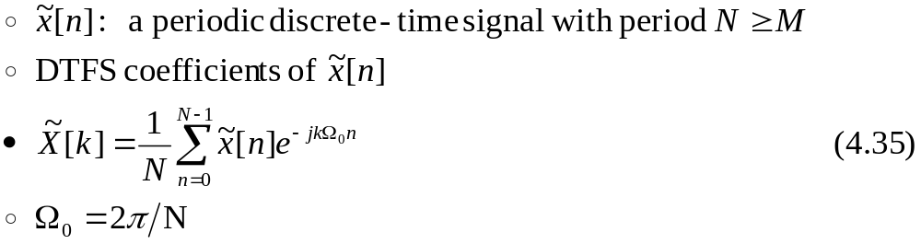
4.8 FS representations of finite-duration nonperiodic signals
4.8.1 Relating the DTFS to the DTFT
DTFT of x[n]
  Fig. 4.52

Slide 18

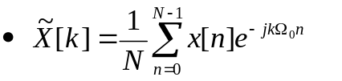
4.8.1 Relating the DTFS to the DTFT(Cont.)
Figure 4.52 (p. 392):
The DTFS of a finite-duration nonperiodic signal.
N>M
=
~
Notes:
신호 및 시스템

Slide 19
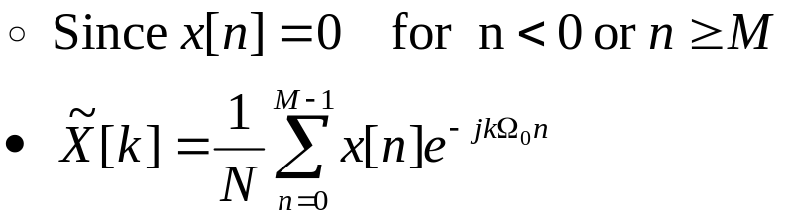
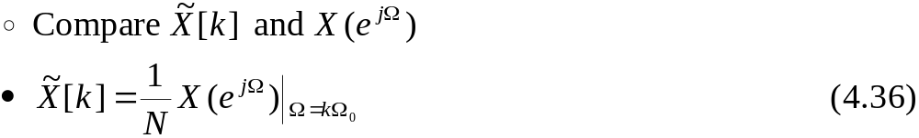
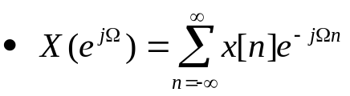
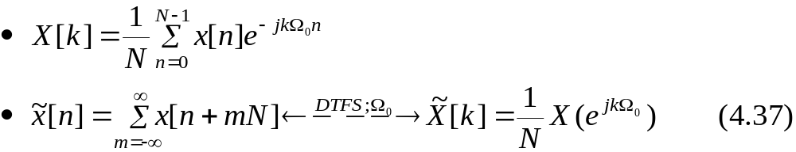
4.8.1 Relating the DTFS to the DTFT (Cont.)
  DTFS coefficients are samples of the DTFT of x[n], divided by N and evaluated at intervals of 2π/N
In order to prevent aliasing, sampling interval Ω₀ to be less than or equal to 2π/M
: DTFS
Fig. 4.52에서
Notes:
신호 및 시스템

Slide 20
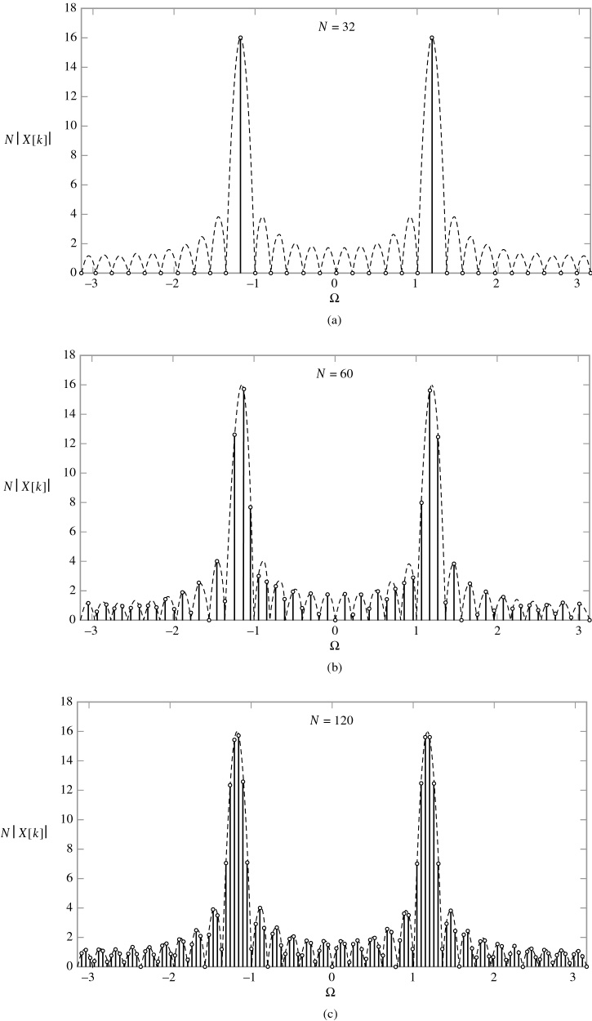
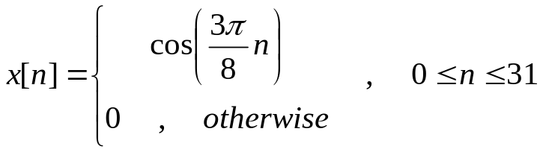
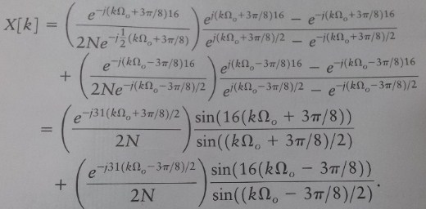
4.8.1 Relating the DTFS to the DTFT (Cont.)
Example 4.14 : Sampling the DTFT
of a Cosine Pulse
Figure 4.53 (p.394)
The DTFT and length-N DTFS
of a 32-point cosine.
The dashed line denotes |X(e^{jΩ})|,
while the stems represent N|X[k]|.
(a) N = 32, (b) N = 60, (c) N = 120.

Slide 21

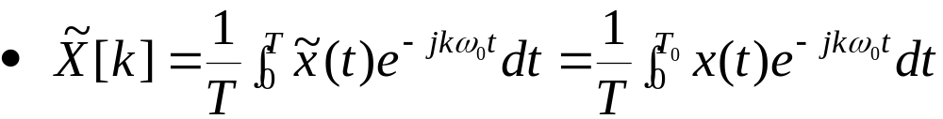
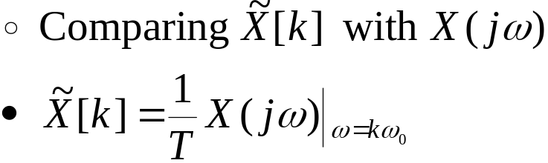
4.8.2 Relating the FS to the FT
Let x(t) have duration T₀
Construct a periodic signal
FS coefficients of the periodic signal
FT of x(t):
FS coefficients are samples of the FT, normalized by T

Slide 22

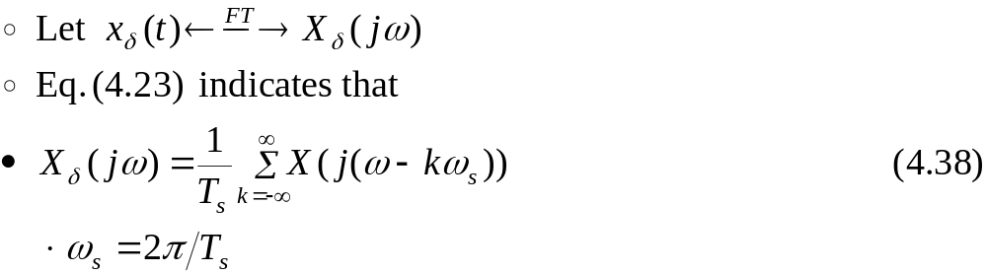

4.9 The discrete-time Fourier series approximation to the Fourier transform
M<N
Figure 4.54 (p. 396)
Block diagram depicting the sequence of operations involved in approximating the FT with the DTFS.
Suppose we wish to approximate X(jω) on the interval -ω_{a}<ω<ω_{a}, and suppose further that x(t) is band limited with maximum frequency ω_{m}≥ω_{a}.

Slide 23
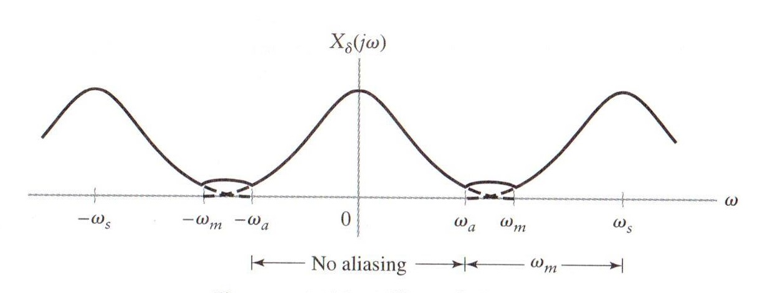
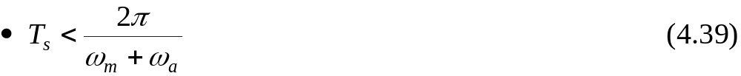
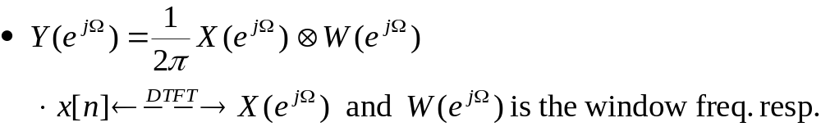
4.9 The discrete-time Fourier series approximation to the Fourier transform (Cont.)
Figure 4.55 (p. 397) : Effect of aliasing.
Aliasing in the band -ω_{a}<ω<ω_{a} is prevented by choosing T_{s} such that ω_{s}>ω_{m}+ω_{a}.
The windowing operation of length M corresponds to the periodic convolution
*

Slide 24
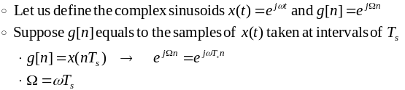
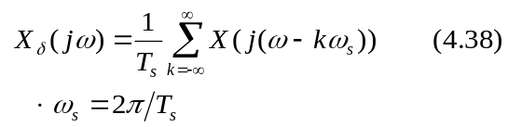
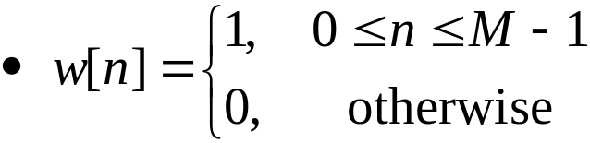
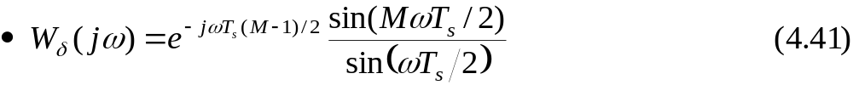
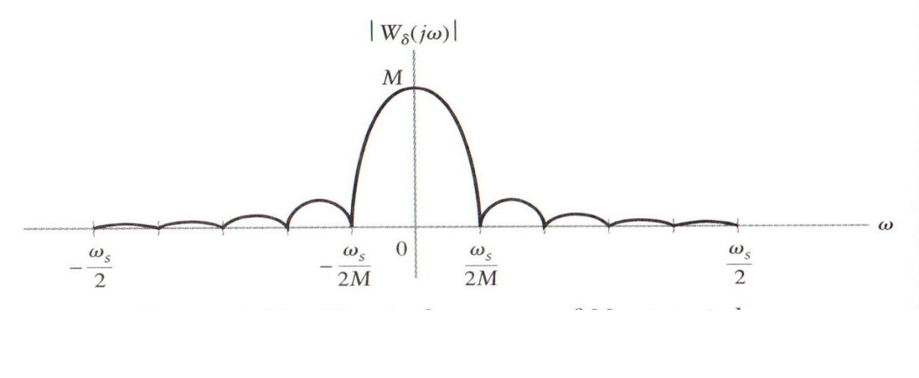
4.9 The discrete-time Fourier series approximation to the Fourier transform (Cont.)
Rewrite the periodic convolution in terms of the continuous-time frequency ω by performing the change of variable Ω= ω T_{s} in the convolution
  Both X_{δ}(jω) and W_{δ}(jω) have the same period ω_{s}.
Figure 4.56 (p. 398) :
Magnitude response
of M-point window.
*
: 부록 774쪽 참고
예제 3.18 참고
Notes:
신호 및 시스템

Slide 25
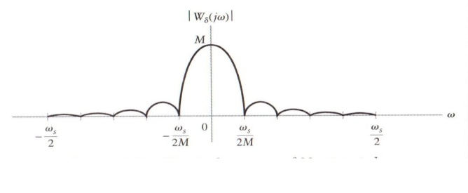
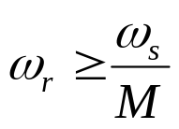
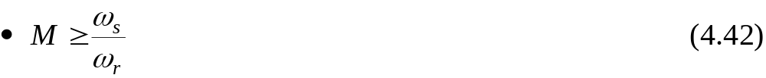
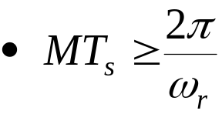


4.9 The discrete-time Fourier series approximation to the Fourier transform (Cont.)
Define the resolution as the mainlobe width ω_{s}/M
To achieve a specified resolution ω_{r}

Slide 26




4.9 The discrete-time Fourier series approximation to the Fourier transform (Cont.)
If the desired sampling interval is at least Δω
M is chosen large enough
The quality of the DTFS approximation to the FT improves as T_{s} decreases(식 4.39), MT_{s} increases(식 4.42 아래), and N increases(식 4.44)
→ Implementation cost increases

Slide 27



4.9 The discrete-time Fourier series approximation to the Fourier transform (Cont.)
Example 4.15
DTFS Approximation
of the FT for Damped
Sinusoids
Figure 4.57 (p.400)
The DTFS approximation to the FT of x(t) = e^{-t/10} u(t)(cos(10t) + cos(12t)). The solid line is the FT |X(jω)|, and the stems denote the DTFS approximation NT_{s}|Y[k]|. Both | X(jω) and NT_{s}|Y[k]| have even symmetry, so only 0 < ω < 20 is displayed. (a) M = 100, N = 4000. (b) M = 500, N = 4000. (c) M = 2500, N = 4000. (d) M = 2500, N = 16,000 for 9 < ω < 13.

Slide 28






4.9 The discrete-time Fourier series approximation to the Fourier transform (Cont.)
Considering using the DTFS to approximate the FT of a complex sinusoid x(t)
Substitute X(jω) into Eq. (4.38)
Substitute this into Eq. (4.40)
Simplify this expression
*

Slide 29




4.9 The discrete-time Fourier series approximation to the Fourier transform (Cont.)
Application of Eq. (4.43) indicates
If we choose N=M (no zero padding) and if the frequency of the complex sinusoid satisfies ω₀=mω_{s}/M, then the DTFS samples W_{δ}(j(ω - ω₀)) at the peak of its mainlobe and at its zero crossings.
In this special case, the continuous-valued impulse with area 2πa in the FT is approximated by a discrete-valued impulse of amplitude a.

Slide 30


4.10 Efficient algorithms for evaluating the DTFS
Fast Fourier Transform (FFT) algorithms
  Exploit “divide and conquer” principle by splitting the DTFS into a series of lower order DTFSs and using the symmetry and periodicity properties of the complex sinusoid e^{jk2πn}.
DTFS pair:
  Evaluating Eq. (4.48) for a single value of n requires N complex multiplications and N-1 complex additions.
  Totally, N² complex multiplications and N²- N complex additions are required..

Slide 31





4.10 Efficient algorithms for evaluating the DTFS (Cont.)
Express Eq. (4.48) as a combination of N/ DTFS coefficients X_{e}[k] and X_{o}[k]:
Write the even and odd indices as 2m and 2m + 1:
Substitute the definition of X_{e}[k], X_{o}[k], and Ω/_{o}=2Ω_{o} into the previous equation

Slide 32

4.10 Efficient algorithms for evaluating the DTFS (Cont.)
Simplify the result by exploiting the periodicity properties of x_{e}[n] and x_{o}[n].
The first N/ values of x[n] and the second N/ values of x[n]
  (N /)² multiplications and N / additional multiplications → N²/2+N/2 multiplications

Slide 33

4.10 Efficient algorithms for evaluating the DTFS (Cont.)
Figure 4.59 (p. 406) :
Block diagrams depicting the decomposition of an inverse DTFS as a combination of lower order inverse DTFSs for N=8. (a) Eight-point inverse DTFS represented in terms of two four-point inverse DTFSs. (b) Four-point inverse DTFS represented in terms of two-point inverse DTFSs. (c) Two-point inverse DTFS.
4
: Bit-reversal
000 – 000
001 – 100
010 – 010
011 - 110
: butterfly
Notes:
신호 및 시스템

Slide 34

4.10 Efficient algorithms for evaluating the DTFS (Cont.)
Figure 4.60 (p. 407) :
Diagram of the FFT algorithm for computing x[n] from X[k] for N = 8.

Slide 35
Q & A
Thank you …
Notes:
신호 및 시스템

Slide 36







[참고]
Linearity
Time-invariant
x(t-z)
y(t-z)
Convolution
x(t)
h(t)
y(t)
X(jω)
H(jω)
Y(jω)
: FT의
Linearity property
* 예, Signal + Noise 에서 noise 제거
오전 3시 16분

