Slide 1
5 Application to Communication Systems
5.1 Introduction ---------------------------------------------------- 3
5.2 Type of Modulation ------------------------------------------- 4
5.3 Benefits of Modulation --------------------------------------- 9
5.4 Full Amplitude Modulation ---------------------------------10
5.5 Double Sideband-Suppressed Carrier Modulation ----21
5.6 Quadrature-carrier multiplexing --------------------------27
5.7 Other Variants of amplitude modulation ----------------28
5.8 Pulse-Amplitude Modulation (PAM) ---------------------34
5.9 Multiplexing ----------------------------------------------------39
5.10 Phase and Group Delays -----------------------------------42

Slide 2
5 Application to Communication Systems
5.1 Introduction
5.2 Type of Modulation
5.3 Benefits of Modulation
5.4 Full Amplitude Modulation
  5.4.1 Percentage of Modulation
  5.4.2 Generation of AM wave
  5.4.3 Possible waveforms of AM wave
  5.4.4 Does Full-Amplitude modulation satisfy the linearity property?
  5.4.5 Frequency-domain description of Amplitude Modulation
  5.4.6 Spectral overlap
  5.4.7 Demodulation of AM wave
5.5 Double Sideband-Suppressed Carrier Modulation
  5.5.1 Frequency-Domain Description
  5.5.2 Coherent detection
  5.5.3 Costas receiver
5.6 Quadrature-carrier multiplexing
5.7 Other Variants of amplitude modulation
  5.7.1 Frequency-domain description of SSB modulation
  5.7.2 Time-domain description of SSB modulation
  5.7.3 Vestigial sideband modulation
5.8 Pulse-Amplitude Modulation (PAM)
  5.8.1 Sampling Revisited
  5.8.2 Mathematical Description of PAM
  5.8.3 Demodulation of PAM Signal
5.9 Multiplexing
  5.9.1 Frequency-Division Multiplexing (FDM)
  5.9.2 Time-Division Multiplexing (TDM)
5.10 Phase and Group Delays
  5.10.1 Some Practical Considerations

Slide 3
5.1 Introduction
Message (generated by a source of information)
Channel
Modulation
Carrier
Modulating wave
Modulated wave
Demodulation
Amplitude modulation (AM)
Pulse-amplitude modulation (PAM)

Slide 4
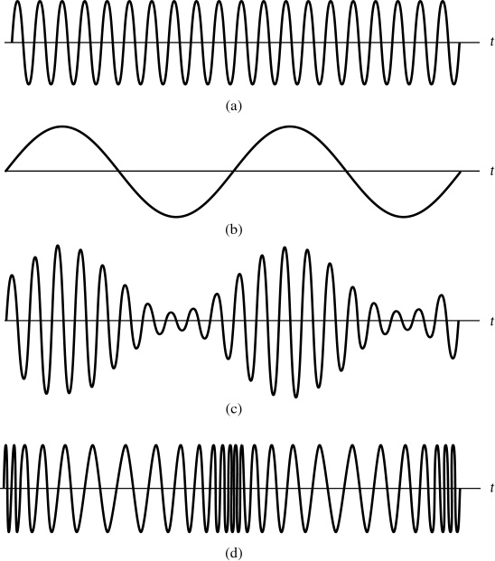
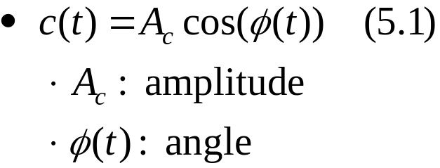
5.2 Type of Modulation
1. Continuous-Wave (CW) Modulation
Form of carrier wave : sinusoidal wave & periodic pulse train
1. Continuous-wave (CW) modulation
Figure 5.1 (p. 426)
Amplitude- and angle-modulated signals for sinusoidal modulation.
(a) Carrier wave. (b) Sinusoidal modulating signal. (c) Amplitude-modulated signal. (d) Angle-modulated signal.

Slide 5
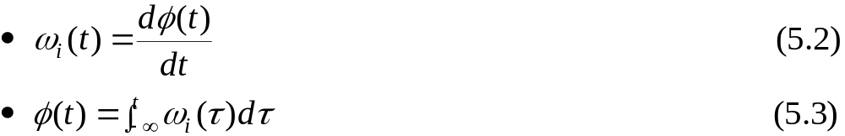

5.2 Type of Modulation
1. Continuous-Wave (CW) Modulation (Cont.)
Amplitude modulation(AM) :
  Full amplitude modulation (double sideband-transmitted carrier)
  Linear modulation
    double sideband-suppressed carrier modulation(DSB-SC)
    single sideband modulation(SSB)
    vestigial-sideband modulation(VSB)
Angle modulation :
  Nonlinear modulation process
Instantaneous radian frequency :
  Assume that the initial value is zero
: angle with respect to time t
Notes:
신호 및 시스템

Slide 6
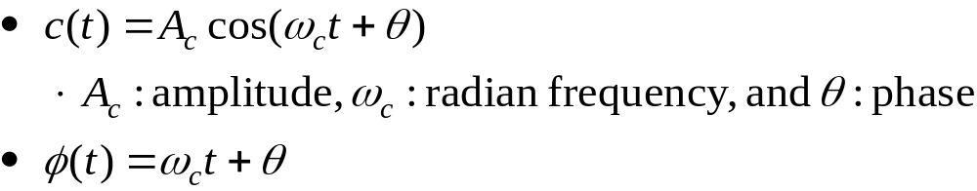
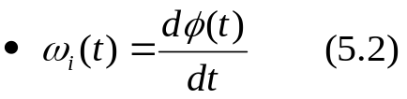

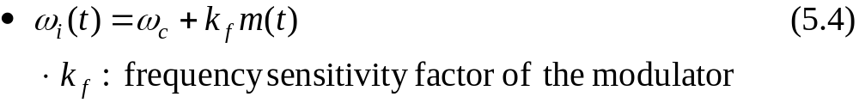


5.2 Type of Modulation
1. Continuous-Wave (CW) Modulation (Cont.)
Ordinary form of a sinusoidal :
Use Eq. (5.2):
When the instantaneous radian frequency ω_{i}(t) is varied in accordance with a message signal denoted by m(t)
Substitute Eq. (5.4) into Eq. (5.3):

Slide 7
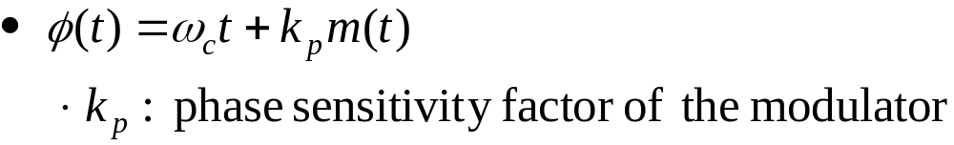
5.2 Type of Modulation
1. Continuous-Wave (CW) Modulation (Cont.)
Frequency Modulation (FM):
When the angle φ(t) is varied in accordance with a message signal denoted by m(t)
Phase Modulation (PM):

Slide 8
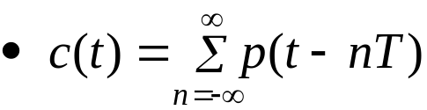
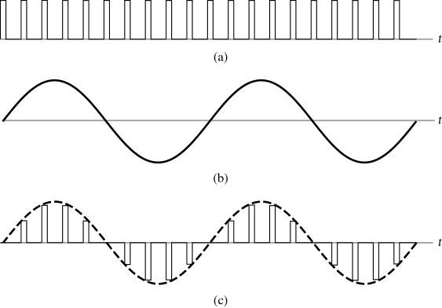
5.2 Type of Modulation (Cont.)
2. Pulse Modulation
Carrier wave:
  Periodic train of narrow pulses
  T: period
  p(t): a pulse of relatively short duration, compared with the period T
Pulse modulation
  Some characteristic parameter of p(t) is varied in accordance with the message signal
Analog pulse modulation
  Pulse-amplitude modulation(PAM)
  Pulse-duration modulation(PDM)
  Pulse-position modulation(PPM)
Digital pulse modulation
  Pulse-coded modulation (PCM)
Figure 5.2 (p. 428)
Pulse-amplitude modulation. (a) Train of rectangular pulses as the carrier wave. (b) Sinusoidal modulating signal. (c) Pulse-amplitude modulated signal.

Slide 9
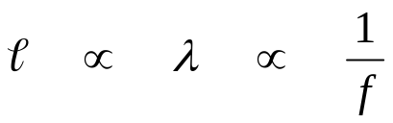
5.3 Benefits of Modulation
1. Modulation is used to shift the spectral content of a message signal so that it lies inside the operating frequency band of a communication channel.
2. Modulation provides a mechanism for putting the information content of a message signal into a form that may be less vulnerable to noise or interference.
3. Modulation permits the use of multiplexing.
4. Modulation makes it possible for the physical size of the transmitting or receiving antenna to assume a practical value.
안테나 유효 구경(길이) :
Notes:
신호 및 시스템

Slide 10
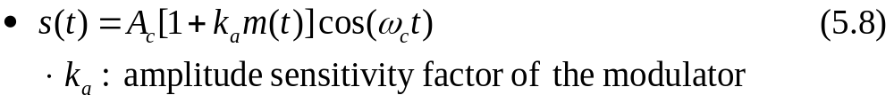
5.4 Full Amplitude Modulation
Sinusoidal carrier wave:
Amplitude modulation(AM),
  Modulated wave:

Slide 11


5.4.1 Percentage of Modulation
The amplitude in Eq. (5.8) is called the envelope of s(t)
Using a(t) to denote the envelope
Two cases arise, depending on the amplitude of k_{a}m(t), compared with unity:
Case 1. Undermodulation
  1+ k_{a}m(t)≥0
Case 2. Overmodulation
  Use Eq. (5.9) in evaluating the envelope of the AM wave
Percentage modulation: The maximum absolute value of k_{a}m(t), multiplied by 100
  Case 1 (percentage mod. ≤ 100 %) and Case 2 (percentage mod. > 100 %)

Slide 12
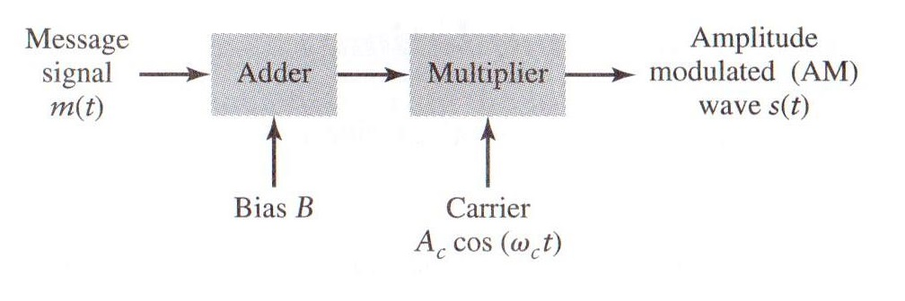
5.4.2 Generation of AM wave
Various schemes have been devised for the generation of AM wave
Rewirte Eq. (5.8) in the equivalent form
Figure 5.3 (p. 432) :
System involving an adder and multiplier for generating an AM wave.
(k_{a})
Notes:
신호 및 시스템

Slide 13
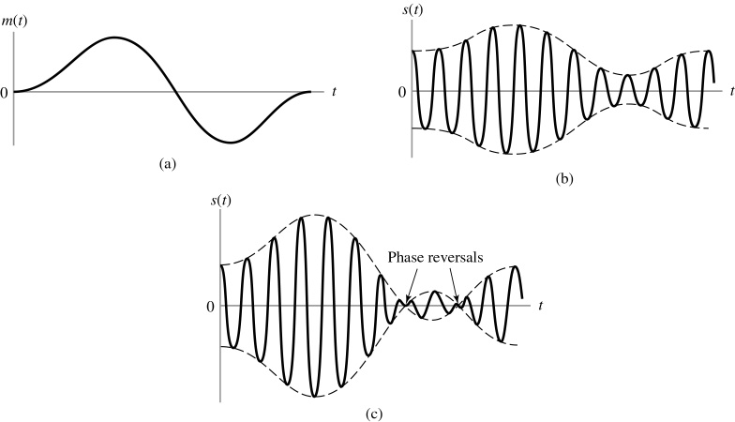
5.4.3 Possible waveforms of AM wave
: 포락선 검파
Figure 5.4 (p. 432)
Amplitude modulation for a varying percentage of modulation. (a) Message signal m(t). (b) AM wave for | k_{a}m(t)| < 1 for all t, where k_{a} is the amplitude sensitivity of the modulator. This case represents undermodulation. (c) AM wave for | k_{a}m(t)| > 1 some of the time. This case represents overmodulation.
(b) percentage modulation : 66.7%
(c) percentage modulation : 166.7%
  envelope distortion, overmodulated
: 포락선 검파 불가
Notes:
신호 및 시스템

Slide 14
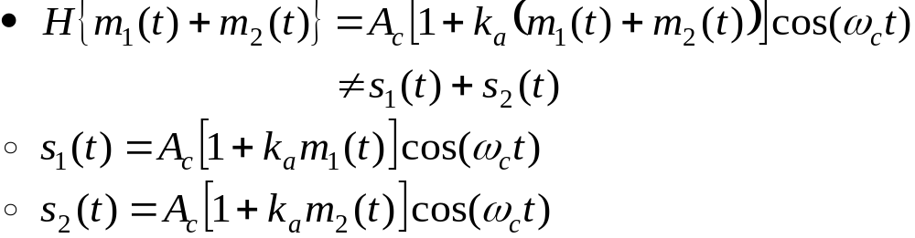
5.4.4 Does Full-Amplitude modulation satisfy the linearity property?
Linear modulation is defined as the form of modulation, if the amplitude of the message signal is scaled by a certain factor, then the amplitude of the modulated wave is scaled by exactly the same factor.
Consider m(t)=m₁(t)+m₂(t)
The operator H denoting the amplitude modulation process
  The principle of superposition is violated.
  The AM signal s(t) in Eq. (5.8) is a linear combination of the carrier component A_{c}cos(ω_{c}t) and the modulated component A_{c}cos(ω_{c}t)m(t) .
  Amplitude modulation permits the use of Fourier analysis without difficulty.

Slide 15

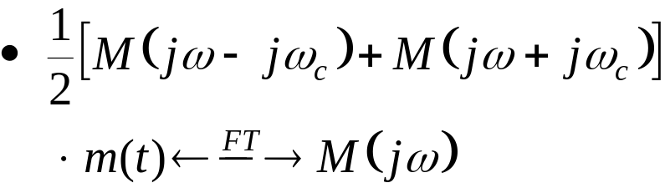
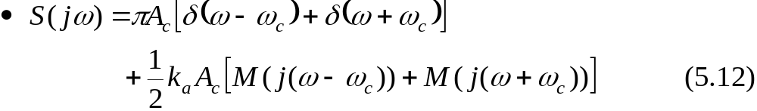
5.4.5 Frequency-domain description of Amplitude Modulation
FT of A_{c}cos(ω_{c}t) : See Example 4.1
FT of m(t)cos(ω_{c}t) : See Example 4.6
FT of s(t)

Slide 16
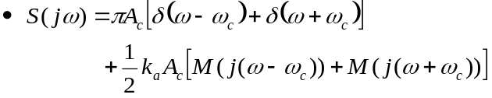
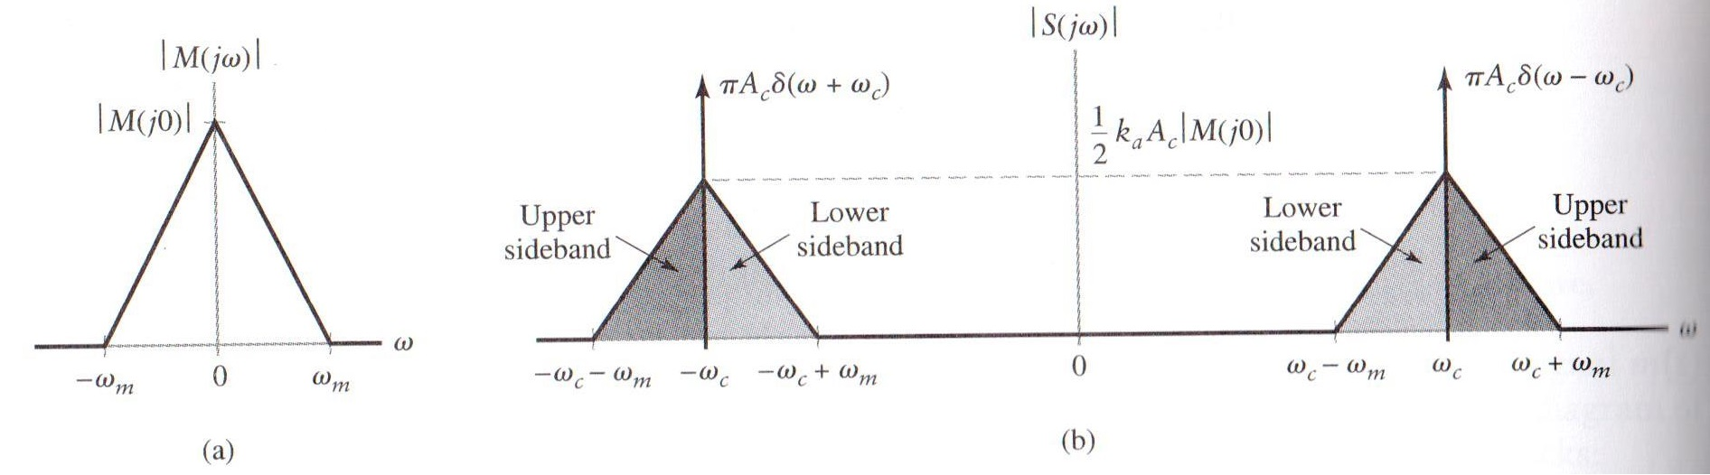
5.4.5 Frequency-domain description of Amplitude Modulation (Cont.)
Figure 5.5 (p. 434) :
Spectral content of AM wave. (a) Magnitude spectrum of message signal. (b) Magnitude spectrum of the AM wave, showing the compositions of the carrier and the upper and lower sidebands.
Both for positive and the negative freq. → upper and lower sidebands
  The condition ω_{c} > ω_{m} is a necessary for the sidebands not to overlap
Transmission bandwidth
  For positive frequencies, the difference between the highest freq. comp. of the AM wave ω_{c} + ω_{m} and the lowest ω_{c} - ω_{m}.
Full amplitude modulation
  The carrier and the upper and the lower sidebands are all represented.

Slide 17
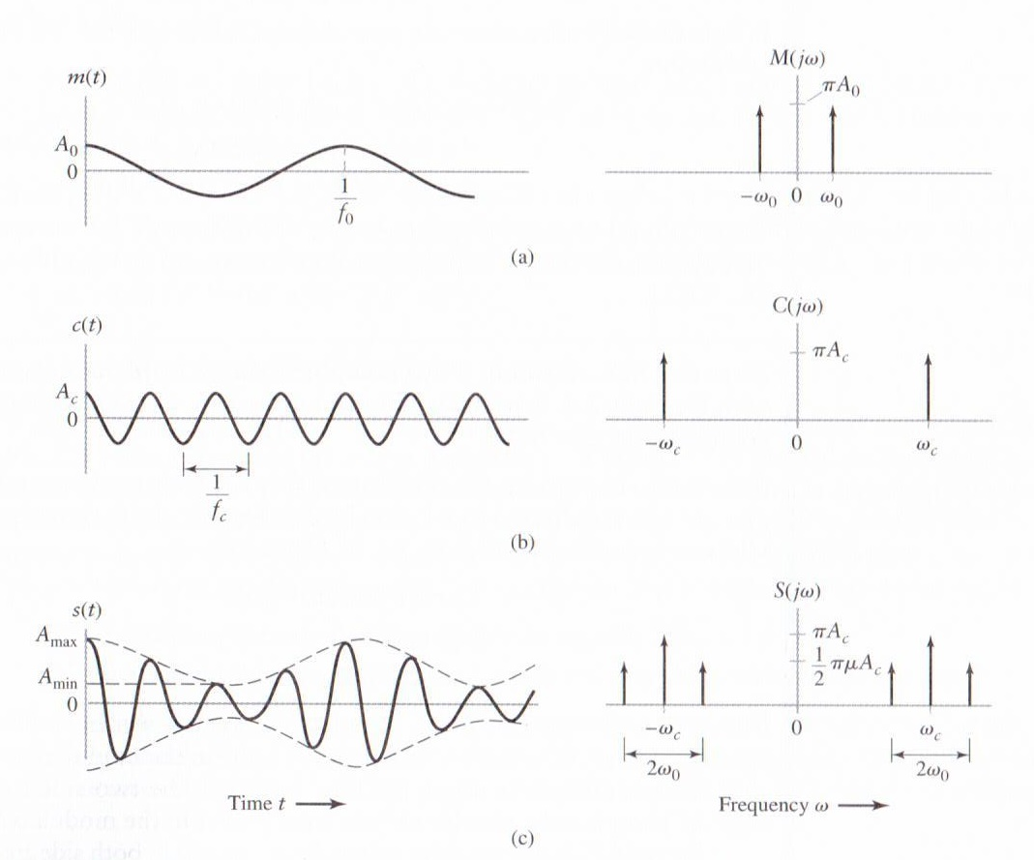
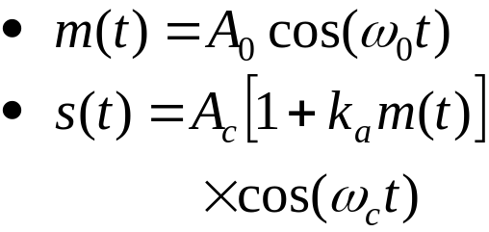

5.4.5 Frequency-domain description of Amplitude Modulation (Cont.)
Example 5.1 Full Amplitude Modulation for Sinusoidal Modulating Signal
Figure 5.6 (p. 435)
Time-domain (on the left) and frequency-domain (on the right) characteristics of AM produced by a sinusoidal modulating wave. (a) Modulating wave. (b) Carrier wave. (c) AM wave.
Modulation factor : µ<1
: Undermodulation
Notes:
신호 및 시스템

Slide 18
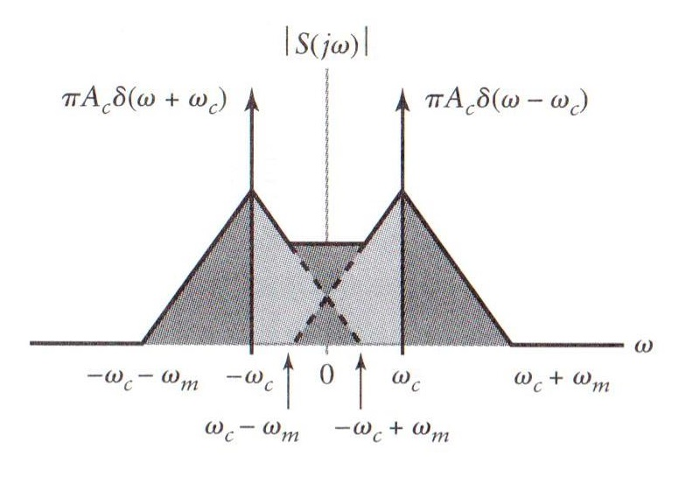

5.4.6 Spectral overlap
Frequency distortion due to spectral overlap :
Figure 5.8 (p. 438) :
Spectral overlap phenomenon in amplitude modulation. The phenomenon arises when the carrier frequency ω_{c} is less than the highest frequency component ω_{m} of the modulating signal.
: overlap 없는 경우
Notes:
신호 및 시스템

Slide 19
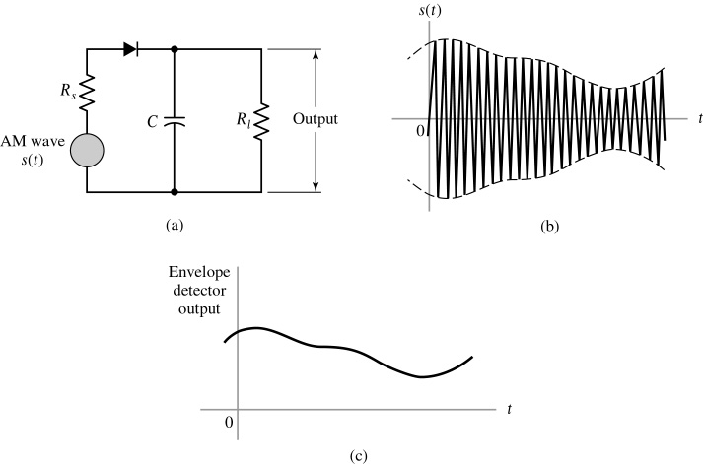
5.4.7 Demodulation of AM wave
Envelope detector provides a simple device for the demodulation of a narrowband AM signal for which the percentage modulation is less than 100%.
Narrowband means that the carrier frequency is large compared with the message bandwidth.
Figure 5.9 (p. 438)
Envelope detector, illustrated by (a) circuit diagram, (b) AM wave input, and (c) envelope detector output, assuming ideal conditions.

Slide 20
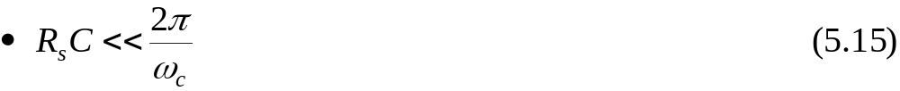
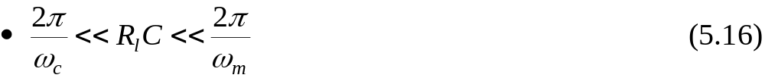
5.4.7 Demodulation of AM wave (Cont.)
Charging time constant
Discharging time constant
  The capacitor discharges slowly
  The detector output usually has a small ripple at the carrier frequency, this ripple is removed by low-pass filtering.

Slide 21
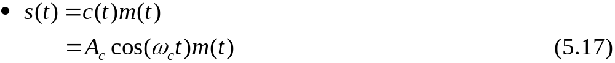
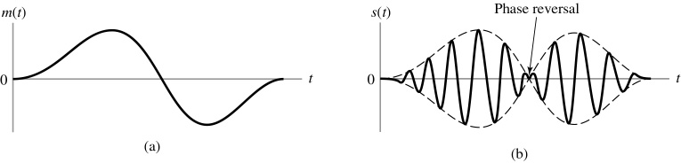
5.5 Double Sideband-Suppressed Carrier Modulation
In full AM, the carrier wave c(t) is independent of m(t).
  Transmission of the carrier wave represents a waste of power.
  Suppress the carrier component from the modulated wave
Double Sideband-Suppressed Carrier (DSB-SC) Modulation
Phase reversal occurs whenever m(t) crosses zero.
Figure 5.10 (p. 440)
Double-sideband-suppressed carrier modulation. (a) Message signal. (b) DSB-SC modulated wave, resulting from multiplication of the message signal by the sinusoidal carrier wave.

Slide 22
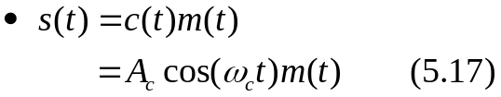
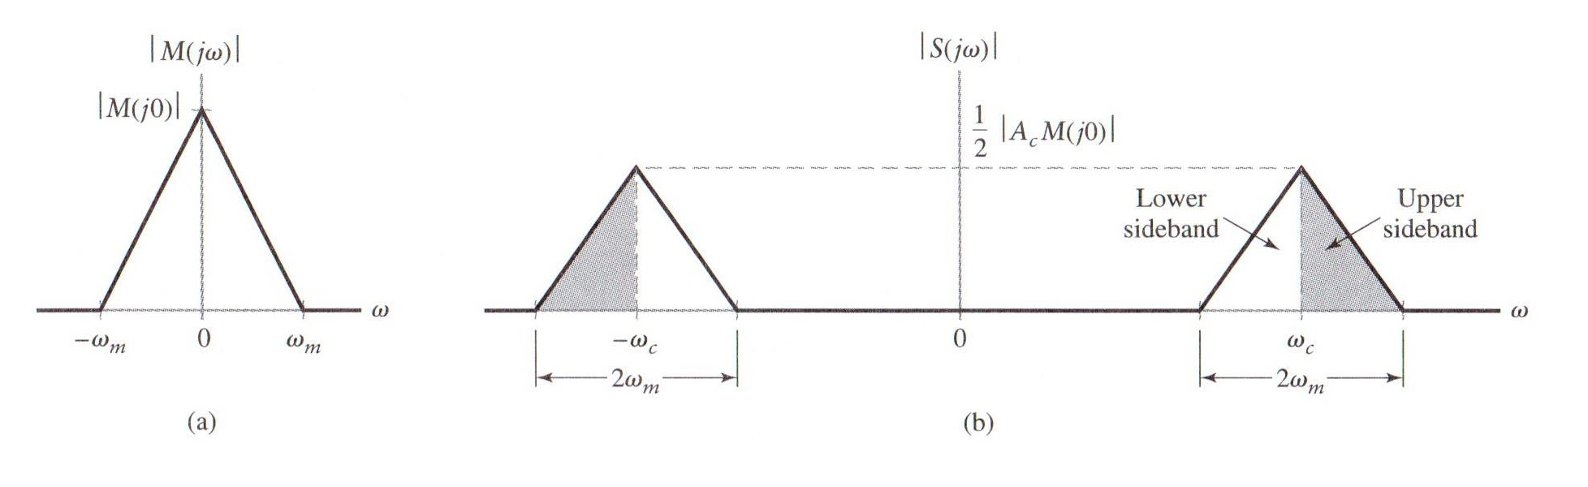
5.5.1 Frequency-Domain Description
FT of the modulated signal in Eq. (5.17): See Example 4.6
Figure 5.11 (p. 441) :
Spectral content of DSB-SC modulated wave. (a) Magnitude spectrum of message signal. (b) Magnitude spectrum of DSB-SC modulated wave, consisting of upper and lower sidebands only.
Carrier is suppressed → Not exist the pair of impulse functions at ± ω_{c}

Slide 23
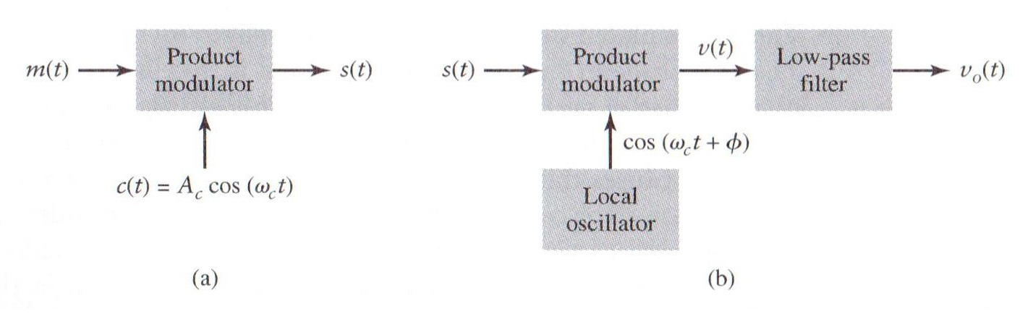
5.5.2 Coherent detection
Product modulator
  Coherent detection or synchronous demodulation
→ The sinusoid wave generated by local oscillator is exactly coherent or synchronized, in both frequency and phase, with the carrier wave c(t) used in the product modulator of the transmitter to generate s(t).
Figure 5.12 (p. 441) :
(a) Product modulator for generating the DSB-SC modulated wave.
(b) Coherent detector for demodulation of the DSB-SC modulated wave.

Slide 24
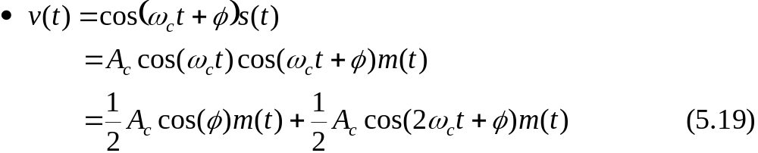
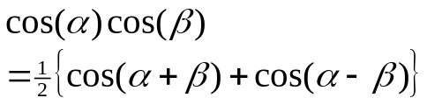
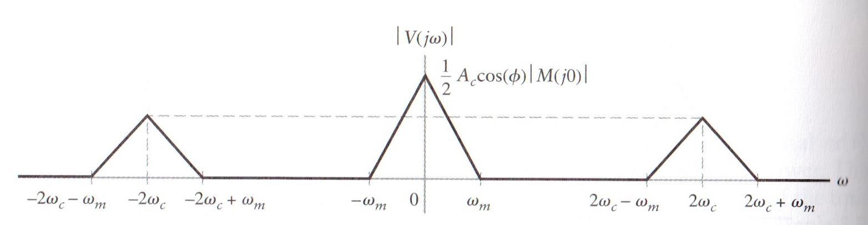
5.5.2 Coherent detection (Cont.)
To derive coherent detection as a special case of the more general demodulation process, using a local oscillator whose output has the same frequency, but arbitrary phase difference φ, measured with respect to the carrier wave c(t).
Figure 5.13 (p. 442) :
Magnitude spectrum of the product modulator output v(t) in the coherent detector of Fig. 5.12(b).

Slide 25
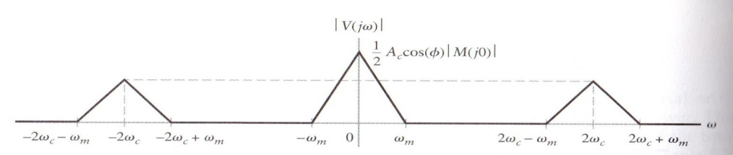
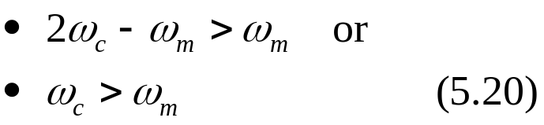
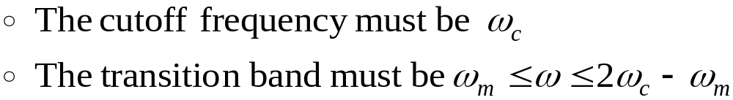
5.5.2 Coherent detection (Cont.)
The clear separation between the spectra of the two components of v(t) indicated in Fig. 5.13 hinges on the assumption that original carrier frequency ω_{c} satisfies the condition
Use a low-pass filter to suppress the unwanted second term of v(t)
Output of the coherent detector:
  v_{o}(t) is proportional to the m(t) when φ is a constant.
  The zero demodulated signal, which occurs for φ =±π/2, represents the quadrature null effect of the coherent detector.
  The phase error φ causes the detector output to be attenuated by cos(φ ).
  As long as φ is a constant, v_{o}(t) provides an undistorted version of m(t) .
  The complexity of the receiver is increased by suppressing the carrier wave to save transmitter power.

Slide 26
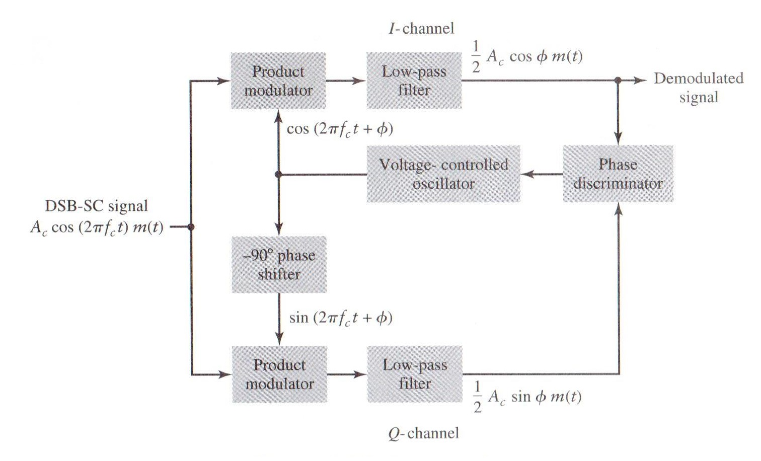
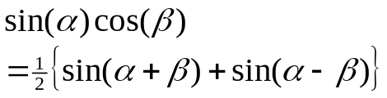
5.5.3 Costas receiver
Demodulating DSB-SC waves
  I-channel : in-phase coherent detector
  Q-channel : quadrature-phase coherent detector
Figure 5.15 (p. 445) : Costas receiver

Slide 27
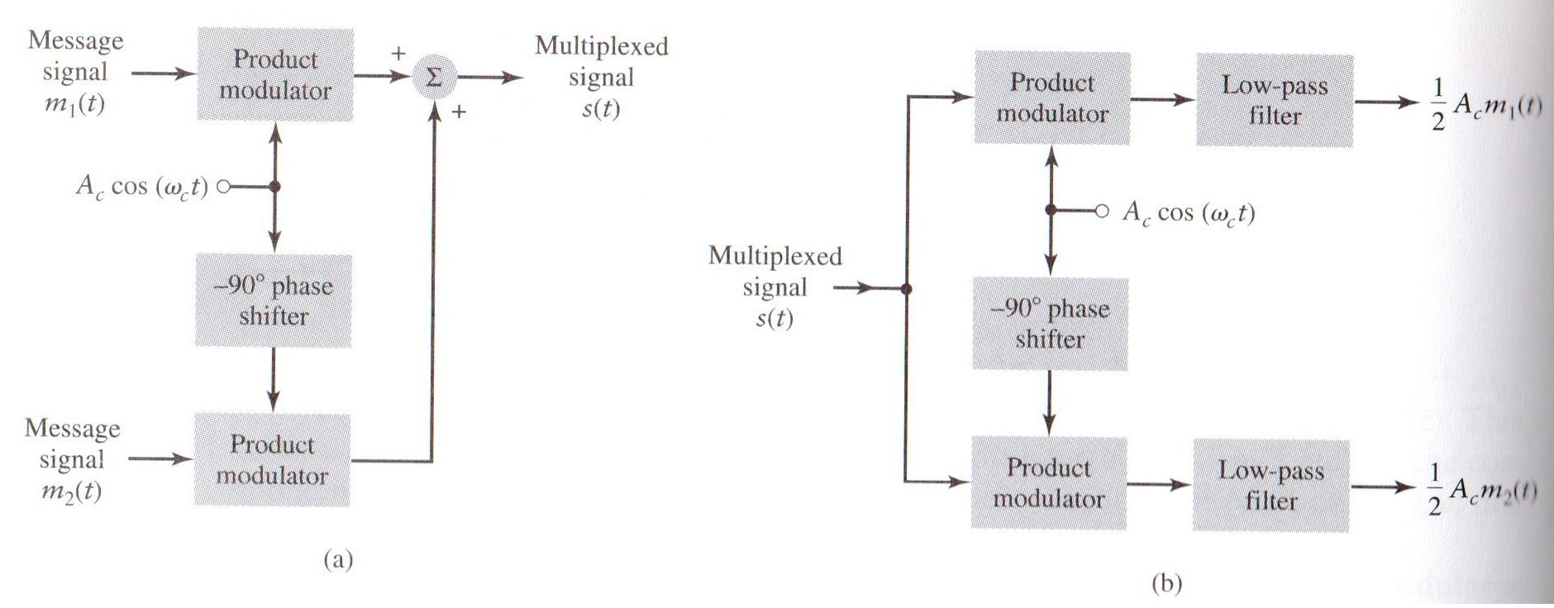
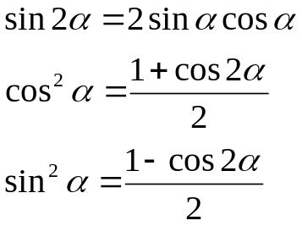
5.6 Quadrature-carrier multiplexing
QAM (quadrature-amplitude modulation)
  bandwidth-conservation scheme
Figure 5.16 (p. 446) :
Quadrature-carrier multiplexing system, exploiting the quadrature null effect. (a) Transmitter. (b) Receiver, assuming perfect synchronization

Slide 28
5.7 Other Variants of amplitude modulation
The full AM and DSB-SC forms of modulation are wasteful of bandwidth
  A transmission bandwidth equals to twice the message bandwidth (the upper and the lower sidebands)
Transmission information is concerned, only one sideband is necessary
  If both the carrier and the other sideband are suppressed at the transmitter, no information is lost.
The channel needs to provide only the same bandwidth as the message signal
SSB (single-sideband) modulation

Slide 29
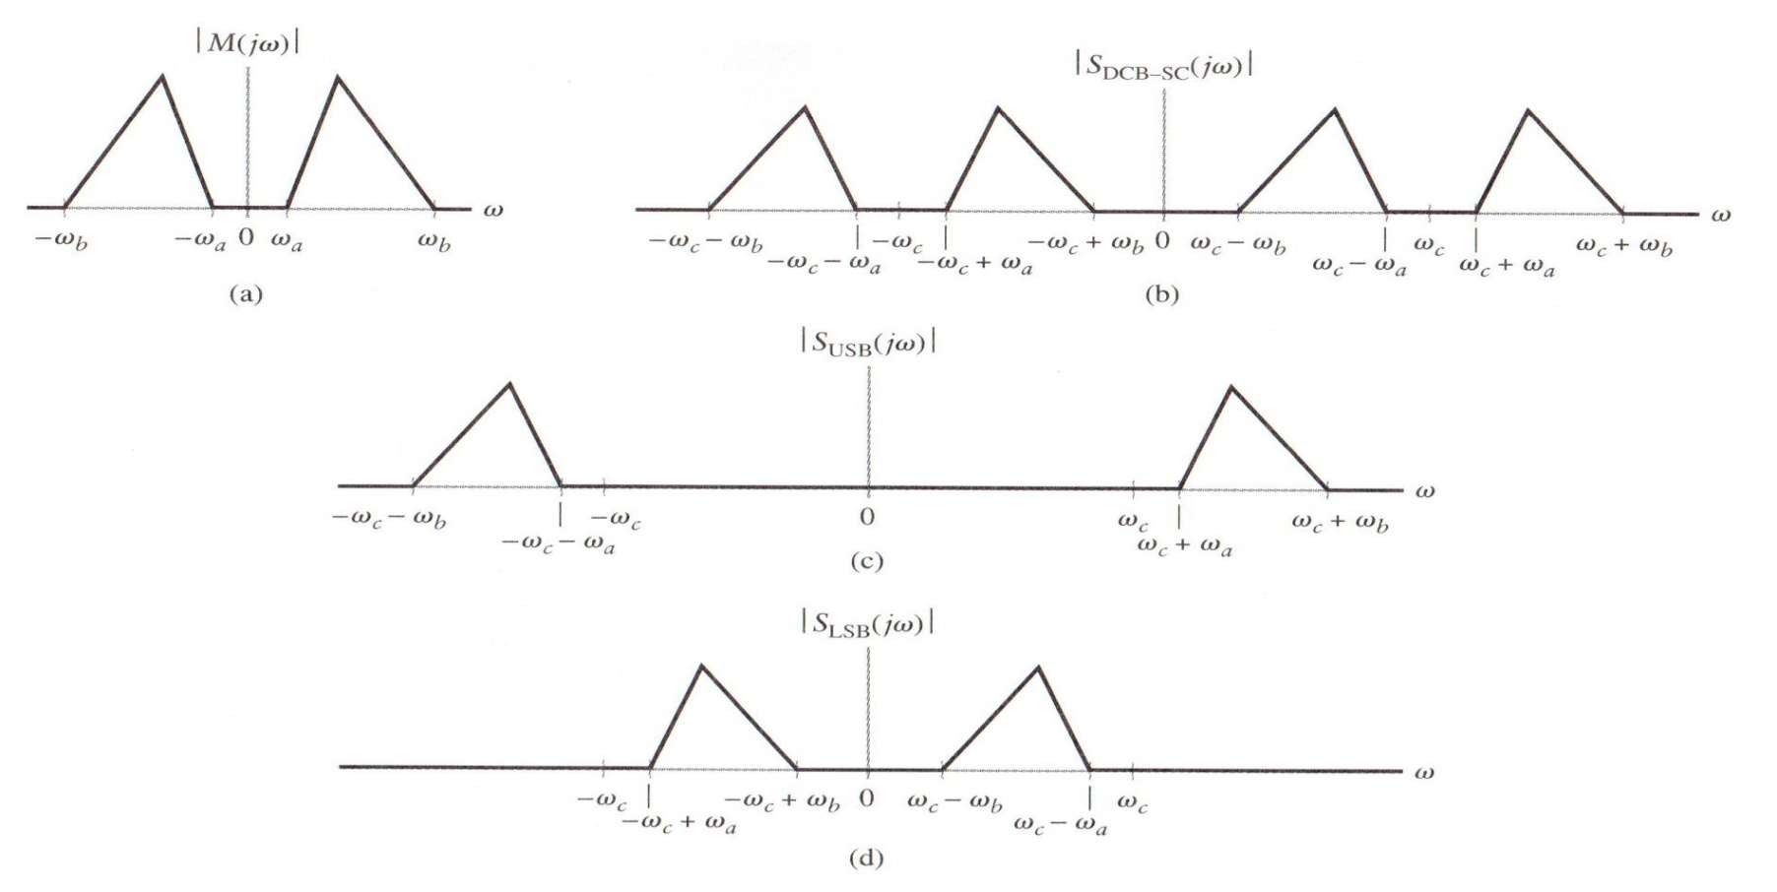
5.7.1 Frequency-domain description of SSB modulation
s
Figure 5.17 (p. 447) :
Frequency-domain characteristics of SSB modulation. (a) Magnitude spectrum of message signal, with energy gap from – ω_{a} to ω_{a}. (b) Magnitude spectrum of DSB-SC signal. (c) Magnitude spectrum of SSB modulated wave, containing upper sideband only. (d) Magnitude spectrum of SSB modulated wave, containing lower sideband only.
upper sideband
lower sideband
Notes:
신호 및 시스템

Slide 30
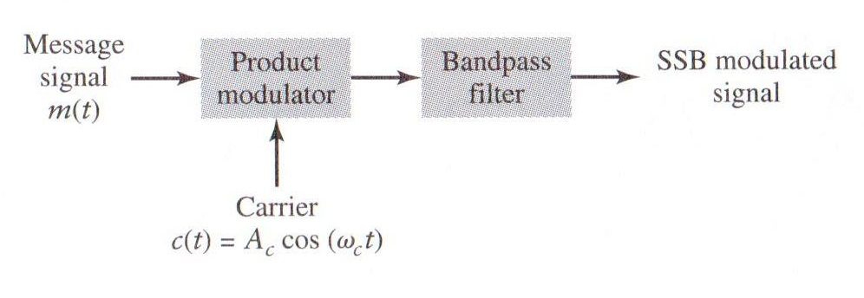
5.7.1 Frequency-domain description of SSB modulation (Cont.)
Figure 5.18 (p. 448) :
System consisting of product modulator and bandpass filter, for generating SSB modulated wave.
The principal disadvantage of SSB modulation is the cost and complexity of implementing both transmitter and the receiver.
The transition band separating the passband from the stopband must have a non-zero width.
  Such a requirement can be satisfied only if the message signal applied to the product modulator has an energy gap.
  Speech signals for telephonic communication do exhibit an energy gap extending from -300 to 300Hz.

Slide 31
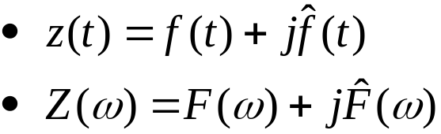

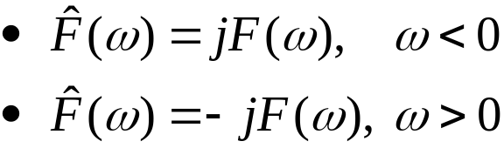
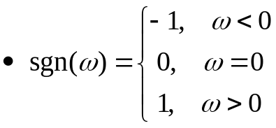


5.7.2 Time-domain description of SSB modulation
Hilbert transform → Hilbert transformer
The frequency response of the Hilbert transformer is characterized as follows:
  The magnitude response is unity for all frequencies, both positive and negative.
  The phase response is – 90º for positive frequencies and + 90º for negative frequencies.
The Hilbert transformer may be viewed as a wideband – 90º phase shifter.
The frequency response of the Hilbert transformer occupies a band of frequencies that, in theory, is infinite in extent.
Read on page 475.
Real valued-signal f(t) :
Z(ω) :SSB , Z(ω)=0, ω<0

Slide 32
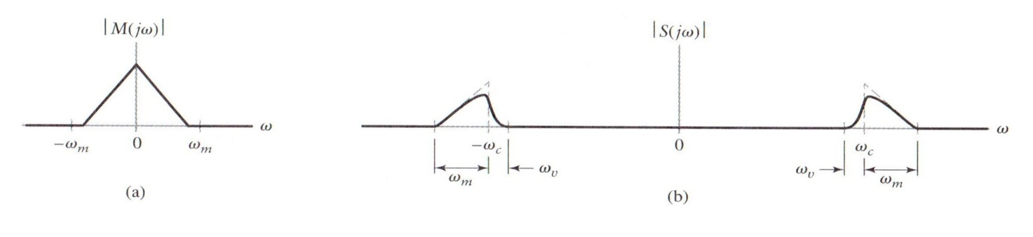
5.7.3 Vestigial sideband modulation
The practical difficulty of building a filter to isolate one sideband completely
Suggest vestigial sideband (VSB) modulation
  a compromise between SSB and DSB-SC forms of modulation.
  One sideband is passed almost completely, whereas just a trace, or vestige, of the sideband is retained
Figure 5.19 (p. 449) :
Spectral content of VSB modulated wave. (a) Magnitude spectrum of message signal. (b) Magnitude spectrum of VSB modulated wave containing a vestige of the lower sideband.
Transmission bandwidth required by the VSB modulation

Slide 33
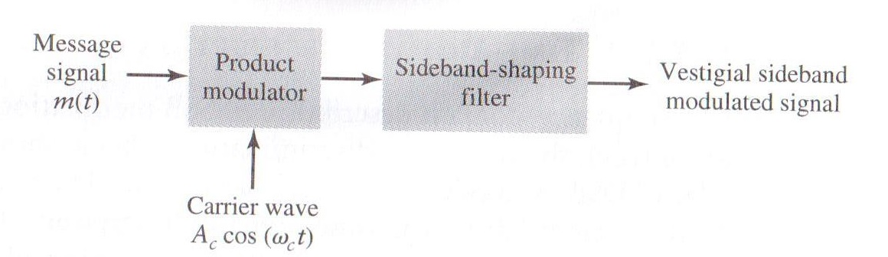
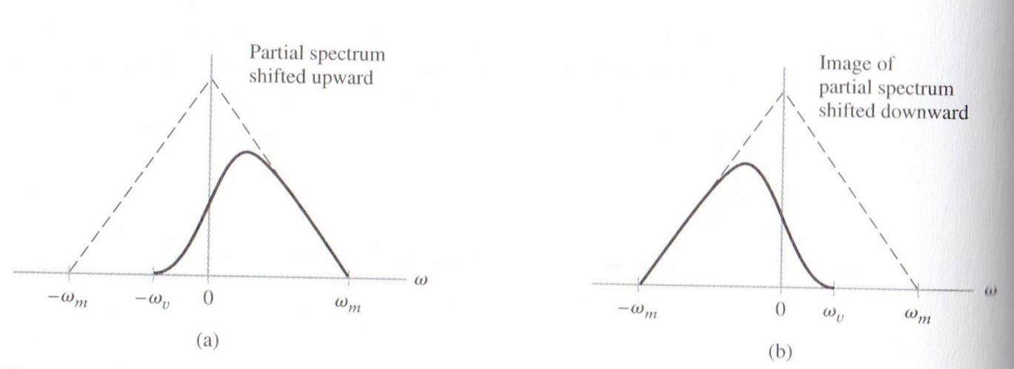
5.7.3 Vestigial sideband modulation (Cont.)
Figure 5.20 (p. 450)
System consisting of product modulator and sideband shaping filter, for generating VSB modulated wave.
Figure 5.21 (p. 450) :
Superposition of the two spectra shown in parts (a) and (b) of the figure results in the original message spectrum (shown dashed) upon demodulation.

Slide 34


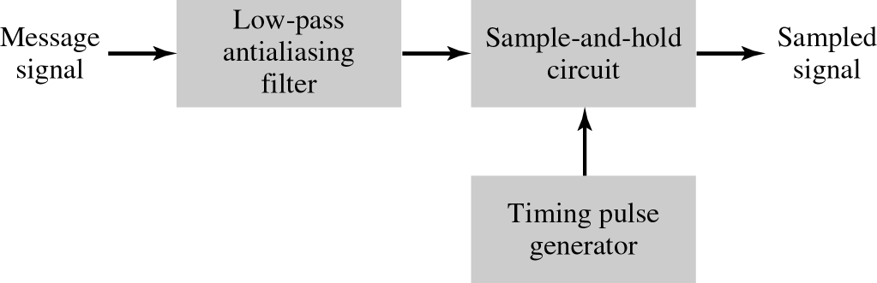
5.8 Pulse-Amplitude Modulation (PAM)
5.8.1 Sampling Revisited
Whereas frequency shifting plays a basic role in the operation of AM systems, the basic operation in PAM system is that of sampling
Restate the sampling theorem in the context of PAM :
  A band-limited signal of finite energy that has no radian frequency components higher than ω_{m} is uniquely determined by the values of the signal at instants of time separated by π/ω_{m} seconds.
  A band-limited signal of finite energy that has no radian frequency components higher then ω_{m} may be completely recovered from a knowledge of its samples taken at the rate of ω_{m}/π per second.
Figure 5.22 (p. 451)
System consisting of anti-aliasing filter and sample-and-hold circuit, for converting a message signal into a flat-topped PAM signal.

Slide 35
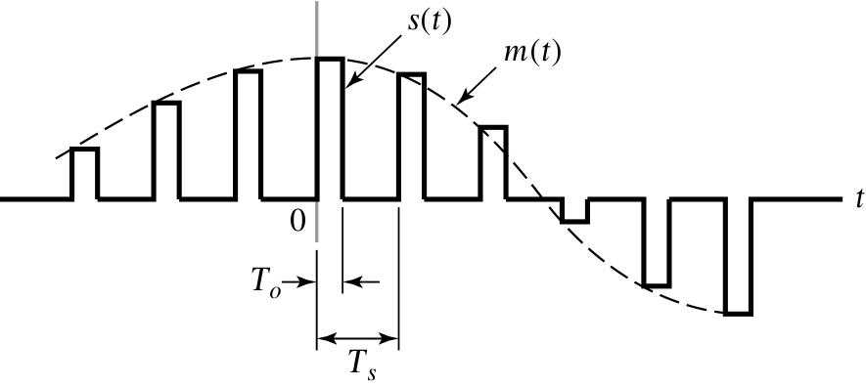
5.8.2 Mathematical Description of PAM
Figure 5.23 (p.452)
Waveform of flat-topped PAM signal with pulse duration T_{o} and sampling period T_{s}.
Mathematical representation of the PAM signal s(t)
  Sample-and-hold operation

Slide 36
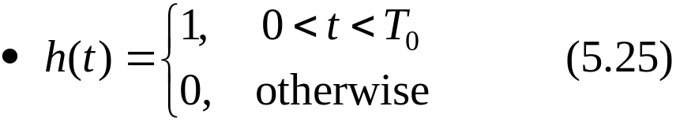

5.8.2 Mathematical Description of PAM (Cont.)
Figure 5.24 (p. 453) :
(a) Rectangular pulse h(t) of unit amplitude and duration T₀. (b) Magnitude spectrum |H(jω)| and phase spectrum arg{H(jω)} of pulse h(t).

Slide 37
5.8.2 Mathematical Description of PAM (Cont.)
Impulse-sampled version of the message signal m(t) :
PAM signal :
Fourier transform :
Fourier transform of m_{δ}(t) :
Substitute Eq. (5.29) into Eq. (5.28)
Fourier transform of Eq. (5.25)
Aperture effect
: 4.6.3절 zero-order hold 참고
Notes:
신호 및 시스템

Slide 38


5.8.3 Demodulation of PAM Signal
Given a sequence of flat-topped s(t), reconstruct m(t)
Figure 5.25 (p. 454)
System consisting of low-pass interpolation filter and equalizer, for reconstructing a message signal from its flat-topped sampled version.
The amplitude of the ideal equalizer
  H(jω) is the frequency response defined in Eq. (5.31)
: 구형파 펄스 이용하여
생긴 Aperture effect 보상
Notes:
신호 및 시스템

Slide 39

5.9 Multiplexing
Multiplexing
  Message signals derived from independent sources are combined into a composite signal suitable for transmission over a common channel
  Frequency-, time-, and code- division multiplexing techniques
Figure 5.27 (p. 456)
Two basic forms of multiplexing. (a) Frequency-division multiplexing (with guardbands). (b) Time-division multiplexing; no provision is made here for synchronizing pulses.

Slide 40

5.9.1 Frequency-Division Multiplexing (FDM)
Figure 5.28 (p. 457)
Block diagram of FDM system, showing the important constituents of the transmitter and receiver.

Slide 41

5.9.2 Time-Division Multiplexing (TDM)
The basic operation of a TDM system is the sampling theorem
Synchronization between the timing operations of the transmitter and receiver in a TDM system is essential for satisfactory performance of the system
Figure 5.29 (p. 458): Block diagram of TDM system, showing the important constituents of the transmitter and receiver.
Frame : The combination of M PAM signals and a synchronization pulse contained in a single sampling period
A simple way of identifying the synchronizing pulse train at the receiver is to take sure that its constant amplitude is large enough to stand above every one of the PAM signal. The synchronizing pulse train is identified at the receiver by using a threshold device set at the appropriate level.

Slide 42


5.10 Phase and Group Delays
Delay is determined by the phase response of the system
Phase response of a dispersive communication channel :
Time delay (or phase delay) is defined as
Suppose that we have a transmitted signal consisting of a DSB-SC modulated wave with carrier frequency ω_{c} and sinusoidal modulation frequency ω₀.
Set A=A_{c}A₀. Expressing s(t) in terms of its upper and lower side freq.

Slide 43




5.10 Phase and Group Delays (Cont.)
Let s(t) be transmitted through the channel with phase response φ(ω)
Assume that the magnitude response of the channel is essentially constant (equal to unity) over the frequency range from ω₁ to ω₂.
Signal received at the channel output
  φ(ω₁) and φ(ω₂) are the phase shifts produced by the channel at frequencies ω₁ and ω₂, respectively.
Rewrite y(t)

Slide 44




5.10 Phase and Group Delays (Cont.)
Compare y(t) in Eq. (5.37) and s(t) in Eq. (5.34) :
  The carrier component at frequency ω_{c} in y(t) lags its counterpart in s(t) by (1/2)(φ(ω₁)+ φ(ω₂))
    Time delay :
  The message component at frequency ω₀ in y(t) lags its counterpart in s(t) by (1/2)(φ(ω₁)- φ(ω₂))
    Time delay :

Slide 45







5.10 Phase and Group Delays (Cont.)
Narrowband signal : ω_{c} >> ω₀
Approximate the phase response φ(ω) in the vicinity of ω = ω_{c} by the two-term Taylor series expansion
  Using this expression to evaluate φ(ω₁) and φ(ω₂) for substitution into Eq. (5.38), we see that the carrier delay is equal to –φ(ω_{c})/ ω_{c}, which is identical to the formula given in Eq. (5.33) for the phase delay.
Time delay τ_{g} is called the envelope delay or group delay
Notes:
신호 및 시스템

Slide 46


5.10.1 Some Practical Considerations
: ω_{c} >> ω₀
: ω_{c} >= ω₀
Narrowband assumption is not satisfied because the message bandwidth is comparable to the carrier frequency
In situations, the group delay is formulated as a frequency-dependent parameter
Figure 5.32 (p. 464) Group delay response of voice-grade telephone channel. (Adapted from J. C. Bellamy, Digital Telephony, Wiley, 1982.)

Slide 47

Q & A
Thank you …
Notes:
신호 및 시스템

