Slide 1



From Prompt to Practice
AI FOR HEALTHCARE · TBILISI, GEORGIA · OCTOBER 2026
AI-Assisted Creation of Immersive Learning Environments for Nursing Education
Hannes Tegelbeckers, PhD, Otto von Guericke University Magdeburg
with 3DBear, Finland
Erasmus+ project NEXR
Nursing Education with Extended Reality
NEXR (2025-1-DE02-KA220-VET-000355712) is co-funded by the Erasmus+ Programme of the European Union. Views and opinions expressed are those of the author(s) only and do not necessarily reflect those of the European Union or EACEA. Neither the European Union nor EACEA can be held responsible for them.
Notes:
Introduce yourself and the professorship. Today's question: can a nurse educator, not a media studio, create an immersive training scenario? And what does it take to use AI for that responsibly?
Everything shown is real material from the NEXR project and from our Finnish partner 3DBear. The live example is on slide 9, the example links on slide 14.

Slide 2
The situations that matter most are the hardest to practise
1 · THE PROBLEM
A client has a stroke during a routine home visit. Nurses must act correctly the first time, yet students rarely meet such situations during training, and they cannot practise them safely on real people.
Rare in placements
Not safe to rehearse
XR has been costly to make
High-risk, low-frequency situations do not happen on demand.
Learning from a wrong decision is valuable, but not with a real patient. Simulation gives room to make the mistake and see its consequence.
A 360° scenario has usually meant filming, actors, a script and a developer. So teachers rarely create one themselves, and content lags behind the curriculum.
“
"Prioritise LOs involving high-risk, low-frequency, or complex clinical situations."
Guideline for partners, NEXR curriculum analysis (WP2, T2.1)
Notes:
This is the starting point of NEXR. In our curriculum analysis we asked every partner country to select learning outcomes where XR adds value, and to give priority to high-risk, low-frequency situations.
The third card is the bottleneck this talk is about: production. If only specialists can make XR, it stays a pilot project.

Slide 3
NEXR: Nursing Education with Extended Reality
2 · THE PROJECT
Erasmus+ cooperation partnership in vocational education (KA220-VET), December 2025 to November 2028, coordinated by Otto von Guericke University Magdeburg.
Six partners, five countries
From curriculum to classroom
OvGU Magdeburg, Germany (coordinator)
Skills Divers, Spain
3DBear, Finland
ESNO, European Specialist Nurses Organisations, Netherlands
IES Los Albares, Spain
FHG Tirol, Austria
WP2 Curriculum analysis: which learning outcomes benefit from XR
WP3 Human-centred design method, 20 XR exercises defined
WP4 XR Training Kit: 10 360° VR scenarios and 10 AI-based XR contents, plus an online course
Pilots with students and teachers in Austria and Spain
WP5 Dissemination and policy recommendations
Notes:
Briefly: NEXR is about modernising nursing education with XR, AI and human-centred design. OvGU coordinates and leads the design methodology. 3DBear leads the two WP4 tasks on 360° VR scenarios and AI-based XR content, and that is what I will show.
WP3 also includes training a pedagogical AI model to produce XR content along human-centred design principles. The workflow you will see is the practical side of that idea.

Slide 4
AI as a process, not a button
3 · THE SHIFT
A chat window returns text. A training scenario must be pedagogically sound, clinically correct, technically working and placed in the curriculum. That needs a process with checkpoints.
AI as a button
AI as a process
Type a prompt, get an output
Quality depends on who writes the prompt
You check everything yourself, afterwards
Every session starts from zero
Asks first: course placement, prior knowledge, learners, language level
Follows written methods ("skills") every time, for example briefing, decision, debriefing
Checks itself: sources traced, automatic tests, the writer is not the reviewer
The teacher decides: approves the plan before anything is generated
The tool shown here is Simuna Creator by 3DBear. Its methods are written down as more than 100 documented skills that the AI agents follow.
Notes:
The key message of the talk. "AI used correctly" is not a better prompt. It is a workflow where the method is built in, the AI is checked, and the teacher keeps the decisions.
A skill is a written method. For simulations it encodes simulation pedagogy: every scenario needs a briefing, at least one decision with a consequence, and a debriefing with reflection. The AI follows it whoever is typing.

Slide 5
The teacher describes a care situation and the learning goal
STEP 1
Describe
STEP 2
Plan
STEP 3
Build
STEP 4
Check and review
STEP 5
Publish
A TEACHER'S DESCRIPTION (ILLUSTRATIVE)
"My practical-nurse students have studied the signs of stroke. I want them to practise a home visit where an elderly client has suddenly become unwell. They should notice the signs and choose the right first action."
Before writing anything, the AI asks
Where in the course does this go, and what comes before it?
What do the students already know?
Who are the learners, and what is their language level?
Is there material to use: a guideline, a video, a recording?
Running example: "Acute deterioration in home care", built for NEXR from a Finnish practical-nurse learning outcome in the NEXR curriculum analysis: "Respond to acute changes in a client's condition and provide first aid" (EQF 4, XR suitability: high).
Notes:
The input is ordinary teacher language. No technical terms, no 3D skills.
Important: the AI does not jump to a result. It asks one question at a time, starting with where the simulation sits in the course. Without that it cannot judge difficulty or what the briefing must contain. Teachers can also upload their own material, such as a national guideline.
The example I use throughout was built by 3DBear for NEXR with the same pipeline, starting from a learning outcome in our own curriculum analysis.

Slide 6
The AI writes a scene plan with the pedagogy built in
STEP 1
Describe
STEP 2
Plan
STEP 3
Build
STEP 4
Check and review
STEP 5
Publish
BRIEFING
EXPLORE
DECIDE
CONSEQUENCE
DEBRIEFING
Arrive at Aino's home
Find the clues
First action?
See what happens
Reflect
Role and context. Activating question: which signs tell you her condition changed suddenly?
→
Look around the room in 360°, find four clinical clues and listen to what Aino says.
→
Four options: call 112 and assess with FAST, put her to bed, give water and check blood sugar, call a relative. Feedback on each.
→
Right: paramedics arrive in time. Wrong: care is delayed, and the learner returns to the decision.
→
What did you notice first? What would be hardest to spot on a busy real visit? Score shown.
Rules the AI follows
The teacher approves the plan
At least one decision where the choice has a consequence
A wrong choice shows its consequence, not only "wrong, try again"
A debriefing with open reflection questions
Short texts: two or three sentences per pop-up
The plan names the task type of each scene and why it was chosen. Generation does not start until the teacher has read and approved it. Changes are made in the plan first.
Notes:
This is the step where pedagogy enters. The structure is briefing, experience, decision, consequence, debriefing, which follows the experiential learning cycle.
Note the wrong answers. "Put her to bed to rest" is the plausible mistake. The scenario shows the consequence, that care is delayed, explains why, and sends the learner back to decide again. Errors are a learning resource, not a dead end.
The approval gate is deliberate. The teacher checks the pedagogy and clinical logic while it is still cheap to change.

Slide 7
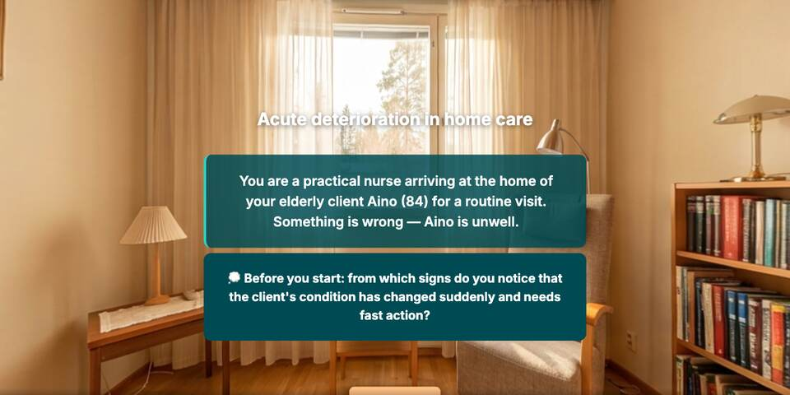
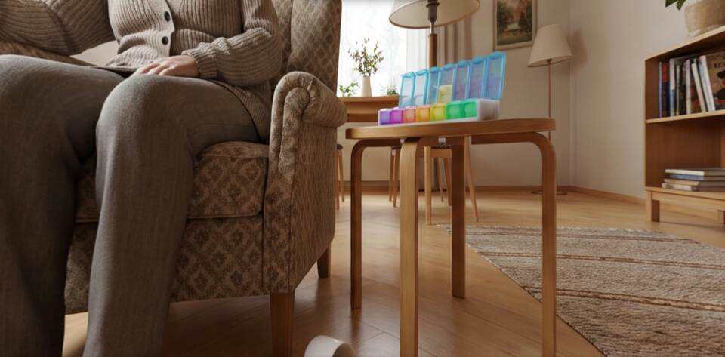
The AI builds the 360° environment
STEP 1
Describe
STEP 2
Plan
STEP 3
Build
STEP 4
Check and review
STEP 5
Publish
360° panoramas are generated from the approved plan by an image model
Image recognition finds the clue objects in each panorama and places the hotspots on them: today's untouched medication, the fallen cane, the spilled coffee, Aino herself
Voices: a narrator for each scene, and here a speaking patient: "Oh… I feel so dizzy… and I can't grip with my right hand."
Five languages, text and voice: Finnish, English, German, Spanish, Croatian
Small fixes without starting over: the teacher marks an area in the image and only that area is redrawn
Briefing scene, English version
Open the environment →
Exploring: pill organiser, spilled coffee, the client
Notes:
Generation runs in the background for a few minutes. The pipeline creates the panoramas, then uses image recognition to find the objects the plan refers to and puts the hotspots exactly on them.
The speaking patient matters. Hearing slurred, confused speech is part of recognising a stroke, so Aino's voice is a clinical clue, not decoration.
If the image has an odd detail, the teacher marks it and only that area is redrawn. Regenerating the whole image would move every object out from under its hotspot.

Slide 8
Checked by machine, reviewed by people, then published
STEP 1
Describe
STEP 2
Plan
STEP 3
Build
STEP 4
Check and review
STEP 5
Publish
4a
4b
5
Automatic checks
Human review
Publish
Structure validated against the simulation format
The scenario is played through in a browser with the correct answers, and every scene's layout is measured
A scenario that cannot be completed does not get a link
The teacher tries it in preview and edits texts and positions directly
A nurse educator checks the clinical content: is this the right first action in our country, with our protocols?
Changes go back through the same checks
Into the learning platform (Moodle) with LTI: the score is reported when the learner reaches the end
As a link, or embedded in a course site
Self-service publishing inside Creator is being built; today 3DBear publishes on request
Notes:
Two kinds of review. The machine checks what machines do well: does every scene load, can the scenario be completed, does anything overlap. People check what only people can: is it clinically right, and right for our context.
Localisation is clinical as well as linguistic. Emergency numbers, assessment tools and responsibilities differ between countries. That decision belongs to a nurse educator, not to the AI.
Be honest about status: publishing directly from Creator is still in development. Today the simulations go into Moodle via LTI, which reports the score back to the gradebook.

Slide 9
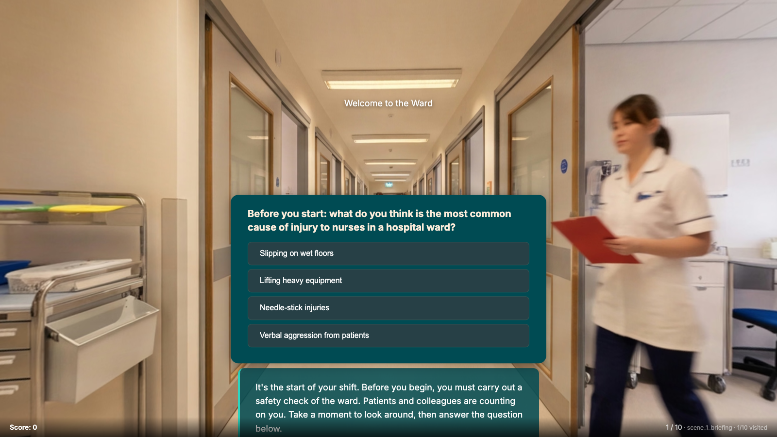
Hospital health and safety: spot the hazard
LIVE EXAMPLE · BUILT WITH THE WORKFLOW
Try it live
Briefing with an activating question
Two rounds of spotting visible and hidden hazards
Two decisions with consequences
Debriefing and final score
Runs in an ordinary browser; no headset needed
Open the live example →
s360.simuna.io/nexr/nursing-home
Notes:
This is a published scenario from the same pipeline, running live. Walk through it briefly: answer the activating question in the briefing, look around the ward in 360°, click two or three hazards (wet floor without a sign, trailing cable, overflowing waste bin), then take the spilled-medication decision. Choose the wrong option first to show the near-miss consequence.
Point out the same structure as the plan on slide 6: briefing, explore, decide, consequence, debriefing.
In PowerPoint: click the screenshot or the button to open the live environment in the browser, then switch back to the slides. It needs an internet connection.

Slide 10
Not a single scenario: a whole course
4 · EXAMPLE FROM FINLAND
"Mental health promotion and preventive substance abuse work", a 30-competence-point unit of Finnish practical-nurse training, produced by 3DBear in the same AI workspace. Work started in March 2026; the course went into production use in July 2026.
MODULE | THEORY BOOKS | PRACTICE HIGHLIGHTS
1 · Professional ethics and legislation | 5 | Case tasks, concept cards, reflection on an ethical situation
2 · Working in a work community | 5 | 360° Equal work community and preventing harassment; first-aid case
3 · Professional interaction | 5 | 360° Meeting an aggressive client · AI talk A respectful first meeting · a quiet, withdrawn client
4 · Planning the work | 7 | AI talk Motivational interviewing · substance and medication interaction micro-simulation · medication monitoring and dose calculation
5 · Mental health promotion and preventive substance abuse work | 8 | 360° Supporting participation · acute psychosis · recognising suicidality and raising the topic
6 · Evaluating the work | 4 | AI talk Joint evaluation with a client · "correct the record" task · final exam
34
interactive theory books
5
360° simulations
4
spoken AI conversation partners
26
practice and review quizzes
43
case-based questions in the final exam
Every module follows the same rhythm: Study, Practise, Revise. Two external subject experts and a pedagogical lead reviewed the content throughout production.
Notes:
This is the outline of a real Finnish course, translated into English. It is a unit in the mental health and substance abuse competence area of the practical-nurse qualification.
Point out the mix: theory books with small tasks, 360° simulations for the high-stakes situations such as acute psychosis or raising suicidality, and spoken conversation practice for interaction skills like motivational interviewing.
The same principle as before applies: AI did the production, people decided. Two external subject experts commented continuously, and their corrections went back through the workspace. About four months from first file to production use.

Slide 11
Finnish material, reused across the consortium
5 · FROM ONE COUNTRY TO FIVE LANGUAGES
The NEXR demonstrator module wraps XR exercises from Finnish practical-nurse courses in a short theory shell, in English, Finnish, German, Spanish and Croatian. Text and narration are translated and re-voiced.
1.1
2.3
3.2
5.1
Dispensing medication into a pill organiser
Considering sexuality in care work
Substance and medication interactions
Acute deterioration in home care
360° simulation
360° video simulation
Interactive micro-simulation
360° simulation with a speaking patient, new for NEXR
Medication management
Encountering the client
Substances and mental health
XR in nursing
Acute situations
The demonstrator has five areas with five topics each. Four topics are fully built; the rest are placeholders that show where the full module is heading.
Notes:
This answers a typical question: does this only work for the country where it was made? Three exercises come from existing Finnish courses, one was built new for NEXR. All four run in five languages, including the narration.
Be clear that this is a demonstrator, not the final NEXR course. Which exercises go into the XR Training Kit is decided through the human-centred design process in WP3 and the pilots.

Slide 12
Used correctly means guardrails, not trust
6 · AI USED CORRECTLY
Source tracing
Hallucination checks
Facts from databases, not memory
Every factual claim in theory text is traced to a source and tagged by risk, so the expert reviews the riskiest claims first.
In a recent university project the brief contained an AI-suggested reading list of 10 sources. 6 did not exist. The pipeline caught them and replaced them with verified sources.
Where errors look plausible, the AI must fetch: molecular structures come from PubChem with the formula checked, and the image model is not allowed to draw formulas.
Expert review
Data protection
The teacher stays the author
Subject experts read the material and their feedback is tracked item by item. Clinical localisation, such as protocols and emergency numbers, is a human decision.
Scenarios are fictional, so no patient or student data goes into authoring, which uses commercial AI models. The learning platform, published content and backups run on EU servers in Helsinki.
The AI proposes, the teacher approves the plan before generation, and every text and position remains editable.
Notes:
This is the "used correctly" part. None of these is a promise that AI is accurate. They assume it is not, and build the checks around it.
The reading-list example is a good illustration: the fake sources looked completely plausible, with authors, titles and years. Only systematic verification found them.
On data protection: authoring needs no personal data at all, because the cases are fictional. Where students interact with AI, the choice of provider is a separate decision for each institution's data-protection assessment.

Slide 13
What changes for teachers and institutions
7 · IMPLICATIONS
For teachers
For institutions
New competences needed
From operating tools to authoring and reviewing: describe, decide, check
Time moves from production to pedagogy and clinical accuracy
Scenarios can follow the curriculum instead of the other way round
XR stops being a one-off project
The method is written into the system, so quality does not depend on one enthusiast
Content can be adapted and translated for partners
Describing a situation precisely
Reviewing AI output critically
A review routine with nursing experts
Informed decisions on AI providers and data
“
Open questions for research: How does the teacher's role change? How do learners respond to AI-generated scenarios? The NEXR pilots in Austria and Spain will give the first evidence.
Notes:
From an engineering pedagogics point of view, the interesting shift is in the teacher's role: less production, more design and judgement. That also means teacher education has to prepare for it.
Avoid promising learning gains. We do not have that evidence yet; the pilots are where we will collect it.

Slide 14
Examples you can open
8 · TRY IT YOURSELF
Hospital health and safety
Acute deterioration in home care
NEXR demonstrator module
Dispensing medication into a pill organiser
Spot the hazard: the live example from slide 9. 360° simulation with decisions and consequences.
360° simulation with a speaking patient. Five languages.
Theory shell with four embedded XR exercises. Five languages.
360° simulation. Five languages.
Open →
Open →
Open →
Open →
Substance and medication interactions
Spoken conversation practice
Ask us for a test workspace
Describe one care situation from your own curriculum, and we build it together with you.
Interactive micro-simulation: give substances, watch alertness, breathing and pulse react. Five languages.
Motivational interviewing with a client, Mikko. From the Finnish course; in Finnish.
Open →
Open →
jussi@3dbear.fi
Notes:
The hazard scenario was shown live on slide 9. If time allows, also open the acute deterioration simulation: switch the language at the top, enter the room, click a clue, listen to Aino, and choose a wrong answer first to show the consequence scene.
The simulations run in an ordinary web browser; no headset is needed.

Slide 15
From prompt to practice, with the teacher in charge
THANK YOU
1 · Describe
2 · Process
3 · Share
The teacher starts from a care situation and a learning outcome, not from technology.
AI produces within written methods and checks, and people review what matters clinically.
Scenarios can be reused, translated and adapted across countries.
Hannes Tegelbeckers, PhD
Professorship of Engineering Pedagogics and Technical Education
Otto von Guericke University Magdeburg
3DBear, Finland
Simuna Creator
jussi@3dbear.fi
NEXR (2025-1-DE02-KA220-VET-000355712) is co-funded by the European Union. Views and opinions expressed are however those of the author(s) only and do not necessarily reflect those of the European Union or the European Education and Culture Executive Agency (EACEA). Neither the European Union nor EACEA can be held responsible for them.
Notes:
Close with the three points and invite questions. If someone asks about cost or access, refer them to 3DBear. If they ask about evidence, point to the NEXR pilots.

