Slide 1
OE
Oakrange Engineering
Certificate Portal
One portal, the right access for every team
Everyone sees exactly the certificates they're responsible for, and nothing else.
Precision calibration. Trusted results.
Notes:
Oakrange customers range from a single workshop to groups with many dealerships. The portal gives each person exactly the right view: their own site, the sites they manage, or the whole company.

Slide 2
OE
Oakrange Engineering
Certificate Portal
ACCESS LEVELS
Three levels of access, one login each
Oakrange sets each person up with the level that matches their role.
LEVEL 1
LEVEL 2
LEVEL 3
Single site
Team manager
Whole company
Company docs
Company docs
Company docs
Customers with one location.
Their own site's certificates only.
One login for every site they look after.
Certificates for all of their sites in one dashboard.
Head office or group compliance.
Every site plus company-wide documents. New sites are included automatically.
e.g. a single dealership or workshop
e.g. a regional manager covering several dealerships
e.g. a group's compliance or head-office team
Secure by design Access is set up by Oakrange and enforced in the database, so certificates stay private to the people allowed to see them.
Notes:
Level 1, single site: staff at a single location only ever see that site's certificates.
Level 2, team manager: Oakrange assigns the sites the manager looks after. One login, one dashboard, certificates for all of those sites, and nothing from sites they don't manage.
Level 3, whole company: head office sees every site plus company-wide documents. When Oakrange adds a new site, it appears automatically.
This is enforced in the database itself, not just hidden on screen.

Slide 3
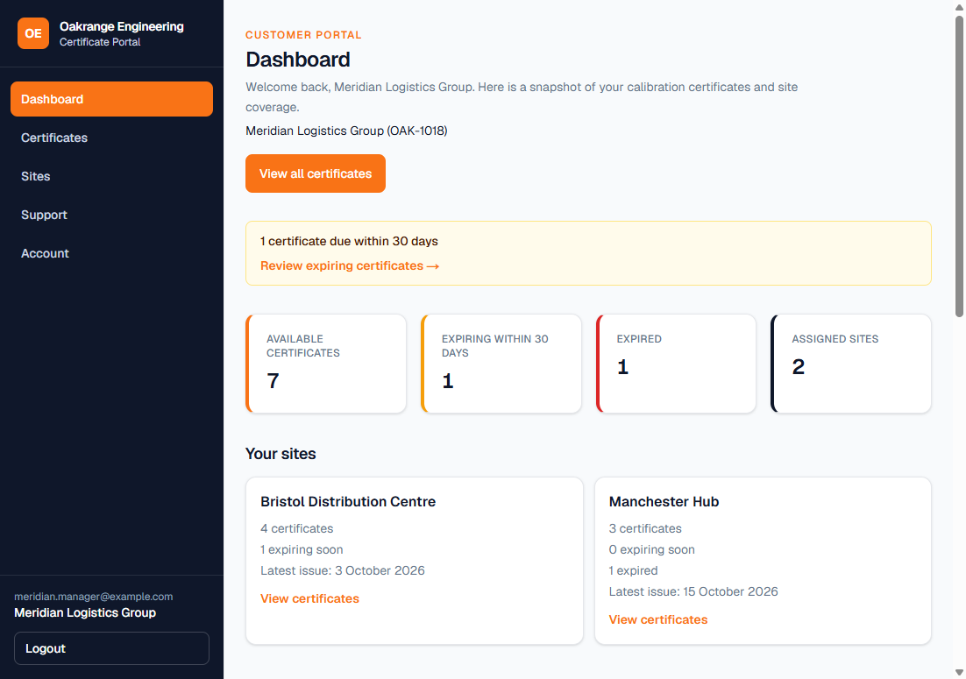
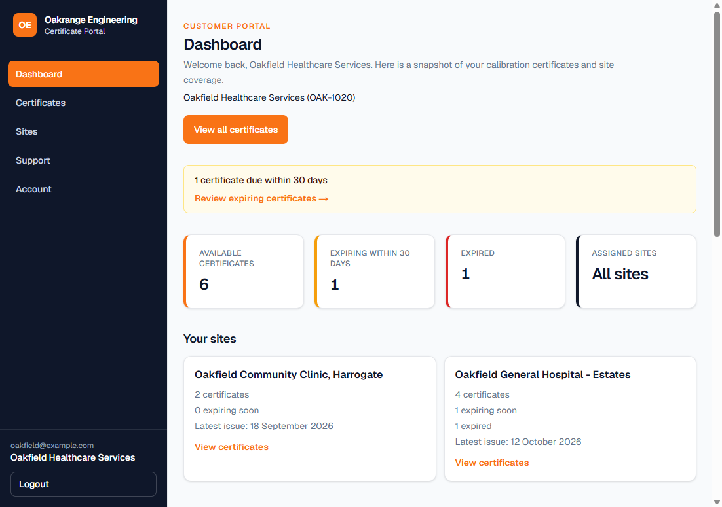
OE
Oakrange Engineering
Certificate Portal
ACCESS LEVELS
What each person sees when they log in
Team manager Dashboard shows only the 2 sites they manage.
Whole company Dashboard covers all sites in the company.
Notes:
Left: a team manager assigned to two sites. The dashboard says 2 assigned sites and lists just those.
Right: a whole-company login. The dashboard says All sites.
Same portal, same screens; the difference is purely which certificates each person is allowed to see.

Slide 4
OE
Oakrange Engineering
Certificate Portal
Live demo
1
Single site
One site's certificates
2
Team manager
Several sites from one login
3
Whole company
Every site and company docs
Notes:
DEMO SCRIPT - presenter only. Do not show these logins on screen.
Site: www.oakrangeportal.co.uk | Password for all three: Testing | Log out between each step.
1. Single site - username Soton1018
Dashboard shows 1 assigned site (Southampton Port Depot) and its 2 certificates. Nothing from Bristol or Manchester.
2. Team manager - username meridianmanager
Dashboard shows 2 assigned sites: Bristol Distribution Centre and Manchester Hub, 7 certificates in total.
Open Certificates and use the site filter to switch between the two. Point out Southampton is not there.
3. Whole company - username 1018MLG
Dashboard says All sites: Bristol, Manchester and Southampton, 10 certificates,
including the company-wide document that isn't tied to any one site.
Backup whole-company login if needed: Cardiff1019 (Harbourview Construction).

