Slide 1

.Arsenal
Book Store
Management
System
Group Number: 7

Slide 2
Contributions
Front-End
Harshit - Angular (HTML,CSS, Bootstrap)
Java
Harshit - Java (Spring Boot, REST-API)
Deepika - Java (Spring Boot, REST-API)
Gouthami - Java (Spring Boot, REST-API)
Bodhini - Java (Spring Boot, REST-API)
Database
Harshit - MYSQL(Schema Design & Implementation)
Deepika - MYSQL (Implementation & ER-Design)
Gouthami - MYSQL (Implementation & ER-Design)
Bodhini - MYSQL(Implementation & Schema)

Slide 3
Introduction
Modern E-commerce Solution: Our Online Book Store Management System leverages the power of Java SpringBoot, Angular, and MySQL to provide a cutting-edge e-commerce platform.
Efficient Inventory Management: With this system, books are efficiently managed in a MySQL database, enabling real-time tracking of book details, availability, and pricing.
Seamless User Experience: Customers can easily search, browse, and purchase books, while the responsive design ensures a consistent look and feel across various devices.
Secure and Scalable: Our system prioritizes security, protecting sensitive data such as customer information and payment details.
Enhanced Customer Interaction: Through personalized recommendations, customer reviews, and efficient order processing, this system fosters better customer engagement.

Slide 4
Introduction
This has 5 key modules namely
Registration
Login
Place Order (Single Unit & Via Cart)
Searching Books and
Admin View.
The main features of this system are reservation, automation of bookstore functions, order, cart and payment management and maintain customer data.

Slide 5
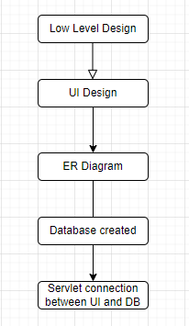
Workflow
First, we went over the project's fundamental requirements. After starting with low level design, we started our UI design in accordance with that.
Later, based on our specifications, we began working on an ER diagram. The DB team began development on the Database after the ER Diagram was approved.
Then the Java team developed API connections between the UI and the database.

Slide 6
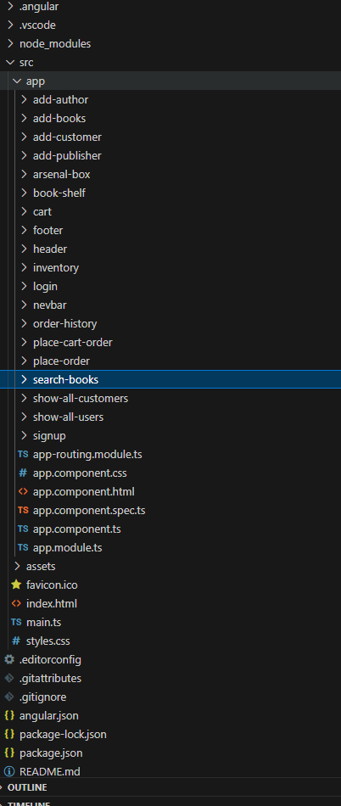
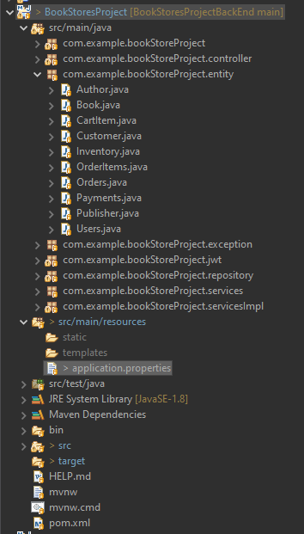
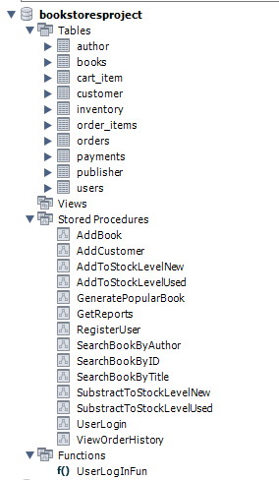
Components

Slide 7
Technologies and Versions of software
FRONT-END : Angular (HTML, CSS, JavaScript, BootStarp)
Software : Visual Studio
JAVA : Java (Spring Boot, REST-API, JWT)
Software : Java 1.8
Spring V 2.7.15
Eclipse 4.27
Postman 10.16
Database : MYSQL
Software : MYSQL Workbench 8.0.30

Slide 8
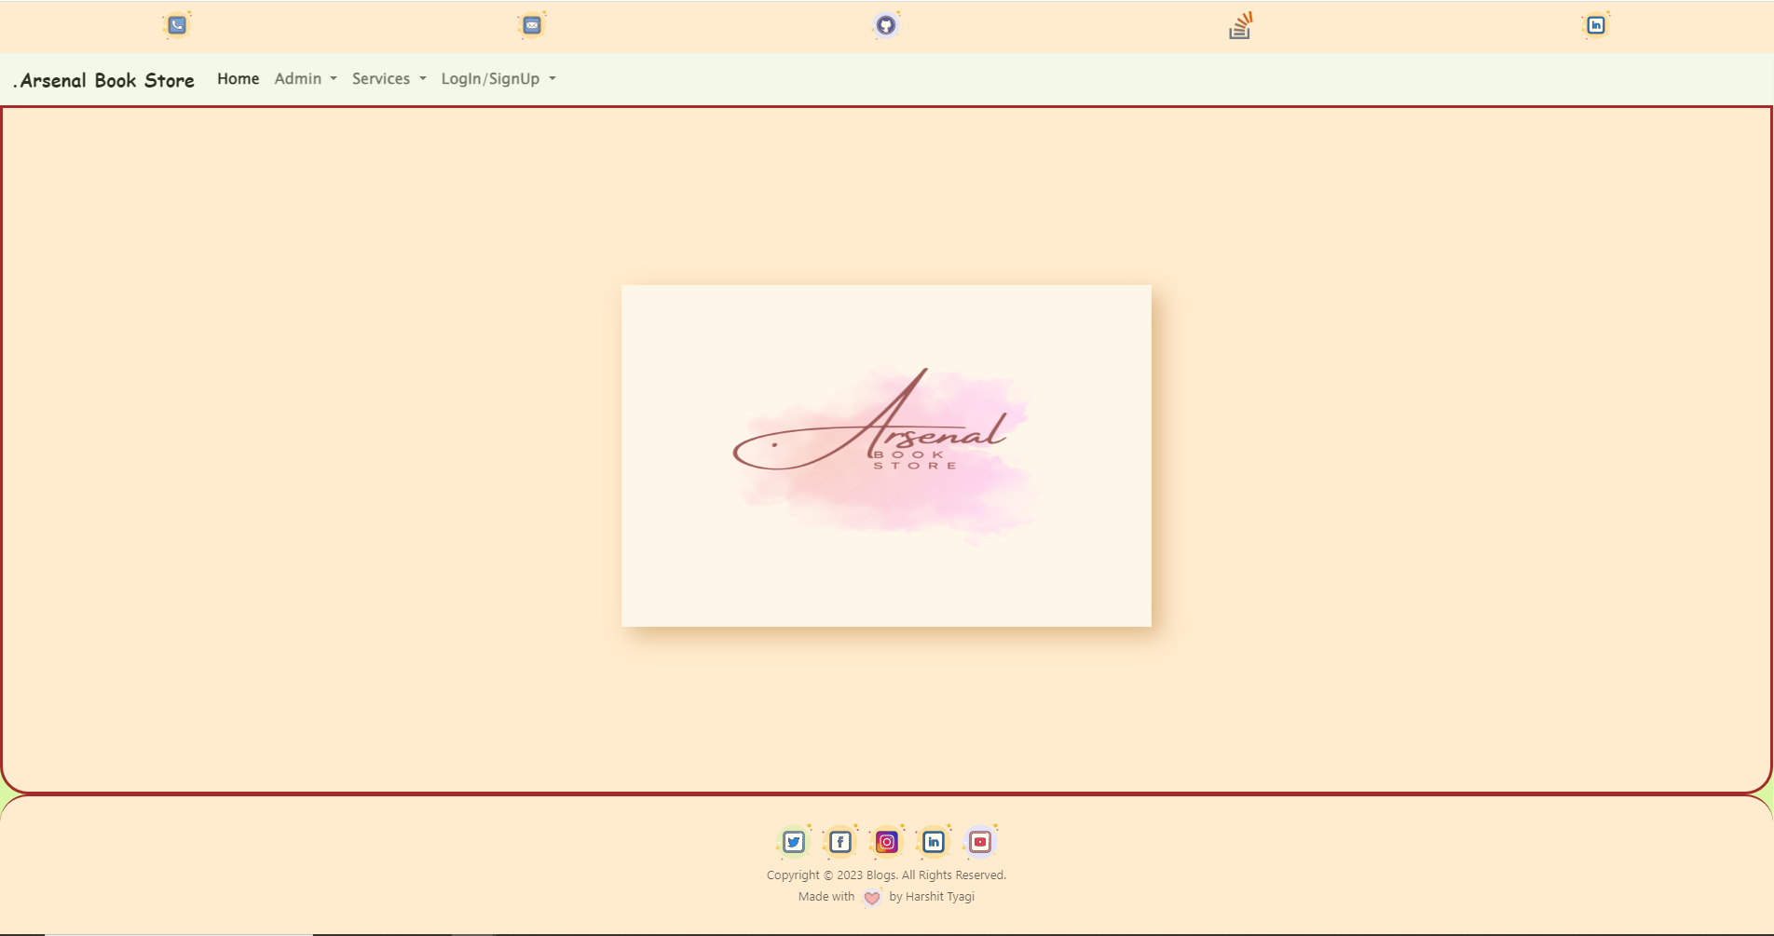
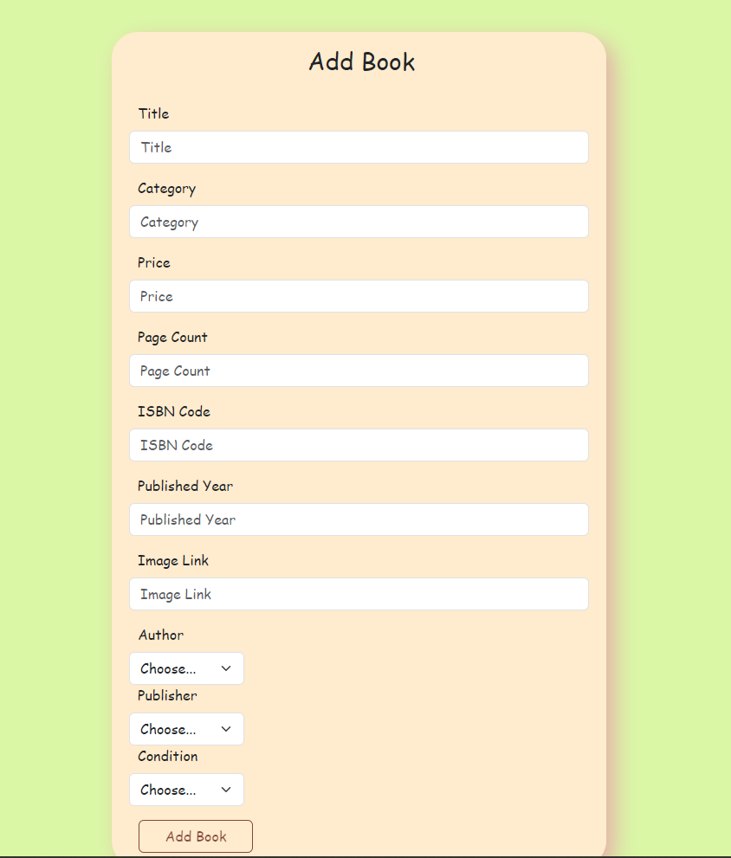
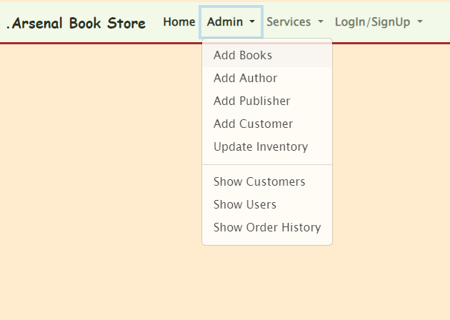
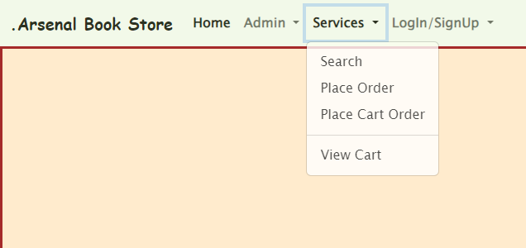
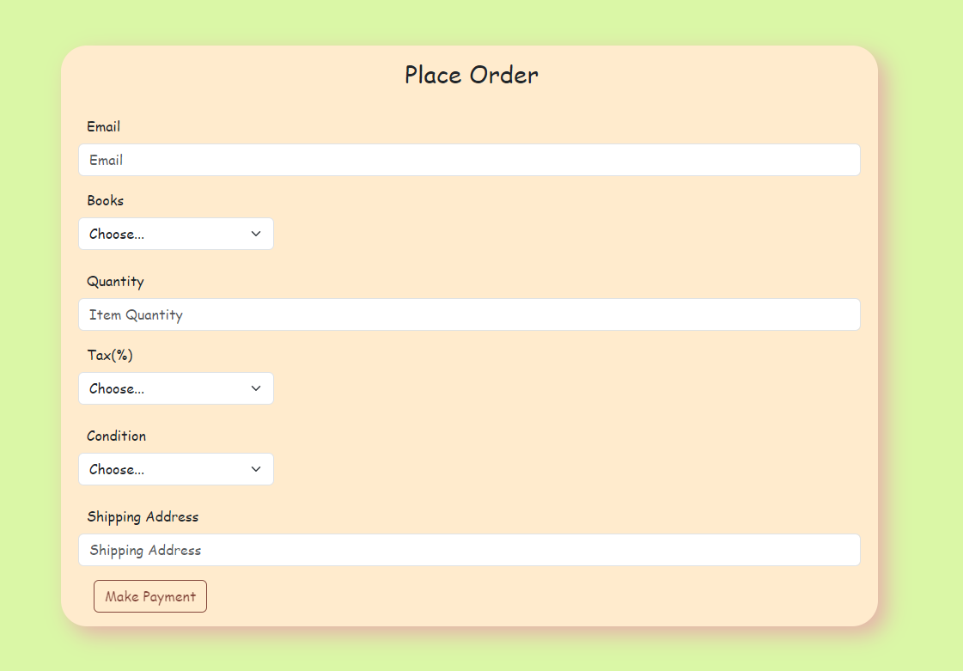
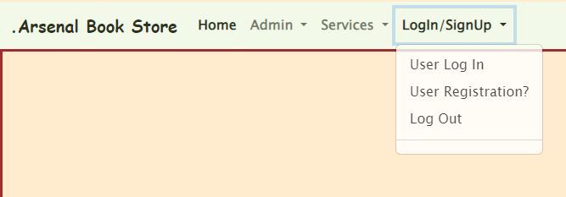
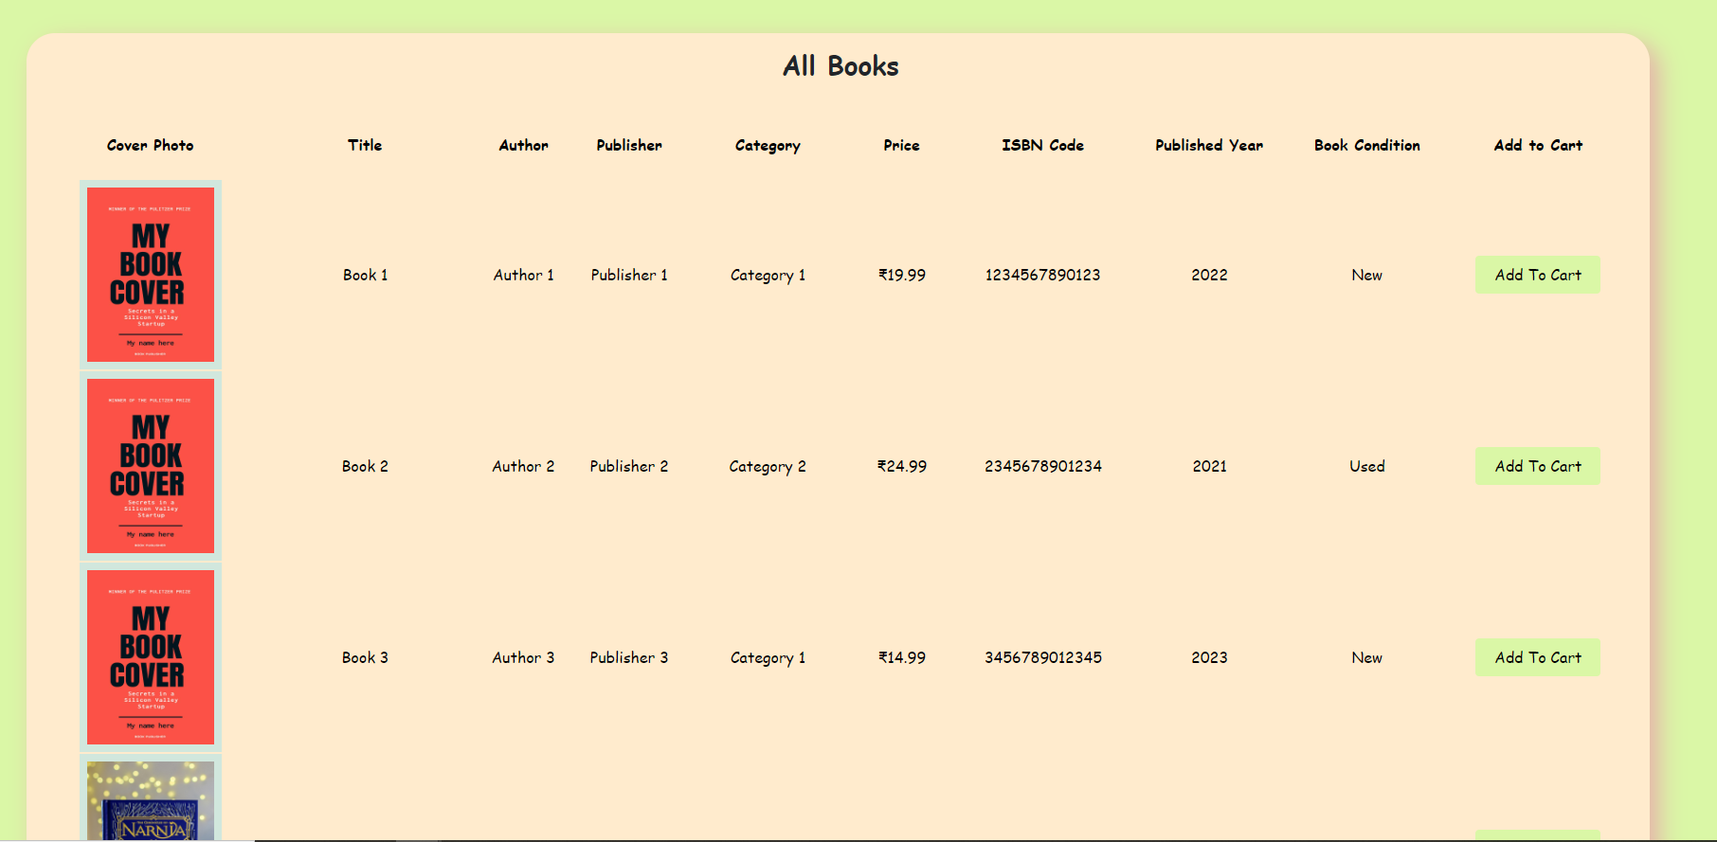
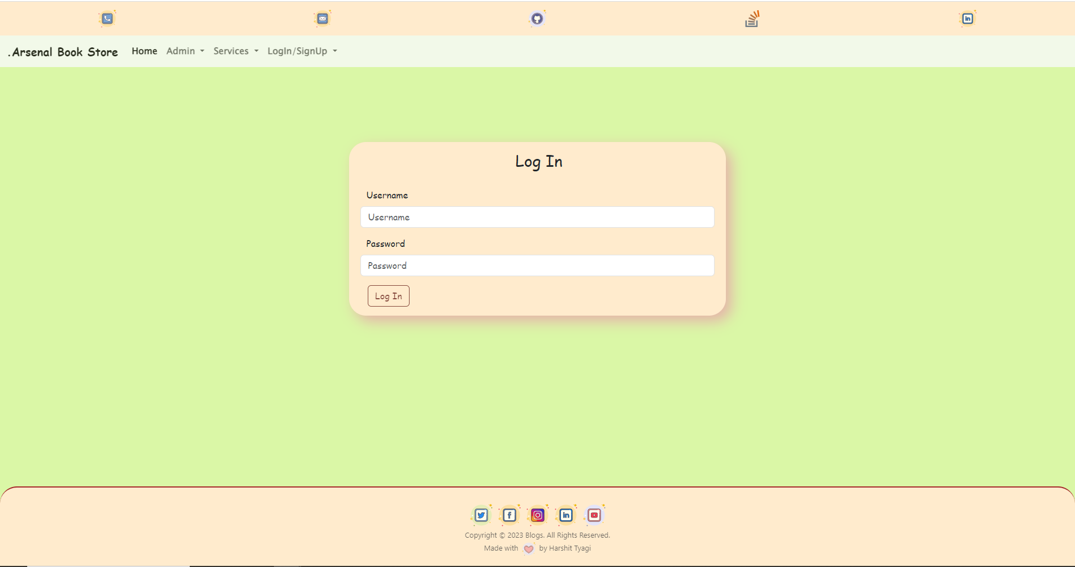
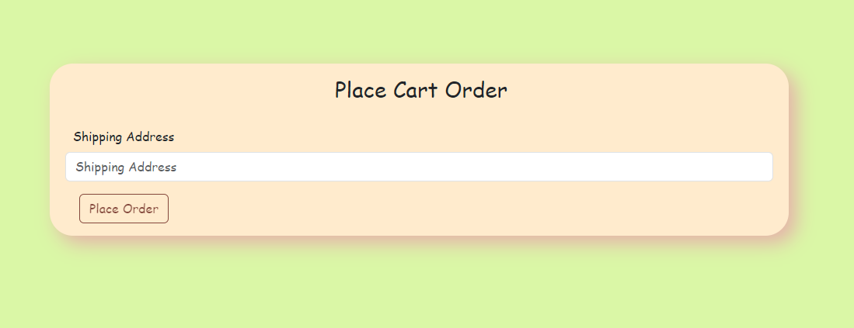
SnapShots

Slide 9




Slide 10
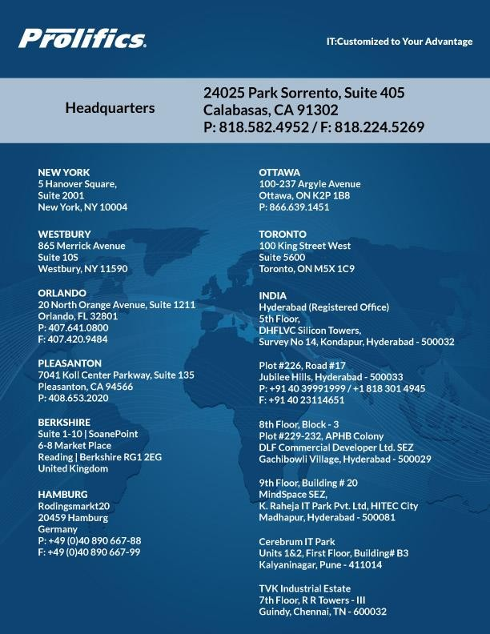
CONNECT WITH US:

