Slide 1
AI-tools with LLMs
How to Gradio

Slide 2
Who are we ? Let’s get acquainted
Who am I?
I am Rolf Guescini
What do you do?
I work as a developer and information architect at “Computer and Medienservice” at Humboldt-Universität zu Berlin
Why are you here today?
I am interested in seeing what tools we might come up with
To have fun of course :D

Slide 3
Prerequisites
Chat AI API key for https://chat-ai.academiccloud.de
MiniConda
Python 3.12 or higher
PyCharm or PyCharm Community

Slide 4
MiniConda / Python Environment
Miniconda is a miniature installation of Anaconda Distribution that includes only conda, Python, the packages they both depend on, and a small number of other useful packages
If one needs more packages, the conda install command enables access to thousands of packages available by default in Anaconda’s public repo, or from other channels, like conda-forge or bioconda
System Requirements: / Older versions Archive: https://repo.anaconda.com/miniconda/
Operating system:
Windows 10 or later, 64-bit macOS 10.15+ (for Intel) or 64-bit macOS 11.1+ (for Apple Silicon), or Linux, including Ubuntu, RedHat, CentOS 7+, and others.
System architecture: Windows - 64-bit x86; macOS - 64-bit x86 or Apple Silicon (ARM64); Linux - 64-bit x86, 64-bit aarch64 (AWS Graviton2), or s390x (Linux on IBM Z & LinuxONE).
Minimum 400 MB disk space to download and install

Slide 5
MiniConda : Install
Windows curl https://repo.anaconda.com/miniconda/Miniconda3-latest-Windows-x86_64.exe -o .\miniconda.exe start /wait "" .\miniconda.exe /S del .\miniconda.exe
Mac mkdir -p ~/miniconda3 curl https://repo.anaconda.com/miniconda/Miniconda3-latest-MacOSX-arm64.sh -o ~/miniconda3/miniconda.sh bash ~/miniconda3/miniconda.sh -b -u -p ~/miniconda3 rm ~/miniconda3/miniconda.sh
Linux mkdir -p ~/miniconda3 wget https://repo.anaconda.com/miniconda/Miniconda3-latest-Linux-x86_64.sh -O ~/miniconda3/miniconda.sh bash ~/miniconda3/miniconda.sh -b -u -p ~/miniconda3 rm ~/miniconda3/miniconda.sh

Slide 6
MiniConda : Install
Windows
After installing, open the “Anaconda Prompt (miniconda3)” program to use Miniconda3.
Mac, Linux
After installing, close and reopen your terminal application or refresh it by running the following command source ~/miniconda3/bin/activate
Then, initialize conda on all available shells by running the following command: conda init --all
Check installation: conda info
Notes:
f you don’t initialize conda after installation, you might see a “conda not found” error, even though conda is installed : https://docs.anaconda.com/reference/troubleshooting/#conda-cmd-not-found
.

Slide 7
conda - Python Environment
Environments in conda are self-contained, isolated spaces where you can install specific versions of
software packages, including dependencies
libraries
Python versions.
This isolation helps avoid conflicts between package versions and ensures that your projects have the exact libraries and tools they need.
Isolation of dependencies
Environments isolate software and their dependencies from the rest of the software installed on your machine
Reproducibility
By creating an environment for each project, you can ensure that your code runs consistently across different machines

Slide 8

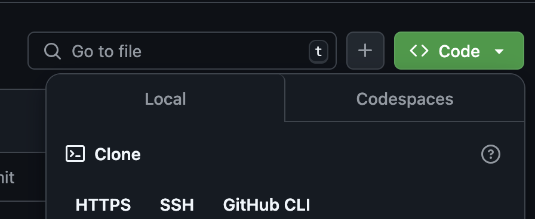
conda - Python Environment
When first installing and using conda, all operations are done to the “base environment”
should only be used for installing anaconda, conda, and conda-related packages
let us create an environment to contain our hackathon code:
go to: https://github.com/HU-CMS/ki-konkret-hackathon
click the „Fork“ button to create a duplicate to your own account
Clone your repository to your local machine

Slide 9

conda - Python Environment
When first installing and using conda, all opertions are done to the “base environment”. This environment is where conda itself is installed, and should only be used for installing anaconda, conda, and conda-related packages
let us create an environment to contain our hackathon code:
go to: https://github.com/HU-CMS/ki-konkret-hackathon
click the „Fork“ button to create a duplicate of the repository to your own account
Untick
Clone your repository to your local machine using the command line:
git clone https://github.com/<youruser>/ki-konkret-hackathon.git

Slide 10
conda - Python Environment
Because environments are isolated spaces, you can only work with one at a time. Selecting an environment to work with is called activating it
Create the environment
Activate / deactivate the environment
# Replace <ENV_NAME> with a name for your environment
# Replace <PACKAGE> with your desired package
# Replace <VERSION> with your desired version (optional)
conda create --name <ENV_NAME> <PACKAGE>=<VERSION> ex: conda create --name myenv python=3.11 beautifulsoup4 docutils jinja2=3.1.4 wheel
# Replace <ENV_NAME> with the name of the environment you want to activate / deactivate
conda activate <ENV_NAME> | conda deactivate <ENV_NAME> :

Slide 11
conda - Python Environment : packages
You can use the conda package manager to access and install over 8,000 open-source data science and machine learning conda packages from Anaconda’s public repository and thousands more community-developed packages published on Anaconda.org and conda-forge
Use the conda install command to install packages into an environment. If no environment is specified in the command, conda installs the package in the working environment
conda strongly recommends installing your project packages in a separate conda environment
protects your base environment from breaking due to complex dependency conflicts and allows you to easily manage and reproduce your environment on other machines.

Slide 12
conda - Python Environment : packages
Search packages
Install packages
conda search <PACKAGE>
conda install
<PACKAGE>=<VERSION> <PACKAGE>=<VERSION> <PACKAGE>=<VERSION> --name <ENVIRONMENT>

Slide 13
conda - Python Environment : pip packages
Most popular packages from the PyPI repository are available in either Anaconda’s public repository, anaconda.org, or conda-forge.
However, you might need to use pip package manager if a package or specific version is not available through conda channels
Installing packages using pip modifies your conda environment, but conda is not aware of these modifications
As a result, when conda later attempts to modify the environment, there’s a high probability that dependency conflicts will arise between the conda-tracked packages and the untracked pip packages, which can lead to a broken environment
pip install <PACKAGE>

Slide 14
conda - Python Environment : environment.yml
To create a stable environment that includes pip packages, Anaconda recommends writing an environment.yml file and then building an environment from that file.
make sure to add pip and its dependencies last, since conda builds environments in the order listed
Syntax example:
name: env-name
channels:
- conda-forge
- defaults
dependencies:
- python=3.7
- codecov
name: is the name of the environment
channels: are the locations where packages are stored.
dependencies: are the packages on which the project is dependent
By default, packages are automatically downloaded and updated from the default channel, which may require a paid license, as described in the repository terms of service. The conda-forge channel is free for all to use.

Slide 15
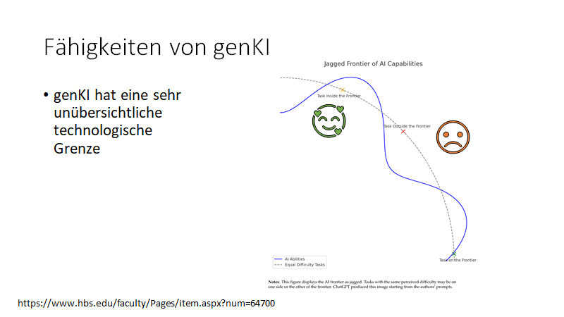
Prompts and Prompt Design

Slide 16
conda - Python Environment : environment.yml
Open and create environment.yml which installs the following packages; make sure to search to see if any need to be installed with pip
gradio
gradio_client
transformers
2. Create your environment using the environment.yml file
conda env create --file environment.yml
3. Add torch and openai to your environment file and update the environment
conda env update --file environment.yml --prune
4. Delete the environment, verify it is deleted
conda remove --name ki-konkret-hackathon --all
conda info --envs

Slide 17
PyCharm a Python IDE
PyCharm is an IDE that integrates with IPython Notebook, has an interactive Python console, and supports Anaconda as well as multiple scientific packages
PyCharm also supports creating virtual environments for Python with conda
creating a new conda environment when you create a new Python project in PyCharm
configure an existing conda environment for a new project, or switch conda environments within a project that already exists

Slide 18
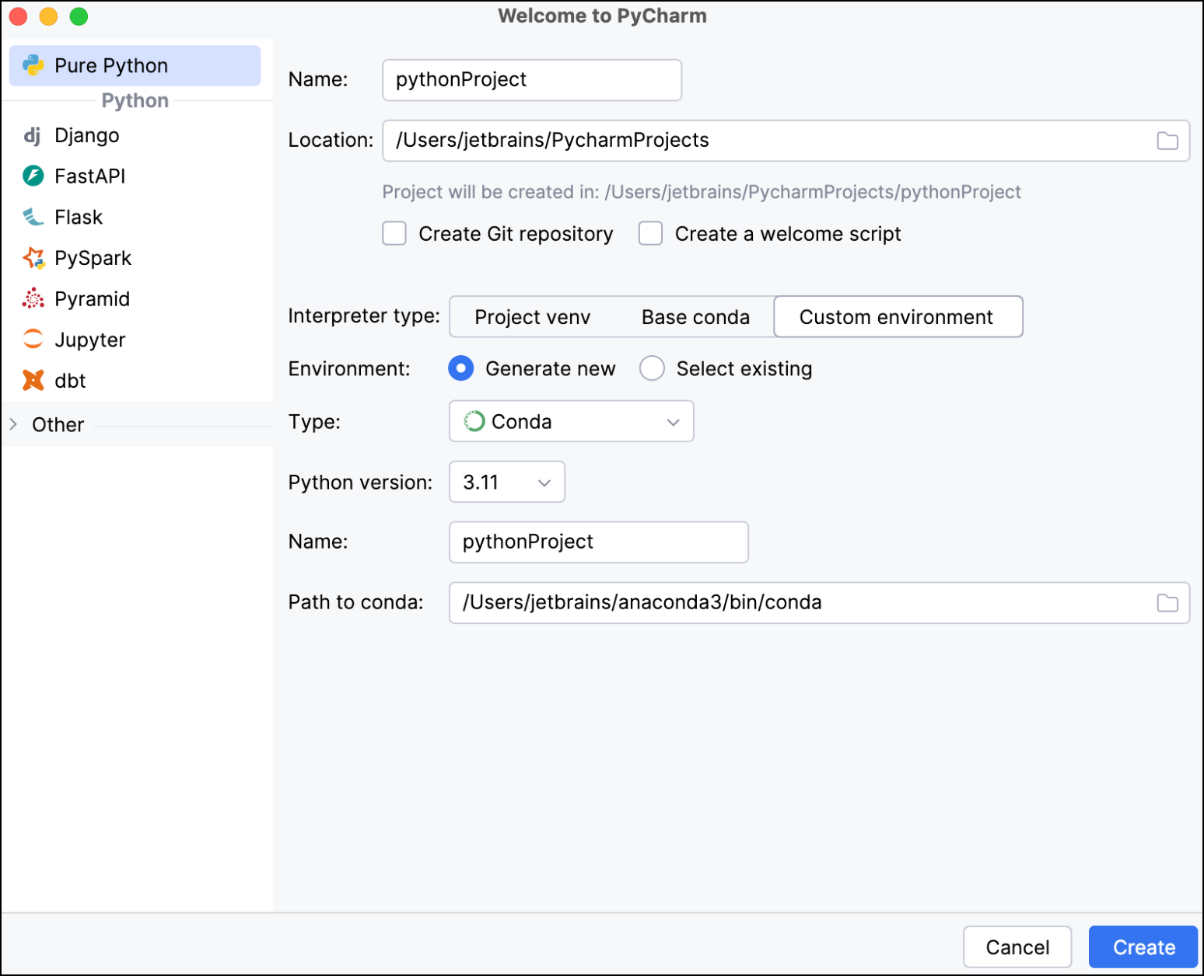
PyCharm a Python IDE
After opening PyCharm, click New Project
In the New Project screen, create the project name and its location
Add a main.py file to your project by selecting Create welcome script
Select Custom environment, then select Generate New
From the Type dropdown, select Conda
From the Python version dropdown select the Python version you want
Create your environment name.
Notes:
You can check that the conda environment was created by using conda info --envs in your Terminal

Slide 19
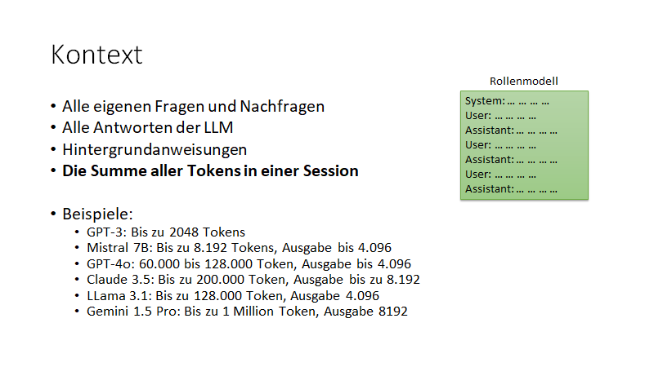

Slide 20
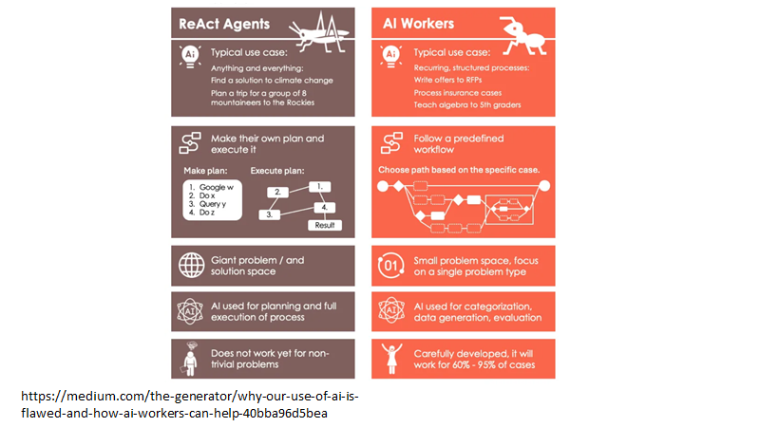

Slide 21
Präzise Prompts
Aspekte für den System Prompt
Welche Aufgabe soll erledigt werden?
Was soll auf keinen Fall passieren?
In welchem Kontext wird die Aufgabe gestellt?
Duktus und Ansprache
Mehrsprachigkeit
Aktuelles Datum und Datum der Daten
Gewünschte Ausgabeformate

Slide 22
Anthropic System Prompts
https://docs.anthropic.com/en/release-notes/system-prompts

Slide 23
Templates für die Ausgabe
Analysiere den folgenden Fehler in meinem Code und liefere einen strukturierten Fehlerbericht nach genau diesem Template:
# FEHLERANALYSE
## FEHLERBESCHREIBUNG
[1-2 Sätze zum Fehler]
## PROBLEMATISCHE ZEILE(N)

Slide 24
Analysiere das folgende Dokument hinsichtlich Rechtschreibung, Stil, Zielgruppeneignung und Klarheit der Darstellung.
Halte dich EXAKT an folgendes Ausgabeformat ohne Abweichungen oder zusätzliche Erklärungen:
# Dokumentanalyse
## Kurzfassung
{{2-3 Sätze zur Gesamteinschätzung des Dokuments}}
## Rechtschreibprüfung
Bewertung: {{Gut/Mittel/Verbesserungswürdig}}
Top-3-Fehler:
- {{Fehler 1}}
- {{Fehler 2}}
- {{Fehler 3}}
## Stilprüfung
Bewertung: {{Gut/Mittel/Verbesserungswürdig}}
Stärken: {{Hauptstärke des Stils}}
Schwächen: {{Hauptschwäche des Stils}}
## Zielgruppenprüfung
Bewertung: {{Gut/Mittel/Verbesserungswürdig}}
Passt für: {{Zielgruppe}}
Anpassungsbedarf: {{Wichtigste Anpassung}}
Zu analysierendes Dokument:
[Hier folgt der Text des zu analysierenden Dokuments]

Slide 25
Einzelne Aufgaben
Du bist ein Expertensystem für die Überarbeitung von Texten
Deine Aufgabe ist es, Texte zu erkennen, die überarbeitet werden müssen
Antworte AUSSCHLIESSLICH in diesem JSON-Format:
{
"should_revise": false,
"revise_text": [],
"revise_reason": "Begründung"
}
WICHTIGE REGELN
IMMER ÜBERARBEITEN
NIE ÜBERARBEITEN

Slide 26
Gradio
open-source Python library that allows you to quickly create user-friendly, interactive web applications that allow users to interact with models, data, and other types of Python code
Easy Integration:
It’s very easy to integrate with any model, whether it’s from libraries like TensorFlow, PyTorch, Hugging Face Transformers, or even your own custom models
Interactive Interfaces:
Gradio automatically generates interactive interfaces like textboxes, buttons, image uploaders, sliders, and more, depending on the input/output type of your model
Sharing and Collaboration:
Gradio allows you to launch a web-based demo with just one line of code. You can share this demo with others by simply sending them a link, enabling real-time collaboration or feedback
Notes:
Check out examples branch

Slide 27
the gr.Interface class
high-level abstraction in Gradio that allows you to quickly create a demo for any Python function simply by specifying the input types and the output types
the Interface class is initialized with three required parameters:
fn:
the function to wrap a user interface (UI) around
inputs: which Gradio component(s) to use for the input.
The number of components should match the number of arguments in your function.
outputs: which Gradio component(s) to use for the output.
The number of components should match the number of return values from your function

Slide 28
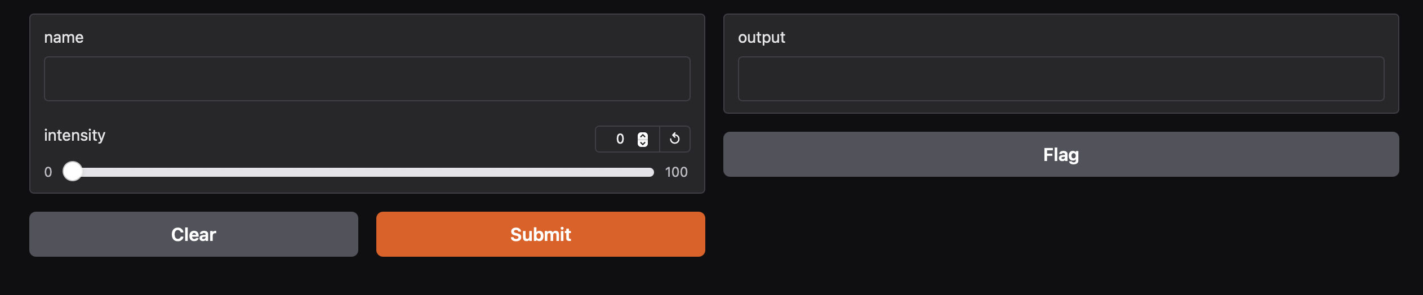
gr.Interface: Hello World
import gradio as gr
def greet(name, intensity):
return "Hello, " + name + "!" * int(intensity)
demo = gr.Interface( fn=greet,
inputs=["text", "slider"],
outputs=["text"]
)
demo.launch()

Slide 29
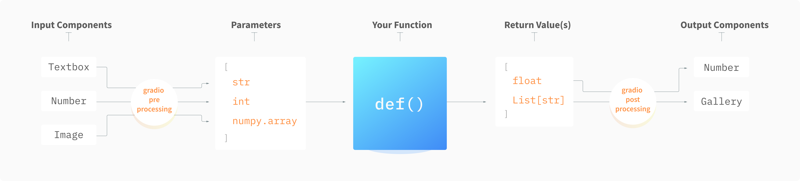
Gradio Components
Gradio includes more than 30 pre-built components (as well as many community-built custom components) that can be used as inputs or outputs in your demo
These components correspond to common data types in machine learning and data science, i.e:
the gr.Image component is designed to handle input or output images
the gr.Label component displays classification labels and probabilities
the gr.LinePlot component displays line plots
the gr.Dataset component Creates a gallery or table to display data samples

Slide 30
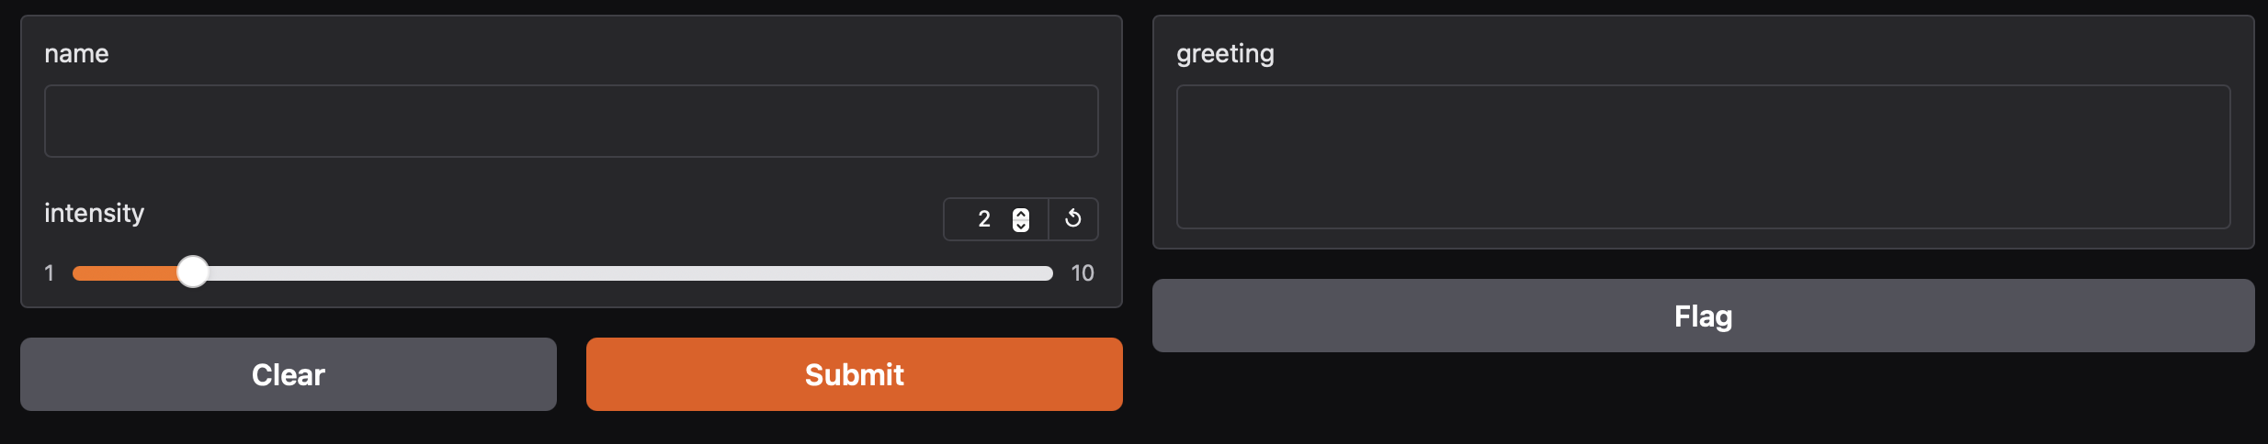
Component Attributes
In Hello world, we used the default versions of the gr.Textbox and gr.Slider with default attributes
using the actual classes for gr.Textbox and gr.Slider instead of the string shortcuts, you have access to much more customizability through component attributes
import gradio as gr
def greet(name, intensity):
return "Hello, " + name + "!" * intensity
demo = gr.Interface(
fn=greet,
inputs=["text",
gr.Slider(value=2, minimum=1,
maximum=10, step=1)
],
outputs=[gr.Textbox(
label="greeting", lines=3)
] )
demo.launch()

Slide 31
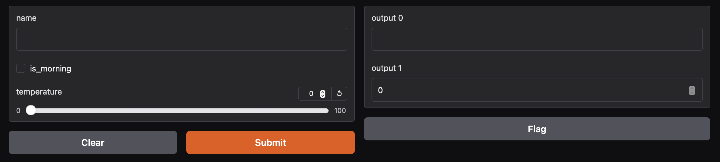
Multiple Input and Output Components
def greet(name, is_morning, temperature):
salutation = "Good morning" if is_morning else "Good evening"
greeting = f"{salutation} {name}. It is {temperature} degrees today"
celsius = (temperature - 32) * 5 / 9
return greeting, round(celsius, 2)
_
import gradio as gr
demo = gr.Interface(
fn=greet,
inputs=["text", "checkbox", gr.Slider(0, 100)],
outputs=["text", "number"],
)
demo.launch()

Slide 32
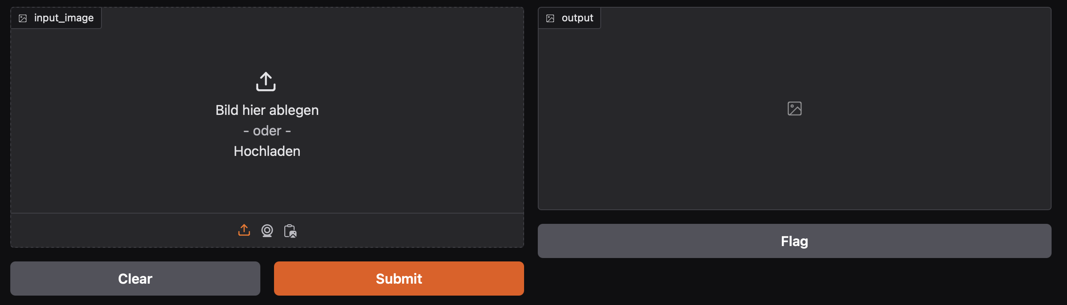
Component example
Gradio supports many types of components, such as Image, DataFrame, Video, or Label
When using the Image component as input, your function will receive a NumPy array with the shape (height, width, 3), where the last dimension represents the RGB values.
We'll return an image as well in the form of a NumPy array.
Gradio handles the preprocessing and postprocessing to convert images to NumPy arrays and vice versa
import numpy as np
import gradio as gr
def sepia(input_image):
sepia_filter = np.array([
[0.393, 0.769, 0.189],
[0.349, 0.686, 0.168],
[0.272, 0.534, 0.131]
])
sepia_image = input_image.dot(sepia_filter.T) # sepia_image = sepia_image / sepia_image.max()
sepia_image /= sepia_image.max()
return sepia_image
demo = gr.Interface(sepia, gr.Image(), "image")
demo.launch()
Notes:
x /= 3# equivalent to x = x / 3

Slide 33
Example Inputs
You can provide example data that a user can easily load into Interface.
This can be helpful to demonstrate the types of inputs the model expects, as well as to provide a way to explore your dataset in conjunction with your model.
To load example data, you can provide a nested list to the examples= keyword argument of the Interface constructor
The format of example data for each component is specified in the Docs

Slide 34
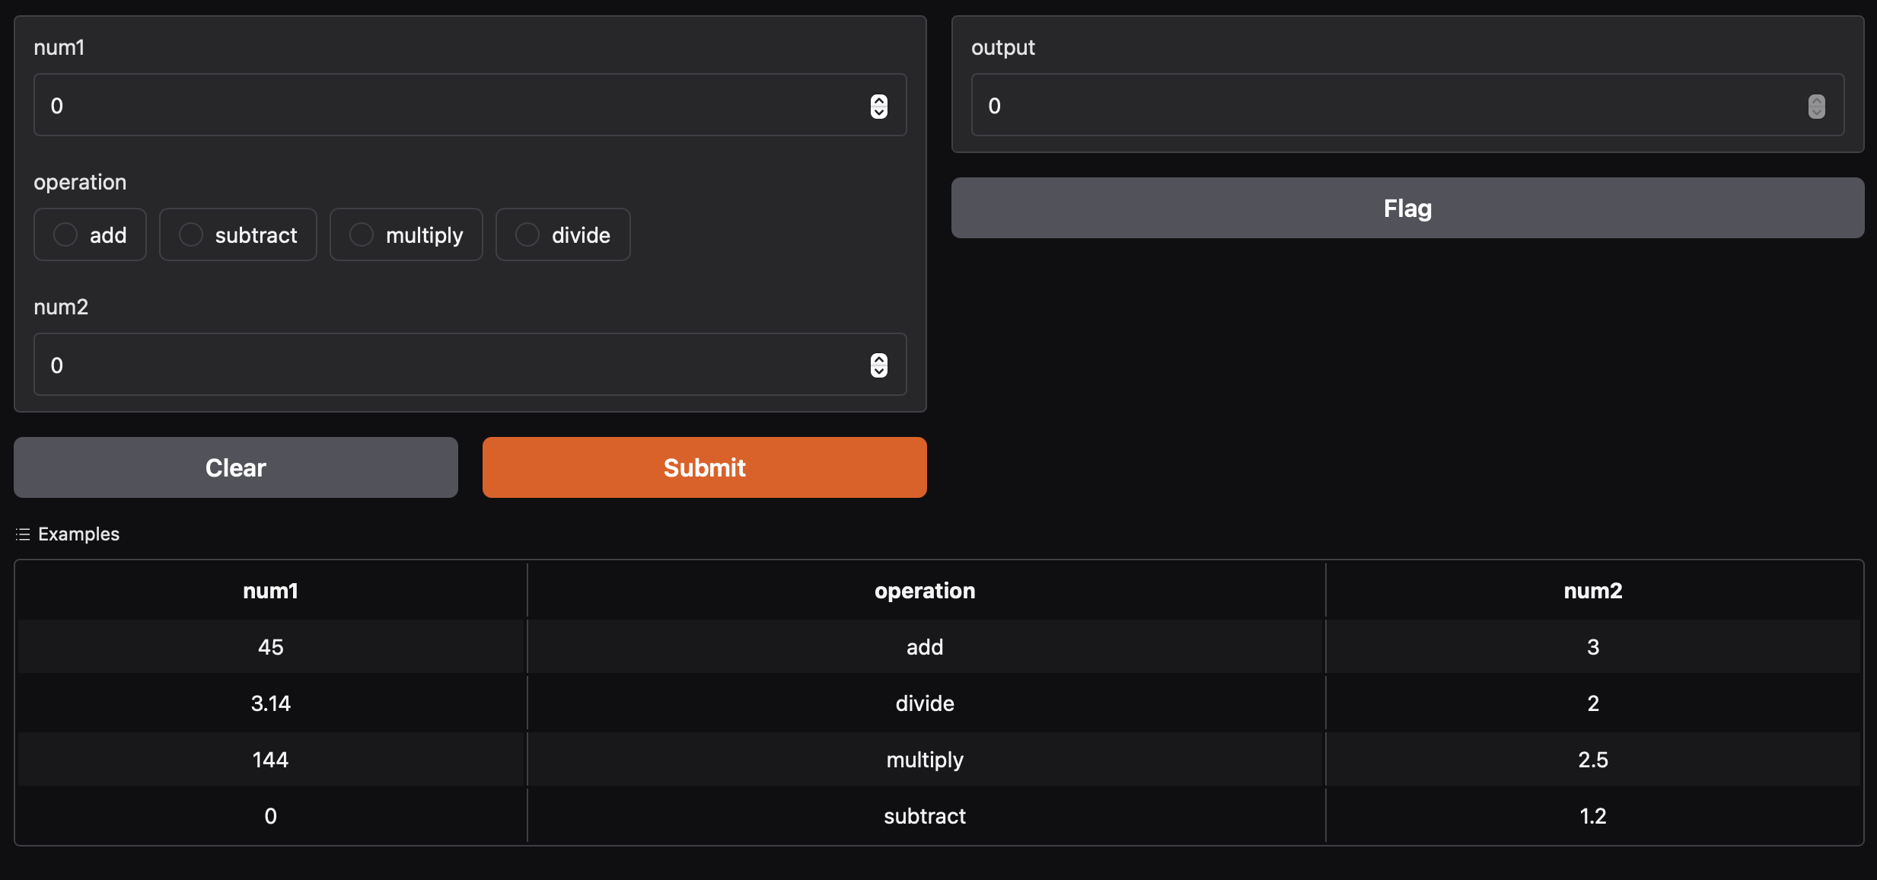
Example Inputs : Toy Calculator
import gradio as gr
def calculator(num1, operation, num2):
demo = gr.Interface(
calculator,
[
"number",
gr.Radio(["add", "subtract", "multiply", "divide"]),
"number"
],
if operation == "add":
return num1 + num2
elif operation == "subtract":
return num1 - num2
elif operation == "multiply":
return num1 * num2
elif operation == "divide":
if num2 == 0:
raise gr.Error("Cannot divide by zero!")
return num1 / num2
"number",
examples=[
[45, "add", 3],
[3.14, "divide", 2],
[144, "multiply", 2.5],
[0, "subtract", 1.2],
],
title="Example Calculator",
description="Here's a sample calculator.",
)
demo.launch()

Slide 35
Interface State
There are two approaches to state in Gradio: global state and session state
Global State
If the state is something that should be accessible to all function calls and all users, you can create a variable outside the function call and access it inside the function
Session State
Gradio supports is session state, where data persists across multiple submits within a page session. However, data is not shared between different users of your model

Slide 36
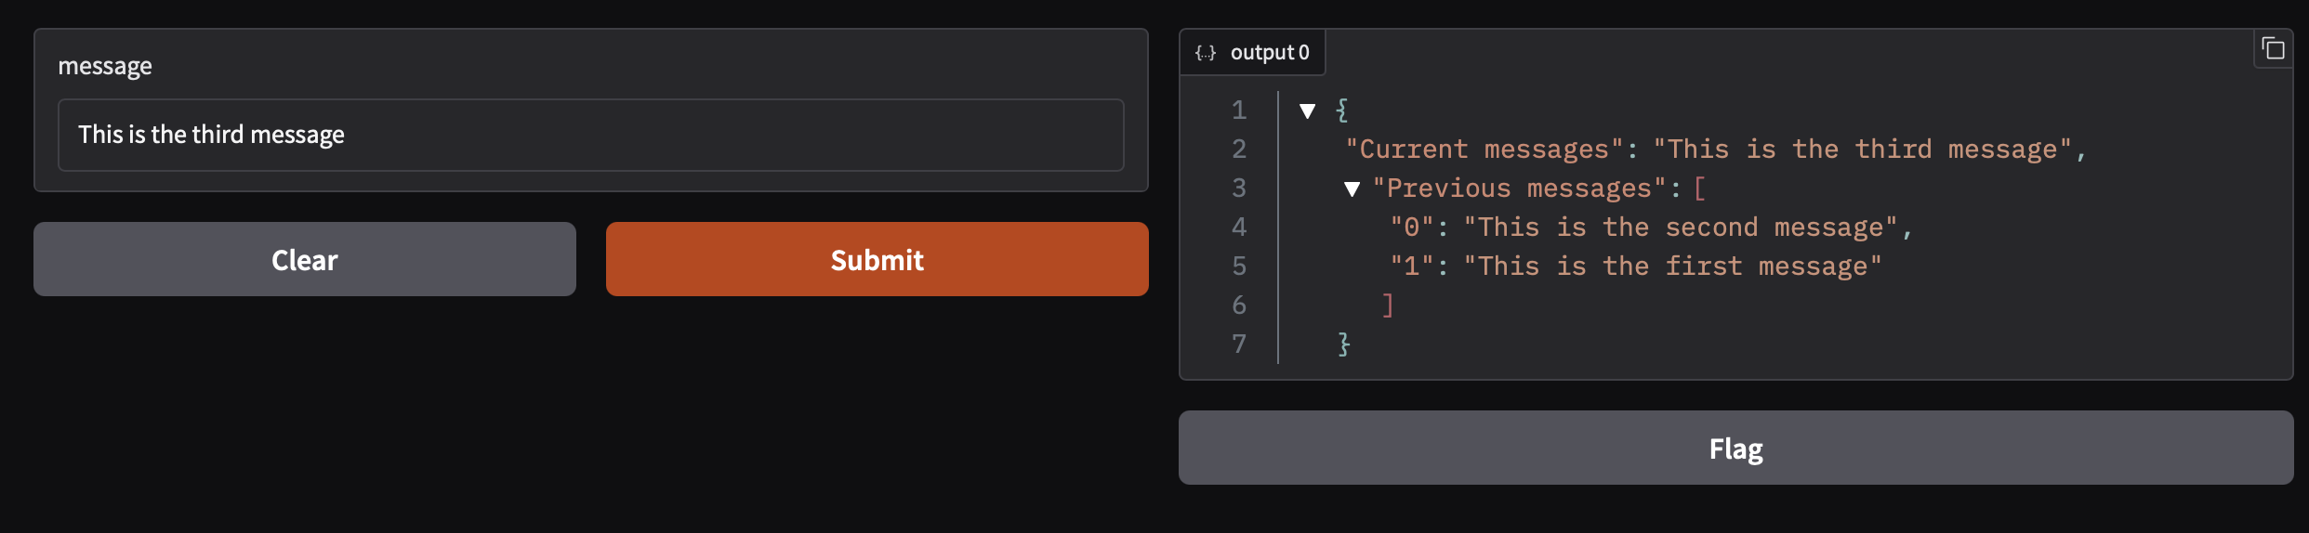
Interface State: Session state
To store data in a session state, you need to do three things:
Pass in an extra parameter into your function, which represents the state of the interface.
At the end of the function, return the updated value of the state as an extra return value
Add the 'state' input and 'state' output components when creating your Interface
def store_message(message: str, history: list[str]):
output = {
"Current messages": message,
"Previous messages": history[::-1]
}
history.append(message)
return output, history
demo = gr.Interface(
fn=store_message,
inputs=["textbox", gr.State(value=[])], outputs=["json", gr.State()])
demo.launch()
Notes:
Interface class only supports a single session state variable (though it can be a list with multiple elements). For more complexuse cases, you can use Blocks,

Slide 37
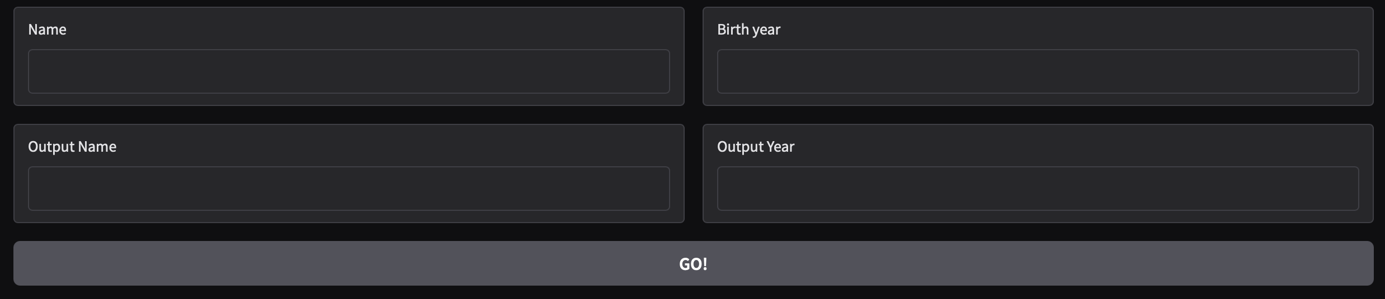
Blocks and block layout
First, note the with gr.Blocks() as demo: clause
The Blocks app code will be contained within this clause
Next come the Components
Components are automatically added to the Blocks as they are created within the with clause
By default, components in Blocks are arranged vertically
with gr.Row() to arrange vertically
with gr.Column() to arrange horizontally
Under the hood, this layout structure uses the flexbox model of web development
with gr.Blocks() as demo: name = gr.Textbox(label="Name")
output = gr.Textbox(label="Output Box")
greet_btn = gr.Button("Greet")
demo.launch()
with gr.Blocks() as demo:
with gr.Row():
with gr.Column(scale=1, min_with=300):
name = gr.Textbox(label="Name")
with gr.Column(scale=1, min_with=300):
age = gr.Textbox(label="Name")
with gr.Row():
output = gr.Textbox(label="Output Box")
with gr.Row():
greet_btn = gr.Button("Greet")
demo.launch()

Slide 38
Blocks and event listeners
Components also come with certain events that they support. These are methods that are triggered with user actions
Event listeners define the data flow within the app
an Event listener can take multiple inputs or outputs, as a dictionary or a list
The callback function must, in the case of multiple outputs, return a list or dictionary of VALUES for the components
One can also return a new component in case one wants to change the configuration of the component
Finally, the click() event listener
with gr.Blocks() as demo:
with gr.Row():
with gr.Column(scale=1,min_width=300):
name = gr.Textbox(label="Name")
with gr.Column(scale=1,min_width=300):
age = gr.Textbox(label="Age")
with gr.Row():
output = gr.Textbox(label="Output Box")
with gr.Row():
greet_btn = gr.Button("Greet")
greet_btn.click(
fn=greet, inputs=[name,age], outputs=output
)
demo.launch()

Slide 39
Blocks and event listeners: I / O
The inputs and outputs between components and events are basically of one of two formats
def greet(name_string, year_string):
return [name_string,year_string]
greet_btn.click(
fn=greet, inputs=[name,age], outputs=[output_name, output_year]
)
A list of arguments
A dictionary keyed by the component name
def greet(data):
return {output_name: data[name], output_year: data[age]}
greet_btn.click(
fn=greet, inputs={name,age}, outputs=[output_name, output_year]
)
Dictionary returns are helpful when an event listener affects many components on return, or conditionally affects outputs and not others
Using keyed dictionaries for instance, gives us the possibility of not updating some components
def greet(data):
if data[age] is None:
return {output_name: data[name]}
else:
return {output_name: data[name],
output_year: data[age]})

Slide 40
Types of Event Listeners
Components support different event listeners , and event listener parameters i.e:
Audio
stream
play
pause
start_recording
Image
clear
upload
many are common with mutiple components
click
select
double_click
change
submit
focus
blur
key_up

Slide 41
Types of Event Listeners: EventData helper
import gradio as gr
with gr.Blocks() as demo:
images = [("images/cat.jpg", "Cat"), ("images/dog.jpg", "Dog"), ("images/cat2.jpg", "Cat too"), ("images/dog2.jpg", "Dog too")]
table = gr.Dataframe([[1, 2, 3], [4, 5, 6]])
gallery = gr.Gallery( images, object_fit="contain", height="auto")
textbox = gr.Textbox("Hello Cats & Dogs!")
statement = gr.Textbox()
def on_select(value, evt: gr.EventData):
return f"The {evt.target} component was selected, and its value was {value}."
table.select(on_select, table, statement)
gallery.select(on_select, gallery, statement)
textbox.select(on_select, textbox, statement)
demo.launch()
When gr.EventData or one of its subclasses is added as a type hint to an argument of a function, a gr.EventData object will automatically be passed as the value of that argument.
The attributes of this object contains information about the event that triggered the listener.
The gr.EventData object itself contains a .target attribute that refers to the component that triggered the event
subclasses of gr.EventData contains additional attributes that are different for each class.

Slide 42
Types of Event Listeners: on (.....)helper
Sets up an event listener that triggers a function when the specified event(s) occur.
This is especially useful when the same function should be triggered by multiple events
One can use decorator syntax as well:
import gradio as gr
with gr.Blocks() as demo:
with gr.Row():
input = gr.Textbox()
button = gr.Button("Submit")
output = gr.Textbox()
gr.on(
triggers=[button.click, input.submit],
fn=lambda x: x,
inputs=[input],
outputs=[output]
)
demo.launch()
import gradio as gr
with gr.Blocks() as demo:
name = gr.Textbox(label="Name")
output = gr.Textbox(label="Output Box")
greet_btn = gr.Button("Greet")
@gr.on( triggers=[name.submit, greet_btn.click], inputs=name, outputs=output)
def greet(name):
return "Hello " + name + "!"
demo.launch()

Slide 43
Multiple Data Flows
A Blocks app is not limited to a single data flow the way Interfaces are
As apps get more complex, many data flows connect various Components
An example, could be a demo where the output of one model (a speech-to-text model) gets fed into the next model (a sentiment classifier)

Slide 44
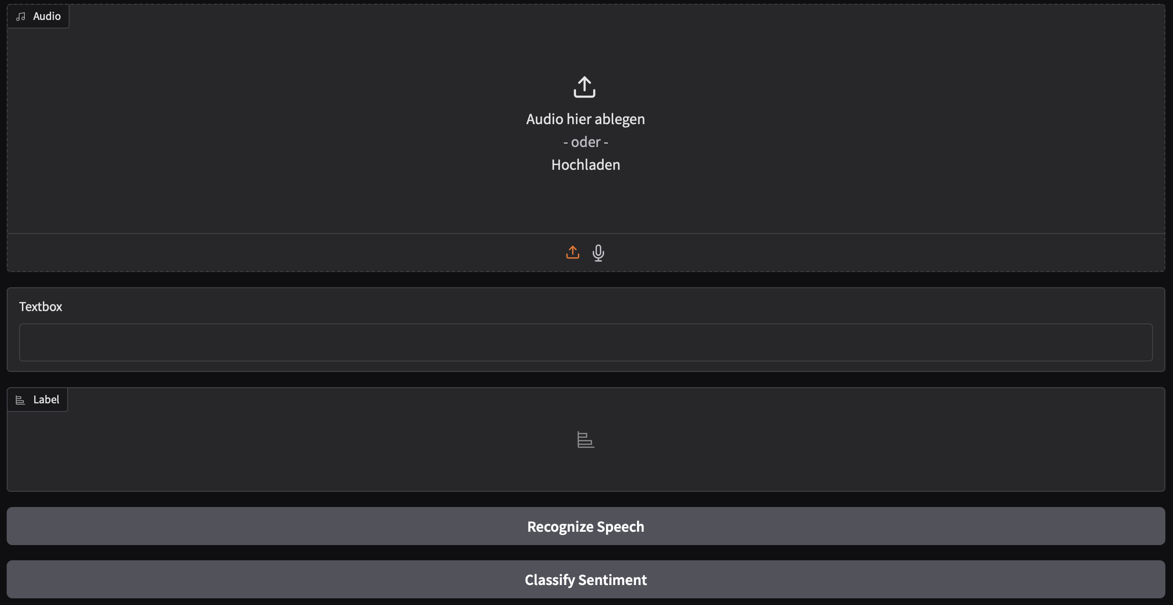
Multiple Data Flows
from transformers import pipeline
import gradio as gr
asr = pipeline("automatic-speech-recognition", "facebook/wav2vec2-base-960h")
classifier = pipeline("text-classification")
def speech_to_text(speech):
text = asr(speech)["text"]
return text
def text_to_sentiment(text):
return classifier(text)[0]["label"]
demo = gr.Blocks()
with demo:
audio_file = gr.Audio(type="filepath")
text = gr.Textbox()
label = gr.Label()
b1 = gr.Button("Recognize Speech")
b2 = gr.Button("Classify Sentiment")
b1.click(speech_to_text, inputs=audio_file, outputs=text)
b2.click(text_to_sentiment, inputs=text, outputs=label)
demo.launch()

Slide 45
Blocks: Managing State
Managing state in blocks, follow the same patterns as for Interfaces
Blocks, in addition, add the possibility of using browser state (v > 5.17.1, still not packaged for conda) , persisting values for each user in the browser's localStorage, allowing data to persist even after the page is refreshed or closed.
To use local state:
Create a gr.BrowserState object. You can optionally provide an initial default value and a key to identify the data in the browser's localStorage
Use it like a regular gr.State component in event listeners as inputs and outputs

Slide 46
Dynamic Apps with the Render Decorator
import gradio as gr
with gr.Blocks() as demo:
input_text = gr.Textbox(label="input")
mode = gr.Radio(["textbox", "button"], value="textbox")
The components and event listeners you define in a Blocks so far have been fixed, the @gr.render decorator introduces the ability to dynamically change this
Create a function and attach the @gr.render decorator to it
Add the input components to the inputs= argument of @gr.render, and create a corresponding argument in your function for each component
Add all components inside the function that you want to render based on the inputs
@gr.render(
inputs=[input_text, mode], triggers=[input_text.submit])
def show_split(text, mode):
if len(text) == 0:
gr.Markdown("## No Input Provided")
else:
for letter in text:
if mode == "textbox":
gr.Textbox(letter)
else:
gr.Button(letter)
demo.launch()

Slide 47
OpenAI API
OpenAI has the first easy-to-use API for an LLM
OpenAI’s REST API Sepcification allows one to interact with models like GPT through standard HTTP requests, but is seemingly also becoming a de facto standard API implementation for interaction with other, open source models, such as the KISSKI Chat AI
Typical end points include:
POST /v1/chat/completions
Given a prompt, the model will return one or more predicted completions along with the probabilities of alternative tokens at each position
POST /embeddings
Get a vector representation of a given input that can be easily consumed by machine learning models and algorithmss to measure the relatedness of text strings

Slide 48
OpenAI API Class for our projects
from openai import OpenAI
class LLM:
def __init__(self, api_key, base_url, model_name):
self.api_key = api_key
self.base_url = base_url
self.model_name = model_name
# Start OpenAI client
self.client = OpenAI(
api_key=self.api_key,
base_url=self.base_url
)
def create_chat_completion(self, message):
chat_completion = self.client.chat.completions.create(
messages = [
{"role":"system",
"content":"You are a helpful assistant"}, #set behavioral context of model
{"role":"user", "content": message}
],
model = self.model_name,
)
return chat_completion

Slide 49
OpenAI API metadata
The openAi requires 3 parameters, base_url, api_key and model
To make the class configurable we will create a YAML file: settings.yml which provide the metadata for for the Client
models:
- meta-llama-3.1-8b-instruct
- codestral-22b
api_key:
- '<api_key>' # Replace with your API key
base_url:
- https://chat-ai.academiccloud.de/v1

Slide 50
OpenAI API class usage
def load_metadata():
try:
with open("settings.yml", "r") as file:
meta_data = yaml.safe_load(file)
except Exception as e:
logger.info(f"Failed to read config file settings.yml \nException was:")
logger.error(e)
raise e
return [meta_data["models"], meta_data['api_key'], meta_data['base_url']]
model, api_key, base_url = load_metadata()
llmConnection = LLM(api_key[0],base_url[0], model[0])

Slide 51
A Simple Chatbot Demo
We import our LLM class from a „functions“ package created in the project
the yaml package to read our meta data and time to throttle our chatbot responses
We create a block setup with components, and assign variabels containing meta data and set up the openAI connection
import gradio as gr
from functions.LLMConnection import LLM
import yaml
import time
with gr.Blocks() as demo:
chatbot = gr.Chatbot(type="messages")
msg = gr.Textbox()
clear = gr.Button("Clear")
model, api_key, base_url = load_metadata()
llmConnection = LLM(api_key[0],base_url[0], model[0])

Slide 52
A Simple Chatbot Demo
the first method user() updates the chatbot with the user message and clears the input field.
The second method, bot()
updates the chatbot history with the bot's response
Gradio automatically turns any function with the yield keyword into a streaming output interface
when a user submits their message, we now chain two events with .then(): the return value of the user() event is fed to the then clause as argument for the bot() function
The chatbot's history is appended with {"role": "user", "content": user_message}.
def user(user_message, history: list):
return "", history +
[{"role": "user", "content": user_message}]
def bot(history: list):
user_query = history[len(history)-1]['content']
bot_message = llmConnection.create_chat_completion(user_query)
history.append({"role": "assistant", "content": bot_message.choices[0].message.content})
for character in bot_message.choices[0].message.content:
history[-1]['content'] += character
time.sleep(0.05)
yield history
msg.submit(user, [msg, chatbot], [msg, chatbot], queue=False) .then(
bot, chatbot, chatbot
) clear.click(lambda: None, None, chatbot, queue=False)
demo.launch()

Slide 53

Questions? Let’s Brainstorm!

